Slide 1
Most Popular Dataset In IDS
참고자료
DARPA 1998 dataset
Sponsorship of Defense Advanced Research Projects Agency (DARPA) and Air Force Research Laboratory (AFRL)
MIT Lincoln Laboratory collected for evaluation of network IDS
Most popular dataset in IDS
7 weeks for training data, 2 weeks for test data
가공된 데이터(레이블링 포함)와 tcpdump data 모두 제공
KDD’99 dataset
Subset of the DARPA dataset prepared by Sal Stofo and Wenke Lee
DARPA 1998 dataset의 tcpdump 파일에서 41개의 feature를 추출
Used for The 3rd International Knowledge Discovery and Data Mining Tools Competition, which was held with KDD99 The 5th International Conference on Knowledge Discovery and Data Mining

Slide 2
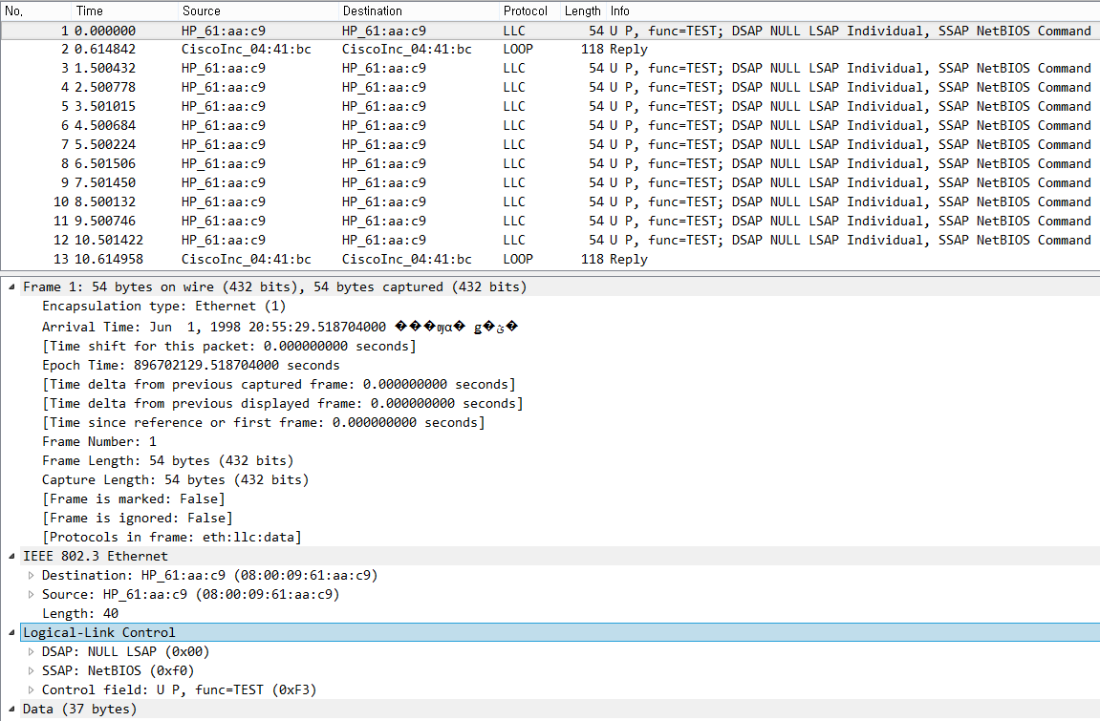
DARPA 1998 dataset
참고자료
Tcpdump file example (Training Data)

Slide 3
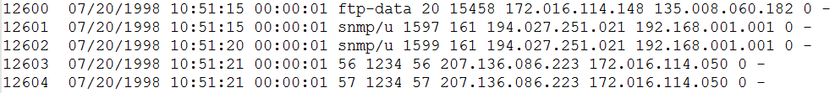
DARPA 1998 dataset
참고자료
Processed data example
Schema
Training data Sample
Test data Sample
DARPA Dataset에서 제공하는 가공된 데이터를 사용하지 않고,
직접 tcpdump 파일을 분석하여 가공된 데이터를 만들어 사용할 수도 있음

Slide 4
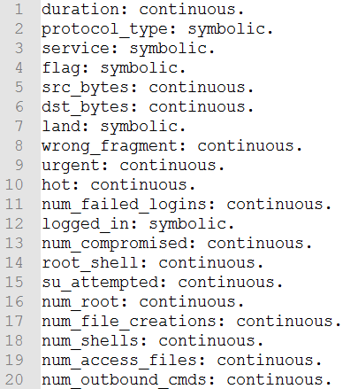
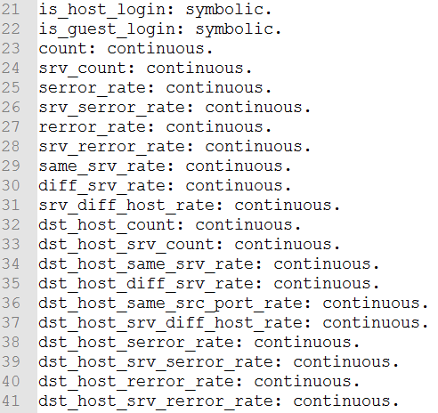
KDD’99 dataset
참고자료
DARPA 1998 Dataset의 tcpdump 파일에서 41개의 feature 추출 + 레이블링
Schema
Test data Sample

Slide 5
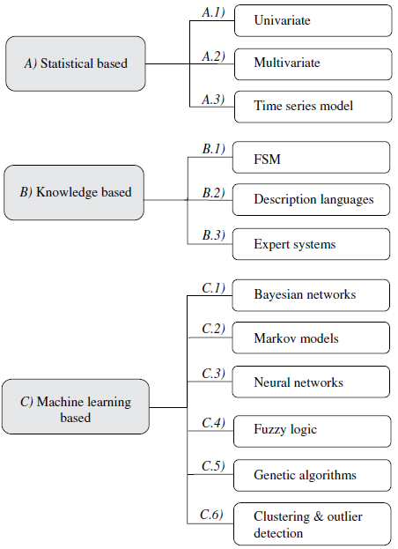
History of Outlier Detection in NIDS (1)
Paper
Requirements and model for IDES – a real time intrusion detection system. /Computer Science Laboratory. (Denning DE, Neumann PG. 1985)
Multivariate statistical analysis of audit trails for host-based intrusion detection. /IEEE Transactions on Computers. (Ye et al. 2002)
Pros
Prior knowledge about normal activity not required
Accurate notification of malicious activities
Cons
Susceptible to be trained by attackers
Difficult setting for parameters and metrics

Slide 6
History of Outlier Detection in NIDS (2)
Paper
Detecting unusual program behavior using the statistical component of the next-generation intrusion detection expert system. /Computer Science Laboratory, SRI international. (Anderson D et al. 1995)
Specification-based anomaly detection: a new approach for detecting network intrusions./ ACM Conference on Computer and Communications Security. (Sekar et al. 2002)
Pros
Robustness, Flexibility, Scalability
Cons
Difficult and time-consuming availability for high-quality knowledge/data.

Slide 7
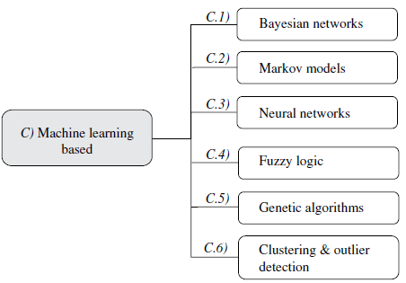
History of Outlier Detection in NIDS (3)
Bayesian networks
Paper
A tutorial on learning with Bayesian networks./ Microsoft Research Technical Report MSRTR-95-06 (Heckerman, 1995)
Statetul intrusion detection for high-speed networks/ IEEE Symposium on Security and Privacy (Kruegel C et al. 2002)
Pros
Encodes probabilistic relationships among variable of interest
Capability of encoding interdependencies
Cons
Low performance
High computational cost

Slide 8
History of Outlier Detection in NIDS (4)
Markov models
Paper
Host-based intrusion detection using dynamic and static behavioral models/ Pattern Recognition (Yeung DY, Ding Y, 2003)
Learning nonstationary models of normal network traffic for detecting novel attacks./ ACM SIGKDD (Mahoney, Chan P.K et al. 2002)
(Hidden) Markov chains
In training phase, probabilities are estimated from the normal behavior
Detection of anomalies is carried out by comparing the anomaly score (probability) obtained for the observed sequences with a fixed threshold
Extensively used in the Host IDS
Less dependent on the assumptions about the behavior accepted for the system (Better than Bayesian Networks)

Slide 9
History of Outlier Detection in NIDS (5)
Neural networks
Paper
A neural network approach towards intrusion detection / National Computer Security Conference (Fox K et al. 1990)
A neural network component for an intrusion detection system./ IEEE Symposium on Research in Computer Security and Privacy (Debar H et al. 2002)
Network intrusion detection using neural networks./ International Conference on Computational Intelligence and Multimedia Applications (ICCMA’97) (Cansian A.M et al. 1997)
Detecting anomalous network traffic with self-organizing maps./ Recent advances in intrusion detection, RAID (Ramadas M et al. 2003)
Pros
Flexibility and Adaptability to environmental changes
Employed to create User Profiles (Predict the next command)
Cons
Can’t providing a descriptive model and explanation about decision
High computational cost

Slide 10
History of Outlier Detection in NIDS (6)
Fuzzy logic
Paper
Fuzzy data mining and genetic algorithms applied to intrusion detection / Proceedings of the National Information Systems Security Conference (Bridges S.M, Vaughn R.B, 2000)
Fuzzy network profiling for intrusion detection/ NAFIPS (Dickerson J.E, 2002)
Pros
Effective on detecting port scans and probes
Cons
High resource consumption
vs Probability Theory (rejected by some engineers and statisticians)

Slide 11
History of Outlier Detection in NIDS (7)
Genetic algorithms
Paper
Using genetic algorithm for network intrusion detection/ C.S.G Department of Energy (Li W, 2004)
Fuzzy data mining and genetic algorithms applied to intrusion detection / Proceedings of the National Information Systems Security Conference (Bridges S.M, Vaughn R.B, 2000)
Pros
Flexible
No prior knowledge about the system behavior
Cons
High resource consumption

Slide 12
History of Outlier Detection in NIDS (8)
Clustering & outlier detection
Paper
Intrusion detection with unlabeled data using clustering/ ACM Workshop on Data Mining Applied to Security (Portnoy L et al. 2001)
Anomaly-based data mining for intrusions/ ACM SIGKDD International Conference on Knowledge Discovery and Data Mining (Sequeira K, Zaki M, 2002)
Use of K-nearest neighbor classifier for intrusion detection/ Computers & Security (Liao Y, Vemuri VR. 2002)
LOF: identifying density-based local outliers/ Proceedings of the ACM SIGMOD, International Conference on Management of Data (Breunig M et al. 2000)
Pros
Only from Normal raw audit Data (No need for sampling outliers/ Low effort to tuning IDS)
Robust to outliers of new type
Relatively low computational complexity
Cons
?

Slide 13
Fraud Detection Roadmap
알고리즘 조사
Neural Net, Deep learning 관련 논문 조사
2016 Fraud Detection Survey의 최신기법 알고리즘 조사(정확도 순)
앙상블 기법을 사용한 fraud detection 논문 조사
Real time 알고리즘 조사
Sampling 기법 조사 (Imbalanced data)
알고리즘 성능평가에 어떤 measure를 사용할 것인지 조사 (타당성)
데이터 수집
보유 : Kaggle, UCSD-FICO data mining contest 2009 데이터 (Anonymized dataset)
스키마 정보가 확실한 완전한 데이터 셋 필요 : 논문에 사용된 데이터 공유 요청

Slide 14
(Network) Traffic Anomaly Detection Using K-Means Clustering
Gerhard Munz, Sa Li, Georg Carle
University of Tuebingen, Germany
GI/ITG Workshop MMBnet, 2007
(124회 인용)
DongHyo Kim

Slide 15
Introduction
Network-based IDS(Intrusion detection systems)
Searches network monitoring data for harmful packets or packet flows
Presenting a novel flow-based anomaly detection scheme based on the K-mean clustering algorithm (Generating additional clusters for anomalous traffic)
Goal : Identify time intervals showing anomalous traffic behavior
Processing steps
Training data containing flow records of both normal and anomalous traffic are transformed into feature datasets
Datasets are divided into different clusters for normal and anomalous traffic using the K-means clustering algorithm
Resulting cluster centroids are deployed for fast detection of anomalies in new monitoring data

Slide 16
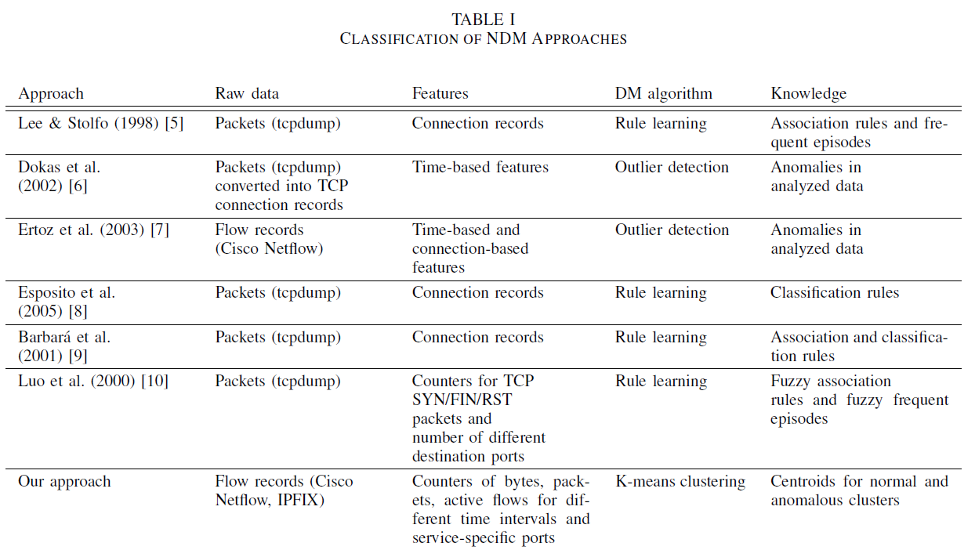
Network Data Mining

Slide 17
Raw Data and Extracted Features (1)
Cisco Netflow flow records
Protocol type
Source IP address, Destination IP address
Source port, Destination port
Statistical information
Transforming Raw data
Classifying transport protocol and predefined port number
• Normal traffic looks very different depending on the service or application
• Motiv. : Applying K-means separately for different services (protocol, port)
• Flow records don’t fit into any of the predefined service classes => default class
Aggregating flow records for equally spaced time intervals

Slide 18
Raw Data and Extracted Features (2)
Transformed dataset
Each dataset contains the following features
• Total number of packets sent from and to the given port in the considered time interval
• Total number of bytes sent from and to the given port in the considered time interval • Number of different source-destination pairs matching the given service-specific port and protocol and being observed in the considered time interval
Idea : The number of packets and bytes allows detecting anomalies in traffic volume, while the third features helps detecting port scans, distributed attacks

Slide 19
K-means Clustering (1)
K-means Clustering algorithm
Define the number of clusters K
Initialize the K cluster centroids
Iterate over all objects and compute the distances to the centroids of all clusters Assign each object to the cluster with the nearest centroid
Recalculate the centroids of both modified clusters
Repeat step 3~4 until the centroids do not change anymore
Training datasets without being labeled
Assumption that normal and anomalous traffic form different clusters in the feature space
Clustering individually for the predefined services identified by (protocol, port) pair
Default class that cover the remaining flows distinguished by the protocol value only

Slide 20

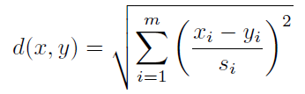
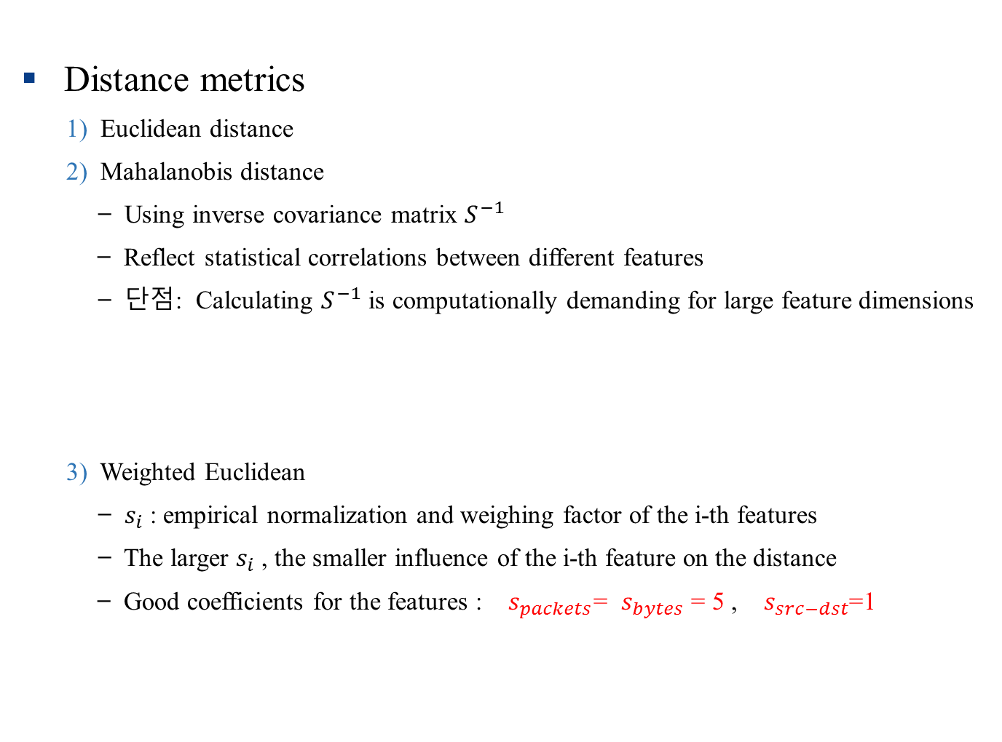
K-means Clustering (2)
Distance metrics
1) Euclidean distance
2) Mahalanobis distance
̶ Using inverse covariance matrix $S^{−1}$
̶ Reflect statistical correlations between different features
̶ 단점: Calculating $S^{−1}$ is computationally demanding for large feature dimensions
3) Weighted Euclidean
̶ $s_{i}$: empirical normalization and weighing factor of the i-th features
̶ The larger $s_{i}$, the smaller influence of the i-th feature on the distance
̶ Good coefficients for the features : $s_{packets}$= $s_{bytes}$ = 5 , $s_{src−dst}$=1

Slide 21
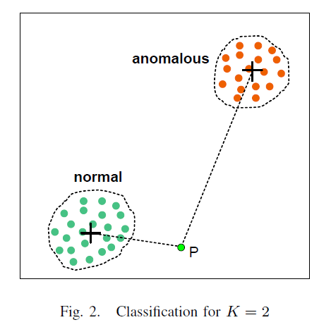
K-means Clustering (3)
̶ 전체 서비스를 포함하는 데이터셋에서 K-means 를 돌리지 않고, 각 서비스마다 K=2인 k-means 클러스터링을 함으로써 정확도와 성능 모두 향상시킴
̶ Input traffic class are calculated using the weighted Euclidean distance
̶ 강점 : Detecting known kinds of anomalies
̶ 약점 : Detecting new anomalies

Slide 22
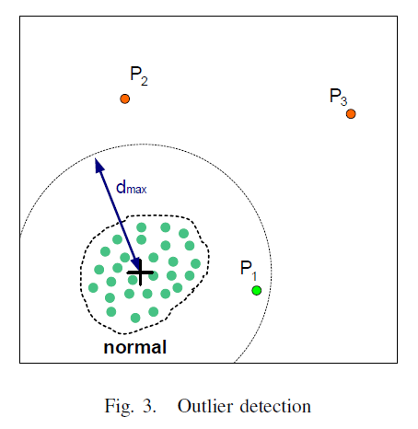
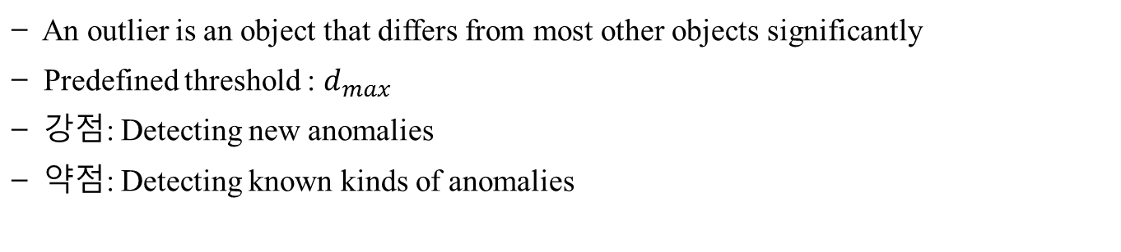
K-means Clustering (4)
̶ An outlier is an object that differs from most other objects significantly
̶ Predefined threshold : $d_{max}$
̶ 강점: Detecting new anomalies
̶ 약점: Detecting known kinds of anomalies

Slide 23
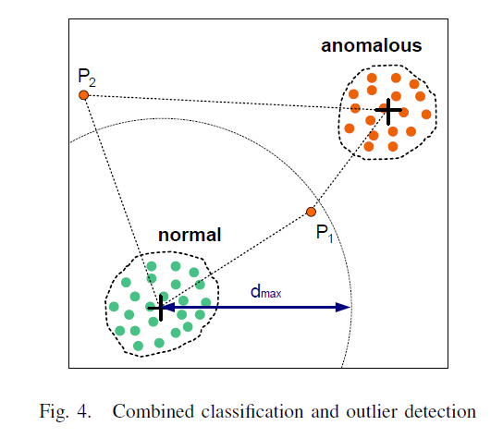
K-means Clustering (5)
̶ Combined way in order to overcome the limitations of each previous method
̶ Anomaly object : if it is closer to anomalous cluster or
if its distance to normal cluster centroid is larger than threshold
̶ Relatively more accurate in detecting known kinds and new anomalies

Slide 24
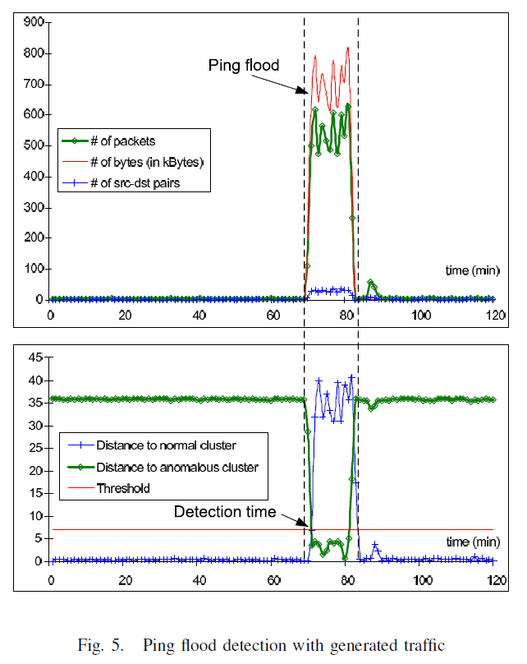

Experimental Results
Environments
Generating traffic in a local testbed
Played back tcpdump traces in a real network
Ping flood starts at t = 70 min
Evaluation
Evaluating the capability to detect port scans and DoS attack
Anomaly detected at t = 71 ~ 84 min
Threshold $d_{max}$ = 7

Slide 25
Comparative Study of Anomaly Detection Schemes in Network Intrusion Detection
Aleksandar Lazarevic, Aysel Ozgur
,Levent Ertoz, Jaideep Srivastava, Vipin Kumar
University of Minnesota, SDM, 2003 - SIAM
(679회 인용)
DongHyo Kim

Slide 26
Introduction (1)
Signature-based detection techniques
Widely deployed methods for detecting cyber attack
Detecting only previously known attacks corresponding signature
Signature database has to be manually revised for each new type of attack
Motivates intrusion detection techniques based on Data Mining
Intrusion detection techniques Based on Data Mining
1) Misuse detection
̶ Each instance in a dataset is labeled as normal or intrusion
̶ Able to automatically retrain intrusion detection models
̶ Accurately detect known attacks
̶ Drawback : Inability to detect novel, previously unseen attacks

Slide 27
Introduction (2)
Intrusion detection techniques Based on Data Mining
2) (Traditional) Anomaly detection
̶ Build models of normal data and detect deviations from the normal model
• Supervised Anomaly detection
☞ Detect new types of intrusions as deviations form normal usage
☞ Determine whether the test data belong to “normal” or not
• Unsupervised Anomaly detection
☞ Detecting anomalous behavior without using any knowledge
̶ However, both detection schemes suffer from a high rate of false alarm because of previously unseen (yet legitimate) system behaviors
♦ This paper focuses on a detailed comparative study of several anomaly detection schemes
♦ Several existing supervised and unsupervised anomaly detection schemes and their variations are evaluated

Slide 28
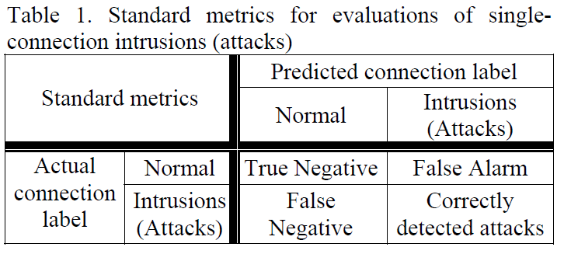
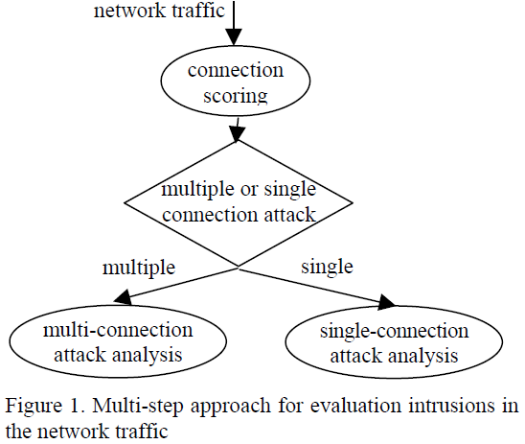
Evaluation of Intrusion Detection Systems (1)
Difficulty in IDS
Problematic to get high-quality data
Labeling requires enormous amount of time for many human experts
Need to measuring not only detection rate, but also the false alarm rate
Two types of attacks
̶ Detection rate
̶ False alarm rate
̶ Do not capture information about the number of connections

Slide 29
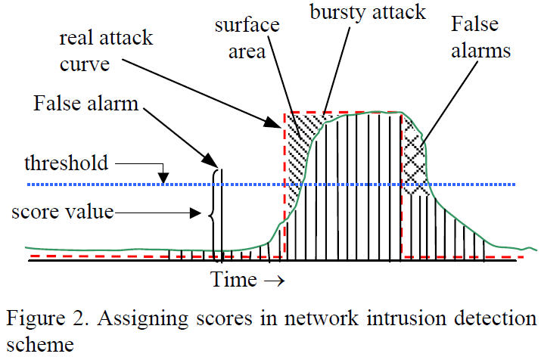
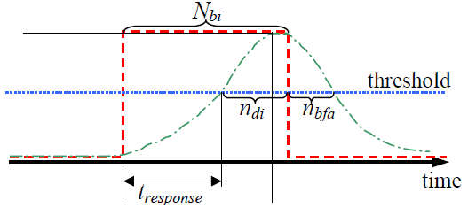
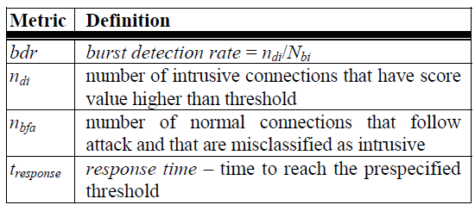
Evaluation of Intrusion Detection Systems (2)
Two types of attacks
1. Burst Detection rate 2. Response time

Slide 30
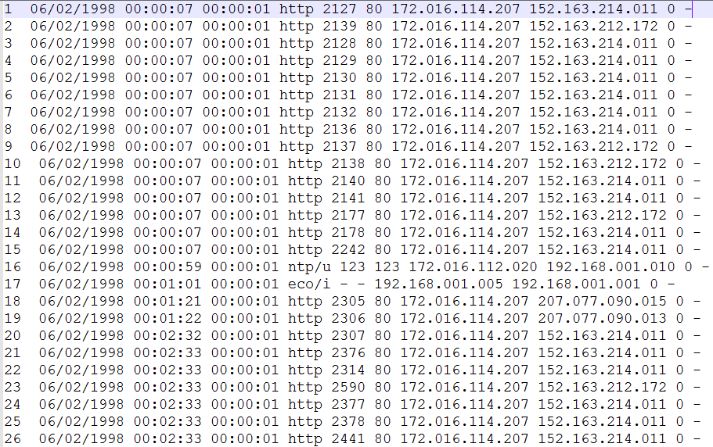
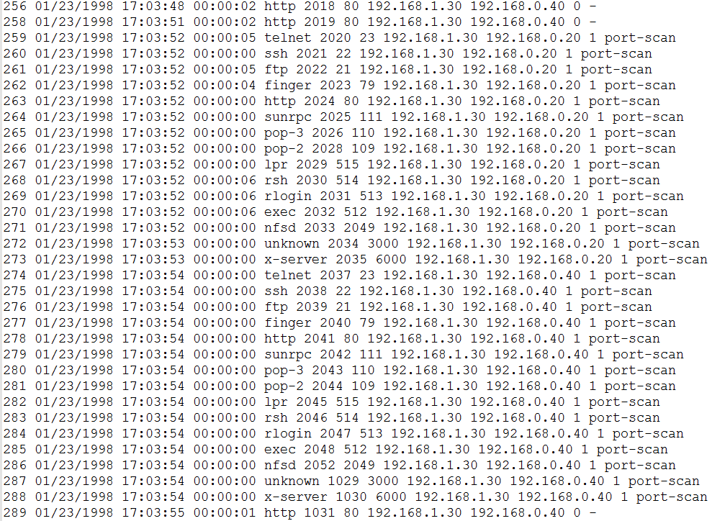
Raw Data
DARPA 1998 data set
Sample Training Data
Sample Test Data

Slide 31
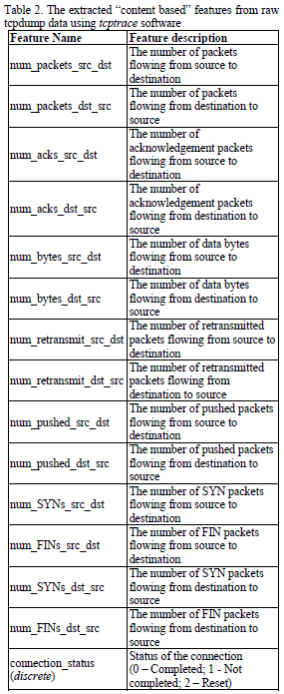
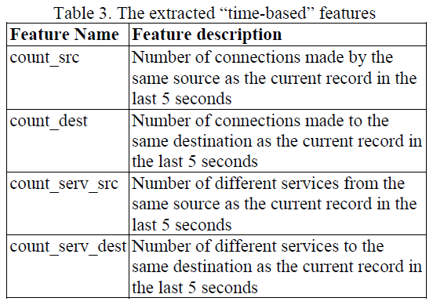
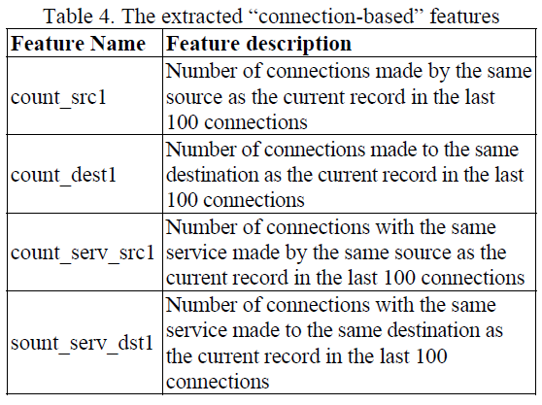
Feature Extraction/Construction

Slide 32
Anomaly Detection Techniques (1)
Outlier Detection Schemes for Anomaly Detection
Most anomaly detection algorithms require a set of purely normal data to train the model
Outlier may be defined as a data point which is very different from the rest of the data
Nearest Neighbor (NN) Approach
Outlier threshold : determine whether the point is an outlier or not
Threshold is based only on the training data and it is set to 2%
In order to compute the threshold, for all data points from training data distances to their nearest neighbors are computed and then sorted

Slide 33

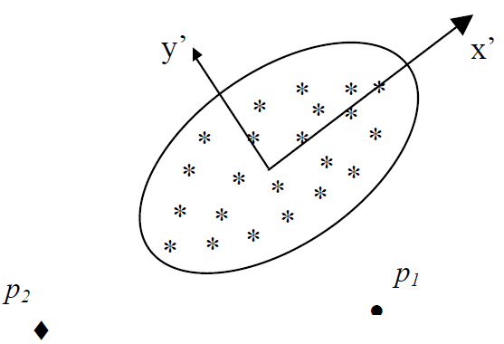
Anomaly Detection Techniques (2)
Mahalanobis-distance Based Outlier Detection
Training data corresponds to “normal behavior”
Compute the mean, standard deviation, covariance matrix of the normal data
All test data points that have distances to the mean of the training normal data greater than the threshold are detected as outliers

Slide 34
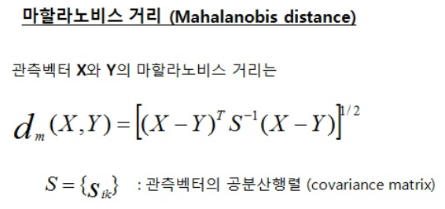

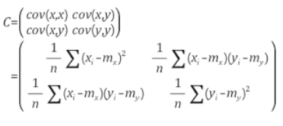
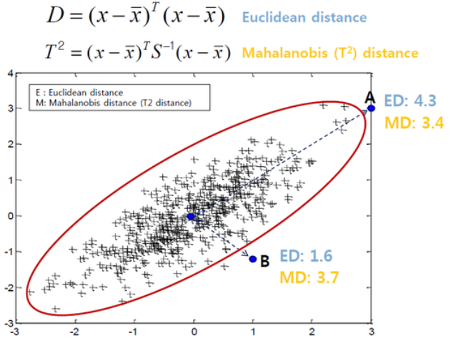
Mahalanobis-distance
참고자료

Slide 35
Anomaly Detection Techniques (3)
Density Based Local Outliers (LOF approach)
Assigning to each data example a degree of being outlier (LOF)
1. For each data example O compute k-distance and k-distance neighborhood
2. Compute reachability distance for each data example O with respect to data example p as : reach-dist(O,p) = max{k-distance(p), d(O,p)}
d(O,p) : distance from data example O to data example p
3. Compute local reachability density of data example O
(local reachability : inverse of the average reachability distance based on the MinPts NN of data example O)
4. Compute the LOF of data example O (local outlier factor : Average of the ratios of the local reachability density of example O and local reachability density of O’s MinPts NN)

Slide 36
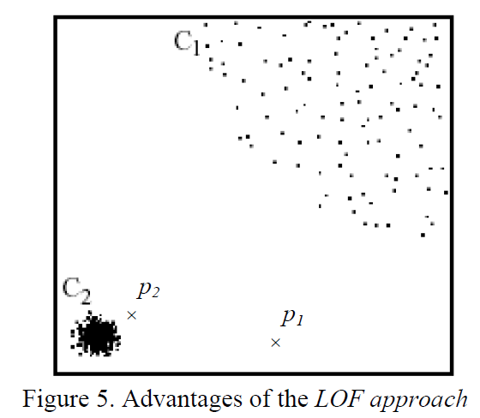
Anomaly Detection Techniques (3)
Density Based Local Outliers (LOF approach)
Unsupervised Support Vector Machines
Attempts to separate the entire set of training data from the origin
Finding a small region where most data lies and label data points in this region as one class
RBF kernel with smaller variance : High detection rate but very high false alarm rate

Slide 37
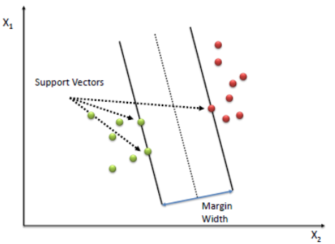
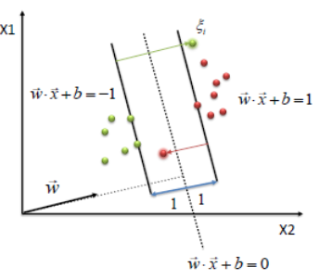
Supervised/Unsupervised SVM (1)
참고자료
(Supervised) Support Vector Machine
Learns a decision boundary by maximizing the margin
Applies the kernel trick for non-linear decision boundaries
Allow some instances to fall off the margin, but penalize them (Slack Variables)

Slide 38

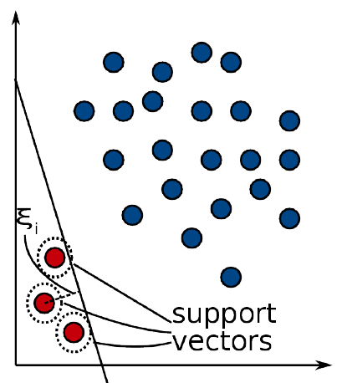
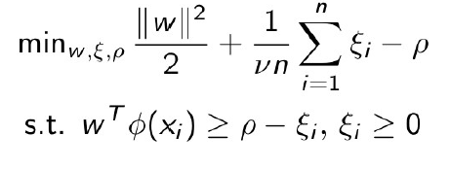
Supervised/Unsupervised SVM (2)
참고자료
One-class SVMs
Trained with normal class only (one-class)
Learns a decision function
Applies the kernel and separates data from the origin
Outliers are allowed by a slack variable
Cons: Outliers still may contribute to the decision boundary

Slide 39
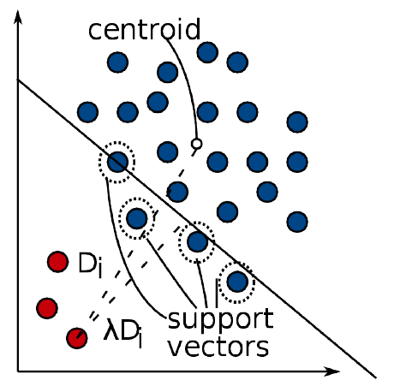
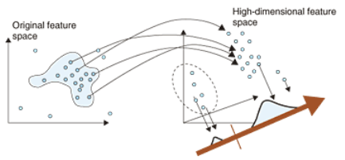
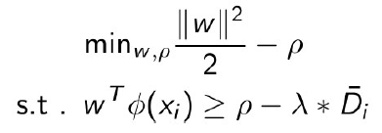
Supervised/Unsupervised SVM (3)
참고자료
Enhanced One-class SVMs
Robust one-class SVMs
Slack variable proportional to the distance to the centroid
Outlier Score
Typically, a one-class SVM outputs class labels “normal” or “outlier”
In unsupervised anomaly detection, scores are preferred

Slide 40
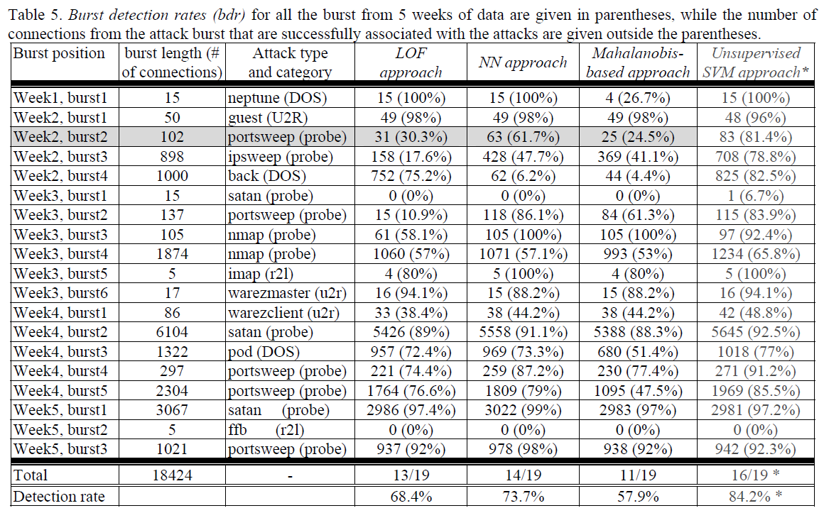
Experiments (1)

Slide 41
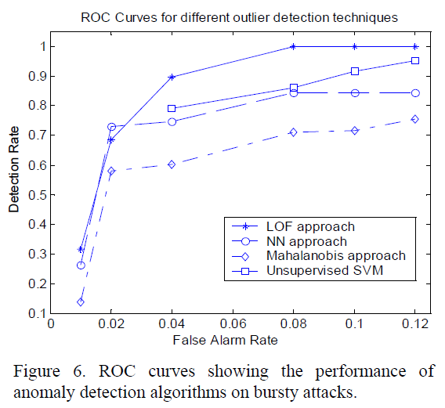
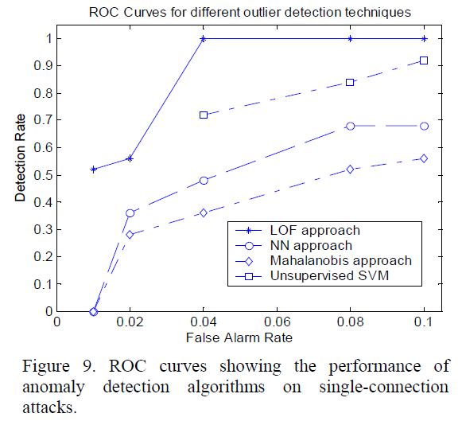
Experiments (2)

Slide 42
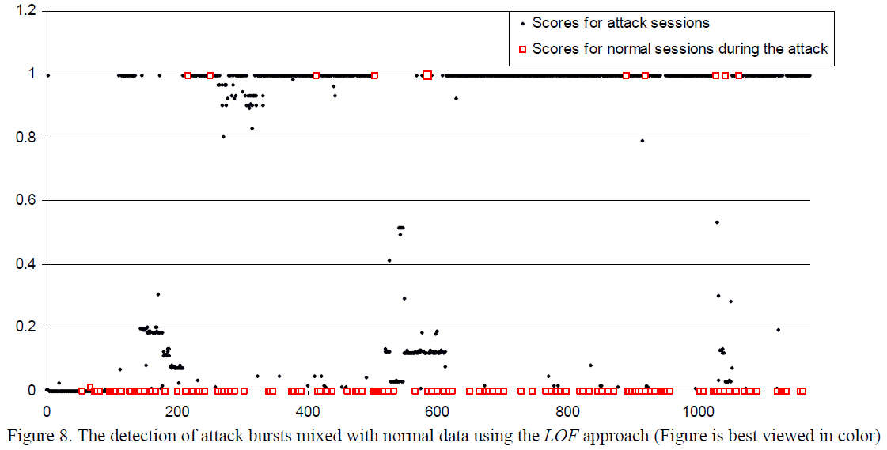
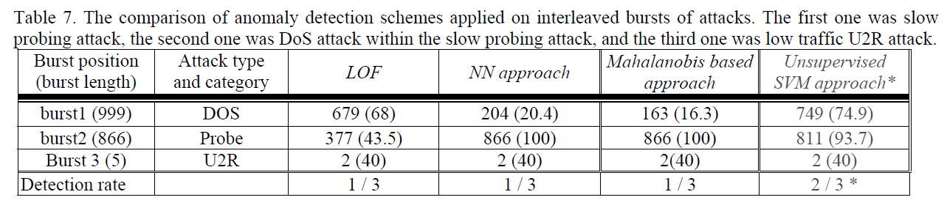
Experiments (3)

