Slide 1
빅데이터 팀 세미나 2주차 #맵리듀스 프레임워크 기초
Some slides from vldb 2012 tutorial

Slide 2
Outline
Map, Reduce, Combine 함수
맵리듀스 예제 : WordCount
맵리듀스 예제 : Inverted Index
맵리듀스 예제 : 행렬의 덧셈과 곱셈

Slide 3
MapReduce
Automatic parallelization & distribution
Fault-tolerant
Provides status and monitoring tools
Clean abstraction for programmers
User writes Map and Reduce functions
BigTable can be input and/or output for MapReduce computations

Slide 4
Programming Model
Borrows from functional programming
Users implement interface of two functions:
map (in_key, in_value) ->
(out_key, intermediate_value) list
reduce (out_key, intermediate_value list) ->
out_value list

Slide 5
Map
Records from the data source (lines out of files, rows of a database, etc) are fed into the map function as (key, value) pairs
map() produces one or more intermediate values along with an output key from the input.

Slide 6
Reduce
After the map phase is over, all the intermediate values for a given output key are combined together into a list
reduce() combines those intermediate values into one or more final values for that same output key
In practice, usually only one final value per key

Slide 7
Map/Reduce
input key*value pairs
input key*value pairs
map
…
map
Map
Input key/value
→ Intermediate result
Reduce
intermediate result → output key/value
Data store 1
Data store 1
(key 1, values…)
(key 2, values…)
(key 3, values…)
(key 1, values…)
(key 2, values…)
(key 3, values…)
== Barrier == : Aggregates intermediate values by output key
key 1, intermediate values
key 2, intermediate values
key 3, intermediate values
reduce
reduce
reduce
final key 1 values
final key 2 values
final key 3 values

Slide 8
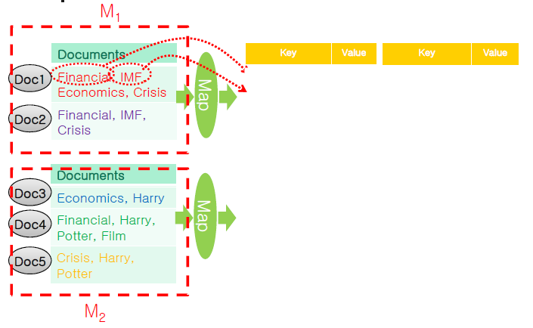
A Word Count Example

Slide 9
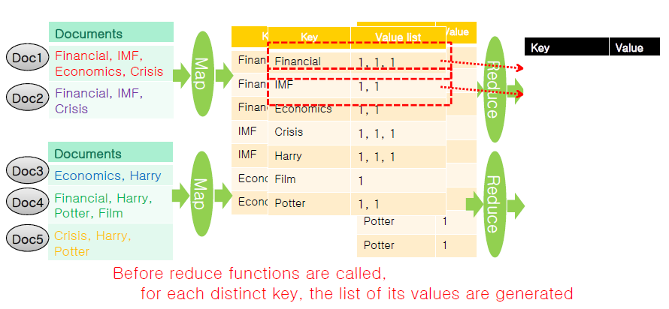
An Example of Word Counting with MR

Slide 10
Java Source Code : Map Function
public static class Map extends MapReduceBase implements Mapper<LongWritable, Text, Text, IntWritable>
{
private final static IntWritable one = new IntWritable(1);
private Text word = new Text();
public void map(LongWritable key, Text value, OutputCollector<Text, IntWritable> output, Reporter reporter) throws IOException {
String line = value.toString();
StringTokenizer tokenizer = new StringTokenizer(line);
String temp="";
while (tokenizer.hasMoreTokens())
{
temp = tokenizer.nextToken().charAt(0)+"";
// 첫 글자가 같은 워드를 하나의 워드로 처리
word.set(temp);
output.collect(word,one);
}
}
}

Slide 11
Java Source Code : Reduce Function
public static class Reduce extends MapReduceBase implements Reducer<Text, IntWritable, Text, IntWritable> {
public void reduce(Text key, Iterator<IntWritable> values, OutputCollector<Text, IntWritable> output, Reporter reporter) throws IOException {
int sum =0;
while (values.hasNext())
{
sum += values.next().get();
}
output.collect(key, new IntWritable(sum));
}
}

Slide 12
Combine Function
Reduce the result size of map functions
Perform reduce-like function in each machine
Decrease the shuffling cost
It is desirable to design MapReduce algorithm to use combine functions

Slide 13
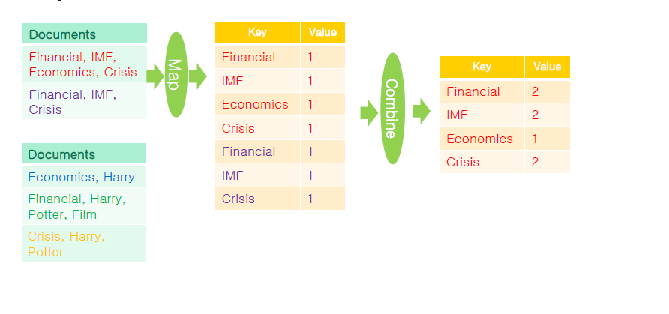
Combine Function [1/3]

Slide 14
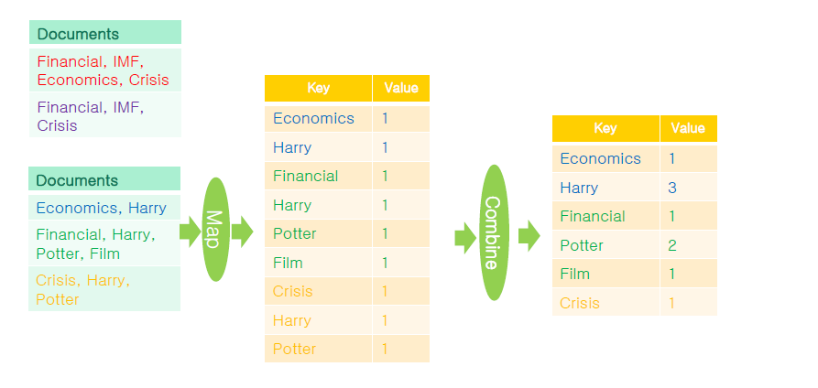
Combine Function [2/3]

Slide 15
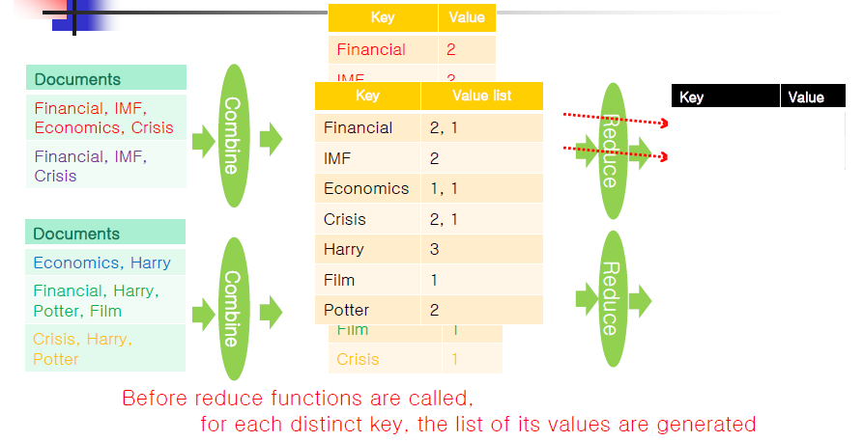
Combine Function [3/3]

Slide 16
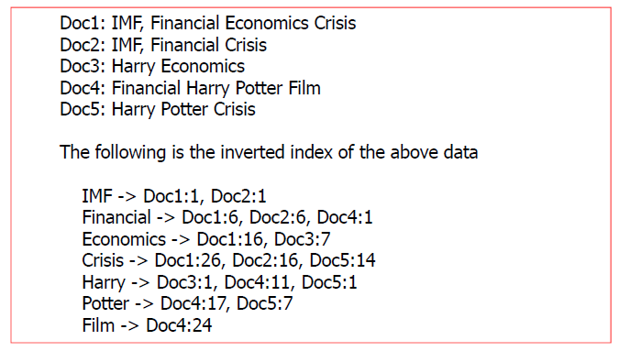
An Example of Building an Inverted Index
Maps words to their location in a set of documents

Slide 17
Implementation : Map
map
key value
(word₁, filename:position)
(word₂, filename:position)
…
(word_{n}, filename:position)
map
Text
…
map

Slide 18
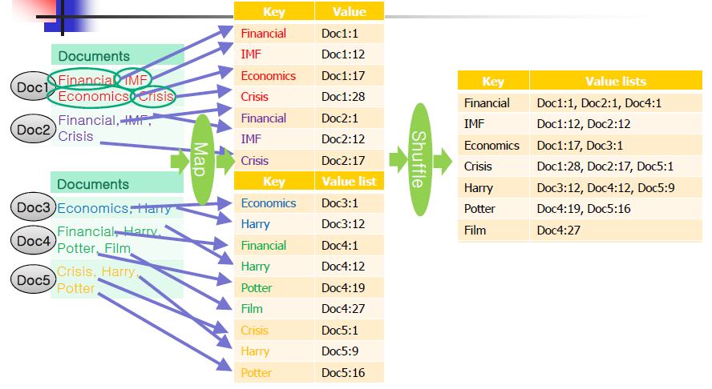
Map Function

Slide 19
Implementation: Reduce
Partitioned
Reduce
key value
(word₁, filename:position
^filename:position^…)
(word₂, filename:position
^filename:position^…)
…
(word_{n}, filename:position
^filename:position^…)
Key value
(word₁, filename:position)
(word₂, filename:position)
(word₁, filename:position)
(word₃, filename:postion)
…
Reduce
…
Reduce

Slide 20
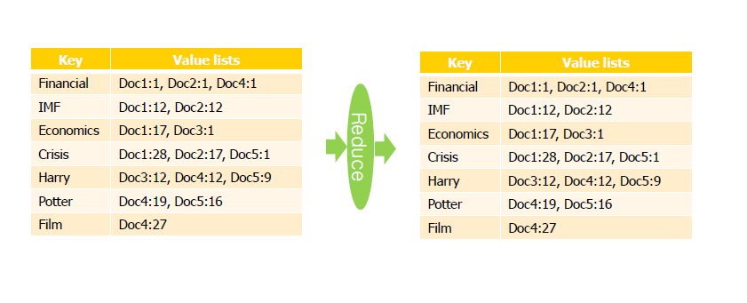
Reduce Function

Slide 21
Matrix Addition
Input
Two matrices, A and B
Map
Input: <[A|B], i, j, value>
Output: <key=______, value=_______>
Reduce
Input: <key, a list of values>
Output: <key=_______, value=________>

Slide 22
Matrix Addition
Input
Two matrices, A and B
Map
Input: <[A|B], i, j, value>
Output: <key={i,j}, value=[A_{ij}|B_{ij}]>
Reduce
Input: <key, a list of values={A_{ij}, B_{ij}}>
Output: <key={i,j}, value=A_{ij}+B_{ij}>

Slide 23
Matrix Multiplication
Input
Two matrices, A (n x l) and B (l x m)
Map
Input: <[A|B], i, j, value>
Output: <key=______, value=_______>
Reduce
Input: <key, a list of values>
Output: <key=_______, value=________>

Slide 24
행렬 곱
A
B
AB
A11
A12
B11
B12
(A11*B11)+(A12*B21)
(A11*B12)+(A12*B22)
A21
A22
B21
B22
(A21*B11)+(A22*B21)
(A21*B12)+(A22*B22)
A11
(A11*B11)+(A12*B21)
(A11*B12)+(A12*B22)
:A의 원소는 B의 열의 수 만큼 값이 필요, 따라서 MAP 함수에서 B의 열수만큼
추가를 함
B11
(A11*B11)+(A12*B21)
(A21*B11)+(A22*B21)
:B의 원소는 A의 행의 수 만큼 값이 필요, 따라서 MAP 함수에서 A의 행수만큼
추가를 함

Slide 25
행렬 곱 (Map)
Key : (i행, j열, B의 열)
MAP
value : (i행 j열의 값)
INPUT (행렬, 행, 열, 값)
A, 1, 1, 1
A, 1, 2, 2
A, 2, 1, 3
A, 2, 2, 4
B, 1, 1, 1
B, 1, 2, 2
B, 2, 1, 3
B, 2, 2, 4
(1,1,1), 1
B의 열수
만큼 필요
(1,1,n), 1
Key : (A의 행, i행, j열)
value : (i행 j열의 값)
(1,1,1), 1
A의 행수
만큼 필요
(n,1,1), 1

Slide 26
행렬 곱 (Reduce)
INPUT (행렬, 행, 열, 값)
((1,1,1), 1) A11
((1,1,2), 1) A11
((1,2,1), 2) A12
((1,2,2), 2) A12
((2,1,1), 3) A21
((2,1,2), 3) A21
((2,2,1), 4) A22
((2,2,2), 4) A22
((1,1,1), 1) B11
((2,1,1), 1) B11
((1,1,2), 2) B12
((2,1,2), 2) B12
((1,2,1), 3) B21
((2,2,1), 3) B21
((1,2,2), 4) B22
((2,2,2), 4) B22
Reduce
같은 key를 가진
값을 곱
(A11*B11)
(A12*B21)
우리가 필요한 것은
(A11*B11) + (A12*B21),
따라서, 또 한번의 맵리듀스
작업이 필요!

Slide 27
행렬 곱 (2차 Map)
MAP
Key : 이전 key값에서 가운데
값을 제거
((1,1,1), 1) A11*B11
((1,1,2), 2) A11*B12
((1,2,1), 6) A12*B21
((1,2,2), 8) A12*B22
((2,1,1), 3) A21*B11
((2,1,2), 9) A21*B12
((2,2,1), 12) A22*B21
((2,2,2), 16) A22*B22
value : (i행 j열의 값)
((1,1), 1) A11*B11
((1,1), 6) A12*B21
Reduce는 같은 key값을
가지는 값을 더해줌

Slide 28
Matrix Multiplication
key value key value key value key value
({1,1,1}, A₁₁) ({2,1,1}, A₂₁) ({1,1,1}, B₁₁) ({1,2,1}, B₁₂)
({1,2,1}, A₁₁) ({2,2,1}, A₂₁) ({2,1,1}, B₁₁) ({2,2,1}, B₁₂)
({1,3,1}, A₁₁) ({2,3,1}, A₂₁) ({3,1,1}, B₁₁) ({3,2,1}, B₁₂)
({1,4,1}, A₁₁) ({2,4,1}, A₂₁) ({4,1,1}, B₁₁) ({4,2,1}, B₁₂)
({1,1,2}, A₁₂) ({2,1,2}, A₂₂) ({1,1,2}, B₂₁) ({1,2,2}, B₂₂)
({1,2,2}, A₁₂) ({2,2,2}, A₂₂) ({2,1,2}, B₂₁) ({2,2,2}, B₂₂)
({1,3,2}, A₁₂) ({2,3,2}, A₂₂) ({3,1,2}, B₂₁) ({3,2,2}, B₂₂)
({1,4,2}, A₁₂) ({2,4,2}, A₂₂) ({4,1,2}, B₂₁) ({4,2,2}, B₂₂)
({1,1,3}, A₁₃) ({2,1,3}, A₂₃) ({1,1,3}, B₃₁) ({1,2,3}, B₃₂)
({1,2,3}, A₁₃) ({2,2,3}, A₂₃) ({2,1,3}, B₃₁) ({2,2,3}, B₃₂)
({1,3,3}, A₁₃) ({2,3,3}, A₂₃) ({3,1,3}, B₃₁) ({3,2,3}, B₃₂)
({1,4,3}, A₁₃) ({2,4,3}, A₂₃) ({4,1,3}, B₃₁) ({4,2,3}, B₃₂)
({1,1,4}, A₁₄) ({2,1,4}, A₂₄) ({1,1,4}, B₄₁) ({1,2,4}, B₄₂)
({1,2,4}, A₁₄) ({2,2,4}, A₂₄) ({2,1,4}, B₄₁) ({2,2,4}, B₄₂)
({1,3,4}, A₁₄) ({2,3,4}, A₂₄) ({3,1,4}, B₄₁) ({3,2,4}, B₄₂)
({1,4,4}, A₁₄) ({2,4,4}, A₂₄) ({4,1,4}, B₄₁) ({4,2,4}, B₄₂)
1st step
A
map
map
B
…
map

Slide 29
Illustration: Matrix Multi.
1st step
key value
({1,1,1}, A₁₁)
({1,1,2}, A₁₁)
…
({1,1,m}, A₁₁)
({1,2,1}, A₁₂)
…
({1,1,1}, B₁₁)
…
({n,1,1}, B₁₁)
…
A
map
map
B
…
map

Slide 30
Method 1: two-step map/reduce
key value
({1,1}, A₁₁* B₁₁)
({1,1}, A₁₂* B₂₁)
…
({1,1}, A_{1l}* B_{l1})
…
Reduce
key value
({1,1,1}, [A_{11,}, B₁₁] )
({1,1,2}, [A₁₂, B₂₁ ])
…
({1, 1, l}, [A₁₁, B_{1l}])
…
Reduce
…
Reduce

Slide 31
Method 1: two-step map/reduce
2nd step
key value
({1,1}, A₁₁* B₁₁)
({1,1}, A₁₂* B₂₁)
…
({1,1}, A_{1l}* B_{l1})
…
({i,j}, A_{i1}* B_{1j})
({i,j}, A_{i2}* B_{2j})
…
({i,j}, A_{il}* B_{lj})
…
key value
({1,1}, A₁₁* B₁₁)
({1,1}, A₁₂* B₂₁)
…
({1,1}, A_{1l}* B_{l1})
…
({i,j}, A_{i1}* B_{1j})
({i,j}, A_{i2}* B_{2j})
…
({i,j}, A_{il}* B_{lj})
…
map
map
…
map

Slide 32
Method 1: two-step map/reduce
key value
({1,1}, A₁₁* B₁₁
+ A₁₂* B₂₁
… + A_{1l}* B_{l1})
…
({i,j}, A_{i1}* B_{1j}
+ A_{i2}* B_{2j}
… + A_{il}* B_{lj})
…
key value
({1,1}, [A₁₁*B₁₁, A₁₂*B₂,…, A_{1l}* B_{l1}])
…
({i,j}, [A_{i1}* B_{1j}, A_{i2}* B_{2j} ,…, A_{il}* B_{lj}])
…
Reduce
Reduce
…
Reduce

Slide 33
Method 2: One-Step
Single step map/reduce
How can we multiply two matrices with a run of map/reduce?
Assumption
A row can be loaded in memory
A reduce for a key is called only once when it have all values for the key
Map
Input
Two matrices, A (n x l) and B (l x m)
Output
For A_{ij}: <{i,1}, {j, A_{ij}}>, …, <{i,m}, {j, A_{ij}}> :B의 열수 만큼
For B_{ij}: <{1,j}, {i, B_{ij}}>, …, <{n,j}, {i, B_{ij}}> : A의 행수 만큼
Reduce
Input
<{i,j}, {{1, A_{i1}}, {1, B_{1j}},…, {l, A_{il}}, {l, B_{lj}}}>
Output
<{i,j}, A_{i1}*B_{1j} + A_{i2}*B_{2j} + … + A_{il}*B_{lj} >

