Slide 1
Stable Classifcation of Text Genres
Philipp Petrenz, Bonnie Webber
University of Edinburgh
Computational Linguistics. 2011, Vol. 37, No. 2
2016.3.25
Hyesung Oh
Notes:
Knowledge Discovery and Data Mining

Slide 2





Introduction
Genre
Topic

Slide 3
Main idea
Genre vs. Topic
A feature indicative of topic might benefit a genre classifier through correlations
However, if the topics addressed in different genres can change
Low-level features that correlated with topic can degrade Automatic Genre Classification systems
PoS features should not be lumped together in AGC

Slide 4
Method
Data
New York Times Annotated Corpus (NYTAC, Sandhaus 2008)
21 years of publication (1987-2007), > 1.8m articles
Rich meta-data, including fields to infer genre and topic
Genre
Types of Material, Taxonomic Classifier
Topic
General Online Descriptors

Slide 5
Framework
Genres
New reports, editorials, and letters
Topics
Education and Schools, Armament, Defense and Military Forces, Medicine and Health
Overlap fewer than 5%
Test set 1
Same distribution as the training set
Test set 2
Genre-topic pairings were inverted

Slide 6
Assessing Performance on Static and Altered Genre–Topic Distributions
KC: Karlgren and Cutting (1994)
Most of features involve PoS frequencies or text statistics
KNS/KNSPOS: Kessler, Nunberg, and Shutze (1997)
Surface cues
FCT: Freund, Clarke, and Toms (2006)
Support vector machine on a simple bag-of-words
FMOG: Feldman et al. (2009)
PoS histograms and principal component analysis
SWM: Sharoff, Wu, and Markert (2010)
Character n-gram

Slide 7
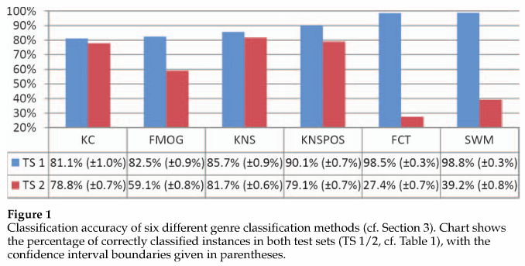
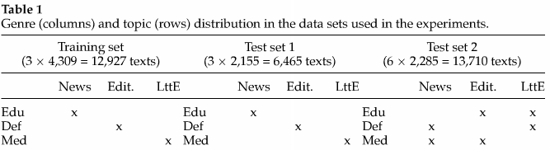
Results

Slide 8
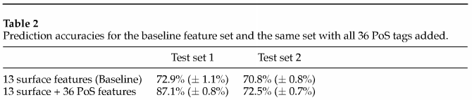
Impact of PoS Features on Performance and Stability
Basic non-PoS features
Character count, sentence count, average character count per sentence, average word count per sentence, average character count per word, type/token ratio, frequency of long words(> 6 letters), and frequencies of the words therefore, I, me, it, and which
PoS-tagged text, 36 non-punctuation tags

Slide 9
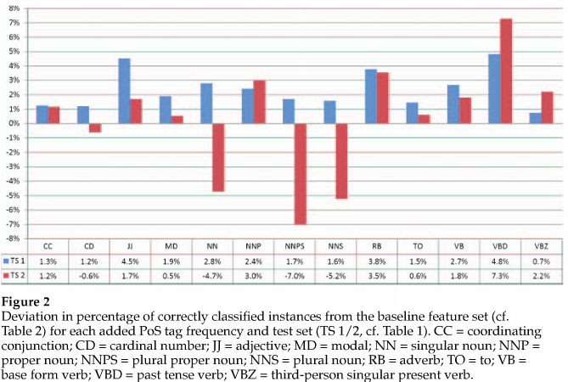
Deviation in percentage of correctly classified instances from the baseline feature set

Slide 10
Conclusion
Prediction accuracy on a static topic distribution should not be the sole basis for the quality of AGC systems
Selective use of PoS-based features can yield high performance

