Slide 1
Reducing Search Space Scheme using RDF-Schema Domain and Range Information for Efficient RDF Query Processing
(
)
효율적인 RDF 질의 처리를 위한 RDF-Schema Domain과 Range 정보기반의 데이타 탐색 범위 감소 기법
Sungtae Kim
SNU OOPSLA Lab.
December 3, 2004

Slide 2
Contents
Introduction
Motivation
Related work
RDF-Schema information
  rdfs:Class, rdfs:domain, rdfs:range
Our Approach
Experiments
Conclusion and Future work

Slide 3
Introduction (1/2)
Semantic Web definition
  Extension of the current web, in which information is given well-defined meaning, better enabling computers and people to work in cooperation
RDF (Resource Description Framework)
  W3C Recommendation for the formulation of meta-data
  Triple structure
RDF-Schema
  Specify domain vocabulary, resource structure and relations
  rdfs:Class, rdfs:domain, rdfs:range
Subject
Predicate
Object

Slide 4
Introduction (2/2)
Ontology data
  Wine Ontology
    Recommend wines to accompany meal courses
  Gene Ontology
    The information about the shared genes and proteins in all diverse organisms
Jena
  Leading semantic web framework (HP Lab)
  Efficient RDF Storage and Retrieval in Jena2
  SWDB 2003. K. Wilkinson, C. Sayers, H. Kuno, D. Reynolds

Slide 5
Motivation (1/2)
Jena2 Database Schema
Jena_long_lit
ID Head CHKSum Tail
Statement table
Jena_graph
ID Name
Subj, Prop, Obj, GraphID
Object
Jena_gntn_stmt
Subj Prop Obj GraphID
Object
Jena_long_uri
ID Head CHKSum Tail
GraphID
Model Info
Jena_gntn_reif
Subj Prop Obj GraphID Stmt HasType
Jena_prefix
ID Head CHKSum Tail
Jena_sys_stmt
Subj Prop Obj GraphID
Model Info
Object
Model Info

Slide 6


Motivation (2/2)
Triple database
Can we reduce search space of table by using
RDF-Schema rdfs:domain and rdfs:range information?
Querying
Result
Statement table
Subject | Predicate | Object
Require
large table self-join
Triple mapping
⋈
⋈
Ontology data
Multiple self-join
1. Duplicate
2. Long strings
3. Object reference

Slide 7
Related Work
Efficient RDF Storage and Retrieval in Jena2
Kevin , Craig , Harumi and Dave
HP Laboratories SWDB 2003
  Introduce Jena for storing OWL by using de-normalization of triple structure
Sesame: A Generic Architecture for Storing and Querying RDF and RDF Schema
Jeen , Arjohn and Frank
On-To-Knowledge Project ISWC 2002
  Store triple by using normalization method and support semantic level query
Database Schema Design and Analysis for the efficient OWL Semantic information processing
Kyung-Hyen Tak, Hag-Soo Kim, Hyun-Seok Cha, Jin-Hyun son
Hanyang University KDBC 2004
  Propose new database schema and eliminate unnecessary table at Sesame

Slide 8
RDF-Schema information
ART
Sculptor
Museum
Painter
Musician
Designer
rdfs:Class (owl:Class)
  Similar type system of object-oriented programming concept
rdfs:domain
  State that specified predicate is instance of subject class
    Triple structure (Subject, Predicate, Object)
rdfs:range
  State that values of a property are instance of object class
    Triple structure (Subject, Predicate, Object)
Brush
Painting
rdfs:domain
<owl:ObjectProperty rdf:ID=“paints”>
<rdfs:domain rdf:resource=“Painter” />
<owl:ObjectProperty>
paints
Painter
Painting
Painter
paints
Subject = { Picasso, Michelangelo, …}
rdfs:range
<owl:ObjectProperty rdf:ID=“exhibited”>
<rdfs:range rdf:resource=“Museum” />
<owl:ObjectProperty>
exhibited
Painting
Museum
exhibited
Museum
Object = { Louvre Museum, Rodin Museum, ...}

Slide 9
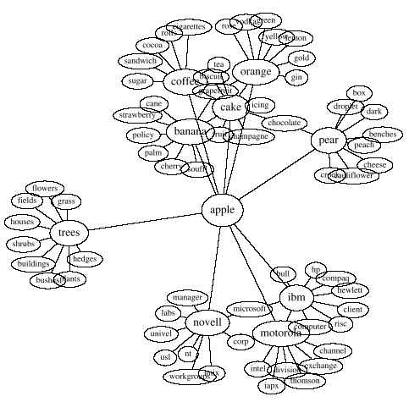
Our approach(1/4)
Ontology schema
Class: GeneProduct
Class: History
Class: Evidence
Class: Term
System flow
Class: Dbxref
Schema analysis
Class: Association
DafaultTriple
Subj | Pred | Obj
GeneProduct
Association
Subj | Pred | Obj
Subj | Pred | Obj
Direct resolve
Extract table
Query
SPO Query Analyzer
Term
Evidence
Result
Subj | Pred | Obj
Subj | Pred | Obj
SQL
Multiple class statement tables
Term
Association
Subj
Pred
Obj
⋈
Subj
Pred
Obj

Slide 10
Our Approach (2/4)
What is the term whose name is “antioxidant^{a)} activity” and related GeneProduct name is “T14G11.18” ?
  Triple input query style
  Pattern 1 (?X , name, ‘antioxidant activity’ )
  Pattern 2 (?X , association, ?Y )
  Pattern 3 (?Y , gene_product, ?Z)
  Pattern 4 (?Z , name, ‘T14G11.18’)
Analysis of twig query tree & problem
&Term
DomainRange
name
association
Domain
Pred
Range
‘antioxidant activity’
&Association
……
Term
Association
GeneProduct
……
……
name
gene_prdouct
name
……
……
null
GeneProduct
null
……
gene_product
Same predicate name
Which class does it belong ?
&GeneProduct
name
‘T14G11.18’
a) Antioxidant : A chemical compound or
substance that inhibits oxidation

Slide 11
Our Approach (3/4)
1
PropDuplicate
Pred | Dupli
…… name gene_product …… | …… 1 0 ……
Edge reverse tracing
SQL query
&Term
name
association
Reverse tracing & use range value
‘antioxidant activity’
&Association
2
gene_product
DomainRange
rdfs:range
&GeneProduct
Domain | Pred | Range
…… Term Association GeneProduct …… | …… name gene_prdouct name …… | …… null GeneProduct null ……
rdfs:domain
name
‘T14G11.18’
SELECT Term.*
FROM Term, Association, GeneProduct
WHERE Term.pred = ‘name’ AND Term.obj = ‘antioxidant activity’ AND
Term.obj = Association.subj AND Associatoin.obj = GeneProduct.subj AND
GeneProduct.pred = ‘name’ AND GeneProduct.obj = ‘T14G11.18’

Slide 12
Our Approach (4/4)
1
PropDuplicate
pred | dupli
…… name gene_product association …… | …… 1 1 0 ……
Multiple edge reverse tracing
Stack operation of pair (Domain, Predicate)
&Term
name
association
2
‘antioxidant activity’
&Association
DomainRange
gene_product
domain | pred | Range
…… Term Association GeneProduct Term …… | …… name gene_prdouct name association …… | …… null GeneProduct null Association……
&GeneProduct
name
‘T14G11.18’
( &x , name )
( &y , gene_product )
( &x , name )
association == 0
( &y , gene_product )
( &x , name )
Association
GeneProduct

Slide 13
Experiments (1/2)
Environment
  Intel Pentium P4 1.6GHz 1GB RAM
  OS : Windows XP
  Database : MySQL 4.0
  Implementation language: Java
  Data set : Gene Ontology termDB
Query Set
Q1 | Find term whose accession is ‘GO:0016209’ and related evidence code value is ‘ISS’
Q2 | Find Q1 term and that is related with database symbol with ‘PMID’
Q3 | Find parent term whose child term’s definition is containing ‘amino acid’
Q4 | Find term whose name is ‘antioxidant’ and related with GeneProduct whose name is ‘T14G11.18’

Slide 14
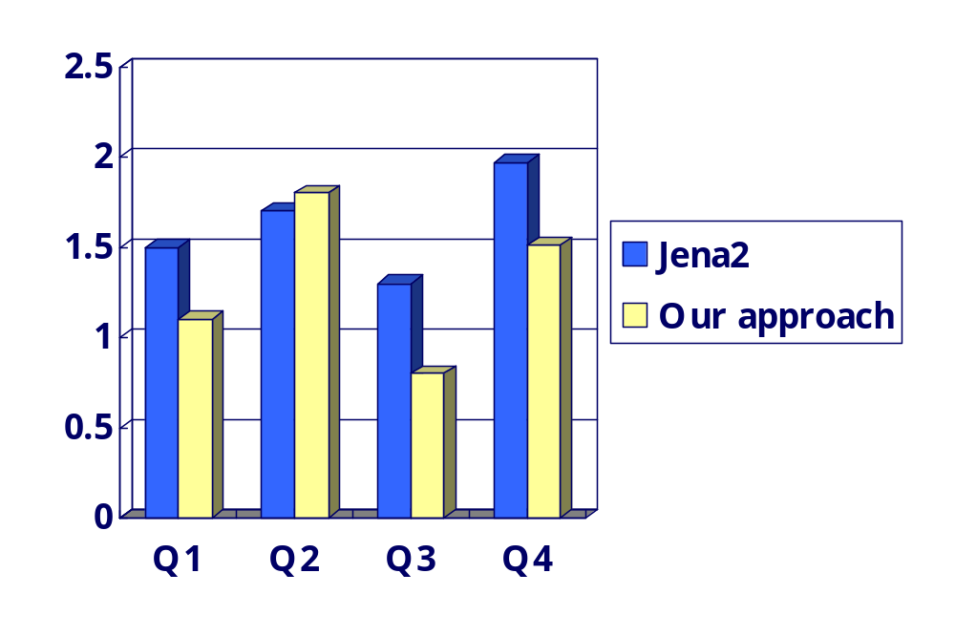
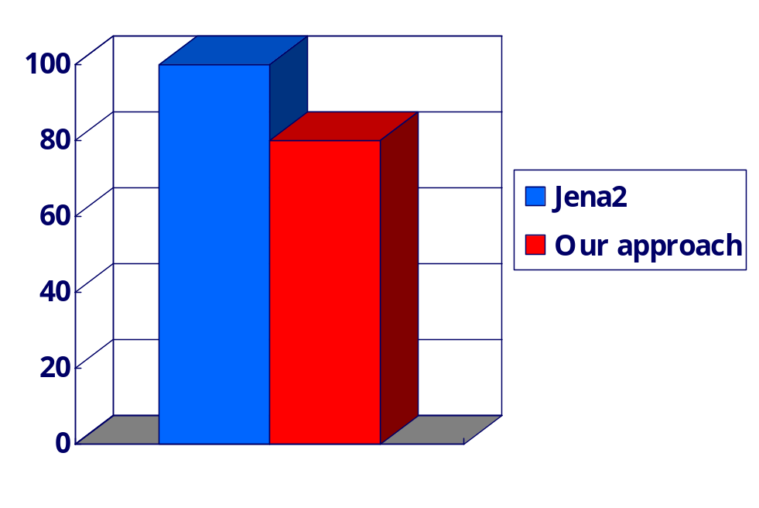
Experiments (2/2)
Response time
Size of Database
sec
%

Slide 15
Conclusion and Future work
Reorganize database schema for storing triple data
  Reduce search space by using both
    Semantic information rdfs:domain and rdfs:range
    Multiple statement tables
  Reduce physical size of table
    Eliminate redundant namespace value
  Overhead
    Require schema analysis
    Maintain DomainRange table and PredicateDuplicate table
Future work
  Ontology schema analysis engine for semi-automatic inserting rdfs:domain and rdfs:range

Slide 16
Query Analyzer Algorithm
APPENDEX 1
Function Query
Input parameter: user query, ModelRDB model
for all input triple do
if is belong to domain and predicate then
if is predicate conflict
get parent predicate for range value
endif
check domain value and extract table name
else
use default triple table
build SQL

Slide 17
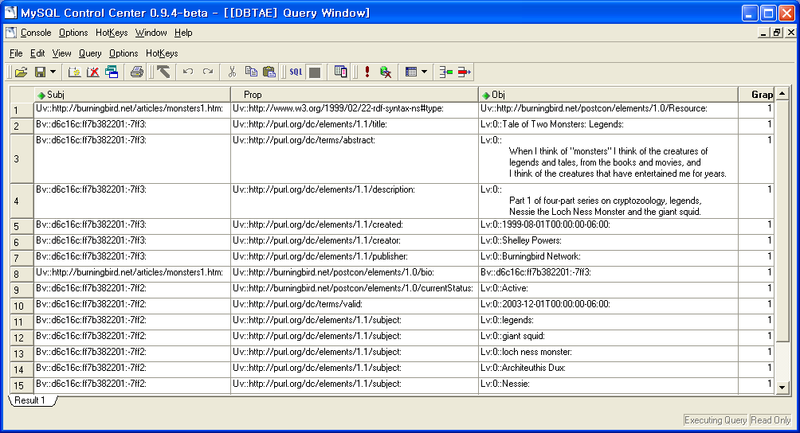
Statement Table Feature
APPENDEX 2

Slide 18
Additional Database Schema
APPENDEX 3
Reorganize database schema
  Construct ‘allNameSpace’ table
    Reduce physical table size
    Add namespace referencing column to a statement table
AllNameSpace
Statement
ID | NameSpace
Subj | NS | Pred | Obj

Slide 19
Sesame Database Schema
APPENDEX 4
Resource-to-inst
Proper_Instanceof
Inst class
Class,class-to-proper_instanceof,class
Direct_subclassof
sub super
Namespaces
Id prefix name
0..0
0..0
0..0
Namespace-assignment
Id-to-sub,
id-to-super
1..*
0..0
Instanceof
Inst class
0..0
2..*
2..*
1..*
Subclassof
sub super
Triples
subject predicate object Explicit
2..*
Resource-to-subject
Resource-to-predicate
Resource-to-object
2..*
1
Resource-assign
Class
id
2..*
0..0
Resources
id namespace localname
0..0
Subpropertyof
sub super
0..0
1
0..0
0..0
Property
id
Literal-to-object
Resource-assign
2..*
0..0
1
Resource-to-property,
resource-to-property
1..*
1..*
1
Id-to-sub,
id-to-super
Literal
id language value
0..0
0..0
Range
property class
Domain
property class
0..0
Direct_subpropertyof
sub super

Slide 20
Gene Ontology Schema
APPENDEX 5
Class: Term
‘http://www.geneontology.org
go#GO:0016209’
is_a
‘http://www.geneontology.org
go#GO:0003674’
definition
accession
name
‘….’
‘GO:0016209’
association
‘Antioxidant
Activity’
dbxref
Class: GeneProduct
Class: Association
gene_product
evidence
dbxref
name
Class: Evidence
Class: Dbxref
‘4930414C22Rik’
dbxref
evidence_code
‘ISS’
database_symbol
reference
‘MGI’
‘MGI:2429377’

