Slide 1
UML 의 실제
© copyright 2001 SNU OOPSLA Lab.

Slide 2

Use case의 구성요소

Slide 3
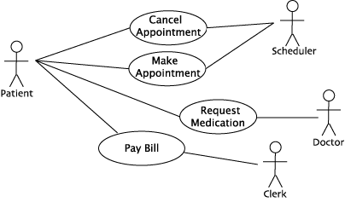
Use case diagram
Make Appointment

Slide 4
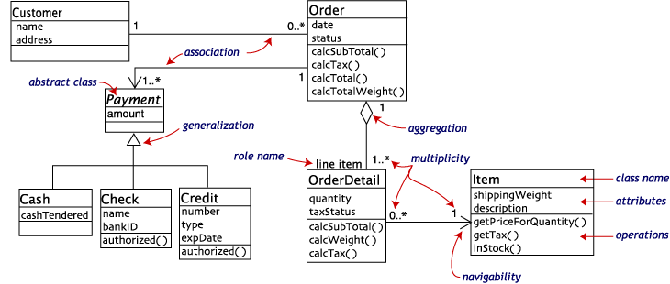
Class diagram
Customer order from a retail catalog

Slide 5
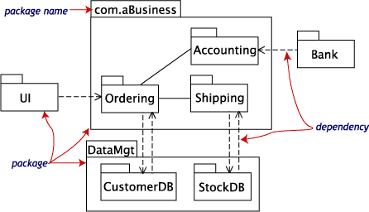
Package diagram
Business model

Slide 6
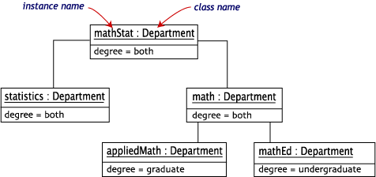
Object diagram
University Department

Slide 7
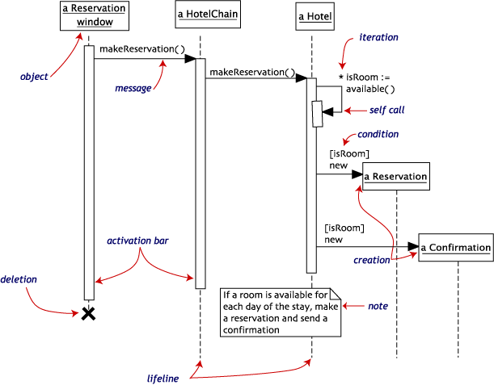
Sequence diagram
Hotel reservation

Slide 8
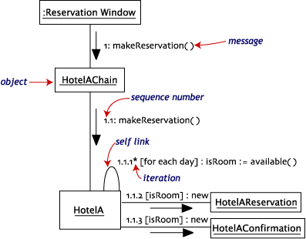
Collaboration diagram
Hotel reservation

Slide 9
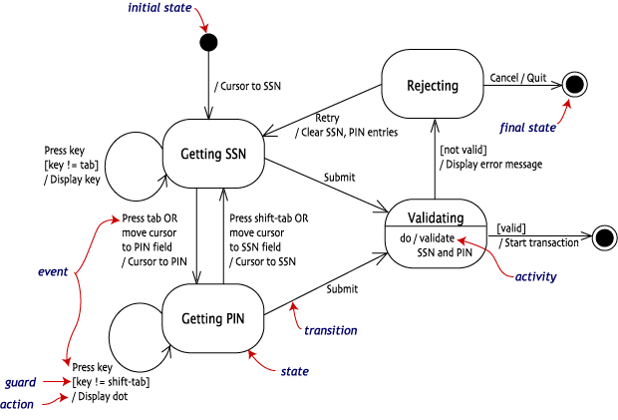
Statechart diagram
Login of an online banking system

Slide 10
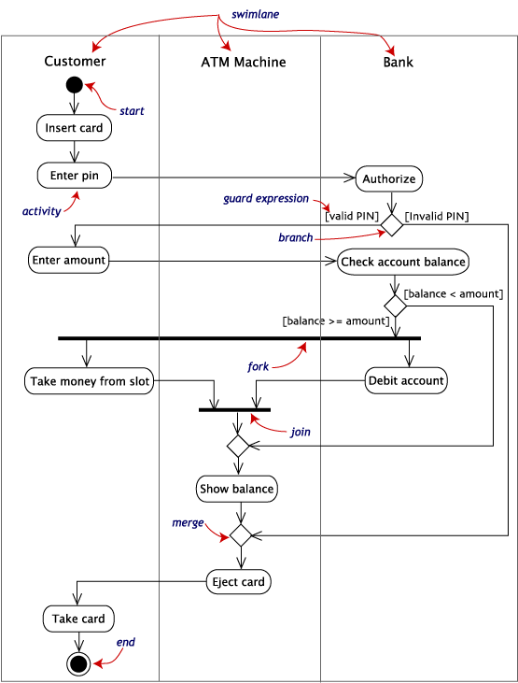
Activity
diagram
withdraw
money
(ATM)

Slide 11
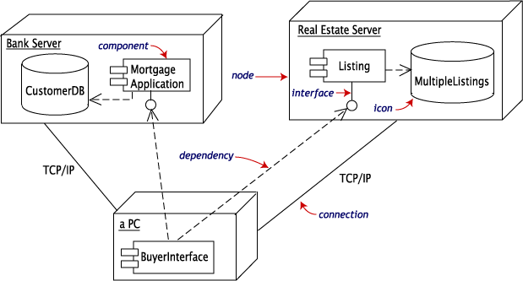
Deployment diagram
In transaction

Slide 12
END

