Slide 1
Ch5. XSL-FO
Seoul National University, Internet Database Laboratory
July, 2011
Sengyu Rim

Slide 2
Contents
The Two Parts of an XSL-FO Document
Creating an XSL-FO Document
Creating and Styling Blocks of Page Content
Adding Images
Defining a Page Template
Creating a Page Template Header
Using XSLT to Create XSL-FO
Inserting Page Breaks
Outputting Page Content in Columns
Adding a New Page Template

Slide 3
The Two Parts of an XSL-FO Document
XSL Formatting Objects, or XSL-FO is a markup language for
XML document formatting which is used to generate PDFs
XSL-FO is a typesetting language which enables you to specify
page layouts
Every XSL-FO document can be broken into two parts
The first part describes the overall structure of the final output
The second part of an XSL-FO document contains and formats the page content of the final output

Slide 4



The Two Parts of an XSL-FO Document
XSL-FO processor

Slide 5
The Two Parts of an XSL-FO Document
First part
Second part
<?xml version="1.0"?>
<fo:root xmlns:fo="http://
www.w3.org/1999/XSL/Format">
<!-- overall structure -->
<fo:layout-master-set>
<fo:simple-page-master
master-name="wonders_cover"
page-width="8.5in"
page-height="11in" margin="1in">
<fo:region-body/>
</fo:simple-page-master>
</fo:layout-master-set>
<!-- page content -->
<fo:page-sequence
master-reference="wonders_cover">
<fo:flow
flow-name="xsl-region-body">
<fo:block font-size="28pt"
text-align="center">
Seven Wonders of the Ancient
World</fo:block>
<fo:block font-size="14pt"
text-align="justify"
space-before=".25in">
The famous Greek historian
Herodotus wrote of seven great
architectural achievements.
...
</fo:flow>
</fo:page-sequence>
</fo:root>

Slide 6
Creating an XSL-FO Document
XSL-FO is an XML markup language, so XSL-FO documents are written using XML syntax
<?xml version="1.0"?>
<fo:root xmlns:fo="http://
www.w3.org/1999/XSL/Format">
<!-- overall structure -->
<fo:layout-master-set>
<fo:simple-page-master
master-name="wonders">
<fo:region-body/>
</fo:simple-page-master>
</fo:layout-master-set>
<!-- page content -->
<fo:page-sequence
master-reference="wonders">
<fo:flow
flow-name="xsl-region-body">
<fo:block>
Colossus of Rhodes</fo:block>
</fo:flow>
</fo:page-sequence>
</fo:root>
Root element
To start the overall structure part
To declare this page master will contain content in the body region
Template name

Slide 7
Creating and Styling Blocks of Page Content
In XSL-FO content such as paragraphs and headlines are
contained in blocks
The XSL-FO processor retrieves each block’s content to generate the final
output
...
<!-- page content -->
<fo:page-sequence
master-reference="wonders">
<fo:flow
flow-name="xsl-region-body">
<fo:block font-size="24pt"
space-after="0.2in">
Colossus of Rhodes
</fo:block>
<fo:block font-size="14pt">
<fo:block space-after="0.1in">
In 294 BC, the people of the
island of Rhodes began building
...
</fo:block>
<fo:block space-after="0.1in">
The Colossus was built with
bronze, reinforced with iron,
...
</fo:block>
</fo:block>
</fo:flow>
</fo:page-sequence>
</fo:root>
Style property
Page content

Slide 8
Adding Images
In addition to text content, the fo:block element can also contain images
The fo:external-graphic element, which identifies the image
...
<!-- page content -->
<fo:page-sequence
master-reference="wonders">
<fo:flow
flow-name="xsl-region-body">
<fo:block font-size="24pt"
text-align="center"
space-after="0.2in">
Colossus of Rhodes
</fo:block>
<fo:block text-align="center"
space-after="0.2in">
<fo:external-graphic
src="url('colossus.jpg')"
content-height="3.5in"
border-style="ridge"
border-width="thick"/>
</fo:block>
<fo:block font-size="14pt">
<fo:block space-after="0.1in">
...
Path to the image file
Style property

Slide 9
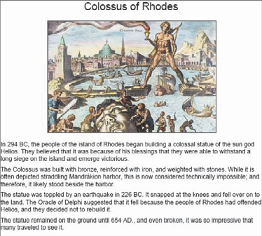
Adding Images
Display

Slide 10
Defining a Page Template
The overall structure part defines the page templates in which the
page content is output
<?xml version="1.0"?>
<fo:root xmlns:fo="http://
www.w3.org/1999/XSL/Format">
<!-- overall structure -->
<fo:layout-master-set>
<fo:simple-page-master
master-name="wonders"
page-width="8.5in"
page-height="11in" margin="1in">
<fo:region-body/>
</fo:simple-page-master>
</fo:layout-master-set>
Style property

Slide 11
Creating a Page Template Header
To create the structure for a header
To set the page content for header
...
<!-- overall structure -->
<fo:layout-master-set>
<fo:simple-page-master
master-name="wonders"
page-width="8.5in"
page-height="11in">
<fo:region-body margin="1in"/>
<fo:region-before extent="1in"/>
</fo:simple-page-master>
</fo:layout-master-set>
...
...
<!-- page content -->
<fo:page-sequence
master-reference="wonders">
<fo:static-content
flow-name="xsl-region-before">
<fo:block font-size="18pt"
text-align="center"
border-bottom-width="medium"
border-bottom-style="solid"
margin="0.25in">
Seven Wonders of the Ancient
World</fo:block>
</fo:static-content>
...
Height of the header region
Refers to the header region

Slide 12
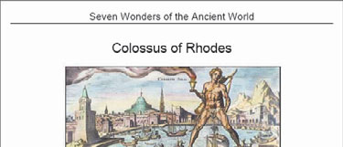
Creating a Page Template Header
Display

Slide 13
Using XSLT to Create XSL-FO
By recombining XSLT and XSL-FO you will format the transformed content into a final output document for publication (XSL-FO)
Instead of starting with an XSL-FO document, start with an XSLT document
<?xml version="1.0"?>
<xsl:stylesheet xmlns:xsl="http://
www.w3.org/1999/XSL/Transform"
version="1.0" xmlns:fo="http://
www.w3.org/1999/XSL/Format"
<xsl:output method="xml"
indent="yes"/>
<xsl:template match="/">
<fo:root>
<!-- overall layout -->
<fo:layout-master-set>
...
To declare the namespace
To define the output method to be xml
To create the XSLT template

Slide 14
Using XSLT to Create XSL-FO
By recombining XSLT and XSL-FO you will format the transformed content into a final output document for publication (XSL-FO)
...
<fo:flow flow-name="xsl-region-body">
<xsl:apply-templates select=
"ancient_wonders/wonder/name
[@language='English']">
<xsl:sort select="."
order="ascending"/>
</xsl:apply-templates>
</fo:flow>
...
...
<xsl:template match="name">
<fo:block font-size="24pt"
text-align="center"
space-after="0.2in">
<xsl:value-of select="."/>
</fo:block>
...
To generate the XSL-FO page content
To call the xsl:template elements

Slide 15
Inserting Page Breaks
Type break-before="page“ inserts a page break before the
block’s content in the final output
...
<xsl:template match="name">
<fo:block font-size="24pt"
text-align="center"
space-after="0.2in"
break-before="page">
<xsl:value-of select="."/>
</fo:block>
...
...
<fo:static-content
flow-name="xsl-region-after">
<fo:block font-size="9pt"
text-align="right" margin="0.5in"
margin-top="0.25in">
Page <fo:page-number/>
</fo:block>
</fo:static-content>
...
To insert a page break
Current page number

Slide 16
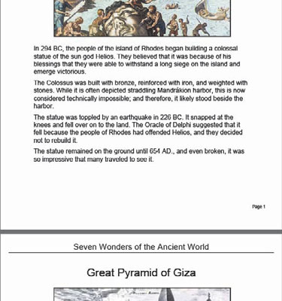
Inserting Page Breaks
Display

Slide 17
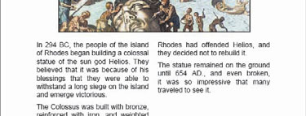
Outputting Page Content in Columns
XSL-FO is able to define columns in which to output page content
...
<!-- overall layout -->
<fo:layout-master-set>
<fo:simple-page-master
master-name="wonders"
page-width="8.5in"
page-height="11in">
<fo:region-body margin="1in"
column-count="2"/>
...
Number of columns

Slide 18
Adding a New Page Template
You can create a cover page with different overall layout by
adding a new page template
To add a new page template
To define page content for a new page template
...
<!-- overall layout -->
<fo:layout-master-set>
<fo:simple-page-master
master-name="wonders_cover"
page-width="8.5in"
page-height="11in" margin="1in">
<fo:region-body/>
</fo:simple-page-master>
...
...
<!-- page content-->
<fo:page-sequence
master-reference="wonders_cover">
<fo:flow
flow-name="xsl-region-body">
<fo:block font-size="28pt"
text-align="center">
Seven Wonders of the Ancient World
...

Slide 19
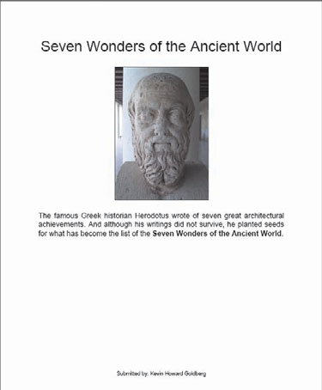
Adding a New Page Template
Display

