Slide 1
A (Sub)Graph Isomorphism Algorithm for Matching Large Graphs
Luigi P. Cordella¹, Pasquale Foggia¹, Calgo Sansone¹, and Mario Vento²
¹Universita di Napoli, Italy
²Universita di Salerno, Italy
IEEE Transactions on Pattern Analysis and Machine Intelligence, 26(10), 2004
30 March 2012
Kisung Kim

Slide 2
Outline
Introduction
The VF2 algorithm
Experimental Results
Conclusions

Slide 3
Introduction
Graph applications increase in
Pattern analysis
Pattern recognition
Computer vision
From the point of view of pattern analysis and recognition, the most important problem of graph processing is matching graphs or subgraphs

Slide 4

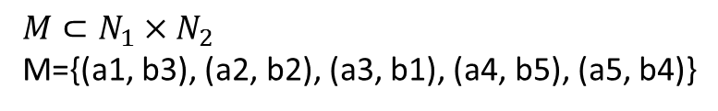



Graph Matching
Graph isomorphism
1
1
2
4
2
4
3
5
3
5
$$G_{1}=(N_{1},B_{1})$$
$$G_{2}=(N_{2},B_{2})$$
$$N_{1}=\{a1, a2, a3, a4, a5\}$$
$$N_{2}=\{b1, b2, b3, b4, b5\}$$
$$M⊂N_{1}×N_{2}$$
M={(a1, b3), (a2, b2), (a3, b1), (a4, b5), (a5, b4)}
M is said to be isomorphism iff M is a bijective function that preserve
the branch structure of two graphs

Slide 5

Graph Matching
Graph-subgraph Isomorphism
1
1
7
2
4
6
2
4
3
5
3
5
8
$$G_{1}=(N_{1},B_{1})$$
$$G_{2}=(N_{2},B_{2})$$
$$N_{1}=\{a1, a2, a3, a4, a5\}$$
$$N_{2}=\{b1, b2, b3, b4, b5,b6,b7,b8\}$$
$$M⊂N_{1}×N_{2}$$
M={(a1, b3), (a2, b2), (a3, b1), (a4, b5), (a5, b4)}
M is said to be subgraph isomorphism iff M is an isomorphism
between G₁ and a subgraph of G₂.
M is injective function.

Slide 6
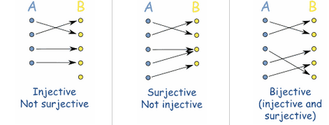
Graph Matching

Slide 7
Graph Matching
Subgraph isomorphism is a NP-complete problem
It is still an open question if graph isomorphism is a NP-complete problem
➔ Exponential time requirement of matching algorithm
Exact graph matching
Strict correspondence between two graphs
Inexact matching
Similarity between two graphs

Slide 8
Existing methods
Reducing complexity by imposing restrictions on the graphs (e.g., polynomial algorithms for trees, planar graphs, or bounded valence graphs)
Pruning unprofitable paths in the search space
Backtracking algorithm proposed by Ullmann
J.R.Ullmann, “An Algorithm for Subgraph Isomorphism”, J. Assoc. for Computing Machinery, 1979
Most commonly used for exact graph matching
Nauty Algorithm
B.D. McKay, “Practical Graph Isomorphism”, Congressus Numerantium, 1981
Transform the graphs to a canonical form
Considered on e of the fastest graph isomorphism algorithms available
Cannot be used for the graph-subgraph isomorphism problem

Slide 9
VF2 Algorithm
State Space Representation
State s: a partial mapping solution M(s)
Transition to a successor state: addition to the partial graphs of a pair (n, m)
1
1
2
4
2
4
3
5
s1
<empty>
3
5
S2
{(a1, b1)}
S6
{(a1, b2)}
s7
{(a1, b3)}
s3
{(a1, b1), (a2, b2)}
S4
{(a1, b1), (a2, b3)}
S5
{(a1, b1),
(a2, b4)}

Slide 10
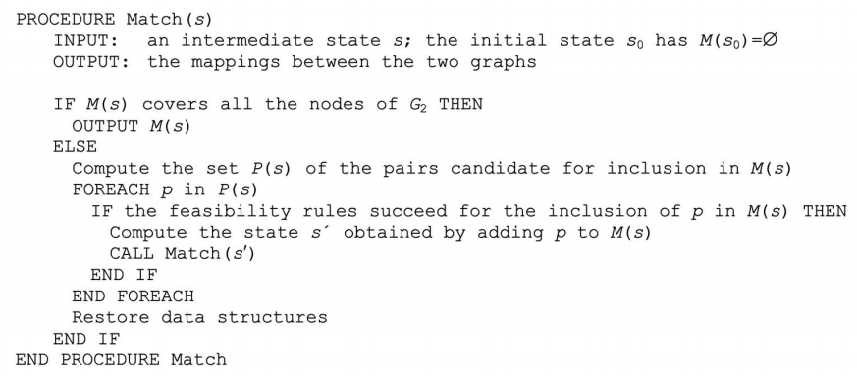
VF2 Algorithm

Slide 11
VF2 Algorithm
A state can be reached through different paths
Define a total order on those nodes of G₂
Add matching pairs according to the total order
s1
<empty>
S2
{(a1, b1)}
S6
{(a2, b3)}
S4
{(a1, b1), (a2, b3)}
S5
{(a2, b3), (a1, b1)}

Slide 12
Sets in VF2
T₁(s)
T₂(s)
T₁^{in}(s)
T₁^{out}(s)
T₂^{in}(s)
T₂^{out}(s)
V₁’(s)
M₂(s)
V₂’(s)
M₁(s)

Slide 13
Candidate Pairs Set
P(s) will be made of all the node pairs (n, m) with
n in T₁^{out}(s) and m to T₂^{out}(s)
n in T₁^{in}(s) and m to T₂^{in}(s)
If the two sets are empty (not connected graphs), all the pairs of nodes not contained neither in G₁(s) nor in G₂(s)

Slide 14
Feasibility Function
Five rules are defined: R_{pred}, R_{succ}, R_{in}, R_{out}, R_{new}
Check consistency of the new partial solution : P_{pred}, R_{succ}
Pruning the search tree
1-look-ahead: R_{in}, R_{out}
2-look-ahead: R_{new}

Slide 15
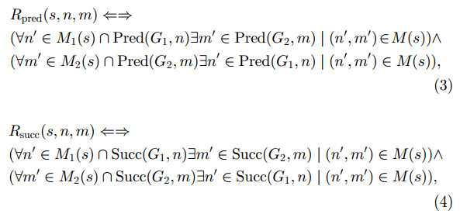
Feasibility Function
Check consistency of the new partial solution
Final isomorphism
Partial isomorphism
M₂(s)
M₁(s)
n
m
G₁
G₂

Slide 16
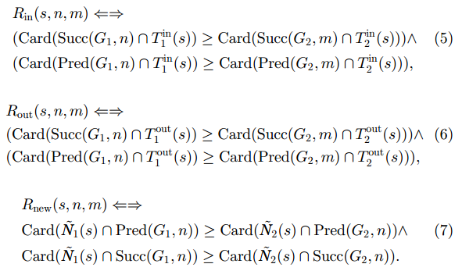
Feasibility Function
Pruning the search tree
Final isomorphism
Partial isomorphism
M₂(s)
M₁(s)
m
n
G₁
G₂

Slide 17
Data Structures
Data structure for the computation of P(s) and F(s, n, m)
Vector core_1, core2
Dimension: the number of nodes in the corresponding graphs
Contain the current mapping
core_1[n]: the index of the node paired with n
Vector in_1, out_1, in_2, out_2
Dimension: the number of nodes in the corresponding graphs
Describe the membership of the terminal sets
Value: the depth in the SSR tree of the state in which the node entered the corresponding set

Slide 18
Data Structures
1
1
core_1:
1
2
N
N
N
2
4
2
4
core_2:
1
2
N
N
N
in_1:
1
2
2
N
N
3
5
3
5
out_1:
1
1
N
1
N
in_2:
1
2
N
N
N
out_2:
s1
<empty>
1
1
2
1
2
S2
{(a1, b1)}
S6
{(a1, b2)}
s7
{(a1, b3)}
s3
{(a1, b1), (a2, b2)}
S4
{(a1, b1), (a2, b3)}
S5
{(a1, b1),
(a2, b4)}

Slide 19
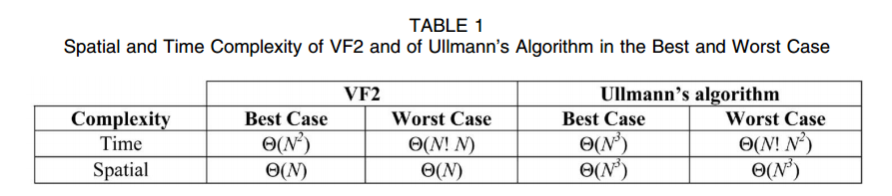
Time Complexity
Computation of P(s): O(|N₁|+|N₂|)
Computation of F(s, n, m): proportional to the number of the branches involving n and m
In the best case, visit N states
In the worst case, visit N! states

Slide 20
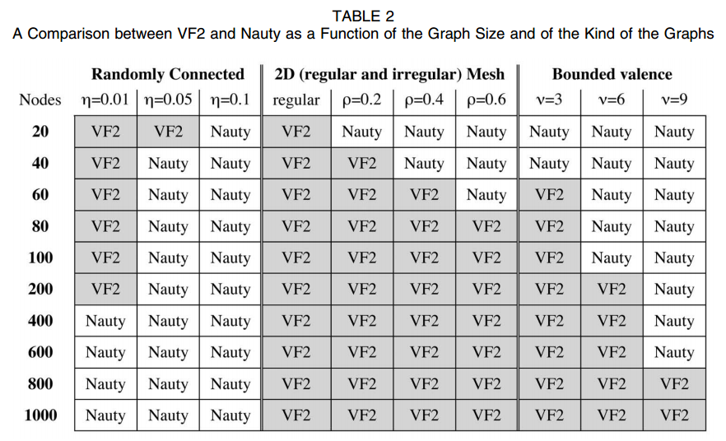
Experimental Results: Graph Isomorphism
Randomly connected graphs
Edges connect nodes without any structural regularity
2D mesh graphs
Regular structures: 4-connected
Bounded valence
A node establishes a fixed number of relations (edges)
For graphs with a more regular structure, VF2 is more efficient, especially for large sizes

Slide 21
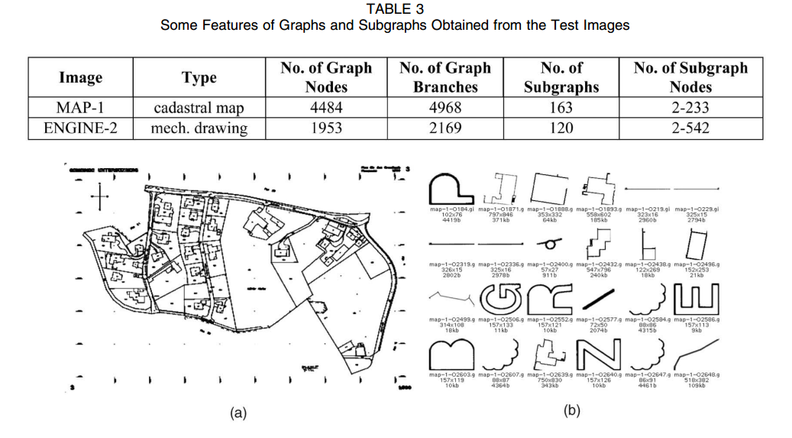
Experimental Results: Subgraph Isomorphism
Derive graphs from large line drawings
Two publicly available images
ENGINE-2: mechanical drawing
MAP-1: cadastral map

Slide 22
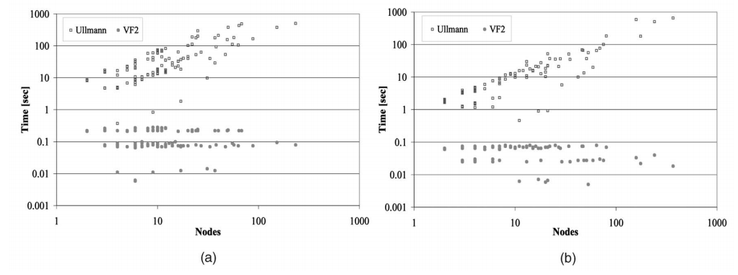
Experimental Results: Subgraph Isomorphism
VF2 performs significantly better, especially when the size of the subgraphs is over about 20 nodes
The time needed by VF2 is almost independent of the number of nodes
MAP-1
ENGINE-2

Slide 23
Conclusions
VF2
Reduce computational complexity of graph matching algorithm due to a set of feasibility rules
Deal with large graphs without assumptions of the nature of the graphs
Can be used for both isomorphism and graph-subgraph isomorphism
Can deal with attributed relational graphs

Slide 24
Discussion
Pros
Provide good review of graph matching algorithms
Well-structured paper
Without any preprocessing of graphs
Cons
Novel idea?
Too concise description of the algorithm
No example, no figure

