Slide 1
Propagation of Trust and Distrust
R. Guha, Ravi Kumar, Prabhakar Raghavan, and Andrew Tomkins
WWW 2004
27 September 2012
Hyewon Lim

Slide 2
Outline
Introduction
Algorithms
Experiments
Conclusions

Slide 3






Introduction

Slide 4
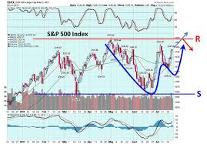



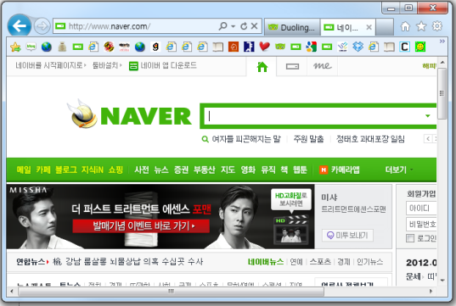
Introduction
Unscrupulous exploitations
Build and maintain a web of trust
Help a user assess the quality of information before acting on it
Perfume for sale:
click here!!
Notes:
Help a user assess the quality of information before acting on it

Slide 5


Introduction
Trust propagation
Through the relationship network with appropriate discounting
Benefits of relationships of trust
To present a view of the data tailored to the individual user
Greater influence and higher prices of globally well-trusted users
How to model and propagate distrust?
Trust score:
Trust?
Distrust?
No opinion?

Slide 6
Outline
Introduction
Algorithms
Experiments
Conclusions

Slide 7
Algorithms
Predict an unknown trust/distrust value between any two users
t_{ij}, matrix of trusts
d_{ij}, matrix of distrusts
F, final trust
B, a set of belief about the world
propagations
Trusts alone (T), or
trusts combined with distrusts (T-D)

Slide 8
Algorithms: Atomic propagation
Direct propagation
Co-citation
Operator M = B
∴ B·M = B²
i
j
k
i
l
Operator M = B^{T}B
∴ B·M = BB^{T}B
j
k

Slide 9
Algorithms: Atomic propagation
Transpose trust
Trust coupling
Combining four schemes
Operator M = B^{T}
∴ B·M = BB^{T}
i
j
i
j
k
Operator M = BB^{T}
∴ B·M = BBB^{T}

Slide 10



Algorithms: Propagation of trust and distrust
Propagation of distrust
P^{(k)}: a belief matrix after k atomic propagation steps
TRUST ONLY
Simply propagate only trust scores
ONE-STEP DISTRUST
Distrust propagates only a single step, while trust many propagate repeatedly
PROPAGATED DISTRUST
Trust and distrust both propagate together
T – D
i
d
j

Slide 11


Algorithms: Propagation of trust and distrust
Iterative propagation
To infer final trust scores from the sequences of propagations
The matrix P^{(k)} for smaller values of k may be more reliable
EIGENVALUE PROPAGATION (EIG)
WEIGHTED LINEAR COMBINATIONS (WLC)
: a discount factor to penalize lengthy propagation steps

Slide 12

Algorithms: Propagation of trust and distrust
Rounding
To round the entries in matrix F to either trust or distrust
GLOBAL ROUNDING
Threshold τ: the overall relative fractions
LOCAL ROUNDING
Threshold τ: the relative fractions of trust vs. distrust by i
MAJORITY ROUNDING
The majority of the labels in the smallest local neighbor hood surrounding it
i

Slide 13

Algorithms: On the transitivity of distrust
Multiplicative: ? = Trust
Some unexpected side-effects: negative product
All earlier definitions implement this notion
Additive: ? = Distrust
To implement the notion in this framework
i
d
j
d
k
?

Slide 14
Outline
Introduction
Algorithms
Experiments
Conclusions

Slide 15
Experiments
Data source: Epinions
131,829 nodes and 841,372 edges, each labeled either trust or distrust
85.29% are labeled trust
Interpret trust to be +1.0 and distrust to be -1.0
3⁴ = 81 experimental schemes
Propagation of distrust: Trust only, one-step distrust, or propagated distrust
Iteration method: EIG, WLC (γ=0.5), and WLC (γ=0.9)
Rounding: Global, local, or majority
Atomic propagations: Direct only, co-citation only, or combined

Slide 16
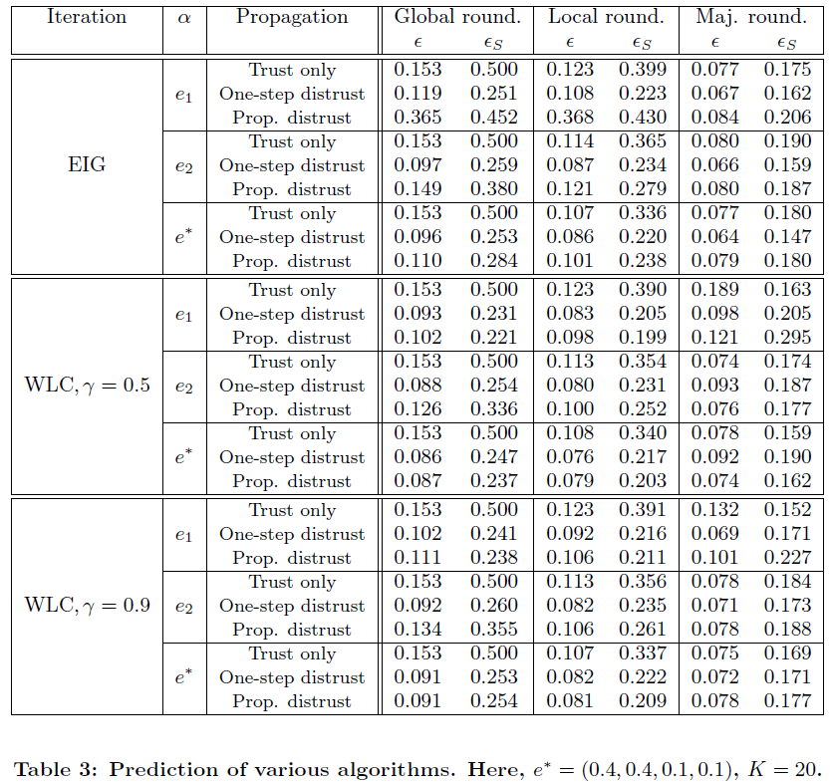
Experiments
Cross-validation method
Mask a single trial edge (i, j), and guess whether i trusts j
85:15
50:50
subset

Slide 17
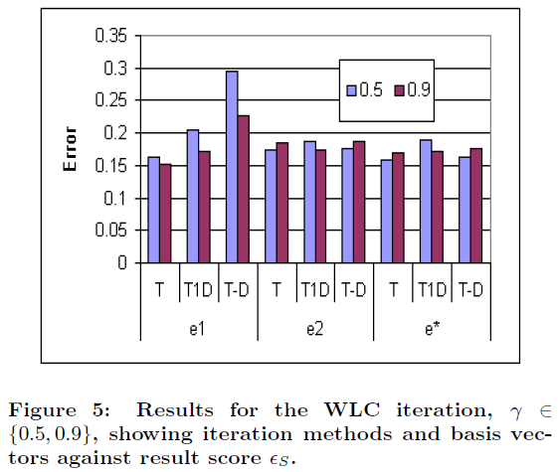
Experiments
Incorporation of distrust
Long paths (0.9 case) performs worse for one-step distrust than the 0.5 case …??????? 내가 멍청한 것인가…

Slide 18
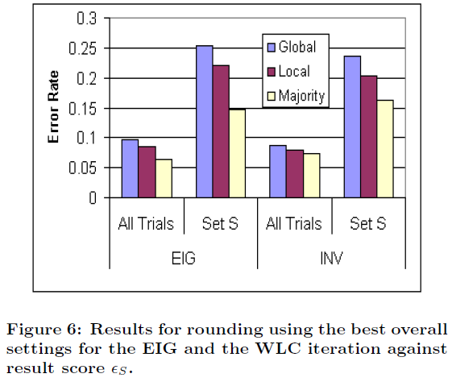
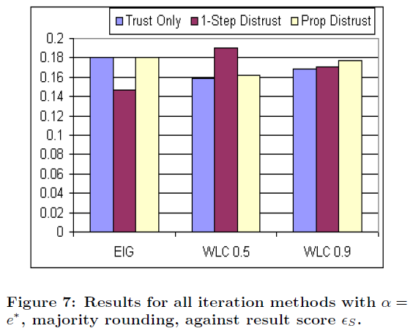
Experiments
Rounding and iteration models

Slide 19
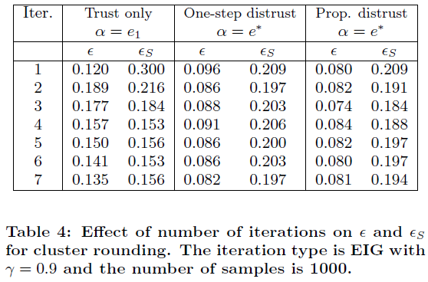
Experiments
The effect of the number of iterations, K
The shortest path between most test pairs has length two

Slide 20
Outline
Introduction
Algorithms
Experiments
Conclusions

Slide 21
Conclusions
Develop a formal framework of trust propagation schemes
The formal and computational treatment of distrust propagation
A treatment of “rounding”
Evaluate the schemes on a large, real world, working trust network
Show how distrust, rounding and other such phenomenon have significant effects on how trust is propagated

Slide 22
Discussion
Strong point
Consider various features
Weak point
Focused on the results of subset data
no explanation about the result of the original data set

