Slide 1
O’Reilly – Hadoop: The Definitive Guide Ch.1 Meet Hadoop
May 28th, 2010
Taewhi Lee

Slide 2
Outline
Data!
Data Storage and Analysis
Comparison with Other Systems
RDBMS
Grid Computing
Volunteer Computing
The Apache Hadoop Project

Slide 3
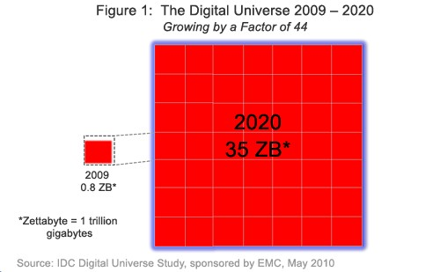
‘Digital Universe’ Nears a Zettabyte
Digital Universe: the total amount of data stored in the world’s computers
Zettabyte: 10²¹ bytes >> Exabyte >> Petabyte >> Terabyte

Slide 4

Flood of Data
NYSE generates 1TB new trade data / day

Slide 5

Flood of Data
Facebook hosts 10 billion photos (1 petabyte)

Slide 6

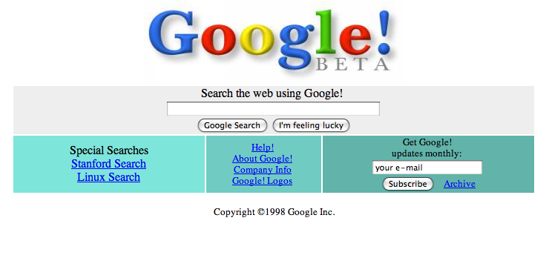
Flood of Data
Internet Archive stores 2 petabytes of data

Slide 7
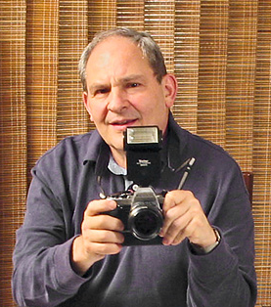

Individuals’ Data are Growing Apace
It becomes easier to take more and more photos

Slide 8
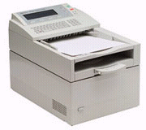
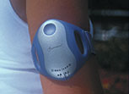
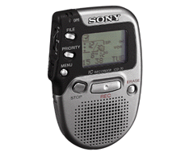







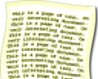


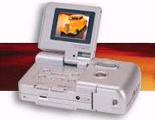
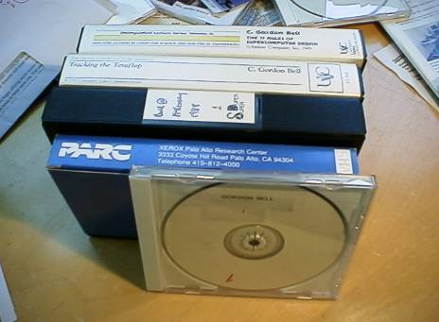
Individuals’ Data are Growing Apace
Microsoft Research’s MyLifeBits Project
Capture and encoding
SQL
LifeLog, my life in a terabyte

Slide 9

Amount of Public Data Increases
Available Public Data Sets on AWS
Annotated Human Genome
Public database of chemical structures
Various census data and labor statistics

Slide 10
Large Data!
“More data usually beats better algorithms”
How to store & analyze large data?

Slide 11
Outline
Data!
Data Storage and Analysis
Comparison with Other Systems
RDBMS
Grid Computing
Volunteer Computing
The Apache Hadoop Project

Slide 12

Current HDD
capacity | 1TB
transfer rate | 100MB/s
How long it takes to read all the data off the disk?
How about using multiple disks?

Slide 13
Problems with Multiple Disks
Hardware Failure
Doing tasks need to combine the distributed data
What Hadoop Provides
Reliable shared storage (HDFS)
Reliable analysis system (MapReduce)

Slide 14
Outline
Data!
Data Storage and Analysis
Comparison with Other Systems
RDBMS
Grid Computing
Volunteer Computing
The Apache Hadoop Project

Slide 15
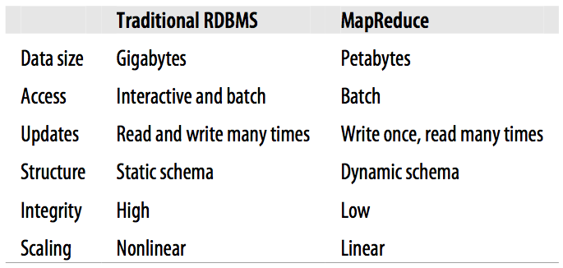
RDBMS
*
**
* Low latency for point queries or updates
** Update times of a relatively small amount of data

Slide 16
Grid Computing
Shared storage (SAN)
Works well for predominantly CPU-intensive jobs
Becomes a problem when nodes need to access large data

Slide 17
Volunteer Computing
Volunteers donate CPU time from their idle computers
Work units are sent to computers around the world
Suitable for very CPU-intensive work with small data sets
Risky due to running work on untrusted machines

Slide 18
Outline
Data!
Data Storage and Analysis
Comparison with Other Systems
RDBMS
Grid Computing
Volunteer Computing
The Apache Hadoop Project

Slide 19
Brief History of Hadoop
Created by Doug Cutting
Originated in Apache Nutch (2002)
Open source web search engine, a part of the Lucene project
NDFS (Nutch Distributed File System, 2004)
MapReduce (2005)
Doug Cutting joins Yahoo! (Jan 2006)
Official start of Apache Hadoop project (Feb 2006)
Adoption of Hadoop on Yahoo! Grid team (Feb 2006)

Slide 20
The Apache Hadoop Project
Pig
Chukwa
Hive
HBase
MapReduce
HDFS
Zoo Keeper
Core
Avro

