Slide 1
Chapter 12: Query Processing

Slide 2

Basic Steps in Query Processing
1. Parsing and translation
2. Optimization
3. Evaluation

Slide 3
Basic Steps in Query Processing (Cont.)
Parsing and translation
  Translate the query into its internal form
  This is then translated into relational algebra
  Parser checks syntax, verifies relations
Optimization
  Enumerate all possible query-evaluation plans
  Compute the cost for the plans
  Pick up the plan having the minimum cost
Evaluation
  The query-execution engine takes a query-evaluation plan,
  executes that plan,
  and returns the answers to the query.

Slide 4
Basic Steps in Query Processing: Optimization
There are more than one way to evaluate a query
  A relational algebra expression may have many equivalent expressions
    E.g., σ_{salary<75000}(∏_{salary}(instructor)) is equivalent to
    ∏_{salary}(σ_{salary<75000}(instructor))
  Each relational algebra operation can be evaluated using one of several different algorithms
    E.g., to find instructors with salary < 75000,
      can use an index on salary,
      or can perform complete relation scan and discard instructors with salary ≥ 75000
Query Optimization
  Amongst all equivalent evaluation plans choose the one with lowest cost
  Cost is estimated using statistical information from the data dictionary
    E.g., number of tuples in each relation, size of tuples, etc.

Slide 5
Basic Steps: Optimization (Cont.)
In this chapter we study
  How to measure query costs
  Algorithms for evaluating relational algebra operations
  How to combine algorithms for individual operations in order to evaluate a complete expression
In Chapter 13
  We study how to optimize queries, that is, how to find an evaluation plan with lowest estimated cost

Slide 6
Measures of Query Cost
Cost is generally measured as total elapsed time for answering query
  Many factors contribute to time cost
    Disk accesses, CPU, or even network communication
Typically disk access is the predominant cost, and is also relatively easy to estimate. Measured by taking into account
  Number of seeks * average-seek-cost
  Number of blocks read * average-block-read-cost
  Number of blocks written * average-block-write-cost
    Cost to write a block is greater than cost to read a block
      Data is read back after being written to ensure that the write was successful

Slide 7
Measures of Query Cost (Cont.)
For simplicity, we just use the number of block transfers from disk and the number of seeks as the cost measures
  t_{T} – time to transfer one block
  t_{S} – time for one seek (seek time + rotational latency)
  Cost for b block transfers plus S seeks
  b * t_{T} + S * t_{S}
We ignore CPU costs for simplicity
  Real systems do take CPU cost into account
We do not include cost to writing output to disk in our cost formulae

Slide 8
Selection Operation
File scan – search algorithms that locate and retrieve records that fulfill a selection condition
Algorithm A1 (linear search). Scan each file block and test all records to see whether they satisfy the selection condition.
  Cost estimate = b_{r} * t_{T} (block transfers) + 1 * t_{S} (seek)
    b_{r} : number of blocks containing records from relation r
    Extra seeks may be required, but we ignore this for simplicity
  If selection is on a key attribute, can stop on finding record
    cost = (b_{r} /2) block transfers + 1 seek
  Linear search can be applied regardless of
    selection condition or
    ordering of records in the file, or
    availability of indices
Note: binary search generally does not make sense since data is not stored consecutively

Slide 9
Selections Using Indices
Index scan – search algorithms that use an index
  Selection condition must be on search-key of index
A2 (primary index, equality on key)
  Retrieve a single record that satisfies the corresponding equality condition
  Cost = (h_{i} + 1) * (t_{T} + t_{S})
    h_{i}: the height of the B⁺ tree
A3 (primary index, equality on nonkey). Retrieve multiple records.
  Records will be on consecutive blocks
    Let b = number of blocks containing matching records
  Cost = h_{i} * (t_{T} + t_{S}) + t_{S} + t_{T} * b

Slide 10
Selections Using Indices
A4 (secondary index, equality on nonkey).
  Retrieve a single record if the search-key is a candidate key
    Cost = (h_{i} + 1) * (t_{T} + t_{S})
  Retrieve multiple records if search-key is not a candidate key
    each of n matching records may be on a different block
    Cost = (h_{i} + n) * (t_{T} + t_{S})
      Can be very expensive!
    each record may be on a different block
      one block access for each retrieved record

Slide 11
Selections Involving Comparisons
Can implement selections of the form σ_{A≤V} (r) or σ_{A ≥ V}(r) by using
  a linear file scan,
  or by using indices in the following ways:
A5 (primary index, comparison). (Relation is sorted on A)
    For σ_{A ≥ V}(r) use index to find first tuple ≥ v and scan relation sequentially from there
    For σ_{A≤V} (r) just scan relation sequentially till first tuple > v; do not use index
A6 (secondary index, comparison).
    For σ_{A ≥ V}(r) use index to find first index entry ≥ v and scan index sequentially from there, to find pointers to records.
    For σ_{A≤V} (r) just scan leaf pages of index finding pointers to records, till first entry > v
    In either case, retrieve records that are pointed to
      requires an I/O for each record
      Linear file scan may be cheaper if many records are to be fetched!

Slide 12
Implementation of Complex Selections
Conjunction: σ_{θ1}∧ _{θ2}∧. . . _{θn}(r)
A7 (conjunctive selection using one index).
  Select a combination of θ_{i} and algorithms A1 through A7 that results in the least cost for σ_{θi} (r)
  Test other conditions on tuple after fetching it into memory buffer
A8 (conjunctive selection using composite index).
  Use appropriate composite (multiple-key) index if available
A9 (conjunctive selection by intersection of identifiers).
  Requires indices with record pointers
  Use corresponding index for each condition, and take intersection of all the obtained sets of record pointers
  Then fetch records from file
  If some conditions do not have appropriate indices, apply test in memory

Slide 13
Algorithms for Complex Selections
Disjunction: σ_{θ1}∨ _{θ2} ∨. . . _{θn} (r).
A10 (disjunctive selection by union of identifiers).
  Applicable if all conditions have available indices
    Otherwise use linear scan
  Use corresponding index for each condition, and take union of all the obtained sets of record pointers
  Then fetch records from file
Negation: σ_{¬θ}(r)
  Use linear scan on file
  If very few records satisfy ¬θ, and an index is applicable to θ
    Find satisfying records using index and fetch from file

Slide 14
Sorting
Sorting of data is important in DBMS for two reasons:
  SQL queries can specify that the output be sorted
  Several of the relational operations (e.g., joins) can be implemented efficiently if the input relations are first sorted
We may use the index to read the relation in sorted order
  May lead to one disk block access for each tuple
For relations that fit in memory, techniques like quicksort can be used
For relations that don’t fit in memory, external sort-merge is a good choice

Slide 15
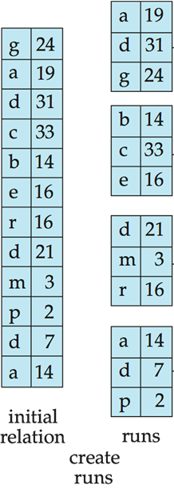
External Sort-Merge
M: memory size (in blocks) available for sorting
Create sorted runs
Let i be 0 initially.
Repeatedly do the following
till the end of the relation:
(a) Read M blocks of relation into memory
(b) Sort the in-memory blocks
(c) Write sorted data to run R_{i}; increment I
Let the final value of i be N (the number of runs).

Slide 16
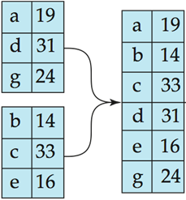
External Sort-Merge (Cont.)
Merge the runs (N-way merge). (Assume for now that N < M)
  Use N blocks of memory to buffer input runs, and
  1 block to buffer output
  Read the first block of each run into its buffer page
  repeat
    Select the first record (in sort order)
    among all buffer pages
    Write the record to the output buffer.
    If the output buffer is full write it to disk.
    Delete the record from its input buffer page.
    If the buffer page becomes empty then
    read the next block (if any)
    of the run into the buffer.
  until all input buffer pages are empty:

Slide 17
External Sort-Merge (Cont.)
Merge the runs (N ≥ M).
  Several merge passes are required
  In each pass, contiguous groups of M - 1 runs are merged
  A pass reduces the number of runs by a factor of M -1, and creates runs longer by the same factor
    E.g. If M=11, and there are 90 runs, one pass reduces the number of runs to 9, each 10 times the size of the initial runs
  Repeated passes are performed till all runs have been merged into one

Slide 18
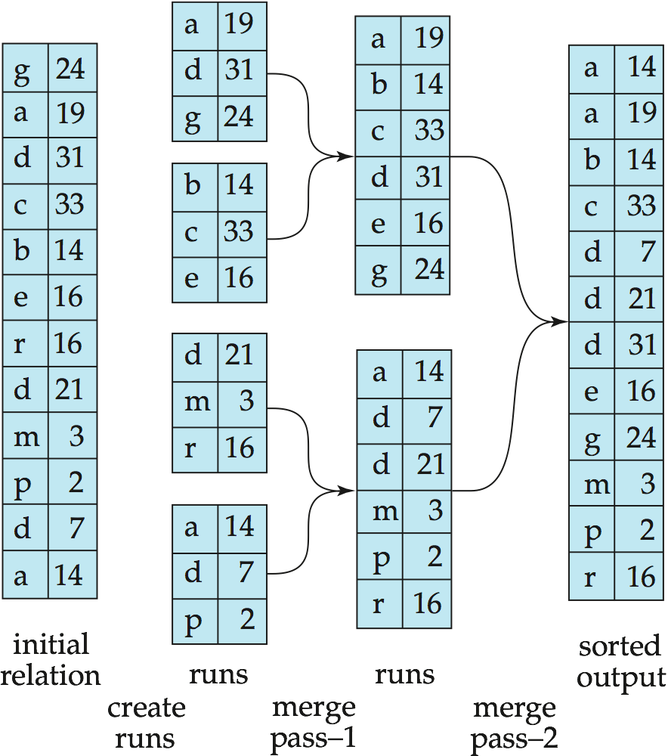
Example: External Sorting Using Sort-Merge
M = 3
Only one tuple
fits in a block

Slide 19
External Merge Sort – Cost Analysis
Total number of merge passes required: ⎡log_{M–1}(b_{r} /M)⎤
  b_{r} / M: the initial number of runs
Block transfers
  For initial run creation as well as in each pass: 2b_{r}
  Thus total number of block transfers for external sorting:
  b_{r} ( 2 ⎡log_{M–1}(b_{r} / M)⎤ + 1)
    We don’t count final write cost for all operations
Seeks
  During run generation: 1 seek to read and 1 seek to write each run
    2 ⎡b_{r} / M⎤
  During the merge phase
    Buffer size: b_{b} (read/write b_{b} blocks at a time)
    Need 2 ⎡b_{r} / b_{b}⎤ seeks for each merge pass
      except the final one which does not require a write
    Total number of seeks:
    2 ⎡b_{r} / M⎤ + ⎡b_{r} / b_{b}⎤ (2 ⎡log_{M–1}(b_{r} / M)⎤ -1)

Slide 20
Join Operation
Several different algorithms to implement joins
  Nested-loop join
  Block nested-loop join
  Indexed nested-loop join
  Merge-join
  Hash-join
Choice based on cost estimate
Examples use the following information
  Number of records of student: 5,000 takes: 10,000
  Number of blocks of student: 100 takes: 400

Slide 21
Nested-Loop Join
To compute the theta join r _{θ} s
for each tuple t_{r} in r do begin
for each tuple t_{s} in s do begin
test pair (t_{r},t_{s}) to see if they satisfy the join condition θ
if they do, add t_{r} • t_{s} to the result.
end
end
r is called the outer relation and s the inner relation of the join
Requires no indices and can be used with any kind of join condition
Expensive since it examines every pair of tuples in the two relations

Slide 22

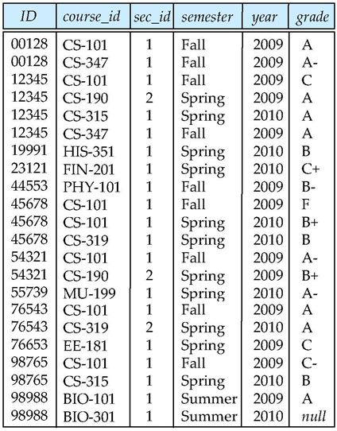
Nested-Loop Join – Example
student
takes

Slide 23
Nested-Loop Join – Cost Analysis
Worst case
  There is memory only to hold one block of each relation
  Cost = n_{r} ∗ b_{s} + b_{r} block transfers and n_{r} + b_{r} seeks
    n_{r}, n_{s} : number of record in R and S
    b_{r}, b_{s}: number of disk blocks in R and S
    Extra seeks may be required, but we ignore this for simplicity
Best case
  Smaller relation fits entirely in memory – use that as the inner relation
  Cost = b_{r} + b_{s} block transfers and 2 seeks
Example
  with student as outer relation:
    5000 ∗ 400 + 100 = 2,000,100 block transfers
    5000 + 100 = 5100 seeks
  with takes as the outer relation
    10000 ∗ 100 + 400 = 1,000,400 block transfers and 10,400 seeks
  If smaller relation (student) fits entirely in memory
    Cost estimate will be 500 block transfers

Slide 24
Block Nested-Loop Join
Variant of nested-loop join in which every block of inner relation is paired with every block of outer relation
for each block B_{r} of r do begin
for each block B_{s} of s do begin
for each tuple t_{r} in B_{r} do begin
for each tuple t_{s} in B_{s} do begin
Check if (t_{r},t_{s}) satisfy the join condition
if they do, add t_{r} • t_{s} to the result.
end
end
end
end
Won Kim’s join method
  One chapter of ’80 PhD Thesis at Univ of Illinois at Urbana-Champaign

Slide 25
Block Nested-Loop Join – Example
student
takes

Slide 26
Block Nested-Loop Join (Cont.)
Worst case estimate: b_{r} ∗ b_{s} + b_{r} block transfers + 2 * b_{r} seeks
  Each block in the inner relation s is read once for each block in the outer relation
Best case: b_{r} + b_{s} block transfers + 2 seeks
Improvements to nested loop and block nested loop algorithms:
  In block nested-loop, use M - 2 disk blocks as blocking unit for outer relations, where M = memory size in blocks; use remaining two blocks to buffer inner relation and output
    Cost = ⎡b_{r} / (M-2)⎤ ∗ b_{s} + b_{r} block transfers +
    2 ⎡b_{r} / (M-2)⎤ seeks
  If equi-join attribute forms a key or inner relation, stop inner loop on first match
  Scan inner loop forward and backward alternately, to make use of the blocks remaining in buffer (with LRU replacement)
  Use index on inner relation if available (next slide)

Slide 27
Indexed Nested-Loop Join
Index lookups can replace file scans if
  Join is an equi-join or natural join and
  An index is available on the inner relation’s join attribute
    Can construct an index just to compute a join
For each tuple t_{r} in the outer relation r, use the index (B+ tree) to look up tuples in s that satisfy the join condition with tuple t_{r}
Worst case: buffer has space for only one page of r, and, for each tuple in r, we perform an index lookup on s
Cost of the join: b_{r} (t_{T} + t_{S}) + n_{r} ∗ c
  Where c is the cost of traversing index and fetching all matching s tuples for one tuple or r
  c can be estimated as cost of a single selection on s using the join condition
If indices are available on join attributes of both r and s,
use the relation with fewer tuples as the outer relation

Slide 28
Indexed Nested-Loop Join – Example
student
takes
B+ tree
Index
on takes

Slide 29
Example of Nested-Loop Join Costs
Example: compute student takes, with student as the outer relation
  Let takes have a primary B⁺-tree index on the attribute ID, which contains 20 entries in each index node
  Since takes has 10,000 tuples, the height of the tree is 4, and one more access is needed to find the actual data
  student has 5000 tuples
Cost of block nested loops join
  400 * 100 + 100 = 40,100 block transfers + 2 * 100 = 200 seeks
    assuming worst case memory
    may be significantly less with more memory
Cost of indexed nested loops join
  100 + 5000 * 5 = 25,100 block transfers and seeks
  CPU cost likely to be less than that for block nested loops join

Slide 30
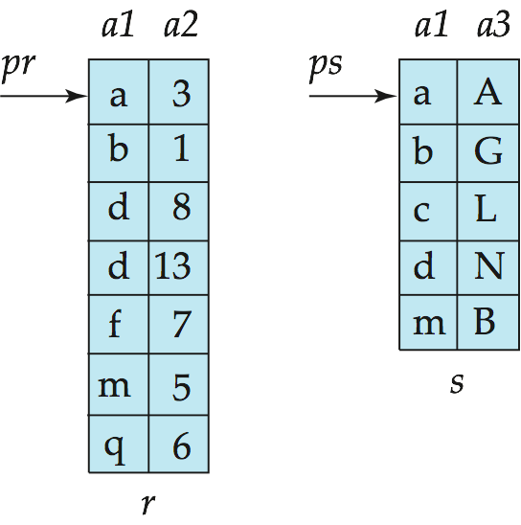
Merge-Join
Sort both relations on their join attribute (if not already sorted)
Merge the sorted relations to join them
  Join step is similar to the merge stage of the sort-merge algorithm
  Main difference is handling of duplicate values in join attribute — every pair with same value on join attribute must be matched
Can be used only for
equi-joins and natural joins
Each block needs to be read only once
(assuming all tuples for any given value
of the join attributes fit in memory)
Thus the cost of merge join is:
b_{r} + b_{s} block transfers
+ ⎡b_{r} / b_{b}⎤ + ⎡b_{s} / b_{b}⎤ seeks
+ the cost of sorting if relations are unsorted

Slide 31
Hash-Join
Applicable for equi-joins and natural joins
A hash function h is used to partition tuples of both relations
h maps JoinAttrs values to {0, 1, ..., n}, where JoinAttrs denotes the common attributes of r and s used in the natural join
  r₀, r₁, . . ., r_{n} denote partitions of r tuples
    Each tuple t_{r} ∈ r is put in partition r_{i} where i = h(t_{r} [JoinAttrs])
  r₀,, r₁. . ., r_{n} denotes partitions of s tuples
    Each tuple t_{s} ∈s is put in partition s_{i}, where i = h(t_{s} [JoinAttrs])
r tuples in r_{i} need only to be compared with s tuples in s_{i}
(Note: In book, r_{i} is denoted as H_{ri}, s_{i} is denoted as H_{si}, and n is denoted as n_{h.})

Slide 32
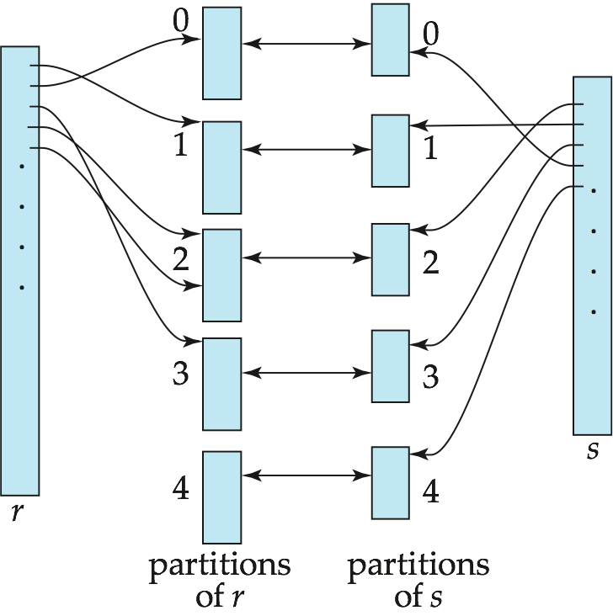
Hash-Join (Cont.)

Slide 33
Hash-Join Algorithm
Partition the relation s using hashing function h
  When partitioning a relation, one block of memory is reserved as the output buffer for each partition.
2. Partition r similarly
3. For each i:
  Load s_{i} into memory and build an in-memory hash index on it using the join attribute
    This hash index uses a different hash function than the earlier one h.
  Read the tuples in r_{i} from the disk one by one
    For each tuple t_{r} locate each matching tuple t_{s} in s_{i} using the in-memory hash index. Output the concatenation of their attributes.
Relation s is called the build input and
r is called the probe input

Slide 34
Handling of Hash Overflows
The value n and the hash function h is chosen such that each s_{i} should fit in memory
Partitioning is said to be skewed if some partitions have significantly more tuples than some others
Hash-table overflow occurs in partition s_{i} if s_{i} does not fit in memory
  Many tuples in s with same value for join attributes
  Bad hash function
Overflow resolution can be done in build phase
  Partition s_{i} is further partitioned using different hash function.
  Partition r_{i} must be similarly partitioned.
This approach fails with large numbers of duplicates
  Fallback option: use block nested loops join on overflowed partitions

Slide 35
Cost of Hash-Join
Cost of hash join
3(b_{r} + b_{s}) + 4 ∗ n_{h} block transfers + 2( ⎡b_{r} / b_{b}⎤ + ⎡b_{s} / b_{b}⎤) + 2 ∗ n_{h} seeks
If the entire build input can be kept in main memory, no partitioning is required
  Cost estimate goes down to b_{r} + b_{s}
Example: instructor teaches
  Memory size = 20 blocks, b_{instructor}= 100, and b_{teaches} = 400
  instructor is to be used as build input
    Partition it into five partitions, each of size 20 blocks (in one pass)
  Similarly, partition teaches into five partitions, each of size 80 (in one pass)
  Therefore total cost, ignoring cost of writing partially filled blocks:
    b_{b} = 3 (3 buffers for the input and each of the 5 output partitions)
    3(100 + 400) = 1500 block transfers
    2( ⎡100/3⎤ + ⎡400/3⎤) + 2 * 5 = 346 seeks

Slide 36
Other Operations
Duplicate elimination can be implemented via hashing or sorting
  On sorting duplicates will come adjacent to each other, and all but one set of duplicates can be deleted
  Optimization: duplicates can be deleted during run generation as well as at intermediate merge steps in external sort-merge
  Hashing is similar – duplicates will come into the same bucket
Projection:
  Perform projection on each tuple
  Followed by duplicate elimination
Aggregation (count, min, max, sum, and avg):
  Can be implemented in a manner similar to duplicate elimination
Set operations (∪, ∩ and ⎯):
  Can either use variant of merge-join after sorting, or variant of hash-join

Slide 37
Evaluation of Expressions
So far: we have seen algorithms for individual operations
Alternatives for evaluating an entire expression tree
  Materialization:
    generate results of an expression whose inputs are relations or are already computed,
    materialize (store) it on disk. Repeat.
  Pipelining:
    pass on tuples to parent operations even as an operation is being executed

Slide 38
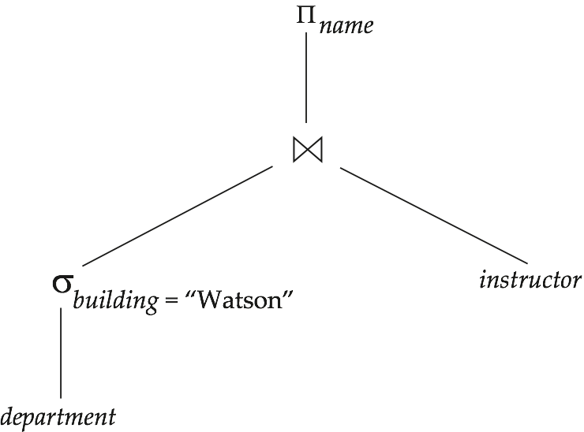
Materialization
Materialized evaluation
  Evaluate one operation at a time, starting at the lowest-level
  Use intermediate results materialized into temporary relations to evaluate next-level operations
E.g.,
  compute and store σ_{building=“Watson”}(department)
  then compute the store its join with instructor,
  and finally compute the projection on name
Materialized evaluation is always applicable
Cost of writing results to disk and reading them back can be quite high
  Our cost formulas for operations ignore cost of writing results to disk
  Overall cost = Sum of costs of individual operations +
  cost of writing intermediate results to disk

Slide 39
Pipelining
Pipelined evaluation
  evaluate several operations simultaneously,
  passing the results of one operation on to the next
E.g.,
  don’t store result of σ_{building=“Watson”}(department)
  instead, pass tuples directly to the join.
  Similarly, don’t store result of join,
  pass tuples directly to projection
Much cheaper than materialization
  No need to store a temporary relation to disk
Pipelining may not always be possible
  e.g., sort, hash-join

Slide 40
End of Chapter 12

