Slide 1
SPARQL Basic Graph Pattern Processing with Iterative MapReduce
Jaeseok Myung, Jongheum Yeon, Sang-goo Lee
Seoul National University
MDAC 2010
12 July 2013
SNU IDB Lab.
Min Sup Lee

Slide 2
Outline
Introduction
BGP Processing with MR
Evaluation
Conclusion

Slide 3
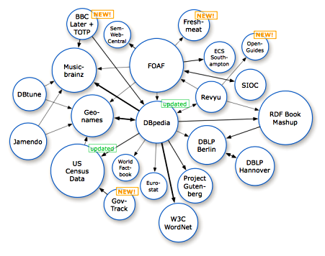
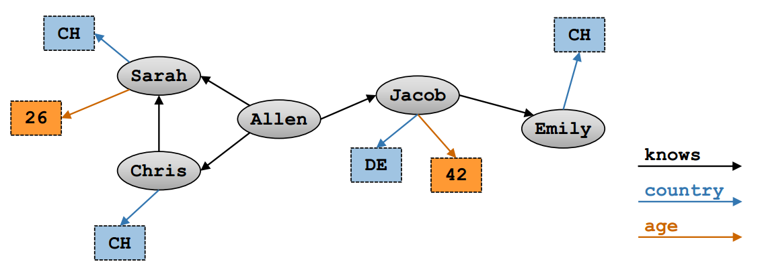
Introduction RDF (Resource Description Framework)
RDF (Resource Description Framework)
The most prominent standards
Storing and representing data
Management of large RDF graphs
Non-trivial task
Single machine approaches are challenged
RDF graph and RDF data
RDF data set consists of a set of RDF triples
<subject, predicate, object>
Subject | Predicate | Object
Allen | Knows | Jacob
Allen | Knows | Chirs
Allen | Knows | Sarah
Sarah | Country | CH
Sarah | Age | 26
Chris | Country | CH
Chirs | Knows | Sarah
Jacob | Country | DE
Jacob | Age | 42
Jacob | Knows | Emily
Emily | Country | CH

Slide 4
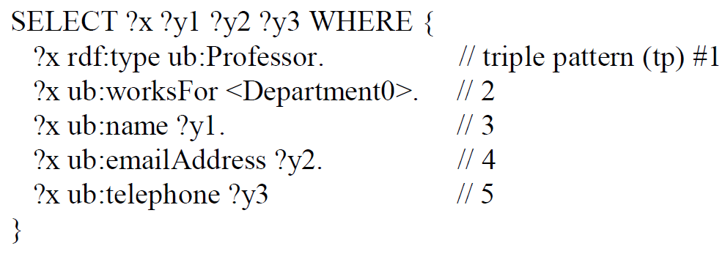
Introduction SPARQL Query Language
Query language to retrieve data from an RDF store
SPARQL Basic Graph Pattern
A set of triple patterns to be joined
Contains 5 triple patterns (shared variable x)

Slide 5
Introduction RDF Query Processing - Selection
Selection for query processing
SELECT ?X WHERE{
Allen Knows ?X }
Subject | Predicate | Object
Allen | Knows | Jacob
Allen | Knows | Chirs
Allen | Knows | Sarah
Sarah | Country | CH
Sarah | Age | 26
Chris | Country | CH
Chirs | Knows | Sarah
Jacob | Country | DE
Jacob | Age | 42
Jacob | Knows | Emily
Emily | Country | CH
Allen | Knows | Jacob
Allen | Knows | Chirs
Allen | Knows | Sarah
Jacob
Chirs
Sarah

Slide 6
Introduction RDF Query Processing - Join
Join for query processing
SELECT ?X WHERE{
Allen Knows ?X
?X Country CH }
Subject | Predicate | Object
Allen | Knows | Jacob
Allen | Knows | Chirs
Allen | Knows | Sarah
Sarah | Country | CH
Sarah | Age | 26
Chris | Country | CH
Chirs | Knows | Sarah
Jacob | Country | DE
Jacob | Age | 42
Jacob | Knows | Emily
Emily | Country | CH
Allen | Knows | Jacob
Allen | Knows | Chirs
Allen | Knows | Sarah
Sarah | Country | CH
Chris | Country | CH
Emily | Country | CH
Sarah
Chris

Slide 7

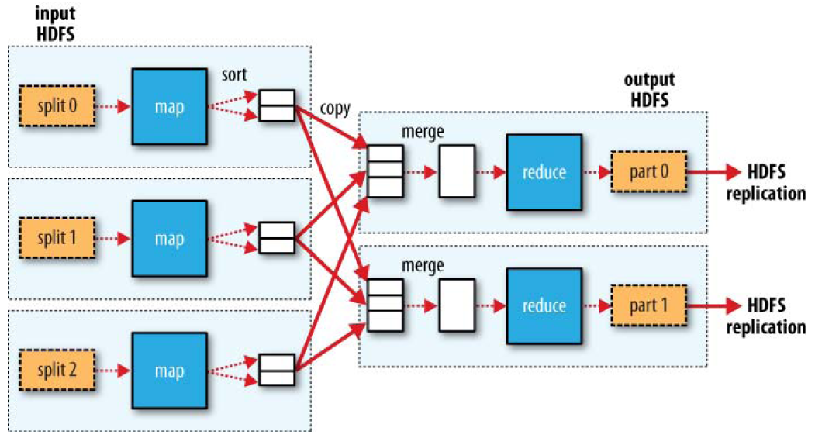

Introduction MapReduce Framework
MapReduce
Runs on off-the-shelf hardware
A simple abstraction for large-scale computation
New computing nodes can easily be added
Hadoop
High fault tolerance and reliability
Provide an implementation of MapReduce programming model

Slide 8
Outline
Introduction
BGP Processing with MR
Evaluation
Conclusion

Slide 9
MapReduce Selection
MR Selection for Query Processing – Map input
Map phase
[Map 1]
<Prof0> | rdf:type | ub:Professor
<Prof0> | Ub:worksFor | <Department0>
<Prof0> | Ub:name | “professor0”
Input Data
Subject | Predicate | Object
<Prof0> | rdf:type | ub:Professor
<Prof0> | Ub:worksFor | <Department0>
<Prof0> | Ub:name | “professor0”
<Prof0> | Ub:emailAddress | prof0@email.com”
<Prof0> | Ub:telephone | “000-0000-0000”
<Prof1> | Rdf:type | Ub:Professor
<Dept0> | ub:name | “Department0”
[Map 2]
<Prof0> | Ub:emailAddress | prof0@email.com”
<Prof0> | Ub:telephone | “000-0000-0000”
[Map 3]
<Prof1> | Rdf:type | Ub:Professor
<Dept0> | ub:name | “Department0”

Slide 10
MapReduce Selection
Map Output
Map Phase
[Map 1]
[Map 1]
Subject | Predicate | Object
<Prof0> | rdf:type | ub:Professor
<Prof0> | ub:worksFor | <Department0>
<Prof0> | ub:name | “professor0”
Key | Value
[x]Prof0 | 1
[x]Prof0 | 2
[x]Prof0|[y1]Professor0 | 3
[Map 2]
[Map 2]
<Prof0> | ub:emailAddress | prof0@email.com”
<Prof0> | ub:telephone | “000-0000-0000”
[x]Prof0|[y2]prof0@email.com | 4
[x]Prof0|[y3]000-0000-0000 | 5
[Map 3]
[Map 3]
<Prof1> | rdf:type | ub:Professor
<Dept0> | ub:name | “Department0”
[x]Prof1 | 1

Slide 11
MapReduce Selection
Reduce Input
Reduce Phase
Map Phase
[Reduce 1]
[Map 1]
Key | Value
[x]Prof0 | 1
[x]Prof0 | 2
Key | Value
[x]Prof0 | 1
[x]Prof0 | 2
[x]Prof0|[y1]Professor0 | 3
[Reduce 2]
[x]Prof0|[y1]Professor0 | 3
[Map 2]
[Reduce 3]
[x]Prof0|[y2]prof0@email.com | 4
[x]Prof0|[y3]000-0000-0000 | 5
[x]Prof0|[y2]prof0@email.com | 4
[Reduce 4]
[x]Prof0|[y3]000-0000-0000 | 5
[Map 3]
[Reduce 5]
[x]Prof1 | 1
[x]Prof1 | 1

Slide 12
MapReduce Selection
Reduce Output
Reduce Phase
[Reduce 1]
[Reduce 1]
Key | Value
[x]Prof0 | 1
[x]Prof0 | 2
Key | Value
<1>x | [x]Prof0
<2>x | [x]Prof0
[Reduce 2]
[Reduce 2]
[x]Prof0|[y1]Professor0 | 3
<3>x|y1 | [x]Prof0|[y1]Professor0
[Reduce 3]
[Reduce 3]
[x]Prof0|[y2]prof0@email.com | 4
<4>x|y2 | [x]Prof0|[y2]prof0@email.com
[Reduce 4]
[Reduce 4]
[x]Prof0|[y3]000-0000-0000 | 5
<5>x|y3 | [x]Prof0|[y3]000-0000-0000
[Reduce 5]
[Reduce 5]
[x]Prof1 | 1
<1>x | [x]Prof1

Slide 13
MapReduce Join
Map Input
Map Phase
Input Data
[Map 1]
Key | Value
<1>x | [x]Prof0
<2>x | [x]Prof0
<3>x|y1 | [x]Prof0|[y1]Professor0
Key | Value
<1>x | [x]Prof0
<2>x | [x]Prof0
<3>x|y1 | [x]Prof0|[y1]Professor0
<4>x|y2 | [x]Prof0|[y2]prof0@email.com
<5>x|y3 | [x]Prof0|[y3]000-0000-0000
<1>x | [x]Prof1
[Map 2]
<4>x|y2 | [x]Prof0|[y2]prof0@email.com
<5>x|y3 | [x]Prof0|[y3]000-0000-0000
<1>x | [x]Prof1

Slide 14
MapReduce Join
Map Output
Map Phase
[Map 1]
[Map 1]
Key | Value
<1>x | [x]Prof0
<2>x | [x]Prof0
<3>x|y1 | [x]Prof0|[y1]Professor0
Key | Value
[x]Prof0 | <1>,[x]Prof0
[x]Prof0 | <2>,[x]Prof0
[x]Prof0 | <3>,[x]Prof0|[y1]Professor0
[Map 2]
[Map 2]
<4>x|y2 | [x]Prof0|[y2]prof0@email.com
<5>x|y3 | [x]Prof0|[y3]000-0000-0000
<1>x | [x]Prof1
[x]Prof0 | <4>,[x]Prof0|[y2]prof0@email.com
[x]Prof0 | <5>,[x]Prof0|[y3]000-0000-0000
[x]Prof1 | <1>,[x]Prof1

Slide 15
MapReduce Join
Reduce output
Map Phase
Reduce Phase
[Map 1]
[Reduce 1]
Key | Value
[x]Prof0 | <1>,[x]Prof0
[x]Prof0 | <2>,[x]Prof0
[x]Prof0 | <3>,[x]Prof0|[y1]Professor0
Key | Value
[x]Prof0 | <1>,[x]Prof0
[x]Prof0 | <2>,[x]Prof0
[x]Prof0 | <3>,[x]Prof0|[y1]Professor0
[x]Prof0 | <4>,[x]Prof0|[y2]prof0@email.com
[x]Prof0 | <5>,[x]Prof0|[y3]000-0000-0000
[Map 2]
[x]Prof0 | <4>,[x]Prof0|[y2]prof0@email.com
[x]Prof0 | <5>,[x]Prof0|[y3]000-0000-0000
[x]Prof1 | <1>,[x]Prof1
[Reduce 2]
[x]Prof1 | <1>,[x]Prof1

Slide 16
MapReduce Join
Reduce Output
The result for the query
Reduce Phase
[Reduce 1]
Key | Value
[x]Prof0 | <1>,[x]Prof0
[x]Prof0 | <2>,[x]Prof0
[x]Prof0 | <3>,[x]Prof0|[y1]Professor0
[x]Prof0 | <4>,[x]Prof0|[y2]prof0@email.com
[x]Prof0 | <5>,[x]Prof0|[y3]000-0000-0000
[Reduce 1]
Key | Value
<1|2|3|4|5>x|y1|Y2|y3 | [x]Prof0|[y1]Professor0|[y2]prof0@email.com|[y3]000-0000-0000
[Reduce 2]
[x]Prof1 | <1>,[x]Prof1

Slide 17
Join-Key Selection Strategies
Greedy Selection
Select a variable according to the number of related triple
Multiple Selection
An effect on resource utilization
Choose b and d
SELECT ?x ?y1 ?y2 ?y3 WHERE {
?x rdf:type ub:Professor
?x ub:worksFor <Department0>
?x ub:name ?y1
?x ub:emailAddress ?y2
?x ub:telephone ?y1
<A path expression>

Slide 18
Outline
Introduction
BGP Processing with MR
Evaluation
Conclusion

Slide 19
Evaluation: Environment
Using Lehigh University Benchmark (LUBM) data set
1, 5, 10, 25, 50, 100 universities
Amazon Web Services (AWS)
Amazon EC2 (1.7GB of RAM, 5 EC2 Compute Units)
Cloudera’s Hadoop Distribution (CDH)
Hadoop Distributed File System (HDFS)

Slide 20
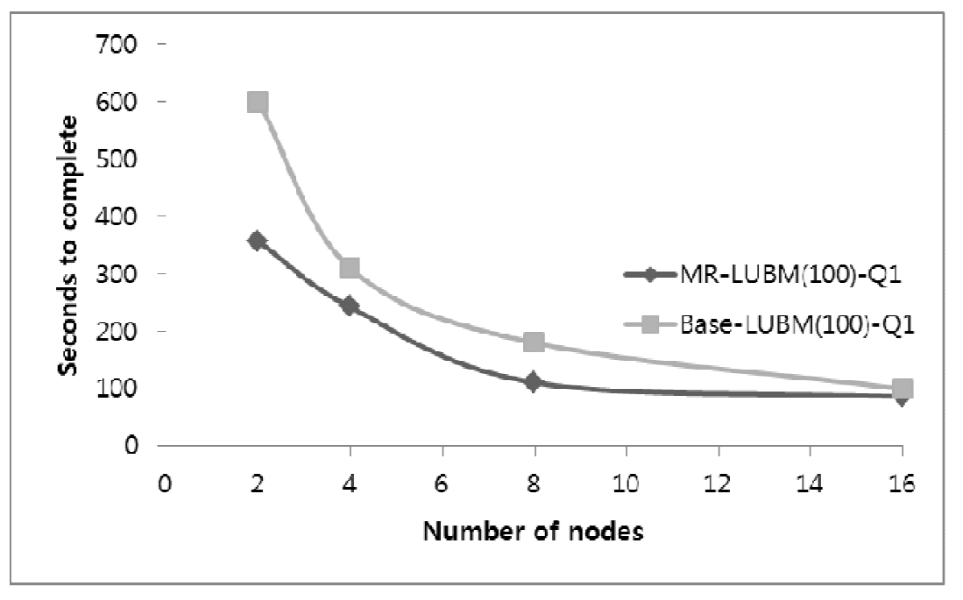
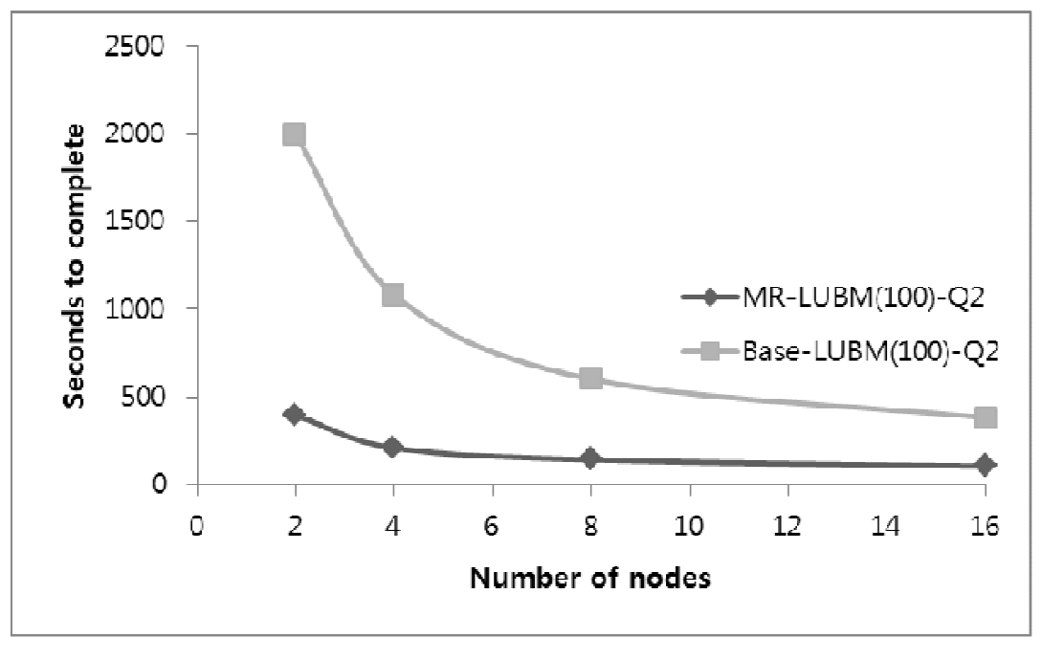
Evaluation: Performance
Performance evaluation usgin LUBM (100)
Base : Does not take advantage of the multi way join
MR : Using multi way join

Slide 21
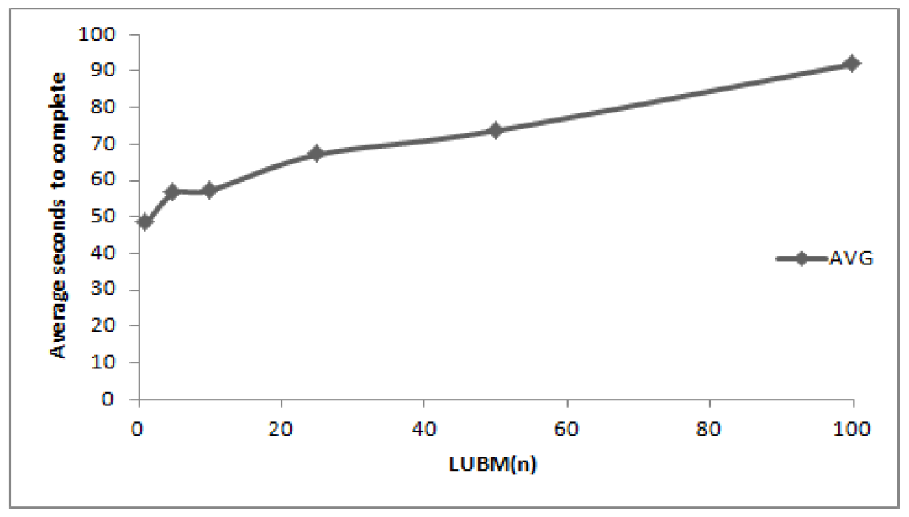
Evaluation: Performance
Average execution time for LUBM (100)
Effectively utilizes the computing resources
Increased only 2 times while the number of triples is increased 100 times
2x
100x

Slide 22
Outline
Introduction
BGP Processing with MR
Evaluation
Conclusion

Slide 23
Conclusion
Conclusion
Showed the possibilities
MapReduce with RDF
Requires iterative processing
Use multi way join
➔ Expensive!

Slide 24
Thank you

Slide 25
Introduction MapReduce Framework
MapReduce Join
SELECT ?X WHERE{
Allen Knows ?X
?X Country CH }
Map
[Machine 1]
Allen | Knows | Jacob
Allen | Knows | Chirs
Allen | Knows | Sarah
Sarah | Country | CH
S | P | O
Allen | Knows | Jacob
Allen | Knows | Chirs
Allen | Knows | Sarah
Sarah | Country | CH
Sarah | Age | 26
Chris | Country | CH
Chirs | Knows | Sarah
Jacob | Country | DE
Jacob | Age | 42
Jacob | Knows | Emily
Emily | Country | CH
Reduce
[Machine 1]
Allen | Knows | Jacob
Emily | Country | CH
[Machine 2]
Sarah | Age | 26
Chris | Country | CH
Chirs | Knows | Sarah
Jacob | Country | DE
[Machine 2]
Allen | Knows | Chirs
Chris
Sarah
Chris | Country | CH
[Machine 3]
[Machine 3]
Jacob | Age | 42
Jacob | Knows | Emily
Emily | Country | CH
Allen | Knows | Sarah
Sarah | Country | CH

