Slide 1
Whose and what chatter matters? The effect of tweets on movie sales
Huaxia Rui, Yizao Liu, Andrew Whinston
Decision Support Systems, 2013 - Elsevier
Mar 27, 2014
Kyung-Bin Lim

Slide 2
Outline
Introduction
Methodology
Discussion
Conclusion

Slide 3
Word-of-Mouth (WOM) Research
Word-of-Mouth is often considered to be the most credible information source to consumers for the purchase of a new product or new service
Offline period (before 2003)
Online period (since 2004)
Big Data period (present)

Slide 4
The Effect of WOM on Product Sales
Awareness Effect
The function of spreading basic information about the product among the population
Persuasive Effect
The functions of altering people’s preferences toward the product and thus influencing their purchase decisions

Slide 5
Motivation 1 – What Chatter matters?
“back at work and recovering from #avatar – fantastic movie!”
“I’m just not excited about the new Alice In Wonderland :/ Tim Burton seems to be running out ideas a bit”
“DAMN IT!! Didn’t make it… Sold out tickets for Avatar!!!”

Slide 6

Motivation 2 – Whose Chatter Matters?
“Today a single customer complaint from someone with influence can have more impact on your company’s reputation than your best marketing.” – Jason Duty, head of Dell’s global social outreach service

Slide 7
Types of WOM
Pre-consumption WOM
Generally about people’s intentions or plans to purchase a product
Dual effects: direct and indirect
Post-consumption WOM
Usually about people’s experiences and/or attitudes toward a product after consumption

Slide 8
Why Twitter WOM data?
Twitter is a more natural environment to study the awareness effect of WOM (push vs. pull)
More social network information is available from Twitter
A new category of WOM: intention WOM (pre-consumption WOM)
Volume: 4 million tweets about 63 movies.

Slide 9
Outline
Introduction
Methodology
Results
Conclusion

Slide 10
Data
Daily box office revenue data from BoxOfficeMojo.com
Tweets from twitter.com collected through Twitter Application Programming Interface (API)
Each tweet: content, time, number of followers
Pre-processing: advertising tweets, irrelevant tweets
Tweet classification
intention tweets
positive tweets
negative tweets
neutral tweets

Slide 11
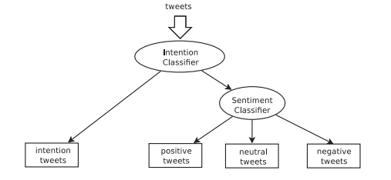
Tweet Classification
Intention Classifier: support vector machine
Sentiment Analysis: Naïve Bayesian Classifier

Slide 12
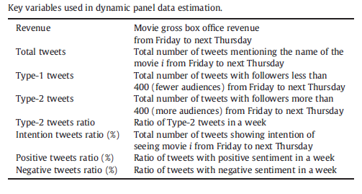
Variables

Slide 13
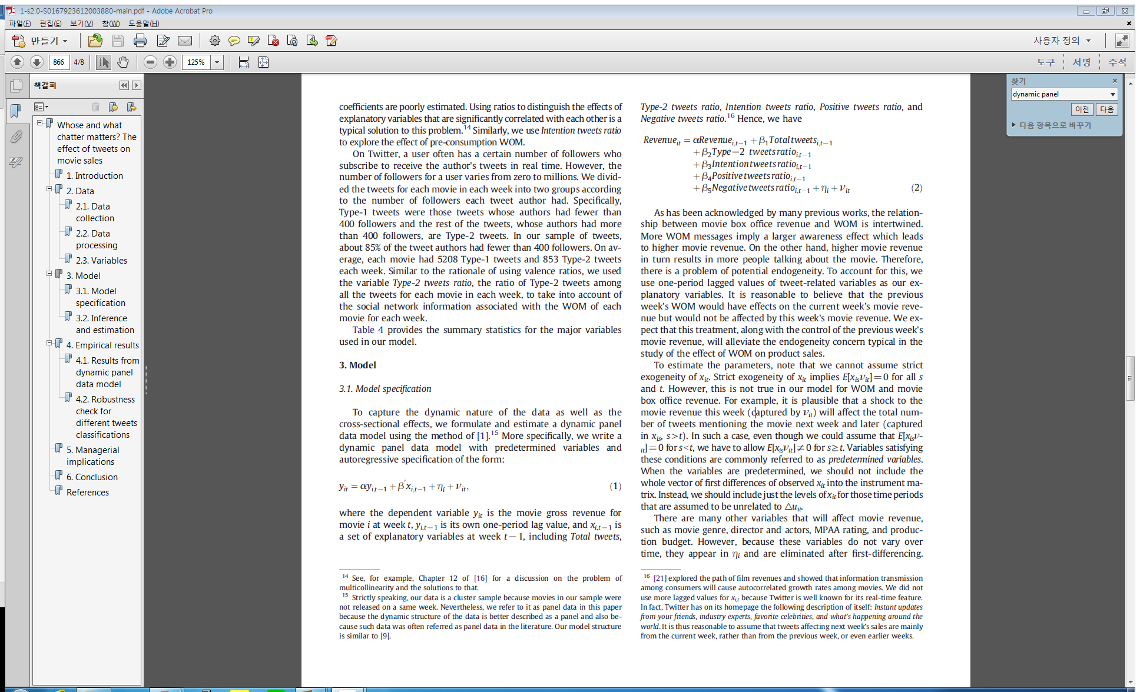
Dynamic Panel Data Model

Slide 14
Outline
Introduction
Methodology
Results
Conclusion

Slide 15
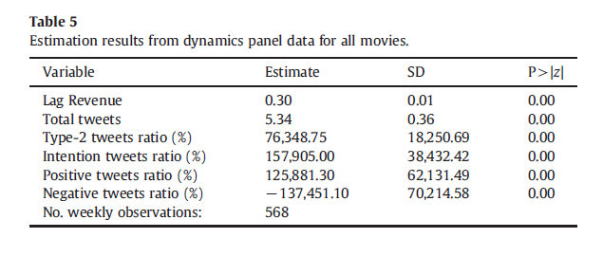
Results

Slide 16
Results
More chatter about a movie is associated with higher sales
Larger WOM volume amplifies the awareness effect of WOM
Higher ratio of type-2 tweets does have a positive and significant effect on movie box office revenue
Intension tweets have positive and significant effect on movie revenues
WOM with positive sentiment toward the movie is associated with higher movie sales in the subsequent week
Negative tweets have significantly negative effects on a movie’s box office revenue (magnitude larger than positive tweets)

Slide 17
Managerial Implications
Firms interested in the online WOM about their products should actively monitor or even seek WOM messages produced by people with large indegree in the social network
Companies may carefully monitor people’s intention toward certain products on Twitter and incorporate that information to better forecast future sales
The dual effect of intention tweets revealed in our study suggests the possibility of targeted advertising on Twitter

Slide 18
Outline
Introduction
Methodology
Results
Conclusion

Slide 19
Conclusion
The effect of WOM on product sales from Twitter users with more followers is significantly larger
The effect of pre-consumption WOM on movie sales is larger than that of post-consumption WOM (dual effects)
Positive WOM increases product sales, whereas negative WOM decreases them

