Slide 1
Extending Map-Reduce for Efficient Predicate-Based Sampling
Raman Grover and Michael J. Carey
University of California, Irvine, USA
ICDE ’12
29 Nov 2012
Taewhi Lee
Based on Raman Grover’s ICDE ’12 presentation slides

Slide 2
Outline
Introduction
Problem Statement
Naïve Predicate-Based Sampling Using Map-Reduce
Incremental Predicate-Based Sampling Mechanism
Experimental Evaluation: Single User Workload
Experimental Evaluation: Multi User Workload
Conclusion

Slide 3


Problem Statement
Predicate-based sampling
Sampled data required to additionally satisfy a given set of predicates
Similar Sampling queries common at Facebook
SELECT age, profession, salary
FROM census
WHERE age > 25 and age <=30
AND gender = `FEMALE`
AND state = `CALIFORNIA`
LIMIT 1000
What we need
Pseudo-random sample
Response time to not be a function of the size of the input
Challenges
Absence of indexes
Various predicates
Input data size
Tera/peta bytes

Slide 4
Naïve Predicate-Based Sampling Using MapReduce
K=required sample size
N=number of map tasks
Select first ‘K’
Reduce
Output contains at most N*K pairs
Collect first ‘K‘ pairs
that satisfy the predicates
Evaluate predicates on input records
Map ₁
Map ₂
Map ₃
Map _{N}
HDFS
Input Data
Drawback: We have to process all of input data!

Slide 5

Inefficiencies in Naïve Predicate-Based Sampling
Map
Map Output
I
N
P
U
T
S
P
L
I
T
S
Reduce
OU TPU T
Desired Sample
‘K’ records, each of which satisfy some given predicates
Did we really need to process the whole of input to produced the desired sample?
Input data could be in range of tera/peta bytes

Slide 6
Outline
Introduction
Incremental Predicate-Based Sampling Mechanism
Hadoop with Incremental Processing
Policies for Incremental Processing of Input
Experimental Evaluation: Single User Workload
Experimental Evaluation: Multi User Workload
Conclusion

Slide 7
Hadoop with Incremental Processing
Input Provider
(configurable)
Do we need to process more input?
Add input
I
N
P
U
T
S
P
L
I
T
S
Enough!
Map Output
Map task report
Reduce
OUTPUT
The job produces the desired output, but does less work and finishes earlier

Slide 8
Parameters for defining a policy
Factors to consider
Capacity of the cluster
Current (or expected) load on the cluster
Parameters
Evaluation interval: time interval between each evaluation
Work threshold: a lower bound(%) on the additional work to be done
Grab limit: # of new input partitions that can be added

Slide 9
Policies for Incremental Processing of Input
IS = # of input splits
TS = Total map slots in the cluster
AS = Available map slots in the cluster
Policy | Description | Work threshold | Grab limit
Hadoop | Hadoop’s default behavior | - | Infinity
HA | Highly Aggressive policy | 0 | Max(0.5 * TS, AS)
MA | Mid Aggressive policy | 5% IS | (AS != 0) ? 0.5 * AS : 0.2 * TS
LA | Less Aggressive policy | 10% IS | (AS != 0) ? 0.2 * AS : 0.1 * TS
C | Conservative policy | 15% IS | 0.1 * AS
Evaluation interval: kept at 4 seconds under each policy

Slide 10
Outline
Introduction
Incremental Predicate-Based Sampling Mechanism
Experimental Evaluation: Single User Workload
Experimental Setup
Results: Response Time
Results: Partitions Processed
Experimental Evaluation: Multi User Workload
Conclusion

Slide 11
Experimental Setup
Test queries & data: LINEITEM table from TPC-H dataset
Hardware
10 node cluster
Each node: 12GB RAM, 4 cores/disks
Scale | Size (GB) | Rows (million) | Partitions on HDFS
5 | 3.8 | 30 | 40
10 | 7.8 | 60 | 80
20 | 15.8 | 120 | 120
40 | 37.6 | 240 | 240
100 | 78.7 | 600 | 600
SELECT <attribute>
FROM LINEITEM
WHERE <predicate>
LIMIT 10000

Slide 12
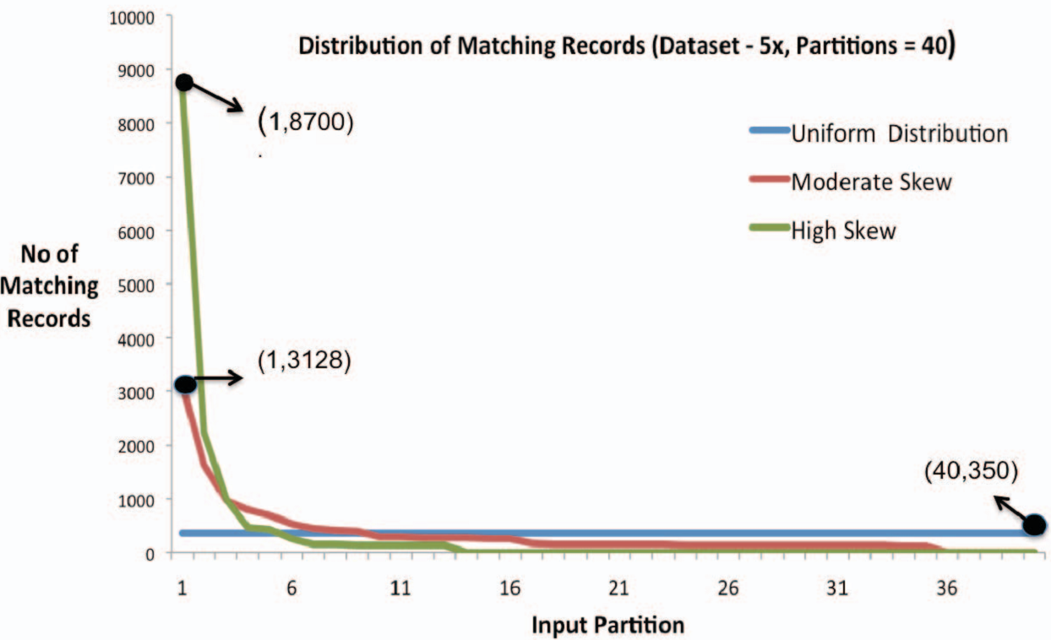
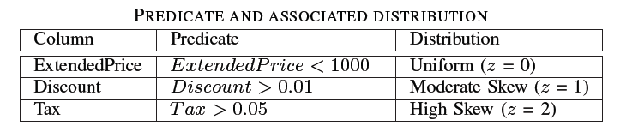
Modeling Data Skew (Zipf Distribution)

Slide 13


Single User Workload
SELECT ORDERKEY, PARTKEY, SUPPKEY
FROM LINEITEM
WHERE predicate LIMIT 10000
Idle Hadoop Cluster

Slide 14
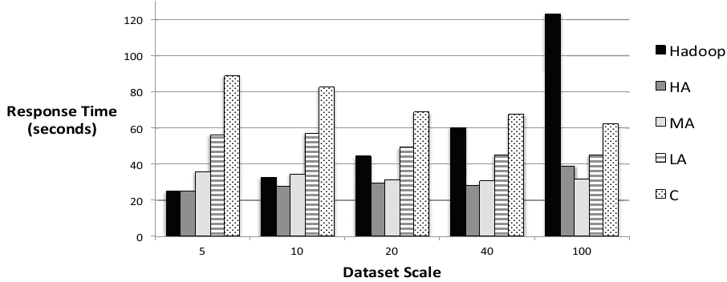
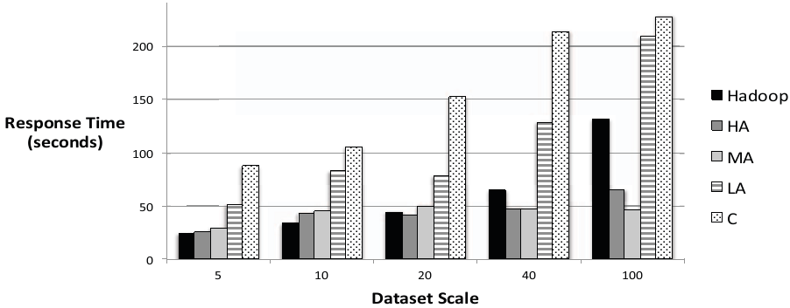
Single User Workload: Response Time
Uniform dist. (Z = 0)
High skew (Z = 2)

Slide 15
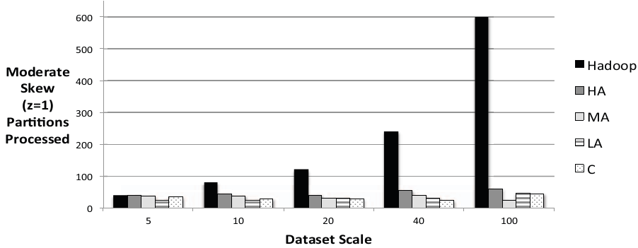
Single User Workload: Partitions Processed
Moderate skew (Z = 1)

Slide 16
Outline
Introduction
Incremental Predicate-Based Sampling Mechanism
Experimental Evaluation: Single User Workload
Experimental Evaluation: Multi User Workload
Results: Homogeneous Workload
Results: Heterogeneous Workload
Conclusion

Slide 17

Single User Workload: Not Realistic!
Sampling
SELECT <attribute(s)>
FROM LINEITEM
WHERE predicate LIMIT 10000
Scheduling Policy
Resource Usage
How to maximize throughput
Other jobs (possibly large jobs)
Hadoop cluster

Slide 18
Homogeneous Workload
SELECT <attribute(s)>
FROM LINEITEM
WHERE predicate LIMIT 10000
10 concurrent users
Each user submits query, waits for completion and submits again
Varying policy in use and data skew

Slide 19
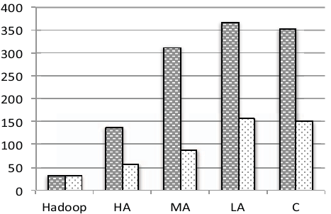

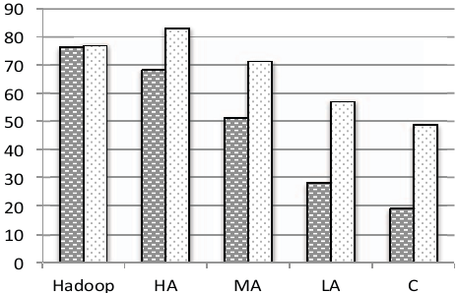
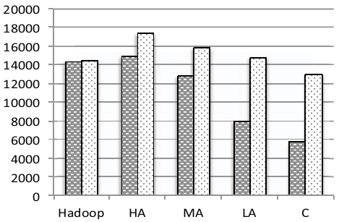
Results: Homogeneous Workload
Throughput (jobs/hour)
CPU utilization (%)
Disk reads (Kbs/sec)

Slide 20
Heterogeneous Workload
SELECT<attribute(s)>
FROM LINEITEM
WHERE predicate LIMIT 10000
Class A : Sampling
SELECT <attribute(s)>
FROM LINEITEM
WHERE predicate
ORDER BY <attribute>
Class B : Non-Sampling
Varying the % of users in class A
Varying the policy used by users in class A

Slide 21
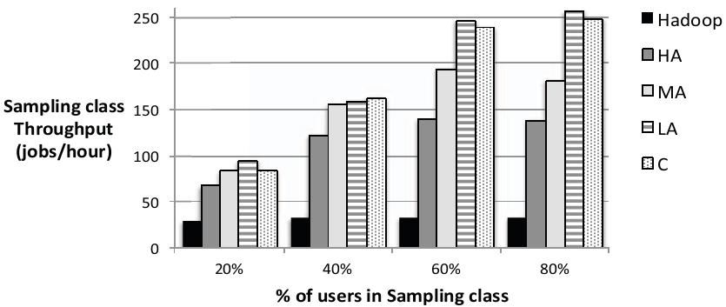
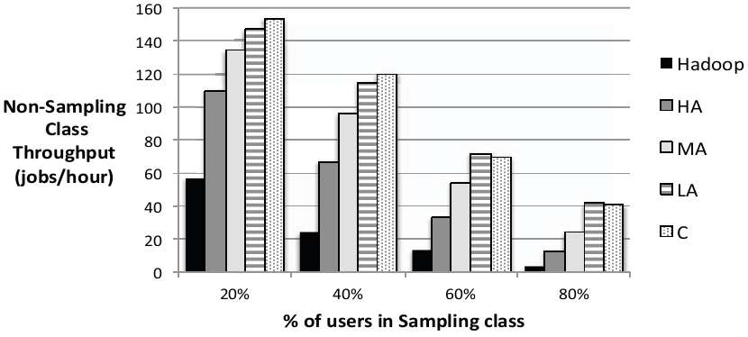
Results: Heterogeneous Workload

Slide 22
Outline
Introduction
Incremental Predicate-Based Sampling Mechanism
Experimental Evaluation: Single User Workload
Experimental Evaluation: Multi User Workload
Conclusion

Slide 23
Conclusion
Modified Hadoop to support incremental processing
Single user workload: conservative policy (C) does not utilize the cluster to its capacity
Multi user workload: conservative policy (C) consumes less resources and give higher throughput
Hadoop’s default policy resulted in least throughput and maximum consumption of resources in all cases
LA policy emerged as a good overall policy in both workload setting

Slide 24
Discussion
Strong points
Requirement analysis at Facebook
Extensive experimental study
Weak points
Choosing the policy according to the dynamic workload

