Slide 1
Chapter 6 – Three Simple Classification Methods
Data Mining for Business Intelligence
Shmueli, Patel & Bruce
© Galit Shmueli and Peter Bruce 2008

Slide 2
Methods & Characteristics
The three methods:
Naïve rule
Naïve Bayes
K-nearest-neighbor
Common characteristics:
Data-driven, not model-driven
Make no assumptions about the data

Slide 3
Naïve Rule
Classify all records as the majority class
Not a “real” method
Introduced so it will serve as a benchmark against which to measure other results

Slide 4
Naïve Bayes

Slide 5
Naïve Bayes: The Basic Idea
For a given new record to be classified, find other records like it (i.e., same values for the predictors)
What is the prevalent class among those records?
Assign that class to your new record

Slide 6
Usage
Requires categorical variables
Numerical variable must be binned and converted to categorical
Can be used with very large data sets
Example: Spell check – computer attempts to assign your misspelled word to an established “class” (i.e., correctly spelled word)

Slide 7
Exact Bayes Classifier
Relies on finding other records that share same predictor values as record-to-be-classified.
Want to find “probability of belonging to class C, given specified values of predictors.”
Even with large data sets, may be hard to find other records that exactly match your record, in terms of predictor values.

Slide 8
Solution – Naïve Bayes
Assume independence of predictor variables (within each class)
Use multiplication rule
Find same probability that record belongs to class C, given predictor values, without limiting calculation to records that share all those same values

Slide 9
Example: Financial Fraud
Target variable: Audit finds fraud, no fraud
Predictors:
  Prior pending legal charges (yes/no)
  Size of firm (small/large)

Slide 10
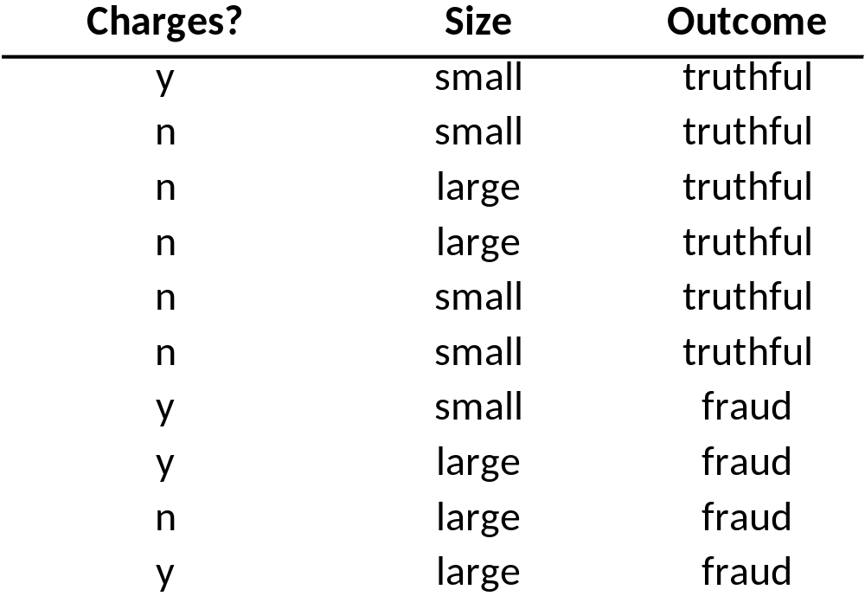

Slide 11
Exact Bayes Calculations
Goal: classify (as “fraudulent” or as “truthful”) a small firm with charges filed
There are 2 firms like that, one fraudulent and the other truthful
P(fraud|charges=y, size=small) = ½ = 0.50
Note: calculation is limited to the two firms matching those characteristics

Slide 12
Naïve Bayes Calculations
Goal: Still classifying a small firm with charges filed
Compute 2 quantities:
  Proportion of “charges = y” among frauds, times proportion of “small” among frauds, times proportion frauds = 3/4 * 1/4 * 4/10 = 0.075
  Prop “charges = y” among frauds, times prop. “small” among truthfuls, times prop. truthfuls = 1/6 * 4/6 * 6/10 = 0.067
P(fraud|charges, small) = 0.075/(0.075+0.067)
= 0.53

Slide 13
Naïve Bayes, cont.
Note that probability estimate does not differ greatly from exact
All records are used in calculations, not just those matching predictor values
This makes calculations practical in most circumstances
Relies on assumption of independence between predictor variables within each class

Slide 14
Independence Assumption
Not strictly justified (variables often correlated with one another)
Often “good enough”

Slide 15
Advantages
Handles purely categorical data well
Works well with very large data sets
Simple & computationally efficient

Slide 16
Shortcomings
Requires large number of records
Problematic when a predictor category is not present in training data
  Assigns 0 probability of response, ignoring information in other variables

Slide 17
On the other hand…
Probability rankings are more accurate than the actual probability estimates
  Good for applications using lift (e.g. response to mailing), less so for applications requiring probabilities (e.g. credit scoring)

Slide 18
K-Nearest Neighbors

Slide 19
Basic Idea
For a given record to be classified, identify nearby records
“Near” means records with similar predictor values X₁, X₂, … X_{p}
Classify the record as whatever the predominant class is among the nearby records (the “neighbors”)

Slide 20
How to Measure “nearby”?
The most popular distance measure is Euclidean distance

Slide 21
Choosing k
K is the number of nearby neighbors to be used to classify the new record
  k=1 means use the single nearest record
  k=5 means use the 5 nearest records
Typically choose that value of k which has lowest error rate in validation data

Slide 22
Low k vs. High k
Low values of k (1, 3 …) capture local structure in data (but also noise)
High values of k provide more smoothing, less noise, but may miss local structure
Note: the extreme case of k = n (i.e. the entire data set) is the same thing as “naïve rule” (classify all records according to majority class)

Slide 23
Example: Riding Mowers
Data: 24 households classified as owning or not owning riding mowers
Predictors = Income, Lot Size

Slide 24
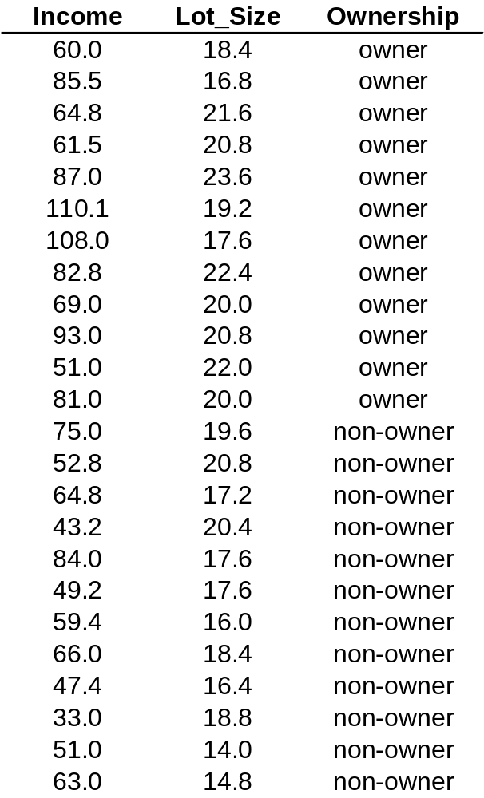

Slide 25
XLMiner Output
For each record in validation data (6 records) XLMiner finds neighbors amongst training data (18 records).
The record is scored for k=1, k=2, … k=18.
Best k seems to be k=8.
K = 9, k = 10, k=14 also share low error rate, but best to choose lowest k.

Slide 26
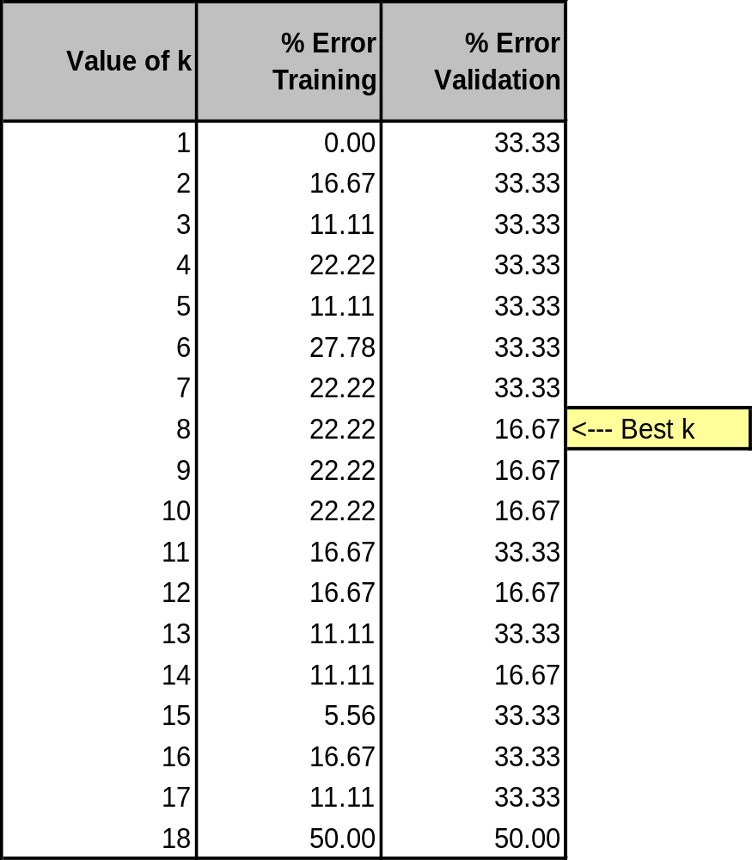

Slide 27
Using K-NN for Prediction
(for Numerical Outcome)
Instead of “majority vote determines class” use average of response values
May be a weighted average, weight decreasing with distance

Slide 28
Advantages
Simple
No assumptions required about Normal distribution, etc.
Effective at capturing complex interactions among variables without having to define a statistical model

Slide 29
Shortcomings
Required size of training set increases exponentially with # of predictors, p
  This is because expected distance to nearest neighbor increases with p (with large vector of predictors, all records end up “far away” from each other)
In a large training set, it takes a long time to find distances to all the neighbors and then identify the nearest one(s)
These constitute “curse of dimensionality”

Slide 30
Dealing with the Curse
Reduce dimension of predictors (e.g., with PCA)
Computational shortcuts that settle for “almost nearest neighbors”

Slide 31
Summary
Naïve rule: benchmark
Naïve Bayes and K-NN are two variations on the same theme: “Classify new record according to the class of similar records”
No statistical models involved
These methods pay attention to complex interactions and local structure
Computational challenges remain

