Slide 1
Serializable Snapshot Isolation in PostgreSQL
Dan R.K. Ports, MIT CSAIL
Kevin Grittner, CCAP Wisconsin Supreme Court
PVLDB, 2012
DongHyo Kim
Notes:
CCAP is responsible for supporting the IT needs of the entire Wisconsin Court System. CCAP's mission is to: maintain reliable necessary and useful data with appropriate uniformity; provide the Wisconsin Court System with ready access to data; maintain, support and explore hardware and software necessary to store, secure and manage data; provide the public access to the Wisconsin Court System; and promote a high level of confidence and satisfaction in the Wisconsin Court System

Slide 2
OVERVIEW
PostgreSQL
Popular open-source database
Highest isolation level : snapshot isolation
did not provide serializable isolation level
Introducing SSI(Serializable Snapshot Isolation)
Retains benefits of snapshot isolation while still guaranteeing serializability
SSI runs transactions using snapshot isolation, but checks at runtime for conflicts between concurrent transactions, and aborts transactions when anomalies are possible
Notes:
Lacking this infrastructure, we were required to build a new lock manager. Our lock manager is specifically optimized for tracking SSI read dependencies, making it simpler in some respects than a classic lock manager but also introducing some unusual challenges. PostgreSQL 9.1 uses this lock manager, along with multiversion concurrency control data, to detect conflicts between concurrent transactions. We also introduce a safe retry rule, which resolves conflicts by aborting transactions in such a way that an immediately retried transaction does not fail in the same way.

Slide 3
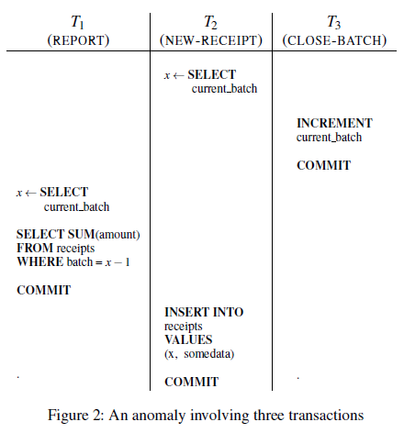
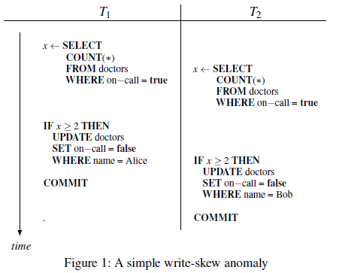
Snapshot Isolation
Snapshot Isolation doesn’t allow standard three anomalies
Dirty read, non-repeatable read, phantom read
However, SI allows several anomalies
Notes:
(Figure2)
read only T(T1)가 anomaly의 일부분으로 참여한 경우
Consider a transaction-processing system that maintains two tables. A receipts table tracks the day’s receipts, with each row tagged with the associated batch number. A separate control table simply holds the current batch number. There are three transaction types:
• NEW-RECEIPT: reads the current batch number from the control table, then inserts a new entry in the receipts table tagged with that batch number
• CLOSE-BATCH: increments the current batch number in the control table
• REPORT: reads the current batch number from the control table, then reads all entries from the receipts table with the previous batch number (i.e. to display a total of the previous
day’s receipts)
The following useful invariant holds under serializable executions: after a REPORT transaction has shown the total for a particular batch, subsequent transactions cannot change that total. This is because the REPORT shows the previous batch’s transactions, so it must follow a CLOSE-BATCH transaction. Every NEW-RECEIPT transaction must either precede both transactions, making it visible to the REPORT, or follow the CLOSE-BATCH transaction, in which case it will be assigned the next batch number.
Interestingly, this anomaly requires all three transactions, including T1 – even though it is read-only. Without it, the execution is serializable, with the serial ordering being hT2, T3i. The fact that read-only transactions can be involved in SI anomalies was a surprising result discovered by Fekete et al.

Slide 4
Serializable Snapshot Isolation
Motivation: Cases that data integrity is a critical concern
e.g) Wisconsin Court System
Why SSI instead of S2PL?
- PostgreSQL did not start with a lock-based serializable mode
Multiversion concurrency control system in 1999 was one of the first major accomplishments of the PostgreSQL community
“Readers don’t block writers, and writers don’t block readers” mantra : S2PL approach was unpalatable to most of the developer
SSI was appealing to us because it built on snapshot isolation, but adds additional checks to determine whether anomalies are possible, and offered higher performance than a S2PL

Slide 5
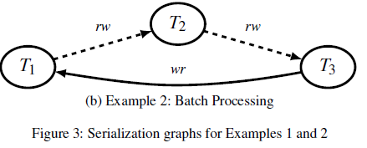
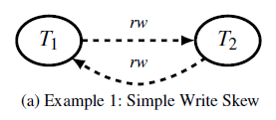
Serializable Isolation Anomalies
Three types of dependencies:
wr-dependencies , ww-dependencies, rw-antidependencies
Theorem 1 (Fekete et al. [10]). Every cycle in the serialization history graph contains a sequence of edges where each edge is a rw-antidependency. Furthermore, T3 must be the first
transaction in the cycle to commit.
Note that a wr-dependency from A to B means that A must have committed before B began, as this is required for A’s changes to be visible to B’s snapshot. The same is true of ww-dependencies because of write locking. However, rw-antidependencies occur between concurrent transactions: one must start while the other was active. Therefore, they play an important role in SI anomalies

Slide 6
SSI
Detecting potential anomalies at runtime
Similar to concurrency control protocols based on serialization graph testing
Rather than testing the graph for cycles, it checks for a “dangerous structure”
If any transaction has both an incoming rw-antidependency and outgoing one, SSI aborts one of the transactions involved
less expensive runtime check than cycle testing
SSI does not need to track wr- and ww- dependency edges
SSI requires detecting rw-antidependencies at runtime
“SIREAD” mode on the data they read
These locks do not block conflicting writes
Conflict between a SIREAD lock and a write lock flags an rw-antidependency
SIREAD locks must persist after a transaction commits, because conflicts can occur even after the reader has committed(e.g Figure2. T1->T2)
Notes:
기본 SI도 Serializability 제공하려 하지만 anomaly 때문에 완벽히 제공 못함(약간의 corruption 발생 가능)
SSI는 anomaly 탐지함으로써 SI에 완전한 serializability 부여
These locks do not block conflicting writes (thus, “lock” is somewhat of a misnomer). Rather, a conflict between a SIREAD lock and a write lock flags an rw-antidependency, which might cause a transaction to be aborted. Furthermore, SIREAD locks must persist after a transaction commits, because conflicts can occur even after the reader has committed (e.g. the T1 →T2 conflict in Example 2). Corollary 2 implies that the locks must be retained until all concurrent transactions commit

Slide 7
Read-Only Optimazation
Long-running read-only transactions are common
These transactions can increase the overhead of SSI
Improve performance for read-only transactions
1) read-only snapshot ordering rule : if a dangerous structure is detected where T1 is read-only, it can be disregarded as a false positive unless T3 committed before T1’s snapshot
reduce the false- positive abort rate
Theorem 3Every serialization anomaly contains a dangerous
structure where if T1 is read-only, T3 must have
committed before T1 took its snapshot.
Notes:
This result can be applied directly to reduce the false positive rate, using the following read-only snapshot ordering rule: if a dangerous structure is detected where T1 is read-only, it can be disregarded as a false positive unless T3 committed before T1’s snapshot. Here, a transaction is considered read-only if it is explicitly declared as such (with BEGIN TRANSACTION READ ONLY) or if it has committed without modifying any data.
This result means that whether a read-only transaction can be a part of a dangerous structure depends only on when it takes its snapshot, not its commit time. Intuitively, it matters when read/write transactions commit, as this is the point when its changes become visible to other transactions. But it does not matter when read-only transactions commit, because they do not make any changes; only their snapshot times have an effect.

Slide 8
Read-Only Optimazation
Improve performance for read-only transactions
2) Safe Snapshots: A read-only transaction T has a safe snap-shot if no concurrent read/write transaction has committed with a rw-antidependency out to a transaction that committed before T’s snapshot
A read-only transaction running on a safe snapshot can read any data (perform any query) without risk of serialization failure. It cannot be aborted, and does not need to take SIREAD locks.
Deferrable Transactions
OLTP transactions, Periodic database maintenance tasks
When a deferrable transaction begins, our system acquires a snapshot, but blocks the transaction from executing. It must wait for concurrent read/write transactions to finish
Notes:
If we can prove that a particular transaction will never be involved in a serialization anomaly, then that transaction can be run using standard snapshot isolation, without the need to track readsets for SSI. The rule above gives us a way to do so. A read-only transaction T1 cannot have a rw-conflict pointing in, as it did not perform any writes. The only way it can be part of a dangerous structure, therefore, is if it has a conflict out to a concurrent read/write transaction T2, and T2 has a conflict out to a third transaction T3 that committed before T1’s snapshot. If no such T2 exists, then T1 will never cause a serialization failure. This depends only on the concurrent transactions, not on T1’s behavior; therefore, we describe it as a property of the snapshot:
- An important special case is a snapshot taken when no read/write transactions are active; such a snapshot is immediately safe and a read-only transaction using it incurs no SSI overhead.
만약 OLTP같은 T를 그냥 진행시키면 SIREAD로 인한 lock overhead 비용 커짐 – concurrent T 끝날 때 까지 유지하기 때문에 메모리 고갈 심해짐
그렇다고 Safe Snapshot으로 바로 간주시킬 수는 없음. 왜냐면 이미 진행중인 T와 rw-conflict 발생할 수 있기 때문.
따라서 현재 진행중인 T가 모두 종료될 때 까지 기다리게 만들어 놓고, 모든 concurrent T종료 된 다음에 OLTP를 실행시킨다
이제는 Safe-Snapshot임을 보장하기 때문에 SIREAD 사용할 필요 없게 되며, Overhead비용 없는 상태에서 T를 수행할 수 있다.
평균적으로 1~6초정도 미뤄짐(OLTP의 전체 수행시간에 비해 미미하므로 수용할만함)

Slide 9
Resolving Conflicts: Safe Retry
Safe retry
If a transaction is aborted, immediately retrying the same transaction will not cause it to fail again with the same serialization failure
Do not abort anything until T3 commits.
Always choose to abort T2 if possible
If both T2 and T3 have committed when the dangerous structure is detected, then the only option is to abort T1.

Slide 10
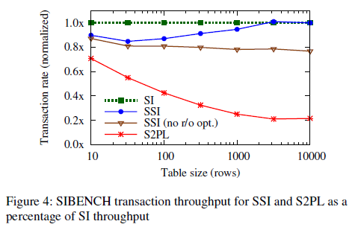
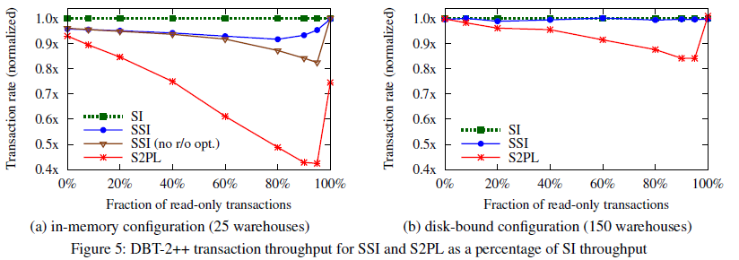
Evaluation
Two overhead
Tracking read dependencies and maintain serialization graph
Retried transactions, some of which may be false positives
Notes:
There are two sources of overhead.
First, tracking read dependencies and maintaining the serialization graph imposes CPU overhead and can cause contention on the lock manager’s lightweight locks
Second, transactions may need to be retried after being aborted by serialization failures, some of which may be false positives.
Figure 4 shows the throughput in committed transactions per second for SSI and S2PL, relative to the performance of snapshot isolation.

