Slide 1
Apache Tomcat Web Server
SNU OOPSLA Lab.
October 2005

Slide 2
Contents
Overview
Tomcat History
Tomcat Requirements and Quality Goals
Tomcat Installation & Setup
Some Features of Tomcat
Summary
Online Resources

Slide 3
Overview (1/5)
Web server which have Servlet/JSP container is needed to use the Java Servlet and JavaServer Pages(JSP) technologies
Tomcat is a Servlet/JSP container
  Also can plays a role as simple web server
  Released under the Apache Software License

Slide 4
Overview (2/5)
Servlet/JSP container
JSP Request
Servlet Request
Compile
JSP → Servlet
Container
Run Servlet
Run Servlet

Slide 5
Overview (3/5)
JSP(JavaServer Pages)
  Server-side script
  Allow us to use Java Servlet without compilation
  → Servlet/JSP container is needed for analysis and compilation of JSP source code

Slide 6
Overview (4/5)
The Jakarta Project
  Offers a diverse set of open source Java solutions
  Tomcat is a part of Jakarta Project
  Developer group of Apache participates in the development of Tomcat
  → Tomcat is working better with Apache web server than other Servlet/JSP containers

Slide 7



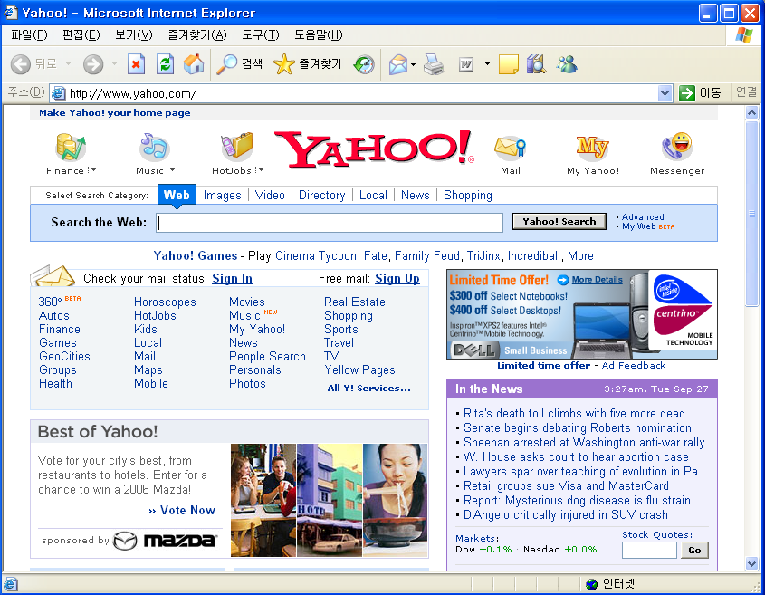
Overview (5/5)
Apache Tomcat Structure
(Apache) Web Server
Tomcat Container
User Request
JSP
Text
HTML
Servlet
Database

Slide 8
Tomcat History (1/3)
Tomcat originated as a result of culmination of two groups of developers
  Open source developers who were working on JServ, an implementation of the Servlet specification
  At the same time, Sun was busy building its own servlet engine
The focus of the two groups was different
  JServ – performance
  Sun – adherence to specification
  → These projects needed to be merged to fully satisfy the needs of the users
Sun realized this need, and donated the code to Apache Software Foundation
→ The Jakarta group was formed, and Tomcat was born

Slide 9
Tomcat History (2/3)
JServ
Open source developers
Sun Microsystems
developers
Performance
Adherence to spec.
Donation
Apache Software Foundation
The Jakarta Group
Tomcat

Slide 10
Apache Tomcat Versions (3/3)
Initial Apache Tomcat release – Apache Tomcat 3.0.x
Latest stable release – Apache Tomcat 5.5.9
Upgrade to Apache Tomcat 5.x whenever possible
(improved performance and stability)
More details about each release can be found in the Jakarta web site: http://jakarta.apache.org/tomcat/
Servlet/JSP Spec. | Tomcat version
2.4/2.0 | 5.5.9
2.3/1.2 | 4.1.31
2.2/1.1 | 3.3.2
(2005/9/30)

Slide 11
Tomcat Requirements and Quality Goals
Strict adherence to Sun’s JSP/Servlet specification : as accurate as possible
Interoperability : to interoperate with many popular web servers
Modifiability : to be adaptable to new changes
Performance
Scalability
High-availability
Security

Slide 12
Tomcat Installation & Setup (1/5)
Java 2 SDK is required
  Set JAVA_HOME, PATH, CLASSPATH environment variables properly
Tomcat Install
  Windows – easy, using the Windows installer
    Tomcat will be installed as a Windows NT/2k/XP service
    If you sets the service as "auto" startup, Tomcat is automatically started when Windows starts
  Unix

Slide 13
Tomcat Installation & Setup (2/5)
Tomcat Install on Unix
Download the binary file of latest stable release
  E.g., jakarta-tomcat-5.5.9.tar.gz(Tomcat 5.5.9, tarball)
Extract it to your Tomcat directory
  E.g., shell> cp jakarta-tomcat-5.5.9.tar.gz /usr/local/share
  shell> cd /usr/local/share
  shell> tar xvfz jakarta-tomcat-5.5.9.tar.gz
Set environment variables
  Edit /etc/profile OR ~/.bash_profile OR etc.
  E.g., shell> vi /etc/profile
  JAVA_HOME=/usr/java/j2sdk1.4.2_05
  CATALINA_HOME=/usr/local/share/jakarta-tomcat-5.0.16
  PATH=$PATH:$JAVA_HOME/bin:$CATALINA_HOME/bin
  export JAVA_HOME CATALINA_HOME PATH
  Apply the changes
  E.g., shell> source /etc/profile

Slide 14
Tomcat Installation & Setup (3/5)
Startup the Tomcat
  E.g., shell> cd /usr/local/share/Jakarta-tomcat-5.5.9/bin
  shell> ./startup.sh OR ./catalina.sh start
  Try to connect http://localhost:8080 or http://host_IP_addr:8080
Shutdown the Tomcat
  E.g., shell> cd /usr/local/share/Jakarta-tomcat-5.5.9/bin
  shell> ./shutdown.sh OR ./catalina.sh stop
The Access Log
  Your Tomcat server logs all HTTP requests made by clients to files of the following form:
  $CATALINA_HOME/logs/localhost_access_log.yyyy-mm-dd.txt

Slide 15
Tomcat Installation & Setup (4/5)
Directories and Files
  $CATALINA_HOME - the root of your Tomcat installation
  /bin - startup, shutdown, and other scripts.
  *.sh files (for Unix) / the *.bat files (for Windows)
  /conf - configuration files and related DTDs
    server.xml : the main configuration file for the container
  /logs - log files
  /webapps - where your webapps go

Slide 16
Tomcat Installation & Setup (5/5)
Configuration
  Changing the Port Numbers
    Edit the conf/server.xml file
    Pick a free port number
  Install Your Own Pages
    The web pages served by Tomcat are stored in the following directory:
    $CATALINA_HOME/webapps/ROOT/
    Also can change the served directory by Tomcat
      Edit the conf/server.xml file

Slide 17
Some Features of Tomcat (1/2)
Tomcat does not reload the Servlet and application code to provide high performance
  Developers have to restart the Tomcat process for testing updated class files
Auto-reload for easy of use
  By enabling the auto reloading feature in the configuration file, you can deploy updated class files and test it without having to restart the Tomcat process
Since auto-reload feature impacts performance, it should not be used in production environment

Slide 18
Some Features of Tomcat (2/2)
A Servlet Engine receives a lot of requests
  Each request is handled by the connector component in a separate thread
  Creating a thread for each request and destroying it after the request has been served creates unnecessary burden on the OS and the JVM
Thread pool for performance
  The max and min threads can be configured

Slide 19
Summary
Tomcat is a Servlet/JSP container
Tomcat is developed in an open environment and released under the Apache Software License
Tomcat try to fully satisfy the needs of the users

Slide 20
Online Resources
The Apache Jakarta Project - Tomcat web page
http://jakarta.apache.org/tomcat/
The Tomcat Web Server
https://www.cs.tcd.ie/courses/baict/bass/4ict12/tomcat.html
Tomcat Web Server
http://www.cs.ucl.ac.uk/teaching/java/tomcat.html
Tomcat Architecture
http://wiki.cs.uiuc.edu/cs427/Tomcat+Architecture
Apache + Tomcat Connection
http://ejavaschool.com.ne.kr/servlet/tomcat3.2.ppt

