Slide 1
Chapter 15 : Concurrency Control

Slide 2
Concurrency Control
A database must provide a mechanism that will ensure that all possible schedules are
  either conflict or view serializable, and
  are recoverable and preferably cascadeless
A policy in which only one transaction can execute at a time generates serial schedules, but provides a poor degree of concurrency
Testing a schedule for serializability after it has executed is a little too late
Goal – to develop concurrency control protocols that will assure serializability
  Concurrency-control schemes tradeoff between the amount of concurrency they allow and the amount of overhead that they incur

Slide 3
Lock-Based Protocols
A lock is a mechanism to control concurrent access to a data item
Data items can be locked in two modes:
1. exclusive (X) mode. Data item can be both read as well as
written. X-lock is requested using lock-X instruction.
2. shared (S) mode. Data item can only be read. S-lock is
requested using lock-S instruction.
Lock requests are made to concurrency-control manager
Transaction can proceed only after request is granted

Slide 4
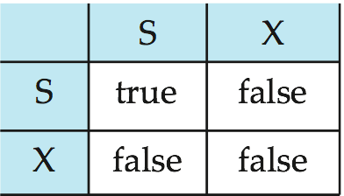
Granting of Locks
Lock-compatibility matrix
A transaction may be granted a lock on an item if the requested lock is compatible with locks already held on the item by other transactions
Any number of transactions can hold shared locks on an item
If any transaction holds an exclusive lock on the item no other transaction may hold any lock on the item
If a lock cannot be granted, the requesting transaction is made to wait till all incompatible locks held by other transactions have been released

Slide 5
Transaction with Locking
Example of a transaction performing locking:
T₂: lock-S(A);
read (A);
unlock(A);
lock-S(B);
read (B);
unlock(B);
display(A+B)
A locking protocol is a set of rules followed by all transactions while requesting and releasing locks
Locking protocols restrict the set of possible schedules

Slide 6

Pitfalls of Lock-Based Protocols
Consider the partial schedule
Neither T₃ nor T₄ can make progress
  Executing lock-S(B) causes T₄ to wait for T₃ to release its lock on B
  Executing lock-X(A) causes T₃ to wait for T₄ to release its lock on A
Such a situation is called a deadlock
  To handle a deadlock one of T₃ or T₄ must be rolled back and its locks released

Slide 7
Pitfalls of Lock-Based Protocols (Cont.)
The potential for deadlock exists in most locking protocols
  Deadlocks are a necessary evil
Starvation is also possible if concurrency control manager is badly designed
Example
  A transaction may be waiting for an X-lock on an item,
  while a sequence of other transactions request and are granted an S-lock on the same item.
  The same transaction is repeatedly rolled back due to deadlocks
Concurrency control manager can be designed to prevent starvation

Slide 8
Two-Phase Locking Protocol (2PL)
This is a protocol which ensures conflict-serializable schedules
Phase 1: Growing Phase
  transaction may obtain locks
  transaction may not release locks
Phase 2: Shrinking Phase
  transaction may release locks
  transaction may not obtain locks
The protocol assures (conflict) serializability
  The transactions can be serialized in the order of their lock points
  (i.e., the point where a transaction acquired its final lock)
  There can be conflict serializable schedules that cannot be obtained if two-phase locking is used

Slide 9

Partial Schedule Under 2PL

Slide 10
Strict / Rigorous 2PL
Two-phase locking does not ensure freedom from deadlocks
Cascading roll-back is possible under two-phase locking
Strict two-phase locking
  Here a transaction must hold all its exclusive locks till it commits/aborts
  No cascading rollback
Rigorous two-phase locking
  Here all locks(shared and exclusive) are held till commit/abort
  No cascading rollback (of course)
  In this protocol transactions can be serialized in the order in which they commit

Slide 11
Lock Conversions
The original lock mode with (lock-X, lock-S)
  assign lock-X on a data D when D is both read and written
Two-phase locking with lock conversions:
– First Phase:
  can acquire a lock-S on item
  can acquire a lock-X on item
  can convert a lock-S to a lock-X (upgrade)
– Second Phase:
  can release a lock-S
  can release a lock-X
  can convert a lock-X to a lock-S (downgrade)
This protocol assures serializability
The refined 2PL gets more concurrency than the original 2PL

Slide 12
Deadlock Detection
Deadlocks can be described as a wait-for graph, which consists of a pair
G = (V,E),
  V is a set of vertices (all the transactions in the system)
  E is a set of edges; each element is an ordered pair T_{i} →T_{j}.
If T_{i} → T_{j} is in E, then there is a directed edge from T_{i} to T_{j}, implying that T_{i} is waiting for T_{j} to release a data item
When T_{i} requests a data item currently being held by T_{j}, then the edge T_{i} → T_{j} is inserted in the wait-for graph
  This edge is removed only when T_{j} is no longer holding a data item needed by T_{i}
The system is in a deadlock state if and only if the wait-for graph has a cycle
  Must invoke a deadlock-detection algorithm periodically to look for cycles

Slide 13
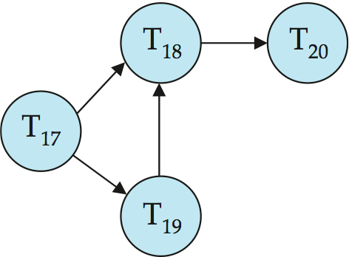
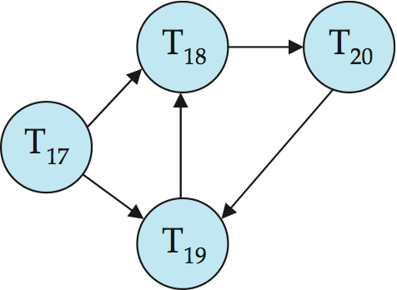
Deadlock Detection (Cont.)
Wait-for graph without a cycle
Wait-for graph with a cycle

Slide 14
Multiversion Two-Phase Locking
Motivation: Decision support queries that read large amounts of data have concurrency conflicts with OLTP transactions that update a few rows
  Poor performance results
Multiversion schemes keep old versions of data item to increase concurrency
  Differentiates between read-only transactions and update transactions
  Ts-counter is a global time-stamp clock
    This is incremented during commit processing
Update transactions acquire read and write locks, and hold all locks up to the end of the transaction
  Each successful write results in the creation of a new version of the data item written
  Each version of a data item has a single timestamp whose value is obtained from ts-counter
Read-only transactions are assigned a timestamp by reading the current value of ts-counter before they start execution

Slide 15
Multiversion Two-Phase Locking (Cont.)
Creation of multiple versions increases storage overhead
  Extra tuples
  Extra space in each tuple for storing version information
Versions can, however, be garbage collected
  E.g., if Q has two versions Q5 and Q9, and the oldest active transaction has timestamp > 9, than Q5 will never be required again
  Problem: works well, but how does system know a transaction is read only?

Slide 16
Snapshot Isolation
A transaction T2 executing with Snapshot Isolation
  takes snapshot of committed data at start
  always reads/modifies data
  in its own snapshot
  updates of concurrent transactions
  are not visible to T2
  writes of T2 complete when it commits
  First-committer-wins rule:
    Commits only if no other concurrent
    transaction has already written data
    that T2 intends to write
T1 | T2 | T3
W(Y := 1) Commit
 | Start R(X) → 0 R(Y)→ 1
 |  | W(X:=2) W(Z:=3) Commit
 | R(Z) → 0 R(Y) → 1 W(X:=3) Commit-Req Abort
Concurrent updates not visible
Own updates are visible
Not first-committer of X
Serialization error, T2 is rolled back

Slide 17
Benefits of Snapshot Isolation
Reading is never blocked
  and also doesn’t block other txs activities
Performance similar to Read Committed
Avoids the usual anomalies
  No dirty read
  No lost update
  No non-repeatable read
  Predicate based selects are repeatable
Problems with SI
  SI does not always give serializable executions
    Serializable: among two concurrent txs, one sees the effects of the other
    SI: neither sees the effects of the other
  Result: integrity constraints can be violated
Variants implemented in many database systems
  E.g., Oracle, PostgreSQL, SQL Server 2005

Slide 18
Weak Levels of Consistency in SQL
SQL allows non-serializable executions
  Serializable: is the default
  Repeatable read: allows only committed records to be read, and repeating a read should return the same value (so read locks should be retained)
    However, the phantom phenomenon need not be prevented
      T1 may see some records inserted by T2, but may not see others inserted by T2
  Read committed: only committed records can be read, but successive reads of record may return different (but committed) values
  Read uncommitted: even uncommitted records may be read
In many database systems, read committed is the default consistency level
  has to be explicitly changed to serializable when required
    set isolation level serializable

Slide 19
End of Chapter 15

