Slide 1
I. Prolinks: a database of protein functional linkage derived from coevolution
II. STRING: known and predicted protein-protein associations, integrated and transferred across organisms
Hoyoung Jeong

Slide 2
Table Of Contents
Introduction
Genomic Inference Method
  Phylogenetic profile method
  Gene cluster method
  Gene neighbor method
  Rosetta Stone method
TextLinks
Comparative benchmarking database
  Prolinks
  STRING
System
  Proteome Navigator
  STRING
Conclusion

Slide 3
Introduction(1/2)
Genome sequencing has allowed scientists to identify most of the genes encoded in each organism
  The function of many, typically 50%, of translated proteins can be inferred from sequence comparison with previously characterized sequences
  The assignment of function by homology gives only a partial understanding of a protein’s role within a cell
  A more complete understanding of a protein function requires the identification of interacting partners

Slide 4
Introduction(2/2)
Functional linkage
  Need the use of non-homology-based methods
  Two proteins are the components of a molecular complex and metabolic pathway
Genomic inference method
  Phylogenetic profile method
  Gene neighbors method
  Rosetta stone method
  Gene cluster method
  These methods infer functional linkage between proteins by identifying pairs of nonhomologous proteins that co-evolve

Slide 5
Phylogenetic profile method(1/3)
Use the co-occurrence or absence of pairs of nonhomologous genes across genomes to infer functional relatedness
  We can define a homolog of a query protein to be present in a secondary genome, using BLAST
  N genomes yield an N-dimensional vector of ones and zeroes for the query protein - phylogenetic profile

Slide 6
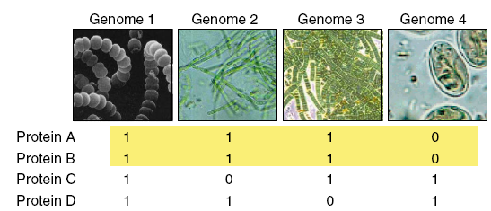
Phylogenetic profile method(2/3)

Slide 7
Phylogenetic profile method(3/3)
Using this approach, we can compute the phylogenetic profiles for each protein coded within a genome of interest
Need to determine the probability that two proteins have co-evolved
  We should compute the probability that two proteins have co-evolved by chance
Hypergeometric ditribution
n N - n
k m - k
P(k’|n,m,N) =
N
m
N represents the total # of genomes analyzed
n, the # of homologs for protein A
m, the # of homologs for protein B
k’, the # of genomes that contain homologs of both A and B
Because P represents the probability that the proteins do not co-evolve, 1-P(k > k’) is then the probability that they co-evolve

Slide 8
Gene cluster method(1/2)
Within bacteria, protein of closely related function are often transcribed from a single functional unit known as an operon
  Operons contain two or more closely spaced genes located on the same DNA strand
  Our approach to the identification of operons that gene start position can be modeled by a Poisson distribution
  Unlike the other co-evolution methods, that is able to identify potential functions for proteins exhibiting no homology to proteins in other genomes

Slide 9
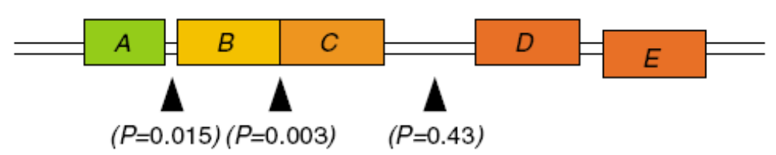
Gene cluster method(2/2)
P(start) = me^{-m}
P(N_positions_without_starts) = me^{-Nm}
Where, m is the total # of genes divided by the # of intergenic nucleotides
The probability that two genes that are adjacent and coded on the same strand are part of an operon is 1-P
x
P(separation < N) = ∫ me^{-mN} = 1-e^{-mx}
0

Slide 10
Gene neighbor method(1/2)
Some of the operons contained within a particular organism may be conserved across other organism
  That may provides additional evidence that the genes within the operon are functionally coupled
  And may be components of a molecular complex and metabolic pathway

Slide 11
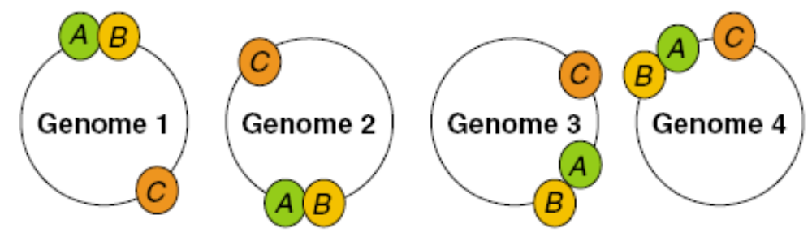
Gene neighbor method(2/2)
Our approach, first computes the probability that two genes are separated by fewer than d genes:
The likelihood of two genes is
2d
P(≤d) =
N - 1
Where, N is the total # of genes in the genome
m-1
(-lnX)^{k}
P_{m}(≤X) = 1 – P_{m}(>X) ≈ X∑
k = 0
k!
m
where X = ∏ Pi(≤di), m is the # of organism that contain homologs of the two genes
i = 1

Slide 12
Rosetta Stone method(1/2)
Occasionally, two proteins expressed separately in one organism can be found as a single chain in the same or second genome
  It may the clue to infer functional relatedness of gene fusion/division
  Proteins may carry out consecutive metabolic steps or are components of molecular complex
  To detect gene-fusion events, we first align all protein-coding sequences from a genome against the database using BLAST

Slide 13
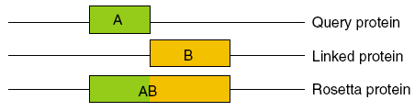
Rosetta Stone method(2/2)
We identify cases where two nonhomologous proteins both align over at least 70% of their sequence to different portions of a third protein
To screen out these confounding fusion, we compute the probability that two proteins are found by chance
Where k’ is the # of Rosetta Stone sequences
Therefore, the probability that two proteins have fused is given by 1 – P(k > k’)
n N - n
k m - k
P(k’|n,m,N) =
N
m

Slide 14
TextLinks(1/2)
Different from the methods above, is not a gene context analysis method
The co-occurrence of gene names and symbols within the scientific literature be used
For this analysis, we have used the PubMed database, containing 14 million abstract and citations
As with the phylogenetic profile method, abstracts and individual gene names were used to develop a binary vector
The result is an N-dimensional vector of ones and zeroes
  Where, N is the total # of abstract
  Marked as one when a protein name is found within a given abstract or citation
  Marked as zero when a protein name is not found within a given abstract or citation

Slide 15
TextLinks(2/2)
To protect a co-occurrence by chance, use a phylogenetic profile method
n N - n
k m - k
P(k’|n,m,N) =
N
m
1 – P(k>k’)

Slide 16
Comparative benchmarking database(1/3)
Database has
  Prolinks(2004)
    83 genomes, 18,077,293 links between proteins
  STRING(2005)
    730,000 proteins
Genomic inference method
  Prolinks
    Phylogenetic profile, Gene neighbors, Rosetta stone, Gene cluster method
    TextLinks
  STRING
    Phylogenetic profile, Gene neighbors, Rosetta stone method
    TextLinks, Experiments, Database, Textmining

Slide 17
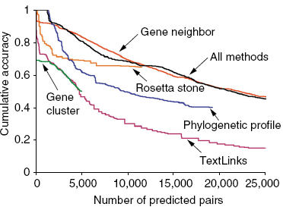
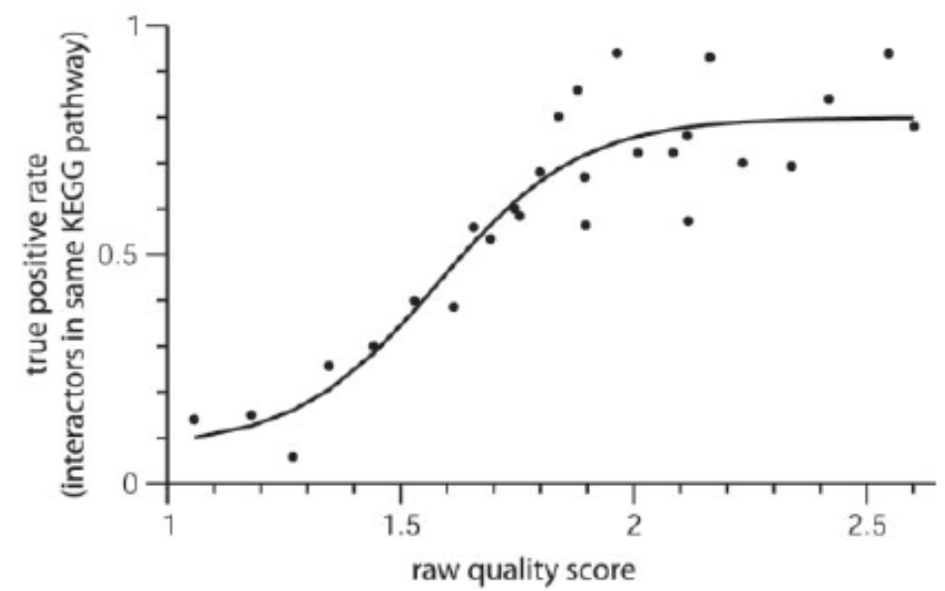
Comparative benchmarking database(2/3)
Confidential metric
  Prolinks - COG(Clusters of Orthologous Groups) pathway
  STRING - KEGG(Kyoto Encyclopedia Genes and Genomes) pathway
Prolinks
STRING

Slide 18
Comparative benchmarking database(3/3)
We have downloaded all the functional links for E. coli each database, we obtained(experimented on by Prolinks, 2004)
  # of Links
    Prolinks - 515,892 links
    STRING - 407,520 links
  Confidence
    Prolinks - 20% of the links between proteins assigned to a COG pathway
    STRING - 17% of the annotated links were between protein in the same
    pathway

Slide 19
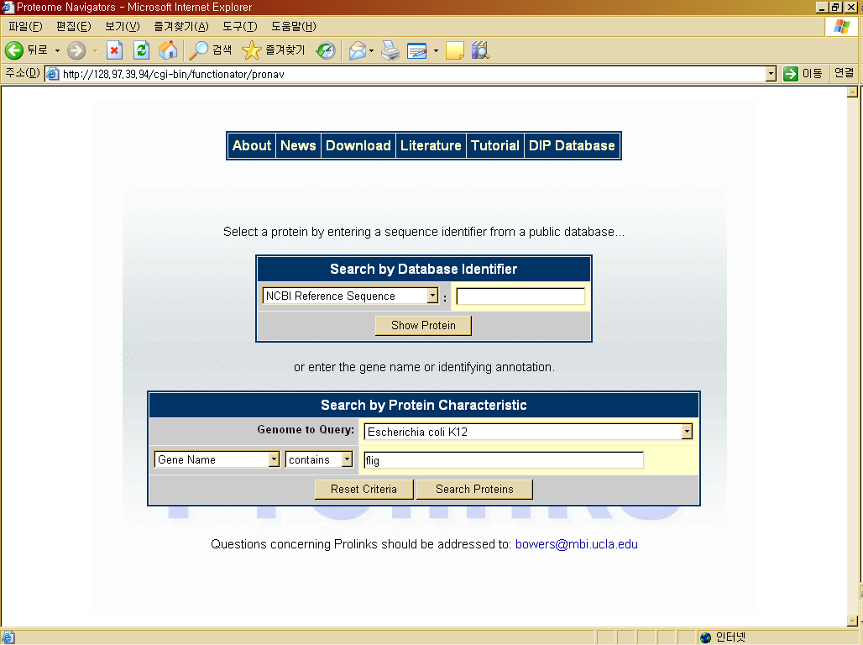
Proteome Navigator

Slide 20
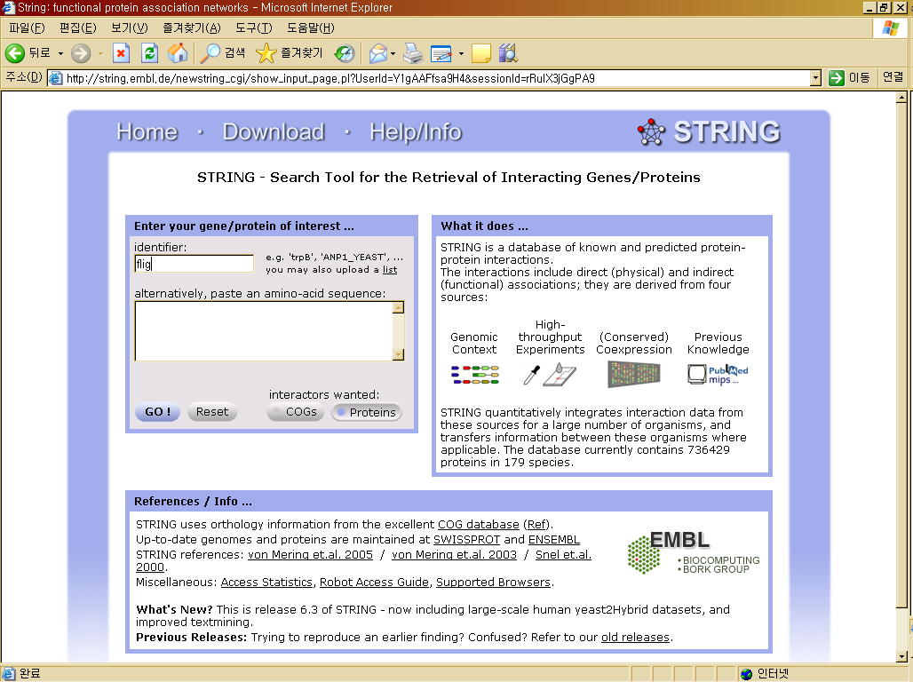

Slide 21
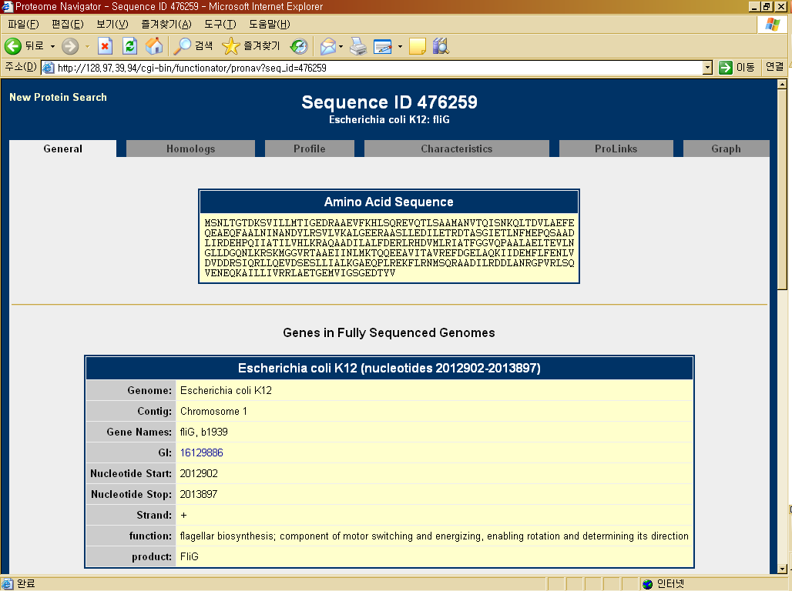
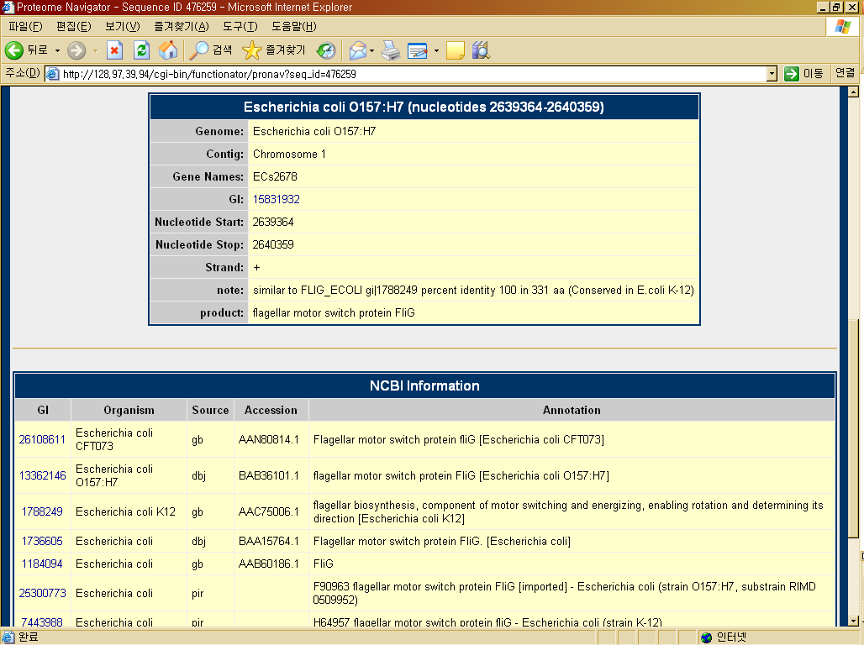

Slide 22
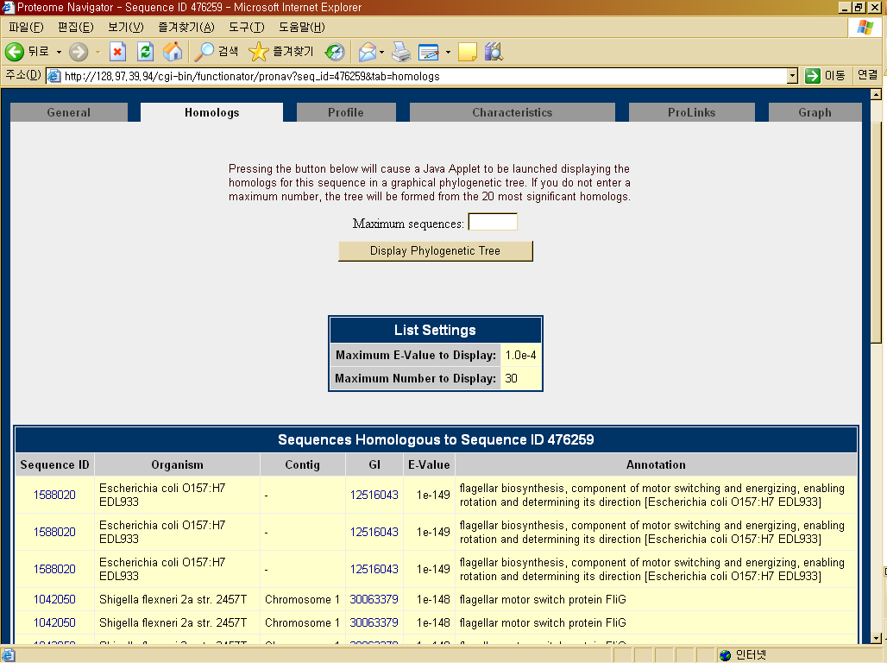

Slide 23
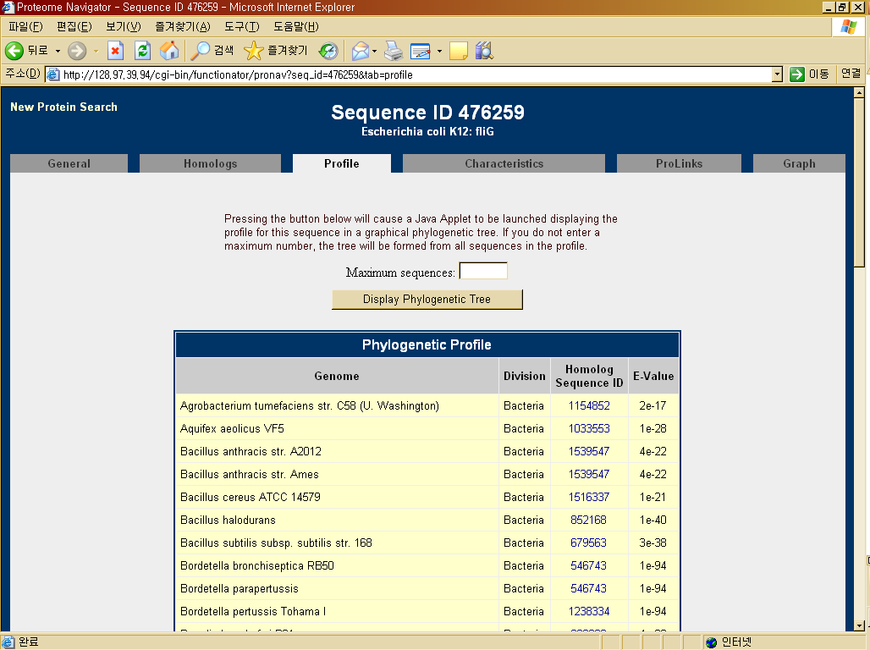

Slide 24
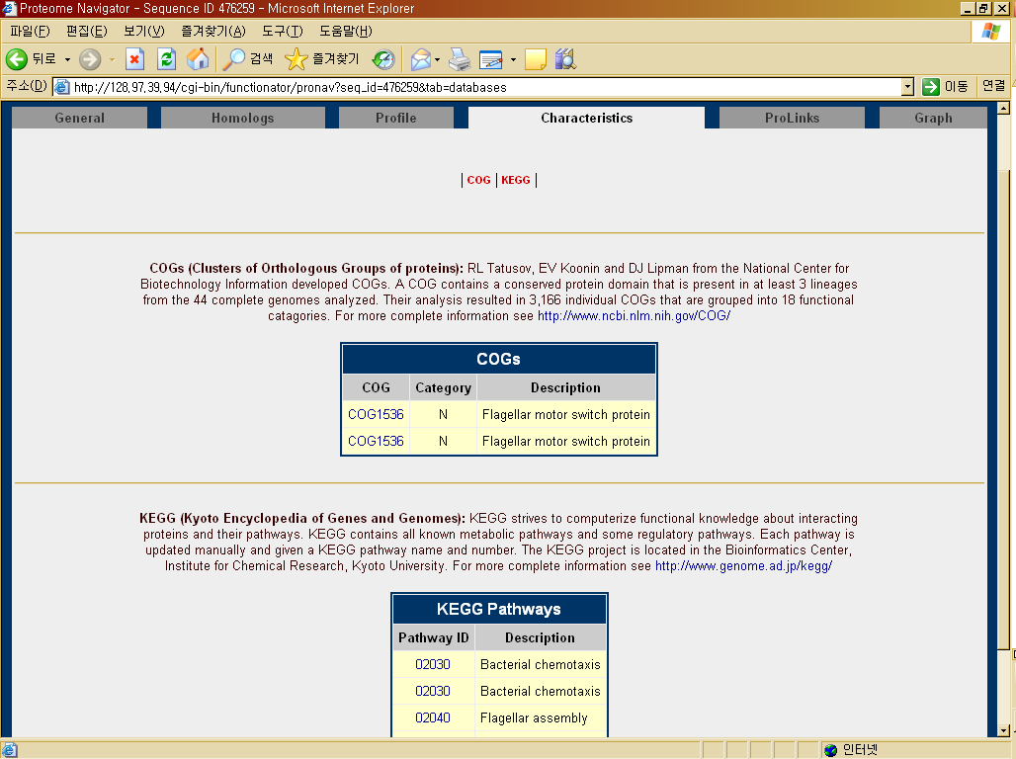

Slide 25
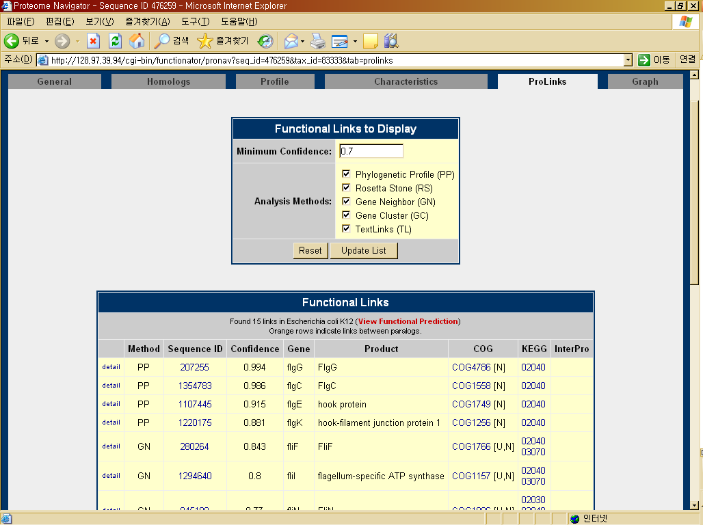
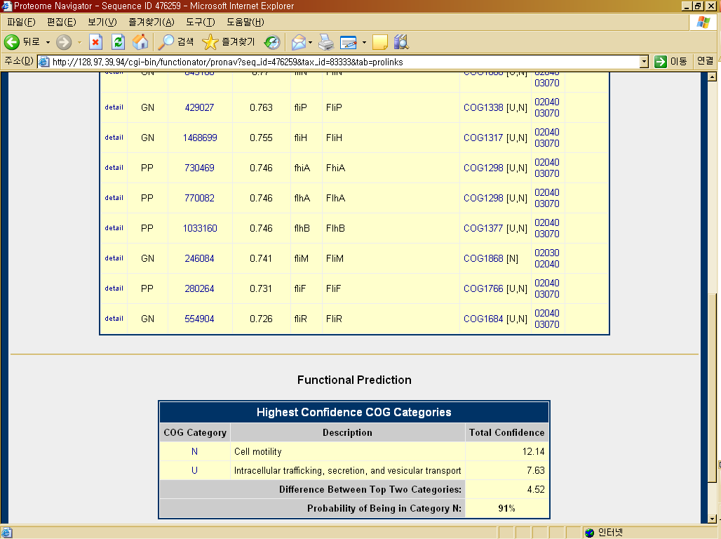

Slide 26
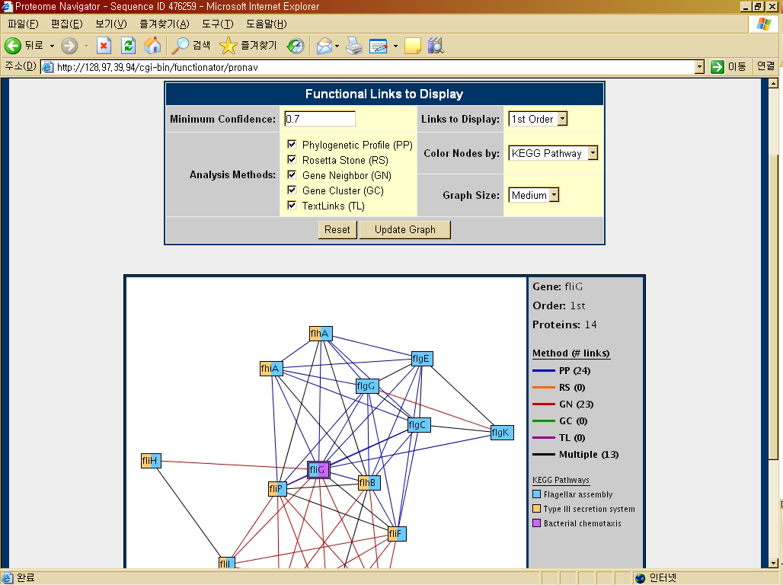

Slide 27
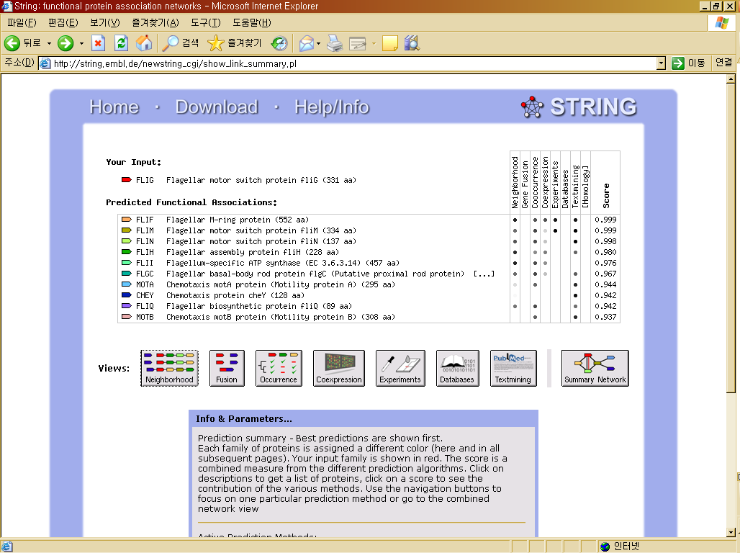
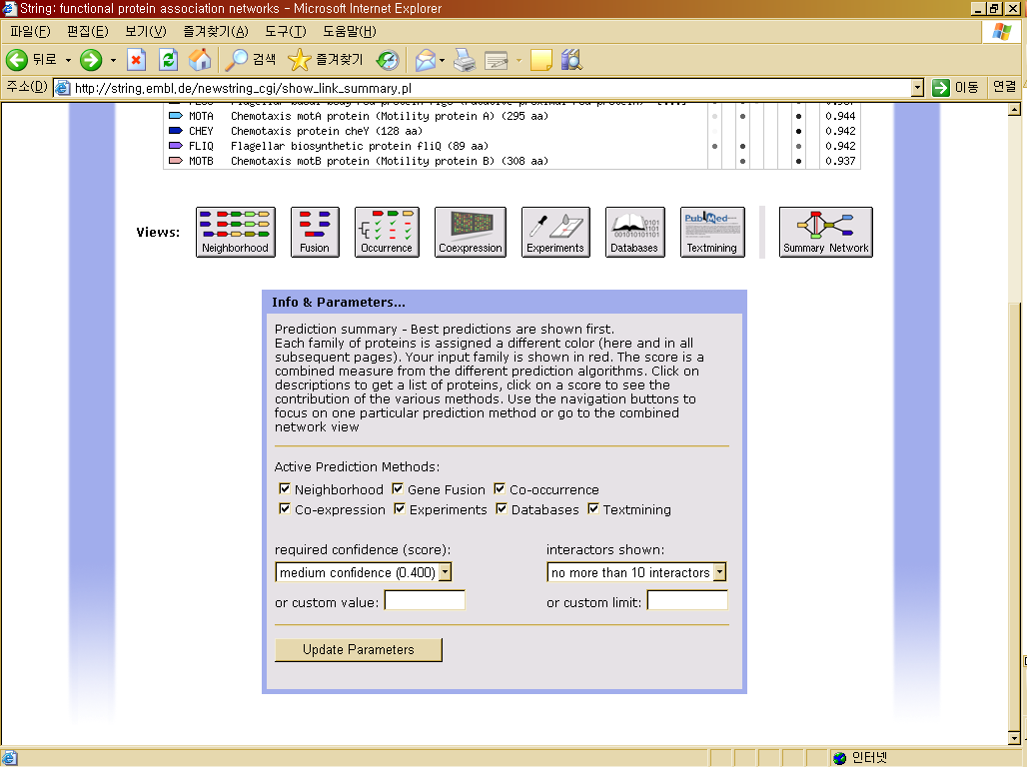

Slide 28
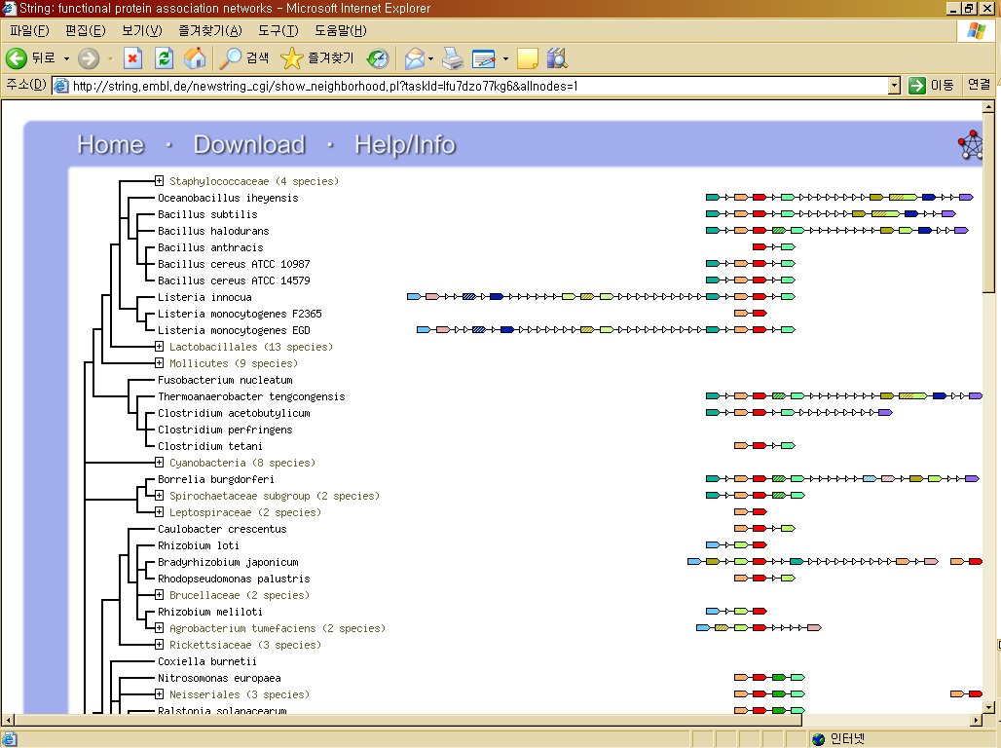

Slide 29
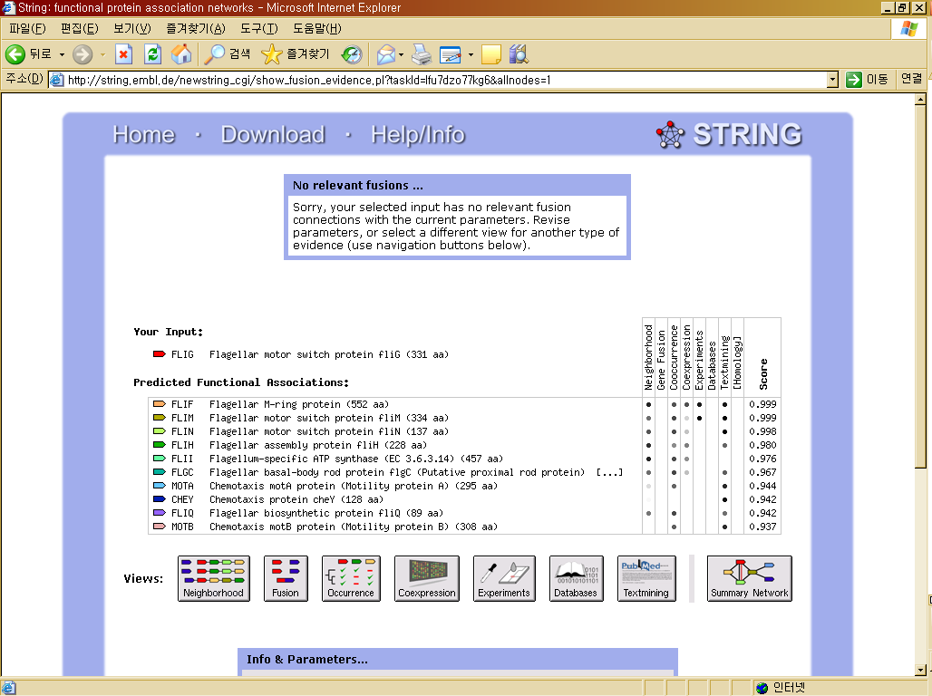

Slide 30
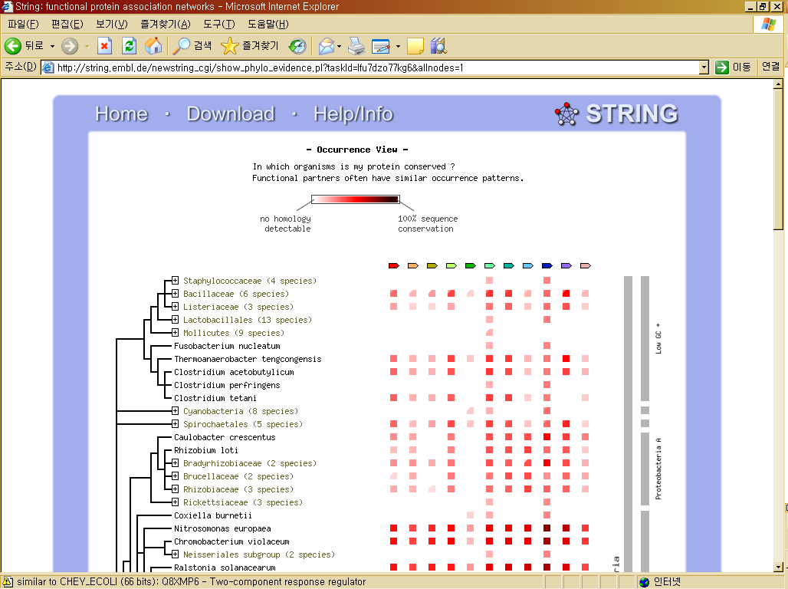

Slide 31
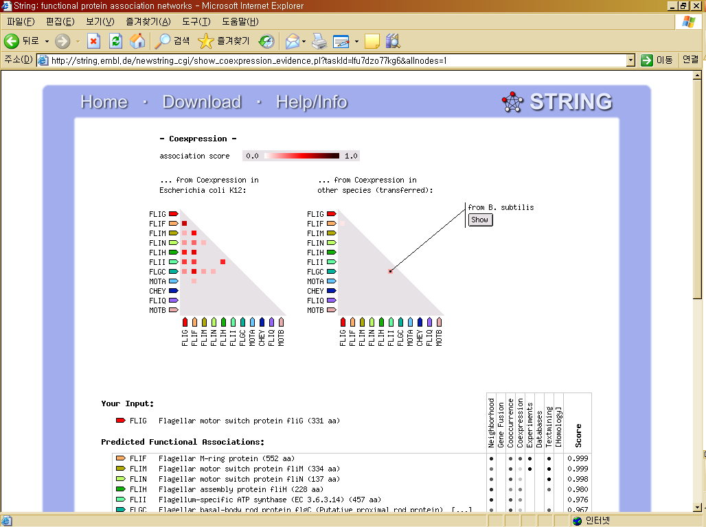

Slide 32
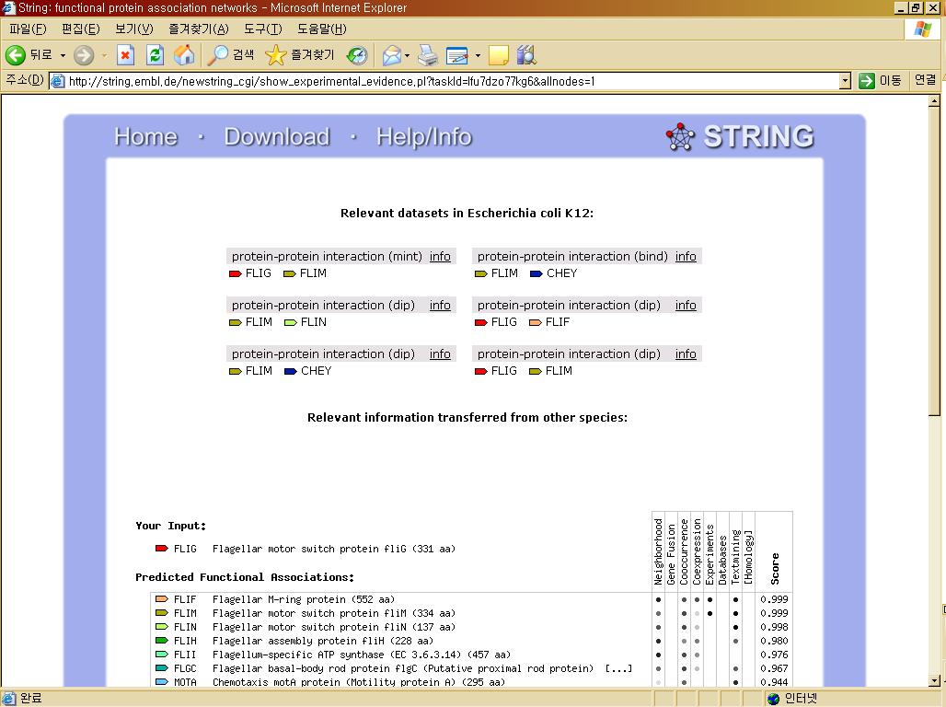

Slide 33
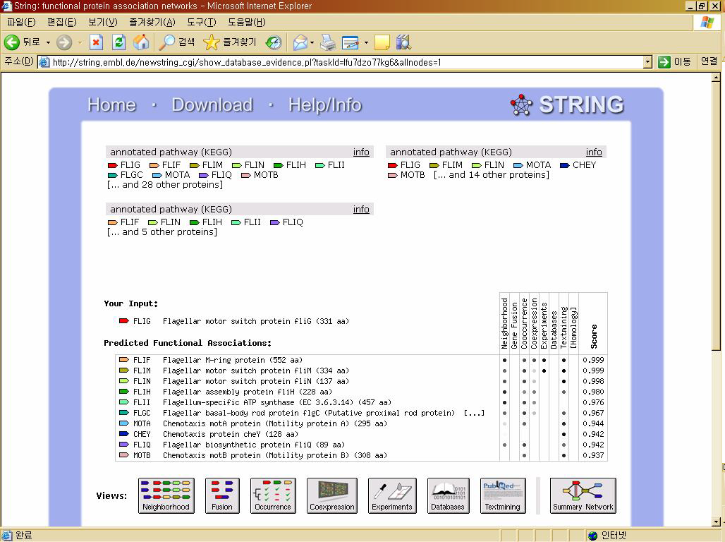

Slide 34
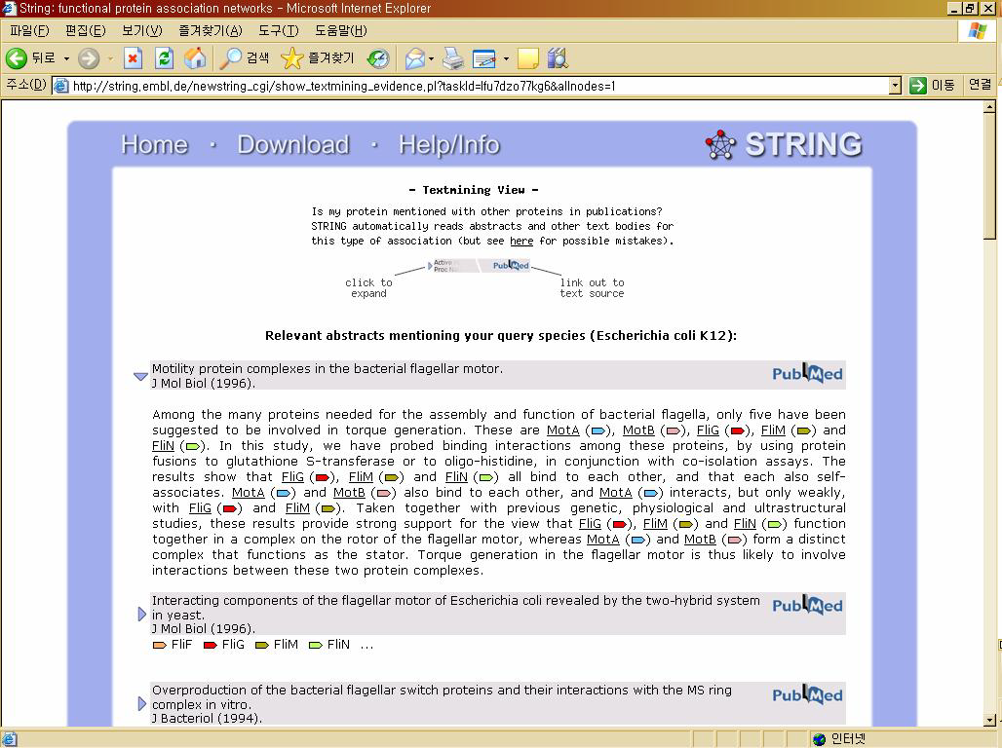

Slide 35
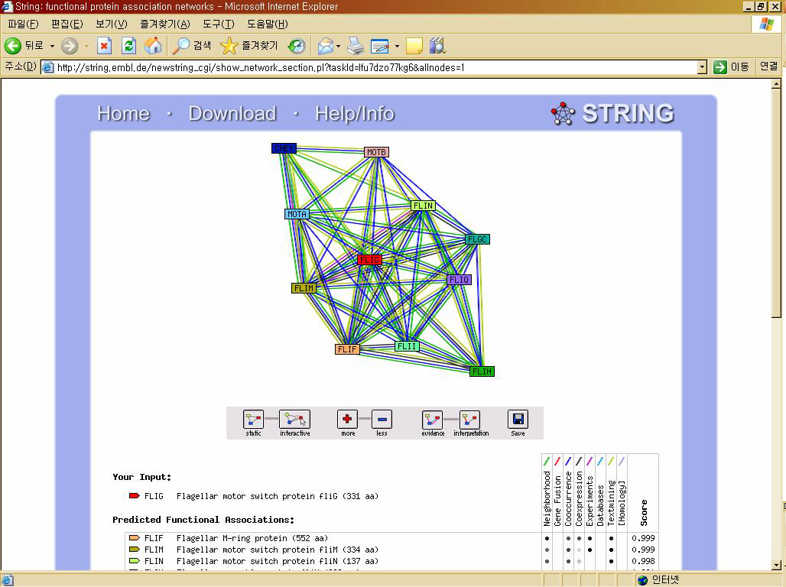

Slide 36
Conclusion
Over the past few years significant progress has been made to protein interaction
  In spite of affluent data, biologists are still limited in their coverage of organism
  The majority of protein interactions have been measured within a single organism
The computational methodology may help them

