Slide 1
Building Discriminative User Profiles for Large-scale Content Recommendation
Erheng Zhong, et al
Personalization Sciences, Yahoo Labs, CA, USA
KDD’15
2016.3.11
Hyesung Oh
Notes:
Knowledge Discovery and Data Mining

Slide 2
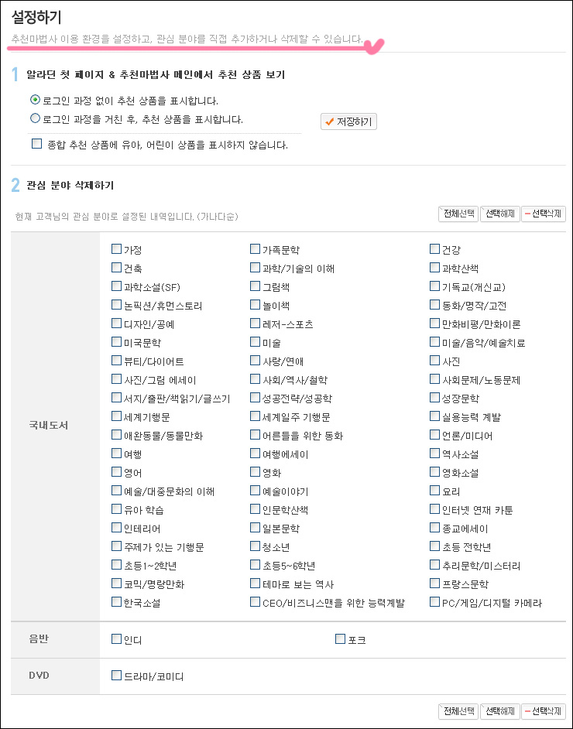
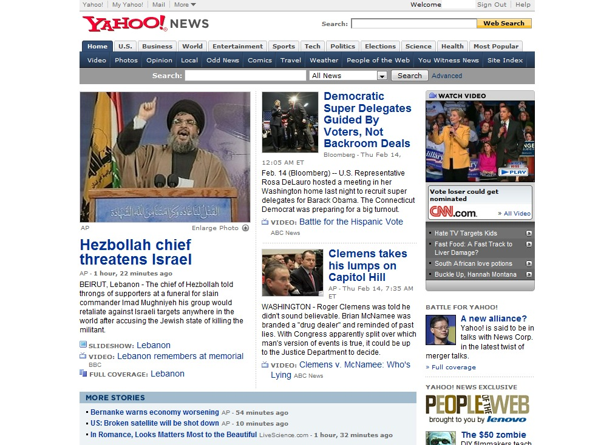
Problem
Personalized news recommendation w/o user’s explicit input

Slide 3
Using user’s implicit feedback
Explicit feedback
Ratings or binary preference indicators
Sparse
Implicit feedback
Positive preference by clicking on an item
Negative feedback are construed from a lack of click

Slide 4
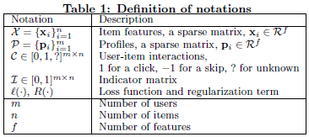
Problem Formulation
News item’s content feature
Topical categories
Set of named entities
Word tokens
…
f
f
n
X
P
C
n
m
m

Slide 5
User Profile Modeling
As baselines, two generative statistical models
TF-IDF(term frequency-inverted document frequency)
Chi Square
Independent learning model(ILM)
Proposed solution
Latent factor model(LFM)

Slide 6
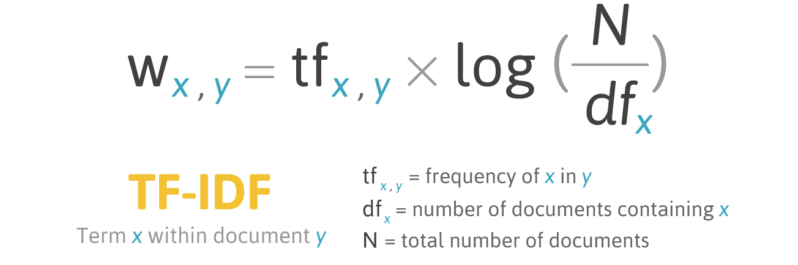
TF-IDF
Removes stop words
a, the, and …
Highlight specific words

Slide 7

Chi Square
Much higher values for user’s preferred words

Slide 8
User Independent Learning Model
Using positive and negative values
Logistic regression with L2-norm regularization
Stochastic Gradient Descent technique to optimize

Slide 9
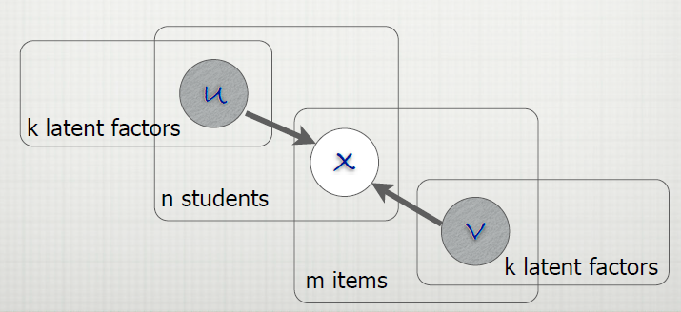
Latent Factor Model
To construct each user’s profile by all users
Based on matrix factorization methods

Slide 10
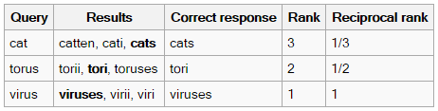
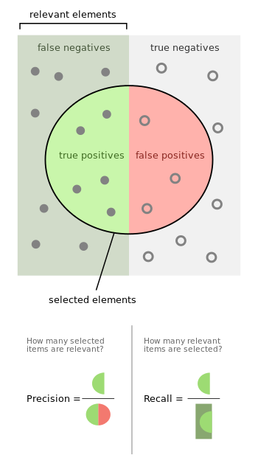
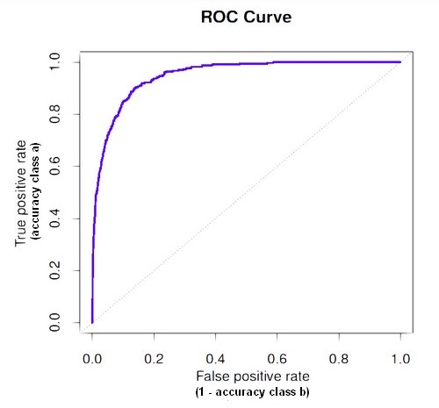
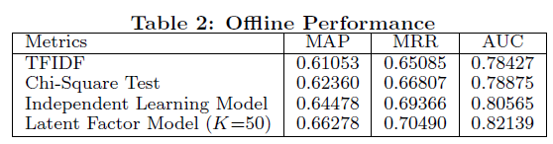
Performance
Mean average precision (MAP)
Mean reciprocal rank (MRR)
Area under the curve (AUC)

Slide 11
Main contribution
Effectively alleviates the data sparseness issue
Using rich signal in the negative implicit feedback
Provide Map-reduce framework that can scale

