Slide 1

Session 2
UML & Development Methodologies
Written by Thomas A. Pender
Published by Wiley Publishing, Inc.
October 5, 2011
Presented by Kang-Pyo Lee

Slide 2
Contents
Some Current Methodologies
The Rational Unified Process
Shlaer-Mellor Method
CRC
Extreme Programming

Slide 3
Some Current Methodologies (1/2)
A methodology consists of a process, a vocabulary, and a set of rules and guidelines
The part of all methodologies that can be standardized is the vocabulary
  Often expressed in a notation
  The UML standard is a common notation that may be applied to many different types of software projects using very different methodologies
One of the challenges inherent in defining a methodology is that it is difficult to define a single process that works for all projects
Even though the UML standardizes the notations gathered from a number of methodologies, the processes used to apply the UML notation are still as diverse as the environments in which they are used

Slide 4
Some Current Methodologies (2/2)
A brief summary of four of the current methodologies
They represent the diversity of the current set of methodologies
This should give a fair idea of the opportunities available to you and the factors that may influence your choices
Methodology | Description
RUP | Works well in large projects where quality artifacts and communication are critical
Shlaer-Melor Method | Developed primarily to address the unique needs of real-time systems long before the UML existed, but has since adopted the UML notation
CRC | Designed as a tool to help people gain an understanding of objects and how they work
Extreme Programming | Tries to reduce many of the existing development practices to the bare essentials, attempting to optimize the relationship between developers and clients

Slide 5
Contents
Some Current Methodologies
The Rational Unified Process
Shlaer-Mellor Method
CRC
Extreme Programming

Slide 6
The Rational Unified Process (1/4)
RUP is the latest version of a series of methodologies resulting from a blending of methodologies
  Objectory Process, Rational Approach, Rational Objectory Process, and the Unified Software Development Process
The hallmarks of RUP are the two terms incremental and iterative
  The goal of the methodology is to deliver an executable release of a product, an increment of the product for every pass, or iteration, through the process
  The motivation is to keep delivery times short and deliveries frequent
    prevents the historical problem of projects that run for months or even years before they actually produce anything
    supports early review and early problem detection

Slide 7
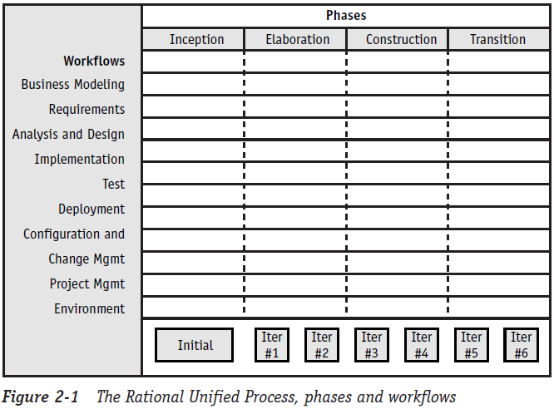
The Rational Unified Process (2/4)
The process is built around the two concepts of project lifecycle phases and process workflow

Slide 8
The Rational Unified Process (3/4)
Strengths
  The emphasis on iterative development and incremental deliveries is a time-tested and valuable approach that prevents many common project problems
    However, this approach is common to most of the current methodologies
  The process is well defined and supported by the Rational modeling tool
  The artifacts and the roles of the project participants are also very well defined
  The process combines many of the best practices from many successful methodologies
  The process is comprehensive

Slide 9
The Rational Unified Process (4/4)
Weaknesses
  In trying to be comprehensive, the RUP becomes very large and difficult, both to learn and to manage
    It is easy to get so caught up in the rules for using the RUP that you forget why you are using it (to deliver software)
  A substantial amount of time is spent trying to customize the RUP for each project
    You run the risk of becoming a slave to the process and losing sight of the reason for the process
  Tool support for the process is limited to Rational’s own products, which are at the high end of the cost range
    A few other vendors are now starting to provide limited support

Slide 10
Contents
Some Current Methodologies
The Rational Unified Process
Shlaer-Mellor Method
CRC
Extreme Programming

Slide 11
Shlaer-Mellor Method (1/4)
The Shlaer-Mellor Method is based on
  An integrated set of models that can be executed for verification
  An innovative approach to design that produces a system design through a translation of the analysis models
The method is built on a set of well-defined rules for
  The construction of the diagrams
  The translation of those diagrams from analysis to design and finally to implementation
Domains
  One of the primary concepts in Shlaer-Mellor
  A domain is a subject area
  Three basic types
    The application domain, the service domains, and the architectural domain
  Each domain has its own unique types of requirements and diagrams
  Together they represent the entire specification for the system

Slide 12
Shlaer-Mellor Method (2/4)
Shlaer-Mellor process
  1. Partition the system into domains
  2. Analyze the application domain using object information models, state models, and action specifications (action data flow diagrams—a non-UML diagram)
  3. Confirm the analysis through static verification and dynamic verification (simulation)
  4. Extract the requirements for the service domains
  5. Analyze the service domains
  6. Specify the components of the architectural domain
  7. Build the architectural components
  8. Translate the models of each domain using the architectural components

Slide 13
Shlaer-Mellor Method (3/4)
Strengths
  The greatest strength is the ability to test your diagrams through simulation
    You actually execute your diagrams
  The process is extremely well defined in terms of rules that govern the construction and testing of the diagrams
  The movement from one step in the process to the next (e.g., from analysis level diagrams to design-level diagrams) is also defined with enough precision to allow the generation of design diagrams directly from the analysis diagrams
    This is a huge time saver and prevents mistakes in the translation
    It also speeds up the process of applying changes because they can be propagated through the diagrams automatically
  The method was developed for and maintains a strong emphasis on real-time systems design
    It provides support that is largely lacking in other methodologies that gloss over the unique demands of real time in favor of the more common business functionality

Slide 14
Shlaer-Mellor Method (4/4)
Weaknesses
  Like the RUP, the tool support is limited to vendors directly associated with the methodologists
    This is changing, but don’t expect it to be quick
  Learning the rules involves a definite learning curve and a serious investment of time and effort
    Steve Mellor is currently leading an enhancement to the UML (called Action Semantics) to improve the definition of Statechart diagrams and build much of this knowledge into the UML 1.5 standard
    Tool support for this enhancement should soon follow
  The methodology was developed for real-time systems, so it places heavy emphasis on state modeling
    Many business applications simply do not warrant a lot of work on state transitions

Slide 15
Contents
Some Current Methodologies
The Rational Unified Process
Shlaer-Mellor Method
CRC
Extreme Programming

Slide 16
CRC (1/5)
CRC stands for Class, Responsibilities, and Collaborators
The CRC was originally developed as a learning tool during the time when object-oriented programming was new
  A lot of procedural programmers needed help making the transition to OO thinking
  The goal was to provide the simplest possible conceptual introduction to OO modeling
The heart of the method is the CRC card
  A CRC card is a 3-x-5" or 4-x-6" lined index card
  The physical nature of the cards emphasizes the division of responsibility across objects
  The physical size of the cards also helps to establish limits for the size and complexity of the classes
  Used to discover information about classes that is then placed into a UML Class diagram

Slide 17
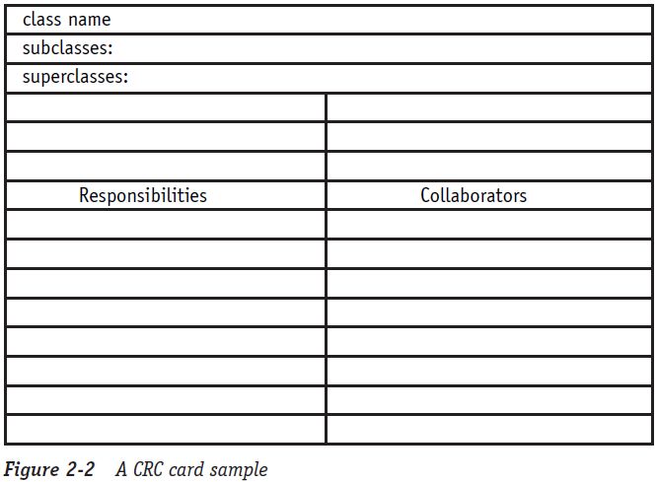
CRC (2/5)
A sample blank CRC card

Slide 18
CRC (3/5)
The CRC process requires a team that includes people in two distinct roles
  Domain expert and OO technology facilitator
The CRC process centers on working through scenarios
  1. Before the Scenario Execution
    a. The Problem
    b. Brainstorming for Classes
    c. Filtering Classes
    d. Assigning Cards
  2. The Scenario Execution
    a. The team walks through the scenario identifying the responsibilities of each class in the scenario
    b. Each discovered responsibility is recorded on the card of the corresponding class
  3. During the Scenario Execution
    a. Grouping the Cards
    b. Scenario List
    c. Collaboration Drawings
  4. After the Scenario Execution
    a. The team reviews the resulting model and plans the implementation

Slide 19
CRC (4/5)
Strengths
  The simplicity of the method has remained a major selling point
    Still a valuable tool for helping a programmer transition from procedural to OO concepts
  It is extremely easy to use and very visual
    Difficult for any participant to claim he didn’t know exactly what was going on
  The technique is very responsibility-driven
    It keeps the participants focused on the value of an object based on what that object contributes to the proper operation of the system
    The result is a system with the minimum number of objects needed to make it work
  The technique helps the participants think like objects and to understand why objects work well or work poorly
    This understanding helps ensure a good design

Slide 20
CRC (5/5)
Weaknesses
  The most significant limitation is also its simplicity
    It only really addresses the problem of finding and modeling classes
    There is a lot more to complete systems development
    So the bulk of the work still rests on the programmers
  The success of the process is very dependent upon the participants and especially on the facilitator
    The simplicity can be very deceptive

Slide 21
Contents
Some Current Methodologies
The Rational Unified Process
Shlaer-Mellor Method
CRC
Extreme Programming

Slide 22
Extreme Programming (1/3)
Extreme Programming (XP) shocked a lot of people, including myself, when it first showed up
Originated by Kent Beck, who was also instrumental in the CRC method
XP does not advocate the UML
XP requires a complete and unwavering commitment from the clients to work side-by-side with the programmers
  Working through stories or scenarios of how the system should work
“The code is everything”
  There is a very heavy emphasis on coding standards and design principles
  There is very little use of up-front modeling
  XP does use the CRC method because of its simplicity and utility
  XP could be seen as bottom-up design

Slide 23
Extreme Programming (2/3)
Strengths
  XP is the first that truly cared about the programming environment and its affects on the participants
  XP encourages an extremely close relationship between clients and developers
  XP faces the fact that change is inevitable and often uncontrollable and builds that fact into the development approach
  Kent Beck has been brave enough to describe what it really takes to create a high-caliber development environment
    Instead of bowing to the status quo of impossible deadlines, inadequate user involvement, ill-defined requirements, and programmer isolation

Slide 24
Extreme Programming (3/3)
Weaknesses
  XP relies heavily on setting up the ideal development environment
  It starts from several questionable assumptions:
    Highly committed clients will spend huge amounts of time working side by side with programmers
    Programmers work extremely well together
    Experienced programmers work with new team members to maintain the system
    Design is a skill that is common to every coder

Slide 25
The End

