Slide 1
Chapter 25:
Advanced Transaction Processing

Slide 2
Database System Concepts
Chapter 1: Introduction
Part 1: Relational databases
  Chapter 2: Relational Model
  Chapter 3: SQL
  Chapter 4: Advanced SQL
  Chapter 5: Other Relational Languages
Part 2: Database Design
  Chapter 6: Database Design and the E-R Model
  Chapter 7: Relational Database Design
  Chapter 8: Application Design and Development
Part 3: Object-based databases and XML
  Chapter 9: Object-Based Databases
  Chapter 10: XML
Part 4: Data storage and querying
  Chapter 11: Storage and File Structure
  Chapter 12: Indexing and Hashing
  Chapter 13: Query Processing
  Chapter 14: Query Optimization
Part 5: Transaction management
  Chapter 15: Transactions
  Chapter 16: Concurrency control
  Chapter 17: Recovery System
Part 6: Data Mining and Information Retrieval
  Chapter 18: Data Analysis and Mining
  Chapter 19: Information Retreival
Part 7: Database system architecture
  Chapter 20: Database-System Architecture
  Chapter 21: Parallel Databases
  Chapter 22: Distributed Databases
Part 8: Other topics
  Chapter 23: Advanced Application Development
  Chapter 24: Advanced Data Types and New Applications
  Chapter 25: Advanced Transaction Processing
Part 9: Case studies
  Chapter 26: PostgreSQL
  Chapter 27: Oracle
  Chapter 28: IBM DB2
  Chapter 29: Microsoft SQL Server
Online Appendices
  Appendix A: Network Model
  Appendix B: Hierarchical Model
  Appendix C: Advanced Relational Database Model

Slide 3
Part 8: Other topics
(Chapters 23 through 25).
Chapter 23: Advanced Application Development
  covers performance benchmarks, performance tuning and standardization.
Chapter 24: Advanced Data Types and New Applications
  covers advanced data types and new applications, including temporal data, spatial and geographic data, multimedia data, and issues in the management of mobile and personal databases.
Chapter 25: Advanced Transaction Processing
  deals with advanced transaction processing. We discuss transaction-processing monitors, high-performance transaction systems, real-time transaction systems, and transactional workflows.

Slide 4
Chapter 25: Advanced Transaction Processing
25.1 Transaction-Processing Monitors
25.2 Transactional Workflows
25.3 E-Commerce
25.4 Main Memory Databases
25.5 Real-Time Transaction Systems
25.6 Long-Duration Transactions
25.7 Transaction Management in Multidatabase systems
25.8 Summary

Slide 5
Transaction Processing Monitors
TP monitors initially developed as multithreaded servers to support large numbers of terminals from a single process.
Provide infrastructure for building and administering complex transaction processing systems with a large number of clients and multiple servers.
Provide services such as:
  Presentation facilities to simplify creating user interfaces
  Persistent queuing of client requests and server responses
  Routing of client messages to servers
  Coordination of 2-phase commit when transactions access multiple servers.
Some commercial TP monitors:
  CICS from IBM
  Pathway from Tandem
  TopEnd from NCR
  Encina from Transarc

Slide 6
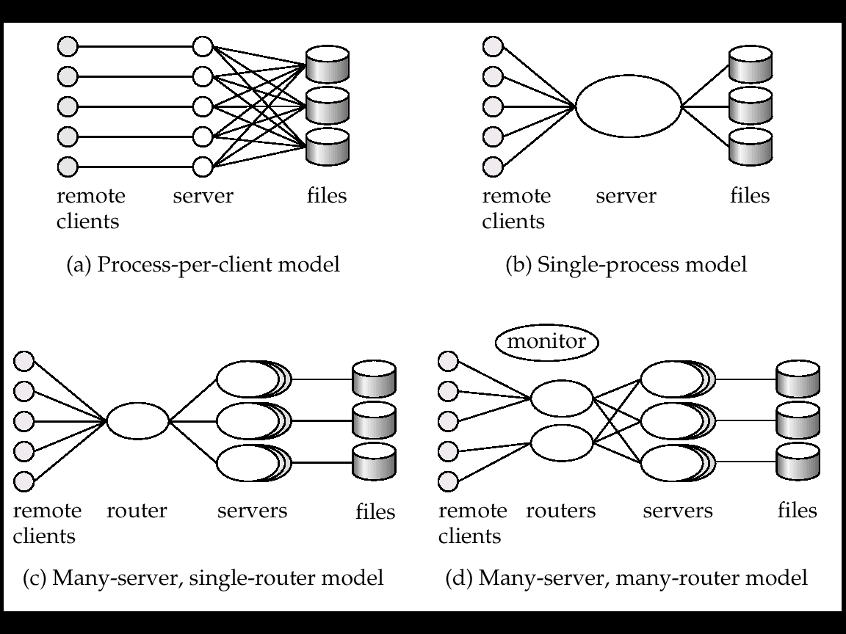
TP Monitor Architectures
process
Process-per-client model - instead of individual login session per terminal, server process communicates with the terminal, handles authentication, and executes actions
  Memory requirements are high
  Multitasking
    high CPU overhead for context switching between processes
  Not adopted in commercial TP monitors

Slide 7
TP Monitor Architectures (cont.)
process
Single-process model - all remote terminals connect to a single server process.
  Used in client-server environments
  Server process is multi-threaded
    low cost for thread switching
  No protection between applications
  Not suited for parallel or distributed databases
  Original version of IBM’s CICS

Slide 8
TP Monitor Architectures (cont.)
process
process
Many-server single-router model - multiple application server processes access a common database
  clients communicate with the application through a single communication process that routes requests.
  Independent server processes for multiple applications
  Multithread server process
  Run on parallel or distributed database
  Also widely used in web server

Slide 9
TP Monitor Architectures (cont.)
process
process
process
Many-server many-router model - multiple processes communicate with clients.
  Client communication processes interact with router processes that route their requests to the appropriate server
  A controller (monitor) process starts up and supervises other processes
  Adopted in most modern TP monitors and web application servers
    Tandem Pathway

Slide 10
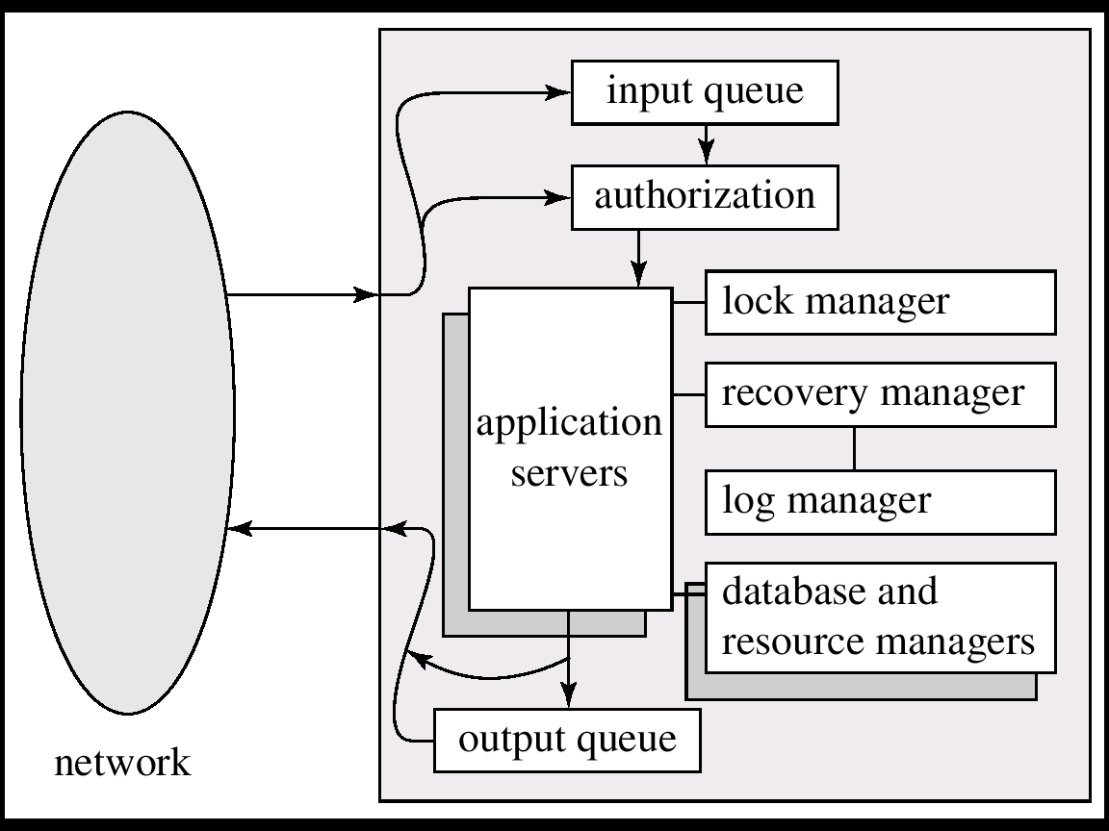
Detailed Structure of a TP Monitor

Slide 11
Detailed Structure of a TP Monitor
Queue manager handles incoming messages
Some queue managers provide durable (persistent) message queueing contents of queue are safe even if systems fails.
Durable (Persistent) queueing of outgoing messages is important
  Application server writes message to durable queue as part of a transaction
  Once the transaction commits, the TP monitor guarantees message is eventually delevered, regardless of crashes.
  ACID properties are thus provided even for messages sent outside the database
Many TP monitors provide locking, logging and recovery services, to enable application servers to implement ACID properties by themselves.

Slide 12
Application Coordination using TP Monitors
TP monitors coordinate large applications built up from relational databases, legacy systems, and communication system
A TP monitor treats each subsystem as a resource manager that provides transactional access to some set of resources.
  The interface between the TP monitor and the resource manager is defined by a set of transaction primitives
  The resource manager interface is defined by the X/Open Distributed Transaction Processing standard.
TP monitor systems provide a transactional RPC interface to their services
  Transactional RPC provides calls to enclose a series of RPC calls within a transaction
  Updates performed by an RPC are carried out within the scope of the transaction, and can be rolled back if there is any failure

Slide 13
X Open/XA 그림예제:
TP Monitor의 Distributed DB 구성

Slide 14
Transaction RPC 그림예제

Slide 15
Chapter 25: Advanced Transaction Processing
25.1 Transaction-Processing Monitors
25.2 Transactional Workflows
25.3 E-Commerce
25.4 Main Memory Databases
25.5 Real-Time Transaction Systems
25.6 Long-Duration Transactions
25.7 Transaction Management in Multidatabase systems
25.8 Summary

Slide 16
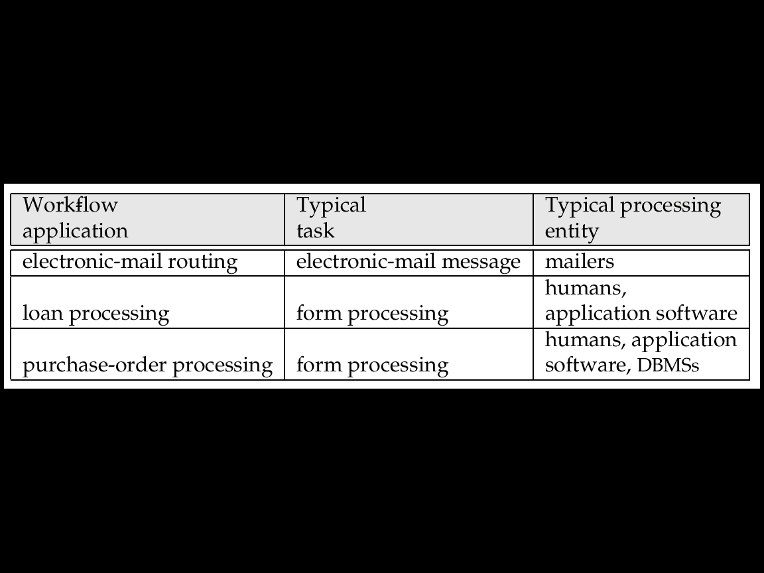
Transactional Workflows
Workflows are activities that involve the coordinated execution of multiple tasks performed by different processing entities.
With the growth of networks and the existence of multiple autonomous database systems, workflows provide a convenient way of carrying out tasks that involve multiple systems.
Example of a workflow: delivery of an email message, which goes through several mails systems to reach destination.
  Each mailer performs a series of tasks
    forwarding of the mail to the next mailer.
    If a mailer cannot deliver mail, failure must be handled semantically (delivery failure message).
Workflows usually involve humans (e.g. loan processing, or purchase order)

Slide 17
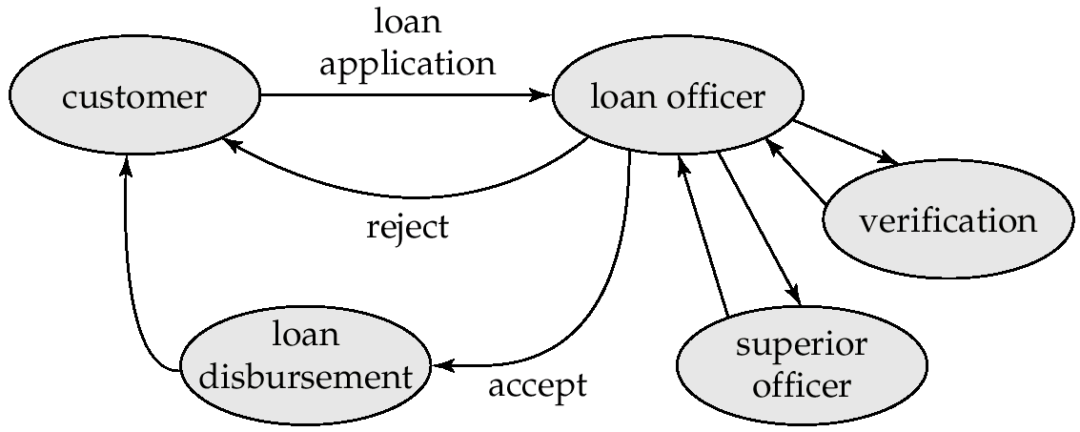
Loan Processing Workflow
In the past, workflows were handled by creating and forwarding paper forms
Computerized workflows aim to automate many of the tasks
  But the humans still play role (e.g. in approving loans.)
Disburse == Pay

Slide 18
Transactional Workflows (cont.)
Must address following issues to computerize a workflow.
  Specification of workflows - detailing the tasks that must be carried out and defining the execution requirements.
  Execution of workflows - execute transactions specified in the workflow while also providing traditional database safeguards related to the correctness of computations, data integrity, and durability.
  E.g.: Loan application should not get lost even if system fails.
Extend transaction concepts to the context of workflows
  Usual ACID transactional properties need to be relaxed
    Acceptable termination states
  Recovery of workflow involves
    Workflow component failure
    Handoff of tasks
    permanent messaging
State of a workflow - consists of the collection of states of its constituent tasks, and the states (i.e. values) of all variables in the execution plan.

Slide 19
Workflow Specification
Static specification of task coordination:
  Tasks and dependencies among them are defined before the execution of the workflow starts.
  Can establish preconditions for execution of each task: tasks are executed only when their preconditions are satisfied.
  Defined preconditions through dependencies:
    Execution states of other tasks.
➔ “task t_{i} cannot start until task t_{j} has ended”
    Output values of other tasks.
  ➔ “task t_{i} can start if task t_{j} returns a value greater than 25”
    External variables, that are modified by external events.
➔ “task t_{i} must be started within 24 hours of the completion of task t_{j}”
Dynamic task coordination
E.g. Electronic mail routing system in which the text to be schedule for a given mail message depends on the destination address and on which intermediate routers are functioning.

Slide 20
Failure-Automicity Requirements of a Workflow
Usual ACID transactional requirements are too strong / unimplementable for workflow applications.
However, workflows must satisfy some limited transactional properties that guarantee a process is not left in an inconsistent state.
Acceptable termination states - every execution of a workflow will terminate in a state that satisfies the failure-atomicity requirements defined by the designer.
  Committed - objectives of a workflow have been achieved.
  Aborted - valid termination state in which a workflow has failed to achieve its objectives.
A workflow must reach an acceptable termination state even in the presence of system failures.

Slide 21
Execution of Workflows
Execution of workflows may be controlled by a human coordinators or Workflow management systems
Workflow management systems include:
  Workflow Scheduler - program that process workflows by
    submitting various tasks for execution,
    monitoring various events and evaluation conditions related to intertask dependencies
  Task agents - control the execution of a task by a processing entity.
  Mechanism to query to state of the workflow system.

Slide 22
Workflow Management System Architectures
Centralized - a single scheduler schedules the tasks for all concurrently executing workflows.
  used in workflow systems where the data is stored in a central database.
  easier to keep track of the state of a workflow.
Partially distributed - has one (instance of a ) scheduler for each workflow.
Fully distributed - has no scheduler, but the task agents coordinate their execution by communicating with each other to satisfy task dependencies and other workflow execution requirements.
  used in simplest workflow execution systems
  based on electronic mail

Slide 23
Workflow Scheduler
Ideally scheduler should execute a workflow only after ensuring that it will terminate in an acceptable state.
Consider a workflow consisting of two tasks S₁ and S₂.
  Let the failure-atomicity requirement be that either both or neither of the subtransactions should be committed.
  Suppose systems executing S₁ and S₂ do not provide prepared-to-commit states and S₁ or S₂ do not have compensating transactions.
  It is then possible to reach a state where one subtransaction is committed and the other aborted. Both cannot then be brought to the same state.
  This workflow specification is unsafe, and should be rejected.
Determination of safety by the scheduler is not possible in general, and is usually left to the designer of the workflow.

Slide 24
Workflow scheduler 그림예제추가

Slide 25
Recovery of a Workflow
Ensure that if a failure occurs in any of the workflow-processing components, the workflow eventually reaches an acceptable termination state.
Failure-recovery routines need to restore the state information of the scheduler at the time of failure, including the information about the execution states of each task.
  Log the status information on stable storage.
Handoff of tasks between agents should occur exactly once in spite of failure.
  Repeating handoff on recovery may lead to duplicate execution of task
  Not repeating handoff may lead to task not being executed
  Solution: Persistent messaging systems
Handoff: pass by hand in rugby or american football

Slide 26
Recovery of a Workflow (Cont.)
Persistent messages: messages are stored in permanent message queue and therefore not lost in case of failure.
  Described in detail in Chapter 19 (Distributed Databases)
Before an agent commits, it writes to the persistent message queue whatever messages need to be sent out.
The persistent message system must make sure the messages get delivered eventually if and only if the transaction commits.
The message system needs to resend a message when the site recovers, if the message is not known to have reached its destination.
Messages must be logged in stable storage at the receiving end to detect multiple receipts of a message.

Slide 27
Recovery of a Workflow 그림예제 추가

Slide 28
Commercial Workflow 시스템 조사

Slide 29
Chapter 25: Advanced Transaction Processing
25.1 Transaction-Processing Monitors
25.2 Transactional Workflows
25.3 E-Commerce
25.4 Main Memory Databases
25.5 Real-Time Transaction Systems
25.6 Long-Duration Transactions
25.7 Transaction Management in Multidatabase systems
25.8 Summary

Slide 30
E-Commerce
E-commerce is the process of carrying out various activities related to commerce through electronic means
Activities include:
  Presale activities: catalogs, advertisements, etc
  Sale process: negotiations on price/quality of service
  Marketplace: e.g. stock exchange, auctions, reverse auctions
  Payment for sale
  Delivery related activities
    electronic shipping, or electronic tracking of order processing/shipping
  Customer support and post-sale service

Slide 31
E-Catalogs
Product catalogs must provide searching and browsing facilities
  Organize products into intuitive hierarchy
  Keyword search
  Help customer with comparison of products
Customization of catalog
  Negotiated pricing for specific organizations
  Special discounts for customers based on past history
    E.g. loyalty discount
  Legal restrictions on sales
    Certain items not exposed to under-age customers
  Requires extensive customer-specific information

Slide 32
E-Catalog 그림예제

Slide 33
Marketplaces
Marketplaces help in negotiating the price of a product when there are multiple sellers and buyers
Several general types of marketplaces
  Reverse auction
  Auction
  Exchange
Other more complicated types of marketplaces due to product differentiation
Database issues in supporting marketplaces:
  Authenticate bidders
  Record buyer-bids and seller-bids securely
  Communicate bids quickly to participants
    Delays can lead to financial loss to some participants
  Need to handle very large volumes of trade at times
    E.g. normally at the end of an auction

Slide 34
Types of Marketplace
Reverse auction system: single buyer, multiple sellers.
  Buyer states requirements, sellers bid for supplying items.
    Lowest bidder wins. (also known as tender system)
  Open bidding vs. closed bidding
Auction: Multiple buyers, single seller
  Simplest case: only one instance of each item is being sold
  Highest bidder for an item wins
  More complicated with multiple copies, and buyers-bid for specific number of copies
Exchange: multiple buyers, multiple sellers
  E.g., stock exchange
  Buyers specify maximum price, sellers specify minimum price
  exchange matches buy-bids and sell-bids, deciding on price for the trade
    e.g. average of buy-bids and sell-bids

Slide 35
Market Place 사이트 그림예제

Slide 36
Order Settlement
Order settlement: payment for goods and delivery
Insecure means for electronic payment: send credit card number
  Buyers may present some one else’s credit card numbers
  Seller has to be trusted to bill only for agreed-on item
  Seller has to be trusted not to pass on the credit card number to unauthorized people
Need secure payment systems
  Avoid above-mentioned problems
  Provide greater degree of privacy
    E.g. not reveal buyers identity to seller
  Ensure that anyone monitoring the electronic transmissions cannot access critical information

Slide 37
Secure Payment Systems
All information must be encrypted to prevent eavesdropping
  Public/private key encryption widely used
Must prevent person-in-the-middle attacks
  E.g. someone impersonates seller or bank/credit card company and fools buyer into revealing information
    Encrypting messages alone doesn’t solve this problem
    More on this in next slide
Three-way communication between seller, buyer and credit-card company to make payment
  Credit card company credits amount to seller
  Credit card company consolidates all payments from a buyer and collects them together
    E.g. via buyer’s bank through physical/electronic check payment
*Impersonate = pretend *fool = deceive *consolidate = combine

Slide 38
Secure Payment Systems (Cont.)
Digital certificates are used to prevent impersonation or man-in-the middle attack
  Certification agency creates digital certificate by encrypting
    e.g., seller’s public key using its own private key
    Verifies sellers identity by external means first!
  Seller sends certificate to buyer
  Customer uses public key of certification agency to decrypt certificate and find sellers public key
    Man-in-the-middle cannot send a fake public key
  Sellers public key is used for setting up secure communication
Several secure payment protocols
  E.g. Secure Electronic Transaction (SET)

Slide 39
Digital Certificate 작동원리

Slide 40
Secure Electronic Transaction 작동원리

Slide 41
Digital Cash
Credit-card payment does not provide anonymity
  The SET protocol hides buyers identity from seller
  But even with SET, buyer can be traced with help of credit card company
Digital cash systems provide anonymity similar to that provided by physical cash
  E.g. DigiCash
  Based on encryption techniques that make it impossible to find out who purchased digital cash from the bank
  Then, digital cash can be spent by the purchaser in parts
    Something like writing a check on an account whose owner is anonymous

Slide 42
Digital Cash 작동원리

Slide 43
Chapter 25: Advanced Transaction Processing
25.1 Transaction-Processing Monitors
25.2 Transactional Workflows
25.3 E-Commerce
25.4 Main Memory Databases
25.5 Real-Time Transaction Systems
25.6 Long-Duration Transactions
25.7 Transaction Management in Multidatabase systems
25.8 Summary

Slide 44
High-Performance Transaction Systems
High-performance hardware and parallelism help improve the rate of transaction processing, but are insufficient to obtain high performance:
  Disk I/O is a bottleneck
    I/O time (10 milliseconds) has not decreased at a rate comparable to the increase in processor speeds.
  Parallel transactions may attempt to read or write the same data item, resulting in data conflicts that reduce effective parallelism
We can reduce the degree to which a database system is disk-bound by increasing the size of the database buffer.

Slide 45
Main-Memory Database
Commercial 64-bit systems can support main memories of tens of gigabytes.
Memory resident data allows faster processing of transactions.
Disk-related limitations:
  Logging is a bottleneck when transaction rate is high.
  Use group-commit to reduce number of output operations (Will study two slides ahead.)
  If the update rate for modified buffer blocks is high, the disk data-transfer rate could become a bottleneck.
  If the system crashes, all of main memory is lost

Slide 46
Main Memory DBMS Architecture 그림

Slide 47
Main-Memory Database Optimizations
To reduce space overheads, main-memory databases can use structures with pointers crossing multiple pages.
  In disk databases, the I/O cost to traverse multiple pages would be excessively high.
No need to pin buffer pages in memory before data are accessed, since buffer pages will never be replaced.
Design query-processing techniques to minimize space overhead
  avoid exceeding main memory limits during query evaluation.
Improve implementation of operations such as locking and latching, so they do not become bottlenecks.
Optimize recovery algorithms, since pages rarely need to be written out to make space for other pages.
TimesTen and DataBlitz

Slide 48
Group Commit in Main-Memory DB
Idea: Instead of performing output of log records to stable storage as soon as a transaction is ready to commit, wait until
  log buffer block is full, or
  a transaction has been waiting sufficiently long after being ready to commit
Results in fewer output operations per committed transaction, and correspondingly a higher throughput.
However, commits are delayed until a sufficiently large group of transactions are ready to commit, or a transaction has been waiting long enough
  leads to slightly increased response time.
Above delay would be acceptable in high-performance transaction systems since log buffer blocks will fill up quickly.

Slide 49
Group Commit 그림예제추가

Slide 50
Commercial Main-Memory DBMS 조사

Slide 51
Chapter 25: Advanced Transaction Processing
25.1 Transaction-Processing Monitors
25.2 Transactional Workflows
25.3 E-Commerce
25.4 Main Memory Databases
25.5 Real-Time Transaction Systems
25.6 Long-Duration Transactions
25.7 Transaction Management in Multidatabase systems
25.8 Summary

Slide 52
Real-Time Transaction Systems
In systems with real-time constraints, correctness of execution involves both database consistency and the satisfaction of deadlines.
  Hard deadline – Serious problems may occur if task is not completed within deadline
  Firm deadline - The task has zero value if it completed after the deadline.
  Soft deadline - The task has diminishing value if it is completed after the deadline.
The wide variance of execution times for read and write operations on disks complicates the transaction management problem for time-constrained systems
  main-memory databases are thus often used
  Waits for locks, transaction aborts, contention for resources remain as problems even if data is in main memory
Design of a real-time system involves ensuring that enough processing power exists to meet deadline without requiring excessive hardware resources.

Slide 53
Real-Time DB 그림예제

Slide 54
Commercial Real-Time DBMS 조사

Slide 55
Chapter 25: Advanced Transaction Processing
25.1 Transaction-Processing Monitors
25.2 Transactional Workflows
25.3 E-commerce
25.4 Main Memory Databases
25.5 Real-Time Transaction Systems
25.6 Long-Duration Transactions
25.7 Transaction Management in Multidatabase systems
25.8 Summary

Slide 56
Long Duration Transactions
Traditional concurrency control techniques do not work well when user interaction is required:
  Long duration: Design edit sessions are very long
  Exposure of uncommitted data: E.g., partial update to a design data
  Subtasks: Support partial rollback
  Recoverability: On crash the state information should be restored even for yet-to-be committed data, so user work is not lost.
  Performance: Fast response time is essential so that user time is not wasted.
Nest short-duration transactions inside the long-duration transactions
    atomic database operations (read/write) at a lowest level.
  If transaction fails, only active short-duration transactions abort.
  Active long-duration transactions resume once any short duration transactions have recovered.
  The efficient management of long-duration waits and the possibility of aborts.
  Need alternatives to waits and aborts
    must ensure correctness without requiring serializability.

Slide 57
Existing CC scheme’s Adverse Effects on
Long Duration Executions (1)
Two-phase Locking
  A transaction must hold locks until the shrinking phase
  Short-duration transaction ➔ short waiting time for locks
  Long-duration transaction ➔ long waiting time for locks
  Long waiting times lead to both longer response time and an increased chance of deadlock.
Graph-based Protocols
  A transaction may have to lock more data than it needs.
  A transaction must hold a lock until there is no chance that the lock will be needed again.
  ➔ Long-duration lock waits are likely to occur.

Slide 58
Existing CC scheme’s Adverse Effects on
Long Duration Executions (2)
Timestamp-based Protocols
  Never require a transaction to wait
  However, they do require transactions to abort under certain circumstances. (for redo, the aborted transactions get a younger timestamp.)
  If a long-duration transaction is aborted, a substantial amount of work is lost. (How is your feeling if your several hours’ worth of work have been undone?)
Validations Protocols
  Like timestamp-based protocols, validation protocols enforce serializability by means of transaction abort.
Enforcement of Serializability in long-duration transactions cause
long waits & miserable recovery

Slide 59
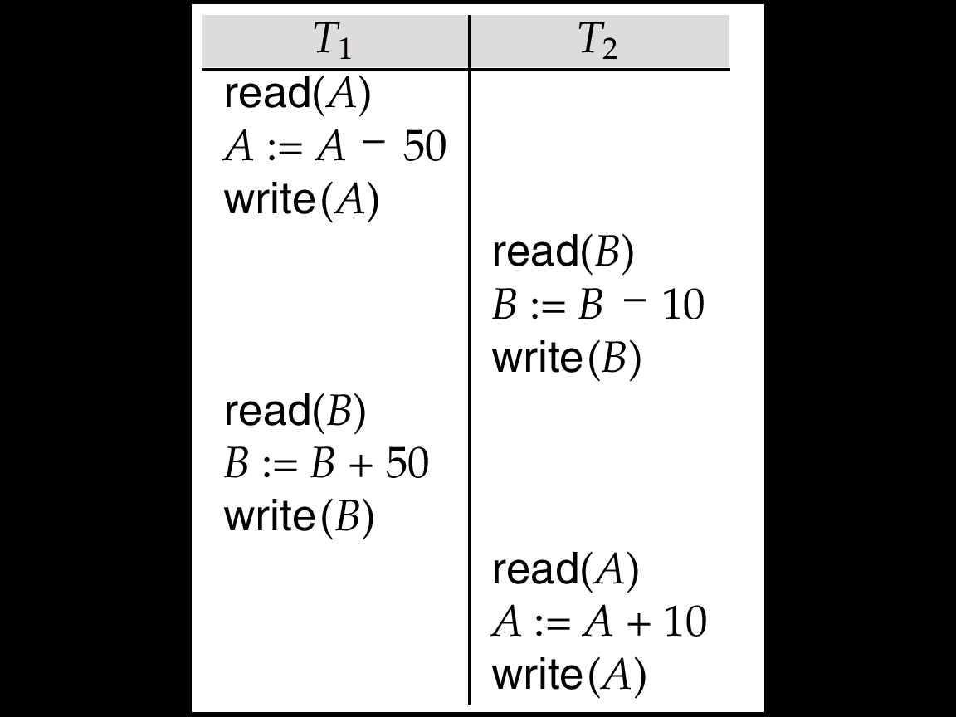
Concurrency Control in Long Duration Transactions
Correctness without serializability:
  depends on the specific consistency constraints for the databases.
  depends on the properties of operations performed by each transaction.
May use database consistency constraints as to split the database into subdatabases on which concurrency can be managed separately.
May treat some operations besides read and write as fundamental low-level operations and extend concurrency control to deal with them
May use variants of multi-version concurrency control schemes
Ex: A non-conflict-serializable schedule that preserves the sum of A + B
2PL cannot generate this schedule
If so, How about splitting T1 and T2 into smaller subtransactions!

Slide 60
Nested and Multilevel Transactions
A nested or multilevel transaction T is represented by
  a set T = {t₁, t₂, ..., t_{n}} of subtransactions and a partial order P on T (i.e., t₁ → t₂)
A subtransaction t_{i} in T may abort without forcing T to abort.
  Instead, T may either restart t_{i}, or simply choose not to run t_{i}.
If t_{i} commits, this action does not make t_{i} permanent (unlike the situation in Ch 15).
  Instead, t_{i} commits to T, and may still abort (or require compensation) if T aborts.
An execution of T must not violate the partial order P
  i.e., if an edge t_{i} → t_{j} appears in the precedence graph, then t_{j} → t_{i} must not be in the transitive closure of P.

Slide 61
Nested and Multilevel Transactions (Cont.)
Subtransactions can themselves be nested/multilevel transactions.
  Lowest level of nesting: standard read and write operations.
Nesting can create higher-level operations that may enhance concurrency.
Types of nested / multilevel transactions:
  Multilevel transaction by Linch: if a subtransaction of T is permitted to release locks on completion.
  Saga by Garcia Molina: if a multilevel transaction represents a long-duration activity.
  Nested transaction by Moss: if locks held by a subtransaction t_{i} of T are automatically assign to T on completion of t_{i}.
But we can use nested transactions and multilevel transactions interchangeably!

Slide 62
Multilevel Transaction by Linch: Example
T : multilevel transaction
T₁
T₂
Get Lock-X(A)
T_{1,1}
read(A)
A := A-50
write(A)
Release Lock-X(A)
read(B)
B := B-10
write(B)
Get Lock-X(B)
T_{2,1}
Release Lock-X(A)
T_{1,2}
read(B)
B := B+50
write(B)
Get Lock-X(B)
Release Lock-X(A)
read(A)
A := A+10
write(A)
T_{2,2}
Get Lock-X(A)
Release Lock-X(A)
Pros:
Cons:

Slide 63
Nested Transaction by Moss: Example
T : nested transaction
T₁
T₂
Get Lock-X(A)
T_{1,1}
read(A)
A := A-50
write(A)
read(B)
B := B-10
write(B)
Get Lock-X(B)
T_{2,1}
Implicitly Get Lock-X(B)
T_{1,2}
read(B)
B := B+50
write(B)
Implicitly Get Lock-X(A)
read(A)
A := A+10
write(A)
T_{2,2}
Release Lock-X(A), Lock-X(B)
Pros:
Cons:

Slide 64
Enhance Concurrency by Nested Transactions
T₁ = { A = A – 50; B = B + 50} and T₂ = { B = B – 10; A = A + 10}
Rewrite transaction T₁ using two subtransactions that perform increment or decrement operations:
  T₁ consists of
    T₁,₁, which subtracts 50 from A (A = A – 50)
    T₁,₂, which adds 50 to B (B = B + 50)
Rewrite transaction T₂ using two subtransactions that perform increment or decrement operations:
  T₂ consists of
    T₂,₁, which subtracts 10 from B (B = B – 10)
    T₂,₂, which adds 10 to A (A = A + 10)
No ordering is specified on subtransactions
  any execution of these subtransactions generates a correct result ➔ concurrency
  Note that < T₁,₁ T₂,₁ T₁,₂ T₂,₂ > is nonserialzable!

Slide 65
Compensating Transactions in Long-Duration Transactions
Compensating transactions deal with the problem of cascading rollbacks
  Alternative to undo operation;
Instead of undoing all changes made by the failed transaction, action is taken to “compensate” for the failure.
Consider a long-duration transaction T_{i} representing a travel reservation, with subtransactions
  T_{i,1}, which makes airline reservations,
  T_{i,2} which reserves rental cars, and
  T_{i,3} which reserves a hotel room.
If hotel cancels the reservation, instead of undoing all of T_{i}
  the failure of T_{i},₃ is compensated for by
    deleting the old hotel reservation and making a new one.
Compensating transactions requires use of semantics of the failed transaction.

Slide 66
Implementation Issues of
Long Duration Transactions
For long-duration transactions to survive system crashes, we must log not only changes to the database, but also changes to internal system data pertaining to these transactions.
Logging of updates is made more complex by physically large data items
  CAD design, document text
  Undesirable to store both old and new values.
Reducing the overhead of ensuring the recoverability of large data items:
  Operation logging: Only the operation performed on the data item and the data-item name are stored in the log.
  Logging and shadow paging
    Use logging from small data items and shadow paging for large data items.
    Only modified pages need to be stored in duplicate.

Slide 67
Long Duration Transaction Support in Commercial DBMS
Oracle (9i ~)
  introduces the idea of a "virtual workspace" called the Workspace Manager
  Workspace Management enables different users to modify a table and still use their own version of the data until changes are merged with the original table. (or rolled back.)
  You can either merge changes to the table with the parent, or discard these changes.
Microsoft SQL Server (2005)
  Snapshot - it is based on the concept of taking a "snapshot" of target objects affected by transactional changes at the designated point in time (when a transaction starts).
  Their original status and all subsequent changes to them are tracked using versioned rows in tempdb database.
Benefit – the ability to run multiple, parallel queries if long running transactions interfere with the need for concurrent read access to frequently updated data
Drawback – additional storage overhead, cost to maintain multiple version

Slide 68
Chapter 25: Advanced Transaction Processing
25.1 Transaction-Processing Monitors
25.2 Transactional Workflows
25.3 E-commerce
25.4 Main Memory Databases
25.5 Real-Time Transaction Systems
25.6 Long-Duration Transactions
25.7 Transaction Management in Multidatabase systems
25.8 Summary

Slide 69
Transaction Management in Multidatabase Systems (cont’d)
Local transactions are executed by each local DBMS, outside of the MDBS system control.
Global transactions are executed under multidatabase control.
Local autonomy - Local DBMSs cannot communicate directly to synchronize global transaction execution and the multidatabase has no control over local transaction execution.
  Local concurrency control scheme needed to ensure that local DBMS’s schedule is serializable
  In case of locking, local DBMS must be able to guard against local deadlocks.
  Need additional mechanisms to ensure global serializability

Slide 70
Transaction Management in Multidatabase Systems – Example
Global Transactions
Global CC Protocol?
Global Serializability
T_{i}
T_{j}
GTM
Global Commit Protocol?
LTM
LTM
Local Transactions
t_{i1} t_{j1}
t_{i2} t_{j2}
Local Transactions
Local CC Protocol C1
Local Serializability
Local CC Protocol C2
Local Serializability
A type
DBMS
B type
DBMS
GTM : Global Transaction Manager
LTM : Local Transaction Manager
Local Commit Protocol 2PC
Local Commit Protocol 3PC

Slide 71
Commit Protocols in Multidatabase Systems
In homogeneous distributed database, global atomicity is achieved if every local site follows the same commit protocols
  2 phase commit protocol or 3 phase commit protocol
Global atomic commit is complicated in multidatabase systems because of the assumption of autonomy
But local DBMS may not use 2PC during the processing a global transactions
Some compromised approaches are available (but not covered here)
  Lack of atomicity for certain failure modes

Slide 72
Concurrency Control in Multidatabase Systems
Transaction management is complicated in multidatabase systems because of the assumption of autonomy
  Global 2PL may guarantees global serializability if
    Each local site uses a strict 2PL (locks are released at the end)
    Locks set as a result of a global transaction are released only when that transaction reaches the end
But……
Due to autonomy requirements, sites cannot cooperate and execute a common concurrency control scheme
    E.g. no way to ensure that all databases follow strict 2PL
Mutidatabase CC Protocols:
  provide very low level of concurrent execution, or
  use weaker levels of consistency (so called, two-level serializability)

Slide 73
Two-Level Serializability (2LSR) in Multidatabase System
Each local DBMS ensures local serializability among its local transactions, including those that are part of a global transaction.
The multidatabase ensures serializability among global transactions alone --ignoring the orderings induced by local transactions
2LSR does not ensure global serializability, however, it can fulfill requirements for strong correctness (weaker than serializability)
  1. Preserve consistency as specified by a given set of constraints
  2. Guarantee that the set of data items read by each transaction is consistent
2LSR CC Protocols distinguish local data and global data
  Local data: data items belong to and are under the control of a particular site
  Global data: data items are under the control of the multidatabase system

Slide 74
Global Data & Local Data in Multidatabase
Global Transactions
Local Transactions
c
a b
d
Global data
Local data
Site 1
Site 2
Site n
Local constraints : ex. a+b
Global constraints : ex. c+d
Local and global constraints preserved
2SLR divides data items into local and global data items

Slide 75
Two-Level Serializability (2LSR) CC Protocols in Multidatabase System (Cont.)
Global-read protocol ensures strong correctness if all these conditions hold
  Global transactions can read, but not update, local data items
  Local transactions do not have access to global data
  There are no consistency constraints between local and global data items.
Local-read protocol ensures strong correctness if all these conditions hold
  Local transactions have read access to global data
  Disallows all access to local data by global transactions
  No transaction may have a value dependency
    A transaction has a value dependency if the value that it writes to a data item at one site depends on a value that it read for a data item on another site.
Global-read-write/local-read protocol ensures strong correctness if all these conditions hold
  Local transactions have read access to global data
  Global transactions may read and write all data
  No consistency constraints between local and global data items
  No transaction may have value dependency.

Slide 76
Global-Read Protocol 동작원리
Global Transactions
내용추가
Local Transactions
c
a b
d
Global data
Local data
Site 1
Site 2
Site n

Slide 77
Local-Read Protocol 동작원리
Global Transactions
내용추가
Local Transactions
c
a b
d
Global data
Local data
Site 1
Site 2
Site n

Slide 78
Global-Read-Write/local-read Protocol 동작원리
Global Transactions
내용추가
Local Transactions
c
a b
d
Global data
Local data
Site 1
Site 2
Site n

Slide 79
Global Serializability in Multidatabase System
Early naïve way of achieving global serializability: Read-only global transactions
Even if no information is available concerning the structure of the various concurrency control schemes, a very restrictive protocol that ensures global serializability is available
Transaction-graph
  A graph with vertices being global transaction names and site names.
  An undirected edge (T_{i}, S_{k}) exists if T_{i} is active at site S_{k}.
Global serializability is assured if transaction-graph contains no undirected cycles.
Protocol for Global Serializability
  Each site S_{i} has a special data item, called ticket
  Every transaction T_{j} that runs at site S_{k} writes to the ticket at site S_{i}
  Ensures global transactions are serialized at each site, regardless of local concurrency control method, so long as the method guarantees local serializability
  Global transaction manager decides serial ordering of global transactions by controlling order in which tickets are accessed
However, above protocol results in low concurrency between global transactions.

Slide 80
Transaction Graph in Multidatabase
Global serializable transactions
Global non-serializable transactions
S1
S2
GT1
GT3
GT2
S1
S2
GT1
GT3
GT2

Slide 81
Global Serializability Protocol – Example
T₁
T₂
Global Transactions
T₃
Local Transactions
ticket
ticket
Site2
Site1
t₁
a
b
c
t₂
Server 1 : r₁(a) w₂(a)
Not good enough
Server 2 : r₃(b) w₁(b) r₂(c) w₃(c) c₃
Server 1 : r₁(t₁)w₁(t₁++)r₁(a)c₁ r₂(t₁)w₂(t₁++)w₂(a)c₂
Server 2 : r₃(b) r₁(t₂)w₁(t₂++)w₁(b)c₁ r₂(t₂)w₂(t₂++)r₂(c) c₂ w₃(c) c₃
Each transaction is supposed to have a time stamp by reading the ticket in the site where the transaction poses its first read or write.
The global transaction manager controls ticket access with the same serializability order in all sites.

Slide 82
Chapter 25: Advanced Transaction Processing
25.1 Transaction-Processing Monitors
25.2 Transactional Workflows
25.3 E-Commerce
25.4 Main Memory Databases
25.5 Real-Time Transaction Systems
25.6 Long-Duration Transactions
25.7 Transaction Management in Multidatabase systems
25.8 Summary

Slide 83
Ch 25: Summary (1)
Workflows are activities that involve the coordinated execution of multiple tasks performed by different processing entities.
  They exist not just in computer applications, but also in almost all organizational activities.
  With the growth of networks, and the existence of multiple autonomous database systems, workflows provide a convenient way of carrying out tasks that involve multiple systems.
Although the usual ACID transactional requirements are too strong to implement for such workflow applications, workflows must satisfy a limited set of transactional properties that guarantee that a process is not left in an inconsistent state.
Transaction-processing monitors were initially developed as multithreaded servers that could service large numbers of terminals from a single process.
  They have since evolved, and today they provide the infrastructure for building and administering complex transaction-processing systems that have a large number of clients and multiple servers.
  They provide services such as durable queueing of client requests and server responses, routing of client messages to servers, persistent messaging, load balancing, and coordination of two-phase commit when transactions access multiple servers.

Slide 84
Ch 25: Summary (2)
Large main memories are exploited in certain systems to achieve high system throughput.
  In such systems, logging is a bottleneck.
  Under the group-commit concept, the number of outputs to stable storage can be reduced, thus releasing this bottleneck.
The efficient management of long-duration interactive transactions is more complex, because of the long-duration waits, and because of the possibility of aborts.
  Since the concurrency-control techniques used in Chapter 16 use waits, aborts, or both, alternative techniques must be considered.
  These techniques must ensure correctness without requiring serializability.
A long-duration transaction is represented as a nested transaction with atomic database operations at the lowest level.
  If a transaction fails, only active short-duration transactions abort.
  Active long-duration transactions resume once any short-duration transactions have received.
  A compensating transaction is needed to undo updates of nested transactions that have committed, if the outer-level transaction fails.

Slide 85
Ch 25: Summary (3)
In systems with real-time constraints, correctness of execution involves not only database consistency but also deadline satisfaction.
  The wide variance of execution times for read and write operations complicates the transaction management problem for time-constrained systems.
A multidatabase system provides an environment in which new database applications can access data from a variety of pre-existing databases located in various heterogeneous hardware and software environments.
  The local database systems may employ different logical models and data-definition and data-manipulation languages, and may differ in their concurrency-control and transaction-management mechanisms.
  A multidatabase system creates the illusion of logical database integration, without requiring physical database integration.

Slide 86
Ch 25: Bibliographical Notes (1)
Gray and Edwards[1995] provides an overview of TP monitor architectures; Gray and Reuter[1993] provides a detailed (and excellent) textbook description of transaction-processing systems, including chapters on TP monitors.
Our description of TP monitors is modeled on these two sources. X/Open[1991] defines the X/Open XA interface.
Transaction processing in Tuxedo is described in Huffman[1993]. Wipfler[1987] is one of several texts on application development using CICS.
Fischer[2001] is a handbook on workflow systems. A reference model for workflows, proposed by the Workflow Management Coalition, is presented in Hollinsworth[1994].
The Web site of the coalition is www.wfmc.org. Our description of workflows follows the model of Rusinkiewicz and Selth [1995].
Reuter[1989] presents ConTracts, a method for grouping transactions into multi-transaction activities.
Some issues related to workflows were addressed in the work on long-running activities described by Dayal et al.[1990] and Dayal et al.[1991].
The authors propose event-condition-action rules as a technique for specifying workflows.

Slide 87
Ch 25: Bibliographical Notes (2)
Jin et al. [1993] describes workflow issues in telecommunication applications.
Garcia-Molina and Salem [1992] provides an overview of main-memory databases.
Jagadish et al. [1993] describes a recovery algorithm designed for main-memory databases.
A storage manager for main-memory databases is described in Jagadish et al.[1994].
Transaction processing in real-time databases is discussed by Abbott and Garcia-Molina [1999] and Dayal et al. [1990].
Barclay et al. [1982] describes a real-time database system used in a telecommunications switching system.
Complexity and correctness issues in real-time databases are addressed by Korth et al. [1990b] and Soparkar et al. [1995].
Concurrency control and scheduling in real-time databases are discussed by Haritsa et al. [1990], Hong et al. [1993], and Pang et al. [1995].
Ozsoyoglu and Snodgrass [1995] is a survey of research in real-time and temporal databases.

Slide 88
Ch 25: Bibliographical Notes (3)
Nested and multilevel transactions are presented by Lynch[1983], Moss[1982], Moss [1985], Lynch and Merritt [1986], Fekete et al. [1990b], Fekete et al. [1990a], Korth and Speegle [1994], and Pu et al. [1988].
Theoretical aspects of multilevel transactions are presented in Lynch et al.[1988] and Weihl and Liskov [1990].
Several extended-transaction models have been defined including Sagas (Garcia-Molina and Salem [1987]), ACTA(Chrysanthis and Ramamritham [1994]), the ConTract model(Wachter and Reuter [1992]), ARIES (Mohan et al.[1992] and Rothermel and Mohan [1989]), and the NT/PV model (Korth and Speegle[1994]).
Splitting transactions to achieve higher performance is addressed in Shasha et al. [1995].
A model for concurrency in nested transactions systems is presented in Beeri et al. [1989].
Relaxation of serializability is discussed in Garcia-Molina [1983] and Sha et al .[1988].
Recovery in nested transaction systems is discussed by Moss [1987], Haerder and Rothermel [1987], Rothermel and Mohan [1989].

Slide 89
Ch 25: Bibliographical Notes (4)
Multilevel transaction management is discussed in Weikum[1991].
Gray [1981], Skarra and Zdonik [1989], Korth and Speegle [1988], and Korth and Speegle [1990] discuss long-duration transactions.
Transaction processing for long-duration transactions is considered by Weikum and Schek [1984], Haerder and Rothermel [1987], Weikum et al. [1990], and Korth et al. [1990a].
Salem et al. [1994] presents an extension of 2PL for long-duration transactions by allowing the early release of locks under certain circumstances.
Transaction processing in design and software-engineering applications is discussed in Korth et al. [1988], Kaiser [1990], and Weikum [1991].
Transaction processing in multidatabase systems is discussed in Breibart et al. [1990], Beribart et al. [1991], Beribart et al. [1992], Soparkar et al. [1991], Mehrotra et al. [1992b] and Mehrotra et al. [1992a].
The ticket scheme is presented in Georgakopoulos et al. [1994]. 2LSR is introduced in Mehrotra et al. [1991].
An earlier approach, called quasi-serializability, is presented in Du and Elmagarmid[1989].

Slide 90
Chapter 25: Advanced Transaction Processing
25.1 Transaction-Processing Monitors
25.2 Transactional Workflows
25.3 E-commerce
25.4 Main Memory Databases
25.5 Real-Time Transaction Systems
25.6 Long-Duration Transactions
25.7 Transaction Management in Multidatabase systems
25.8 Summary

Slide 91
End of Chapter

Slide 92
Weak Levels Consistency
Use alternative notions of consistency that do not ensure serializability, to improve performance.
Degree-two consistency avoids cascading aborts without necessarily ensuring serializability.
  Unlike two-phase locking, S-locks may be released at any time, and licks may be acquired at any time.
  X-locks be released until the transaction either commits or aborts.

Slide 93
Example Schedule with Degree-Two Consistency
Nonserializable schedule with degree-two consistency (Figure 20.5) where T₃ reads the value if Q before and after that value is written by T_{4.}
T₃
T₄
lock-S (Q)
read (Q)
unlock (Q)
lock-X (Q)
read (Q)
write (Q)
unlock (Q)
lock-S (Q)
read (Q)
unlock (Q)

Slide 94
Cursor Stability
Form of degree-two consistency designed for programs written in general-purpose, record-oriented languages (e.g., Pascal, C, Cobol, PL/I, Fortran).
Rather than locking the entire relation, cursor stability ensures that
  The tuple that is currently being processed by the iteration is locked in shared mode.
  Any modified tuples are locked in exclusive mode until the transaction commits.
Used on heavily accessed relations as a means of increasing concurrency and improving system performance.
Use is limited to specialized situations with simple consistency constraints.

