Slide 1
Practical RDF Chapter 2. RDF: Heart and Soul
Shelley Powers, O’Reilly
SNU IDB Lab.
Taikyoung Kim

Slide 2
Outline
The Search for Knowledge
The RDF Triple
The Basic RDF Data Model and the RDF Graph
URIs
RDF Serialization
N3
N-triples
Lingo and Vocabulary

Slide 3
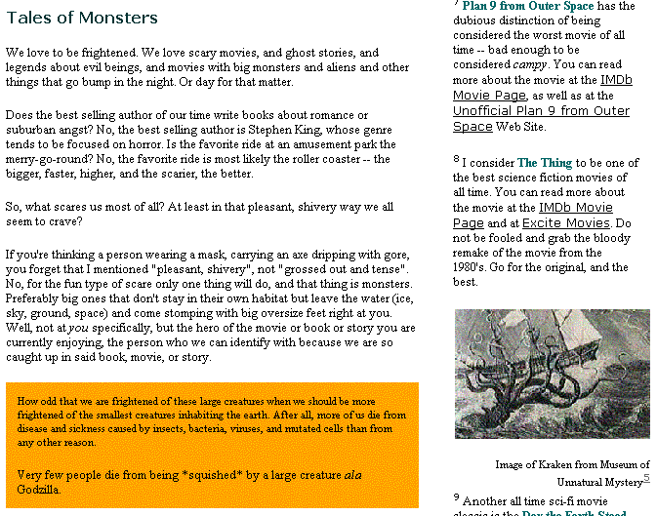
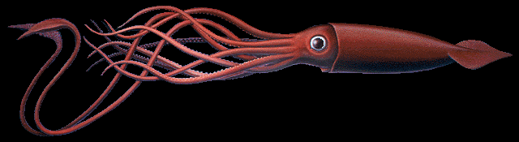

The search for knowledge (1/2)
Previous method
What is giant squid?
[Links about giant squid]
Giant squid company ..
Giant squid restaurant ..
Giant squid food ..
..
..
Legend of giant squid

Slide 4
The search for knowledge (2/2)
The reason we get so many links
Most search engine use keyword based search
Need for context based search
Attach information about the context of the resource
Ex) The article’s title is “Architeuthis Dux”
The article’s author is Shelly Powers
The article’s is part of a series
The related article is …
The article is about the giant squid and its place in the legends
RDF records data in a machine understandable format
RDF is based on a domain-neutral model

Slide 5
The RDF triple (1/3)
Three pieces of information are all that’s needed in order to fully define a single bit of knowledge
The RDF triple is what allows human understanding and meaning to be interpreted consistently and mechanically
RDF triple
Subject : something to describe
Property(predicate) : attributes, relationships
value(object) : the value associated with the property
Ex)
I(subject) have a name(property), which is Shelley Powers(property value)
I(subject) have a height(property), which is five feet eleven inches(property value)

Slide 6
The RDF triple (2/3)
The title of the article is “Architeuthis Dux”
(predicate) (subject) (object)
In RDF terms, a resource identified by URI
The title of the article at http://burningbird.net/articles/monsters1.htm is “Architeuthis Dux”
Providing a URI is equivalent to giving a person a unique identifier within a personal system
Each of the three components specifically broken out into the following format
<subject> has <predicate> <object>
Ex) http://burningbird.net/articles/monsters1.htm has a title of “Architeuthis Dux”

Slide 7
The RDF triple (3/3)
One shorthand technique
{ subject, predicate, object }
Ex){ http://burningbird.net/articles/monsters1.htm, title, “Architeuthis Dux” }
Regardless of the manner, four facts are immutable
Each RDF triple is made up of subject, predicate, and object
Each RDF triple is a complete and unique fact
An triple is a 3-tuple, which is made up of a subject, predicate, and object which are respectively a uriref or bnode; a uriref; and a uriref, bnode or literal
Each RDF triple can be joined other RDF triples, but it still retains its own unique meaning

Slide 8
The Basic RDF data model and the RDF graph (1/3)
RDF graph
RDF Core Working Group decided on it
A directed labeled graph
Graphs are extremely easy to read
RDF data model can be represented in RDF graphs
The graph consists of a set of nodes connected by arcs
Node – Arc – Node

Slide 9
The Basic RDF data model and the RDF graph (2/3)
Node of RDF graph
Uriref node : Uniform Resource Identifier(URI) that provides a specific identifier unique to the node
Blank node : nodes that don’t have a URI
Literal : literal values represent RDF objects
The arcs are directional and labeled with the predicate
Predicate is given a uriref equal to the schema for RDF vocabulary elements
http://burningbird.net/postcon/elements/1.0/title
http://burningbird.net/articles/monsters1.htm
Architeuthis Dux

Slide 10
The Basic RDF data model and the RDF graph (3/3)
Blank node example
Most tools generate a unique identifier for each blank node
http://www.w3.org/1999/02/22-rdf-syntax-ns#Subject
http://www.webreference.com/dhtml/hiemenus
http://www.w3.org/1999/02/22-rdf-syntax-ns#predicate
http://burningbird.net/schema/Contains
genid:158
http://www.w3.org/1999/02/22-rdf-syntax-ns#object
Tutorials and source code about creating
hierarchical menus in DHTML
http://www.w3.org/1999/02/22-rdf-syntax-ns#type
http://www.w3.org/1999/02/22-rdf-syntax-ns#Statement
http://burningbird.net/schema/recommendedBy
Shelley Powers

Slide 11
URIs [Uniform Resource Identifier]
The identifiers contained within a uriref
Used to identify specific predicates
Provide a common syntax for naming a resource regardless of the protocol used to access the resource
Absolute or Partial URIs
http://burningbird.net/articles/monsters1.htm
monsters1.htm
URI include fragment identifier (#)
http://burningbird.net/articles/monsters1.htm#introduction
URL(Uniform Resource Locators)
A location of an object
URN(Uniform Resource Name)
Globally unique name

Slide 12
RDF Serialization (1/4)
The basic structure of an N3(or Notation3) tuple
subject predicate object .
Ex) <http://webblog.burningbird.net/fires/000805.htm> <http://purl.org/dc/elements/1.1/creatir> Shelley.
QNames can be used instead of the full namespace
Ex) <bbd:000805.htm> dc:creator Shelley.

Slide 13
RDF Serialization (2/4)
N-Triples
N-triples is a subset of N3
It supports the same format for RDF triples
subject predicate object .
N-triples can contain comments
#comment
The subject can consist of either a uriref or a blank node identifier
_:name
The predicate is always a uriref

Slide 14
RDF Serialization (3/4)
N-Triples
http://burningbird.net/postcon/elements/1.0/title
http://burningbird.net/articles/monsters2.htm
Architeuthis Dux
Shelley Powers
http://burningbird.net/postcon/elements/1.0/author
RDF graph
<http://burningbird.net/articles/monsters2.htm> <http://burningbird.net/postcon/elements/1.0/author> “Shelly Powers” .
<http://burningbird.net/articles/monsters2.htm> <http://burningbird.net/postcon/elements/1.0/title> “Architeuthis Dux” .
N-Triples output

Slide 15
RDF Serialization (4/4)
Ex) N-triples output with generated blank node identifier
_:j0 <http://www.w3.org/1999/02/22-rdf-syntax-ns#Subject> <http://www.webreference.com/dhtml/hiemenus> .
_:j0 <http://www.w3.org/1999/02/22-rdf-syntax-ns#predicate> <http://burningbird.net/schema/Contains > .
_:j0 <http://www.w3.org/1999/02/22-rdf-syntax-ns#object> “Tutorials and source code about creating hierarchical menus in DHTML” .
_:j0 <http://www.w3.org/1999/02/22-rdf-syntax-ns#type> <http://www.w3.org/1999/02/22-rdf-syntax-ns#Staement> .
_:j0 <http://burningbird.net/schema/recommendedBy> “Shelley Powers” .

Slide 16
Lingo and vocabulary (1/2)
Graph and subgraphs
Subgraph is a subset of the triples contained in the graph
Merge of the graphs
Union of two or more RDF graphs
Blank nodes are never merged in a graph
There is no way of determining whether two nodes are same
Ground and not graph
An RDF graph is considered grounded if there are no blank nodes
Entailment
Within RDF semantics document, entailment describes two graphs, which are equal in all aspects

Slide 17
Lingo and vocabulary (2/2)
Merged RDF graph (with disconnected nodes)
http://www.w3.org/1999/02/22-rdf-syntax-ns#Subject
http://www.webreference.com/dhtml/hiemenus
http://www.w3.org/1999/02/22-rdf-syntax-ns#predicate
http://burningbird.net/schema/Contains
genid:158
http://www.w3.org/1999/02/22-rdf-syntax-ns#object
Tutorials and source code about creating
hierarchical menus in DHTML
http://www.w3.org/1999/02/22-rdf-syntax-ns#type
http://www.w3.org/1999/02/22-rdf-syntax-ns#Statement
http://burningbird.net/schema/recommendedBy
Shelley Powers
http://burningbird.net/postcon/elements/1.0/title
http://burningbird.net/articles/monsters2.htm
Architeuthis Dux
Grounded RDF Graph

