Slide 1
Chapter 24:
Advanced Data Types and New Applications

Slide 2
Database System Concepts
Chapter 1: Introduction
Part 1: Relational databases
  Chapter 2: Relational Model
  Chapter 3: SQL
  Chapter 4: Advanced SQL
  Chapter 5: Other Relational Languages
Part 2: Database Design
  Chapter 6: Database Design and the E-R Model
  Chapter 7: Relational Database Design
  Chapter 8: Application Design and Development
Part 3: Object-based databases and XML
  Chapter 9: Object-Based Databases
  Chapter 10: XML
Part 4: Data storage and querying
  Chapter 11: Storage and File Structure
  Chapter 12: Indexing and Hashing
  Chapter 13: Query Processing
  Chapter 14: Query Optimization
Part 5: Transaction management
  Chapter 15: Transactions
  Chapter 16: Concurrency control
  Chapter 17: Recovery System
Part 6: Data Mining and Information Retrieval
  Chapter 18: Data Analysis and Mining
  Chapter 19: Information Retreival
Part 7: Database system architecture
  Chapter 20: Database-System Architecture
  Chapter 21: Parallel Databases
  Chapter 22: Distributed Databases
Part 8: Other topics
  Chapter 23: Advanced Application Development
  Chapter 24: Advanced Data Types and New Applications
  Chapter 25: Advanced Transaction Processing
Part 9: Case studies
  Chapter 26: PostgreSQL
  Chapter 27: Oracle
  Chapter 28: IBM DB2
  Chapter 29: Microsoft SQL Server
Online Appendices
  Appendix A: Network Model
  Appendix B: Hierarchical Model
  Appendix C: Advanced Relational Database Model

Slide 3
Part 8: Other topics
(Chapters 23 through 25).
Chapter 23: Advanced Application Development
  covers performance benchmarks, performance tuning and standardization.
Chapter 24: Advanced Data Types and New Applications
  covers advanced data types and new applications, including temporal data, spatial and geographic data, multimedia data, and issues in the management of mobile and personal databases.
Chapter 25: Advanced Transaction Processing
  deals with advanced transaction processing. We discuss transaction-processing monitors, high-performance transaction systems, real-time transaction systems, and transactional workflows.

Slide 4
Overview: Advanced Data Types and New Applications
24.1 Motivation
24.2 Time in Databases
24.3 Spatial and Geographic Data
24.4 Multimedia Databases
24.5 Mobility and Personal Databases
24.6 Summary

Slide 5
Motivation
Temporal Data
  data about current state and past states
Spatial Data
  geographic data such as maps and associated information
  computer aided design data such as VLSI or building design
Multimedia Data:
  image, video, and audio data
  require retrieval at a steady rate, predetermined rate
  so called, continuous-media data
Mobile Data
  notebook computers, palmtop computing devices
  connected to base stations via wireless digital networks

Slide 6
Overview: Advanced Data Types and New Applications
24.1 Motivation
24.2 Time in Databases
24.3 Spatial and Geographic Data
24.4 Multimedia Databases
24.5 Mobility and Personal Databases
24.6 Summary

Slide 7
Time In Databases
While most databases tend to model reality at a point in time (at the ``current'' time), temporal databases model the states of the real world across time.
Valid time: Facts in temporal relations have associated times when they are valid in the real world, which can be represented as a union of intervals.
Transaction time: The transaction time for a fact is the time interval during which the fact is current within the database system.
In a temporal relation, each tuple has an associated time when it is true;
  The time may be either valid time or transaction time.
A bi-temporal relation stores both valid and transaction time.

Slide 8
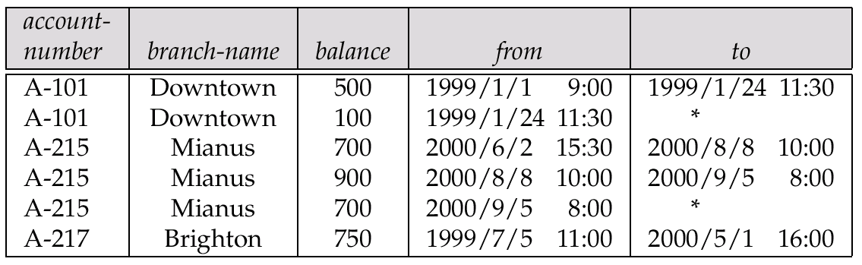
Time In Databases (Cont.)
Example of a temporal relation:
Temporal query languages have been proposed to simplify modeling of time as well as time related queries.

Slide 9
Time Specification in SQL-92
date: four digits for the year (1--9999), two digits for the month (1--12), and two digits for the date (1--31).
time: two digits for the hour, two digits for the minute, and two digits for the second, plus optional fractional digits.
timestamp
  the fields of date and time, with six fractional digits for the seconds field.
Times are specified in the Universal Coordinated Time
  abbreviated UTC (from the French);
  supports time with time zone.
Interval
  refers to a period of time (e.g., 2 days and 5 hours), without specifying a particular time when this period starts;
  could more accurately be termed a span.

Slide 10
Temporal Query Languages
Predicates precedes, overlaps, and contains on time intervals.
Intersect can be applied on two intervals, to give a single (possibly empty) interval; the union of two intervals may or may not be a single interval.
A snapshot of a temporal relation at time t consists of the tuples that are valid at time t, with the time-interval attributes projected out.
Temporal selection: involves time attributes
Temporal projection: the tuples in the projection inherit their time-intervals from the tuples in the original relation.
Temporal join: the time-interval of a tuple in the result is the intersection of the time-intervals of the tuples from which it is derived.
  If intersection is empty, tuple is discarded from join.
SQL:1999 Part 7 (SQL/Temporal) is a proposed extension to SQL:1999 to improve support of temporal data.

Slide 11
Temporal Query 예제 추가

Slide 12
Temporal Functional Dependency
Functional dependencies must be used with care
  adding a time field may invalidate functional dependency
A temporal functional dependency x → Y holds on a relation schema R if, for all legal instances r of R, all snapshots of r satisfy the functional dependency X → Y.
τ
Temporal FD가 성립하는 예제 relation 추가

Slide 13
Overview: Advanced Data Types and New Applications
24.1 Motivation
24.2 Time in Databases
24.3 Spatial and Geographic Data
24.4 Multimedia Databases
24.5 Mobility and Personal Databases
24.6 Summary

Slide 14
Spatial and Geographic Databases
Spatial databases store information related to spatial locations and support efficient storage, indexing and querying of spatial data.
Special purpose index structures are important for accessing spatial data, and for processing spatial join queries.
Computer Aided Design (CAD) databases store design information about how objects are constructed
  E.g.: designs of buildings, aircraft, layouts of integrated-circuits
Geographic databases store geographic information (e.g., maps)
  often called geographic information systems or GIS

Slide 15
Representation of Geometric Information
Various geometric constructs can be represented in a database in a normalized fashion.
Represent a line segment by the coordinates of its endpoints.
Approximate a curve by partitioning it into a sequence of segments
  Create a list of vertices in order, or
  Represent each segment as a separate tuple that also carries with it the identifier of the curve (2D features such as roads).
Closed polygons
  List of vertices in order, starting vertex is the same as the ending vertex, or
  Represent boundary edges as separate tuples, with each containing identifier of the polygon, or
  Use triangulation — divide polygon into triangles
    Note the polygon identifier with each of its triangles.

Slide 16
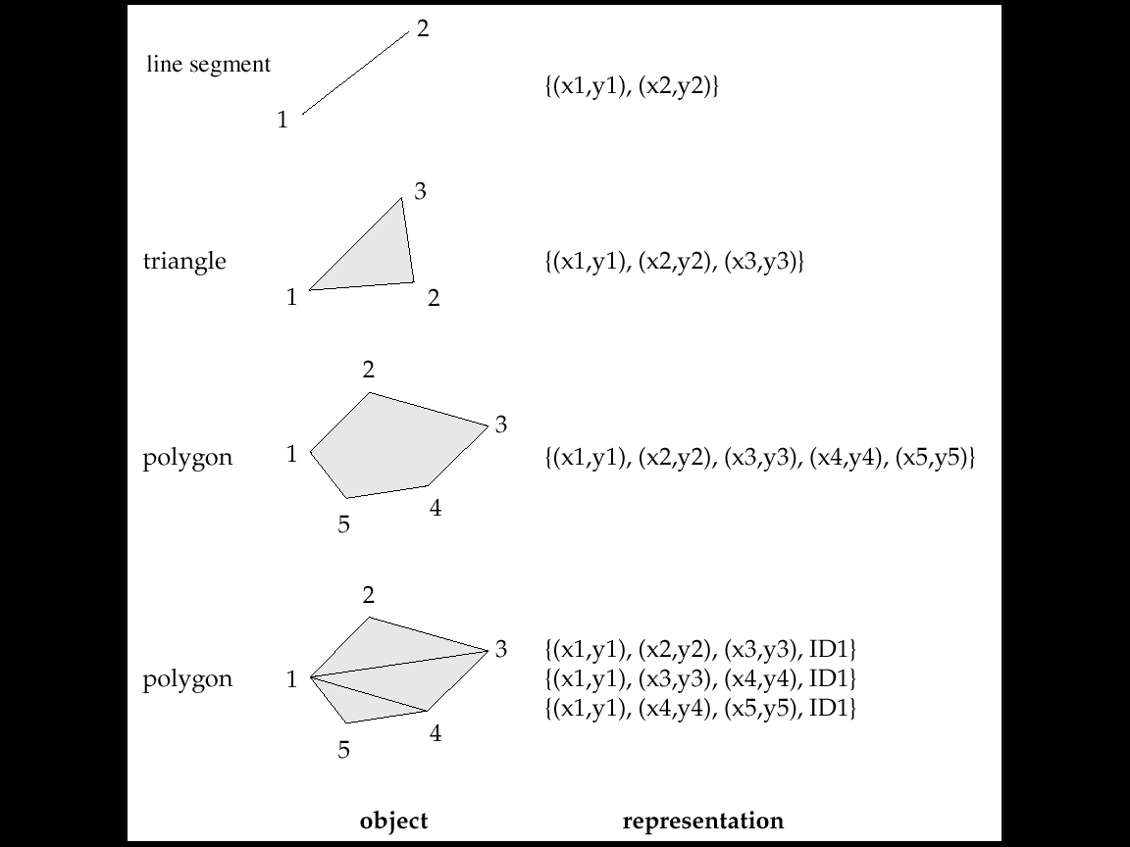
Representation of 2D Objects

Slide 17
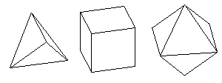
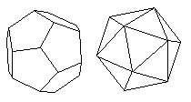
Representation of 3D Objects
Representation of points and line segment in 3-D similar to 2-D, except that points have an extra z component
Represent arbitrary polyhedra by dividing them into tetrahedrons, like triangulating polygons.
Alternative:
  List their faces, each of which is a polygon,
  along with an indication of which side of the face is inside the polyhedron.
Tetrahedra: 4면체
Polyhedra: 다면체

Slide 18

Design Databases
Represent design components as objects (generally geometric objects)
  the connections between the objects indicate how the design is structured.
Simple two-dimensional objects
  points, lines, triangles, rectangles, polygons.
Complex two-dimensional objects
  formed from simple objects via union, intersection, and difference operations.
Complex three-dimensional objects
  formed from simpler objects such as spheres, cylinders, and cuboids, by union, intersection, and difference operations.
Wireframe models represent three-dimensional surfaces as a set of simpler objects.
Sphere: 구, 지구본
Cuboid: 직평행6면체

Slide 19
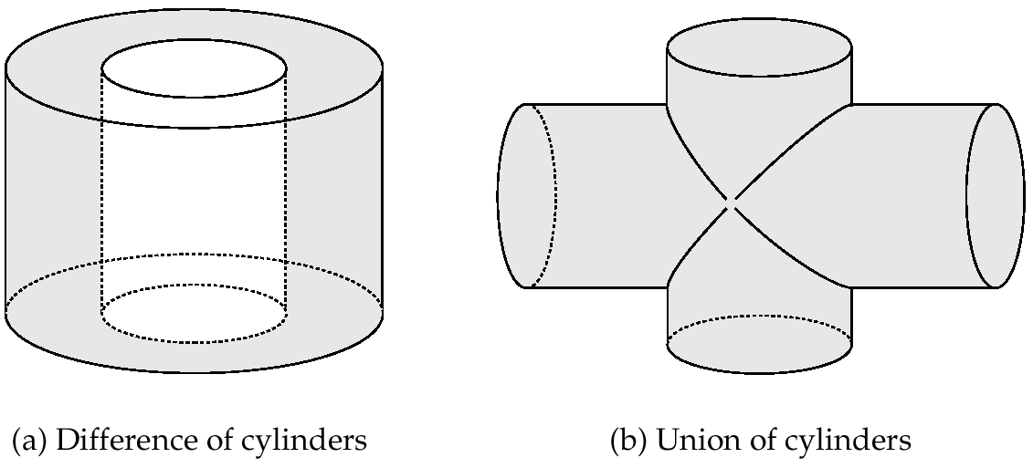
Representation of Geometric Constructs
(a) Difference of cylinders
(b) Union of cylinders
Design databases also store non-spatial information about objects (e.g., construction material, color, etc.)
Spatial integrity constraints are important.
  E.g., pipes should not intersect, wires should not be too close to each other, etc.

Slide 20
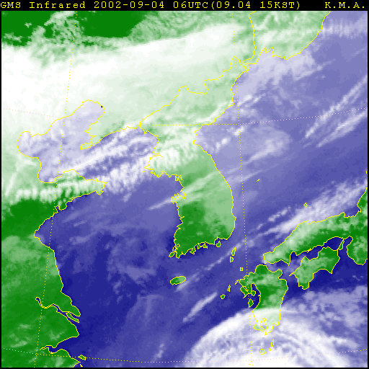
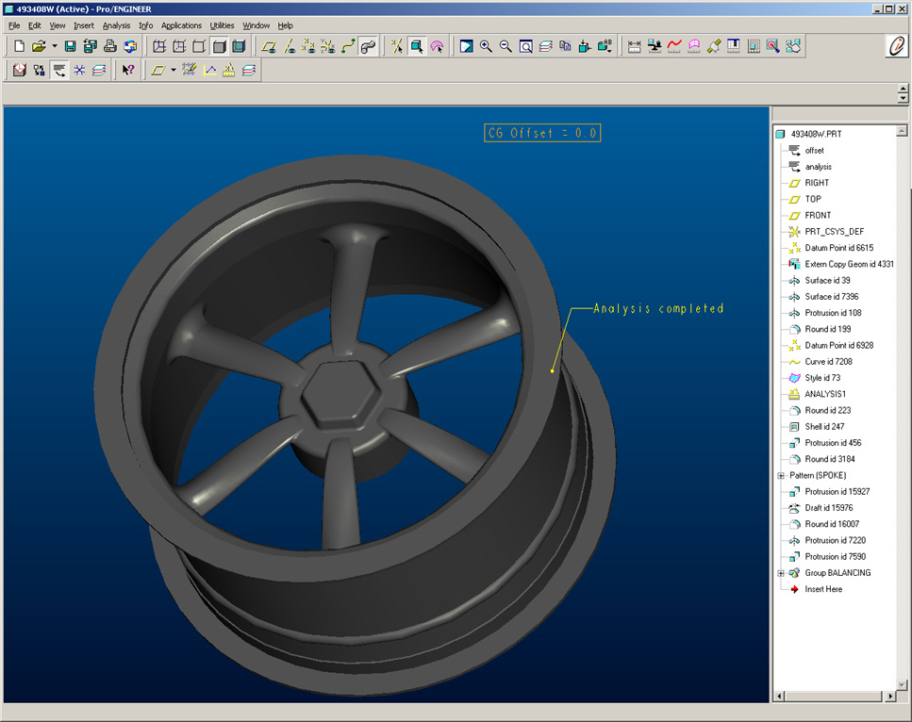
Geographic Data
Raster data consist of bit maps or pixel maps, in two or more dimensions.
  Example 2-D raster image: satellite image of cloud cover, where each pixel stores the cloud visibility in a particular area.
  Additional dimensions might include the temperature at different altitudes at different regions, or measurements taken at different points in time.
Design databases generally do not store raster data

Slide 21
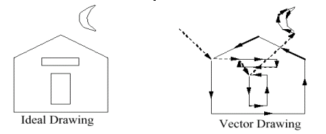
Geographic Data (Cont.)
Vector data are constructed from basic geometric objects
  points, line segments, triangles, and other polygons in two dimensions, and cylinders, speheres, cuboids, and other polyhedrons in three dimensions.
Vector format often used to represent map data.
  Roads can be considered as two-dimensional and represented by lines and curves.
  Some features, such as rivers, may be represented either as complex curves or as complex polygons, depending on whether their width is relevant.
  Features such as regions and lakes can be depicted as polygons.

Slide 22
Applications of Geographic Data
Examples of geographic data
  map data for vehicle navigation
  distribution network information for power, telephones, water supply, and sewage
Vehicle navigation systems store information about roads and services for the use of drivers:
  Spatial data: e.g, road/restaurant/gas-station coordinates
  Non-spatial data: e.g., one-way streets, speed limits, traffic congestion
Global Positioning System (GPS)
  utilizes information broadcast from GPS satellites to find the current location of user with an accuracy of tens of meters.
  increasingly used in vehicle navigation systems as well as utility maintenance applications.

Slide 23
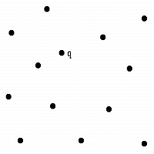
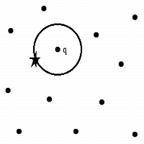
Spatial Queries
Nearness queries request objects that lie near a specified location.
  Nearest neighbor queries, given a point or an object, find the nearest object that satisfies given conditions.
Region queries deal with spatial regions.
  e.g., ask for objects that lie partially or fully inside a specified region.
  Queries that compute intersections or unions of regions.
Spatial join of two spatial relations with the location playing the role of join attribute.
Input: A set S of n points in d dimensions; a query point q.
Problem: Which point in S is closest to q?

Slide 24
Spatial Queries (Cont.)
Spatial data is typically queried using a graphical query language
  results are also displayed in a graphical manner.
Graphical interface constitutes the front-end
Extensions of SQL with abstract data types, such as lines, polygons and bit maps, have been proposed to interface with back-end.
  allows relational databases to store and retrieve spatial information
  queries can use spatial conditions (e.g. contains or overlaps)
  queries can mix spatial and nonspatial conditions

Slide 25
Indexing of Spatial Data
k-d tree - early structure used for indexing in multiple dimensions.
Each level of a k-d tree partitions the space into two.
  choose one dimension for partitioning at the root level of the tree.
  choose another dimensions for partitioning in nodes at the next level and so on, cycling through the dimensions.
In each node, approximately half of the points stored in the sub-tree fall on one side and half on the other.
Partitioning stops when a node has less than a given maximum number of points.
The k-d-B tree extends the k-d tree to allow multiple child nodes for each internal node; well-suited for secondary storage.

Slide 26
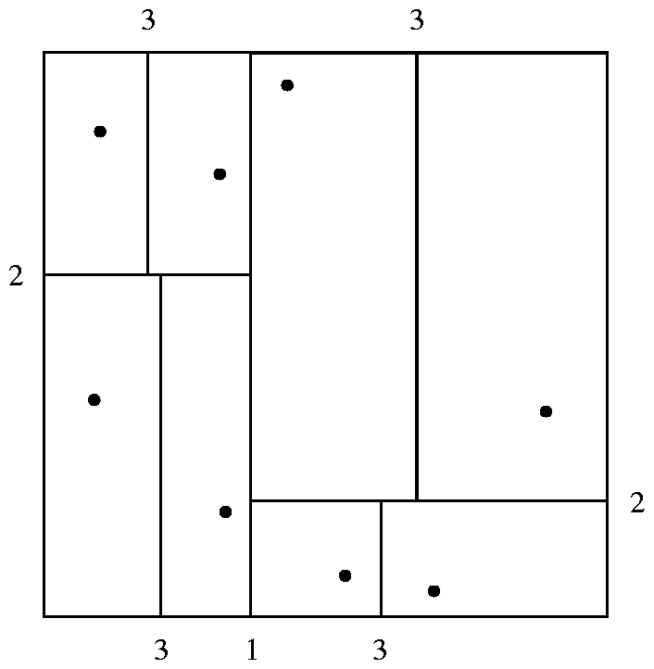
Division of Space by a k-d Tree
Each line in the figure (other than the outside box) corresponds to a node in the k-d tree
  the maximum number of points in a leaf node has been set to 1.
The numbering of the lines in the figure indicates the level of the tree at which the corresponding node appears.

Slide 27
K-D Tree 작동원리 그림예제 추가

Slide 28
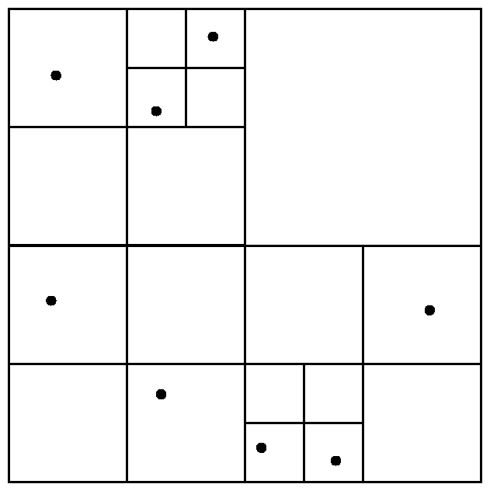
Division of Space by Quadtrees
Quadtrees
Each node of a quadtree is associated with a rectangular region of space; the top node is associated with the entire target space.
Each non-leaf nodes divides its region into four equal sized quadrants
  correspondingly each such node has four child nodes corresponding to the four quadrants and so on
Leaf nodes have between zero and some fixed maximum number of points (set to 1 in example).

Slide 29
Quad Tree 작동원리 그림예제 추가

Slide 30
Quadtrees (Cont.)
PR quadtree (Point Region Quadtree)
  stores points; space is divided based on regions, rather than on the actual set of points stored.
Region quadtrees store array (raster) information.
  A node is a leaf node if all the array values in the region that it covers are the same. Otherwise, it is subdivided further into four children of equal area, and is therefore an internal node.
  Each node corresponds to a sub-array of values.
  The sub-arrays corresponding to leaves either contain just a single array element, or have multiple array elements, all of which have the same value.
Extensions of k-d trees and PR quadtrees have been proposed to index line segments and polygons
  Require splitting segments/polygons into pieces at partitioning boundaries
    Same segment/polygon may be represented at several leaf nodes

Slide 31
Region Quad Tree 예제

Slide 32
R-Trees
R-trees are a N-dimensional extension of B⁺-trees, useful for indexing sets of rectangles and other polygons.
Supported in many modern database systems, along with variants like R⁺ -trees and R*-trees.
Basic idea: generalize the notion of a one-dimensional interval associated with each B+ -tree node to an N-dimensional interval, that is, an N-dimensional rectangle.
Will consider only the two-dimensional case (N = 2)
  generalization for N > 2 is straightforward, although R-trees work well only for relatively small N

Slide 33
B+ tree for 1-D Intervals 예제

Slide 34
R Trees (Cont.)
A rectangular bounding box is associated with each tree node.
  Bounding box of a leaf node is a minimum sized rectangle that contains all the rectangles/polygons associated with the leaf node.
  The bounding box associated with a non-leaf node contains the bounding box associated with all its children.
  Bounding box of a node serves as its key in its parent node (if any)
  Bounding boxes of children of a node are allowed to overlap
A polygon is stored only in one node, and the bounding box of the node must contain the polygon
  The storage efficiency or R-trees is better than that of k-d trees or quadtrees since a polygon is stored only once

Slide 35
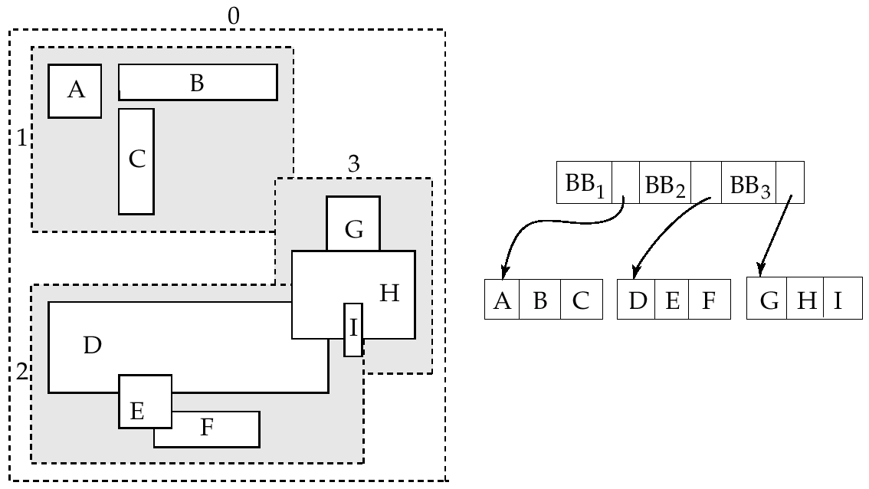
Example R-Tree
A set of rectangles (solid line) and the bounding boxes (dashed line) of the nodes of an R-tree for the rectangles.
The R-tree is shown on the right.

Slide 36
Search in R-Trees
To find data items (rectangles/polygons) intersecting (overlaps) a given query point/region, do the following, starting from the root node:
  If the node is a leaf node, output the data items whose keys intersect the given query point/region.
  Else, for each child of the current node whose bounding box overlaps the query point/region, recursively search the child
Can be very inefficient in worst case since multiple paths may need to be searched
  but works acceptably in practice.
Simple extensions of search procedure to handle predicates contained-in and contains

Slide 37
R Tree 작동원리 그림예제 추가

Slide 38
Search in R-Trees (Cont.)
P1-1
P2-1
P1-2
P2-2
Search Point

Slide 39
Insertion in R-Trees
To insert a data item:
  Find a leaf to store it, and add it to the leaf
    To find leaf, follow a child (if any) whose bounding box contains bounding box of data item, else child whose overlap with data item bounding box is maximum
  Handle overflows by splits (as in B+ -trees)
    Split procedure is different though (see below)
  Adjust bounding boxes starting from the leaf upwards
Split procedure:
  Goal: divide entries of an overfull node into two sets such that the bounding boxes have minimum total area
    This is a heuristic. Alternatives like minimum overlap are possible
  Finding the “best” split is expensive, use heuristics instead
    See next slide

Slide 40
Insertion in R-Tree: Splitting an R-Tree Node
Quadratic split divides the entries in a node into two new nodes as follows
  Find pair of entries with “maximum separation”
    that is, the pair such that the bounding box of the two would has the maximum wasted space (area of bounding box – sum of areas of two entries)
  Place these entries in two new nodes
  Repeatedly find the entry with “maximum preference” for one of the two new nodes, and assign the entry to that node
    Preference of an entry to a node is the increase in area of bounding box if the entry is added to the other node
  Stop when half the entries have been added to one node
    Then assign remaining entries to the other node
Cheaper linear split heuristic works in time linear in number of entries,
  Cheaper but generates slightly worse splits.

Slide 41
Quadratic Split in R-Tree
Maximum separation
Maximum preference (difference between increase of S1 and S2)
case1
case2
More wasted space → better pair
increase in S1
increase in S1=0
S1
S1
n2
n1
increase in S2
increase in S2
S2
S2
n2 is assigned to S1 earlier than n1

Slide 42
Deletion in R-Trees
Deletion of an entry in an R-tree done much like a B⁺-tree deletion.
  In case of underfull node, borrow entries from a sibling if possible, else merging sibling nodes
  Alternative approach removes all entries from the underfull node, deletes the node, then reinserts all entries
Deletion in R-tree 예제 추가

Slide 43
Overview: Advanced Data Types and New Applications
24.1 Motivation
24.2 Time in Databases
24.3 Spatial and Geographic Data
24.4 Multimedia Databases
24.5 Mobility and Personal Databases
24.6 Summary

Slide 44
Multimedia Databases
To provide such database functions as indexing and consistency, it is desirable to store multimedia data in a database
  rather than storing them outside the database, in a file system
The database must handle large object representation.
Similarity-based retrieval must be provided by special index structures.
Must provide guaranteed steady retrieval rates for continuous-media data.
Input Image
PREPROCESSING MODULE
Image
Input/Scanner
Feature
Extraction
Update
Index/
Database
QUERY MODULE
Feature/Image
Database
Runtime
Processor
User
Query
Interactive
Query
Formulation
Feature
Extraction
Concurrency
Control &
Recovery
Manager
Output
Retrieved
Image
Browsing&
Feedback
Feature
Matching

Slide 45
Multimedia Data Formats
Store and transmit multimedia data in compressed form
  JPEG and GIF the most widely used formats for image data.
  MPEG standard for video data use commonalties among a sequence of frames to achieve a greater degree of compression.
MPEG-1 quality comparable to VHS video tape.
  A standard for storage and retrieval of moving pictures and associated audio on storage media
  stores a minute of 30-frame-per-second video and audio in approximately 12.5 MB
MPEG-2 designed for digital broadcast systems and digital video disks; negligible loss of video quality.
  A standard for digital television
  Compresses 1 minute of audio-video to approximately 17 MB.
Several alternatives of audio encoding
  MPEG-1 Layer 3 (MP3), RealAudio, WindowsMedia format, etc.

Slide 46
Continuous-Media Data
Most important types are video and audio data
Characterized by high data volumes and real-time information-delivery requirements.
  Data must be delivered sufficiently fast that no gaps in the audio or video result
  Data must be delivered at a rate that does not cause overflow of system buffers.
  Synchronization among distinct data streams must be maintained
    Lips moving should be synchronized with the audio
Video-on-demand systems deliver video from central video servers, across a network, to terminals (Must guarantee end-to-end delivery rates)
  Current video-on-demand servers are based on file systems
    Existing database systems do not meet real-time response requirements.
    Multimedia data are stored on several disks (RAID configuration), or on tertiary storage for less frequently accessed data.
  Head-end terminals - used to view multimedia data
    PCs or TVs attached to a small, inexpensive computer called a set-top box.
  High-Capacity Network

Slide 47
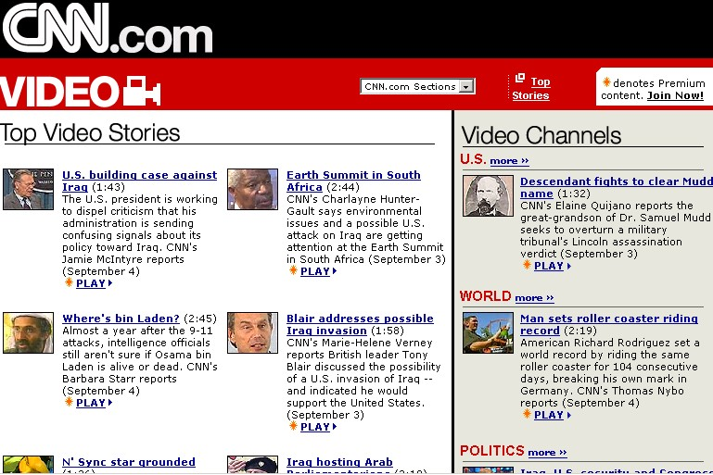
Video Servers
CNN On Demand Video Service

Slide 48
Similarity-Based Retrieval
Examples of similarity based retrieval & the notion of similarity
Pictorial data: Two pictures or images that are slightly different as represented in the database may be considered the same by a user.
  E.g., identify similar designs for registering a new trademark.
Audio data: Speech-based user interfaces allow the user to give a command or identify a data item by speaking.
  E.g., test user input against stored commands.
  Dial-by-name, voice-activated telephone system
Handwritten data: Identify a handwritten data item or command stored in the database
Main Issues
  Feature extraction
  Feature matching

Slide 49
Feature Extraction & Matching 예제추가

Slide 50
Similarity Query 예제 추가

Slide 51
Overview: Advanced Data Types and New Applications
24.1 Motivation
24.2 Time in Databases
24.3 Spatial and Geographic Data
24.4 Multimedia Databases
24.5 Mobility and Personal Databases
24.6 Summary

Slide 52
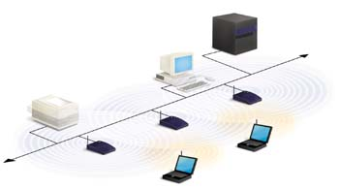
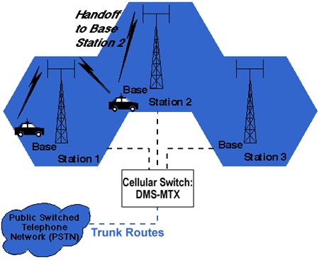
Mobile Computing Environments
A mobile computing environment consists of mobile computers, referred to as mobile hosts, and a wired network of computers.
Mobile host may be able to communicate with wired network through a wireless digital communication network
  Wireless LAN (within a building): E.g. Avaya’s Orinico Wireless LAN
  Wireless WAN (Wide areas networks)
    Cellular digital packet networks: 3 G and 2.5 G cellular networks
Wireless LAN
Cellular networks

Slide 53
Mobile Computing Environments (Cont.)
A model for mobile communication
  Mobile hosts communicate to the wired network via computers referred to as mobile support (or base) stations.
  Each mobile support station manages those mobile hosts within its cell.
  When mobile hosts move between cells, there is a handoff of control from one mobile support station to another.
Direct communication, without going through a mobile support station is also possible between nearby mobile hosts
  E.g. Supported by the Bluetooth standard (up to 10 meters, at up to 721 kbps)

Slide 54





Issues in Mobile Computing Environments
Low battery
Inconsistent data
Connection time charge
Disconnected

Slide 55
Database Issues in Mobile Computing
New issues for query optimization.
  Connection time charges and number of bytes transmitted
  Energy (battery power) is a scarce resource and its usage must be minimized
Mobile user’s locations may be a parameter of the query
  GIS queries
  Techniques to track locations of large numbers of mobile hosts
Broadcast data can enable any number of clients to receive the same data at no extra cost
  leads to interesting querying and data caching issues.
Users may need to be able to perform database updates even while the mobile computer is disconnected.
  e.g., mobile salesman records sale of products on (local copy of) database.
  Can result in conflicts detected on reconnection, which may need to be resolved manually.

Slide 56
Routing and Query Processing in Mobile DB
Must consider these competing costs:
  User time
  Communication cost
    Connection time - used to assign monetary charges in some cellular systems.
    Number of bytes, or packets, transferred - used to compute charges in digital cellular systems
    Time-of-day based charges - vary based on peak or off-peak periods
  Energy - optimize use of battery power by minimizing reception and transmission of data
    Receiving radio signals requires much less energy than transmitting radio signals.

Slide 57
Broadcast Data in Mobile DB
Mobile support stations can broadcast frequently-requested data
  Allows mobile hosts to wait for needed data, rather than having to consume energy transmitting a request
  Supports mobile hosts without transmission capability
A mobile host may optimize energy costs by determining if a query can be answered using only cached data
  If not then must either;
    Wait for the data to be broadcast
    Transmit a request for data and must know when the relevant data will be broadcast.
Broadcast data may be transmitted according to a fixed schedule or a changeable schedule.
  For changeable schedule: the broadcast schedule must itself be broadcast at a well-known radio frequency and at well-known time intervals
Data reception may be interrupted by noise
  Use techniques similar to RAID to transmit redundant data (parity)

Slide 58
Disconnectivity and Consistency in Mobile DB
A mobile host may remain in operation during periods of disconnection.
Problems created if the user of the mobile host issues queries and updates on data that resides or is cached locally:
  Recoverability
    Updates entered on a disconnected machine may be lost if the mobile host fails
    Since the mobile host represents a single point of failure, stable storage cannot be simulated well.
  Consistency
    Cached data may become out of date, but the mobile host cannot discover this until it is reconnected.

Slide 59
Mobile Updates in Mobile DB
Partitioning via disconnection is the normal mode of operation in mobile computing.
For data updated by only one mobile host, simple to propagate update when mobile host reconnects
  in other cases data may become invalid and updates may conflict.
When data are updated by other computers, invalidation reports inform a reconnected mobile host of out-of-date cache entries
  however, mobile host may miss a report
How to detect the inconsistent updates in mobile DB
  Version-numbering-based schemes guarantee detecting the inconsistent updates
  only if two hosts independently update the same version of a document by exchanging information either directly or through a common host
Clash: 충돌

Slide 60
Version Vector Scheme in Mobile DB
Version vector schemes
  were developed to deal with failures in a distributed file system, where inconsistencies are rare.
  are used to maintain a unified file system between a fixed host and a mobile computer, where updates at the two hosts have to be merged periodically.
    Also used for similar purposes in groupware systems
    In this case, a “document” may be a single record
  are used in mobile database systems where mobile users may need to perform transactions.
Version vector scheme fails to address the reconciliation of inconsistent updates
  Dealing with inconsistent updates is hard in general.
    Manual intervention often required to merge the updates.
  Inconsistencies must either be very rare, or fall in special cases that are easy to deal with in most cases
Version vector scheme requires substantial communication between a reconnecting mobile host and the host’s mobile support station

Slide 61
Detecting Inconsistent Updates in Version Vector Scheme
Version vector scheme used to detect inconsistent updates to documents at different hosts (sites).
Copies of document d at hosts i and j are inconsistent if
  the copy of document d at i contains updates performed by host k that have not been propagated to host j (k may be the same as i), and
  the copy of d at j contains updates performed by host l that have not been propagated to host i (l may be the same as j)
Basic idea:
  each host i stores, with its copy of each document d, a version vector - a set of version numbers, with an element V_{d,i} [k] for every other host k
  When a host i updates a document d, it increments the version number V_{d,i} [i] by 1

Slide 62
Detecting Inconsistent Updates in Version Vector Scheme (Cont.)
When two hosts i and j connect to each other, they check if the copies of all documents d that they share are consistent:
  If the version vectors are the same on both hosts (that is, for each k, V_{d,i} [k] = V_{d,j} [k]) then the copies of d are identical.
  If, for each k, V_{d,i} [k] ≤ V_{d,j} [k], and the version vectors are not identical, then the copy of document d at host i is older than the one at host j
    That is, the copy of document d at host j was obtained by one or more modifications of the copy of d at host i.
    Host i replaces its copy of d, as well as its copy of the version vector for d, with the copies from host j.
  If there is a pair of hosts k and m such that V_{d,i} [k] < V_{d,j} [k], and
  V_{d,i} [m] > V_{d,j} [m], then the copies are inconsistent
    That is, two or more updates have been performed on d independently.

Slide 63
Detecting Inconsistent Updates in Version Vector Scheme (Cont.)
host i
host j
identical
1
1
1
1
1
1
1
1
i has older version of document
1
1
1
1
1
2
1
2
inconsistent
1
2
1
2
2
1
1
2

Slide 64
Version Vector Scheme 동작원리 상세그림추가

Slide 65
Cell Phone DBMS: 요구사항

Slide 66
Cell Phone DBMS: Architecture

Slide 67
Flash-Memory based DBMS (1)

Slide 68
Flash-Memory based DBMS (2)

Slide 69
RFID and USN 개념

Slide 70
Database Environment for RFID and USN

Slide 71
Overview: Advanced Data Types and New Applications
24.1 Motivation
24.2 Time in Databases
24.3 Spatial and Geographic Data
24.4 Multimedia Databases
24.5 Mobility and Personal Databases
24.6 Summary

Slide 72
Ch 23: Summary (1)
Time plays an important role in database systems. Databases are models of the real world.
  Whereas most databases model the state of the real world at a point in time(at the current time), temporal databases model the states of the real world across time.
Facts in temporal relations have associated times when they are valid, which can be represented as a union of intervals.
  Temporal query languages simplify modeling of time, as well as time-related queries.
Spatial databases are finding increasing use today to store computer-aided-design data as well as geographical data.
Design data are stored primarily as vector data; geographic data consist of a combination of vector and raster data.
  Spatial-integrity constraints are important for design data.

Slide 73
Ch 23: Summary (2)
Vector data can be encoded as first-normal-form data, or can be stored using non-first-normal-form structures, such as lists.
  Special-purpose index structures are particularly important for accessing spatial data, and for processing spatial queries.
R-trees are a multidimensional expression of B-trees; with variants such as R+-trees and R*-trees, they have proved popular in spatial databases.
  Index structures that partition space in a regular fashion, such as quadtrees, help in processing spatial join queries.
Multimedia databases are growing in importance.
  Issues such as similarity-based retrieval and delivery of data at guaranteed rates are topics of current research.

Slide 74
Ch 23: Summary (3)
Mobile computing systems have become common, leading to interest in database systems that can run on such systems.
  Query processing in such systems may involve lookups on server databases.
  The query cost model must include the cost of communication, including monetary cost and battery-power cost, which is relatively high for mobile systems.
Broadcast is much cheaper per recipient than is point-to-point communication, and broadcast of data such as stock-market data helps mobile systems to pick up data inexpensively.
Disconnected operation, use of broadcast data, and caching of data are three important issues being addressed in mobile computing.

Slide 75
Ch 23: Bibliographical Notes (1)
The incorporation of time into the relational data model is discussed in Snodgrass and Ahn [1985], Clifford and Tansel [1985], Gadia [1986], Gadia [1988], Snodgrass [1987], Tensel et al. [1993], Snodgrass et al. [1994], and Tuzhilin and Clifford [1990].
Stam and Snodgrass [1988] and Soo [1991] provide surveys on temporal data management.
Jensen et al. [1994] presents a glossary of temporal-database concepts, aimed at unifying the terminology, a proposal that had significant impact on the SQL standard.
Tansel et al. [1993] is a collection of articles on different aspects of temporal databases.
Chomicki [1995] presents techniques for managing temporal integrity constraints.
A concept of completeness for temporal query languages analogous to relational completeness(euqivalence to the relational algebra) is given in Clifford et al. [1994].
Bentley [1975] describes the k-d tree, and Robinson [1981] describes the k-d B-tree.
The R-tree was originally presented in Guttman [1984].
Extensions of R-tree are presented by Sellis et al. [1987], which describes the R+ tree; Beckmann et al. [1990], which describes the R* tree; and Kamel and Faloutsos [1992], which describes a parallel version of the R-tree.

Slide 76
Ch 23: Bibliographical Notes (2)
Brinkhoff et al. [1993] discusses an implementation of spatial joins using R-trees.
Lo and Ravishankar [1996] and Patel and DeWitt [1996] present partitioning-based methods for computation of spatial joins.
Samet and Aref [1995] provides an overview of spatial data models, spatial operations, and the integration of spatial and nonspatial data.
Indexing of handwritten documents is discussed in Aref et al. [1995b], Aref et al. [1995a], and Lopresti and Tomkins [1993].
Joins of approximate data are discussed in Barbara et al. [1992].
Evangelidis et al. [1995] presents a technique for concurrent access to indices on spatial data.
Samet [1995b] provides an overview of the large amount of work in spatial index structures.
Samet [1990] provides a textbook coverage of spatial database structures.
An early description of the quad tree is provided by Finkel and Bentley [1974].
Samet [1990] and Samet [1995b] describe numerous variants of quad trees.
Samet [1995a] discribes research issues in multimedia databases.

Slide 77
Ch 23: Bibliographical Notes (3)
Indexing of multimedia data is discussed in Faloutsos and Lin [1995].
Video servers are discussed in Anderson et al. [1992], Rangan et al. [1992], Ozden et al. [1994], Freedman and DeWitt [1995], and Ozden et al. [1996b].
Fault tolerance is discussed in Berson et al. [1995] and Ozden et al. [1996a].
Reason et al. [1996] suggests alternative compression schemes for video transmission over wireless networks.
Disk storage management techniques for video data are described in Chen et al. [1995], Chevenrak et al. [1995], Ozden et al. [1995a], and Ozden et al. [1995b].
Information management in systems that include mobile computers is studied on Alonso and Korth [1993] and Imielinski and Badrinath [1994].
Imielinski and Korth [1996] presents an introduction to mobile computing and a collection of research papers on the subject. Indexing of data broadcast over wireless media is considered in Imielinski et al. [1995].
Caching of data in mobile environments is discussed in Barbara and Imielinski [1994] and Acharya et al. [1995].
Disk management in mobile computers is addressed in Douglis et al. [1994].
The version-vector scheme for detecting inconsistency in distributed file systems is described by Popek et al. [1981] and Parker et al. [1983].

Slide 78
Overview: Advanced Data Types and New Applications
24.1 Motivation
24.2 Time in Databases
24.3 Spatial and Geographic Data
24.4 Multimedia Databases
24.5 Mobility and Personal Databases
24.6 Summary

Slide 79
End of Chapter

