Slide 1
Chapter 16 : Concurrency Control

Slide 2
Database System Concepts
Chapter 1: Introduction
Part 1: Relational databases
  Chapter 2: Relational Model
  Chapter 3: SQL
  Chapter 4: Advanced SQL
  Chapter 5: Other Relational Languages
Part 2: Database Design
  Chapter 6: Database Design and the E-R Model
  Chapter 7: Relational Database Design
  Chapter 8: Application Design and Development
Part 3: Object-based databases and XML
  Chapter 9: Object-Based Databases
  Chapter 10: XML
Part 4: Data storage and querying
  Chapter 11: Storage and File Structure
  Chapter 12: Indexing and Hashing
  Chapter 13: Query Processing
  Chapter 14: Query Optimization
Part 5: Transaction management
  Chapter 15: Transactions
  Chapter 16: Concurrency control
  Chapter 17: Recovery System
Part 6: Data Mining and Information Retrieval
  Chapter 18: Data Analysis and Mining
  Chapter 19: Information Retreival
Part 7: Database system architecture
  Chapter 20: Database-System Architecture
  Chapter 21: Parallel Databases
  Chapter 22: Distributed Databases
Part 8: Other topics
  Chapter 23: Advanced Application Development
  Chapter 24: Advanced Data Types and New Applications
  Chapter 25: Advanced Transaction Processing
Part 9: Case studies
  Chapter 26: PostgreSQL
  Chapter 27: Oracle
  Chapter 28: IBM DB2
  Chapter 29: Microsoft SQL Server
Online Appendices
  Appendix A: Network Model
  Appendix B: Hierarchical Model
  Appendix C: Advanced Relational Database Model

Slide 3
Part 5: Transaction management
(Chapters 15 through 17).
Chapter 15: Transactions
  focuses on the fundamentals of a transaction-processing system, including transaction atomicity, consistency, isolation, and durability, as well as the notion of serializability.
Chapter 16: Concurrency control
  focuses on concurrency control and presents several techniques for ensuring serializability, including locking, timestamping, and optimistic (validation) techniques. The chapter also covers deadlock issues.
Chapter 17: Recovery System
  covers the primary techniques for ensuring correct transaction execution despite system crashes and disk failures. These techniques include logs, checkpoints, and database dumps.

Slide 4
Chapter 16: Concurrency Control
16.1 Lock-Based Protocols
16.2 Timestamp-Based Protocols
16.3 Validation-Based Protocols
16.4 Multiple Granularity
16.5 Multiversion Schemes
16.6 Deadlock Handling
16.7 Insert and Delete Operations
16.8 Weak Levels of Consistency
16.9 Concurrency in Index Structures
16.10 Summary and Bibliographic Notes

Slide 5
Lock-Based Protocols
A lock is a mechanism to control concurrent access to a data item
Data items can be locked in two modes :
1. exclusive (X) mode: Data item can be both read as well as written.
  X-lock is requested using lock-X instruction.
2. shared (S) mode: Data item can only be read.
  S-lock is requested using lock-S instruction.
Lock requests are made to concurrency-control manager
Transaction can proceed only after request is granted

Slide 6

Lock-Based Protocols (Cont.)
Lock-compatibility matrix
A transaction may be granted a lock on an item if the requested lock is compatible with locks already held on the item by other transactions
Any number of transactions can hold shared locks on an item, but if any transaction holds an exclusive lock on the item no other transaction may hold any lock on the item.
If a lock cannot be granted, the requesting transaction is made to wait till all incompatible locks held by other transactions have been released. The lock is then granted.

Slide 7
Lock-Based Protocols (Cont.)
Example of a transaction performing locking:
T₂: lock-S(A);
read (A);
unlock(A);
lock-S(B);
read (B);
unlock(B);
display(A+B)
Locking as above is not sufficient to guarantee serializability — if A and B get updated in-between the read of A and B, the displayed sum would be wrong.
A locking protocol is a set of rules followed by all transactions while requesting and releasing locks
Locking protocols restrict the set of possible schedules.
The locking protocol must ensure serializability.

Slide 8
Fig 16.4 Schedule for Transactions: non-serializable schedule
Sample Transactions with Locks
T1 T2 concurrency-control manager
lock-X(B)
grant-X(B, T1)
Read(B
B = B - 50;
write(B);
unlock(B);
lock-S(A)
grant-S(A, T2)
read(A)
unlock(A)
lock-S(B)
grant-S(B, T2)
read(B);
unlock(B);
display(A+B);
lock-X(A);
grant-X(A, T2)
read(A);
A = A + 50;
write(A);
unlock(A);
T1: lock-X(B) T2: lock-S(A)
read(B) read(A)
B = B -50; unlock(A)
write(B); lock-S(B)
unlock(B); read(B);
lock-X(A); unlock(B);
read(A); display(A+B);
A = A + 50;
write(A);
unlock(A);

Slide 9

Pitfalls of Lock-Based Protocols
Consider the partial schedule
Neither T₃ nor T₄ can make progress
  Executing lock-S(B) causes T₄ to wait for T₃ to release its lock on B, while executing lock-X(A) causes T₃ to wait for T₄ to release its lock on A.
Such a situation is called a deadlock.
  To handle a deadlock one of T₃ or T₄ must be rolled back and its locks must be released.
The potential for deadlock exists in most locking protocols.
Starvation is also possible if concurrency control manager is badly designed. For example:
  A transaction may be waiting for an X-lock on an item, while a sequence of other transactions request and are granted an S-lock on the same item.
  The same transaction is repeatedly rolled back due to deadlocks.
Concurrency control manager can be designed to prevent starvation.

Slide 10
The Two-Phase Locking Protocol
This is a protocol which ensures conflict-serializable schedules.
Phase 1: Growing Phase
  transaction may obtain locks
  transaction may not release locks
Phase 2: Shrinking Phase
  transaction may release locks
  transaction may not obtain locks
The protocol assures serializability.
  It can be proved that the transactions can be serialized in the order of their lock points (i.e. the point where a transaction acquired its final lock).

Slide 11
The Two-Phase Locking Protocol (Cont.)
Two-phase locking does not ensure freedom from deadlocks
Cascading roll-back is possible under two-phase locking.
Strict two-phase locking.
  Here a transaction must hold all its exclusive locks till it commits/aborts.
  No cascading rollback
Rigorous two-phase locking is even stricter:
  Here all locks (shared and exclusive) are held till commit/abort.
  No cascading rollback (of course)
  In this protocol transactions can be serialized in the order in which they commit.

Slide 12

Fig 16.8 Partial Schedule Under 2PL

Slide 13
Examples of 2PL
T1 | T2
lock-X(A)
read(A)
A←A+100
write(A)
lock-X(B)
unlock(A)
 | lock-X(A)
 | read(A)
 | A←A*2
 | write(A)
read(B)
B←B+100
write(B)
unlock(B)
 | lock-X(B)
 | unlock(A)
 | read(B)
 | B←B*2
 | wrtie(B)
 | unlock(B)
T1 | T2
lock-S(X)
A1←read(X) A1←A1-K
lock-X(X)
 | lock-S(X)
X←A1
write(X)
lock-S(Y)
A2←read(Y)
A2←A2+K
lock-X(Y)
Y←A2
write(Y)
unlock(X)
 | A1←read(X)
 | A1←A1*0.01
 | lock-X(X)
 | X←A1
 | write(X)
 | lock-S(Y)
unlock(Y)
 | A2←read(Y)
 | A2←A2*0.01
 | lock-X(Y)
 | Y←A2
 | write(Y)
 | unlock(X)
 | unlock(Y)

Slide 14
The Two-Phase Locking Protocol (Cont.)
There can be conflict serializable schedules that cannot be obtained if 2PL is used.
However, in the absence of extra information (e.g., ordering of access to data), 2PL is needed for conflict serializability in the following sense:
Given a transaction T_{i} that does not follow 2PL, we can find a transaction T_{j} that uses 2PL, and a schedule for T_{i} and T_{j} that is not conflict serializable.
Serializable schedules
Serializable
schedules
by 2PL
Serializable schedules
by other CC protocol

Slide 15
2PL with Lock Conversions
The original lock mode with (lock-X, lock-S)
  assign lock-X on a data D when D is both read and written
Two-phase locking with lock conversions:
– First Phase:
  can acquire a lock-S on item
  can acquire a lock-X on item
  can convert a lock-S to a lock-X (upgrade)
– Second Phase:
  can release a lock-S
  can release a lock-X
  can convert a lock-X to a lock-S (downgrade)
This protocol assures serializability.
The refined 2PL gets more concurrency than the original 2PL

Slide 16

Fig 16.9 Incomplete Schedule With a Lock Conversion
** Unless lock conversion, the first step “lock-S (a1)” in T8 should be “lock-X (a1)”, then T8 and T9 in the following schedule cannot be run concurrently in the original 2PL.
** However, T8 and T9 can run concurrently in the refined 2PL owing to the lock conversion
T8 | T9
lock-X (a1)
lock –S (a2) ….. lock-S (an) unlock (a1) | lock-S (a1)
 | lock-S (a2)
T8 | T9
read (a1) | read (a1)
read (a2) ….. read (an) a1 = a1 + a2 … an | read (a2) a3 = a2 – a1
write(a1)
Strict 2PL (with Lock conversions) & Rigorous 2PL (with Lock conversions) are used extensively in commercial DBMSs

Slide 17
Automatic Acquisition of Locks
A transaction T_{i} issues the standard read/write instruction, without explicit locking calls.
The operation read(D) is processed as:
if T_{i} has a lock on D
then
read(D)
else
begin
if necessary ➔ wait until no other transaction has a lock-X on D;
grant T_{i} a lock-S on D;
read(D);
end

Slide 18
Automatic Acquisition of Locks (Cont.)
write(D) is processed as:
if T_{i} has a lock-X on D
then
write(D)
else
begin
if necessary ➔ wait until no other trans. has any lock on D ;
if T_{i} has a lock-S on D
then
upgrade lock on D to lock-X
else
grant T_{i} a lock-X on D
write(D)
end;
All locks are released after commit or abort

Slide 19
Implementation of Locking
A Lock manager can be implemented as a separate process to which transactions send lock and unlock requests
The lock manager replies to a lock request by sending a lock grant messages (or a message asking the transaction to roll back, in case of a deadlock)
The requesting transaction waits until its request is answered
The lock manager maintains a data structure called a lock table to record granted locks and pending requests
The lock table is usually implemented as an in-memory hash table indexed on the name of the data item being locked
  Hashing with overflow chaining
  Lock request on item I ➔ Hashing (I) & enqueue & wait
  Lock granted
  Unlock request ➔ dequeue

Slide 20

Lock Table
Black rectangles indicate granted locks, white ones indicate waiting requests
Lock table also records the type of lock granted or requested
New request is added to the end of the queue of requests for the data item, and granted if it is compatible with all earlier locks
Unlock requests result in the request being deleted, and later requests are checked to see if they can now be granted
If transaction aborts, all waiting or granted requests of the transaction are deleted
  lock manager may keep a list of locks held by each transaction, to implement this efficiently

Slide 21

Graph-Based Protocols
Graph-based protocols are an alternative to two-phase locking
Impose a partial ordering → on the set D = {d₁, d₂ ,..., d_{h}} of all data items.
  If d_{i} → d_{j} then any transaction accessing both d_{i} and d_{j} must access d_{i} before accessing d_{j}.
  Implies that the set D may now be viewed as a directed acyclic graph (DAG), called a database graph.
The tree-protocol is a simple kind of graph protocol.
  Only exclusive locks are allowed.
  The first lock by T_{i} may be on any data item if there is no lock on the data item.
  Subsequently, a data Q can be locked by T_{i} only if the parent of Q is currently locked by T_{i}.
  Data items may be unlocked at any time.

Slide 22
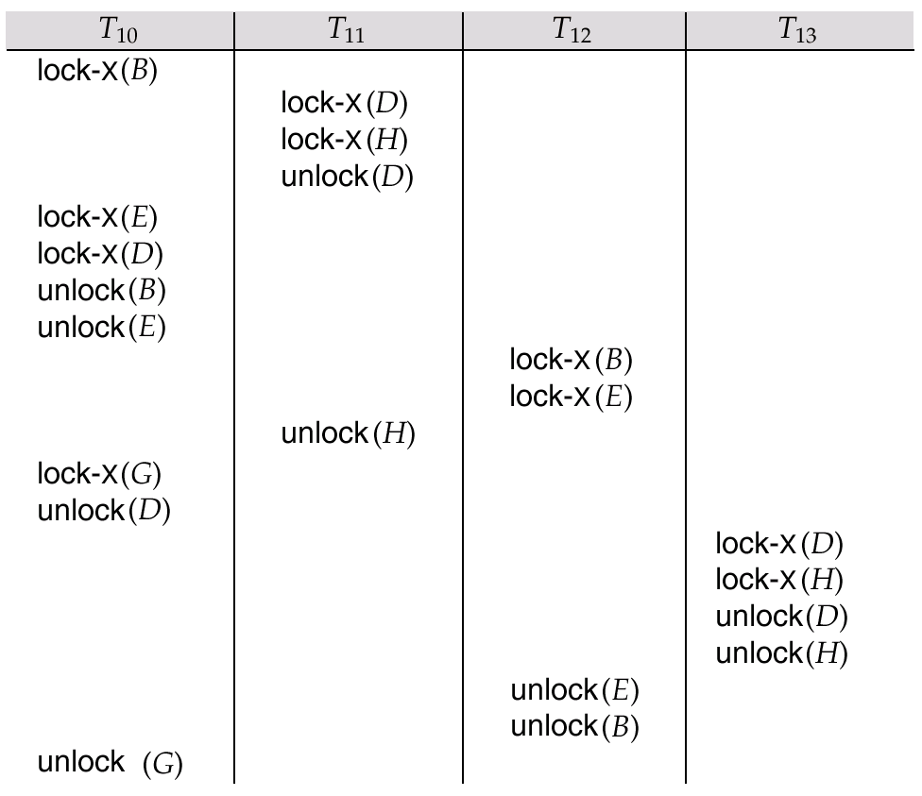
Fig 16.12 Serializable Schedule Under the Tree Protocol

Slide 23
Graph-Based Protocols (Cont.)
The tree protocol ensures conflict serializability as well as freedom from deadlock.
Unlocking may occur earlier in the tree-locking protocol than in the two-phase locking protocol.
  shorter waiting times, and increase in concurrency
  protocol is deadlock-free, no rollbacks are required
  the abort of a transaction can still lead to cascading rollbacks.
  (this correction has to be made in the book also.)
However, in the tree-locking protocol, a transaction may have to lock data items that it does not access.
  increased locking overhead and additional waiting time
  potential decrease in concurrency
Some schedules not possible under 2PL are possible under tree protocol, and vice versa.

Slide 24
Chapter 16: Concurrency Control
16.1 Lock-Based Protocols
16.2 Timestamp-Based Protocols
16.3 Validation-Based Protocols
16.4 Multiple Granularity
16.5 Multiversion Schemes
16.6 Deadlock Handling
16.7 Insert and Delete Operations
16.8 Weak Levels of Consistency
16.9 Concurrency in Index Structures
16.10 Summary and Bibliographic Notes

Slide 25
Timestamp-Based Protocols
Each transaction is issued a timestamp when it enters the system.
If an old transaction T_{i} has time-stamp TS(T_{i}), a new transaction T_{j} is assigned time-stamp TS(T_{j}) such that TS(T_{i}) < TS(T_{j}).
The protocol manages concurrent execution such that the time-stamps determine the serializability order.
In order to assure such behavior, the protocol maintains for each data Q two timestamp values:
  W-timestamp(Q) is the largest time-stamp of any transaction that executed write(Q) successfully.
  R-timestamp(Q) is the largest time-stamp of any transaction that executed read(Q) successfully.

Slide 26
Timestamp-Based Protocols (Cont.)
The timestamp ordering protocol ensures that any conflicting read and write operations are executed in timestamp order.
Suppose a transaction T_{i} issues a read(Q)
1. If TS(T_{i}) < W-timestamp(Q),
  T_{i} needs to read a value of Q that was already overwritten.
  Hence, the read operation is rejected, and T_{i} is rolled back.
2. If TS(T_{i}) ≥ W-timestamp(Q),
  The read operation is executed, and R-timestamp(Q) is set to the maximum of R-timestamp(Q) and TS(T_{i}).

Slide 27
Timestamp-Based Protocols (Cont.)
Suppose that transaction T_{i} issues a write(Q).
If TS(T_{i}) < R-timestamp(Q),
  The value of Q that T_{i} is producing was needed previously, and the system assumed that that value would never be produced.
  Hence, the write operation is rejected, and T_{i} is rolled back.
If TS(T_{i}) < W-timestamp(Q),
  Then T_{i} is attempting to write an obsolete value of Q.
  Hence, this write operation is rejected, and T_{i} is rolled back.
Otherwise, ( TS(T_{i}) ≥ R-timestamp(Q) and TS(T_{i}) ≥ W-timestamp(Q))
  The write operation is executed, and W-timestamp(Q) is set to TS(T_{i}).

Slide 28
Example Use of the Timestamp Protocol
A partial schedule for several data items for transactions with timestamps 1, 2, 3, 4, 5
younger
T₁
T₂
T₃
T₄
T₅
read(X)
read(Y)
read(Y)
write(Y)
write(Z)
read(Z)
read(X)
abort
read(X)
write(Z)
abort
write(Y)
write(Z)

Slide 29
Correctness of Timestamp-Ordering Protocol
The timestamp-ordering protocol guarantees serializability since all the arcs in the precedence graph are of the form:
Thus, there will be no cycles in the precedence graph
Timestamp protocol ensures freedom from deadlock as no transaction ever waits.
But the schedule may not be cascade-free, and may not even be recoverable.
transaction
with smaller
timestamp
transaction
with larger
timestamp

Slide 30
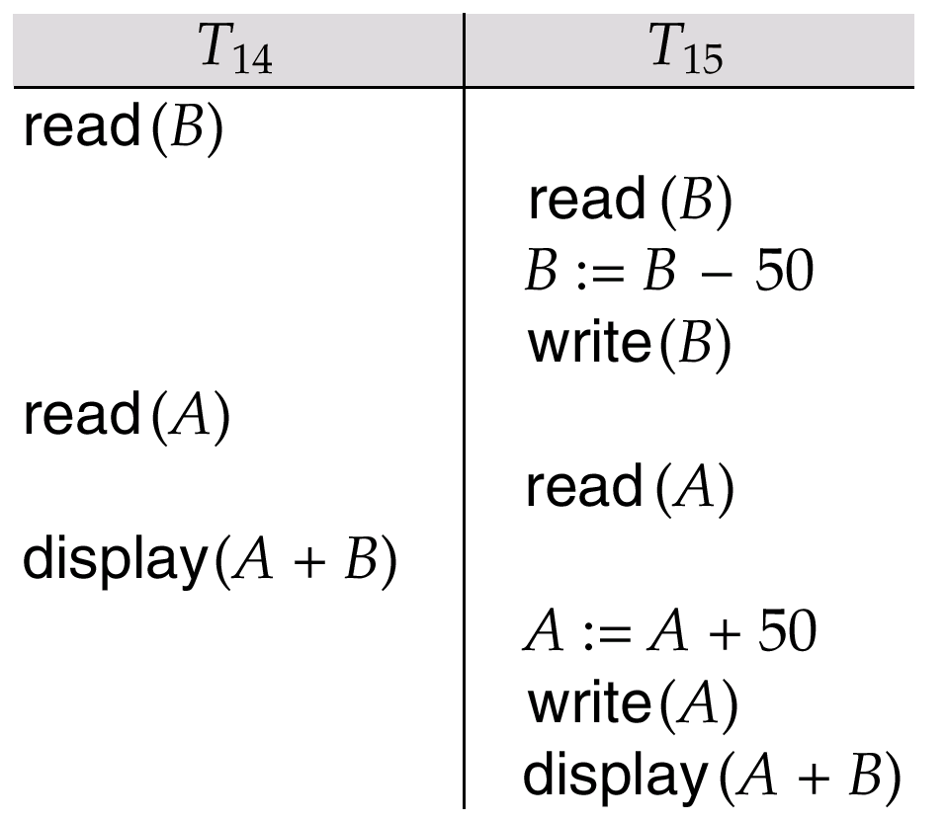
Fig 16.13 Schedule 3: Not possible under 2PL, but possible under the time stamping protocol
Should wait in 2PL

Slide 31
Recoverability and Cascade Freedom
Problem with timestamp-ordering protocol:
  Suppose T_{i} aborts, but T_{j} has read a data item written by T_{i}
  Then T_{j} must abort; if T_{j} had been allowed to commit earlier, the schedule is not recoverable.
  Further, any transaction that has read a data item written by T_{j} must abort
  This can lead to cascading rollback --- that is, a chain of rollbacks
Solution:
  A transaction is structured such that its writes are all performed at the end of its processing
  All writes of a transaction form an atomic action; no transaction may execute while a transaction is being written
Starvation problem
  A transaction that aborts is restarted with a new timestamp

Slide 32
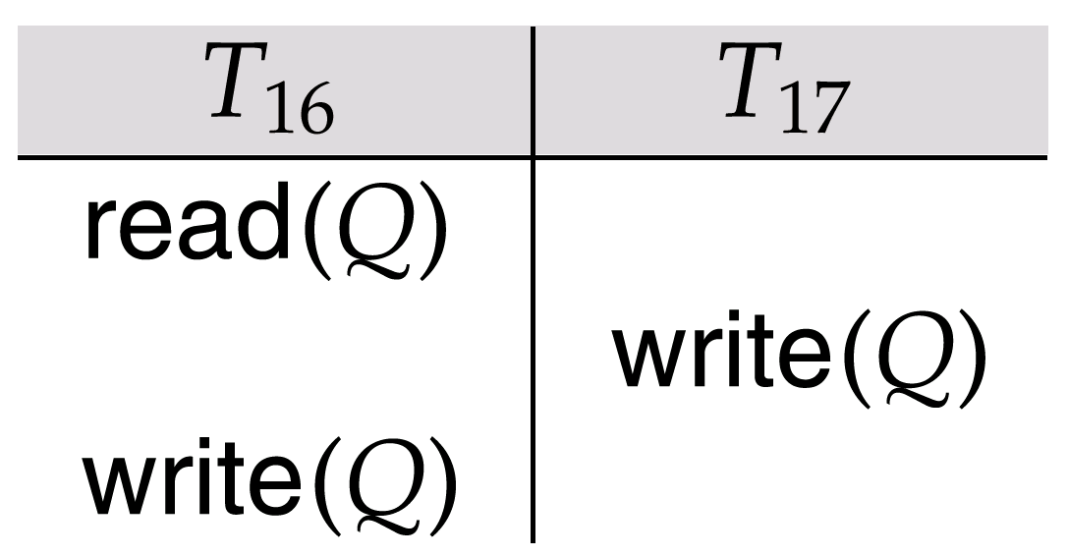
Time Stamping with Thomas’ Write Rule
Modified version of the timestamp-ordering protocol in which obsolete write operations may be ignored under certain circumstances.
When T_{i} attempts to write data item Q, if TS(T_{i}) < W-timestamp(Q), then T_{i} is attempting to write an obsolete value of {Q}.
  Hence, rather than rolling back T_{i} as the timestamp ordering protocol would have done, this “write” operation can be ignored.
Otherwise this protocol is the same as the timestamp ordering protocol.
Thomas' Write Rule allows greater potential concurrency.
  Unlike previous protocols, it allows some view-serializable schedules that are not conflict-serializable.
Fig 16.14 Schedule 4:
Not possible under 2PL, but possible in the timestamping with the Thomas’s write rule

Slide 33
Chapter 16: Concurrency Control
16.1 Lock-Based Protocols
16.2 Timestamp-Based Protocols
16.3 Validation-Based Protocols
16.4 Multiple Granularity
16.5 Multiversion Schemes
16.6 Deadlock Handling
16.7 Insert and Delete Operations
16.8 Weak Levels of Consistency
16.9 Concurrency in Index Structures
16.10 Summary and Bibliographic Notes

Slide 34
Validation-Based Protocol
Execution of transaction T_{i} is done in three phases.
1. Read and execution phase
  Transaction T_{i} writes only to temporary local variables
2. Validation phase
  Transaction T_{i} performs a ``validation test'' to determine if local variables can be written without violating serializability.
3. Write phase
  If T_{i} is validated, the updates are applied to the database; otherwise, T_{i} is rolled back.
The three phases of concurrently executing transactions can be interleaved, but each transaction must go through the three phases in that order.
Also called as optimistic concurrency control since transaction executes fully in the hope that all will go well during validation

Slide 35
Validation-Based Protocol (Cont.)
Each transaction T_{i} has 3 timestamps
Start(T_{i}) : the time when T_{i} started its execution
Validation(T_{i}): the time when T_{i} entered its validation phase
Finish(T_{i}) : the time when T_{i} finished its write phase
Serializability order is determined by timestamp given at validation time, to increase concurrency.
  Thus TS(T_{i}) is given the value of Validation(T_{i}).
This protocol is useful and gives greater degree of concurrency if probability of conflicts is low.
  That is because the serializability order is not pre-decided and relatively less transactions will have to be rolled back.

Slide 36
Validation Test for Transaction T_{j}
If for all T_{i} with TS (T_{i}) < TS (T_{j}) either one of the following conditions holds:
  finish(T_{i}) < start(T_{j})
  start(T_{j}) < finish(T_{i}) < validation(T_{j}) and the set of data items written by T_{i} does not intersect with the set of data items read by T_{j}
then validation succeeds and T_{j} can be committed.
Otherwise, validation fails and T_{j} is aborted.
Ti: start → validation → finish
Tj: start →
Ti: start → validation → finish
Tj: start → validation → finish
Justification: Either first condition is satisfied, and there is no overlapped execution, or second condition is satisfied and
1. the writes of T_{j} do not affect reads of T_{i} since they occur after T_{i} has finished its reads.
2. the writes of T_{i} do not affect reads of T_{j} since T_{j} does not read any item written by T_{i}.

Slide 37
Schedule Produced by Validation
Example of schedule produced using validation
T₁₄
T₁₅
read(B)
read(B)
B:- B-50
read(A)
A:- A+50
NOT POSSIBLE IN 2PL
read(A)
(validate)
display (A+B)
(validate)
write (B)
write (A)

Slide 38
Chapter 16: Concurrency Control
16.1 Lock-Based Protocols
16.2 Timestamp-Based Protocols
16.3 Validation-Based Protocols
16.4 Multiple Granularity
16.5 Multiversion Schemes
16.6 Deadlock Handling
16.7 Insert and Delete Operations
16.8 Weak Levels of Consistency
16.9 Concurrency in Index Structures
16.10 Summary and Bibliographic Notes

Slide 39
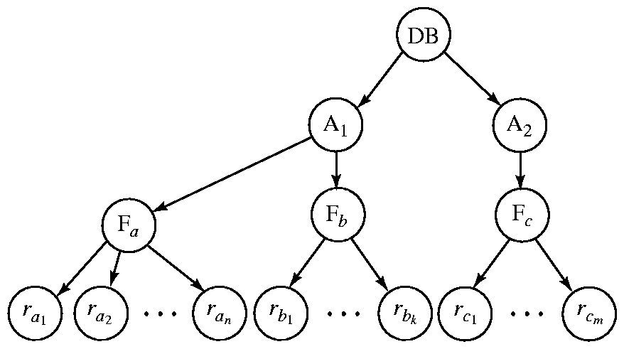
Multiple Granularity
Allow data items to be of various sizes and define a hierarchy of data granularities, where the small granularities are nested within larger ones
  Can be represented graphically as a tree (but don't confuse with tree-locking protocol)
  When a transaction locks a node in the tree explicitly, it implicitly locks all the node's descendents in the same mode.
Granularity of locking (level in tree where locking is done):
  fine granularity (lower in tree): high concurrency, high locking overhead
  coarse granularity (higher in tree): low locking overhead, low concurrency
The highest level is the entire database and then area, file and record.

Slide 40
Intention Lock Modes
In addition to S and X lock modes, there are three additional lock modes with multiple granularity:
  intention-shared (IS): indicates explicit locking at a lower level of the tree but only with shared locks.
  intention-exclusive (IX): indicates explicit locking at a lower level with exclusive or shared locks
  shared and intention-exclusive (SIX): the subtree rooted by that node is locked explicitly in shared mode and explicit locking is being done at a lower level with exclusive-mode locks.
Intention locks allow a higher level node to be locked in S or X mode without having to check all descendent nodes.

Slide 41
Compatibility Matrix with Intention Lock Modes
The compatibility matrix for all lock modes is:
Requesting
IS
IX
S
S IX
X
IS
✓
✓
✓
✓
×
IX
✓
✓
×
×
×
Holding
S
✓
×
✓
×
×
S IX
✓
×
×
×
×
X
×
×
×
×
×

Slide 42
Multiple Granularity Locking Scheme
Transaction T_{i} can lock a node Q, using the following rules:
1. The lock compatibility matrix must be observed.
2. The root of the tree must be locked first, and may be locked in any mode.
3. A node Q can be locked by T_{i} in S or IS mode only if the parent of Q is currently locked by T_{i} in either IX or IS mode.
4. A node Q can be locked by T_{i} in X, SIX, or IX mode only if the parent of Q is currently locked by T_{i} in either IX or SIX mode.
5. T_{i} can lock a node only if it has not previously unlocked any node
(that is, T_{i} is two-phase).
6. T_{i} can unlock a node Q only if none of the children of Q are currently locked by T_{i}.
Observe that locks are acquired in root-to-leaf order, whereas they are released in leaf-to-root order.

Slide 43
MGL 예제 추가

Slide 44
Chapter 16: Concurrency Control
16.1 Lock-Based Protocols
16.2 Timestamp-Based Protocols
16.3 Validation-Based Protocols
16.4 Multiple Granularity
16.5 Multiversion Schemes
16.6 Deadlock Handling
16.7 Insert and Delete Operations
16.8 Weak Levels of Consistency
16.9 Concurrency in Index Structures
16.10 Summary and Bibliographic Notes

Slide 45
Multiversion Schemes
Multiversion schemes keep old versions of data item to increase concurrency.
  Multiversion Timestamp Ordering
  Multiversion Two-Phase Locking
Each successful write results in the creation of a new version of the data item written.
Use timestamps to label versions.
When a read(Q) operation is issued, select an appropriate version of Q based on the timestamp of the transaction, and return the value of the selected version.
reads never have to wait as an appropriate version is returned immediately.

Slide 46
Multiversion Timestamp Ordering
Each data item Q has a sequence of versions <Q₁, Q₂,...., Q_{m}>.
Each version Q_{k} contains three data fields:
  Content -- the value of version Q_{k}.
  W-timestamp(Q_{k}) -- timestamp of the transaction that created (wrote) version Q_{k}
  R-timestamp(Q_{k}) -- largest timestamp of a transaction that successfully read version Q_{k}
When a transaction T_{i} creates a new version Q_{k} of Q, Q_{k}'s W-timestamp and R-timestamp are initialized to TS(T_{i}).
R-timestamp of Q_{k} is updated whenever a transaction T_{j} reads Q_{k}, and TS(T_{j}) > R-timestamp(Q_{k}).

Slide 47
Multiversion Timestamp Ordering (Cont)
The multiversion timestamp scheme presented next ensures serializability.
Suppose that transaction T_{i} issues a read(Q) or write(Q) operation.
  Let Q_{k} denote the version of Q whose write timestamp is the largest write timestamp less than or equal to TS(T_{i}).
1. If transaction T_{i} issues a read(Q), then the value returned is the content of version Q_{k}.
2. If transaction T_{i} issues a write(Q),
if TS(T_{i}) < R-timestamp(Q_{k}), then transaction T_{i} is rolled back.
Otherwise if TS(T_{i}) = W-timestamp(Q_{k}), the contents of Q_{k} are overwritten, otherwise a new version of Q is created.
Note that Reads always succeed
But a write by T_{i} is rejected if some other transaction T_{j} that (in the serialization order defined by the timestamp values) should read T_{i}'s write, has already read a version created by a transaction older than T_{i}.

Slide 48
Multiversion Timestamping 예제추가

Slide 49
Multiversion Two-Phase Locking
Differentiates between read-only transactions and update transactions
Ts-counter is a global time-stamp clock
Update transactions acquire read and write locks, and hold all locks up to the end of the transaction.
  That is, update transactions follow rigorous two-phase locking.
  Each successful write results in the creation of a new version of the data item written.
  each version of a data item has a single timestamp whose value is obtained from a counter ts-counter that is incremented during commit processing.
Read-only transactions are assigned a timestamp by reading the current value of ts-counter before they start execution
  they follow the multiversion timestamp-ordering protocol for performing reads.

Slide 50
Multiversion Two-Phase Locking (Cont.)
When an update transaction wants to read a data item,
  it obtains a shared lock on it,
  and reads the latest version.
When an update transaction wants to write an item,
  it obtains X lock on;
  it then creates a new version of the item and sets this version's timestamp to ∞ (infinity).
When an update transaction T_{i} completes, commit processing occurs:
  T_{i} sets timestamp on the versions it has created to ts-counter + 1
  T_{i} increments ts-counter by 1
Read-only transactions that start after T_{i} increments ts-counter will see the values updated by T_{i}.
Read-only transactions that start before T_{i} increments the ts-counter will see the value before the updates by T_{i}.
Only serializable schedules are produced.

Slide 51
Multiversion 2PL 예제 추가

Slide 52
Chapter 16: Concurrency Control
16.1 Lock-Based Protocols
16.2 Timestamp-Based Protocols
16.3 Validation-Based Protocols
16.4 Multiple Granularity
16.5 Multiversion Schemes
16.6 Deadlock Handling
16.7 Insert and Delete Operations
16.8 Weak Levels of Consistency
16.9 Concurrency in Index Structures
16.10 Summary and Bibliographic Notes

Slide 53
Deadlock Handling
Consider the following two transactions:
T₁: write (X) T₂: write(Y)
write(Y) write(X)
Schedule with deadlock
T₁
T₂
lock-X on X
write (X)
lock-X on Y
write (Y)
wait for lock-X on X
write(X)
wait for lock-X on Y
write(Y)

Slide 54
Deadlock Handling
System is deadlocked if there is a set of transactions such that every transaction in the set is waiting for another transaction in the set.
Deadlock prevention protocols ensure that the system will never enter into a deadlock state.
Some prevention strategies :
  Require that each transaction locks all its data items before it begins execution (predeclaration).
  Impose partial ordering of all data items
    require that a transaction can lock data items only in the order specified by the partial order (graph-based protocol).
  Timeout-Based Schemes :
    a transaction waits for a lock only for a specified amount of time.
      After the wait time is out and the transaction is rolled back. (No deadlock!)
    simple to implement; but starvation is possible
    Also difficult to determine good value of the timeout interval.
  Use timestamping (in the next slide)

Slide 55
Deadlock Prevention with Timestamps
Following schemes use transaction timestamps for the sake of deadlock prevention alone.
Wait-die scheme — non-preemptive
  Older transaction may wait for younger one to release data item.
  Younger transactions never wait for older ones; they are rolled back instead.
  A transaction may die several times before acquiring needed data item
Wound-wait scheme — preemptive
  Older transaction wounds (forces rollback of) younger transaction instead of waiting for it.
  Younger transactions may wait for older ones.
  May be fewer rollbacks than wait-die scheme.
Both in wait-die and in wound-wait schemes, a rolled back transaction is restarted with its original timestamp.
  Older transactions thus have precedence over newer ones in these schemes, and starvation is hence avoided.

Slide 56
Wait-Die & Wound Wait 예제추가

Slide 57


Deadlock Detection
Deadlocks can be described as a wait-for graph, which consists of a pair G = (V,E),
  V is a set of vertices (all the transactions in the system)
  E is a set of edges; each element is an ordered pair T_{i} →T_{j}.
If T_{i} → T_{j} is in E, then there is a directed edge from T_{i} to T_{j}
  implying that T_{i} is waiting for T_{j} to release a data item.
When T_{i} requests a data item held by T_{j}, then T_{i} → T_{j} is inserted in the wait-for graph.
  This edge is removed only when T_{j} is no longer holding a data item needed by T_{i}.
The system is in a deadlock state if and only if the wait-for graph has a cycle.
The system invokes a deadlock-detection algorithm periodically to look for cycles.
Wait-for graph without a cycle
Wait-for graph with a cycle

Slide 58
Deadlock Recovery
When deadlock is detected:
  Some transaction will have to rolled back (made a victim) to break deadlock.
    Select that transaction as victim that will incur minimum cost.
  Rollback -- determine how far to roll back transaction
    Total rollback: Abort the transaction and then restart it.
    Partial rollback: More effective to roll back transaction only as far as necessary to break deadlock.
  Starvation happens if same transaction is always chosen as victim.
    The system may include the number of rollbacks in the cost factor to avoid starvation

Slide 59
Chapter 16: Concurrency Control
16.1 Lock-Based Protocols
16.2 Timestamp-Based Protocols
16.3 Validation-Based Protocols
16.4 Multiple Granularity
16.5 Multiversion Schemes
16.6 Deadlock Handling
16.7 Insert and Delete Operations
16.8 Weak Levels of Consistency
16.9 Concurrency in Index Structures
16.10 Summary and Bibliographic Notes

Slide 60
Insert and Delete Operations
So far, we considered only reads and writes on the values of existing tuples
What about creating new data items! (Insert a new record)
T29: Select sum(balance)
From account
Where branch-name = “Perryridge”
T30: Insert into account values (A-201, “Perryridge”, 900)
Case 1: If T29 uses a new tuple by T30, T30 must come before T29
Case 2: If T29 does not use a new tuple by T30, T29 must come before T30.
  Case 2 is curious because T29 & T30 may conflict in spite of not accessing any tuple in common. (called, phantom phenomenon)
If we understand the meaning of T29 & T30 correctly, T29 and T30 should not run concurrently even though there is no common tuples in T29 and T30
  Only serial executions of {T29;T30} or {T30; T29} should be allowed
But if we just use the 2PL at the tuple granularity, we cannot enforce it!
  Arbitrarily Interleaved schedules from T29 & T30 can be generated!

Slide 61
Insert and Delete Operations (Cont.)
Observation: The transaction scanning the relation is reading information that indicates what tuples the relation contains, while a transaction inserting a tuple updates the same information.
  “The information” should be locked.
One naïve solution:
  Associate a data item with the relation, to represent the information about what tuples the relation contains.
  Transactions scanning the relation acquire a shared lock in the data item,
  Transactions inserting or deleting a tuple acquire an exclusive lock on the data item. (Note: locks on the data item do not conflict with locks on individual tuples.)
The above protocol provides very low concurrency for insertions/deletions.
Instead, Index locking protocols provide higher concurrency while preventing the phantom phenomenon, by requiring locks on certain index buckets.

Slide 62
Index Locking Protocol
Every relation must have at least one B+ tree index.
Access to a relation must be made only through one of the indices on the relation.
A transaction T_{i} that performs a lookup must lock all the index buckets that it accesses, in S-mode.
A transaction T_{i} may not insert (delete, update) a tuple t_{i} into a relation r without updating all indices to r.
  T_{i} must perform a lookup on every index to find all index buckets that could have possibly contained a pointer to tuple t_{i}, if it had existed already, and obtain locks in X-mode on all these index buckets.
  T_{i} must also obtain locks in X-mode on all index buckets that it modifies.
The rules of the 2PL protocol must be observed.
Observations
  Insertions & Deletions are all preceded by a lookup in B+ tree index
  The lookups of insertions & deletions competes with other lookups in average, sum, and so on.
Only serial executions of {T29;T30} or {T30; T29} can be allowed
Phantom phenomenon can be avoided

Slide 63
Index Locking Protocol 그림원리추가

Slide 64
Chapter 16: Concurrency Control
16.1 Lock-Based Protocols
16.2 Timestamp-Based Protocols
16.3 Validation-Based Protocols
16.4 Multiple Granularity
16.5 Multiversion Schemes
16.6 Deadlock Handling
16.7 Insert and Delete Operations
16.8 Weak Levels of Consistency
16.9 Concurrency in Index Structures
16.10 Summary and Bibliographic Notes

Slide 65
Weak Levels of Consistency
Weaker consistency ➔ More concurrency
Degree-two consistency: S-locks may be released at any time, and locks may be acquired at any time (differs from 2PL)
  Avoids cascading aborts
  X-locks must be held till the end of transaction
  Serializability is not guaranteed, programmer must ensure that no erroneous database state will occur
Cursor stability:
  A form of degree-two consistency for programs written in host language
  Instead of locking the entire relation
    For reads, each tuple is S-locked, read, and the S-lock is immediately released
    X-locks are held until the transaction commits
  Not 2PL!, so serializability is not guaranteed, but the performance improves

Slide 66
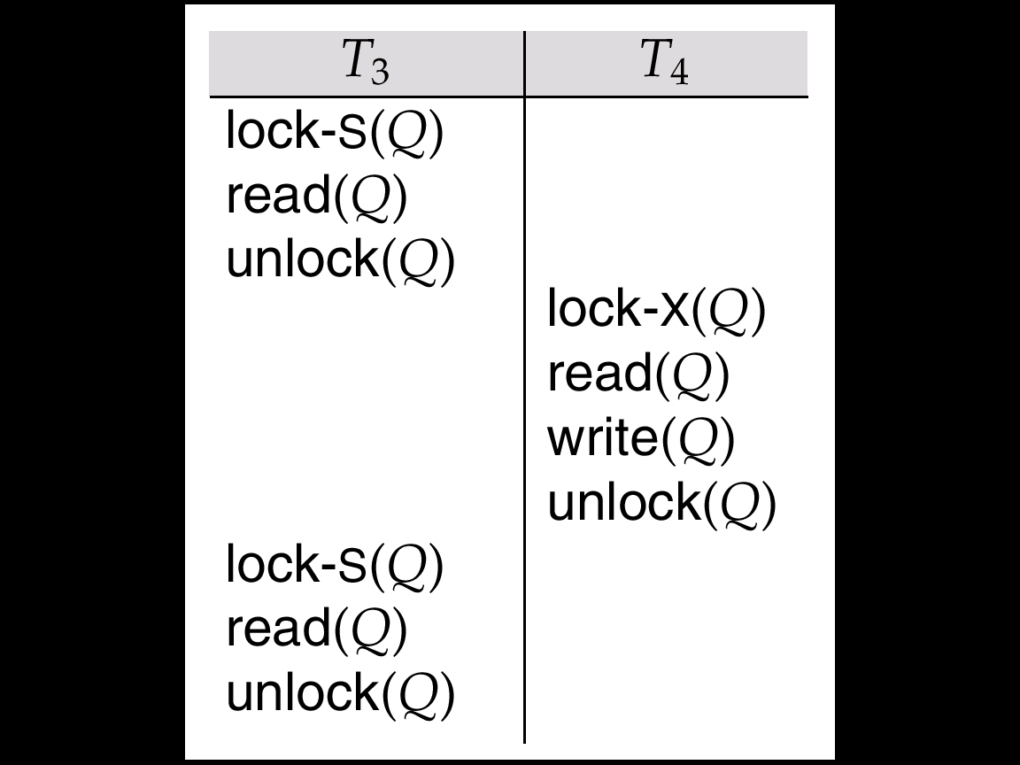
Fig 16.20 Nonserializable Schedule with Degree-Two Consistency
Beyond Serializability and 2PL
SQL allows non-serializable executions (other types of weak levels of consistency)
  Serializable: is the default
  Repeatable read: allows only committed records to be read, and repeating a read should return the same value (so read locks should be retained)
      T1 may see some records inserted by T2, but may not see others inserted by T2 (the phantom phenomenon can happen)
  Read committed: allows only committed recrods, but does not require repeatable reads
    same as degree-two consistency
    most systems implement it as cursor-stability
  Read uncommitted: allows even uncommitted data to be read

Slide 67
Weak Level Consistency 예제보충
Repeatable reads 를 보여주는 스케쥴의 예제
Read uncommitted를 보여주는 스케쥴의 예제
Cursor stability 를 보여주는 실제 host 프로그램 예제

Slide 68
Chapter 16: Concurrency Control
16.1 Lock-Based Protocols
16.2 Timestamp-Based Protocols
16.3 Validation-Based Protocols
16.4 Multiple Granularity
16.5 Multiversion Schemes
16.6 Deadlock Handling
16.7 Insert and Delete Operations
16.8 Weak Levels of Consistency
16.9 Concurrency in Index Structures
16.10 Summary and Bibliographic Notes

Slide 69

Concurrency in Index Structures
Indices are to help in accessing data (unlike other database items)
  Index-structures are accessed more frequently than other database items
  Treating index-structures like other database items leads to low concurrency
  2PL on an index may result in transactions executing practically one-at-a-time.
It is acceptable to have nonserializable concurrent access to an index as long as the accuracy of the index is maintained.
  In particular, the exact values read in an internal node of a B⁺-tree are irrelevant so long as we land up in the correct leaf node.
There are index concurrency protocols where locks on internal nodes are released early, and not in a two-phase fashion.
  Crabbing Protocol
  B-link-tree locking protocol

Slide 70
Index Concurrency Protocol
Use crabbing protocol instead of 2PL on the nodes of the B⁺-tree, as follows.
During search/insertion/deletion:
  First lock the root node in shared mode.
  After locking all required children of a node in shared mode, release the lock on the node.
  During insertion/deletion, upgrade leaf node locks to exclusive mode.
  When splitting or coalescing requires changes to a parent, lock the parent in exclusive mode.
Crabbing protocol can cause excessive deadlocks.
Better protocols are available: the B-link-tree locking protocol
  Intuition: release lock on parent before acquiring lock on child
  And deal with changes that may have happened between lock release and acquire

Slide 71
Crabbing Protocol 그림예제추가

Slide 72
B-link-tree locking protocol
교과서 pp 670, 671, 672 참고하여 이페이지를 완성하시요.
설명과 예제도 추가하시요.

Slide 73
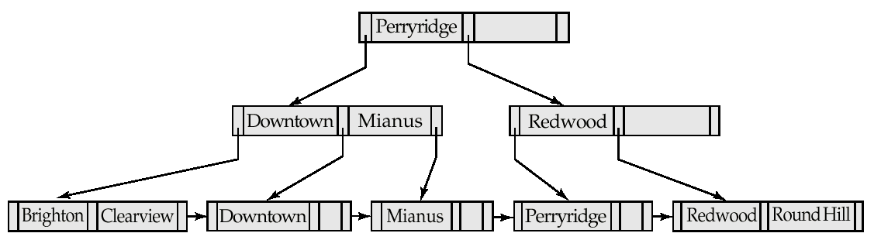
Fig 16.21 B⁺-Tree For account File with n = 3.
Fig 16.22 Insertion of “Clearview” Into the B⁺-Tree of Figure 16.21

Slide 74
Key-Value Locking & Next-Key Locking
Pp 672, 673을 참고하여 이 페이지를 완성하시요
그림과 예제도 추가하시요

Slide 75
Chapter 16: Concurrency Control
16.1 Lock-Based Protocols
16.2 Timestamp-Based Protocols
16.3 Validation-Based Protocols
16.4 Multiple Granularity
16.5 Multiversion Schemes
16.6 Deadlock Handling
16.7 Insert and Delete Operations
16.8 Weak Levels of Consistency
16.9 Concurrency in Index Structures
16.10 Summary and Bibliographic Notes

Slide 76
Ch16. Summary (1)
When several transactions execute concurrently in the database, the consistency of data may no longer be preserved.
  It is necessary for the system to control the interaction among the concurrent transactions, and this control is achieved through one of a variety of mechanisms call concurrency-control schemes.
To ensure serializability, we can use various concurrency- schemes. All these schemes either delay an operation or abort the transaction that issued the operation.
  The most common ones are locking protocols, timestapmp-ordering schemes, validation techniques, and multiversion schemes.
A locking protocol is a set of rules that state when a transaction may lock and unlock each of the data items in the database.
The two-phase locking protocol allows a transaction to lock a new data item only if that transaction has not yet unlocked any data item.
  The protocol ensures serializability, but deadlock freedom. In the absence of information concerning the manner in which data items are accessed.
  The two-phase locking protocol is both necessary and sufficient for ensuring serializability.

Slide 77
Ch16. Summary (2)
The strict two- phases locking protocol permits release of exclusive lock only at the end of transaction, in order to ensure recoverability and cascadelessness of the resulting schedules.
  The rigorous two-phase locking protocol releases all lock only at the end of the transaction.
A timestamp-ordering scheme ensures serializability by selecting an ordering in advance between every pair of transactions.
  A unique fixed timestamp is associated with each transactions in the system.
  The timestamps of the transactions determine the serializability order.
  Thus, if the timestamp of transaction Tj is smaller than the timestamp of transaction Tj then the scheme ensures that produced is equivalent to a serial schedule in which transaction Tj appears before transaction Tj.
  It does so by rolling back a transaction whenever such an order is violated.

Slide 78
Ch16. Summary (3)
A validation scheme is an appropriate concurrency-control method in cases where a majority of transactions are read-only transactions, and thus the rate of conflicts among these transactions is low.
  A unique fixed timestamp is associated with each transaction in the system.
  The serializabiliy order is determined by the timestamp of the transaction.
  A transaction in this scheme is never delayed. It must, however, pass a validation test to complete.
  If it does not pass the validation test, the system rolls it back to its initial state.
There are circumstances where it would be advantageous to group several data item, and to treat them as one aggregate data item for purposes of working, resulting in multiple levels of granularity.
  We allow data items of various sizes, and define a hierarchy of data items, where the small items are nested within larger ones.
  Such a hierarchy can be represented graphically as tree. Locks are acquired in root-to leaf order: they are released in leaf-to-root order.
  The protocol ensures serializability, but not freedom from deadlock

Slide 79
Ch16. Summary (4)
In multiversion timestamp ordering, a write operation may result in the rollback of the transaction.
  In mulitiversion two-phase locking, write operations may result in a lock wait or, possibly, in deadlock.
Various locking protocols do not guard against deadlocks.
  One way to prevent deadlock is to use an ordering of data items, and to request locks in a sequence consistent with the ordering.
Another way to prevent deadlock is to use preemption and transaction rollbacks.
  To control the preemption, we assign a unique timestamp to each transaction.
  The system uses these timestamps to decide whether a transaction should wait or roll back.
  If a transaction is rolled back, it retains its old timestamp when restarted.
  The wound-wait scheme is a preemptive scheme.

Slide 80
Ch.16 Summary (5)
If deadlocks are not prevented, the system must deal with them by using a deadlock detection and recovery scheme.
  To do so, the system constructs a wait-for graph.
  A system is in a deadlock detection algorithm determines that a deadlock exists, the system must recover from the deadlock.
  It does so by rolling back one or more transactions to break the deadlock.
A delete operation may be performed only if the transaction deleting the tuple has an exclusive lock on the tuple to be deleted.
  A transaction that inserts a new tuple inteo the database is given an exclusive lock on the tuple.
Insertions can lead to the phantom phenomenon, in which an insertion logically conflicts with a query even though the two transactions may access no tuple in common.
  Such conflict cannot be detected if locking is done only on tuples accessed by the transaction.
  Locking is required on the data used to find the tuples in the relation.
  The index-locking technique solves this problem by requiring locks on certain index buckets.
  These locks ensure that all conflicting transactions conflict on real data item, rather than on phantom.

Slide 81
Ch16. Summary (6)
Weak levels of consistency are used in some application where consistency of query results in not critical, and using serializability would result in queries adversely affecting transaction processing.
  Degree-two consistency is one such weaker level of consistency, and is widely used.
  SQL: cursor stability is a special case of degree-two consistency, and is widely used.
  SQL: 1999 allows queries to specify the level of consistency that require.
Special concurrency-control techniques can be developed for special data structures.
  Often, special techniques are applied in B⁺ tree to allow greater concurrency.
  These techniques allow nonserializable access to the B⁺ tree, but they ensure that the B⁺ tree structure is correct, and ensure that accesses to the databases itself are serializable

Slide 82
Ch.16 Bibliographical Notes (1)
Gray and Reuter[1993] provides detailed textbook coverage of transaction-processing concepts, including concurrency control concepts and implementation details.
Bernstein and Newcomer [1997] provides textbook coverage of various aspects of transaction processing including concurrency control.
Early textbook discussions of concurrency control and recovery included Papadimitriou[1986]and Bernstein et al.[1987].
An early survey paper on implementation issues in concurrency control and recovery is presented by Gray [1978]
The two-phase locking protocol was introduced by Eswarn et al.[1976].
The tree-locking protocols is from Silberschatz and Kedam[1980].
Other non-two-phase locking protocols that operate on more general graphs are described in Yannakakis et al.[1979], Kedem and Silberschatz [1983], and Buckley and Silberschatz[1985].
General discussions concerning locking protocols are offered by Lien and Weinberger[1978], Yannakakis et al.[1979], Yannakakis[1981], and Papadimitriou[1982

Slide 83
Ch16. Bibliographical Notes (2)
Korth[1983] explores various lock modes that can be obtained from the basic shared and exclusive lock modes.
Exercise 16.6 is from Buckley and Silberschatz [1984]. Exercise 16.8 is from Kedem and silberschatz [1983]. Exercise 16.9 is from Kedem and silberschatz [1979]. Exercise 16.10 is from Yannakakis et al. [1979]. Exercise 16.13 is from Korth. [1983].
The timestamp-based concurrency-control scheme is from Reed [1983].
An exposition of various timestamp-bases concurrency-control algorithms is presented by Bernstein and Goodman [1980].
A timestamp algorithm that does not require any rollback to ensure serializability is presented by Buckley and Silberschatz [1983].
The validation concurrency-control scheme is from Kung and Robinson [1981].
The locking protocol for multiple-granularity data item is from Gray et al. [1975].
A detailed description is presented by Gray et al. [1976].
The effects of locking granularity are discussed by Ries and Stonebraker. [1977].

Slide 84
Ch.16 Bibliographical Notes (3)
Korth [1983] formalizes multiple-granularity locking for an arbitrary collection of lock modes (allowing for more semantics than simply read and write). This approach includes a class of lock modes call update modes to deal with lock conversion.
Carey [1983] extends the multiple-granularity idea to timestamp-base concurrency control.
An extension of the protocol to ensure deadlock freedom is presented by Korth [1982].
Multiple-granularity locking for object-oriented database systems is discussed in Lee and Liou [1996].
Discussions concerning multiversion concurrency control are offered by Bernstein et al. [1983].
A multiversion tree-locking algorithm appears in Silberschatz [1982].
Multiversion timestamp order was introduced in Reed [1978] and Reed [1983].
Lai and Wilkinson [1984] describes a multiversion two-phase locking certifier.
Dijkstra [1965] was one of the first and most influential contributors in the dead-lock area.

Slide 85
Ch.16 Bibliographical Notes (4)
Holt [1971] and Holt [1972] were the first to formalize the notion of dead locks in terms of a graph model similar to one presented in this chapter.
An analysis of the probability waiting and deadlock is presented by Gray et al.[1981a].
Theoretical results concerning deadlocks and serializability are presented by Fussell et al. [1981] and Yannakakis [1981].
Cycle-detection algorithms can be found in standard algorithm textbooks, such as Cormen et al. [1990].
Degree-two consistency was introduced in Gray et al. [1975].
The level of consistency-or isolation-offered in SQL are explained and critiqued in Berenson et al. [1995].
Concurrency in B⁺ trees was studied by Bayer and Schkolnick [1977] and Johnson and Shasha [1993].
The techniques presented in Section 16.9 are based on kung and Lehman [1980]and Lehman and Yao [1981].

Slide 86
Ch.16 Bibliographical Notes (5)
The technique of key-value locking used in ARIES provides for very high concurrency B⁺ tree access, and is described in Mohan [1990a] and Mohan and Levine [1992].
Shasha and Goodman [1988] presents a good characterization of concurrency protocols for index structures.
Ellis [1987] presents a concurrency-control technique for linear hashing.
Lomet and Salzberg [1992] present some extensions of B-link trees.
Concurrency-control algorithms for other index structures appear in Ellis [1980a] and Ellis [1980b].

Slide 87
Chapter 16: Concurrency Control
16.1 Lock-Based Protocols
16.2 Timestamp-Based Protocols
16.3 Validation-Based Protocols
16.4 Multiple Granularity
16.5 Multiversion Schemes
16.6 Deadlock Handling
16.7 Insert and Delete Operations
16.8 Weak Levels of Consistency
16.9 Concurrency in Index Structures
16.10 Summary and Bibliographic Notes

Slide 88
End of Chapter

Slide 89
Extra Slides
Snapshot Isolation

Slide 90
Snapshot Isolation
Motivation: Decision support queries that read large amounts of data have concurrency conflicts with OLTP transactions that update a few rows
  Poor performance results
Solution 1: Give logical “snapshot” of database state to read only transactions, read-write transactions use normal locking
  Multiversion 2-phase locking
  Works well, but how does system know a transaction is read only?
Solution 2: Give snapshot of database state to every transaction, updates alone use 2-phase locking to guard against concurrent updates
  Problem: variety of anomalies such as lost update can result
  Partial solution: snapshot isolation level (next slide)
    Proposed by Berenson et al, SIGMOD 1995
    Variants implemented in many database systems
      E.g. Oracle, PostgreSQL, SQL Server 2005

Slide 91
Snapshot Isolation
A transaction T1 executing with Snapshot Isolation
  takes snapshot of committed data at start
  always reads/modifies data in its own snapshot
  updates of concurrent transactions are not visible to T1
  writes of T1 complete when it commits
  First-committer-wins rule:
    Commits only if no other concurrent transaction has already written data that T1 intends to write.
T1 | T2 | T3
W(Y := 1) Commit
 | Start R(X) → 0 R(Y)→ 1
 |  | W(X:=2) W(Z:=3) Commit
 | R(Z) → 0 R(Y) → 1 W(X:=3) Commit-Req Abort
Concurrent updates not visible
Own updates are visible
Not first-committer of X
Serialization error, T2 is rolled back

Slide 92
Benefits of SI
Reading is never blocked,
  and also doesn’t block other txns activities
Performance similar to Read Committed
Avoids the usual anomalies
  No dirty read
  No lost update
  No non-repeatable read
  Predicate based selects are repeatable (no phantoms)
Problems with SI
  SI does not always give serializable executions
    Serializable: among two concurrent txns, one sees the effects of the other
    In SI: neither sees the effects of the other
  Result: Integrity constraints can be violated

Slide 93
Snapshot Isolation
E.g. of problem with SI
  T1: x:=y
  T2: y:= x
  Initially x = 3 and y = 17
    Serial execution: x = ??, y = ??
    if both transactions start at the same time, with snapshot isolation: x = ?? , y = ??
Called skew write
Skew also occurs with inserts
  E.g:
    Find max order number among all orders
    Create a new order with order number = previous max + 1

Slide 94
Snapshot Isolation Anomalies
SI breaks serializability when txns modify different items, each based on a previous state of the item the other modified
  Not very commin in practice
    Eg. the TPC-C benchmark runs correctly under SI
    when txns conflict due to modifying different data, there is usually also a shared item they both modify too (like a total quantity) so SI will abort one of them
  But does occur
    Application developers should be careful about write skew
SI can also cause a read-only transaction anomaly, where read-only transaction may see an inconsistent state even if updaters are serializable
  We omit details

Slide 95
SI In Oracle and PostgreSQL
Warning: SI used when isolation level is set to serializable, by Oracle and PostgreSQL
  PostgreSQL’s implementation of SI described in Section 26.4.1.3
  Oracle implements “first updater wins” rule (variant of “first committer wins”)
    concurrent writer check is done at time of write, not at commit time
    Allows transactions to be rolled back earlier
  Neither supports true serializable execution
Can sidestep for specific queries by using select .. for update in Oracle and PostgreSQL
  Locks the data which is read, preventing concurrent updates
  E.g.
    select max(orderno) from orders for update
    read value into local variable maxorder
    insert into orders (maxorder+1, …)

Slide 96
End of Chapter
Thanks to Alan Fekete and Sudhir Jorwekar for Snapshot Isolation examples

Slide 97

Snapshot Read
Concurrent updates invisible to snapshot read

Slide 98

Snapshot Write: First Committer Wins
  Variant: “First-updater-wins”
    Check for concurrent updates when write occurs
    (Oracle uses this plus some extra features)
    Differs only in when abort occurs, otherwise equivalent

Slide 99
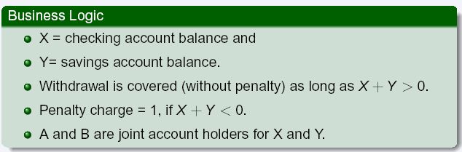
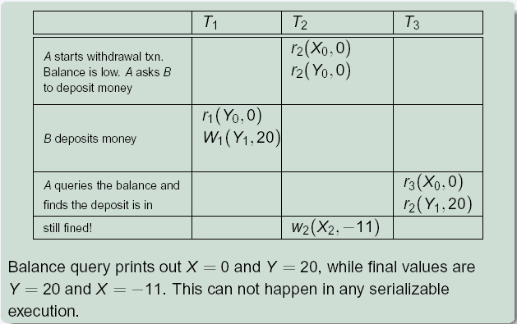
SI Non-Serializability even for Read-Only Transactions

