Slide 1
Chapter 15: Transactions

Slide 2
Database System Concepts
Chapter 1: Introduction
Part 1: Relational databases
  Chapter 2: Relational Model
  Chapter 3: SQL
  Chapter 4: Advanced SQL
  Chapter 5: Other Relational Languages
Part 2: Database Design
  Chapter 6: Database Design and the E-R Model
  Chapter 7: Relational Database Design
  Chapter 8: Application Design and Development
Part 3: Object-based databases and XML
  Chapter 9: Object-Based Databases
  Chapter 10: XML
Part 4: Data storage and querying
  Chapter 11: Storage and File Structure
  Chapter 12: Indexing and Hashing
  Chapter 13: Query Processing
  Chapter 14: Query Optimization
Part 5: Transaction management
  Chapter 15: Transactions
  Chapter 16: Concurrency control
  Chapter 17: Recovery System
Part 6: Data Mining and Information Retrieval
  Chapter 18: Data Analysis and Mining
  Chapter 19: Information Retreival
Part 7: Database system architecture
  Chapter 20: Database-System Architecture
  Chapter 21: Parallel Databases
  Chapter 22: Distributed Databases
Part 8: Other topics
  Chapter 23: Advanced Application Development
  Chapter 24: Advanced Data Types and New Applications
  Chapter 25: Advanced Transaction Processing
Part 9: Case studies
  Chapter 26: PostgreSQL
  Chapter 27: Oracle
  Chapter 28: IBM DB2
  Chapter 29: Microsoft SQL Server
Online Appendices
  Appendix A: Network Model
  Appendix B: Hierarchical Model
  Appendix C: Advanced Relational Database Model

Slide 3
Part 5: Transaction management
(Chapters 15 through 17).
Chapter 15: Transactions
  focuses on the fundamentals of a transaction-processing system, including transaction atomicity, consistency, isolation, and durability, as well as the notion of serializability.
Chapter 16: Concurrency control
  focuses on concurrency control and presents several techniques for ensuring serializability, including locking, timestamping, and optimistic (validation) techniques. The chapter also covers deadlock issues.
Chapter 17: Recovery System
  covers the primary techniques for ensuring correct transaction execution despite system crashes and disk failures. These techniques include logs, checkpoints, and database dumps.

Slide 4
Chapter 15: Transactions
15.1 Transaction Concept
15.2 Transaction State
15.3 Implementation of Atomicity and Durability
15.4 Concurrent Executions
15.5 Serializability
15.6 Recoverability
15.7 Implementation of Isolation
Aux: Transaction Definition in SQL
15.8 Testing for Serializability
15.9 Summary

Slide 5
Transaction Concept
A transaction is a unit of program execution that accesses and possibly updates various data items
A transaction must see a consistent database
During transaction execution the database may be inconsistent
When the transaction is committed, the database must be consistent
Two main issues to deal with:
  Failures of various kinds, such as hardware failures and system crashes
  Concurrent execution of multiple transactions

Slide 6
ACID Properties
To preserve integrity of data, the database system must ensure:
Atomicity. Either all operations of the transaction are properly reflected in the database or none are.
Consistency. Execution of a transaction in isolation preserves the consistency of the database.
Isolation.
  Although multiple transactions may execute concurrently, each transaction must be unaware of other concurrently executing transactions.
  Intermediate transaction results must be hidden from other concurrently executed transactions.
  That is, for every pair of transactions T_{i} and T_{j}, it appears to T_{i} that either T_{j} finished execution before T_{i} started, or T_{j} started execution after T_{i} finished.
Durability. After a transaction completes successfully, the changes it has made to the database persist, even if there are system failures.

Slide 7
Example of Fund Transfer
Transaction to transfer $50 from account A to account B:
  1. read(A)
  2. A := A – 50
  3. write(A)
  4. read(B)
  5. B := B + 50
  6. write(B)

Slide 8
Example of Fund Transfer (Cont.)
Consistency requirement – the sum of A and B is unchanged by the execution of the transaction.
Atomicity requirement — if the transaction fails after step 3 and before step 6, the system should ensure that its updates are not reflected in the database, else an inconsistency will result.
Durability requirement — once the user has been notified that the transaction has completed (i.e., the transfer of the $50 has taken place), the updates to the database by the transaction must persist despite failures.
Isolation requirement — if between steps 3 and 6, another transaction is allowed to access the partially updated database, it will see an inconsistent database (the sum A + B will be less than it should be).
Can be ensured trivially by running transactions serially, that is one after the other. However, executing multiple transactions concurrently has significant benefits, as we will see.

Slide 9
Chapter 15: Transactions
15.1 Transaction Concept
15.2 Transaction State
15.3 Implementation of Atomicity and Durability
15.4 Concurrent Executions
15.5 Serializability
15.6 Recoverability
15.7 Implementation of Isolation
Aux: Transaction Definition in SQL
15.8 Testing for Serializability
15.9 Summary

Slide 10
Transaction State
Active ➔ the initial state; the transaction stays in this state while it is executing
Partially committed ➔ after the final statement has been executed.
Failed ➔ after the discovery that normal execution can no longer proceed.
Aborted ➔ after the transaction has been rolled back and the database restored to its state prior to the start of the transaction.
Two options after it has been aborted:
  restart the transaction – only if no internal logical error
  kill the transaction
Committed ➔ after successful completion.

Slide 11

Transaction State (Cont.)

Slide 12
Chapter 15: Transactions
15.1 Transaction Concept
15.2 Transaction State
15.3 Implementation of Atomicity and Durability
15.4 Concurrent Executions
15.5 Serializability
15.6 Recoverability
15.7 Implementation of Isolation
Aux: Transaction Definition in SQL
15.8 Testing for Serializability
15.9 Summary

Slide 13
Implementation of Atomicity and Durability
The recovery-management component of a database system implements the support for atomicity and durability.
Recovery Schemes: Log-based approach vs Shadowing approach
The shadow-database scheme:
  assume that only one transaction is active at a time.
  a pointer called db_pointer always points to the current consistent copy of the database.
  all updates are made on a shadow copy of the database, and db_pointer is made to point to the updated shadow copy only after the transaction reaches partial commit and all updated pages have been flushed to disk.
  in case transaction fails, old consistent copy pointed to by db_pointer can be used, and the shadow copy can be deleted.

Slide 14
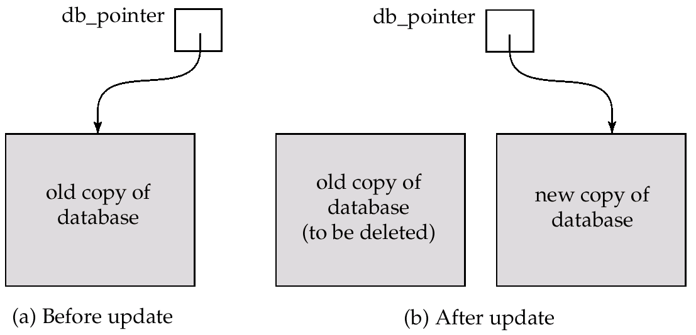
Implementation of Atomicity and Durability (Cont.)
The shadow-database scheme:
Assumes disks to not fail
Simple & Useful for text editors, but extremely inefficient for large databases: executing a single transaction requires copying the entire database.
Will see better schemes (log based recovery) in Chapter 17.

Slide 15
Chapter 15: Transactions
15.1 Transaction Concept
15.2 Transaction State
15.3 Implementation of Atomicity and Durability
15.4 Concurrent Executions
15.5 Serializability
15.6 Recoverability
15.7 Implementation of Isolation
Aux: Transaction Definition in SQL
15.8 Testing for Serializability
15.9 Summary

Slide 16
Concurrent Executions
Multiple transactions are allowed to run concurrently in the system. Advantages are:
  increased processor and disk utilization
    leading to better transaction throughput
    one transaction can be using the CPU while another is reading from or writing to the disk
  reduced average response time for transactions
    short transactions need not wait behind long ones
Concurrency control schemes
  mechanisms to achieve isolation
  i.e., to control the interaction among the concurrent transactions in order to prevent them from destroying the consistency of the database
  Will study in Chapter 14, after studying notion of correctness of concurrent executions.

Slide 17
Schedules
Schedules – sequences that indicate the chronological order in which instructions of concurrent transactions are executed
  a schedule for a set of transactions must consist of all instructions of those transactions
  must preserve the order in which the instructions appear in each individual transaction.
Serial Schedule – instruction sequences from one by one transactions

Slide 18

Example Schedule: Schedule 1 in the text
Let T₁ transfer $50 from A to B, and T₂ transfer 10% of the balance from A to B.
The following is a serial schedule in which T₁ is followed by T₂.

Slide 19
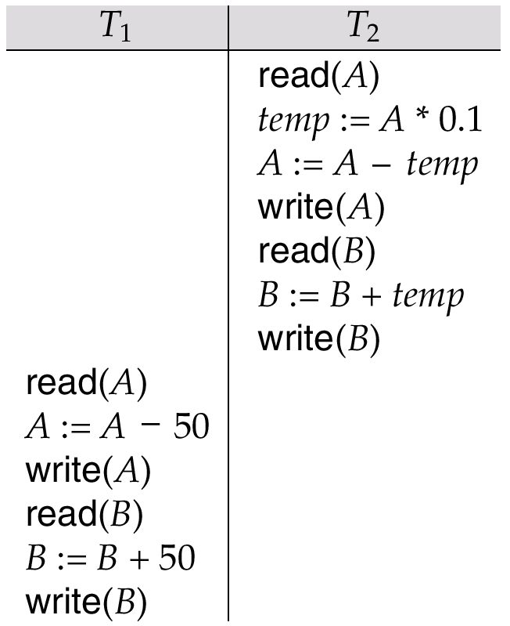
Schedule 2 -- Another Serial Schedule
The following is a serial schedule in which T2 is followed by T1.

Slide 20

Example Schedule: Schedule 3 in the text
Let T₁ and T₂ be the transactions defined previously.
The following schedule is not a serial schedule, but it is equivalent to Schedule 1
We call it a serializable schedule
In both Schedule 1 and 3, the sum A + B is preserved.

Slide 21

Example Schedule: Schedule 4 in the text
The following concurrent schedule does not preserve the value of the the sum A + B.
The following schedule is not serializable.

Slide 22
Chapter 15: Transactions
15.1 Transaction Concept
15.2 Transaction State
15.3 Implementation of Atomicity and Durability
15.4 Concurrent Executions
15.5 Serializability
15.6 Recoverability
15.7 Implementation of Isolation
Aux: Transaction Definition in SQL
15.8 Testing for Serializability
15.9 Summary

Slide 23
Serializability
Basic Assumption – Each transaction preserves database consistency.
Thus serial execution of a set of transactions preserves database consistency.
A (possibly concurrent) schedule is serializable if it is equivalent to a serial schedule.
Different forms of schedule equivalence give rise to the notions of:
  1. conflict serializability
  2. view serializability
We ignore operations other than read and write instructions, and we assume that transactions may perform arbitrary computations on data in local buffers in between reads and writes.
  Our simplified schedules consist of only read and write instructions.

Slide 24
Conflict Serializability
Instructions l_{i} and l_{j} of transactions T_{i} and T_{j} respectively, conflict if and only if there exists some item Q accessed by both l_{i} and l_{j}, and at least one of these instructions wrote Q.
1. l_{i} = read(Q), l_{j} = read(Q). l_{i} and l_{j} don’t conflict.
2. l_{i} = read(Q), l_{j} = write(Q). They conflict.
3. l_{i} = write(Q), l_{j} = read(Q). They conflict
4. l_{i} = write(Q), l_{j} = write(Q). They conflict
Intuitively, a conflict between l_{i} and l_{j} forces a (logical) temporal order between them.
  If l_{i} and l_{j} are consecutive in a schedule and they do not conflict, their results would remain the same even if they had been interchanged in the schedule.

Slide 25
Conflict Serializability (Cont.)
If a schedule S can be transformed into a schedule S´ by a series of swaps of non-conflicting instructions, we say that S and S´ are conflict equivalent.
We say that a schedule S is conflict serializable if it is conflict equivalent to a serial schedule
Example of a schedule that is not conflict serializable:
T₃ T₄
read(Q)
write(Q)
write(Q)
We are unable to swap instructions in the above schedule to obtain either the serial schedule < T₃, T₄ >, or the serial schedule < T₄, T₃ >.
T₃ T₄ T₃ T₄
read(Q) write(Q)
write(Q) read(Q)
write(Q) write(Q)

Slide 26

Conflict Serializability (Cont.)
Schedule 3 below can be transformed into Schedule 1, a serial schedule where T₂ follows T₁, by series of swaps of non-conflicting instructions.
The 3rd and 4th lines can be swapped with 5th and 6th lines
Therefore the following schedule 3 is conflict serializable.
Schedule3

Slide 27
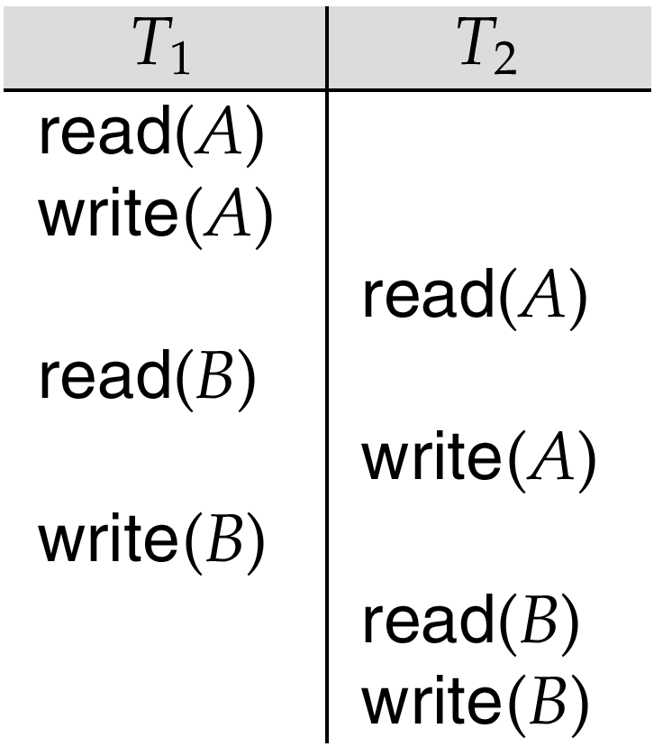
Schedule 5 –
After Swapping a Pair of non conflicting Instructions in schedule 3

Slide 28
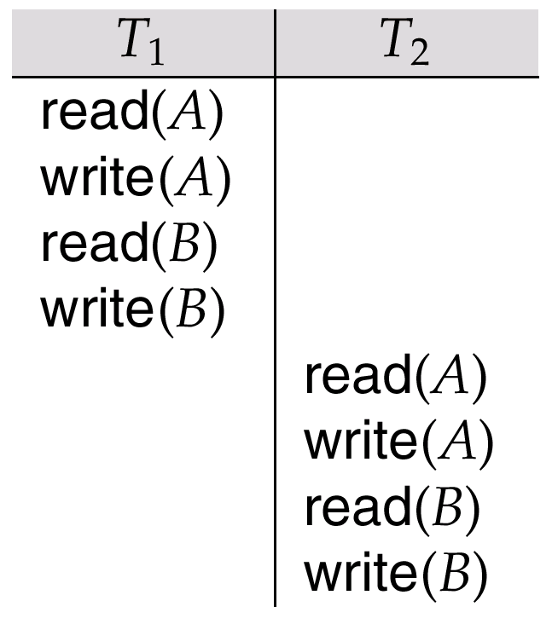
Schedule 6 –
A Serial Schedule That is Equivalent to Schedule 3

Slide 29
View Serializability
Let S and S´ be two schedules with the same set of transactions. S and S´ are view equivalent if the following three conditions are met:
  1. For each data item Q, if transaction T_{i} reads the initial value of Q in schedule S, then transaction T_{i} must, in schedule S´, also read the initial value of Q.
  2. For each data item Q, if transaction T_{i} executes read(Q) in schedule S, and that value was produced by transaction T_{j} (if any), then transaction T_{i} must in schedule S´ also read the value of Q that was produced by transaction T_{j} .
  3. For each data item Q, the transaction (if any) that performs the final write(Q) operation in schedule S must perform the final write(Q) operation in schedule S´.
As can be seen, view equivalence is also based purely on reads and writes alone.

Slide 30
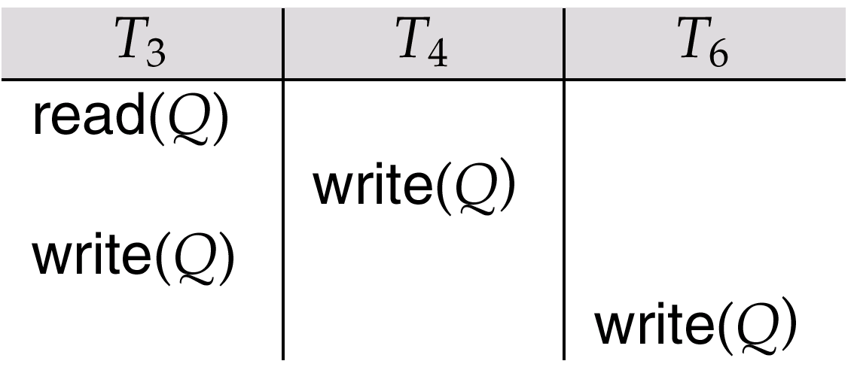
View Serializability (Cont.)
A schedule S is view serializable it is view equivalent to a serial schedule.
Every conflict serializable schedule is also view serializable.
Schedule 9 (from text) — a schedule which is view-serializable but not conflict serializable.
Every view serializable schedule that is not conflict serializable has blind writes.

Slide 31
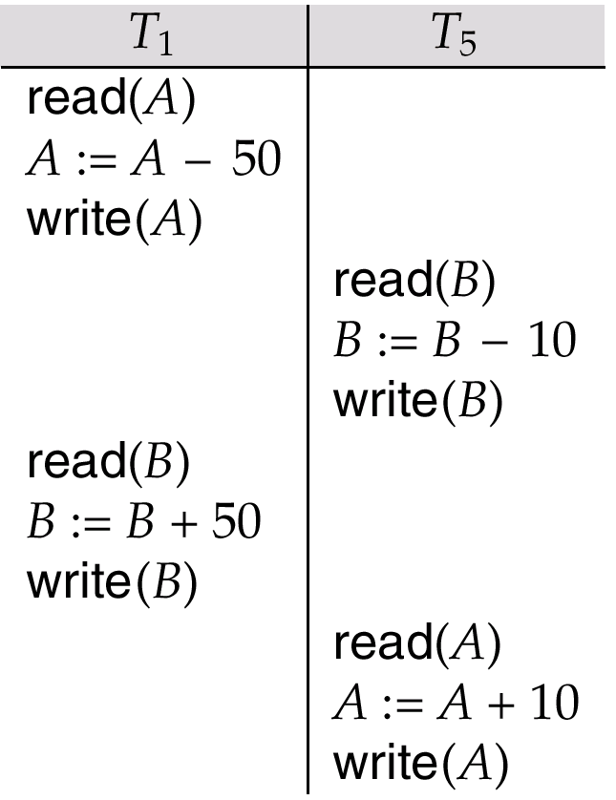
Other Notions of Serializability
Schedule 8 (from text) given below produces same outcome as the serial schedule < T₁, T₅ >, yet is not conflict equivalent or view equivalent to it.
Determining such equivalence requires analysis of operations other than read and write.

Slide 32
Chapter 15: Transactions
15.1 Transaction Concept
15.2 Transaction State
15.3 Implementation of Atomicity and Durability
15.4 Concurrent Executions
15.5 Serializability
15.6 Recoverability
15.7 Implementation of Isolation
Aux: Transaction Definition in SQL
15.8 Testing for Serializability
15.9 Summary

Slide 33
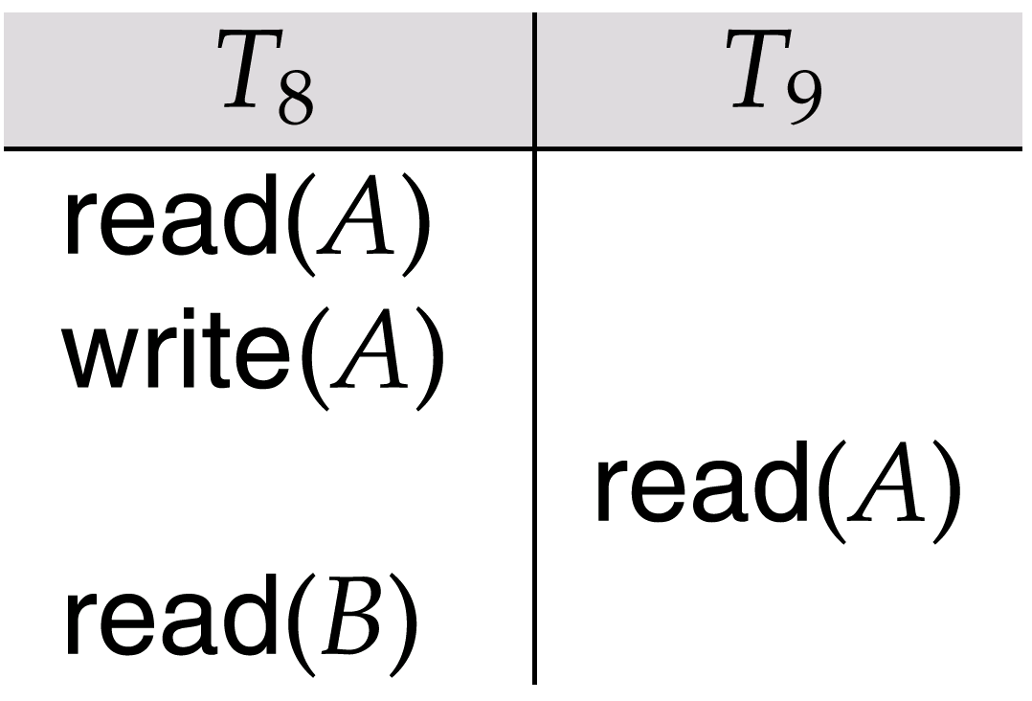
Recoverability
Need to address the effect of transaction failures on concurrently running transactions.
Recoverable schedule — if a transaction T_{j} reads a data items previously written by a transaction T_{i} , the commit operation of T_{i} appears before the commit operation of T_{j}.
The following schedule (Schedule 11) is not recoverable if T₉ commits immediately after the read
If T₈ should abort, T₉ would have read (and possibly shown to the user) an inconsistent database state.
Hence database must ensure that schedules are recoverable.
Schedule 11

Slide 34
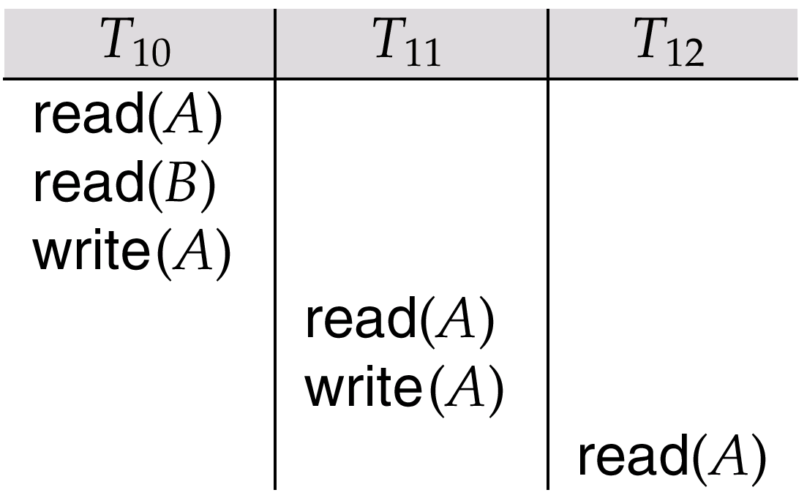
Recoverability (Cont.)
Cascading rollback – a single transaction failure leads to a series of transaction rollbacks.
Consider the following schedule where none of the transactions has yet committed (so the schedule is recoverable)
** Suppose the lock of A is released without executing the commit instruction in T_{10,} If T₁₀ fails, T₁₀ is supposed to be rolled back, then T₁₁ and T₁₂ must also be rolled back.
Cascading rollback can lead to the undoing of a significant amount of work

Slide 35
Recoverability (Cont.)
Cascadeless schedules — cascading rollbacks cannot occur;
  for each pair of transactions T_{i} and T_{j} such that T_{j} reads a data item previously written by T_{i}, the commit operation of T_{i} appears before the read operation of T_{j}.
Every cascadeless schedule is also recoverable
It is desirable to restrict the schedules to those that are cascadeless
Idea: hold locks until executing the commit instruction!
More concurrency ➔ More cascading rollback
Less cascading rollback ➔ Less concurrency

Slide 36
Chapter 15: Transactions
15.1 Transaction Concept
15.2 Transaction State
15.3 Implementation of Atomicity and Durability
15.4 Concurrent Executions
15.5 Serializability
15.6 Recoverability
15.7 Implementation of Isolation
Aux: Transaction Definition in SQL
15.8 Testing for Serializability
15.9 Summary

Slide 37
Implementation of Isolation
Schedules must be conflict or view serializable, and recoverable, for the sake of database consistency, and preferably cascadeless.
A policy in which only one transaction can execute at a time generates serial schedules, but provides a poor degree of concurrency.
Concurrency-control schemes tradeoff between the amount of concurrency they allow and the amount of overhead that they incur.
Some schemes allow only conflict-serializable schedules to be generated, while others allow view-serializable schedules that are not conflict-serializable.

Slide 38
Chapter 15: Transactions
15.1 Transaction Concept
15.2 Transaction State
15.3 Implementation of Atomicity and Durability
15.4 Concurrent Executions
15.5 Serializability
15.6 Recoverability
15.7 Implementation of Isolation
Aux: Transaction Definition in SQL
15.8 Testing for Serializability
15.9 Summary

Slide 39
Transaction Definition in SQL
Data manipulation language must include a construct for specifying the set of actions that comprise a transaction.
In SQL, a transaction begins implicitly.
A transaction in SQL ends by:
  Commit work commits current transaction and begins a new one.
  Rollback work causes current transaction to abort.
Levels of consistency specified by SQL-92:
  Serializable — default
  Repeatable read
  Read committed
  Read uncommitted

Slide 40
Levels of Consistency in SQL-92
Serializable — default
Repeatable read — only committed records to be read, repeated reads of same record must return same value. However, a transaction may not be serializable – it may find some records inserted by a transaction but not find others.
Read committed — only committed records can be read, but successive reads of record may return different (but committed) values.
Read uncommitted — even uncommitted records may be read.
Lower degrees of consistency useful for gathering approximate
information about the database, e.g., statistics for query optimizer.

Slide 41
Chapter 15: Transactions
15.1 Transaction Concept
15.2 Transaction State
15.3 Implementation of Atomicity and Durability
15.4 Concurrent Executions
15.5 Serializability
15.6 Recoverability
15.7 Implementation of Isolation
Aux: Transaction Definition in SQL
15.8 Testing for Serializability
15.9 Summary

Slide 42
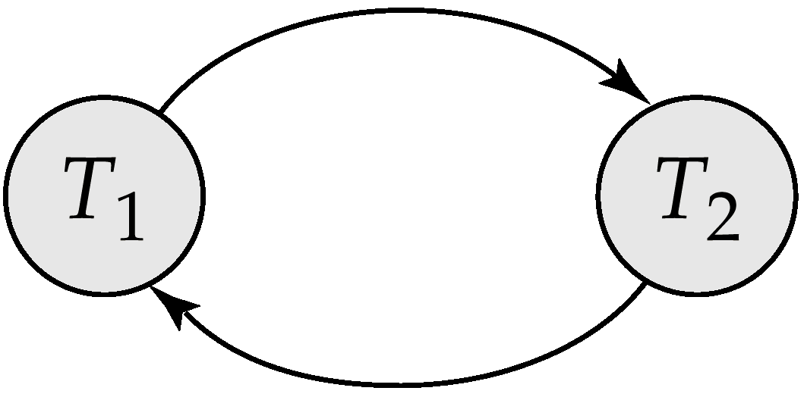
Testing for Serializability
Consider some schedule of a set of transactions T₁, T₂, ..., T_{n}
Precedence graph — a direct graph where the vertices are the transactions (names)
We draw an arc from T_{i} to T_{j} if the two transaction conflict, and T_{i} accessed the data item on which the conflict arose earlier.
We may label the arc by the item that was accessed.
Example 1
A
B

Slide 43
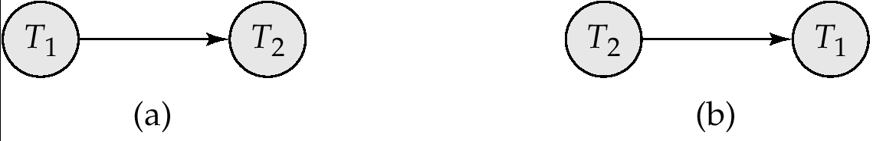
Precedence Graph for (a) Schedule 1 and (b) Schedule 2

Slide 44
Example Schedule (Schedule A)
T₁ T₂ T₃ T₄ T₅
read(X)
read(Y)
read(Z)
read(V)
read(W)
read(W)
read(Y)
write(Y)
write(Z)
read(U)
read(Y)
write(Y)
read(Z)
write(Z)
read(U)
write(U)

Slide 45
Precedence Graph for Schedule A
Y
T₁
T₂
T₅
Y
Z
T₄
T₃
Z

Slide 46
Test for Conflict Serializability
A schedule is conflict serializable if and only if its precedence graph is acyclic.
Cycle-detection algorithms exist which take order n² time, where n is the number of vertices in the graph. (Better algorithms take order n + e where e is the number of edges.)
If precedence graph is acyclic, the serializability order can be obtained by a topological sorting of the graph.
  This is a linear order consistent with the partial order of the graph.
  For example, a serializability order for Schedule A would be
  T₅ → T₁ → T₃ → T₂ → T₄ or T₁ → T₃ → T₂ → T₄ → T₅

Slide 47
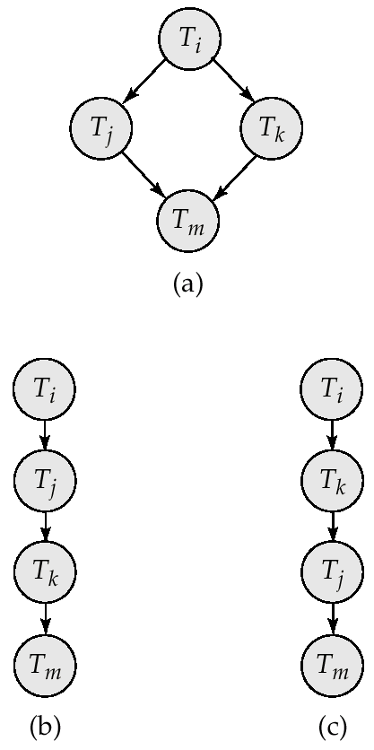
Illustration of Topological Sorting

Slide 48
Test for View Serializability
The precedence graph test for conflict serializability must be modified to apply to a test for view serializability.
The problem of checking if a schedule is view serializable falls in the class of NP-complete problems.
  Thus existence of an efficient algorithm is unlikely.
  However practical algorithms that just check some sufficient conditions for view serializability can still be used.

Slide 49
Concurrency Control vs. Serializability Tests
Testing a schedule for serializability after it has executed is a little too late!
Goal – to develop concurrency control protocols that will assure serializability.
  They will generally not examine the precedence graph as it is being created;
  instead a protocol will impose a discipline that avoids nonseralizable schedules.
  Will study such protocols in Chapter 16.
Tests for serializability help understand why a concurrency control protocol is correct.

Slide 50
Chapter 15: Transactions
15.1 Transaction Concept
15.2 Transaction State
15.3 Implementation of Atomicity and Durability
15.4 Concurrent Executions
15.5 Serializability
15.6 Recoverability
15.7 Implementation of Isolation
Aux: Transaction Definition in SQL
15.8 Testing for Serializability
15.9 Summary

Slide 51
Ch.15 Summary (1)
A transaction is a unit of program execution that accesses and possibly updates various data items.
Understanding the concept of a transaction is critical for understanding and implementing updates of data in a database, in such a way that concurrent executions and failures of various forms do not result in the database becoming inconsistent.
Concurrent execution of transactions improves throughput of transactions and system utilization, and reduces waiting time of transactions.
Transactions are required to have the ACID properties: atomicity, consistency, isolation, and durability.
  Atomicity ensures that either all the effects of a transaction are reflected in the database, or none are; a failure cannot leave the database in a state where a transaction is partially executed.
  Consistency ensures that, if the database is initially consistent, the execution of the transaction (by itself) leaves the database in a consistent state.
  Isolation ensures that concurrently executing transactions are isolated from one another, so that each has the impression that no other transaction is executing concurrently with it.
  Durability execution of transactions has been committed, that transaction’s updates do not get lost, even if there is a system failure.

Slide 52
Ch15. Summary (2)
When several transactions execute concurrently in the database, the consistency of data may no longer be preserved. It is therefore necessary for the system to control the interactions.
  Since A transaction is a unit that preserves consistency, a serial execution of transactions guarantees that consistency is preserved.
  A schedule capture the key action of transactions that affect concurrent execution, such as read and write operations, while abstracting away internal details of the executions of the transactions.
  We require that any schedule produced by concurrent processing of a set of transactions will have and write operations, while abstracting away internal details of the executions of the transactions.
  A system that guarantees this property is said to ensure serializability.
  There are several different notions of equivalence leading to the concepts of conflict serializability and view serializability.

Slide 53
Ch.15 Summary (3)
Serializability of schedules generated by concurrently executing transactions can be ensured through one of a variety of mechanisms called concurrency-control schemes.
Schedules must be recoverable, to make sure that if transaction a sees the effects of transaction b and b then aborts, then a also gets aborted.
Schedules should preferably be cascadeless, so that the abort of transaction does not result in cascading aborts of other transactions. Cascadelessness is ensured by allowing transactions to only read committed data.
The concurrency-control-management component of the database is responsible for handing the concurrency-control schemes. Chapter 16 describes concurrency-control schemes.

Slide 54
Ch15. Summary (4)
The recovery-management component of a database is responsible for ensuring the atomicity and durability properties.
The shadow copy scheme is sued for ensuring atomicity and durability in text editors; it has extremely high overheads when used for database systems, and, moreover, it does not support concurrent executions.
Chapter 17 covers better schemes.
We can test a given schedule for conflict serializability by constructing a precedence graph for the schedule, and by searching for absence of cycles in the graph.
However, there are more efficient concurrency control schemes for ensuring serializbility.

Slide 55
Ch15. Bibliographical Notes
Gray and Reuter [1993] provides detailed coverage of transaction processing concepts, techniques and implementation details, including concurrency control and recovery issues.
Bernstein and Newcomer [1997] provides textbook coverage of various aspects of transaction processing.
Early textbook discussions of concurrency control and recovery included Papadimitriou [1986] and Bernstein et al. [1987].
An early survey paper on implementation issues in concurrency control and recovery is presented by Gray [1978].
The concept of serializability was formalized by Eswaran et al. [1976] in connection to work on concurrency control for testing for System R.
The results concerning serializability testing and NP- completeness of testing for view serializability are for from Papadimitriou et al. [1977]and Papadimitriou [1979].
Cycle-detection algorithms as well as an introduction to NP-completeness can be found in standard algorithm textbooks such as Cormen et al. [1990]
References covering specific aspects of transaction processing, such as concurrency control and recovery, are cited in Chapters 16,17, and 24

Slide 56
Chapter 15: Transactions
15.1 Transaction Concept
15.2 Transaction State
15.3 Implementation of Atomicity and Durability
15.4 Concurrent Executions
15.5 Serializability
15.6 Recoverability
15.7 Implementation of Isolation
Aux: Transaction Definition in SQL
15.8 Testing for Serializability
15.9 Summary

Slide 57
End of Chapter

