Slide 1
Appendix A: Network Model

Slide 2
Database System Concepts
Chapter 1: Introduction
Part 1: Relational databases
  Chapter 2: Relational Model
  Chapter 3: SQL
  Chapter 4: Advanced SQL
  Chapter 5: Other Relational Languages
Part 2: Database Design
  Chapter 6: Database Design and the E-R Model
  Chapter 7: Relational Database Design
  Chapter 8: Application Design and Development
Part 3: Object-based databases and XML
  Chapter 9: Object-Based Databases
  Chapter 10: XML
Part 4: Data storage and querying
  Chapter 11: Storage and File Structure
  Chapter 12: Indexing and Hashing
  Chapter 13: Query Processing
  Chapter 14: Query Optimization
Part 5: Transaction management
  Chapter 15: Transactions
  Chapter 16: Concurrency control
  Chapter 17: Recovery System
Part 6: Data Mining and Information Retrieval
  Chapter 18: Data Analysis and Mining
  Chapter 19: Information Retreival
Part 7: Database system architecture
  Chapter 20: Database-System Architecture
  Chapter 21: Parallel Databases
  Chapter 22: Distributed Databases
Part 8: Other topics
  Chapter 23: Advanced Application Development
  Chapter 24: Advanced Data Types and New Applications
  Chapter 25: Advanced Transaction Processing
Part 9: Case studies
  Chapter 26: PostgreSQL
  Chapter 27: Oracle
  Chapter 28: IBM DB2
  Chapter 29: Microsoft SQL Server
Online Appendices
  Appendix A: Network Model
  Appendix B: Hierarchical Model
  Appendix C: Advanced Relational Database Model

Slide 3
Online Appendices
(available only in http://www.db-book.com)
Appendix A: Network Model
Appendix B: Hierarchical Model
Although most new database applications use either the relational model or the object-relational model, the network and hierarchical data models are still in use in some legacy applications.
Appendix C: Advanced Relational Database Model
  describes advanced relational-database design, including the theory of multivalued dependencies, join dependencies, and the project-join and domain-key normal forms.

Slide 4
Table of Contents
Basic Concepts
Data-Structure Diagrams
The DBTG CODASYL Model
DBTG Data-Retrieval Facility
DBTG Update Facility
DBTG Set-Processing Facility
Mapping of Networks to Files

Slide 5
Basic Concepts
Data are represented by collections of records.
  similar to an entity in the E-R model
  Records and their fields are represented as record type
type customer = record type account = record
customer-name: string; account-number: integer;
customer-street: string; balance: integer;
customer-city: string;
end end
Relationships among data are represented by links
  similar to a restricted (binary) form of an E-R relationship
  restrictions on links depend on whether the relationship is many-many, many-to-one, or one-to-one.

Slide 6
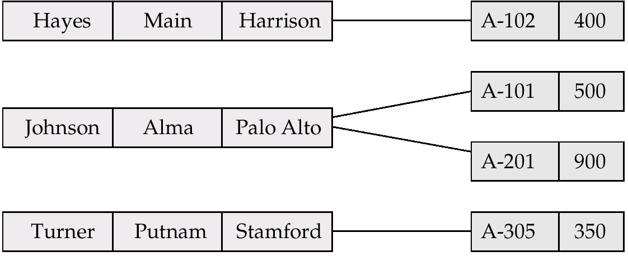
Sample Network Database
G

Slide 7
Table of Contents
Basic Concepts
Data-Structure Diagrams
The DBTG CODASYL Model
DBTG Data-Retrieval Facility
DBTG Update Facility
DBTG Set-Processing Facility
Mapping of Networks to Files

Slide 8
Data-Structure Diagrams
Schema representing the design of a network database.
A data-structure diagram consists of two basic components:
  Boxes, which correspond to record types.
  Lines, which correspond to links.
Specifies the overall logical structure of the database.

Slide 9
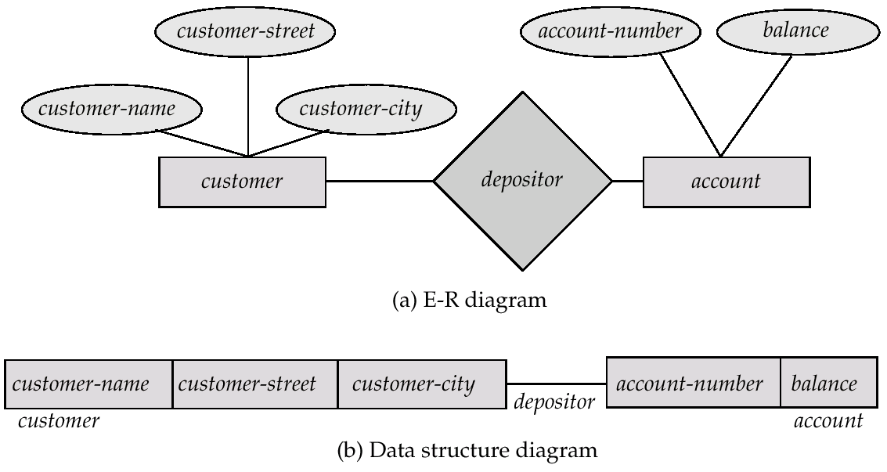
Data-Structure Diagrams (Cont.)
G
For every E-R diagram, there is a corresponding data-structure diagram.

Slide 10
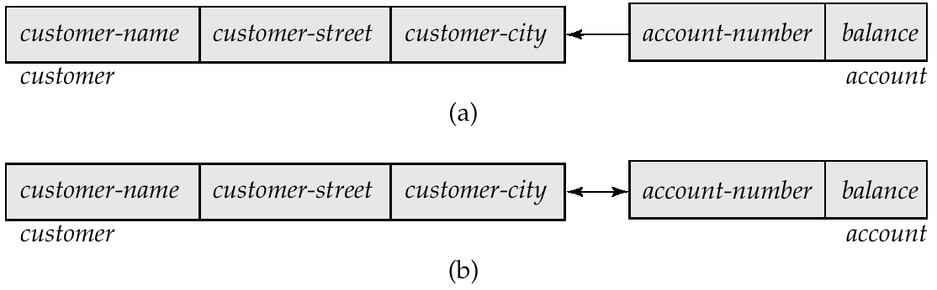
Two Data-Structure Diagrams

Slide 11
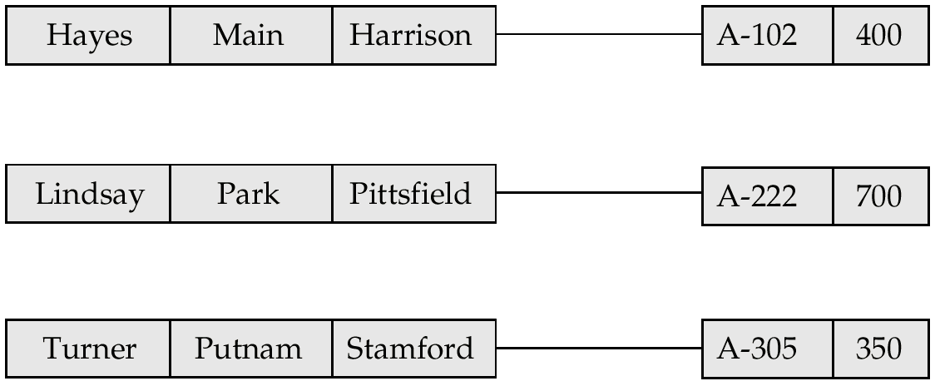
Sample Database Corresponding to Diagram of Figure A.3b

Slide 12
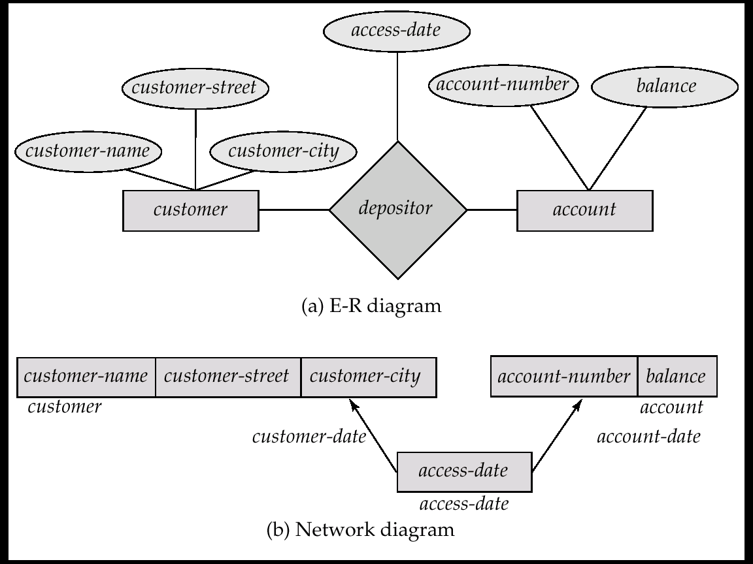
Data-Structure Diagrams (Cont.)
Since a link cannot contain any data value, represent an E-R relationship with attributes with a new record type and links.

Slide 13
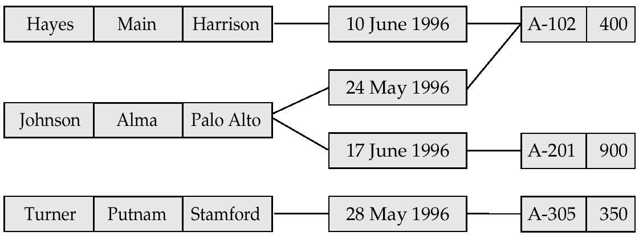
Sample Database Corresponding to Diagram of Figure A.6b

Slide 14
General Relationships
To represent an E-R relationship of degree 3 or higher, connect the participating record types through a new record type that is linked directly to each of the original record types.
1. Replace entity sets account, customer, and branch with record types account, customer, and branch, respectively.
2. Create a new record type Rlink (referred to as a dummy record type).
3. Create the following many-to-one links:
  CustRlink from Rlink record type to customer record type
  AcctRlnk from Rlink record type to account record type
  BrncRlnk from Rlink record type to branch record type

Slide 15
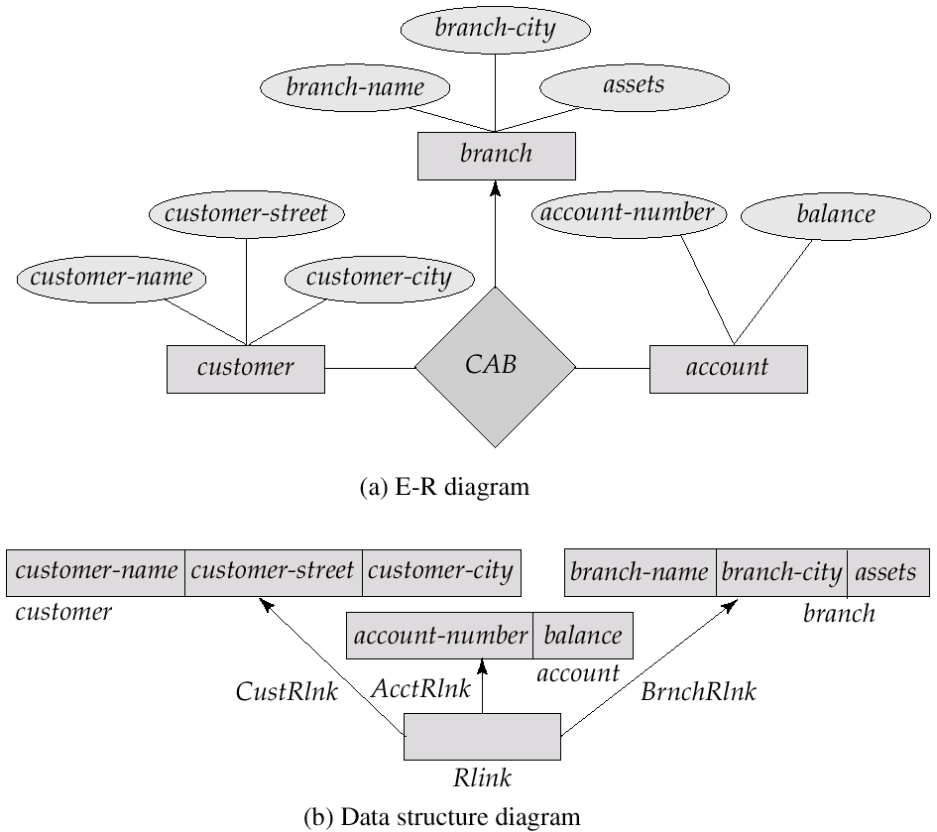
Network Representation of Ternary Relationship

Slide 16
Appendix-A: Network Model
Basic Concepts
Data-Structure Diagrams
The DBTG CODASYL Model
DBTG Data-Retrieval Facility
DBTG Update Facility
DBTG Set-Processing Facility
Mapping of Networks to Files
Bibliography

Slide 17
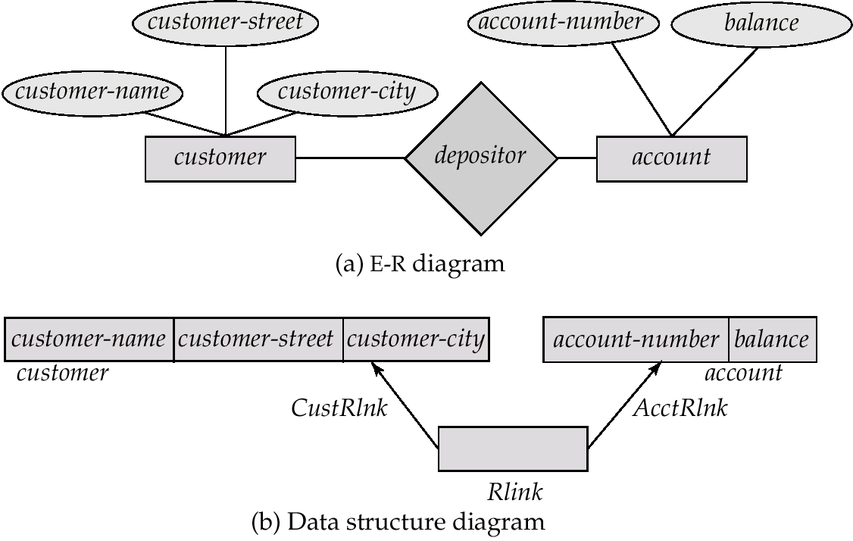
The DBTG CODASYL Model
G
All links are treated as many-to-one relationships.
To model many-to-many relationships, a record type is defined to represent the relationship and two links are used.

Slide 18
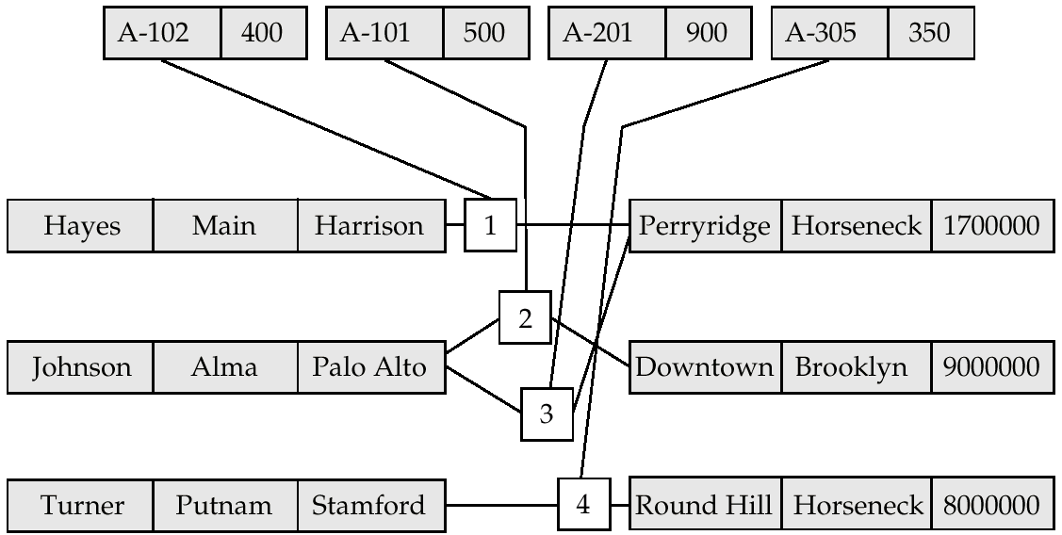
Sample Database Corresponding to
Diagram of Figure A.8b
G
Every record has one pointer to another record!!!!

Slide 19
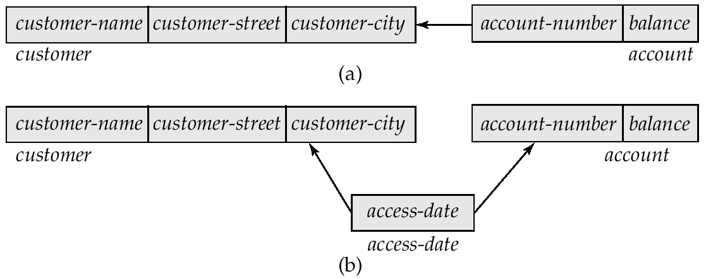
Two Data-Structure Diagrams

Slide 20
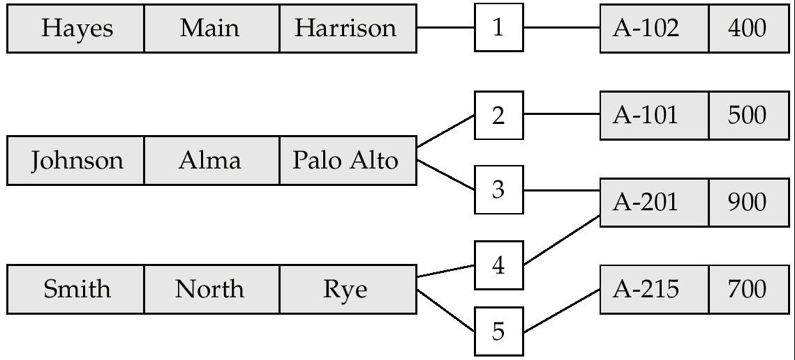
Sample Database Corresponding to the Diagram of Figure A.11

Slide 21
DBTG Sets
G
The structure consisting of two record types that are linked together is referred to in the DBTG model as a DBTG set
In each DBTG set, one record type is designated as the owner, and the other is designated as the member, of the set.
Each DBTG set can have any number of set occurrences (actual instances of linked records).
Since many-to-many links are disallowed, each set occurrence has precisely one owner, and has zero or more member records.
No member record of a set can participate in more than one occurrence of the set at any point.
A member record can participate simultaneously in several set occurrences of different DBTG sets.

Slide 22
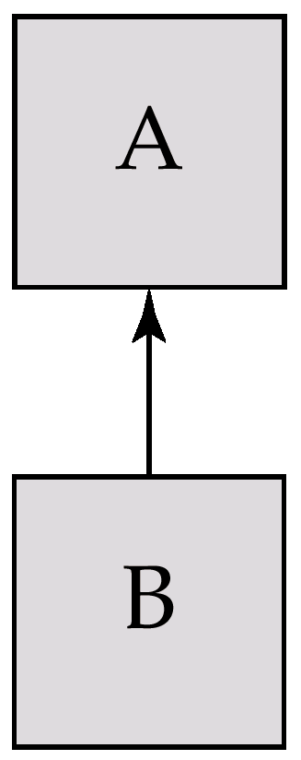
DBTG Set

Slide 23
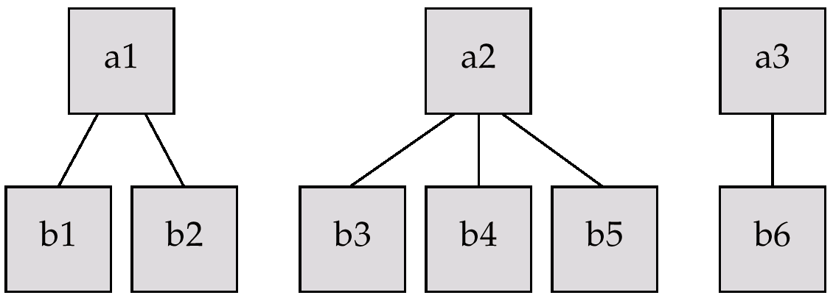
Three Set Occurrences
G

Slide 24
Sample Network Database
G

Slide 25
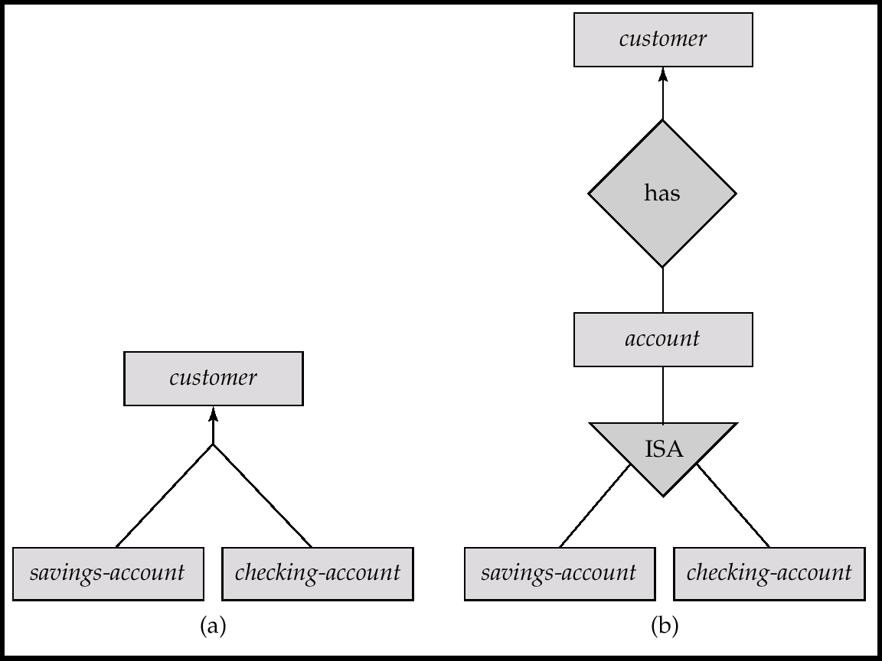
Data-Structure and E-R Diagram

Slide 26
Repeating Groups
Provide a mechanism for a field to have a set of values rather than a single value.
Alternative representation of weak entities from the E-R model
Example: Two sets.
  customer (customer-name)
  customer-address (customer-street, customer-city)
The following diagrams represent these sets without the repeating-group construct.

Slide 27
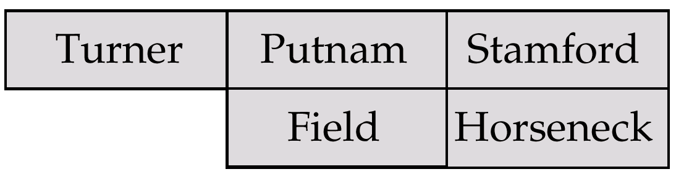
A customer Record

Slide 28
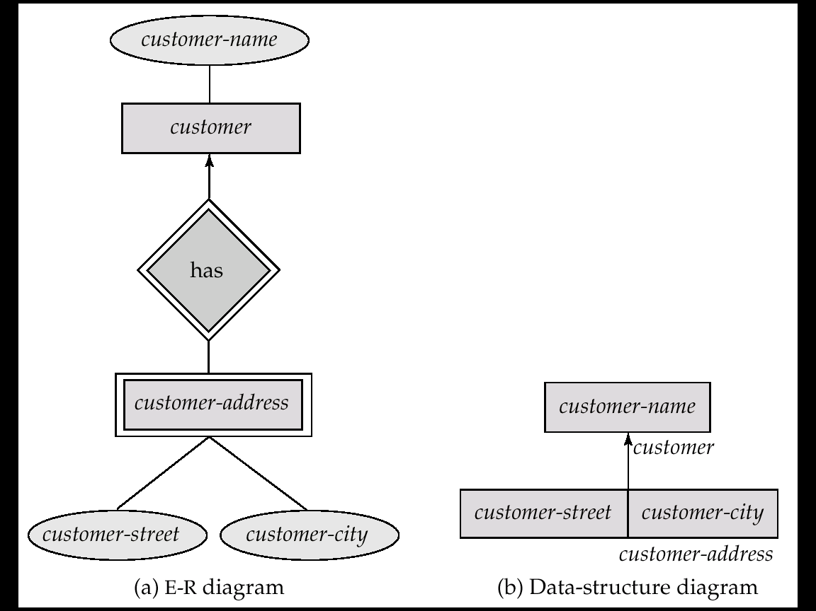
Repeating Groups (Cont.)
With the repeating-group construct, the data-structure diagram consists of the single record type customer.

Slide 29
Appendix-A: Network Model
Basic Concepts
Data-Structure Diagrams
The DBTG CODASYL Model
DBTG Data-Retrieval Facility
DBTG Update Facility
DBTG Set-Processing Facility
Mapping of Networks to Files
Bibilography

Slide 30
DBTG Data-Retrieval Facility
G
The DBTG data manipulation language consists of a number of commands that are embedded in a host language.
Run unit — system application program consisting of a sequence of host language and DBTG command statements. Statements access and manipulate database items as well as locally declared variables.
Program work-area (or user work area) — a buffer storage area the system maintains for each application program

Slide 31
DBTG Variables
Record Templates
Currency pointers
  Current of record type
  Current of set type
  Current of run unit
Status flags
  DB-status is most frequently used
  Additional variables: DB-set-name, DB-record-name, and
  DB-data-name

Slide 32
Example Program Work Area
Templates for three record types: customer, account, and branch.
Six currency pointers
  Three pointers for record types: one each tot he most recently accessed customer, account, and branch record
  Two pointers for set types: one to the most recently accessed record in an occurrence of the set depositor, one to the most recently accessed record in an occurrence of the set account-branch
  One run-unit pointer.
Status flags: four variables defined previously
Following diagram shows an example program work area state.

Slide 33
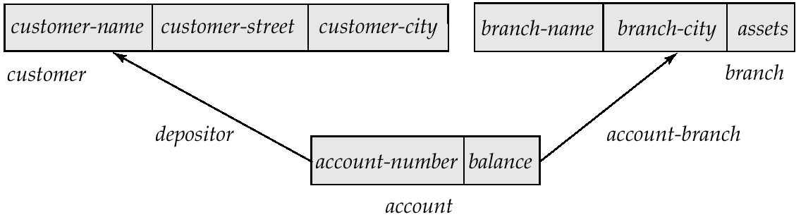
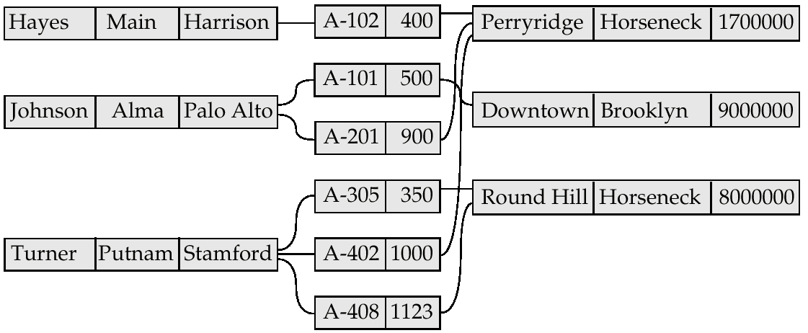
Example Schema
G

Slide 34
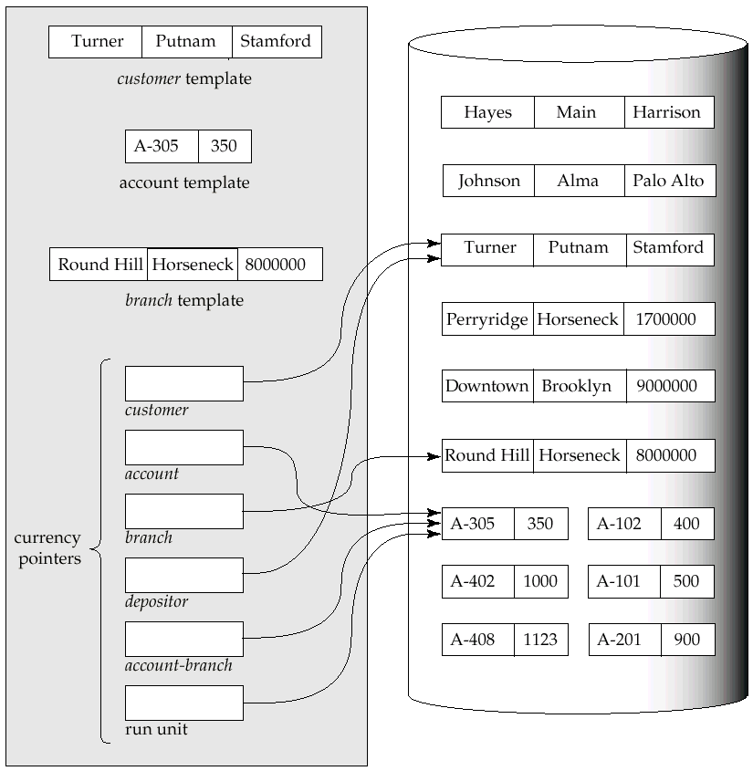
G

Slide 35
The Find and Get Commands
find locates a record in the database and sets the appropriate currency pointers
get copies of the record to which the current of run-unit points from the database to the appropriate program work area template
Example: Executing a find command to locate the customer record belonging to Johnson causes the following changes to occur in the state of the program work area.
  The current of the record type customer now points to the record of Johnson.
  The current of set type depositor now points to the set owned by Johnson
  The current of run unit now points to customer record Johnson.

Slide 36
Access of Individual Records
find any <record type> using <record-field>
Locates a record of type <record type> whose <record-field>
value is the same as the value of <record-field> in the
<record type> template in the program work area.
Once such a record is found, the following currency pointers are set to point to that record:
  The current of run-unit pointer
  The record-type currency pointer for <record type>
  For each set in which that record belongs, the appropriate set currency pointer
find duplicate <record type> using <record-field>
Locates (according to a system-dependent ordering) the next record that matches the <record-field>

Slide 37
Access of Records Within a Set
Other find commands locate records in the DBTG set that is pointed to by the <set-type> currency pointer.
find first <record type> within <set-type>
Locates the first database record of type <record type>
belonging to the current <set-type>.
To locate the other members of a set,k we use
find next <record type> within <set-type>
which finds the next element in the set <set-type>.
find owner within <set-type>
Locates the owner of a particular DBTG set

Slide 38
Predicates
For queries in which a field value must be matched with a specified range of values, rather than to only one, we need to:
  get the appropriate records into memory
  examine each one separately for a match
  determine whether each is the; target of our find statement

Slide 39
Example DBTG Query
G
Print the total number of accounts in the Perryridge branch with a balance greater than $10,000.
count := 0;
branch.branch-name := “Perryridge”;
find any branch using branch-name;
find first account within account-branch;
while DB-status = 0 do
begin
get account
if account.balance > 10000 then count := count + 1;
find next account within account-branch;
end
print (count);

Slide 40
Appendix-A: Network Model
Basic Concepts
Data-Structure Diagrams
The DBTG CODASYL Model
DBTG Data-Retrieval Facility
DBTG Update Facility
DBTG Set-Processing Facility
Mapping of Networks to Files
Bibliography

Slide 41
DBTG Update Facility
DBTG mechanisms are available to update information in the database.
To create a new record of type <record type>
  insert the appropriate values in the corresponding
  <record type> template
  add this new record to the database by executing
  store <record type>
Can create and add new records only one at a time

Slide 42
DBTG Update Facility (Cont.)
To modify an existing record of type <record type>
  find that record in the database
  get that record into memory
  change the desired fields in the template of <record type>
  reflect the changes to the record to which the currency point of <record type> points by executing
  modify <record type>

Slide 43
DBTG Update Facility (Cont.)
To delete an existing record of type <record type>
  make the currency pointer of that type point to the record in the database to be deleted
  delete that record by executing
  erase <record type>
Delete an entire set occurrence by finding the owner of the set and executing
  erase all <record type>
  Deletes the owner of the set, as well as all the set’s members.
  If a member of the set is an owner of another set, the members of that second set also will be deleted.
  erase all is recursive.

Slide 44
Appendix-A: Network Model
Basic Concepts
Data-Structure Diagrams
The DBTG CODASYL Model
DBTG Data-Retrieval Facility
DBTG Update Facility
DBTG Set-Processing Facility
Mapping of Networks to Files
Bibliography

Slide 45
DBTG Set-Processing Facility
G
Mechanisms are provided for inserting records into and removing records from a particular set occurrence
Insert a new record into a set by executing the connect statement.
  connect <record type> to <set-type>
Remove a record from a set by executing the disconnect statement.
  disconnect <record type> from <set-type>

Slide 46
Example disconnect Query
Close account A-201, that is, delete the relationship between account A-201 and its customer, but archive the record of account A-201.
The following program removes account A-201 from the set occurrence of type depositor.
The account will still be accessible in the database for record-keeping purposes.
account.account-number := “A-201”;
find for update any account using account-number.
get account,
find owner within depositor,
disconnect account from depositor.

Slide 47
DBTG Set-Processing Facility (Cont.)
To move a record of type <record type> from one set occurrence to another set occurrence of type <set-type>
  Find the appropriate record and the owner of the set occurrences to which that record is to be moved.
  Move the record by executing
    reconnect <record type> to <set-type>
Example: Move all accounts of Hayes that are currently at the Perryridge branch to the Downtown branch.

Slide 48
Example reconnect Query
customer.customer-name := “Hayes”;
find any customer using customer-name;
find first account within depositor;
while DB-status = 0 do
begin
find owner within account-branch;
get branch;
if branch.branch-name = “Perryridge” then
begin
branch.branch-name := “Downtown”;
find any branch using branch-name;
reconnect account to account-branch;
end
find next account within depositor,
end

Slide 49
DBTG Set-Processing Facility (Cont.)
A newly created member record of type <record type> of a set type <set-type> can be added to a set occurrence either explicitly (manually) or implicitly (automatically).
Specify the insert mode at set-definition time via
  insertion is <insert mode>
  manual: connect <record type> to <set-type>
  automatic: store <record type>

Slide 50
Set Insertion Example
Create account A535 for customer Hayes at the Downtown branch.
Set insertion is manual for set type depositor and is automatic for set type account-branch.
branch.branch-name := “Downtown”;
find any branch using branch-name;
account.account-number := “A-535”;
account.balance := 0;
store account;
customer.customer-name := “Hayes”;
find any customer using customer-name;
connect account to depositor;

Slide 51
DBTG Set-Processing Facility (Cont.)
Restrictions on how and when a member record can be removed from a set occurrence are specified at set-definition time via
retention is <retention-mode>
<retention-mode> can take one of the three forms:
1. fixed — a member record cannot be removed. To reconnect a record to another set, we must erase that record, recreate it, and then insert it into the new set occurrence.
2. mandatory — a member record of a particular set
occurrence can be reconnected to another set occurrence of only type <set-type>.
3. optional — no restrictions on how and when a member record can be removed from a set occurrence.

Slide 52
DBTG Set-Processing Facility (Cont.)
The best way to delete a record that is the owner of set occurrence of type <set-type> depends on the specification of the set retention of <set-type>.
optional — the record will be deleted and every member of the set that it owns will be disconnected. These records, however, will be in the database.
fixed — the record and all its owned members will be deleted; a member record cannot be removed from the set occurrence without being deleted.
mandatory — the record cannot be erased, because the mandatory status indicates that a member record must belong to a set occurrence. The record cannot be disconnected from that set.

Slide 53
Set Ordering
Set ordering is specified by a programmer when the set is defined:
order is <order-mode>
first. A new record is inserted in the first position; the set is in reverse chronological ordering.
last. A new record is inserted in the final position; the set is in chronological ordering.
next. Suppose that the currency pointer or <set-type> points to record X.
  If X is a member type, a new record is inserted in the next position following X.
  If X is an owner type, a new record is inserted in the first position.

Slide 54
Set Ordering (Cont.)
prior. If X is a member type, a new record is inserted in the position just prior to X. If X is an owner type, a new record is inserted in the last position.
system default. A new record is inserted in an arbitrary position determined by the system.
sorted. A new record is inserted in a position that ensures that the set will remain sorted. The sorting order is specified by a particular key value when a programmer defines the set.
Example: Consider the set occurrence of type depositor with the owner-record customer Turner and member-record accounts
A-305, A-402, and A-408 ordered as indicated in our example schema (page A.14).

Slide 55
Set Ordering Example
Add a new account A-125. For each <order-mode> option, the new set ordering is as follows:
first: {A-125,A-305,A-402,A-408}
last: {A-305,A-402,A-408,A-125}
next: Suppose that the currency pointer points to record “Turner”; then the new set order is {A-125,A-305,A-402,A-408}
prior: Suppose that the currency pointer points to record A-402; then the new set order is {A-305,A-125,A-402,A-408}
system default: Any arbitrary order is acceptable; thus,
{A-305,A-402,A-125,A-408} is a valid set ordering
sorted: The set must be ordered in ascending order with account number being the key; thus, the ordering must be
{A-125,A-305,A-402,A-408}

Slide 56
Appendix-A: Network Model
Basic Concepts
Data-Structure Diagrams
The DBTG CODASYL Model
DBTG Data-Retrieval Facility
DBTG Update Facility
DBTG Set-Processing Facility
Mapping of Networks to Files
Bibliography

Slide 57
Mapping of Networks to Files
We implement links by adding pointer fields to records that are associated via a link
Each record must have one pointer field for each link with which it is associated.
Example data-structure diagram and corresponding database.
Figure missing

Slide 58
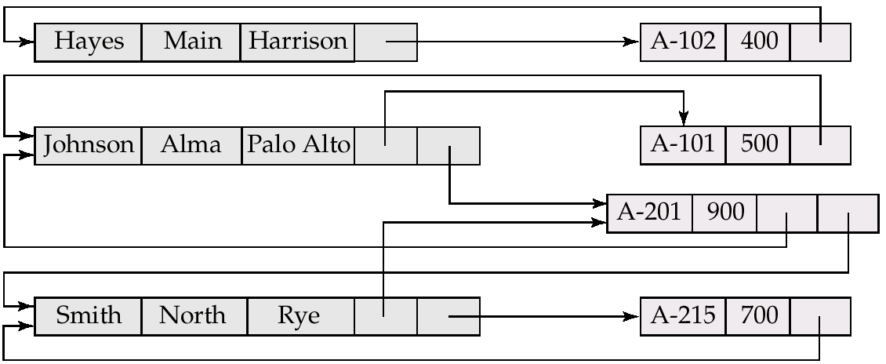
Mapping of Networks to Files (Cont.)
Diagram showing the sample instance with pointer fields to represent the links. Each link is replaced by two pointers.

Slide 59
Mapping of Networks to Files (Cont.)
Since the depositor link is many to many, each record can be associated with an arbitrary number of records (e.g., the account record would have a pointer to the customer record for each customer who has that account).
Direct implementation of many-to-many relationships requires the use of variable length records.
The DBTG model restricts links to be either one to one or one to many; the number of pointers needed is reduced, and it is possible to retain fixed-length records.

Slide 60
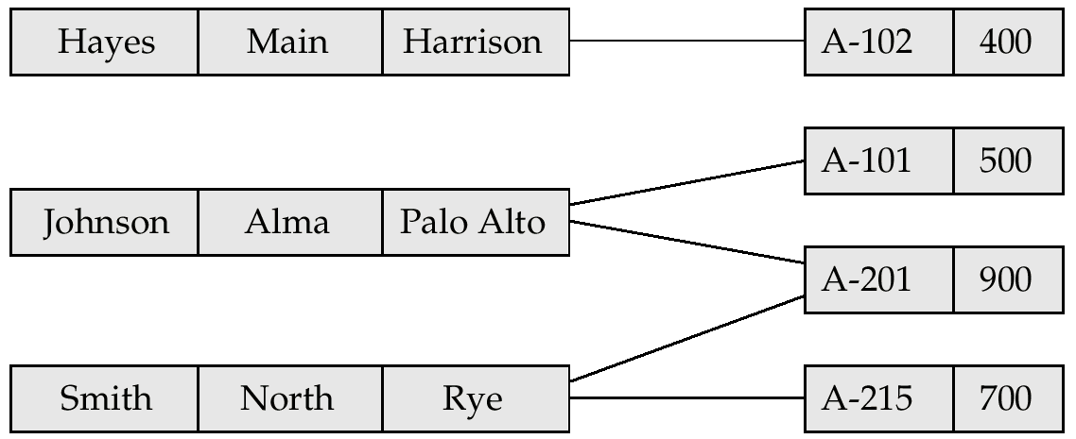
Mapping of Networks to Files (Cont.)
Assume that the depositor link is one to many and is represented by the DBTG set depositor and this corresponding sample database.
set name is depositor
owner is customer
member is account

Slide 61
Mapping of Networks to Files (Cont.)
Because an account record can be associated with only one customer record, we need only one pointer in the account record to represent the depositor relationship.
A customer record can be associated with many account records.
Rather ant using multiple pointers in the customer record, we can use a ring structure to represent the entire occurrence of the DBTG set depositor.
In a ring structure, the records of both the owner an member types for a set occurrence are organized into a circular list.
There is one circular list for each set occurrence (that is, for each record of the owner type).

Slide 62
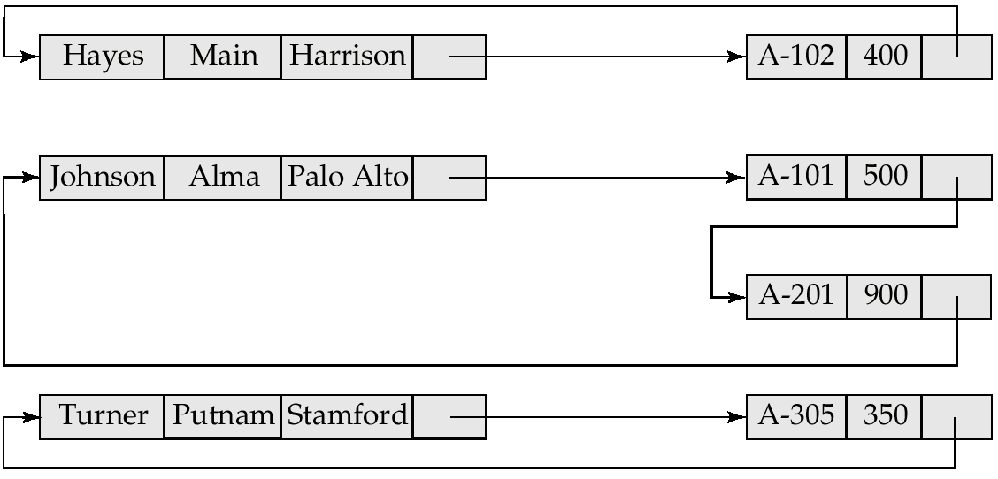
Example Ring Structure

Slide 63
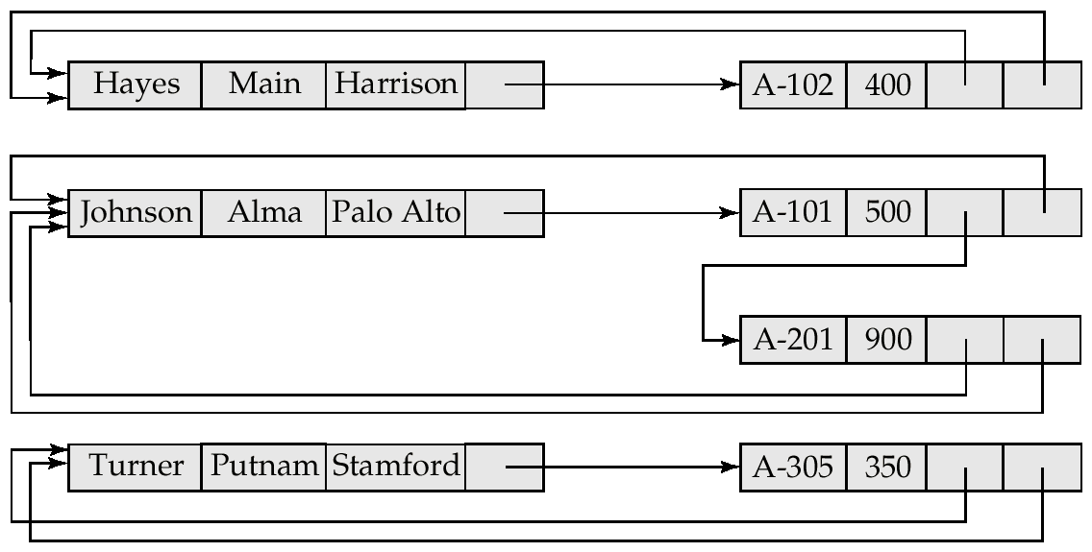
Modified Ring Structures
Execute find owner via a ring structure in which every member-type record contains a second pointer which points to the owner record.

Slide 64
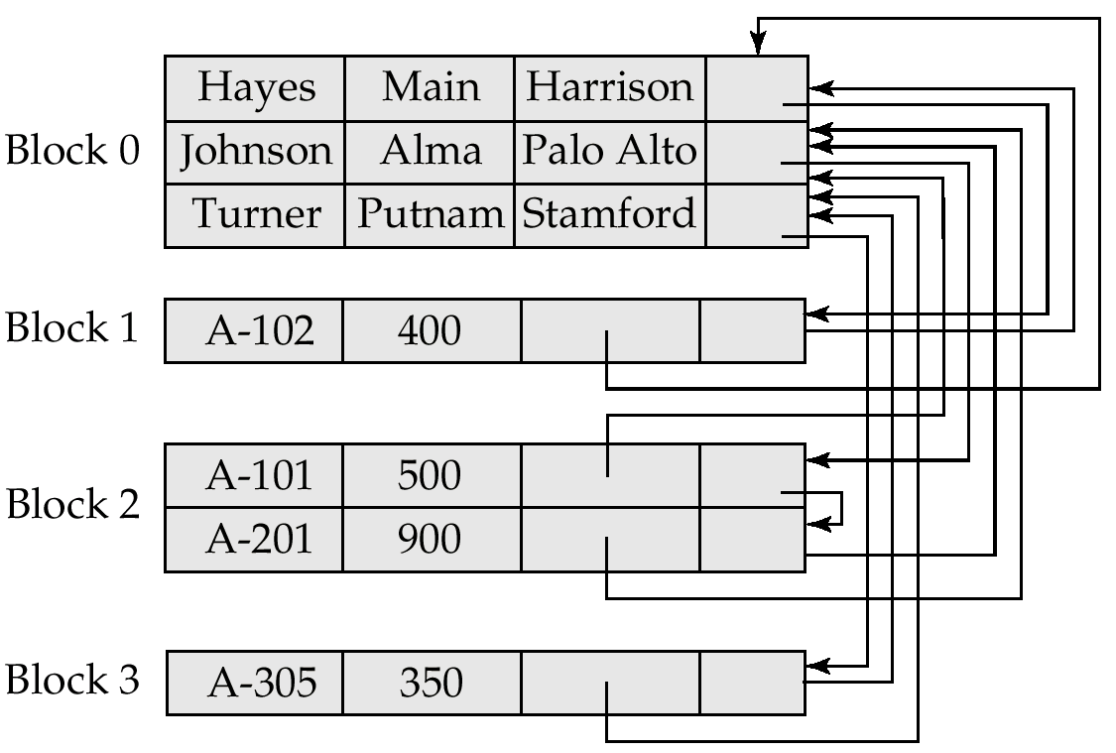
Clustered Record Placement for Instance for Figure A.1

Slide 65
Physical Placement of Records
To specify the storage strategy for DBTG set, add a placement clause to the definition of the member record type.
The clause
placement clustered via depositor
will store members of each set occurrence close to one another physically on disk, if possible, in the same block.
Store owner and member records close to one another physically on disk by adding the clause near owner.
placement clustered via depositor near owner

Slide 66
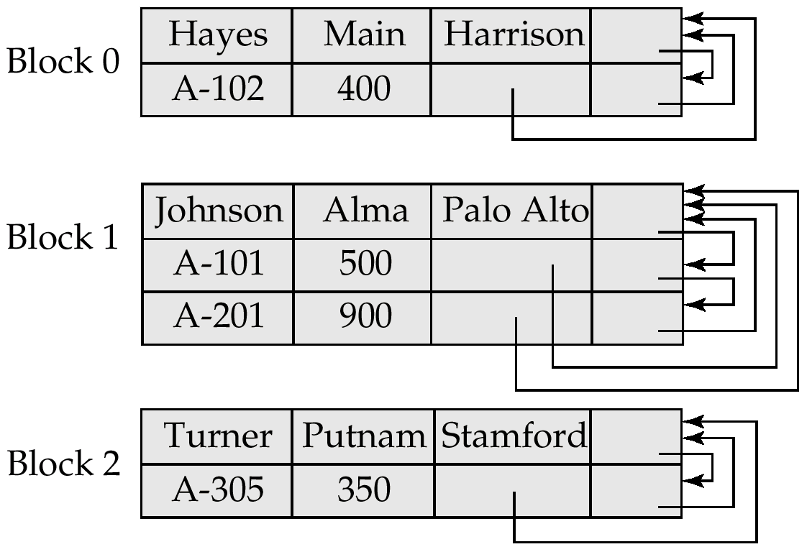
Physical Placement of Records (Cont.)
Storing member records in the same block as the owner reduces the number of block accesses required to read an entire set occurrence.

Slide 67
Appendix-A: Network Model
Basic Concepts
Data-Structure Diagrams
The DBTG CODASYL Model
DBTG Data-Retrieval Facility
DBTG Update Facility
DBTG Set-Processing Facility
Mapping of Networks to Files
Bibliography

Slide 68
Appendix-A: Bibliographical Notes (1)
In the late 1960s, several commercial database systems emerged that relied on the network model.
The most influential of these systems were the Integrated Data Store (IDS) system, which was developed in General Electric under the guidance of Charles Bachman [Bachman and Williams 1964], and Associate PL / I (APL) [Dodd 1969].
These and other systems were studied extensively by the DBTG within the CODASYL group that earlier set the standard for COBOL.
This study resulted in the first database standard specification, called the CODASYL DBTG 1971 report [CODASYL 1971].
Since then, a number of changes have been suggested to that report, including [CODASYL 1978].

Slide 69
Appendix-A: Bibliographical Notes (2)
The concept of data-structure diagrams was introduced by Bachman [1969].
The original presentation of data-structure diagrams used arrows to point from owner to member record types.
This presentation corresponds to the physical pointer implementation.
We have used the arrows pointing from member to owner record types to be consistent with our presentation of the E-R model. The same convention is used by Ullman [1988].

Slide 70
Appendix-A: Bibliographical Notes (C)
Implementation and design issues concerning the DBTG model are discussed by Schenk [1974], Gerritsen [1975], Dahl and Bubenko [1982], and Whang et al. [1982].
Discussions concerning the view level (the external level) of DBTG are offered by Zaniolo [1979a, 1979b] and Clemons [1979, 1979].
A high-level query language for the network model is proposed by Bradley [1978].
Translation of network queries to relational queries is discussed by Katz and Wong [1982].
Taylor and Frank[1976] is a survey paper on the DBTG model.

Slide 71
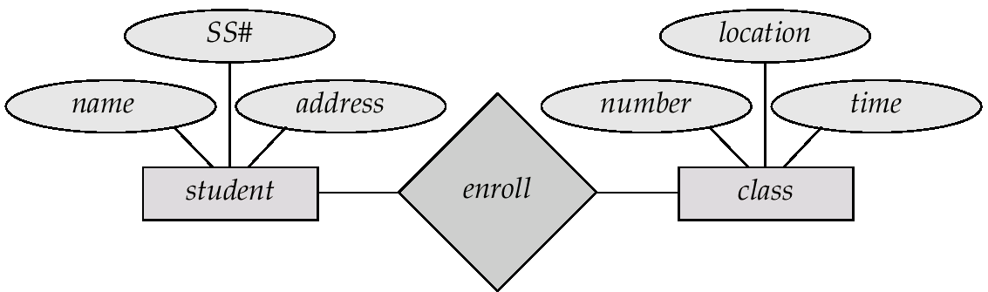
Class Enrollment E-R Diagram

Slide 72
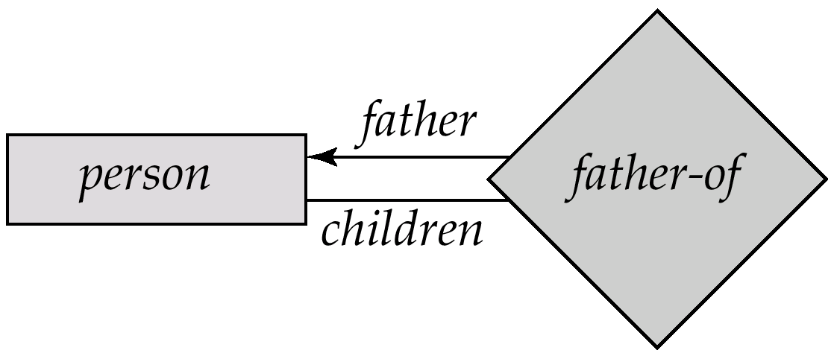
Parent—Child E-R Diagram

Slide 73
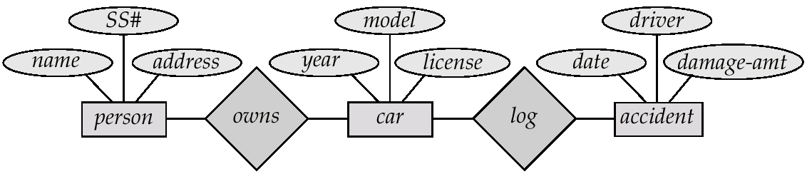
Car-Insurance E-R Diagram

