Slide 1
Chapter 27: Oracle

Slide 2
Database System Concepts
Chapter 1: Introduction
Part 1: Relational databases
  Chapter 2: Relational Model
  Chapter 3: SQL
  Chapter 4: Advanced SQL
  Chapter 5: Other Relational Languages
Part 2: Database Design
  Chapter 6: Database Design and the E-R Model
  Chapter 7: Relational Database Design
  Chapter 8: Application Design and Development
Part 3: Object-based databases and XML
  Chapter 9: Object-Based Databases
  Chapter 10: XML
Part 4: Data storage and querying
  Chapter 11: Storage and File Structure
  Chapter 12: Indexing and Hashing
  Chapter 13: Query Processing
  Chapter 14: Query Optimization
Part 5: Transaction management
  Chapter 15: Transactions
  Chapter 16: Concurrency control
  Chapter 17: Recovery System
Part 6: Data Mining and Information Retrieval
  Chapter 18: Data Analysis and Mining
  Chapter 19: Information Retreival
Part 7: Database system architecture
  Chapter 20: Database-System Architecture
  Chapter 21: Parallel Databases
  Chapter 22: Distributed Databases
Part 8: Other topics
  Chapter 23: Advanced Application Development
  Chapter 24: Advanced Data Types and New Applications
  Chapter 25: Advanced Transaction Processing
Part 9: Case studies
  Chapter 26: PostgreSQL
  Chapter 27: Oracle
  Chapter 28: IBM DB2
  Chapter 29: Microsoft SQL Server
Online Appendices
  Appendix A: Network Model
  Appendix B: Hierarchical Model
  Appendix C: Advanced Relational Database Model

Slide 3
Part 9: Case studies
(Chapters 26 through 29).
Chapter 26: PostgreSQL
Chapter 27: Oracle
Chapter 28: IBM DB2
Chapter 29: Microsoft SQL Server.
These chapters outline unique features of each of these systems, and describe their internal structure.
They provide a wealth of interesting information about the respective products, and help you see how the various implementation techniques described in earlier parts are used in real systems.
They also cover several interesting practical aspects in the design of real systems.

Slide 4
Chapter 27: Oracle
27.0 Introduction
27.1 Database Design and Querying Tools
27.2 SQL Variations and Extensions
27.3 Storage and Indexing
27.4 Query Processing and Optimization
27.5 Concurrency Control and Recovery
27.6 System Architecture
27.7 Replication, Distribution, and External Data
27.8 Database Administration Tools
27.9 Data Mining
Summary
Bibliographical Notes

Slide 5
Introduction
This chapter surveys a subset of the features, options, and functionality of Oracle products
New versions of the products are being developed continually, so all product descriptions are subject to change
The feature set is based on the first release of Oracle10g
Notes:
history

Slide 6
Chapter 27: Oracle
27.0 Introduction
27.1 Database Design and Querying Tools
27.2 SQL Variations and Extensions
27.3 Storage and Indexing
27.4 Query Processing and Optimization
27.5 Concurrency Control and Recovery
27.6 System Architecture
27.7 Replication, Distribution, and External Data
27.8 Database Administration Tools
27.9 Data Mining
Summary
Bibliographical Notes

Slide 7
Database Design and Querying Tools
Oracle provides a variety of tools for
  Database design
  Querying
  Report generation
  Data analysis, including OLAP (Online Analytical Processing)

Slide 8
Database Design and Querying Tools (cont.)
Oracle Developer Suite
  Forms development
  Data modeling
  Reporting
  Querying
Tools in Oracle Developer Suite
  Oracle Designer
  Oracle Repository
  JDeveloper
  Oracle Warehouse Builder

Slide 9
Database Design and Querying Tools (cont.)
Oracle Designer
  E-R diagrams
  Information engineering
  Object analysis and design
Oracle Repository
  Configuration management for database objects
  Forms applications
  Java classes
  XML files
JDeveloper
  End-to-end development of J2EE applications
Oracle Warehouse Builder
  Schema design
  Data mapping and transformations
  Data loading
  Metadata management

Slide 10
Database Design and Querying Tools (cont.)
Oracle Application Server Discoverer is a querying tool
  Web-based
  Ad-hoc query
  Reporting
  Analysis
  Web publishing tool

Slide 11
Chapter 27: Oracle
27.0 Introduction
27.1 Database Design and Querying Tools
27.2 SQL Variations and Extensions
27.3 Storage and Indexing
27.4 Query Processing and Optimization
27.5 Concurrency Control and Recovery
27.6 System Architecture
27.7 Replication, Distribution, and External Data
27.8 Database Administration Tools
27.9 Data Mining
Summary
Bibliographical Notes

Slide 12
SQL Variations and Extensions
Oracle supports all core SQL:1999 features fully or partially
Oracle-specific in syntax or functionality
  connect by: for transitive closure
  upsert
    Upsert combines update and insert
    Useful for merging new data with old data
    If a new row has the same key value as an old row ➔ The old row is updated
    Otherwise, the new row is inserted.
# SQL:1999 was developed by the NCITS Technical Committee H2 on Database This committee develops standards for the syntax and semantics of database languages.

Slide 13
SQL Variations and Extensions (cont.)
Oracle-specific in syntax or functionality (cont.)
  multitable inserts
    Update multiple tables based on a single scan of new data
  with clause
    Described in Section 3.8.2
  model clause
    Array algebra calculations on relational data

Slide 14
SQL Variations and Extensions (cont.)
    Example: Inserting new customer information from the customers_new table into two tables, customers and customers_special.
    INSERT FIRST
    WHEN cust_credit_limit >=4500 THEN
    INTO customers_special VALUES(cust_id,cust_credit_limit)
    INTO customers
    ELSE
    INTO customers
    SELECT * FROM customers_new;

Slide 15
SQL Variations and Extensions (cont.)
Object-Relational (OR) Features
  Object types
  Collection types
  Object tables
  Table functions
  Object views
  Methods
  User-defined aggregate functions
  XML as a native data types

Slide 16
SQL Variations and Extensions (cont.)
OLAP
  Now, OLAP processing is done inside the RDB
  Reasons for moving away from a separate multidimensional storage engine
    A relational engine can scale to much larger data sets
    A common security model can be used for the analytical applications and the data warehouse
    Multidimensional modeling can be integrated with data warehouse modeling
    The relational database management system has a larger set of features and functionality in many areas such as high availability, backup and recovery, and third-party tool support
    There is no need to train database administrators for two database engines

Slide 17
SQL Variations and Extensions (cont.)
Triggers :
For triggers that execute on DML statements such as insert, update, and delete, Oracle supports
  Statement triggers
  Executed just once per statement.
  Row triggers
  Executed once for every row that is affected (updated or deleted, for example) by the DML operation
The creation of instead of triggers
    For views that cannot be subject to DML operation
    A user can create an instead of trigger on a view to specify manually what operations on the base tables are to occur in response to the DML operation on the view

Slide 18
Chapter 27: Oracle
27.0 Introduction
27.1 Database Design and Querying Tools
27.2 SQL Variations and Extensions
27.3 Storage and Indexing
27.4 Query Processing and Optimization
27.5 Concurrency Control and Recovery
27.6 System Architecture
27.7 Replication, Distribution, and External Data
27.8 Database Administration Tools
27.9 Data Mining
Summary
Bibliographical Notes

Slide 19
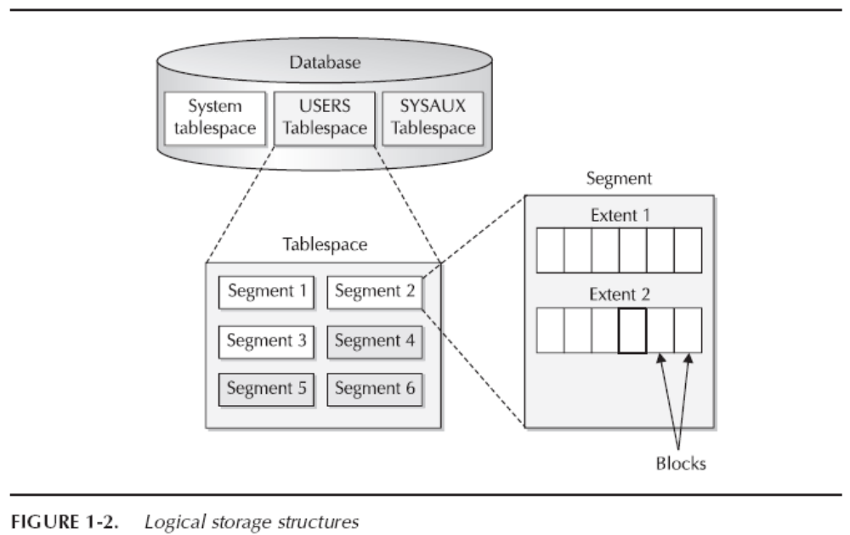
Storage and Indexing

Slide 20
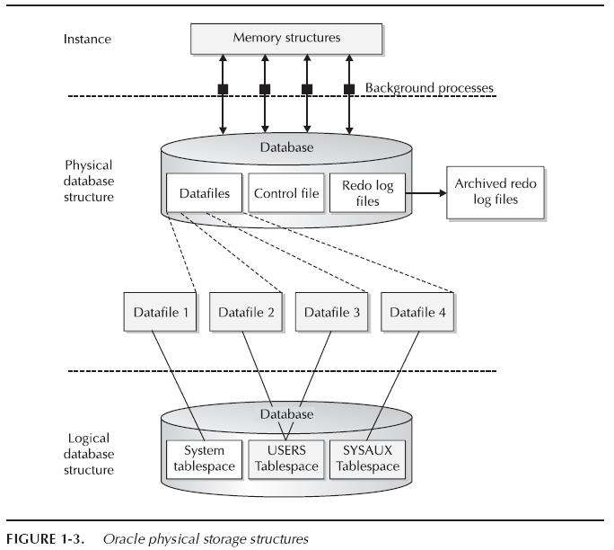
Storage and Indexing (cont.)

Slide 21
Storage and Indexing (cont.)
Table Spaces :
  A database consists of one or more logical storage units called tablespaces
  Each table space consists of one or more physical structures called data files
  System tablespace
    Data-dictionary table, storage for triggers and stored procedures
  User data tablespace
    Created to store user data
  Temporary tablespace
    When DB operations require sorting the data
    If the sort cannot be done in memory, the sort routine stores the data temporarily on disk

Slide 22
Storage and Indexing (cont.)
Segments :
  The space in a table space is divided into units, called segments, that each contain data for a specific data structure
  Data segments
    Where table data are stored
  Index segments
    Each index in a tablespace has its own index segment
  Temporary segments
    When a sort operation need to write data to disk
    Or when data are inserted into temporary table
  Rollback segments
    Contain undo information to roll back an uncommitted transaction

Slide 23
Storage and Indexing (cont.)
Segments (cont.) :
  Below the level of segment, space is allocated at a level of granularity called extent
  Each extent consists of a set of contiguous database blocks
  A database block is the lowest level of granularity at which Oracle performs disk I/O
  A database block does not have to be the same as an OS block in size, but should be a multiple thereof

Slide 24
Storage and Indexing (cont.)
Tables :
  A standard table in Oracle is heap organized
    The storage location of a row in a table is not based on the values contained in the row, and is fixed when the row is inserted
  If the table is partitioned, the content of the row affects the partition in which it is stored
  Therefore, there are several features and variations

Slide 25
Storage and Indexing (cont.)
Tables (cont.) :
  Oracle supports nested tables
    A table can have a column whose data type is another table
    The nested table is not stored in line in the parent table, but is stored in a separate table
  Oracle supports temporary tables
    The duration of the data is either the transaction in which the data are inserted, or the user session
    The data are removed automatically at the end of duration

Slide 26
Storage and Indexing (cont.)
Tables (cont.) :
Cluster
  Another form of organization for table data
  Rows from different tables are stored together in the same block on the basis of some common columns
  For example, a department table and an employee table could be clustered so that each row in the department table is stored together with all the employee rows for those employees who work in that department
  Advantage: When two tables are joined
    Performance benefits without the space penalty
  Trade-off: Need to have a larger number of blocks

Slide 27
Storage and Indexing (cont.)
Index-Organized Tables :
  Records are stored in an Oracle B-tree index instead of in a heap
  An index-organized table requires that a unique key be identified for use as the index key
  Index-organized table can improve both performance and space utilization
  Secondary indices on nonkey columns of an index-organized table are different from indices on a regular heap table
  A secondary index on an index-organized table contains not normal row-ids, but logical row-ids instead

Slide 28
Storage and Indexing (cont.)
Indices :
  Oracle supports several different types of indices
    B-tree Index
    Bitmap Index
    Function-Based Index
    Join Index
    Domain Index

Slide 29
Storage and Indexing (cont.)
1. B-tree indices :
  Format: <col1><col2><col3><row-id>
  <col1> : the value for column 1
  <row-id> : row-id for the row
  Oracle can optionally compress the prefix of entry to save space
  The representation of each distinct <col1><col2> prefix can be shared

Slide 30
Storage and Indexing (cont.)
2. Bitmap Indices :
  Use a bitmap representation for index entries
  The form of bitmap index entry
  <col1><startrow-id><endrow-id><compressedbitmap>
  1 bit : the column value of that row is that of the index entry
  0 bit : the row has some other value, or does not actually exist in the table
  The compression algorithm, like BBC, deals with long strings of consecutive zeros

Slide 31
Storage and Indexing (cont.)
3. Function-Based Indices :
  Oracle allows indices to be created on expressions that involve one or more columns
  ➔ col1 + col2 * 5
  For example, in order to find all rows with name “van Gogh”
  upper(name) = ‘VAN GOGH’
  Oracle then matches the condition with the index definition

Slide 32
Storage and Indexing (cont.)
4. Join Indices :
  A join index is an index where the key columns are not in the table that is referenced by the row-ids in the index
  For example, if there is a column for product names in a product dimension table
  ➔ A bitmap join index on the fact table with this key column could be used to retrieve the fact table rows that correspond to a product with a specific name
  Oracle allows bitmap join indices to have more than on key column

Slide 33
Storage and Indexing (cont.)
5. Domain Indices :
  Support to develop so-called cartridges with functionality for specific application domains
  For example, a domain index for advanced text searches may support an operator contains
  Once this operator has been registered, the domain index will be considered as an access path for a query like
  select *
  from employees
  where contains (resume, ‘LINUX’)

Slide 34
Storage and Indexing (cont.)
Partitioning :
  Oracle supports various kinds of horizontal partitioning of tables and indices
  And this feature plays a major role in Oracle’s ability to support very large databases
  The ability to partition a table or index has advantages
    Backup and recovery are easier and faster
    Loading operations in a data warehousing environment are less intrusive
    Query performance benefits substantially

Slide 35
Storage and Indexing (cont.)
Partitioning (cont.) :
  Several ways to map column values to partitions, giving rise to several types of partitioning, each with different characteristics
    Range Partitioning
    ➔ Criteria: the range of value
    Hash Partitioning
    ➔ Hash function maps rows to partitions
    Composite Partitioning
    ➔ Table is range partitioned, but each partition is subpartitioned
    by using hash or list partitioning
    List Partitioning
    ➔ The values associated with a particular partition are state in a list

Slide 36
Storage and Indexing (cont.)
Materialized Views :
  Allows the result of an SQL query to be stored in a table and used for later query processing
  Oracle maintains the materialized result, updating it when the referenced tables in the query are updated
  Materialized views are used in data warehousing to speed up query processing
  ➔ A common usage is to summarize data

Slide 37
Storage and Indexing (cont.)
Materialized Views (cont.) :
  While it can improve query performance, it uses up space, and creating and maintaining it consumes resources.
  To help resolve this trade-off
  ➔ Oracle provides an advisor that can help a user create the most cost-effective materialized views, given a particular query workload as input

Slide 38
Chapter 27: Oracle
27.0 Introduction
27.1 Database Design and Querying Tools
27.2 SQL Variations and Extensions
27.3 Storage and Indexing
27.4 Query Processing and Optimization
27.5 Concurrency Control and Recovery
27.6 System Architecture
27.7 Replication, Distribution, and External Data
27.8 Database Administration Tools
27.9 Data Mining
Summary
Bibliographical Notes

Slide 39
Query Processing and Optimization
Execution Methods :
  Data can be accessed through a various access methods
  Full table scan: scans the entire table.
  Index scan: scans to a relevant part of the index
  Index fast full scan: scans the extents in the same way as the table extent in a full table scan
  Index join: is used If a query needs only a small subset of the columns of a wide table, but no single index contains all those columns
  Cluster and hash cluster access: accesses the data by using the cluster key

Slide 40
Query Processing and Optimization (cont.)
Optimization :
Query Transformations
  Oracle does query optimization in several steps
  One step is to perform various query transformations and rewrites
  Another step is to perform access-path selection
  Major types of transformations and rewrites
    View merging
    Complex view merging
    Subquery flattening
    Materialized view rewrite
    Star transformation

Slide 41
Query Processing and Optimization (cont.)
Optimization (cont.) :
Access-Path Selection
  Oracle has a cost-based optimizer that determines join order, join methods, and access paths
  Each operation that the optimizer considers has an associated cost function
  The optimizer tries to generate the combination of operations that has the lowest overall cost

Slide 42
Query Processing and Optimization (cont.)
SQL Tuning Advisor :
  Improves the performance of high-load SQL statements by making various kinds of recommendations
  Four categories :
    Statistics Analysis
    SQL Profiling
    Access-Path Analysis
    SQL Structure Analysis

Slide 43
Query Processing and Optimization (cont.)
Parallel Execution :
  Oracle allows the execution of a single SQL statement to be parallelized by dividing the work between multiple processes on a multiprocessor computer
  Several ways to spilt up the work
    For operations that access base object (tables and indices)
    # Divide the work by horizontal slices of data
    For joins
    # Divide one of the inputs to the join
    # Large table Small table
    # By hashing on the value of the join columns
    For sort operations
    # Parallelize by value ranges of the column on sorting

Slide 44
Query Processing and Optimization (cont.)
Parallel Execution (cont.) :
  The processes involved in the parallel execution of an SQL statement consist of :
    A coordinator process
    A number of parallel server processes
  The coordinator
    Assigns work to the parallel servers
    Collects and returns data to the user process that issued the statement
  The degree of parallelism
    = The number of parallel server processes
    Is determined by the optimizer

Slide 45
Chapter 27: Oracle
27.0 Introduction
27.1 Database Design and Querying Tools
27.2 SQL Variations and Extensions
27.3 Storage and Indexing
27.4 Query Processing and Optimization
27.5 Concurrency Control and Recovery
27.6 System Architecture
27.7 Replication, Distribution, and External Data
27.8 Database Administration Tools
27.9 Data Mining
Summary
Bibliographical Notes

Slide 46
Concurrency Control and Recovery
Concurrency Control :
  Oracle’s concurrency control differs from the concurrency mechanisms used by most other database vendors
    Basically the multiversion two-phase locking protocol
    Using System Change Number (SCN)
  During recovery from a backup, Oracle performs two steps to reach a consistent state
    First, Oracle rolls forward by applying the (archived) redo logs to the backup
    Second, Oracle rolls back uncommitted transactions by using the rollback segment
  Recovery Manager
    A GUI tool which automates most of backup and recovery tasks

Slide 47
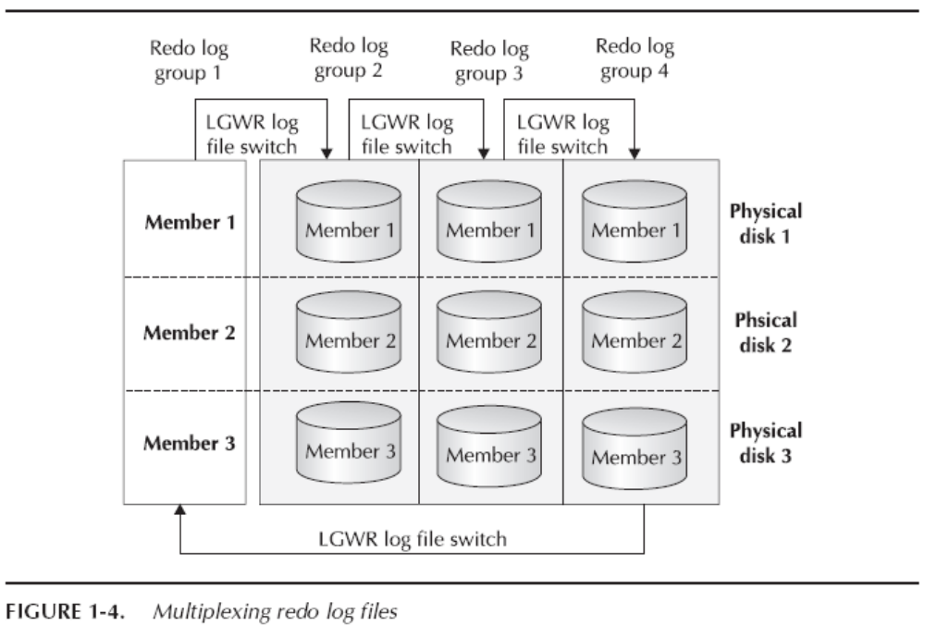
Concurrency Control and Recovery (cont.)

Slide 48
Concurrency Control and Recovery (cont.)
Oracle Data Guard :
  To ensure high availability, Oracle provides a standby database feature, Data Guard
  A standby database is a copy of the regular database that is installed on a separate system
  When a failure occurs on the primary system, the standby system is activated and takes over

Slide 49
Chapter 27: Oracle
27.0 Introduction
27.1 Database Design and Querying Tools
27.2 SQL Variations and Extensions
27.3 Storage and Indexing
27.4 Query Processing and Optimization
27.5 Concurrency Control and Recovery
27.6 System Architecture
27.7 Replication, Distribution, and External Data
27.8 Database Administration Tools
27.9 Data Mining
Summary
Bibliographical Notes

Slide 50
System Architecture
Dedicated Server : Memory Structures
  The memory used by Oracle falls mainly into three categories:
    Software code areas
      the parts of the memory where the Oracle server code resides
    System global area (SGA)
      a memory area for structures that are shared among users
    Program global area (PGA)
      allocated for each process to hold its local data and control information

Slide 51
System Architecture (cont.)
Dedicated Server : Memory Structures (cont.)
  The SGA is made up by several major structures
  Buffer cache
    Keeps frequently accessed data blocks in memory to reduce the need to perform physical disk I/O
  Redo log buffer
    Contains the part of the redo log that has not yet been written to disk
  Shared pool
    The sharable parts of the data structures representing the SQL statement are stored

Slide 52
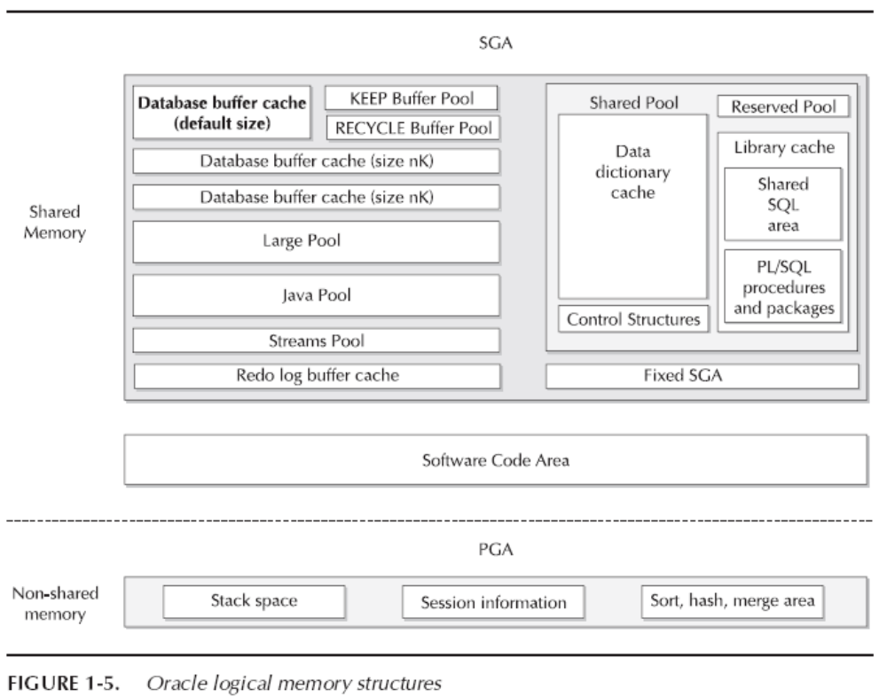
System Architecture (cont.)

Slide 53
System Architecture (cont.)
Dedicated Server : Process Structures
  Two types of processes that execute Oracle server code
  Server processes
    Process SQL statements
  Background processes
    Perform various administrative and performance-related tasks

Slide 54
System Architecture (cont.)
Dedicated Server : Process Structures (cont.)
  The most important types of background processes
  Database writer
    When a buffer is removed from the buffer cache, it must be written back to disk if it has been modified since it entered the cache
  Log writer
    Writes entries in the redo log buffer to the redo log file on disk
  Checkpoint
    Updates the headers of the data file when a checkpoint occurs
  System monitor
    Performs crash recovery if needed
  Process monitor
    Performs process recovery
  Recoverer
    Resolves failures and conducts cleanup for distributed transactions
  Archiver
    Copies the online redo log file to an archived redo log

Slide 55
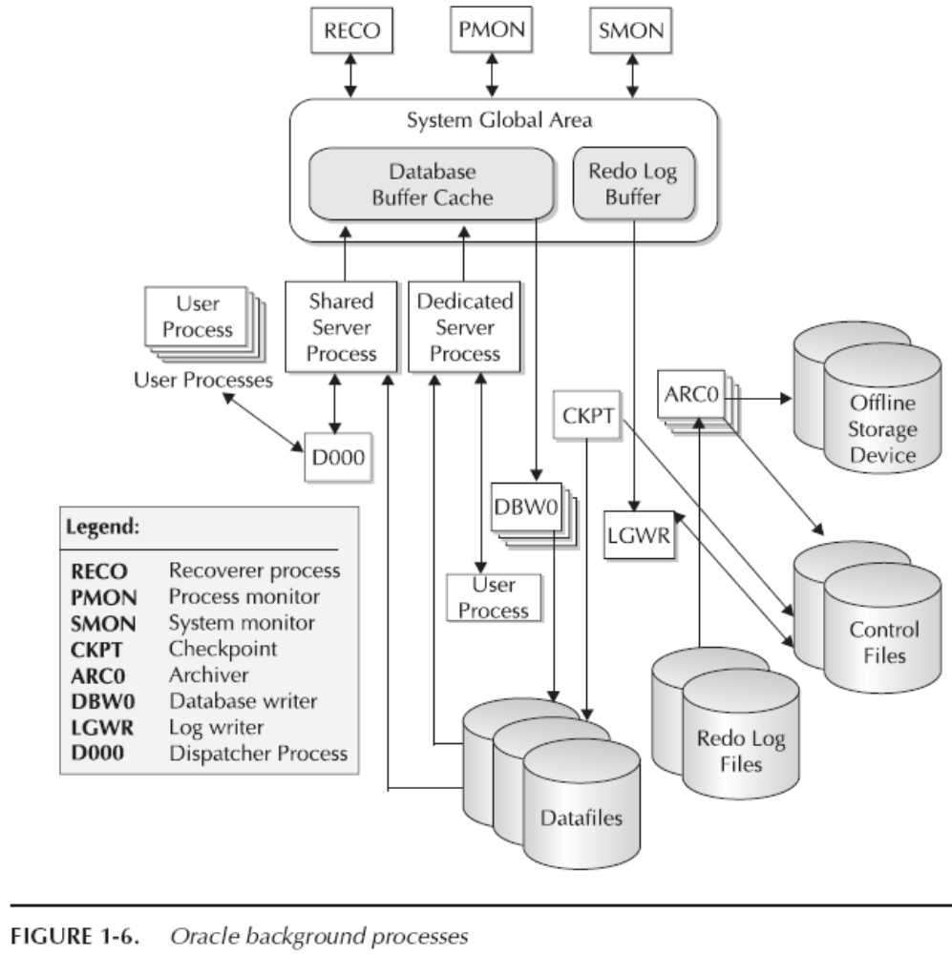
System Architecture (cont.)

Slide 56
System Architecture (cont.)
Shared Server :
  The shared server configuration increases the number of users that a given number of server processes can support by sharing server processes among statements
  Differences from the dedicated server architecture
    A background dispatch process routes user requests to the next available server process
    Since a server process is shared among multiple SQL statements, Oracle stores the session-specific data in the SGA

Slide 57
System Architecture (cont.)
Oracle Real Application Clusters :
  Oracle Real Application Clusters (RAC) is a feature that allows multiple instances of Oracle to run against the same database
  An instance is the combination of background processes and memory areas (in Oracle terminology)
  This feature enables Oracle to run on clustered and MPP (shared-disk and shared-nothing) hardware architectures

Slide 58
System Architecture (cont.)
Oracle Real Application Clusters (cont.) :
  The ability to cluster multiple nodes has important benefits for scalability and availability
    High Scalability
      More nodes mean more processing power
    High Availability
      If one node fails, the remaining ones are still available to the application accessing the database
      The remaining instances will automatically roll back uncommitted transactions

Slide 59
System Architecture (cont.)
Oracle Real Application Clusters (cont.) :
  Having multiple instances run against the same database gives rise to some technical issues
  There is always the possibility of overlap, which affects locking and cache management
  Oracle supports the cache fusion feature
    It allows data blocks to flow directly among caches on different instances without being written to disk
  # Cache Fusion
  Oracle’s cache fusion architecture is a new shared cache architecture that provides e-business applications the benefits of both shared-disk and shared-nothing databases without the drawbacks of either architecture

Slide 60
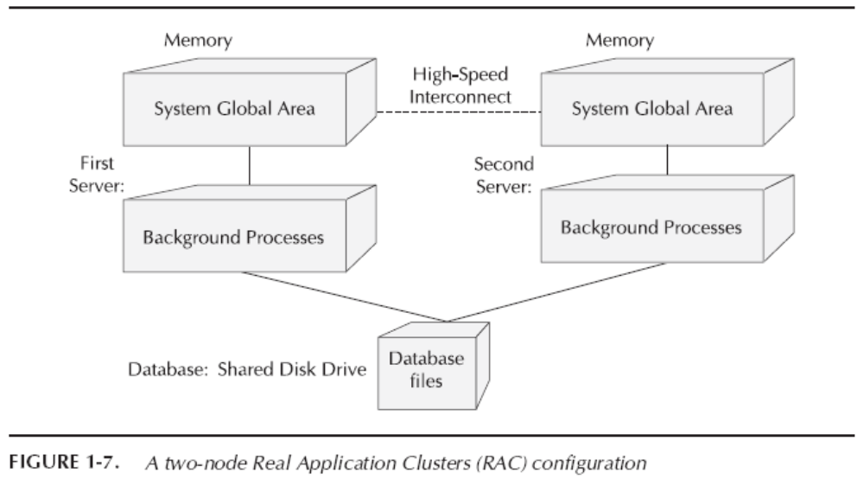
System Architecture (cont.)

Slide 61
Chapter 27: Oracle
27.0 Introduction
27.1 Database Design and Querying Tools
27.2 SQL Variations and Extensions
27.3 Storage and Indexing
27.4 Query Processing and Optimization
27.5 Concurrency Control and Recovery
27.6 System Architecture
27.7 Replication, Distribution, and External Data
27.8 Database Administration Tools
27.9 Data Mining
Summary
Bibliographical Notes

Slide 62
Replication, Distribution, and External Data
Replication :
  Data in a master site are replicated to other sites in the form of snapshots
    A snapshot does not have to contain all the master data
    It can, for example, exclude certain columns from a table for security reasons
    Two types of snapshots
      read only
      Updatable
  Oracle supports multiple master sites for the same data, where all master sites act as peers

Slide 63
Replication, Distribution, and External Data
Distributed Databases :
  Oracle supports queries and transactions spanning multiple databases on different systems
    Oracle can optimize a query that includes tables at different sites, retrieve the relevant data, and return the result
    Oracle also transparently supports transactions spanning multiple sites by a built-in two-phase-commit protocol

Slide 64
Replication, Distribution, and External Data (cont.)
External Data Sources :
  Oracle has several mechanisms for supporting external data sources
  The most common usage is in data warehousing when large amounts of data are regularly loaded from a transactional system
  SQL*Loader
    Oracle has a direct load utility that supports fast parallel loads of large amounts of data from external files

Slide 65
Replication, Distribution, and External Data (cont.)
External Data Sources (cont.) :
  External Tables
    An external table is defined by metadata that describe the Oracle column types and the mapping of the external data into those columns
    The external table feature is primarily intended for extraction, transformation, and loading (ETL) operations in a data warehousing environment
    Data can be loaded into the data warehouse from a flat file using,
  create table table as
  select … from <external table>
  where …

Slide 66
Chapter 27: Oracle
27.0 Introduction
27.1 Database Design and Querying Tools
27.2 SQL Variations and Extensions
27.3 Storage and Indexing
27.4 Query Processing and Optimization
27.5 Concurrency Control and Recovery
27.6 System Architecture
27.7 Replication, Distribution, and External Data
27.8 Database Administration Tools
27.9 Data Mining
Summary
Bibliographical Notes

Slide 67
Database Administration Tools
Automatic Workload Repository :
  In the release Oracle10g, much emphasis was put on the concept of manageability
  Automatic Workload Repository (AWR) is one of the central pieces of infrastructure for manageability
  Oracle monitors the activity on the database system and records various information about workloads and resource consumption

Slide 68
Database Administration Tools (cont.)
Database Resource Management :
  This feature allows the DBA to divide users into resources consumer groups with different priorities and properties
  For example,
    A group of high-priority, interactive users
    A low-priority group
  DBA can also set the degree of parallelism, time limit, and number of user sessions for each group

Slide 69
Database Administration Tools (cont.)
Oracle Enterprise Manager :
  Oracle Enterprise Manager (OEM) is Oracle’s main tool for database-systems management
  OEM provides easy-to-use GUI for tasks including,
    Configuration
    Performance monitoring
    Resource management
    Security management
    Access to various advisors

Slide 70
Chapter 27: Oracle
27.0 Introduction
27.1 Database Design and Querying Tools
27.2 SQL Variations and Extensions
27.3 Storage and Indexing
27.4 Query Processing and Optimization
27.5 Concurrency Control and Recovery
27.6 System Architecture
27.7 Replication, Distribution, and External Data
27.8 Database Administration Tools
27.9 Data Mining
Summary
Bibliographical Notes

Slide 71
Data Mining
Oracle Data Mining :
  Oracle provides functionality for both supervised and unsupervised learning
    Classification
    Regression
    Attribute importance
    Clustering
    Market basket analysis
    Feature extraction
    Text mining
    Bioinformatics (BLAST)

Slide 72
Chapter 27: Oracle
27.0 Introduction
27.1 Database Design and Querying Tools
27.2 SQL Variations and Extensions
27.3 Storage and Indexing
27.4 Query Processing and Optimization
27.5 Concurrency Control and Recovery
27.6 System Architecture
27.7 Replication, Distribution, and External Data
27.8 Database Administration Tools
27.9 Data Mining
Summary & Bibliographical Notes

Slide 73
Summary (1)
This chapter surveys a subset of the features, options, and functionality of Oracle products
Oracle provides various tools for database design, querying, report generation, and data analysis including OLAP
Oracle supports all core SQL:1999 features fully or partially
Oracle database consists of information stored in files and is accessed through an instance
Oracle supports a large variety of processing techniques in its query-processing engine

Slide 74
Summary (2)
Oracle supports concurrency-control and recovery techniques
Oracle has two server architecture: dedicated and multithreaded
Oracle provides support for replication and distributed transactions with two-phase commit
Oracle provides users a number of tools and features for system management and application development
Oracle Data Mining provides various algorithms that embed the data-mining process inside the database

Slide 75
Bibliographical Notes (1)
Up-to-date product information, including documentation, on Oracle products can be found at the Web sites http://www.oracle.com and http://technet.oracle.com
Extensible indexing in Oracle is described in Srinivasan et al. [2000b] and Srinivasan et al. [2000c]
Index-organized tables are described in Srinivasan et al. [2000a], Banerjee et al. [2000], Murphy and Banerjee [2003]]
Krishnaprasad et al. [2004] describe XML support in Oracle
Bello et al.[1998] describe materialized views in Oracle
Antoshenkov [1995] describes the byte-aligned bitmap compression technique used in Oraclel; see also Johnson [1999]
Lahiri et al. [2001b] describe the cache fusion functionality of Oracle Real Application Clusters

Slide 76
Bibliographical Notes (2)
Recovery in Oracle is described in Joshi et al. [1998] and Lahiri et al. [2001a]
Messaging and queuing in Oracle are described in Gawlick[1998]
Witkowski et al. [2003a] and Witkowski et al. [2003b] describe the MODEL clause
The memory management algorithms for sorting and hashing are described in Dageville and Zait [2002]
Poess and Potapov [2003] describe Oracle’s table compression feature
The frequent item set algorithm for market basket analysis in Oracle Data Mining is described in Li and Mozes [2004]
Automatic SQL tuning is described in Dageville et al. [2004b]
Cruanes et al. [2004] describe parallel execution in Oracle

Slide 77
Chapter 27: Oracle
27.0 Introduction
27.1 Database Design and Querying Tools
27.2 SQL Variations and Extensions
27.3 Storage and Indexing
27.4 Query Processing and Optimization
27.5 Concurrency Control and Recovery
27.6 System Architecture
27.7 Replication, Distribution, and External Data
27.8 Database Administration Tools
27.9 Data Mining
Summary & Bibliographical Notes

Slide 78
End of Chapter

