Slide 1
Topic-sensitive PageRank
Taher H. Haveliwala
Stanford University, Stanford, CA
WWW 2012
Jan 16, 2013
Hee-gook Jun

Slide 2
Outline
Introduction
Topic-sensitive PageRank
Experiments
Conclusion

Slide 3

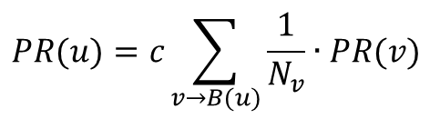
Simplified PageRank
Link-based ranking algorithm
5
PageRank Value =
10
A
5
$$PR(u)=c\sum_{v→B(u)}{\frac{1}{N_{v}}∙PR(v)}$$
PageRank Value =
30
10
10
$=\frac{1}{2}∙10$ + $\frac{1}{3}∙30$ + $\frac{1}{4}∙80$
$$=35$$
B
D
10
20
PageRank Value =
80
20
C
20
20

Slide 4
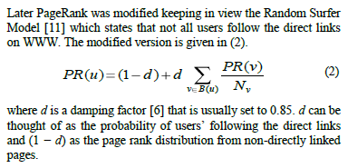
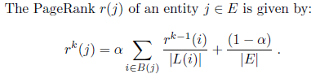
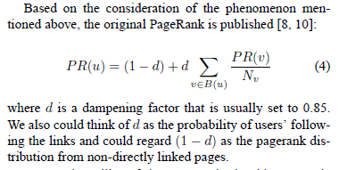
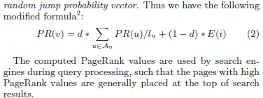
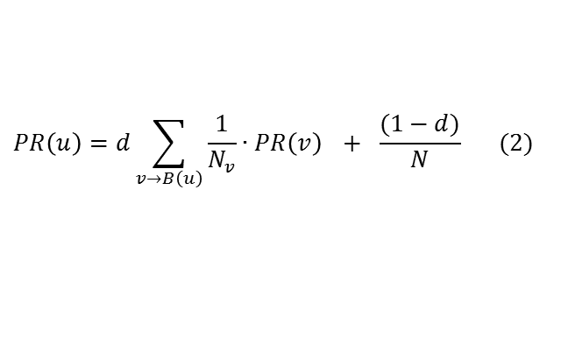
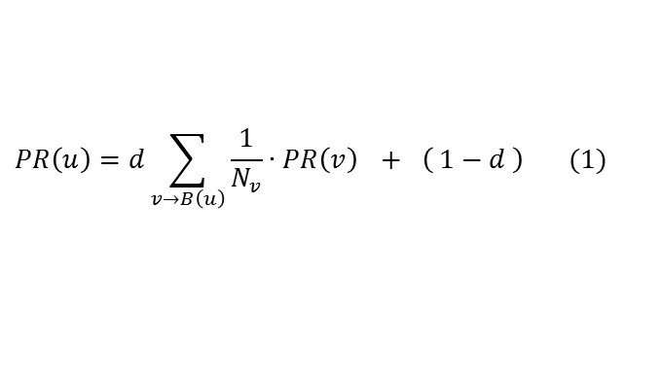
Confusion of PageRank formula
Which formula is correct?
$$PR\left(u\right)=d\sum_{v→B\left(u\right)}{\frac{1}{N_{v}}∙PR\left(v\right)} + \left( 1−d \right) (1)$$
$$PR\left(u\right)=d\sum_{v→B\left(u\right)}{\frac{1}{N_{v}}∙PR\left(v\right)} + \frac{(1−d)}{N} (2)$$

Slide 5
Random Surfer Model
However, in real life,
User may follow links
User may get bored and jumps to a new page
Probability of choosing a page?
1 / N

Slide 6

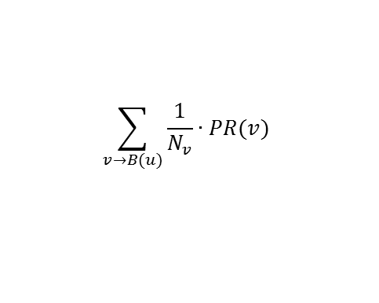
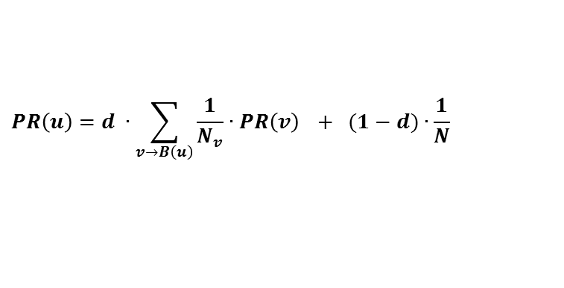
Probability of a Page Receiving PR Value
1. Link Chain
2. Jump to a page
A
A
Sum of previous PageRank values
Probability of randomly selecting a page
$$\sum_{v→B(u)}{\frac{1}{N_{v}}∙PR(v)}$$
$$\frac{1}{N}$$
85%
15%
$$PR\left(u\right)=d ∙\sum_{v→B\left(u\right)}{\frac{1}{N_{v}}∙PR\left(v\right)} + (1−d)∙\frac{1}{N}$$

Slide 7
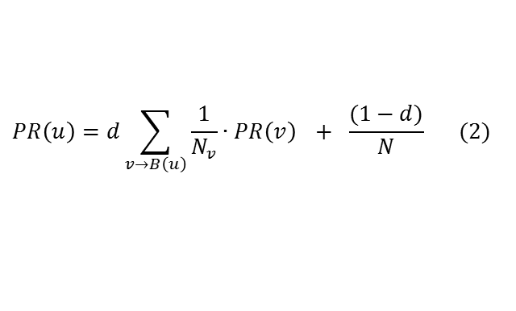
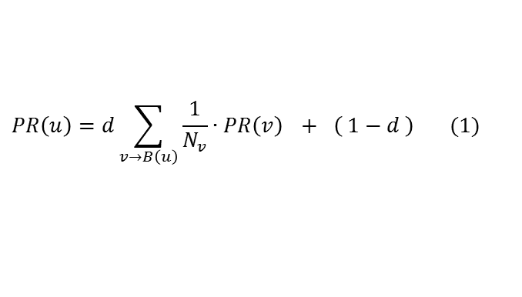

PageRank vs. PageRank
Page and Brin confused the two formulas*
They mistakenly claimed that the first formula formed a probability distribution over web pages.
Contradiction: the sum of all PageRank is one
$$PR\left(u\right)=d\sum_{v→B\left(u\right)}{\frac{1}{N_{v}}∙PR\left(v\right)} + \left( 1−d \right) (1)$$
$$PR\left(u\right)=d\sum_{v→B\left(u\right)}{\frac{1}{N_{v}}∙PR\left(v\right)} + \frac{(1−d)}{N} (2)$$
$$\frac{(1−d)}{N} × N$$
It counts for all page’s probability
* http://en.wikipedia.org/wiki/PageRank#cite_note-originalpaper-4

Slide 8
Topic-sensitive PageRank vs. PageRank
PageRank
Query independent
Preprocessing
Topic-sensitive PageRank
Query dependent
Preprocessing + query time processing

Slide 9
Example[1/3]: Preprocessing
Two topics
Health and money
Compute rank score of each topic
Health
Money

Slide 10

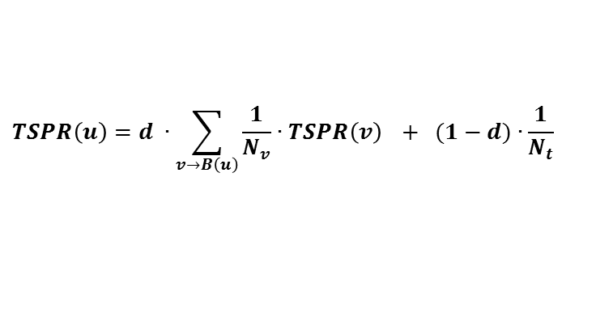


Example[2/3]: Preprocessing
Multiple scores are computed for every topic
$$TSPR\left(u\right)=d ∙\sum_{v→B\left(u\right)}{\frac{1}{N_{v}}∙TSPR\left(v\right)} + (1−d)∙\frac{1}{N_{t}}$$
Unbiased
$$\frac{1}{N}=\frac{1}{9}$$
Health
$$\frac{1}{N_{t}}=\frac{1}{6}$$
Money
$$\frac{1}{N_{t}}=\frac{1}{4}$$

Slide 11
Example[3/3]: Query time processing
Given a query “Dollar”
Calculate similarity based on probability
Sim(“Dollar”, “Health”)
Sim(“Dollar”, “Money”)
Money

Slide 12
Experimental Setup
Web data
Stanford WebBase (120 million pages)
16 Topics
Taken from the Open Directory
10 Query and 5 volunteers

Slide 13
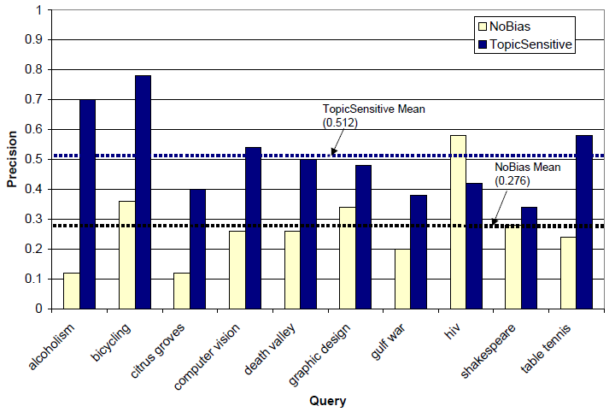
Results
Topic-sensitive PageRank scores is substantially higher
Precision @ 10 results for our test queries. The average precision over the ten queries is also shown

Slide 14
Conclusion
Topic-sensitive PageRank
Provide query term relative ranking
Various similarity method
Issue
Number of topics
Time and Cost
Query classification

