Slide 1
Practical RDF Chapter 7. Editing, Parsing, and Browsing RDF/XML
Shelley Powers, O’Reilly
SNU IDB Lab.
Taikyoung Kim

Slide 2
Contents
Browser
BrownSauce
Parsers
ARP2
ICS_FORTH Validating RDF Parser
Editors
IsaViz
RDF Editor in Java

Slide 3

Browser BrownSauce
Java based RDF/XML browser tool
Parse RDF/XML and transform into a readable format
Server : parse data and transform it into HTML format
Browse a RDF/XML using any Internet browser application
Predicate : hypertext linked
Literal : non-hypertext linked
Doesn’t provide parsed access to data
Provide a human-readable format for examining RDF/XML documents
Local
Web
BrownSauce
Server
RDF/XML URL
Modified result
RDF/XML Document

Slide 4
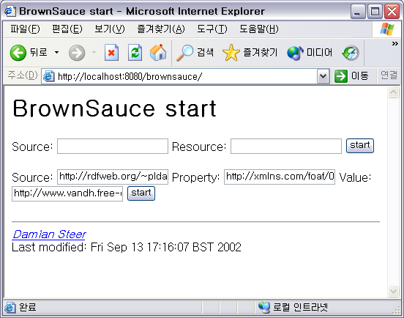
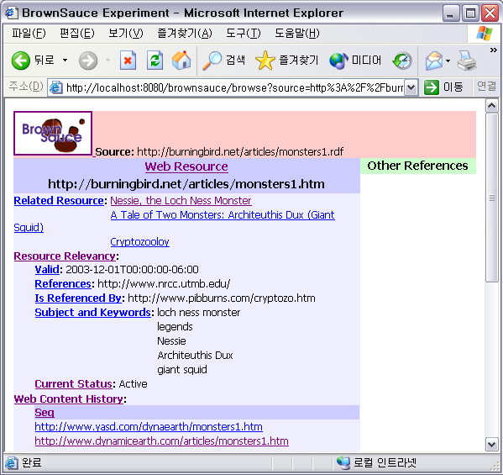
BrownSauce
Install BrownSauce
Open web browser with BrownSauce address
Enter source and resource values
Source: http://burningbird.net/articles/monsters1.rdf
Resource : http://burningbird.net/articles/monsters1.htm

Slide 5
BrownSauce
<pstcn:Resource rdf:about="monsters1.htm">
…
<pstcn:relevancy rdf:parseType="Resource">
<pstcn:currentStatus>Active</pstcn:currentStatus>
<dcterms:valid>2003-12-01…06:00</dcterms:valid>
<dc:subject>legends</dc:subject>
<dc:subject>giant squid</dc:subject>
<dc:subject>loch ness monster</dc:subject>
<dc:subject>Architeuthis Dux</dc:subject>
<dc:subject>Nessie</dc:subject>
<dcterms:isReferencedBy>http://www.pi…</dcterms:isReferencedBy> <dcterms:references>http://www.nrcc.utmb.edu/</dcterms:references>
</pstcn:relevancy>
…
<pstcn:history>
<rdf:Seq>
<rdf:_1 rdf:resource="http://www.yasd.com/dynaearth..." />
<rdf:_2 rdf:resource="http://www.dynamicearth.com/articles/..." />
<rdf:_3 rdf:resource="http://burningbird.net/articles..." />
</rdf:Seq>
</pstcn:history>
…
<pstcn:related rdf:resource="monsters2.htm" />
<pstcn:related rdf:resource="monsters3.htm" />
<pstcn:related rdf:resource="monsters4.htm" />
…
<rdf:Property rdf:about="http://burningbird.net/postcon/elements/1.0/relevancy">
<rdfs:isDefinedBy rdf:resource="http://burningbird.net/postcon/elements/1.0/"/>
<rdfs:label xml:lang="en">Resource Relevancy</rdfs:label>
<rdfs:comment xml:lang="en"> Biographical information for resource </rdfs:comment>
<rdfs:range rdf:resource="http://burningbird.net/postcon/elements/1.0/Resource"/>
<rdfs:domain rdf:resource="http://burningbird.net/postcon/elements/1.0/Resource"/>
</rdf:Property>

Slide 6
Parsers ARP2
Part of Jena Toolkit
Normally used within another application
NTriple class
Parse RDF/XML and output N-Triples format
Produce either a listing of N-Triples or errors if there’s something wrong
Can be used testing the viability of RDF/XML
<http://burningbird.net/articles/monsters1.htm> <http://www.w3.org/1999/02/22-rdf-syntax-ns#type> <http://burningbird.net/postcon/elements/1.0/Resource> .
_:jA1 <http://purl.org/dc/elements/1.1/title> "Tale of Two Monsters: Legends" .
_:jA1 <http://purl.org/dc/terms/abstract> "\n When I think of \"monsters\" I think of the creatures of \n … " .
_:jA1 <http://purl.org/dc/elements/1.1/description> "\n Part 1 of four-part series on cryptozoology, legends, \n …" .
_:jA1 <http://purl.org/dc/elements/1.1/created> "1999-08-01T00:00:00-06:00" .
_:jA1 <http://purl.org/dc/elements/1.1/creator> "Shelley Powers" .
_:jA1 <http://purl.org/dc/elements/1.1/publisher> "Burningbird Network" .
<http://burningbird.net/articles/monsters1.htm> <http://burningbird.net/postcon/elements/1.0/bio> _:jA1 .
_:jA2 <http://burningbird.net/postcon/elements/1.0/currentStatus> "Active" .
_:jA2 <http://purl.org/dc/terms/valid> "2003-12-01T00:00:00-06:00" .
_:jA2 <http://purl.org/dc/elements/1.1/subject> "legends" .
_:jA2 <http://purl.org/dc/elements/1.1/subject> "giant squid" .
_:jA2 <http://purl.org/dc/elements/1.1/subject> "loch ness monster" .
_:jA2 <http://purl.org/dc/elements/1.1/subject> "Architeuthis Dux" .
_:jA2 <http://purl.org/dc/elements/1.1/subject> "Nessie" .
…
N-Triple Result of monster1.rdf

Slide 7
Parsers ICS-FORTH Validating RDF Parser
ICS-FORTH
Institute of Computer Science of the Foundation for Research and Technology – Hellas
Research area : bio-informatics, web systems and technologies, embedded systems, GRID and large-scale computing, life-like systems, semantic web
VRP is a part of the RDFSuite
Can be used within another Java application
Present a standalone validating application (GUI)
Several input and output options
Output the validating result to a file
Validation
Syntactic validation
Semantic validation

Slide 8
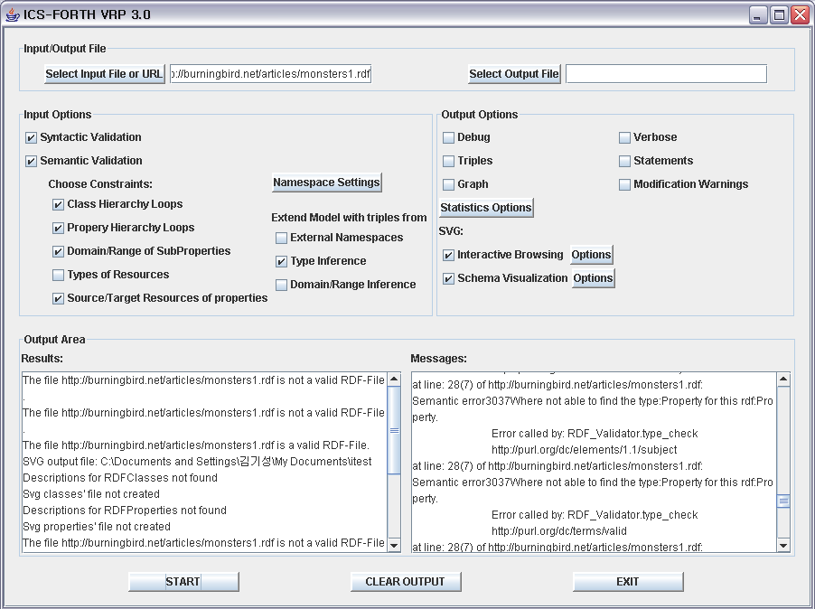
Parsers ICS-FORTH Validating RDF Parser

Slide 9
Editors IsaViz
Visual RDF/XML editing tool
Examine and edit the model
Export multiple views of the model
RDF/XML file
N-Triples file
PNG graphic
SVG graphic

Slide 10
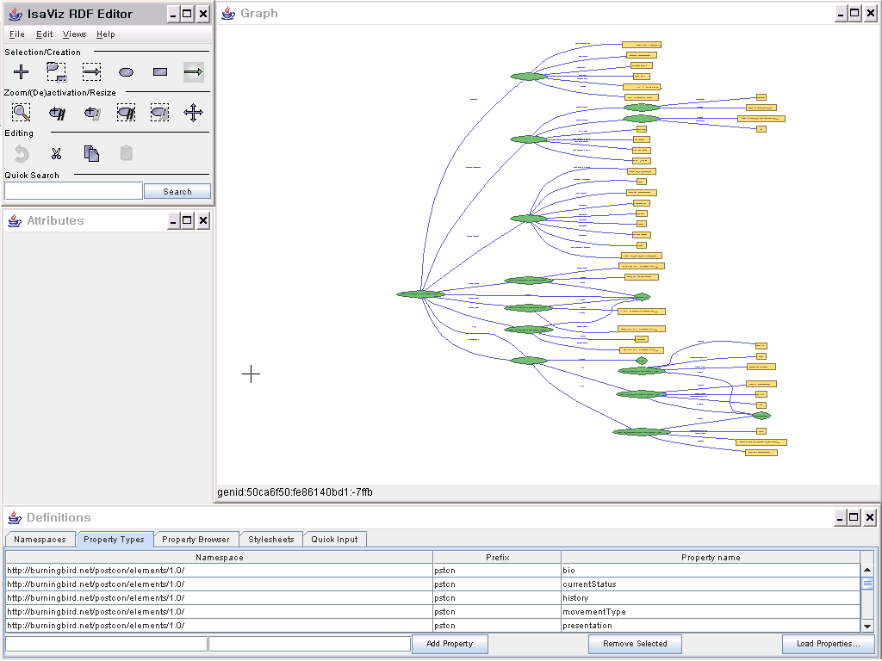
Editors IsaViz

Slide 11
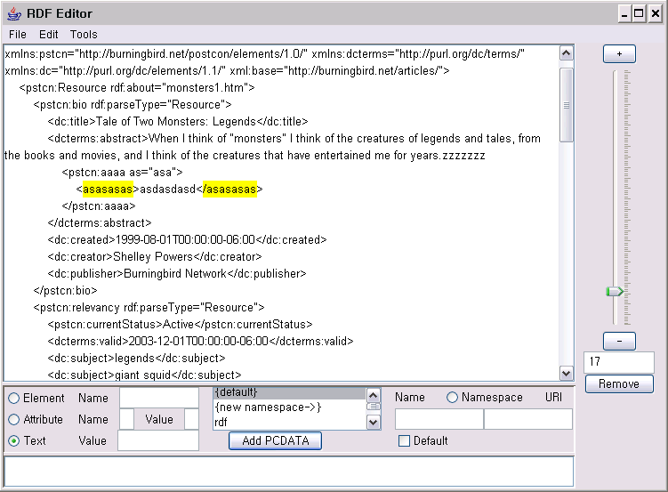
Editor RDF Editor in Java
RDF editing tool
Simple inter face
Add(remove) elements, attributes and literal
[ Ruler ]
Select element
[ Control bar ]
Add new element, attributes and literals

Slide 12
URLS
BrownSauce
http://brownsauce.sourceforge.net
ARP2
http://www.hpl.hp.com/semweb/arp.htm
ICS-FORTH Validating RDF Parser
http://athena.ics.forth.gr:9090/RDF
IsaViz
http://www.w3.org/2001/11/IsaViz
RDF Editor in Java
http://sourceforge.net/projects/rdfeditor

