Slide 1
Practical RDF Chapter 12. Ontologies: RDF Business Models
Shelley Powers, O’Reilly
SNU IDB Lab.
Taikyoung Kim

Slide 2
Outline
Introduction
Why Ontology?
OWL Use Cases & Requirement
OWL Specifications
OWL Guide 1.0
OWL Abstract Syntax & Semantics
Basic Constructs of OWL
OWL Header
OWL Classes and Individuals
OWL Simple Properties and Complex Data Types
Bits of Knowledge: More Complex OWL Construct
Property characteristics
Property restrictions
Complex Classes
The Complementary Nature of RDF and OWL
Ontology Tools: Editors
Protégé

Slide 3
Introduction
An ontology formally defines a common set of terms that are used to describe and represent a domain
If (RDF → relational data model) and (SQL → RDF/XML), then Ontologies built on RDF/XML → large architected business applications

Slide 4
Why Ontology?
RDFS Vs. OWL (Web Ontology Language)
RDFS imposes fairly loose constraints on vocabularies
OWL adds additional constraints that increase the accuracy of implementations of a given vocabulary
OWL allows additional information to be inferred about the data
RDFS provides properties, such as subClassOf, that define relationship between two classes
OWL can add additional class characteristics , such as uniqueness, that aren’t defined within RDFS

Slide 5
OWL Use Cases & Requirement
Ontology encompasses four concepts :
Classes
Relationships between classes
Properties of classes
Constraints on relationships between the classes and properties of the classes

Slide 6
OWL Specifications OWL Guide 1.0
“An ontology differs from an XML schema in that it is a knowledge representation, not a message format”
3 different types of OWL :
OWL Lite : simple classifications
OWL DL (Description Logics) : more complex ontologies
OWL Full : full support for maximum freedom of RDF

Slide 7
OWL Specifications OWL Abstract Syntax & Semantics
Provides a semantic definition of what is a “fact” within OWL
The formal definition of a description is :
Primarily, an OWL description is one of a class identifier, a property restriction, or a complex class association
< description> ::= <classID>
| <restriction>
| unionOf( {<description>} )
| intersectionOf( {<description>} )
| complementOf( {<description>} )
| oneOf( {<individualID>} )

Slide 8
Basic Constructs of OWL
OWL elements:
owl:Class owl:Datatype owl:DatatypeProperty rdfs:domain owl:imports owl:ObjectProperty | owl:Ontology rdf:Property rdfs:range rdfs:subClassOf rdfs:subPropertyOf owl:versionInfo

Slide 9
Basic Constructs of OWL OWL Header
Outer OWL block, delimited by owl:Ontology, containing owl:versionInfo and owl:imports
<rdf:RDF
xmlns:psctn=“http://burningbird.net/postcon”
xmlns:owl=“http://www.w3.org/2002/07/owl#”
xmlns:rdf=“http://www.w3.org/1999/02/22-rdf-syntax-ns#”
xmlns:rdfs=“http://www.w3.org/2000/01/rdf-schema#”
xmlns:dc=“http://purl.org/dc/elements/1.1/”
xmlns:xsd=“http://www.w3.org/2000/10/XMLSchema#”>
<owl:Ontology rdf:about=“http://burningbird.net/postcon”>
<owl:comment>PostContent Management</owl:comment>
<owl:versionInfo>
$Id: Overview.html, v 1.2 2002/11/08 16:42:25 connolly Exp $
</owl:versionInfo>
<dc:creator>Shelly Powers</dc:creator>
<dc:title>PostCon</dc:title>
</owl:Ontology>
</rdf:RDF>

Slide 10
Basic Constructs of OWL OWL Classes & Individuals
Like RDFS, OWL classes define entities via properties
In addition, OWL is the hierarchical nature of the classes
The Resource moves from location to location
There are other resources that are related in some way to the Resource
So the ResourceMovement and RelatedResource become subclasses of the Resource
<owl:Class rdf:ID=“Resource” />
<owl:Class rdf:ID=“RelatedResource”>
<owl:subClassOf rdf:resource=“#Resource” />
</owl:Class>
<owl:Class rdf:ID=“ResourceMovement”>
<owl:subClassOf rdf:resource=“#Resource” />
</owl:Class>

Slide 11
Basic Constructs of OWL OWL Simple Properties
An OWL property is very similar to a property defined in RDFS (They share the same use of rdfs:domain, rdfs:range)
But in addition, constraints that aren’t defined in RDFS can be applied to OWL properties
<owl:ObjectProperty rdf:ID=“movementType”>
<rdfs:domain rdf:resource=“#ResourceMovement” />
<rdfs:range rdf:resoruce=“” />
</owl:ObjectProperty>

Slide 12
Bits of Knowledge: More Complex OWL Constructs
OWL elements :
owl:allValuesFrom owl:cardinality owl:complementOf owl:differentFrom owl:disjointWith owl:FunctionalProperty owl: hasValue owl:intersectionOf owl:InverseFunctionalProperty owl:inverseOf | owl:maxCardinality owl:minCardinality owl:ObjectRestriction owl:oneOf owl:onProperty owl:Restriction owl:someValuesFrom owl:SymmetricProperty owl:TransitiveProperty owl:unionOf

Slide 13
Property Characteristics [1/5]
TransitiveProperty :
P(x,y) & P(y,z) implies P(x,z)
<owl:ObjectProperty rdf:ID=“partOf”>
<rdf:type rdf:resource=“owl:TransitiveProperty” />
<rdfs:doman rdf:resoruce=“&owl;Thing” />
<rdfs:range rdf:resoruce=“#Resource” />
</owl:ObjectProperty>
<Resource rdf:ID=“sectionHeader1a”>
<partOf rdf:resource=“sectionHeader1” />
</Resource>
<Region rdf:ID=“sectionHeader1”>
<partOf rdf:resource=“#monsters1” />
</Region>

Slide 14
Property Characteristics [2/5]
SymmetricProperty :
P(x,y) iff P(y,x)
<owl:ObjectProperty rdf:ID=“sectionPeer”>
<rdf:type rdf:resource=“&owl;SymmetricProperty” />
<rdfs:doman rdf:resoruce=“#Resource” />
<rdfs:range rdf:resoruce=“#Resource” />
</owl:ObjectProperty>
<Resource rdf:ID=“sectionHeader1a”>
<partOf rdf:resource=“#sectionHeader1” />
<sectionPeer rdf:resoruce=“#sectionHeader1b” />
</Resource>
<Resource rdf:ID=“sectionHeader1b”>
<part of rdf:resource=“#sectionHeader1” />
<sectionPeer rdf:resoruce=“#sectionHeader1a” />
</Resource>

Slide 15
Property Characteristics [3/5]
FunctionalProperty :
P(x,y) & P(x,z) implies y = z
“Functional” in that all movement types can be assigned only one value, and the value must be from allowable types
<owl:Class rdf:ID=“MovementType” />
<owl:ObjectProperty rdf:ID=“movementType”>
<rdf:type rdf:resource=“&owl;FunctionalProperty” />
<rdfs:doman rdf:resoruce=“#ResourceMovement” />
<rdf:range rdf:resoruce=“#MovementType” />
</owl:ObjectProperty>

Slide 16
Property Characteristics [4/5]
inverseOf :
P1(x,y) iff P2(y,x)
A new property can be defined as the inverse of an existing property
<owl:ObjectProperty rdf:ID=“hasChild”>
<owl:inverseOf rdf:resource=“#partOf” />
</owl:ObjectProperty>

Slide 17
Property Characteristics [5/5]
InverseFunctionalProperty :
P(y,x) & P(z,x) implies y = z
Combines the logic of both the inverse and the FunctionalProperty
<owl:ObjectProperty rdf:ID=“partOf”>
<rdf:type rdf:resource=“&owl;FunctionalProperty” />
</owl:ObjectProperty>
<owl:ObjectProperty rdf:ID=“childOf”>
<rdf:type rdf:resource=“&owl;InverseFunctionalProperty” />
<owl:inverseOf rdf:resource=“#partOf” />
</owl:ObjectProperty>

Slide 18
Property Restrictions [1/3]
allValuesFrom
Restricting values for the property to MovementType values only
someValuesFrom :
a less restricted version of allValuesFrom, used to specify that at least one of the properties restricted
<owl:Class rdf:ID=“ResourceMovement”>
<owl:subClassOf rdf:resource=“#Resource” />
<rdfs:subClassOf>
<owl:Restriction>
<owl:onProperty rdf:resource=“#reason” />
<owl:allValuesFrom rdf:resource=“#MovementType” />
<owl:/Restriction>
</rdfs:subClassOf>
</owl:Class>

Slide 19
Property Restrictions [2/3]
cardinality
Cardinality indicates the exact number of individual instances of a property allowed within a class
For OWL Full, owl:maxCardinality, owl:minCardinality
<owl:Class rdf:ID=“ResourceMovement”>
<rdfs:subClassOf>
<owl:Restriction>
<owl:onProperty rdf:resource=“#movementType” />
<owl:cardinality>1</owl:cardinality>
<owl:/Restriction>
</rdfs:subClassOf>
</owl:Class>

Slide 20
Property Restrictions [3/3]
hasValue
Used with a class to differentiate those with properties from a specific range
<owl:Class rdf:ID=“ResourceMovement”>
<rdfs:subClassOf>
<owl:Restriction>
<owl:onProperty rdf:resource=“#movementType” />
<owl:hasValue rdf:resource=“#MovementType” />
<owl:/Restriction>
</rdfs:subClassOf>
</owl:Class>

Slide 21
Complex Classes [1/5] : Intersection
intersectionOf :
In case of an intersection of a class and one or more properties
<owl:Class rdf:ID=“XMLResource”>
<owl:intersectionOf rdf:parseType=“Collection”>
<owl:Class rdf:about=“#Resource” />
<owl:Restriction>
<owl:onProperty rdf:resource=“#hasFormat” />
<owl:hasValue rdf:resource=“#XML” />
<owl:/Restriction>
</owl:intersectionOf>
</owl:Class>

Slide 22
Complex Classes [2/5] : Union
unionOf :
Creates a class whose members combine the properties of both classes being joined
<owl:Class rdf:ID=“WebpageResource”>
<owl:unionOf rdf:parseType=“Collection”>
<owl:Class rdf:about=“#XMLResource” />
<owl:Class rdf:about=“#HTMLResource” />
</owl:unionOf>
</owl:Class>

Slide 23
Complex Classes [3/5] : Complement
complementOf :
Creates a class that consists of all members of a specific domain that do not belong to a specific class
<owl:Class rdf:ID=“WebResource” />
<owl:Class rdf:ID=“NotWebPage”>
<owl:complementOf rdf:resource=“#WebpageResource” />
</owl:Class>

Slide 24
Complex Classes [4/5] : Enumeration
oneOf :
An enumeration is a class with a predetermined, closed set of members
<owl:Class rdf:ID=“GraphicResource”>
<rdfs:subClassOf rdf:resource=“#Resource” />
<owl:oneOf rdf:parseType=“Collection”>
<owl:Thing rdf:about=“#JPEG” />
<owl:Thing rdf:about=“#PNG” />
<owl:Thing rdf:about=“#GIF” />
</owl:oneOf>
</owl:Class>

Slide 25
Complex Classes [5/5] : Disjoint
disjointWith :
Lists all of the classes that a particular class is guaranteed not to be a member of
<owl:Class rdf:ID=“TextFile”>
<rdfs:subClassOf rdf:resource=“#Resource” />
<owl:disjointWith rdf:resource=“#GraphicResource”>
<owl:disjointWith rdf:resource=“#VideoResource”>
</owl:Class>

Slide 26
The Complementary Nature of RDF & OWL
When to use RDF & RDFS
If you’re defining a fairly simple vocabulary primarily for your own use
If you’re concerned primarily with the striped nature of RDF/XML
When to use OWL
If you’re documenting a model of a specific domain and you hope to encourage others to use it and be able to use the data to make sophisticated queries

Slide 27
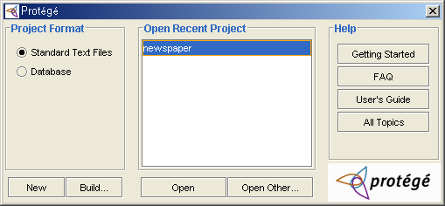
Ontology Tools : Editors
Protégé

Slide 28
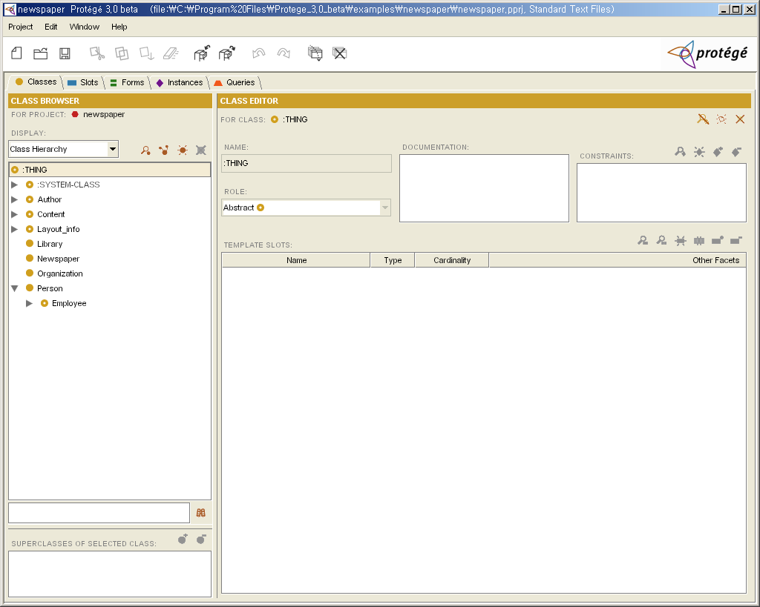

Slide 29
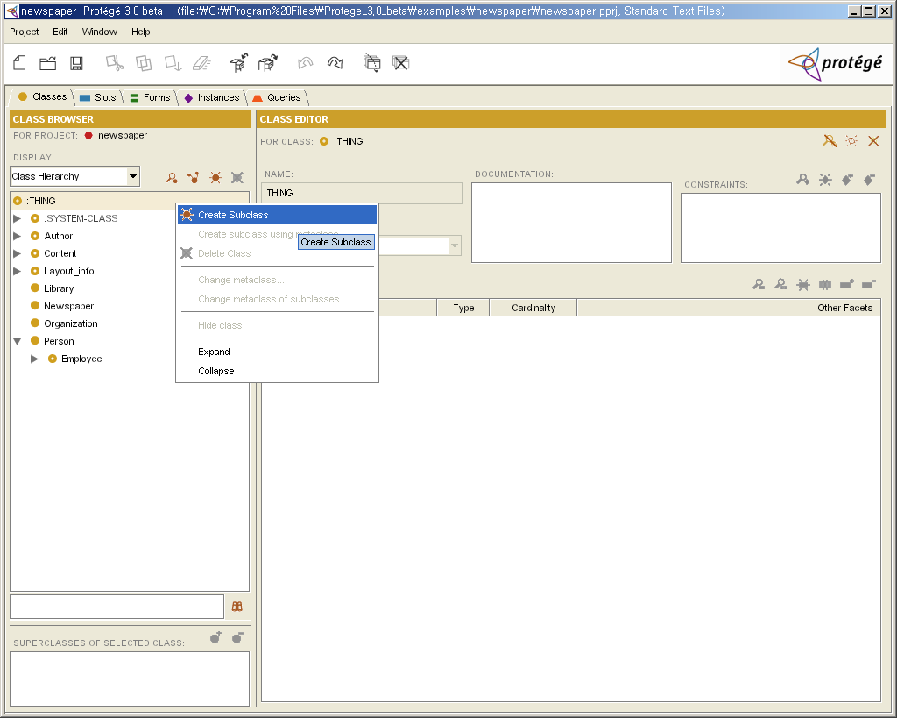

Slide 30
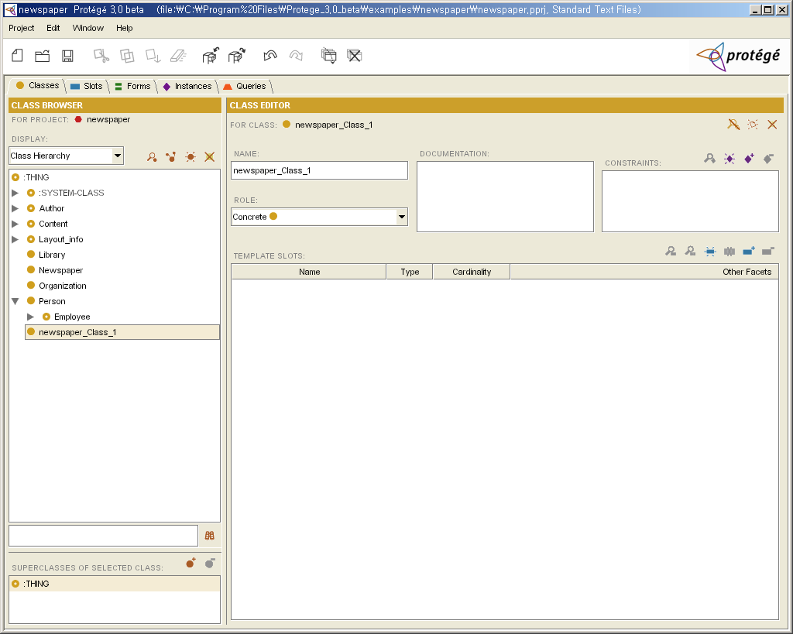

Slide 31
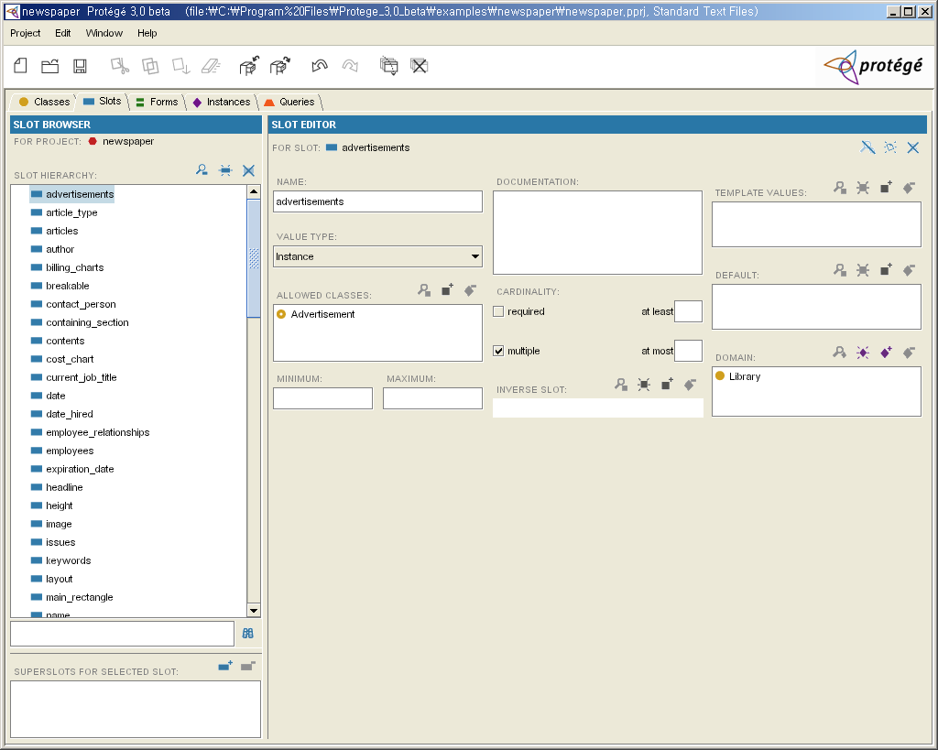

Slide 32
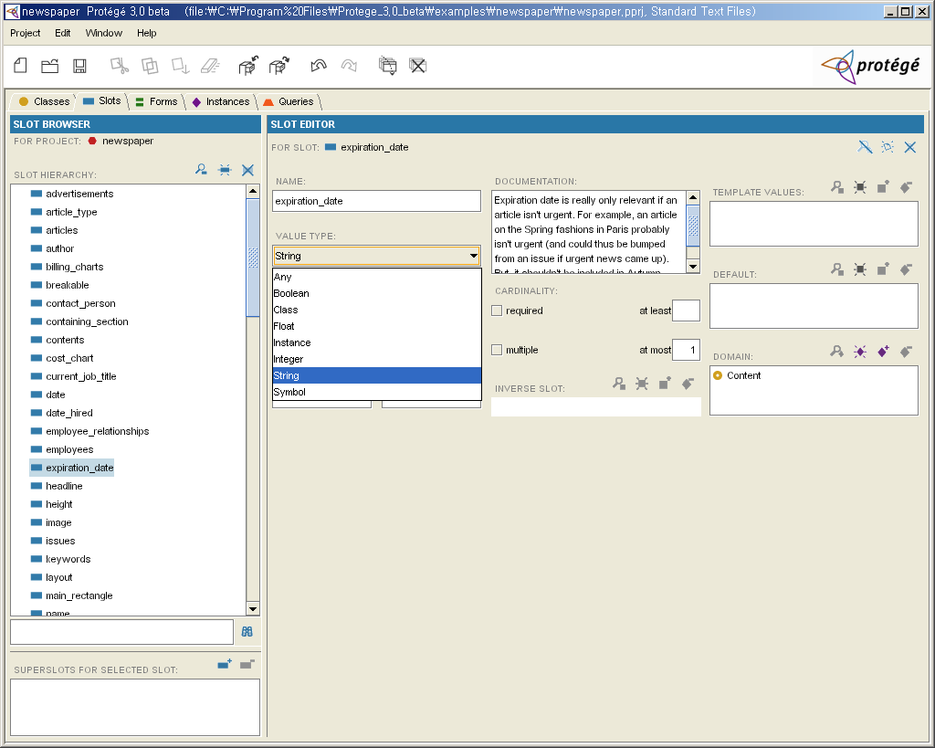

Slide 33
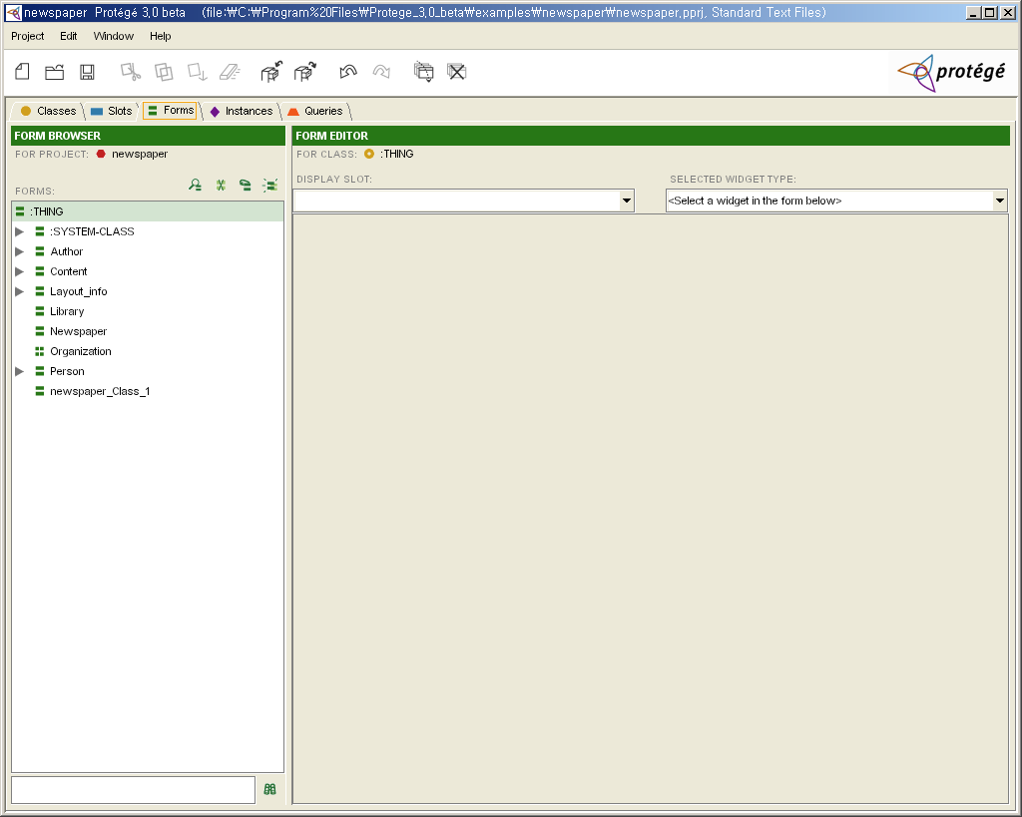

Slide 34
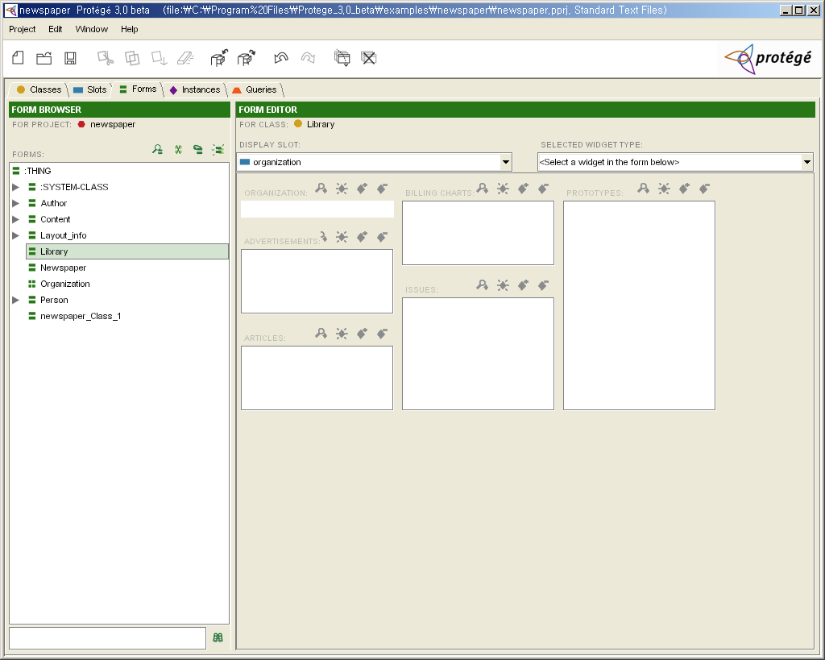

Slide 35
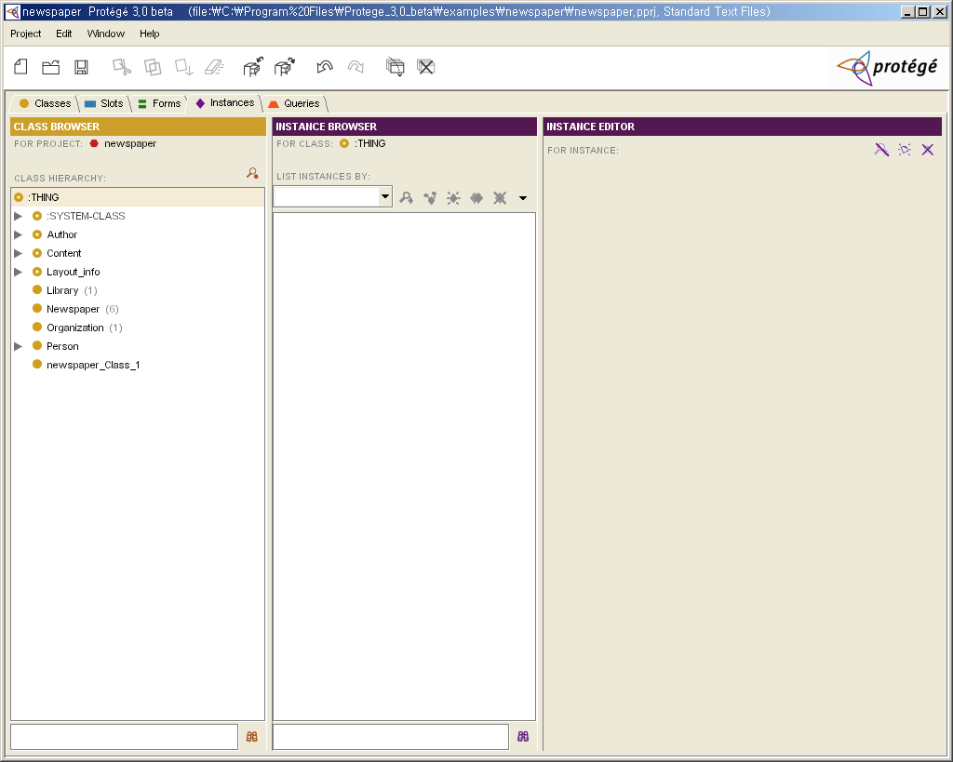

Slide 36
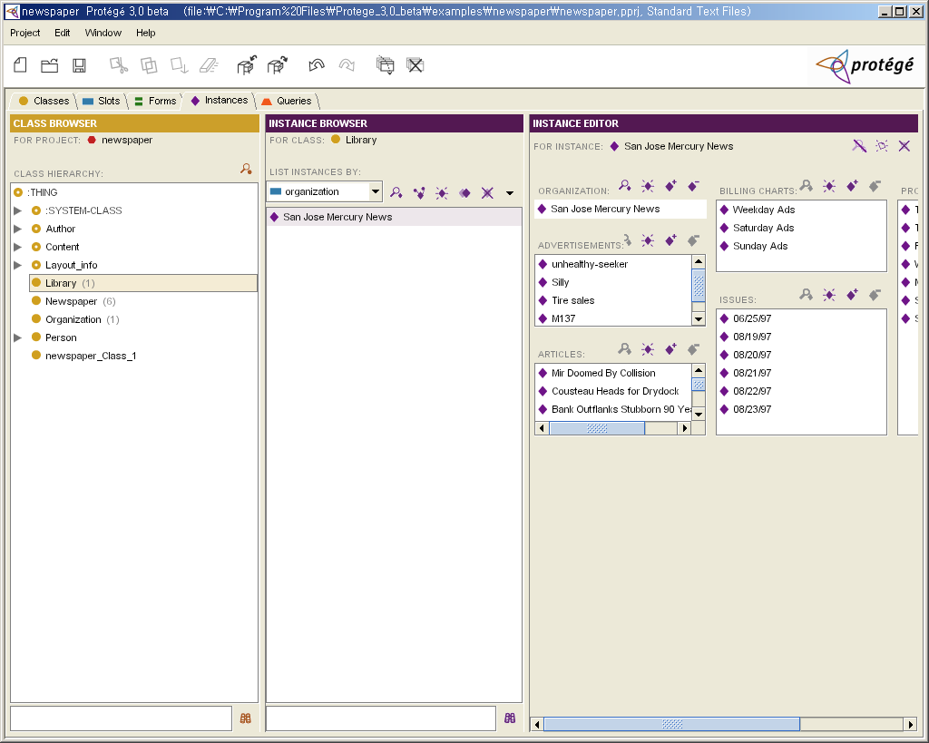

Slide 37
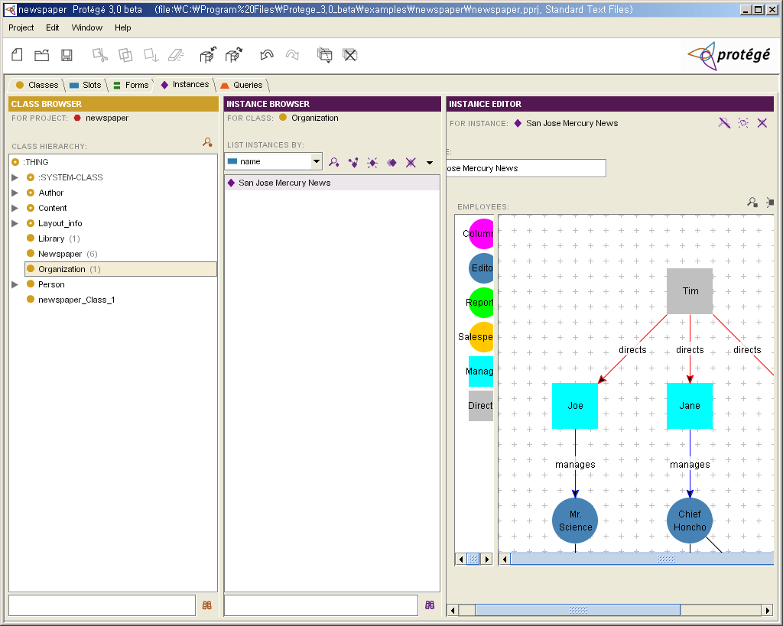

Slide 38
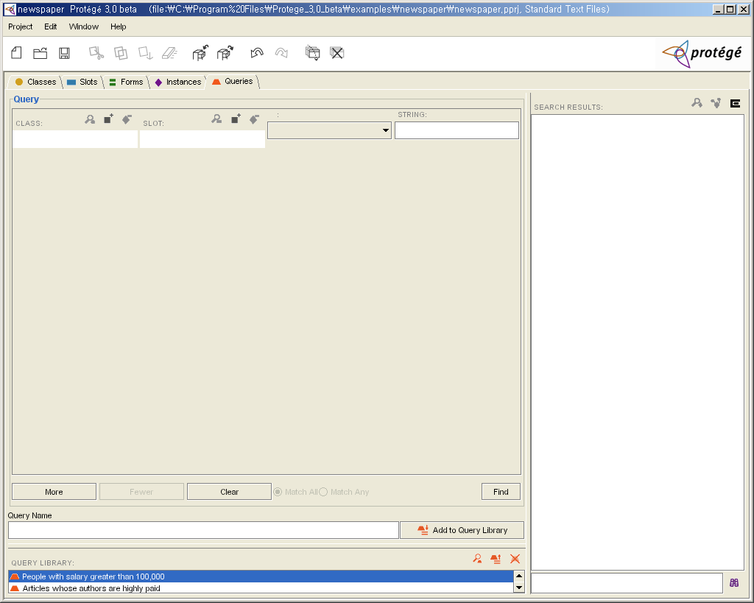

Slide 39
