Slide 1
Chapter 14: Transactions

Slide 2
Transaction Concept
A transaction is a unit of program execution that accesses and possibly updates various data items
E.g. transaction to transfer $50 from account A to account B:
  1. read(A)
  2. A := A – 50
  3. write(A)
  4. read(B)
  5. B := B + 50
  6. write(B)
Two main issues to deal with:
  Failures of various kinds, such as hardware failures and system crashes
  Concurrent execution of multiple transactions

Slide 3
ACID Properties
To preserve the integrity of data the database system must ensure:
Atomicity. Either all operations of the transaction are properly reflected in the database or none are.
Consistency. Execution of a transaction in isolation preserves the consistency of the database.
Isolation. Although multiple transactions may execute concurrently, each transaction must be unaware of other concurrently executing transactions.
Durability. After a transaction completes successfully, the changes it has made to the database persist, even if there are system failures.

Slide 4
Atomicity
“All or nothing”
The system should ensure that updates of a partially executed transaction are not reflected in the database
Transaction to transfer $50 from account A to account B:
  1. read(A)
  2. A := A – 50
  3. write(A)
  4. read(B)
  5. B := B + 50
  6. write(B)
System crash
  Money will be “lost” leading to an inconsistent database state

Slide 5
Consistency
  When the transaction completes successfully, the database must be consistent
  During transaction execution, the database may be temporarily inconsistent
  A transaction must see a consistent database
Transaction to transfer $50 from account A to account B:
  1. read(A)
  2. A := A – 50
  3. write(A)
  4. read(B)
  5. B := B + 50
  6. write(B)
In general, consistency requirements include
  Explicitly specified integrity constraints such as primary keys and foreign keys
  Implicit integrity constraints
    e.g. sum of balances of all accounts, minus sum of loan amounts
  the sum of A and B is unchanged
  by the execution of the transaction

Slide 6
Isolation
Each transaction must be unaware of other concurrently executing transactions
  Intermediate transaction results must be hidden from other concurrently executed transactions
  Isolation can be ensured trivially by running transactions serially
    That is, one after the other.
Transaction to transfer $50 from account A to account B:
T1 T2
  1. read(A)
  2. A := A – 50
  3. write(A)
  read(A), read(B), print(A+B)
  4. read(B)
  5. B := B + 50
  6. write(B)
However, executing multiple transactions concurrently has significant benefits, as we will see later.
If T2 accesses the partially updated database,
it will see an inconsistent database
(the sum A + B will be less than it should be).

Slide 7
Durability
The updates to the database by the transaction must persist even if there are software or hardware failures
Transaction to transfer $50 from account A to account B:
  1. read(A)
  2. A := A – 50
  3. write(A)
  4. read(B)
  5. B := B + 50
  6. write(B)
  Once the user has been notified that the transaction has completed (i.e., the transfer of the $50 has taken place), it must persist

Slide 8
Transaction State
Active – the initial state; the transaction stays in this state while it is executing
Partially committed – after the final statement has been executed
Failed – after the discovery that normal execution can no longer proceed
Aborted – after the transaction has been rolled back and the database restored to its state prior to the start of the transaction
Two options after it has been aborted:
  restart the transaction
    can be done only if no internal logical error
  kill the transaction
Committed – after successful completion

Slide 9

Transaction State (Cont.)

Slide 10
Concurrent Executions
Multiple transactions are allowed to run concurrently in the system. Advantages are:
  Increased processor and disk utilization, leading to better transaction throughput
  Reduced average response time for transactions: short transactions need not wait behind long ones
Concurrency control schemes – mechanisms to achieve isolation
  To control the interaction among the concurrent transactions in order to prevent them from destroying the consistency of the database

Slide 11
Schedules
Schedule – a sequences of instructions that specify the chronological order in which instructions of concurrent transactions are executed
  a schedule for a set of transactions must consist of all instructions of those transactions
  must preserve the order in which the instructions appear in each individual transaction
Serial schedule – instruction sequences from one by one transactions
Simplified view of transactions
  Our simplified schedules consist of only read and write instructions
  We assume that transactions may perform arbitrary computations on data in local buffers in between reads and writes

Slide 12

Schedule 1
Let T₁ transfer $50 from A to B, and T₂ transfer 10% of the balance from A to B
A serial schedule in which T₁ is followed by T₂ :

Slide 13

Schedule 2
A serial schedule in which T₂ is followed by T₁ :

Slide 14

Schedule 3
The following schedule is not a serial schedule, but it is equivalent to Schedule 1
  We call it a serializable schedule
In Schedules 1, 2 and 3, the sum A + B is preserved.

Slide 15

Schedule 4
The following concurrent schedule does not preserve the value of (A + B). The following schedule is not serializable.

Slide 16
Serializability
Basic Assumption – Each transaction preserves database consistency
Thus serial execution of a set of transactions preserves database consistency
A (possibly concurrent) schedule is serializable if it is equivalent to a serial schedule. Different forms of schedule equivalence give rise to the notions of:
  1. conflict serializability
  2. view serializability

Slide 17
Conflicting Instructions
Instructions l_{i} and l_{j} of transactions T_{i} and T_{j} respectively,
conflict if and only if
  There exists some item Q accessed by both l_{i} and l_{j},
  and at least one of these instructions wrote Q.
1. l_{i} = read(Q), l_{j} = read(Q). l_{i} and l_{j} don’t conflict.
2. l_{i} = read(Q), l_{j} = write(Q). They conflict.
3. l_{i} = write(Q), l_{j} = read(Q). They conflict
4. l_{i} = write(Q), l_{j} = write(Q). They conflict
Intuitively, a conflict between l_{i} and l_{j} forces a (logical) temporal order between them
  If l_{i} and l_{j} do not conflict, their results would remain the same
  even if they had been interchanged in the schedule

Slide 18
Conflict Serializability
Schedules S and S’ are conflict equivalent if S can be transformed into a schedule S’ by a series of swaps of non-conflicting instructions
A schedule S is conflict serializable if It is conflict equivalent to a serial schedule
Example of a schedule that is not conflict serializable:
T₃ T₄
read(Q)
write(Q)
write(Q)
We are unable to swap instructions in the above schedule to obtain either the serial schedule < T₃, T₄ >, or the serial schedule < T₄, T₃ >.
T₃ T₄ T₃ T₄
read(Q) write(Q)
write(Q) read(Q)
write(Q) write(Q)

Slide 19

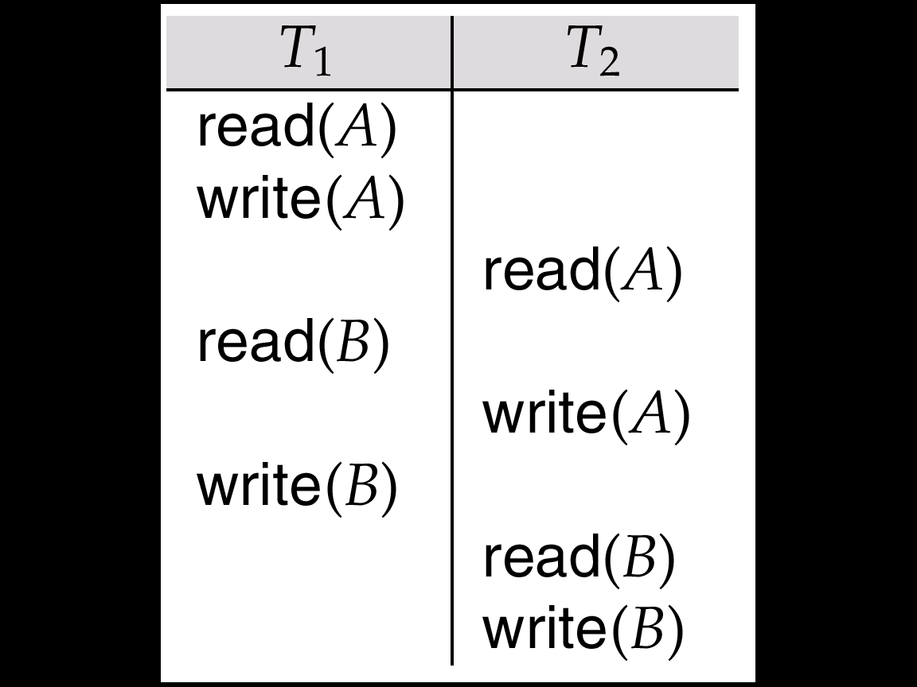
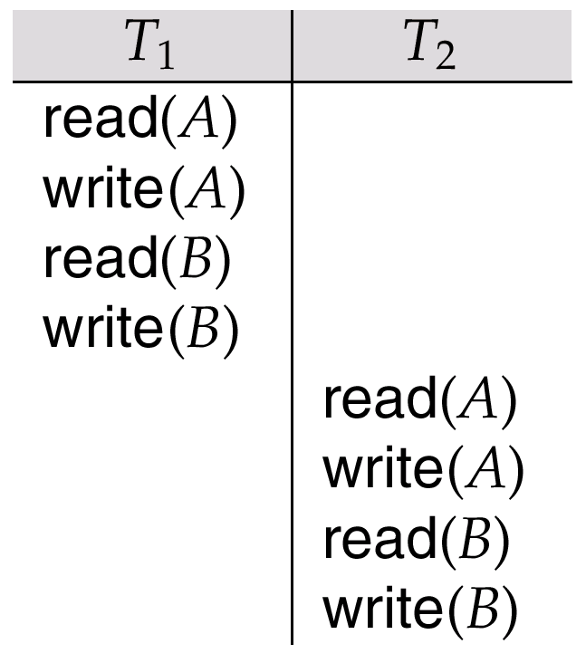
Conflict Serializability (Cont.)
Schedule 3 can be transformed into Schedule 6, a serial schedule where T₂ follows T₁, by series of swaps of non-conflicting instructions. Therefore Schedule 3 is conflict serializable.
Schedule 5 –
After Swapping a Pair of non conflicting Instructions in schedule 3
Schedule 6 –
A Serial Schedule That is Equivalent to Schedule 3
Schedule3

Slide 20
View Serializability
Schedules S and S’ are view equivalent if the following three conditions are met, for each data item Q:
  If in S, transaction T_{i} reads the initial value of Q,
  then in S’ also transaction T_{i} must read the initial value of Q.
  If in S, T_{i} executes read(Q), and that value was produced by T_{j} (if any),
  then in S’ also T_{i} must read the value of Q that was produced by the same write(Q) operation of T_{j} .
  The transaction (if any) that performs the final write(Q) operation in S must also perform the final write(Q) operation in S’.
A schedule S is view serializable if it is view equivalent to a serial schedule

Slide 21

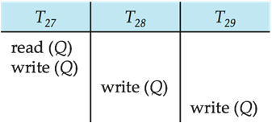
View Serializability (Cont.)
Every conflict serializable schedule
is also view serializable
Below is a schedule which is view-serializable but not conflict serializable.
Every view serializable schedule that is not conflict serializable has blind writes
View Serializable
Schedules
Conflict Serializable
Schedules
A view equivalent
serial schedule

Slide 22


Testing for Serializability
Consider some schedule of a set of transactions T₁, T₂, ..., T_{n}
Precedence graph – a direct graph where the vertices are transactions(names)
  draw an arc from T_{i} to T_{j} if the two transaction conflict,
  and T_{i} accessed the data item on which the conflict arose earlier
  may label the arc by the item that was accessed
Example
A, B
A, B

Slide 23

Test for Conflict Serializability
A schedule is conflict serializable if and only if
its precedence graph is acyclic
Cycle-detection algorithms exist which take order n² time, where n is the number of vertices in the graph
  (Better algorithms take order n + e where e is the number of edges.)
If precedence graph is acyclic, the serializability order can be obtained by a topological sorting of the graph
  A linear order consistent with the partial order of the graph

Slide 24
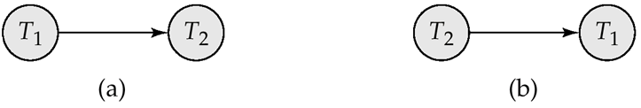

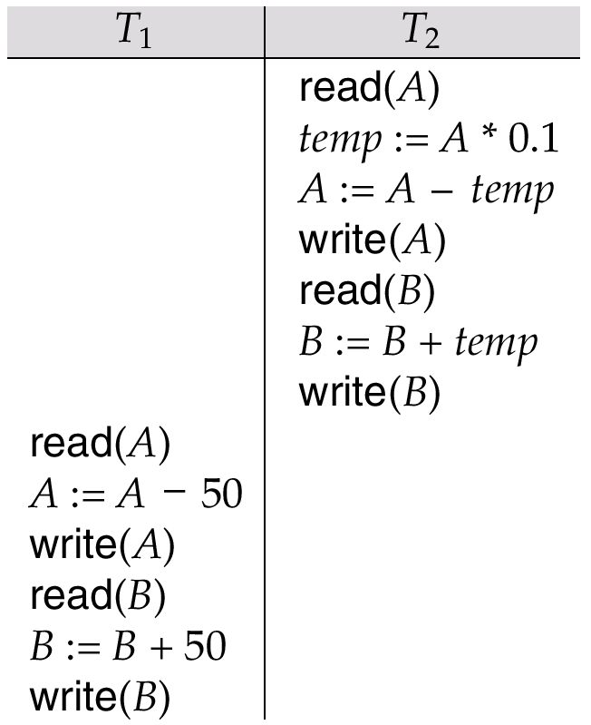
Precedence Graph for Serial Schedules
A, B
A, B
(a) Schedule 1
(b) Schedule 2

Slide 25
Test for View Serializability
The precedence graph test for conflict serializability cannot be used directly to test for view serializability
  Extension to test for view serializability has cost exponential in the size of the precedence graph
The problem of checking if a schedule is view serializable falls in the class of NP-complete problems
  Thus existence of an efficient algorithm is extremely unlikely
However, practical algorithms that just check some sufficient conditions for view serializability can still be used

Slide 26

Recoverable Schedules
Need to address the effect of transaction failures on concurrently
running transactions
Recoverable schedule
  If a transaction T_{j} reads a data item previously written by a transaction T_{i} ,
  then the commit operation of T_{i} appears before the commit operation of T_{j}
The following schedule is not recoverable if T₉ commits immediately after the read
DBMS must ensure that schedules are recoverable

Slide 27

Cascading Rollbacks
A single transaction failure leads to a series of transaction rollbacks
Consider the following schedule where none of the transactions has yet committed (so the schedule is recoverable)
Can lead to the undoing of a significant amount of work

Slide 28
Cascadeless Schedules
Cascadeless schedules — cascading rollbacks cannot occur;
  For each pair of transactions T_{i} and T_{j} such that T_{j} reads a data item previously written by T_{i},
  The commit operation of T_{i} appears before the read operation of T_{j}
Every cascadeless schedule is also recoverable
It is desirable to restrict the schedules to those that are cascadeless
Idea: block other transactions until executing the commit instruction
  More concurrency ➔ More cascading rollback
  Less cascading rollback ➔ Less concurrency

Slide 29
Concurrency Control
A database must provide a mechanism that will ensure that all possible schedules are
  either conflict or view serializable, and
  are recoverable and preferably cascadeless
A policy in which only one transaction can execute at a time generates serial schedules, but provides a poor degree of concurrency
Testing a schedule for serializability after it has executed is a little too late
Goal – to develop concurrency control protocols that will assure serializability
  Concurrency-control schemes tradeoff between the amount of concurrency they allow and the amount of overhead that they incur

Slide 30
Weak Levels of Consistency
Some applications are willing to live with weak levels of consistency, allowing schedules that are not serializable
  Some transactions need not be serializable with respect to other transactions
    E.g. a read-only transaction that wants to get an approximate total balance of all accounts
    E.g. database statistics computed for query optimization can be approximate (why?)
Tradeoff accuracy for performance

Slide 31
Levels of Consistency in SQL-92
Serializable — default
Repeatable read — only committed records to be read, repeated reads of same record must return same value
  However, a transaction may not be serializable – it may find some records inserted by a transaction but not find others
Read committed — only committed records can be read, but successive reads of record may return different (but committed) values
Read uncommitted — even uncommitted records may be read
Warning: some database systems do not ensure serializable schedules by default
  E.g. Oracle and PostgreSQL by default support a level of consistency called snapshot isolation (not part of the SQL standard)

Slide 32
Transaction Definition in SQL
Data manipulation language must include a construct for specifying the set of actions that comprise a transaction
In SQL, a transaction begins implicitly
A transaction in SQL ends by:
  Commit work commits current transaction and begins a new one.
  Rollback work causes current transaction to abort.
In almost all database systems, by default, every SQL statement also commits implicitly if it executes successfully
  Implicit commit can be turned off by a database directive
    E.g. in JDBC, connection.setAutoCommit(false);

Slide 33
End of Chapter 14

