Slide 1
Java Applet & JavaScript
SNU OOPSLA Lab.
September 2005

Slide 2
Contents
Java Applet
  Overview
  History
  Features of Java Applet
  Applet vs. Application
  Applet vs. JavaScript
  How Java Applet Works
  Basic Methods
  AWT Components
  Example
  Online Resources
JavaScript
  Overview
  History
  Features of JavaScript
  Pros and Cons
  How JavaScript Works
  Events
  Example
  Online Resources

Slide 3
Overview(1/2)
An applet is a software component that runs in the context of another program, e.g. a web browser
A Java applet is an applet written in the Java programming language
Java applets can run in a web browser using a Java virtual machine (JVM), or in Sun’s AppletViewer(a stand alone tool to test applets)
Java applets are platform-independent, in comparison with ActiveX controls

Slide 4
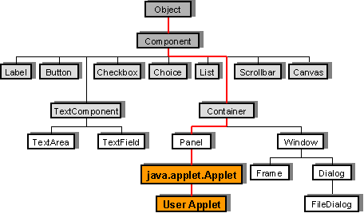
Overview(2/2)
Inheritance Hierarchy of the Applet Class
Applet inherits AWT Component class and AWT Container class
Notes:
Object -> component -> Container -> Panel -> Applet

Slide 5
History
Java applets were introduced by Sun in 1995
Netscape 2.0 included JVM in 1996
Internet Explorer 3.0 included JVM in 1996
J2SE 5.0 is released recently(2005)

Slide 6
Features of Java Applet
Applets provide interactive features to web applications that cannot be provided by HTML
Web browsers get applet classes from the web site and execute it on local machine
Applets are executed in a sandbox by most web browsers, preventing them from accessing local data
Since Java’s bytecode is platform independent, Java applets can be executed by browsers for many platforms, including Windows, Unix, Mac OS and Linux

Slide 7
Applet vs. Application
Java Application
Code size is relatively big
Run independently(on JVM)
Can access to system resources(e.g. Files)
Java Applet
Code size is relatively small
Run on browsers(if JRE is installed)
Run in sandbox, ensuring security
Imports java.applet package
Should be a subclass of Applet
Can be imported using <APPLET>, <OBJECT>(Internet Explorer) or <EMBED>(Netscape Navigator) tag
Notes:
MS IE 6.0부터는 JVM을 내장하고 있지 않다. 따라서 <applet> 태그를 이용한 과거의 많은 웹 페이지들에서 애플릿 안 보인다. (설치하라는 메시지조차 뜨지 않음) 따라서, JRE나 J2SDK를 다운받아 설치해야 하며, <object> 태그를 쓰는 게 낫다(설치하라는 메시지 뜸).

Slide 8
Applet vs. JavaScript
JavaScript
No need to compile
Can use functions without defining them
Can use variables without defining them
Can be embed in HTML using <script> tags
Users can view source codes
Java Applet
Need to compile all the classes
Should define all the methods before using them
Should define all the variables before using them
CLASS/JAR files are needed in addition to HTML
Compiled source codes

Slide 9
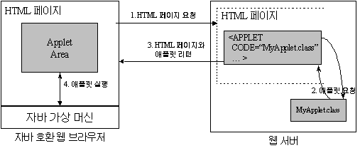
How Java Applet Works

Slide 10
Basic Methods(1/2)
Methods for Milestones
  init() – initialize the applet
  start() – start the applet’s execution
  stop() – stop the applet’s execution
  destroy() – perform a final cleanup

Slide 11
Basic Methods(2/2)
Typical Structure
import java.applet.Applet;
import java.awt.Graphics;
public class Simple extends Applet {
...
public void init() {
...
}
public void start() {
...
}
public void stop() {
...
}
public void destroy() {
...
}
public void paint(Graphics g) {
...
}
}
<APPLET CODE=... CODEBASE=...
WIDTH=... HEIGHT=...>
...
</APPLET>
<Applet Code>
<HTML Code>

Slide 12
AWT Components(1/3)
Structure of AWT
Object
mouseDown
Component
update
paint
action(deprecated)
add/remove
Button
Container
setLayout
CheckBox
Label
Panel
ScrollPanel
Window
List
TextField
Applet
Frame
Dialog
TextArea
Scrollbar
Notes:
IE에 JVM이 내장되어 있던 과거에는 별도로 JRE 다운로드할 필요가 없다는 이유로 AWT를 사용했지만, 요즘에는 Swing을 쓰는 게 낫다.

Slide 13
AWT Components(2/3)
Painting Methods(1/2)
  public void paint(Graphics g)
    is called when the component needing repair
    painted area : clip rectangle in the “g” parameter
    g - The graphics context to use for painting
  public void update(Graphics g)
    is called when repaint, update or paint is called
    can assume that the background is not cleared
    fill background
      set the color of the graphics context
      calls this component's paint()
    g - the specified context to use for updating

Slide 14
AWT Components(3/3)
Painting Methods(2/2)
  public void repaint()
    repaints this component
    causes a call to this component's update() as soon as possible
  public void repaint(int x, int y, int width, int height)
    repaints the specified rectangle of this component
  Summary
    repaint() ➔ update() ➔ paint()

Slide 15
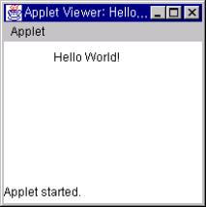
Example
Source Code
Result
import java.applet.Applet;
import java.awt.Graphics;
public class HelloWorld extends Applet {
public void paint(Graphics g) {
g.drawString("Hello", 50,20);
}
}
HelloWorld.java
<APPLET CODE="HelloWorld.class“
WIDTH=200 HEIGHT=140>
</APPLET>
HelloWorld.htm

Slide 16
Online Resources
Java Introduction
http://oopsla.snu.ac.kr/research/object/java
Java Tutorial
http://java.sun.com/docs/books/tutorial/index.html
Using tags in HTML to embed an applet
http://java.sun.com/j2se/1.4.2/docs/guide/plugin/developer_guide/using_tags.html

Slide 17
Contents
Java Applet
  Overview
  History
  Features of Java Applet
  Main Differences
  How Java Applet Works
  Basic Methods
  AWT Components
  Example
  Online Resources
JavaScript
  Overview
  History
  Features of JavaScript
  Pros and Cons
  How JavaScript Works
  Events
  Example
  Online Resources

Slide 18
Overview(1/2)
Language used for adding dynamism to Web pages
Loosely typed – Variables not typed
Object-based – Limited support for inheritance
Interpreted – Interpreter built into browsers
Modeled after C++
  Similar syntax
JavaScript can
  Put dynamic text into an HTML page
  React to events
  Read and write HTML elements
  Be used to validate data

Slide 19
Overview(2/2)
Object Model in Internet Explorer
all
window
anchors
document
applets
document
body
Collections
frames
embeds
document
history
filters
Objects
forms
navigator
plugins
images
location
links
plugins
event
scripts
screen
styleSheets

Slide 20
History
JavaScript had been known as LiveWire then LiveScript
Sun Microsoftsystems changed its name to JavaScript in 1995
Microsoft released Internet Explorer 3.0 in 1996, which partly supported JavaScript
JavaScript support of earlier versions of Internet Explorer was weaker than Netscape Navigator, but current version of Internet Explorer supports JavaScript well

Slide 21
Features of JavaScript
Dynamism takes three forms
  Events: Allows you to monitor events and and change positioning or content based on events
  Dynamic positioning: Can tell the browser where to place content without using tables
  Dynamic content: Allows dynamic updating of data at specified time intervals

Slide 22
Pros and Cons
Pros
JavaScript can
Control document appearance and content
Control the behavior of the browser
Interact with document content
Interact with the user
Read and write client state with cookies
Interact with applets
Manipulate embedded images
Cons
No graphics capabilities
No reading/writing of files on the client side
No networking except to arbitraty URLs
No multithreading

Slide 23
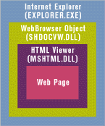
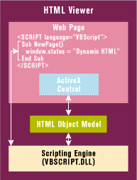
How JavaScript Works
HTML Viewer
Executing Scripts

Slide 24
Events
One of the primary uses of Javascript is to make web pages interactive, i.e. responsive to user actions
Javascript provides event handlers
  Execute segment of code based on events occurring within the application
Event Listener Types
  onload: When a document is loaded
  onclick: When the element is clicked
  onfocus: When the element is given input focus
  onSubmit: When the submit button is clicked
  onerror: When the element is not loaded properly

Slide 25
Example(1/3)
Source Code(1/2)
<html>
<head>
<title>Javascript Test</title>
<script language=“Javascript” type=“text/javascript”>
function calcTotal(){
tot = document.totalForm.price.value
* document.totalForm.qty.value;
document.totalForm.total.value = tot;
}
</script>
</head>
<body bgcolor=“papayawhip”>
<h1>Simple Example to Show the use of Events</h1>
<p>Enter a price and move cursor out of box.

Slide 26
Example(2/3)
Source Code(2/2)
The new total will be calculated automatically.
</p>
<form name=“totalForm”>
Price of item:
<input type=“text” name=“price” onmouseout=“calcTotal()” />
<br>
Quantity purchased:
<input type=“text” name=“qty” onmouseout=“calcTotal()” />
<br><br>
The total is:
<input type=“text” name=“total” />
<br>
</form>
</body>
</html>

Slide 27
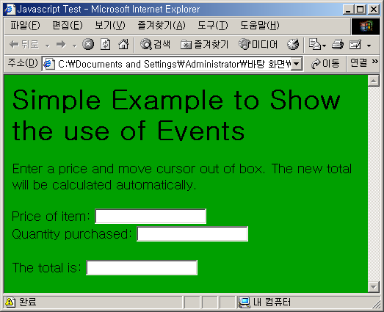
Example(3/3)
Result

Slide 28
Online Resources
JavaScript Introduction
http://oopsla.snu.ac.kr/research/object/java
JavaScript Tutorial
http://icen.virtualave.net/javascript/not.htm
JavaScript Examples and Documents
http://javascript.internet.com/

