Slide 1
Link creation and profile alignment in the aNobii social network
Luca Maria Aiello et al.
Social Computing 2010
6 Feb 2014
Hyewon Lim

Slide 2
Outline
Introduction
Dataset Description
Static Analysis
Dynamical Analysis and Network Growth
Conclusions

Slide 3
Introduction
Mechanism of online social linking
Investigations of the interplay between social links and profile similarity
Analyze the influence of geographic parameters
Role in social partner selection
Investigate the time evolution of links
Analyze the dynamics of link formation and profile alignment

Slide 4
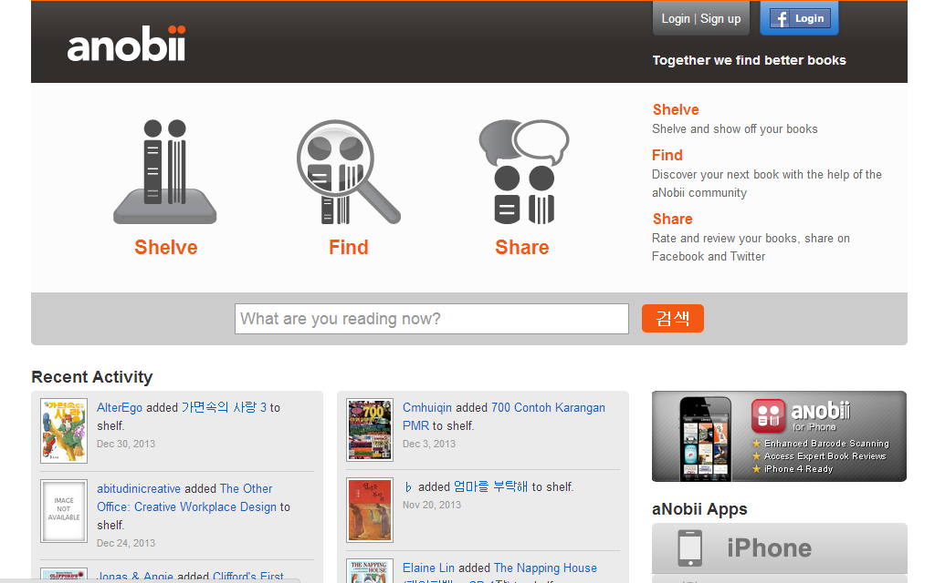
Dataset Description

Slide 5
Dataset Description
aNobii
Created in Hong Kong in 2005
Indexes about 20M titles
Wishlist and library
Friendship and neighborhood
Groups
Extracted data
Six snapshots, 15 days apart, starting from 9 Nov 2009
Profile, Library information, Groups affiliations

Slide 6
Outline
Introduction
Dataset Description
Static Analysis
Dynamical Analysis and Network Growth
Conclusions

Slide 7
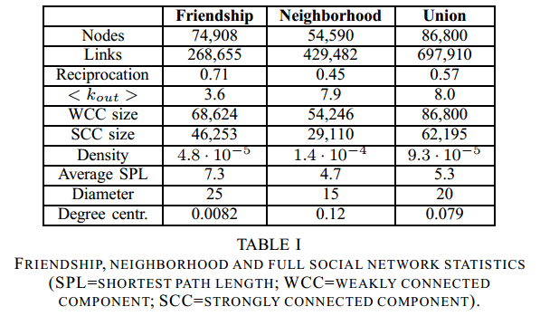
Static Analysis 24 Dec 2009 snapshot
Network characteristics

Slide 8
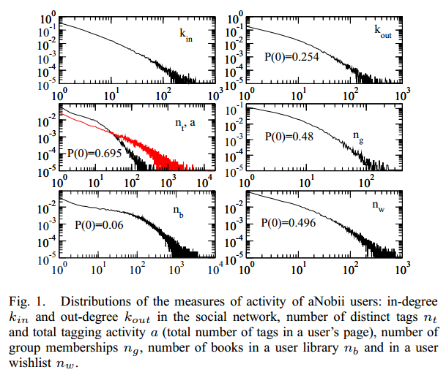
Static Analysis 24 Dec 2009 snapshot
Network characteristics

Slide 9
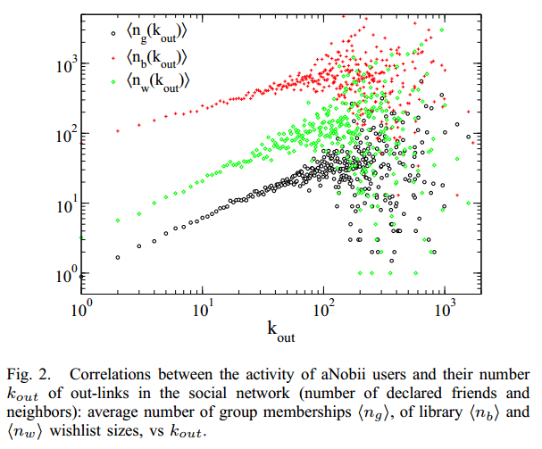
Static Analysis 24 Dec 2009 snapshot
Correlations and mixing patterns

Slide 10
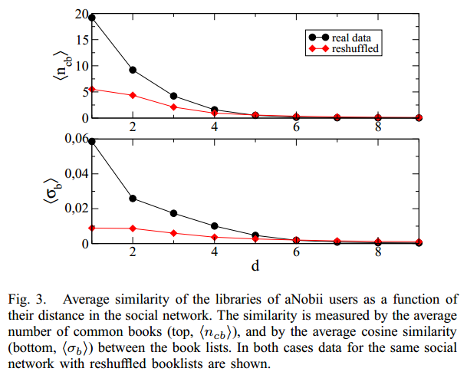
Static Analysis 24 Dec 2009 snapshot
Topical alignment
Average number of common books
cosine similarity
Notes:
Active users tend to be connected to other active users.
Connected users are more likely to have similar profiles.

Slide 11
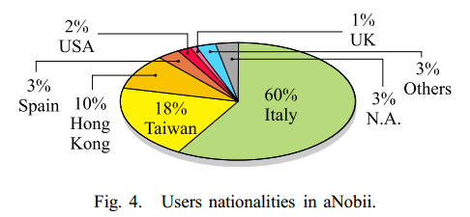
Static Analysis 24 Dec 2009 snapshot
Geographic Analysis
97% specify the country
38% include also the city
Notes:
지금은 영국에 팔려서 비율이 달라졌을듯

Slide 12
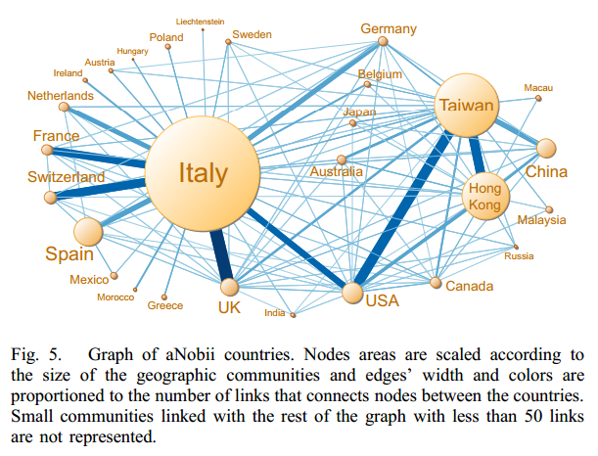
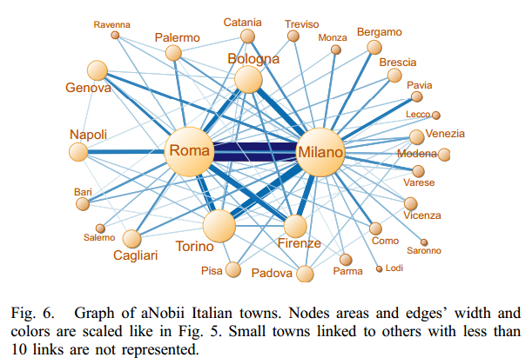
Static Analysis 24 Dec 2009 snapshot
Geographic Analysis (cont.)
Graph of aNobii countries
Language homophily
Geographic proximity homophily
Notes:
지금은 영국에 팔려서 비율이 달라졌을듯

Slide 13
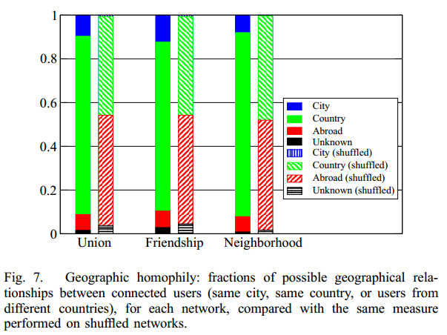
Static Analysis 24 Dec 2009 snapshot
Geographic Analysis (cont.)
Geographic homophily
Compared with a reshuffled version

Slide 14
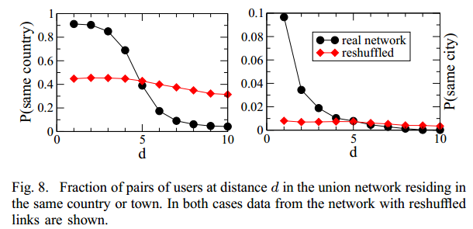
Static Analysis 24 Dec 2009 snapshot
Geographic Analysis (cont.)
Relationship between geographic aggregation and distance in the social graph
Tend to choose people geographically close

Slide 15
Outline
Introduction
Dataset Description
Static Analysis
Dynamical Analysis and Network Growth
Conclusions

Slide 16
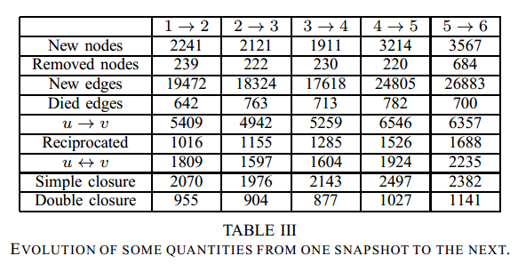
Dynamical Analysis and Network Growth
Triangle closure and preferential attachment

Slide 17
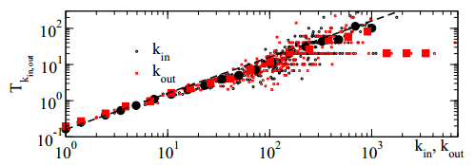
Dynamical Analysis and Network Growth
Triangle closure and preferential attachment (cont.)
New users
Preferential attachment mechanism
Users with already large numbers of links are preferentially chosen
Many users join the network’s largest component by creating links to pairs of already connected users

Slide 18
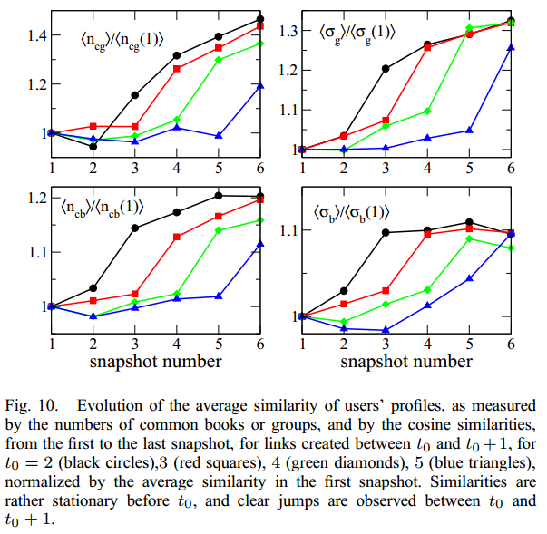
Dynamical Analysis and Network Growth
Causal connection between similarity and link creation

Slide 19
Outline
Introduction
Dataset Description
Static Analysis
Dynamical Analysis and Network Growth
Conclusions

Slide 20
Conclusions
The creation of a social tie
Strongly driven by homophily and proximity
Strongly influenced by language barriers
Establish social ties with similar interest and geographic distance
Social graph evolution
Reciprocation and triadic closure are very common pattern
Causal relationship
Search for friends with similar taste -> linked -> profile alignment

