Slide 1

Session 12
Applying the Class Diagram to the Case Study
Written by Thomas A. Pender
Published by Wiley Publishing, Inc.
October 12, 2011
Presented by Hyewon Lim

Slide 2
Contents
Modeling the Inventory Control System for the Case Study
Understanding UML Notation for Design Patterns
Using Design Patterns in the Class Diagram

Slide 3
Modeling the Inventory Control System for the Case Study (1/3)
Problem statement: for the inventory control system
Our system is designed to inventory and ship uniquely identified products. These products may be purchased directly from vendors and resold as is,
or we can package vendor products together to make our own custom product. Customers place orders for one or more items, but we acknowledge interested customers in the system whether they have purchased yet or not. Each item corresponds to a product. We identify each product using a unique serial number. The Customer may inquire on the status of his Orders using the order number.
Shipments of products from vendors are received and placed into inventory. Each product is assigned to a location so that we can easily find it later when filling orders. Each location has a unique location identifier. Customer orders are shipped as the products become available, so there may be more than one shipment to satisfy a single customer order. But a single shipment may contain products from multiple orders. Any items that have not been shipped are placed on a backorder with a reference to the original order.

Slide 4
Modeling the Inventory Control System for the Case Study (2/3)
Building the Class diagram
  Identify the classes, name them, and define them so you know why they are part of the model
  Identify name, and define the associations between pairs of classes
    Watch out for reflexive associations as well
    Assign multiplicity and constraints where needed
  Evaluate each association to determine where it should be defined as aggregation
    If it is aggregation, then could it be composition?
  Evaluate the classes for possible specialization or generalization

Slide 5

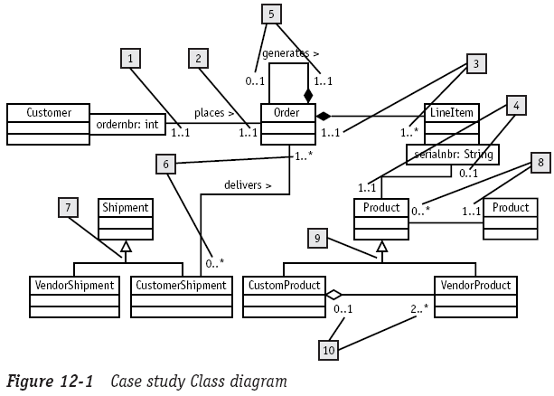
Modeling the Inventory Control System for the Case Study (3/3)

Slide 6
Contents
Modeling the Inventory Control System for the Case Study
Understanding UML Notation for Design Patterns
Using Design Patterns in the Class Diagram

Slide 7

Understanding UML Notation for Design Patterns (1/5)
Patterns
  Help architects work more easily with complex structures
  E.g., Kitchen?

Slide 8
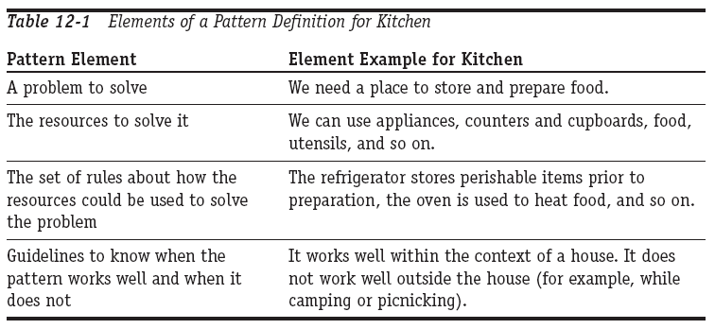
Understanding UML Notation for Design Patterns (2/5)
If everyone knows what a kitchen is, does that mean that all kitchens are identical? No!!!
  Kitchen is only a pattern, the concept of kitchen can be implemented in literally thousands of different ways
Four basic elements for defining a pattern

Slide 9
Understanding UML Notation for Design Patterns (3/5)
A pattern is that they define a concept, not the code
  A concept designed to help developers communicate common solutions to common problems
E.g., Observer design pattern
  Addresses the problem where one object needs to know when something happens to another object so that it can respond immediately to the change

Slide 10
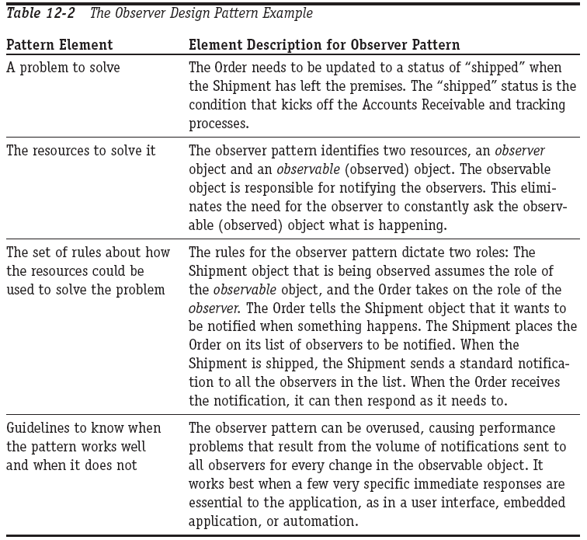
Understanding UML Notation for Design Patterns (4/5)
E.g., Observer design pattern
Notes:
Describe how the observer pattern allows to immedeiately update the Order when the Shipment leaves the building

Slide 11
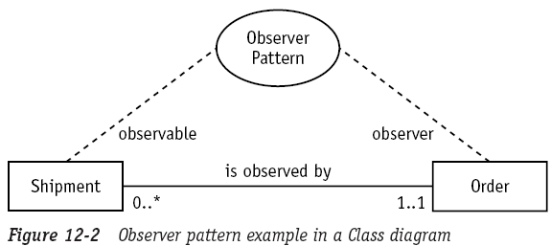
Understanding UML Notation for Design Patterns (5/5)
UML refers to a pattern as a collaboration
  An oval shape containing the pattern name
  Draw dashed lines from the collaboration to the classes that implement the pattern
  Place the role that the class plays in the implementation of the pattern

Slide 12
Contents
Modeling the Inventory Control System for the Case Study
Understanding UML Notation for Design Patterns
Using Design Patterns in the Class Diagram

Slide 13
Using Design Patterns in the Class Diagram (1/5)
Managing complex state-specific behavior
  When you checked the attribute values in the conditional logic, you were actually checking the object’s state
  When the implementation of the methods depends on changes in the attribute values (state changes), the code can quickly become very complicated to write and difficult to maintain
  ⇨ state design pattern offers a solution!

Slide 14
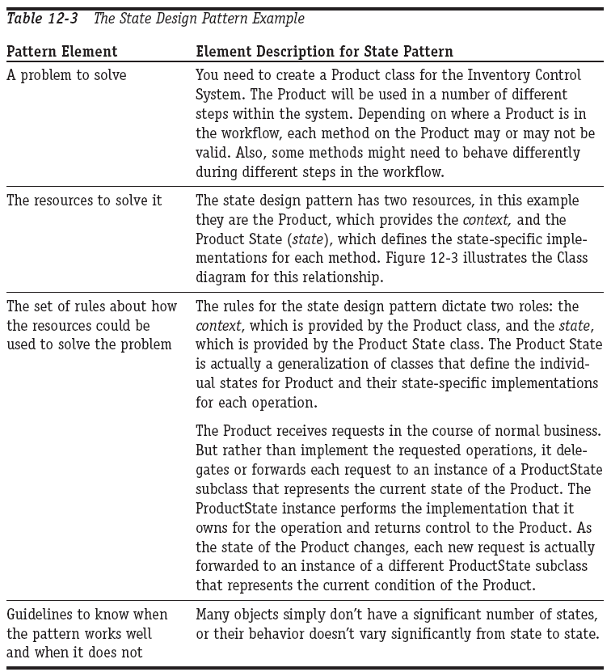
Using Design Patterns in the Class Diagram (2/5)
State design pattern

Slide 15
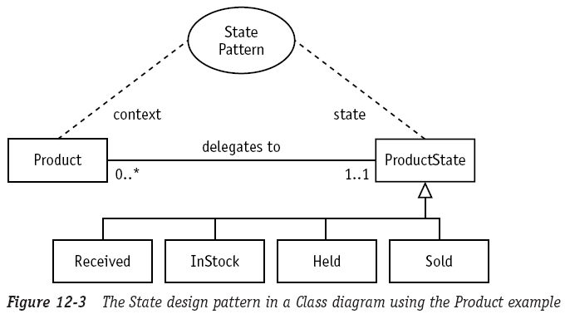
Using Design Patterns in the Class Diagram (3/5)
State design pattern in a Class diagram

Slide 16
Using Design Patterns in the Class Diagram (4/5)
Pattern notation
  Explains their communication, the methods they need to support, and the attributes they will need in order to support the relationship and the communication
  Using the design pattern notation in the Class diagram can streamline the review process
To learn patterns, keep in mind the four element listed in this session
  Learn to identify the problems that the patterns are designed to address
  Know when not to use a pattern
Notes:
문제점을 파악하는 방법을 배워야 함
언제 쓰지 말아야 하는지 알아야 한다. -> Kitchen은 집 같은데서 필요한거지, backpacking할 땐 필요 없잖아!

Slide 17
Using Design Patterns in the Class Diagram (5/5)
Caution about patterns
  Patterns improve your ability to share common solutions with your teammates
    If you throw lots of new patterns into your design and your teammates have no idea what you’re doing, then what have you gained?
  Some patterns are refined so much that they aren’t very easy to understand
Notes:
이런 경우, 패턴을 썼다 하더라도 결국엔 teammates들에게 내 디자인에 대해 일일이 설명해야만 한다.
유지 보수하는 프로그래머랑 테스터가 당신의 코드를 알아보지 못하기 때문에, 당신이 점점 더 추상적이고 테스트/유지보수가 어렵도록 코드를 짜는 걸지도 모른다……

Slide 18
The End

