Slide 1
Chapter 19: Information Retrieval

Slide 2
Database System Concepts
Chapter 1: Introduction
Part 1: Relational databases
  Chapter 2: Relational Model
  Chapter 3: SQL
  Chapter 4: Advanced SQL
  Chapter 5: Other Relational Languages
Part 2: Database Design
  Chapter 6: Database Design and the E-R Model
  Chapter 7: Relational Database Design
  Chapter 8: Application Design and Development
Part 3: Object-based databases and XML
  Chapter 9: Object-Based Databases
  Chapter 10: XML
Part 4: Data storage and querying
  Chapter 11: Storage and File Structure
  Chapter 12: Indexing and Hashing
  Chapter 13: Query Processing
  Chapter 14: Query Optimization
Part 5: Transaction management
  Chapter 15: Transactions
  Chapter 16: Concurrency control
  Chapter 17: Recovery System
Part 6: Data Mining and Information Retrieval
  Chapter 18: Data Analysis and Mining
  Chapter 19: Information Retreival
Part 7: Database system architecture
  Chapter 20: Database-System Architecture
  Chapter 21: Parallel Databases
  Chapter 22: Distributed Databases
Part 8: Other topics
  Chapter 23: Advanced Application Development
  Chapter 24: Advanced Data Types and New Applications
  Chapter 25: Advanced Transaction Processing
Part 9: Case studies
  Chapter 26: PostgreSQL
  Chapter 27: Oracle
  Chapter 28: IBM DB2
  Chapter 29: Microsoft SQL Server
Online Appendices
  Appendix A: Network Model
  Appendix B: Hierarchical Model
  Appendix C: Advanced Relational Database Model

Slide 3
Part 6: Data Mining and Information Retrieval (Chapters 18 and 19).
Chapter 18: Data Analysis and Mining
  introduces the concept of a data warehouse and explains data mining and online analytical processing (OLAP), including SQL support for OLAP and data warehousing.
Chapter 19: Information Retreival
  describes information retrieval techniques for querying textual data, including hyperlink-based techniques used in Web search engines.

Slide 4
Chapter 19: Information Retrieval
19.1 Overview
19.2 Relevance Ranking using Terms
19.3 Relevance using Hyperlinks
19.4 Synonyms, Homonyms, and Ontologies
19.5 Indexing of Documents
19.6 Measuring Retrieval Effectiveness
19.7 Web Search Engines
19.8 Information Retrieval and Structured Data
19.9 Directories
19.10 Summary

Slide 5
Information Retrieval Systems
Information retrieval (IR) systems use a simpler data model than database systems
  Information organized as a collection of documents
  Documents are unstructured, no schema
Information retrieval locates relevant documents, on the basis of user input such as keywords or example documents
  e.g., find documents containing the words “database systems”
Information retrieval can be used even on textual descriptions provided with non-textual data such as images
Web search engines are the most familiar example of IR systems

Slide 6
Information Retrieval Systems (Cont.)
Differences from database systems
  IR systems don’t deal with transactional updates (including concurrency control and recovery)
  Database systems deal with structured data, with schemas that define the data organization
  IR systems deal with some querying issues not generally addressed by database systems
    Approximate searching by keywords
    Ranking of retrieved answers by estimated degree of relevance

Slide 7
Keyword Search
In full text retrieval, all the words in each document are considered to be keywords.
  We use the word term to refer to the words in a document
Information-retrieval systems typically allow query expressions formed using keywords and the logical connectives and, or, and not
  “ands” are implicit, even if not explicitly specified
Ranking of documents on the basis of estimated relevance to a query is critical
  Relevance ranking is based on factors such as
    Term frequency (TF)
      Frequency of occurrence of query keyword in document
    Inverse document frequency (IDF)
      1 / number of documents that contains the query keyword
        Fewer ➔ give more importance to keyword
    Hyperlinks to documents
      More links to a document ➔ document is more important

Slide 8
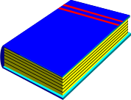

Original
Texts
Text-Based
Full Text Retrieval System
Digitization
Information
Retrieval
System
User Query
.......
..........
........
.........
...
..........
........
.........
...
..........
........
.........
Digitized
Full Texts
Relevant
Digitized Full Texts

Slide 9
Chapter 19: Information Retrieval
19.1 Overview
19.2 Relevance Ranking using Terms
19.3 Relevance using Hyperlinks
19.4 Synonyms, Homonyms, and Ontologies
19.5 Indexing of Documents
19.6 Measuring Retrieval Effectiveness
19.7 Web Search Engines
19.8 Information Retrieval and Structured Data
19.9 Directories
19.10 Summary

Slide 10
Relevance Ranking using Terms
TF-IDF (Term Frequency / Inverse Document Frequency) ranking:
  Let n(d) = number of terms in the document d
  n(d, t) = number of occurrences of term t in the document d.
  Relevance of a document d to a term t
    One naïve way of defining TF: Just count the number of occurrences
    The number of occurrences depends on the length of the document
    A document containing 10 occurrences of a term may not be 10 times as relevant as a document containing one word
n(d, t)
TF (d, t) =
n(d)

Slide 11
Relevance Ranking using Terms (cont.)
  Applying log factor is to avoid excessive weight to frequent terms
  IDF
    n(t) is number of documents containing term t
  Relevance of a document d to a query Q
n(d, t)
1 +
TF (d, t) = log ( )
n(d)
IDF(t) = 1 / n(t)
TF (d, t)
∑
TF (d, t) * IDF(t)
∑
r (d, Q) =
=
n(t)
t∈Q
t∈Q

Slide 12
Relevance Ranking using Terms (Cont.)
Most systems add the following tips to the above TF model
  Words that occur in title, author list, section headings, etc. are given greater importance
  Words whose first occurrence is late in the document are given lower importance
  Very common words such as “a”, “the”, “it” (stop words) are eliminated
  Proximity: if keywords in query occur close together in the document, the document has higher importance than if they occur far apart
Documents are returned in decreasing order of relevance score
  Usually only top few documents are returned, not all

Slide 13
Similarity Based Retrieval
Similarity based retrieval - retrieve documents similar to a given document A
  Similarity may be defined on the basis of common words
    find k terms in a document A with highest values of TF (A, t ) / n (t )
    use these k terms to find relevance of other documents.
Vector space model: define an n-dimensional space, where n is the number of words in the document set.
  Vector for document d having terms t1, t2, … tn goes from origin to a point
    i ^{th} coordinate of the point is r(d, ti) = TF (d, ti ) * IDF (ti )
  The cosine of the angle between the vectors of two documents is used as a measure of their similarity.
Relevance feedback: Similarity can be used to refine answer set to keyword query
  User selects a few relevant documents from those retrieved by keyword query, and system finds other documents similar to these

Slide 14
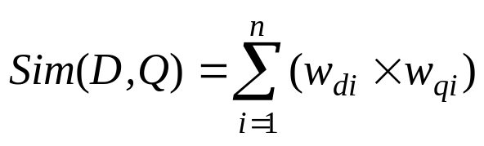
Vector Space Model
문서와 질의를 가중치가 부여된 색인어들의 벡터로 표현
  D = {(t₁, w_{d1}), (t₂, w_{d2}), ... , (t_{n}, w_{dn})} w_{di} : 문서 D 에서 i번째 색인어 t_{i} 의 가중치
  Q = {(t₁, w_{q1}), (t₂, w_{q2}), ... , (t_{n}, w_{qn})} w_{ti} : 질의 Q 에서 i번째 색인어 t_{i} 의 가중치
문서D 와 질의 Q 의 유사도
예제) 다음 문서 D 와 Q의 유사도 계산
D = {(정보, 0.3), (검색, 0.5), (시스템, 0.2)}
Q = {(정보, 0.4), (검색, 0.7)}
Sim (D,Q) = 0.3*0.4 + 0.5*0.7 = 0.47
D
t₂
θ
Q
t₁
t₃

Slide 15
Chapter 19: Information Retrieval
19.1 Overview
19.2 Relevance Ranking using Terms
19.3 Relevance using Hyperlinks
19.4 Synonyms, Homonyms, and Ontologies
19.5 Indexing of Documents
19.6 Measuring Retrieval Effectiveness
19.7 Web Search Engines
19.8 Information Retrieval and Structured Data
19.9 Directories
19.10 Summary

Slide 16
Relevance using Hyperlinks
If only term frequencies are taken into account
  Number of documents relevant to a query can be enormous
  Using high term frequencies makes “spamming” easy
      E.g. a travel agency can add many occurrences of the words “travel” to its page to make its rank very high
The advent of WWW
  Observation: Most of the time people are looking for pages from popular sites
  Idea: use popularity of Web site (e.g. how many people visit it) to rank site pages that match given keywords
  Problem: hard to find actual popularity of site
    Solution: next slide

Slide 17
Popularity Ranking
Solution: use number of hyperlinks to a site as a measure of the popularity or prestige of the site
  Count only one hyperlink from each site (why? - see previous slide)
  Popularity measure is for site, not for individual page
    But, most hyperlinks are to root of site
    Also, concept of “site” difficult to define since a URL prefix like cs.yale.edu contains many unrelated pages of varying popularity
Refinements
  When computing prestige based on links to a site, give more weight to links from sites that themselves have higher prestige
    Definition is circular
    Set up and solve system of simultaneous linear equations
  Above idea is basis of the Google PageRank ranking mechanism

Slide 18
PageRank 설명추가

Slide 19
Other Measures of Popularity
Connections to social networking theories that ranked prestige of people
  E.g. the president of the U.S.A has a high prestige since many people know him
  Someone known by multiple prestigious people has high prestige
The HITS algorithm (Hub and authority based ranking)
  A hub is a page that stores links to many pages (on a topic)
  An authority is a page that contains actual information on a topic
  Each page gets a hub prestige based on prestige of authorities that it points to
  Each page gets an authority prestige based on prestige of hubs that point to it
  Again, prestige definitions are cyclic, and can be got by solving linear equations
  Use authority prestige when ranking answers to a query
The HITS algorithm is susceptible to spamming

Slide 20
HITS Algorithm 작동 그림예제

Slide 21
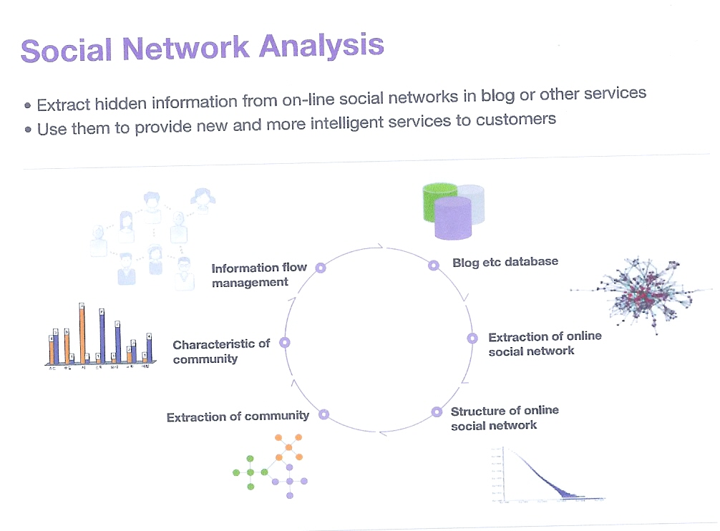
Social Network Analysis

Slide 22
Chapter 19: Information Retrieval
19.1 Overview
19.2 Relevance Ranking using Terms
19.3 Relevance using Hyperlinks
19.4 Synonyms, Homonyms, and Ontologies
19.5 Indexing of Documents
19.6 Measuring Retrieval Effectiveness
19.7 Web Search Engines
19.8 Information Retrieval and Structured Data
19.9 Directories
19.10 Summary

Slide 23
Synonyms and Homonyms
Synonyms
  E.g. document: “motorcycle repair”, query: “motorcycle maintenance”
    need to realize that “maintenance” and “repair” are synonyms
  System can extend query as “motorcycle and (repair or maintenance)”
Homonyms
  E.g. “object” has different meanings as noun/verb
  “table” could be a dinner table or a table in RDB
  System can disambiguate meanings (to some extent) from the context
But, extending queries automatically using synonyms can be problematic
  Need to understand intended meaning in order to infer synonyms
    or verify synonyms with user
  Synonyms may have other meanings as well

Slide 24
Concept-Based Querying
Approach
  For each word, determine the concept it represents from context
  Use one or more ontologies:
    Hierarchical structure showing relationship between concepts
    E.g.: the ISA relationship that we saw in the E-R model
This approach can be used to standardize terminology in a specific field
  Gene Ontology
  Ontology for home appliances
Ontologies can link multiple languages
  WordNet for English
  WordNet for Korean
Foundation of the Semantic Web (not covered here)

Slide 25
Ontology & concept query 그림예제

Slide 26
Chapter 19: Information Retrieval
19.1 Overview
19.2 Relevance Ranking using Terms
19.3 Relevance using Hyperlinks
19.4 Synonyms, Homonyms, and Ontologies
19.5 Indexing of Documents
19.6 Measuring Retrieval Effectiveness
19.7 Web Search Engines
19.8 Information Retrieval and Structured Data
19.9 Directories
19.10 Summary

Slide 27
Indexing of Documents
An inverted index maps each keyword K_{i} to a set of documents S_{i} that contain the keyword
  Documents identified by identifiers
Inverted index may record
  Keyword locations within document to allow proximity based ranking
  Counts of number of occurrences of keyword to compute TF
“and” operation
  Finds documents that contain all of K₁, K₂, ..., K_{n}.
  Intersection S₁ ∩S₂ ∩..... ∩ S_{n}
“or” operation
  Finds documents that contain at least one of K₁, K₂, …, K_{n}
  union, S₁U S₂ U..... U S_{n},.
Each S_{i} is kept sorted to allow efficient intersection/union by merging
  “not” can also be efficiently implemented by merging of sorted lists

Slide 28
Inverted Index 그림예제

Slide 29
Chapter 19: Information Retrieval
19.1 Overview
19.2 Relevance Ranking using Terms
19.3 Relevance using Hyperlinks
19.4 Synonyms, Homonyms, and Ontologies
19.5 Indexing of Documents
19.6 Measuring Retrieval Effectiveness
19.7 Web Search Engines
19.8 Information Retrieval and Structured Data
19.9 Directories
19.10 Summary

Slide 30
Measuring Retrieval Effectiveness
Information-retrieval systems save storage space by using index structures that support only approximate retrieval.
May result in:
  false negative (false drop) - some relevant documents may not be retrieved.
  false positive - some irrelevant documents may be retrieved.
  For many applications a good index should not permit any false drops, but may permit a few false positives.
Relevant performance metrics
Precision
  what percentage of the retrieved documents are relevant to the query = C / A
Recall
  what percentage of the documents relevant to the query were retrieved = C / B
Document pool
A: Retrieved
documents
B: Relevant
documents
C

Slide 31
Measuring Retrieval Effectiveness (Cont.)
The tradeoff in Recall vs. Precision:
  Retrieving many documents (down to a low level of relevance ranking) can increase recall, but many irrelevant documents would reduce precision
Better measure of retrieval effectiveness:
  Recall as a function of number of documents fetched, or
  Precision as a function of recall
    Equivalently, as a function of number of documents fetched
  E.g. “precision of 75% at recall of 50%, & precision 60% at a recall of 75%”
Problem: which documents are actually relevant, and which are not!

Slide 32
Precision & Recall 그림예제 추가

Slide 33
Chapter 19: Information Retrieval
19.1 Overview
19.2 Relevance Ranking using Terms
19.3 Relevance using Hyperlinks
19.4 Synonyms, Homonyms, and Ontologies
19.5 Indexing of Documents
19.6 Measuring Retrieval Effectiveness
19.7 Web Search Engines
19.8 Information Retrieval and Structured Data
19.9 Directories
19.10 Summary

Slide 34
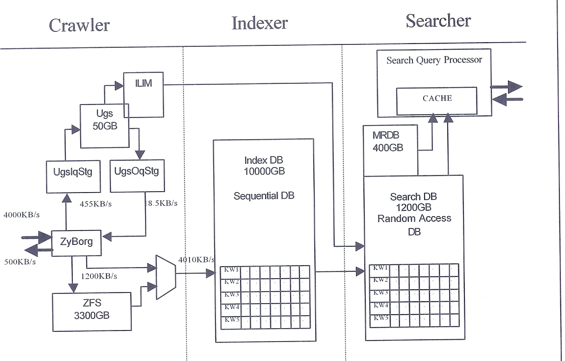
Web Search Engine Architecture
NAVER: more than 3000 servers
Google: more than 20,000 servers

Slide 35
Web Search Engines
Web crawlers are programs that locate and gather information on the Web
  Recursively follow hyperlinks present in known documents, to find other documents
    Starting from a seed set of documents
  Fetched documents
    Handed over to an indexing system
    Can be discarded after indexing, or store as a cached copy
Crawling the entire Web would take a very large amount of time
  Search engines typically cover only a part of the Web, not all of it
  Take months to perform a single crawl

Slide 36
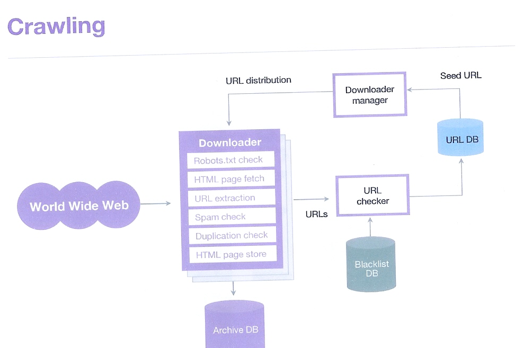
Web Crawler

Slide 37
Web Search Engines (Cont.)
Crawling is done by multiple processes on multiple machines, running in parallel
  Set of links to be crawled are stored in a database
  New links found in crawled pages are added to this set, to be crawled later
Indexing process also runs on multiple machines
  Creates a new copy of index instead of modifying old index
  Old index is used to answer queries
  After a crawl is “completed” new index becomes “old” index
Multiple machines used to answer queries
  Indices may be kept in memory
  Queries may be routed to different machines for load balancing

Slide 38
Chapter 19: Information Retrieval
19.1 Overview
19.2 Relevance Ranking using Terms
19.3 Relevance using Hyperlinks
19.4 Synonyms, Homonyms, and Ontologies
19.5 Indexing of Documents
19.6 Measuring Retrieval Effectiveness
19.7 Web Search Engines
19.8 Information Retrieval and Structured Data
19.9 Directories
19.10 Summary

Slide 39
Information Retrieval and Structured Data
Originally IR systems treated documents as a collection of words (unstructured), there is a increasing need for understanding the documents
  Extract structured documents from unstructured documents
  Natural Language Processing
Information extraction systems infer structure from documents, e.g.:
  Extraction of house attributes (size, address, number of bedrooms, etc.) from a text advertisement
  Extraction of topic and people named from a new article
  Relations or XML structures are used to store extracted data
Querying Structured Data (Keyword search in relational data and XML data)
  Keyword “Smith Queens” may be “Smith” in customer tuple or “Queens” in branch tuple
    Don’t care schema / Don’t care SQL
  Techniques using connections among keywords or assigning popularity to keywords

Slide 40
Doc
1
...
XML-Based
Full Text Retrieval System
Doc
2
Doc
n
Information
Processing
XML
Query
Documents
Information
Retrieval
XML
System
Parser
Verified
Verified
XML
XML
XML
Viewer
Documents
Documents
XML-Text
Converter
Plain Text
There are lots of issues !!!!

Slide 41
IR and Question Answering System
Question answering in web search engine
  Question ➔ “Who killed Lincoln?”
  Answer ➔ “Abraham Lincoln was shot by John Wilkes Booth in 1865”
  Steps of QA system
    Extract some keywords from the submitted question
    Execute keyword searching against Web search engine
    Parse the returned documents and generate the answer
      A number of linguistic techniques and heuristics from AI Natural Language Processing

Slide 42
Original
Texts
Passage-Based
Full Text Retrieval System
Digitization
.......
..........
........
.........
...
..........
........
.........
...
..........
........
.........
Digitized
Full Texts
User Query
Information
Retrieval
System
Relevant
Passages
Passage
Generation
Relevant Passage
Generated Passages

Slide 43
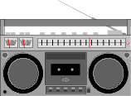

Original Information Items
Advanced
Information
Systems
Digitization
Text Summ.
OCR
Color Ext.
Feature Ext.
Voice Rec.
Text
SGML
Tiff
JPEG
MPEG
WAV
et al.
Manual
Information
Processing
Digitized
Information
Automatic
Information
Processing
Query
Information
Retrieval
System
Secondary
Information
Relevant
Secondary
Information
Relevant
Digitized
Information

Slide 44
Chapter 19: Information Retrieval
19.1 Overview
19.2 Relevance Ranking using Terms
19.3 Relevance using Hyperlinks
19.4 Synonyms, Homonyms, and Ontologies
19.5 Indexing of Documents
19.6 Measuring Retrieval Effectiveness
19.7 Web Search Engines
19.8 Information Retrieval and Structured Data
19.9 Directories
19.10 Summary

Slide 45
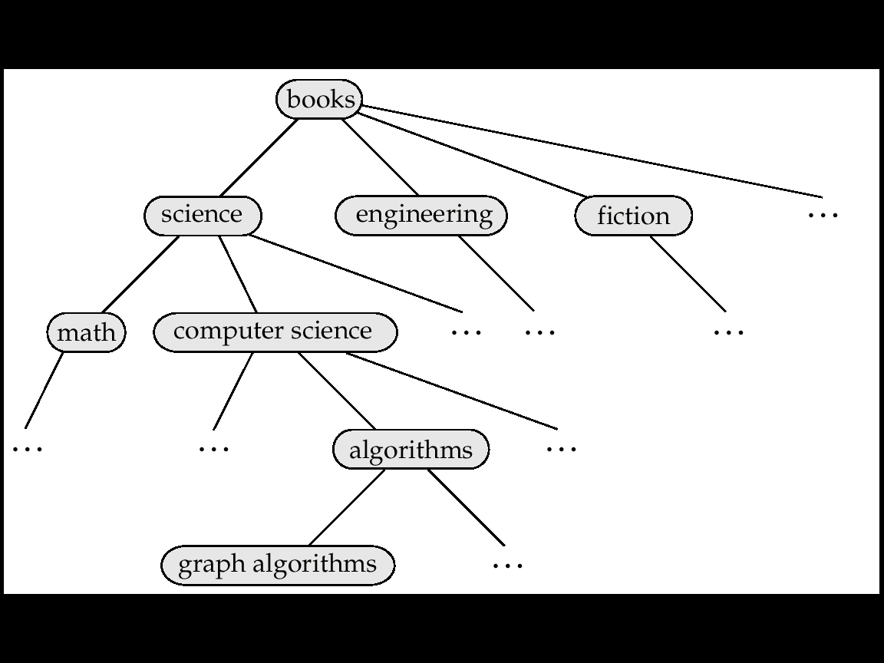
Directory in IR System (1)
Storing related documents together in a library facilitates browsing
  users can see not only requested document but also related ones.
Browsing is facilitated by classification system that organizes logically related documents together.
A Classification Hierarchy for a Library IR System

Slide 46
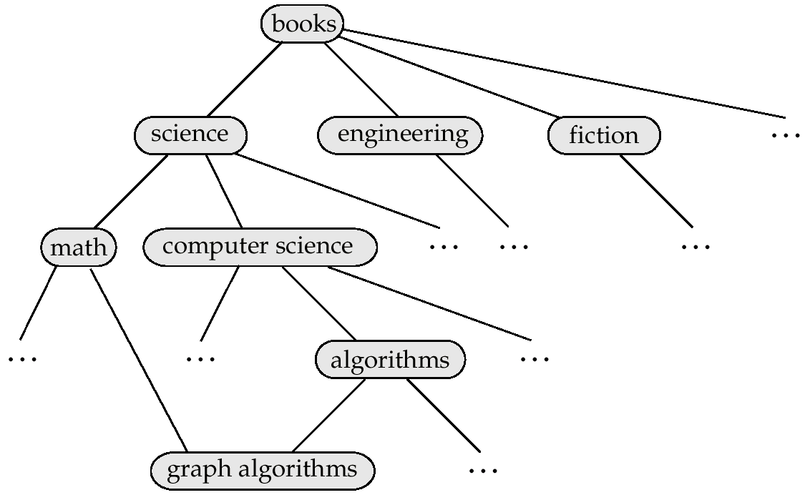
Directory in IR System (2)
Directed Acyclic Graph (DAG)
Documents can reside in multiple places in a hierarchy in an information retrieval system, since physical location is not important.
A Classification DAG For A Library IR System

Slide 47
Web Directories
A Web directory is just a classification directory on Web pages
Organizing the huge information on the Web is not an easy task
  1st problem: determining what exactly the directory hierarchy should be
  2nd problem: deciding which nodes of the directory are suitable categories
  Often done manually: Yahoo’s Open Directory project
    Classification of documents into a hierarchy may be done based on term similarity in an automatic tool
Tagging vs. Directory

Slide 48
Tagging 설명과 예제추가

Slide 49
Chapter 19: Information Retrieval
19.1 Overview
19.2 Relevance Ranking using Terms
19.3 Relevance using Hyperlinks
19.4 Synonyms, Homonyms, and Ontologies
19.5 Indexing of Documents
19.6 Measuring Retrieval Effectiveness
19.7 Web Search Engines
19.8 Information Retrieval and Structured Data
19.9 Directories
19.10 Summary

Slide 50
Ch 19: Summary (1)
Information retrieval systems are used to store and query textual data such as documents.
  They use a simpler data model than do database systems, but provide more powerful querying capabilities within the restricted model.
  Queries attempt to locate documents that are of interest by specifying, for example, sets of keywords.
  The query that a user has in mind usually cannot be stated precisely; hence, information-retrieval systems order answers on the basis of potential relevance.
Relevance ranking makes use of several types of information such as:
  Term frequency: how important each term is to each document.
  Inverse document frequency.
  Popularity ranking.

Slide 51
Ch 19: Summary (2)
Similarity of documents is used to retrieve documents similar to an example document.
  The cosine metric is used to define similarity, and is based on the vector space model.
PageRank and hub/authority rank are two ways to assign prestige to pages on the basis of links to the page.
  The PageRank measure can be intuitively understood using a random-walk model.
  Anchor text information is also used to compute a per-keyword notion of popularity.
Search engine spamming attempts to get (an undeserved) high ranking for a page.
Synonyms and homonyms complicate the task of information retrieval.
  Concept-based querying aims at finding documents containing specified concepts, regardless of the exact words (or language) in which the concept is specified.
  Ontologies are used to relate concepts using relationships such as is-a or part-of.

Slide 52
Ch 19: Summary (3)
Inverted indices are used to answer keyword queries.
Precision and recal1 are two measures of the effectiveness of an information retrieval system.
Web search engines crawl the Web to find pages, analyze them to compute prestige measures, and index them.
Techniques have been developed to extract structured information from textual data, to perform keyword querying on structured data, and to give direct answers to simple questions posed m natural language.
Directory structures are used to classify documents with other similar documents.

Slide 53
Ch 19: Bibliographical Notes (1)
Chakrabarti [2002], Grossman and Frieder [2004l, Wltten et al. [1999] and Baeza Yates and Ribeiro-Neto[1999] provide textbook descriptions of information retrieval.
Chakrabarti [2002] provides detailed coverage of Web crawling ranking techniques, and clustering and other mining techniques related to information retrieval.
Indexing of documents is covered in detail by Witten et a1. [1999].
Jones and Willet [1997] is a collection of articles on information retrieval.
Salton [1989] is an early textbook on information-retrieval systems.
Brin and Page [1998] describes the anatomy of the Google search engine including the PageRank technique, while a hubs-and authorities-based ranking technique called HITS is described by Kleinberg [1999].
Bharat and Henzinger [1998] presents a refinement of the HITS ranking technique. These techniques, as well as other popularity based ranking techniques (and techniques to avoid search engine spamming) are described in detail in Chakrabarti [2002].

Slide 54
Ch 19: Bibliographical Notes (2)
Chakrabarti et al. [1999] addresses focused crawling of me Web to find pages related to a specific topic.
Chakrabarti [1999] provides a survey of Web resource discovery.
The Citeseer system (citeseer.ist.psu.edu) maintains a very large database of publications (articles) with citation links between the publications, and uses citations to rank publications. It includes a technique for adjusting the citation ranking based on the age of a publication, to compensate for the fact that citations to a publication increase time passes; without the adjustment, older documents tend to get a higher ranking than they truly deserve.
Information extraction and extraction and question answering have had a fairly long history in the artificial intelligence community.
Jackson and Moulinier [2002] provides textbook coverage of natural language processing technique with an emphasis on information extraction.
Soderland [1999] describes information extraction using the WHISK system, while Appelt and Israel [1999] provides a tutorial on information extraction.

Slide 55
Ch 19: Bibliographical Notes (3)
The annual Text Retrieval Conference (TREC) has a number of tracks including document retrieval, question answering, genomics search and so on. Each track defines a problem and infrastructure to test the quality of solutions to the problem. Details on TREC may be found at trec.nist.gov. Information about the question answering track may be found at trec.nist.gov/data/qa.html.
More information about WordNet can be found at wordnet.princeton.edu and globalwordnet.org. The goal of the Cyc system was a formal representation of large amounts of human knowledge. Its knowledge base contains a large number of terms, and assertions about each term. Cyc also includes a support for natural language understanding and disambiguation. Information about the Cyc system may be found at cyc.com and opencyc.org.
Agrawal et al. [2002], Bhalotia et al. [2002], and Hristidis and Papakonstantinou [2002] cover keyword querying of relational data.
Keyword querying of XML data is addressed by Florescu et al. [2000a] and Guo et al. [2003], among others.

Slide 56
Ch 19: Tools
Google (www.goog|e.com) is currently the most popular Search engine, but there are a number of other search engines, such as MSN Search (search-msn.com) and Yahoo search (search.yahoo.com).
The site searchenginewatch.com provides a variety of information about search engines.
Yahoo (www.yahoo.com) and the Open Directory Project (dmoz.org) provide classification hierarchies for Web sites.

Slide 57
Chapter 19: Information Retrieval
19.1 Overview
19.2 Relevance Ranking using Terms
19.3 Relevance using Hyperlinks
19.4 Synonyms, Homonyms, and Ontologies
19.5 Indexing of Documents
19.6 Measuring Retrieval Effectiveness
19.7 Web Search Engines
19.8 Information Retrieval and Structured Data
19.9 Directories
19.10 Summary

Slide 58
End of Chapter

