Slide 1
Democrats, Republicans and Starbucks Afficionados: User Classification in Twitter
Marco Pennacchiotti, Ana-Maria Popescu (Yahoo! Labs)
KDD 2011
November 3, 2011
Hyewon Lim

Slide 2
Outline
Introduction
Related Work
Machine Learning Model
Graph-based Label Update
Experimental Evaluation
Conclusions and Future Work

Slide 3
Introduction
The explosion of real-time microblogging services
Led to a wealth of efforts to make use of social media content as well as various social graphs
Automatic user classification and profiling
i.e., mining values of various user attributes
Demographic characteristics
Coarse- and fine-grained interests
Stances on various issues, Etc.
These user models can help in multiple application scenarios
Authoritative users extraction
Post reranking in web search
User recommandation

Slide 4
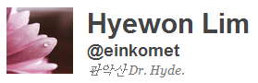
Introduction
Most services already store profile information
Often incomplete or misleading
Interests or political preferences are mostly omitted
A user classification task
User-centric information + Social graph information

Slide 5
Related Work
User attribute detection based on user communication streams
Detection of gender
Understanding how the political orientation of a user is reflected in their writing
Explored attributes include the user’s location, location of origin and age
Twitter-related research and applications
Spam detection research
Tweet sentiment analysis
Conversation modeling

Slide 6
Outline
Introduction
Related Work
Machine Learning Model
Graph-based Label Update
Experimental Evaluation
Conclusions and Future Work

Slide 7
Machine Learning Model
Task
Build a general, scalable and robust architecture for automatically computing the values of given user attributes for a large set of Twitter users
Solution overview
Machine learning algorithm
Learns a classification model from labeled data and user-centric features
Then the model is used to classify new incoming users
Graph-based label updating function
Uses social graph information in order to revise the classification label assigned to each user by the initial machine learning component

Slide 8
Machine Learning Model
Scalability
Architectural component run over a Map/Reduce Hadoop system
Use a large set of features to learn the classification model
Profile
Messaging (tweeting) behavior
Linguistic content of messages
Social network information

Slide 9
Machine Learning Model Profile Features
Twitter API provides access to basic user information
Only 26% of users report a specific location (Cheng et al.[6])
Pilot study I
Identifying a user’s gender and ethnicity using such information
14M users active in April 2010
48% provide a short bio and 80% a location
Matched more than 30 regular expression patterns over the bio field
Result
Ethnicity for 0.1%
Gender for 80% with very low accuracy

Slide 10
Machine Learning Model Profile Features
Pilot study II
Identifying a user’s gender and ethnicity using the profile avatar
Pictures
Less than 50% were correlated with a clear ethnicity
57% were correlated with a specific gender
Often be misleading: not of the account owner
→ Picture fields do not contain enough good-quality information to be directly used for user classification purposes

Slide 11
Machine Learning Model Profile Features
Implement basic profile-based features (PROF)
Length of the user name
# of numeric & alphanumeric characters in the user name
Different capitalization forms in the user name
Use of the avatar picture
# of followers
# of friends
Friends/followers ratio
Date of account creation
Matching of various regular expression patterns in the bio field
Presence of the location field

Slide 12
Machine Learning Model Tweeting Behavior Features
Tweeting behavior
Characterized by a set of statistics capturing the way the user interacts with the micro-blogging service
The average # of messages per day, # of replies, etc.
→ Such information is useful for constructing a model of the user
More than 20 tweeting behavior features (BEHAV)
# of tweets posted by the user
# and fraction of tweets that are retweets/replies
Average # of hashtags and URLs per tweet
Fraction of tweets that are truncated
Average time and SD between tweets
Etc.

Slide 13
Machine Learning Model Linguistic Content Features
Linguistic content information
Encapsulates the user’s lexical usage and the main topics of interest to the user
Prototypical words (LING-WORD)
Classes can be described by prototypical words
Typical lexical expressions for people in a specific class (e.g. dude, lmao)
Phrases denoting typical interests of people in that class
Health care: Democrats > Republicans
Employ a probabilistic model for automatically extracting proto words

Slide 14
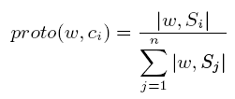
Machine Learning Model Linguistic Content Features
Prototypical words (LING-WORD)
Employ a probabilistic model for automatically extracting proto words
Each word w is assigned a score for each of the classes
|w, S_{i}|: # times the word w is issued by all users for class c_{i}
Retain as proto wards the highest scoring k words
n classes
S₁
S₂
S_{n}
c₁
c₂
c_{n}

Slide 15

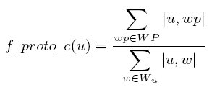
Machine Learning Model Linguistic Content Features
Prototypical words (LING-WORD)
The n*k proto words collected across all classes serve as features for representing a given user
For each proto word wp, the user u is assigned the score:
|u, wp|: # times the word w is issued by user u
W_{u}: the set of all words issued by u
For each class, the user is also assigned an aggregated feature:
WP: the set of all words for class c

Slide 16
Machine Learning Model Linguistic Content Features
Prototypical hashtags (LING-HASH)
Implemented similarly to LING-WORD
Given seed user set S_{i} for a class c_{i} , we collect all the hashtags h contained in the tweets of each seed user
In Eq. 1: w -> h
Sentiment words (LING-SENT)
Identify terms or entities about which a particular user class has an overall majority opinion which is not shared by a different class
“Ronald Reagan”: Republicans+, Democrats-

Slide 17
Machine Learning Model Linguistic Content Features
Generic LDA (LING-GLDA)
An adaptation of the original LDA where documents are replaced by users
Hypothesis
A user can be represented as a multinomial distribution over topics
Obtain 100 topics which will each be used to derive features for classification
Domain-specific LDA (LING-DLDA)
LDA model derived from users drawn from the training set
Not a generic set of users
LING-GLDA | LING-DLDA
Returns coarse-grained topics such as soccer, music, and politics | Return fine-grained topics that are more discriminative for the classification task

Slide 18
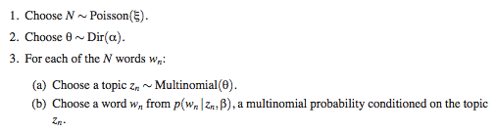
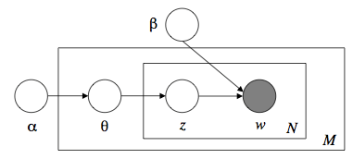
Machine Learning Model Linguistic Content Features
LDA (Latent Dirichlet Allocation)

Slide 19
Machine Learning Model Social Network Features
“Friend” features (SOC-FRIE)
Hypothesis
Users from other classes may also share specific “friend” accounts
Prototypical replied (SOC-REP) & retweeted (SOC-RET) users
Users from a particular class tend to reply to and retweet messages of specific accounts

Slide 20
Outline
Introduction
Related Work
Machine Learning Model
Graph-based Label Update
Experimental Evaluation
Conclusions and Future Work

Slide 21

Graph-based Label Update
Graph-based label updating algorithm
Attempts to further improve the quality of the users’ classification by taking into account social connections
Social connections can provide signals for correcting the errors of the machine learning component by inverting the classification label
Algorithm is applied after the ML classification step
Label update function uses the classification confidence value returned by GBDT for each user
[+1, -1], positive values = positively classified users
ML
Graph-based

Slide 22
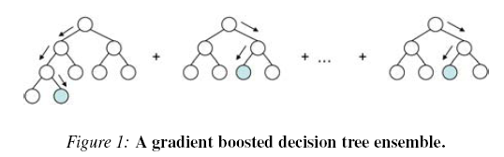
Graph-based Label Update
Gradient Boosted Decision Trees (GBDT)
Ye et al., Stochastic Gradient Boosted Distributed Decision Trees, CIKM09

Slide 23



Graph-based Label Update
Graph-based label updating algorithm
Not all friends are equally strongly connected to a user and that some friends are overall more influential than others
Information source
Information seeker

Slide 24
Outline
Introduction
Related Work
Machine Learning Model
Graph-based Label Update
Experimental Evaluation
Conclusions and Future Work

Slide 25
Experimental Evaluation
Political affiliation
Democrats (positive set) or Republicans (negative set)
Gold standard dataset: from WeFollow and Twellow
Ethnicity
African-Americans or not
Gold standard dataset
Collect users who explicitly mention their ethnicity in their profile
Starbucks fans
Gold standard dataset
Already follow Starbucks (positive set) or not (negative set)

Slide 26
Experimental Evaluation
Evaluation metrics
Precision, recall, F-measure, accuracy
10-folds cross validation
System Configurations
ML / GRAPH / HYBRID
Two baselines for comparing performance
B2: trained only on the profile and tweeting behavior features
B1
Political affiliation: mentioning their political affiliation in the bio field
Ethnicity: according to their profile picture
Starbucks fans: mention Starbucks in their bio field

Slide 27
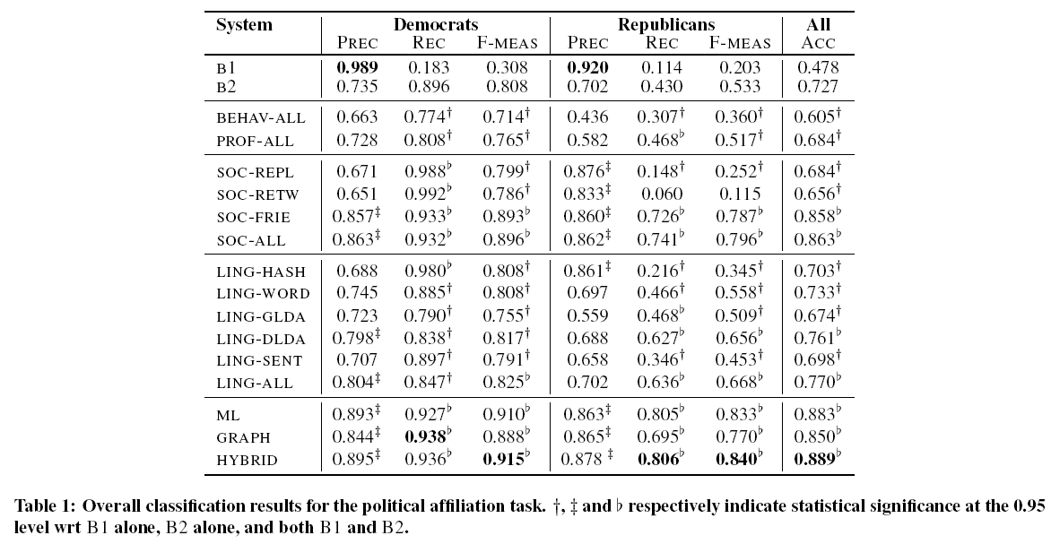
Experimental Evaluation Experimental Results
Political affiliation

Slide 28
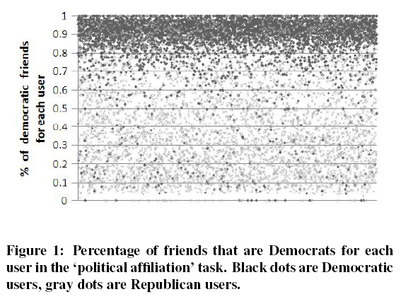
Experimental Evaluation Experimental Results
Political affiliation

Slide 29
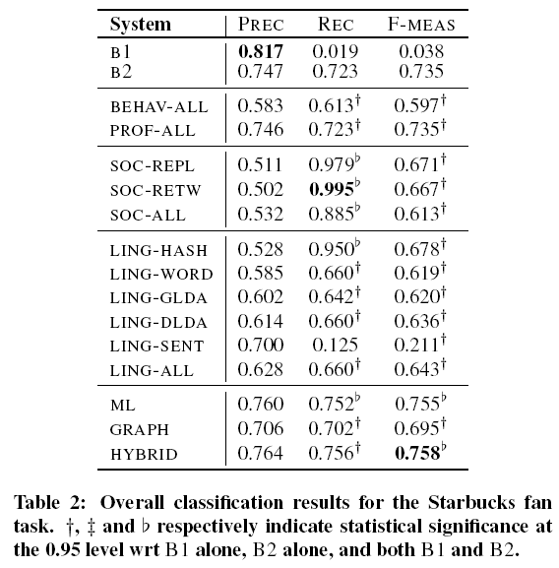
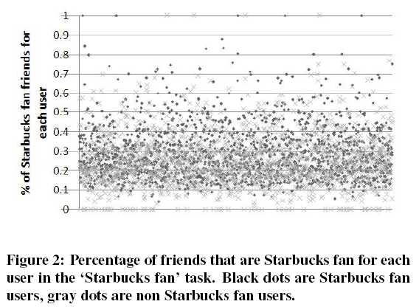
Experimental Evaluation Experimental Results
Starbucks fans

Slide 30
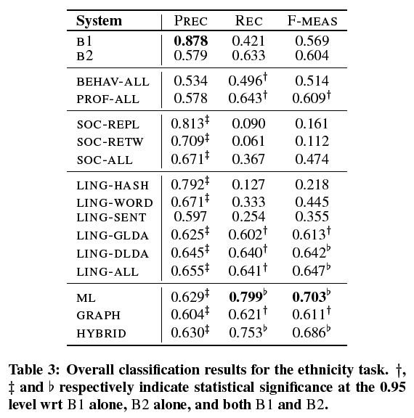
Experimental Evaluation Experimental Results
Ethnicity

Slide 31
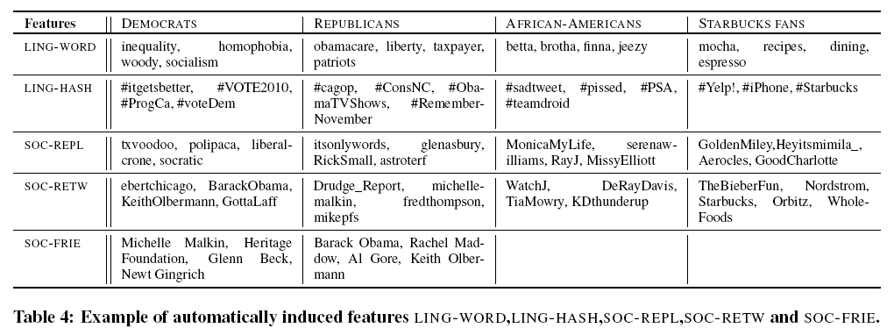
Experimental Evaluation Experimental Results
Ethnicity
Examples of the lexical usage and issues or entities in African-American user accounts

Slide 32
Outline
Introduction
Related Work
Machine Learning Model
Graph-based Label Update
Experimental Evaluation
Conclusions and Future Work

Slide 33
Conclusions and Future Work
User classification is in general a feasible task
Results vary across different classes
Currently work on deploying and testing the models in a real-time
Plan to integrate the user classification models into systems for content display personalization

