Slide 1
Impact and degree of user sociability in social media
Hyoseop Shin, Jeehoon Lee
Information Sciences (2012. 2)
23 March 2012
Hyewon Lim

Slide 2
Outline
Introduction
Background and motivation
The conventional reputation rank
The proposed ranking schemes
Degree of user sociability
Experimental results
Conclusion
Discussion

Slide 3
Introduction
Ability to rank users
Discover the power users
effectively rank user-generated contents
For data mining processes as in user clustering

Slide 4
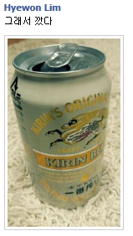

Introduction
Problem of users’ rankings
Link analysis of the social interactions between the users themselves within the graph
PageRank, HITS
For users’ rankings, especially for users’ reputation
No consideration of the fact that the user’s sociability can affect the user’s reputation
user
user
feedback

Slide 5
Introduction
In this paper…
Propose two different factors that affect each user’s ranking score
User’s reputation
User’s sociability
Present novel schemes to separately and effectively measure both the reputation and the sociability of the users in social media
Present several schemes to measure the degree of the user sociability in a social network

Slide 6
Outline
Introduction
Background and motivation
The conventional reputation rank
The proposed ranking schemes
Degree of user sociability
Experimental results
Conclusion
Discussion

Slide 7
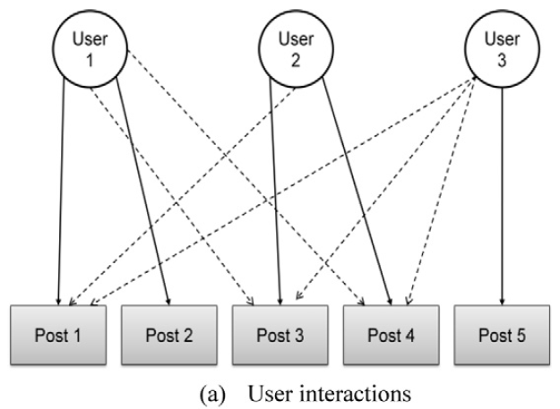
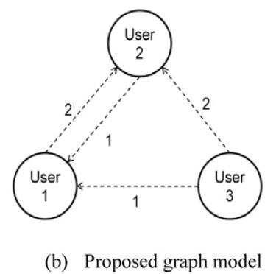
Background and motivation
1. Graph model
Commonly, if a user gets a large number of feedbacks from other users, then the user must be very popular or the user has a higher reputation

Slide 8

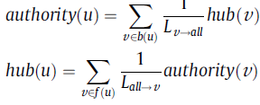


Background and motivation
2. Ranking algorithm
PageRank
HITS
$$\frac{1}{k}$$
$$\frac{1}{k}$$
$$\frac{1}{k}$$
$$\frac{1}{k}$$
q
$$\frac{1}{k}$$
…
$$\frac{1}{k}$$
$$\frac{1}{k}$$
$$\frac{1}{k}$$
authority
p
feedback
q
hub

Slide 9
Background and motivation
3. Motivation
Characteristics of the links
Online user network graphs
Web
weight
Random feedback model
Choose a user for the next feedback based on the frequencies of previous feedbacks the user gave to other users
Random walk model
Random surfer (or a feedback giver) moves with an equal probability
Users’ interactivity aa
Users’ interactivity aa

Slide 10
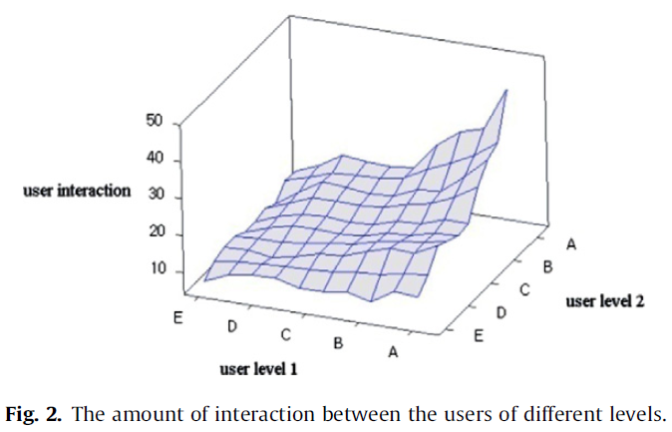
Background and motivation
3. Motivation (cont.)
Sociability of users
Within the random walk model based ranking methods, Users with a lower (higher) sociability rank may unfairly get a lower (higher) score than expected
[Shin08] observed that the amount of exchange of feedbacks is heavily associated with the users’ rank
# feedback exchanges between power users
# feedback exchanges between power & non-power users
# feedback exchanges between non-power users

Slide 11
Background and motivation
3. Motivation (cont.)
Users’ sociability alone plays a very important role in determining the users’ ranks
We propose two separate schemes to measure two different user’s ranking measure
Pure reputation measure
Sociability measure
Then we combine these two measures together to produce an optimal user ranking model

Slide 12
Outline
Introduction
Background and motivation
The conventional reputation rank
The proposed ranking schemes
Degree of user sociability
Experimental results
Conclusion
Discussion

Slide 13


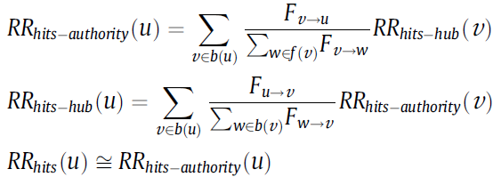
The conventional reputation rank
Conventional user ranking schemes based on PageRank and HITS under the graph model
1. user’s Reputation Rank (RR) based on the random walk model
2. HITS-based user reputation
However, it is not possible to find an optimal user ranking model
Two aspects of users are arbitrarily mixed up in the equations

Slide 14
Outline
Introduction
Background and motivation
The conventional reputation rank
The proposed ranking schemes
Degree of user sociability
Experimental results
Conclusion
Discussion

Slide 15
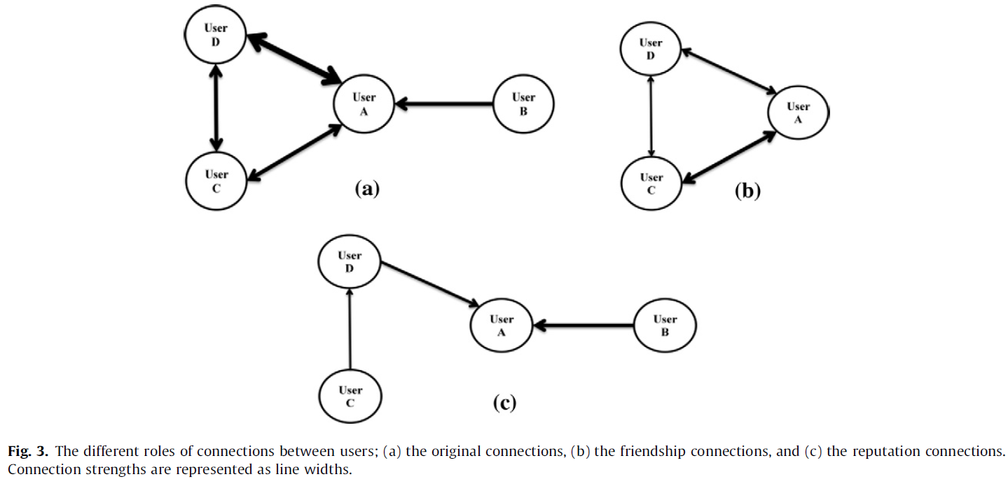
The proposed ranking schemes

Slide 16

The proposed ranking schemes
1. The sociability rank
Sociability
Reputation
Bi-direction
Single direction
Reputation = may be higher
Sociability = ???
…

Slide 17
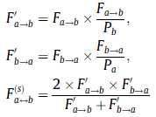

The proposed ranking schemes
1. The sociability rank (cont.)
Sociability strength between user a and b
The equation of the user’s sociability based on the random walk model
P_{k} = # posts that were posted by k
F’_{a→b} = [0 ~ P_{b}]
F’_{b→a} = [0 ~ P_{a}]
Harmonic mean of F’_{a→b} and F’_{a→b}

Slide 18
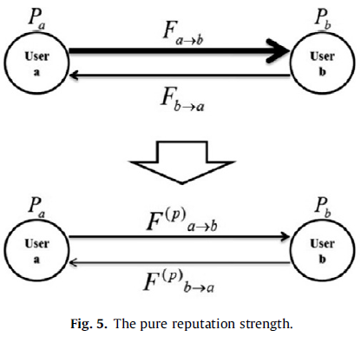
The proposed ranking schemes
2. The pure reputation rank
Conventional reputation rank can lead to faulty user’s ranking results
The reputation scores randomly reflect both the sociability and the reputation of the users
Pure reputation score of a user must be computed by subtracting the sociability score of the user from the general reputation score of the user
High-level sociability score => Part of reputation score was likely gained from some of the user’s acquaintances
General
R score
S score
Pure
R score

Slide 19

The proposed ranking schemes
2. The pure reputation rank (cont.)
Pure reputation strength from the user a to the user b
Users’ pure reputation score based on the random walk model
HITS-based pure reputation score can be computed in the corresponding way

Slide 20
Outline
Introduction
Background and motivation
The conventional reputation rank
The proposed ranking schemes
Degree of user sociability
Experimental results
Conclusion
Discussion

Slide 21
Degree of user sociability
Several schemes to evaluate the characteristics of the sociability of a social networks
Correlation, extent, and density
How the sociability scores of a social network change along the users’ pure reputation rankings
Each social network will show a different contour of the fluctuation of the sociability across the users’ pure reputation rankings

Slide 22


Degree of user sociability
1. correlation
Measure how much the sociability scores aware correlated with the pure reputation scores of the users
Pearson product-moment correlation scheme
The large the correlation value, the more correlated the pure reputation and the sociability of top-k users are
=

Slide 23

Degree of user sociability
2. Extent of sociability
Examine the absolute and relative amount of the sociability score of a ranked user
MA (moving average)-applied sociability score of user k (k-th ranked user)
Relative extent of the sociability against the pure reputation of user k

Slide 24
Degree of user sociability
3. Density of sociability
Conjecture the outline of the distributions of the social interactions in a social network
Density of a dichotomous graph, G = (V, E)
Density of a weighted graph, G = (V, E)
Notes:
Some networks would form strong social connections between highly-ranked users, showing the outline of a homogeneous and concentrated distribution. Meanwhile, other networks would show a heterogeneous and distributed structure, as the social connections between highly-ranked users are relatively weak.

Slide 25

Degree of user sociability
3. Density of sociability
Sociability density of the top-k users a social network
Pure reputation density of a social network
Relative density of the sociability against the pure reputation of the top-k users in a social network

Slide 26
Outline
Introduction
Background and motivation
The conventional reputation rank
The proposed ranking schemes
Degree of user sociability
Experimental results
Conclusion
Discussion

Slide 27
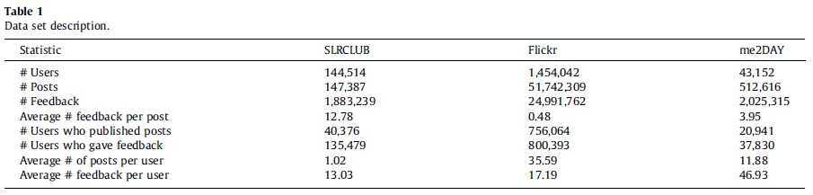
Experimental results
Experimental environments
Data sets
Three algorithms (PageRank-based formulae)
RR: general reputation-based user ranking algorithms
SR: proposed user ranking algorithm for sociability
PR: proposed user ranking algorithms for pure reputation

Slide 28
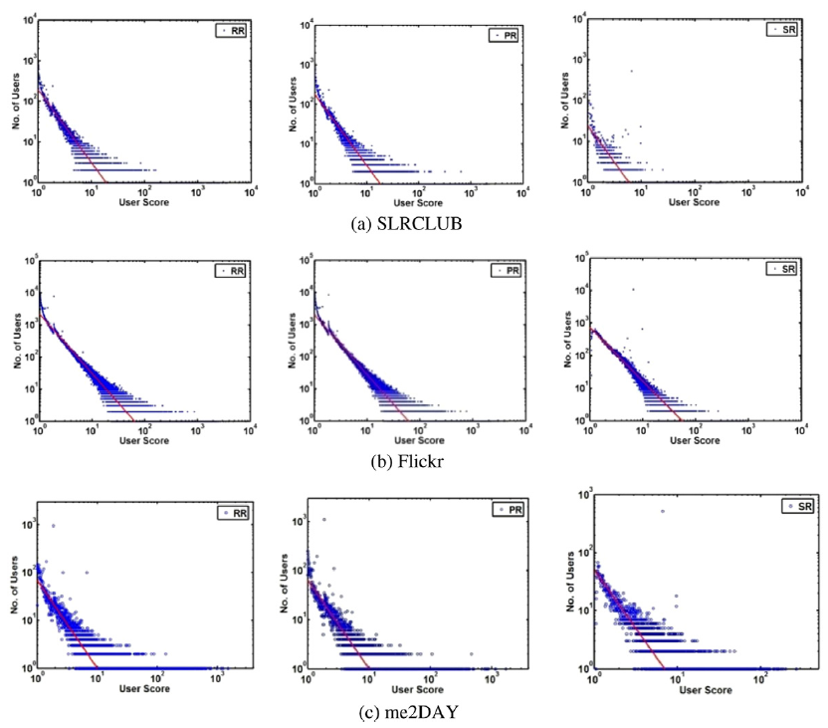
Experimental results
User score/rank distributions
Distributions of the number of users against the user scores

Slide 29
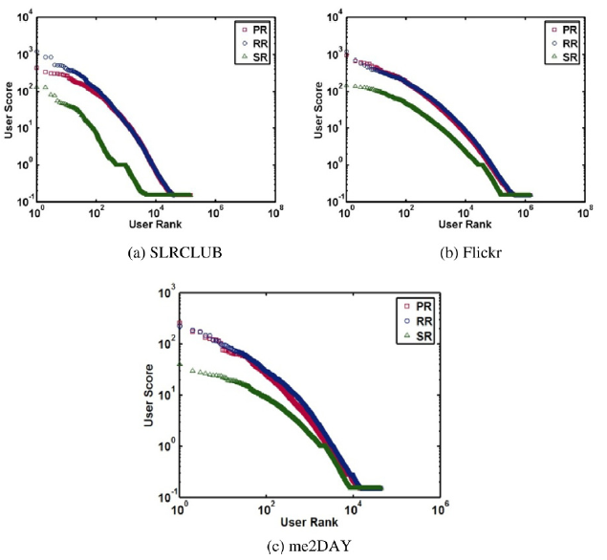
Experimental results
User score/rank distributions (cont.)
User rank vs. user score

Slide 30
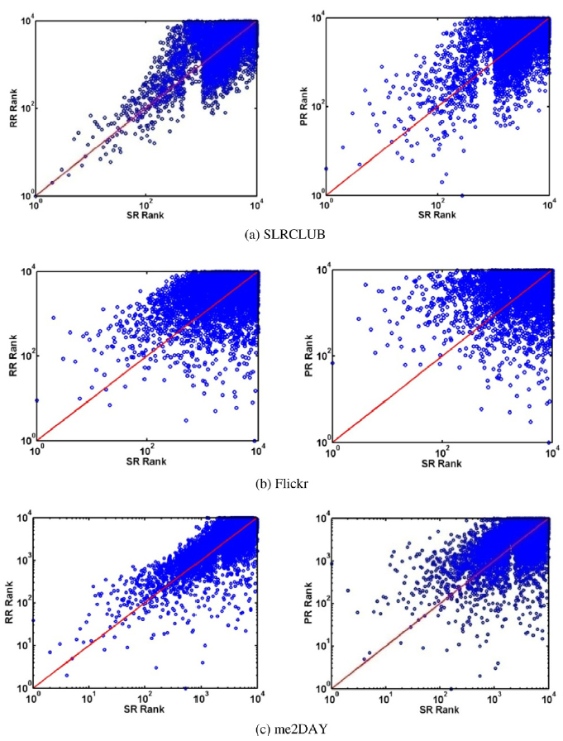
Experimental results
User score/rank distributions (cont.)
Rank distributions between SR and RR, and SR and PR

Slide 31
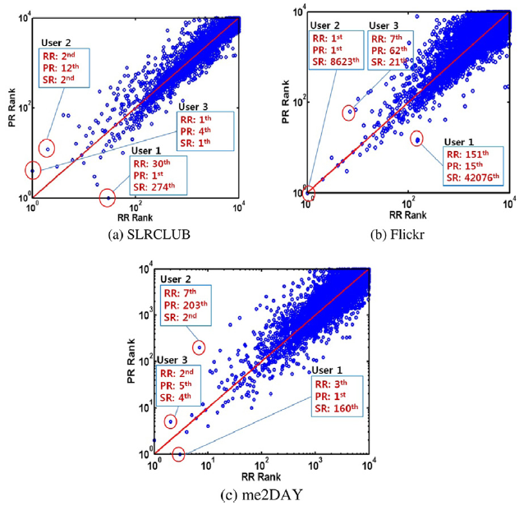
Experimental results
User score/rank distributions (cont.)
Relationship between RR and PR ranks

Slide 32
Experimental results
User rank performance
Pairwise user comparison (RR vs. PR)
Two sets of user pairs
Coarse-grained Selection
Fine-grained selection
Generate
user pair
Merge
RR
PR
RR
PR
1
1
5
…
…
…
10
…
…
…
1000
150
Choose 30 random users

Slide 33
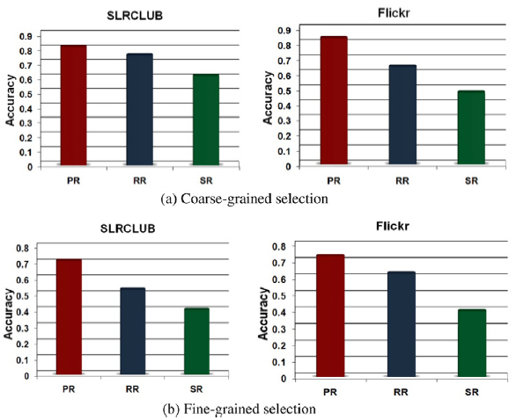
Experimental results
User rank performance (cont.)
Pairwise user comparison (RR vs. PR)

Slide 34
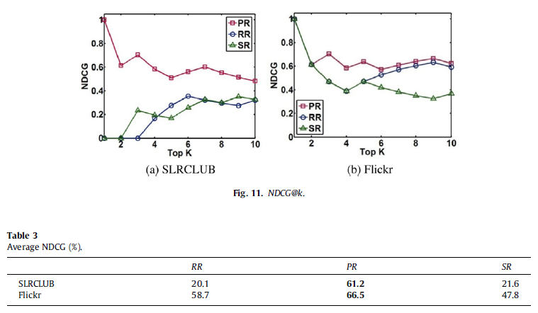
Experimental results
User rank performance (cont.)
Power user detection
Selected by human judgment vs. top-k results from each algorithm
1. NDCG
Notes:
PR is effective because it reduces the phenomenon whereby users inadequately obtain their reputation score due to the user’s sociability

Slide 35
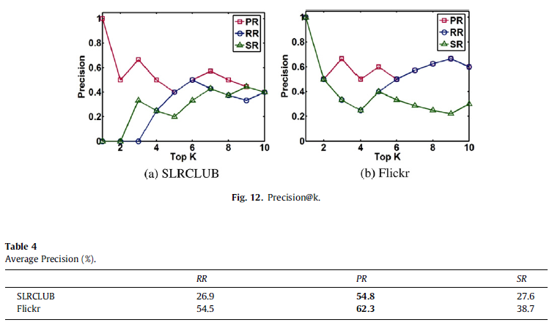
Experimental results
User rank performance (cont.)
Power user detection
Selected by human judgment vs. top-k results from each algorithm
2. Precision

Slide 36
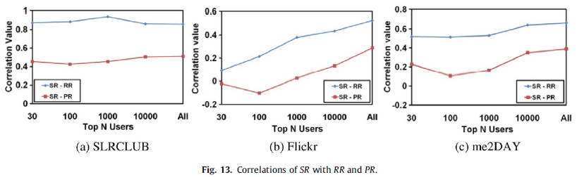
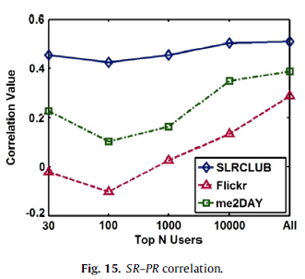
Experimental results
Measurement of degree of user sociability
Correlation of sociability with reputation

Slide 37
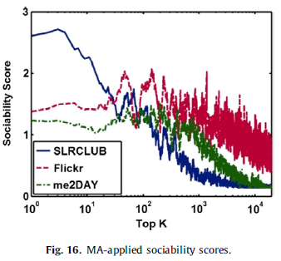
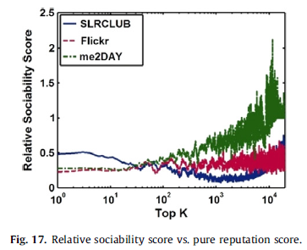
Experimental results
Measurement of degree of user sociability (cont.)
Extent of sociability

Slide 38
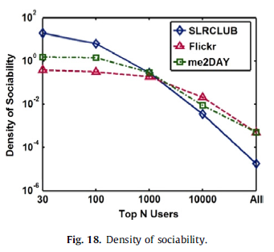
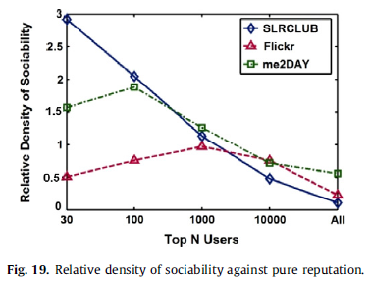
Experimental results
Measurement of degree of user sociability (cont.)
Density of sociability
How frequent the sociability-based interactions are among the top-k users

Slide 39
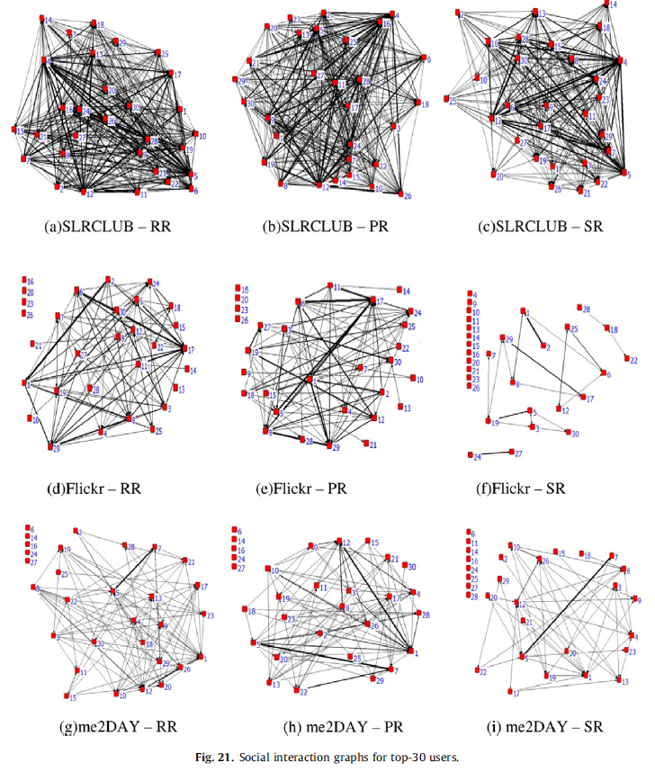
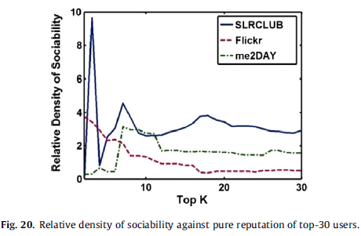
Experimental results
Measurement of degree of user sociability (cont.)
Density of sociability

Slide 40
Outline
Introduction
Background and motivation
The conventional reputation rank
The proposed ranking schemes
Degree of user sociability
Experimental results
Conclusion
Discussion

Slide 41
Conclusion
The users’ pure reputation could not be precisely measured
In social media, a user’s reputation is implicitly affected by the user’s sociability
We presented…
Schemes to separate user sociability from user reputation
Several measurement schemes of the degree of the user sociability
Lead to better understanding of the outline and the structure of social interactions in a social network
Future work
Further data mining using user ranking results
User clustering
User-generated content ranking

Slide 42
Outline
Introduction
Background and motivation
The conventional reputation rank
The proposed ranking schemes
Degree of user sociability
Experimental results
Conclusion
Discussion

Slide 43
Discussion
Pros
Various analysis
Phased explanation
Cons

