Slide 1
LDA (Latent Dirichlet Allocation)
Yi Wang, Distributed Gibbs Sampling of Latent Topic Models: The Gritty Details, 2008.
T. Griffiths and M. Steyvers. Finding scientific topics. In PNAS, volume 101, 2004.
D. Blei, A. Ng, M. Jordan, and J. Lafferty. Latent dirichlet allocation. JMLR, 2003.
T. Minka and J. Lafferty. Expectation propagation for the generative aspect model, 2002.
Hee-Gook Jun
Apr 28, 2015

Slide 2
LDA Computation Methods
Limitation: overfitting Problem
EM with variational inference
EM with expectation propagation
Gibbs sampling
Tolerant to local optima
Notes:
D. Blei, A. Ng, M. Jordan, and J. Lafferty. Latent dirichlet allocation. JMLR, 3:993-1022, 20003.
T. Minka and J. Lafferty. Expectation propagation for the generative aspect model. In UAI, 2002. https://research.microsoft.com/ minka/papers/aspect/minka-aspect.pdf.
T. Griffiths and M. Steyvers. Finding scientific topics. In PNAS, volume 101, pages 5228-5235, 2004.

Slide 3
LDA: Finding Topics
document ={d1, d2, d3}
topic = {color, school, fruit, company}
d1 - words
d2 - words
d3 - words
red blue apple
book study black
grape melon apple
MS math black white
EA GE apple
MS science pink
d1 - topics
d2 - topics
d3 - topics
color color fruit
school school color
fruit fruit fruit
company school color color
company company
company
company school color

Slide 4

Topic Distribution per Document
Z ~ Multinomial($θ)$
color color fruit
school school color
fruit fruit fruit
company school color color

Slide 5


Topic Distribution per Document Cont.
Z ~ Multinomial($θ)$
$\text{Θ}$~Dirichlet($α$)
Document
Word
𝛼
θ
Z
W
N_{d}: # of words in doc d
M: # of documents

Slide 6

Word Distribution per Topic
topic = {fruit, company}
vocabulary = {apple, grape, apple, MS, melon, MS, apple, banana}
W ~ Multinomial($\text{Φ})$

Slide 7


Word Distribution per Topic Cont.
W ~ Multinomial($\text{Φ})$
$\text{Φ}$ ~Dirichlet($β$)
Topic
β
Φ
K: # of topics
Document
Word
W
N_{d}: # of words in doc d
M: # of documents

Slide 8
Graphical Representation
Topic
β
Φ
K: # of topics
Document
Word
𝛼
θ
Z
W
N_{d}: # of words in doc d
M: # of documents

Slide 9
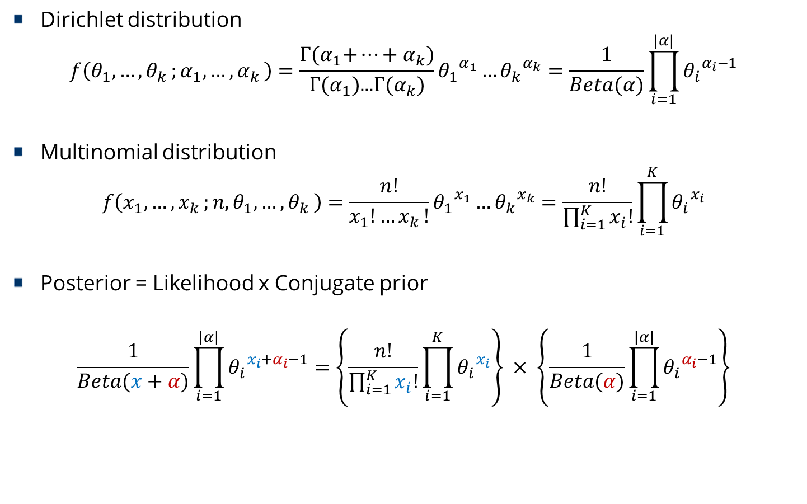
Dirichlet and Multinomial
Dirichlet distribution
$$f\left(θ_{1},{…,θ}_{k};α_{1},{…,α}_{k}\right)=\frac{\text{Γ}\text{(}α_{1}\text{+}…+α_{k}\text{)}}{\text{Γ}\text{(}α_{1}\text{)...}\text{Γ}\text{(}α_{k}\text{)}}{θ_{1}}^{α_{1}}…{θ_{k}}^{α_{k}}=\frac{1}{Beta(α)}\prod_{i=1}^{|α|}{{θ_{i}}^{α_{i}−1}}$$
Multinomial distribution
$$f\left(x_{1},{…,x}_{k};n,θ_{1},{…,θ}_{k}\right)=\frac{n!}{x_{1}!{…x}_{k}!}{θ_{1}}^{x_{1}}…{θ_{k}}^{x_{k}}=\frac{n!}{\prod_{i=1}^{K}{x_{i}!}}\prod_{i=1}^{K}{{θ_{i}}^{x_{i}}}$$
Posterior = Likelihood x Conjugate prior
$$\frac{1}{Beta(x+α)}\prod_{i=1}^{|α|}{{θ_{i}}^{{x_{i}+α}_{i}−1}}=\left\{\frac{n!}{\prod_{i=1}^{K}{x_{i}!}}\prod_{i=1}^{K}{{θ_{i}}^{x_{i}}}\right\} × \left\{\frac{1}{Beta(α)}\prod_{i=1}^{|α|}{{θ_{i}}^{α_{i}−1}}\right\}$$

Slide 10
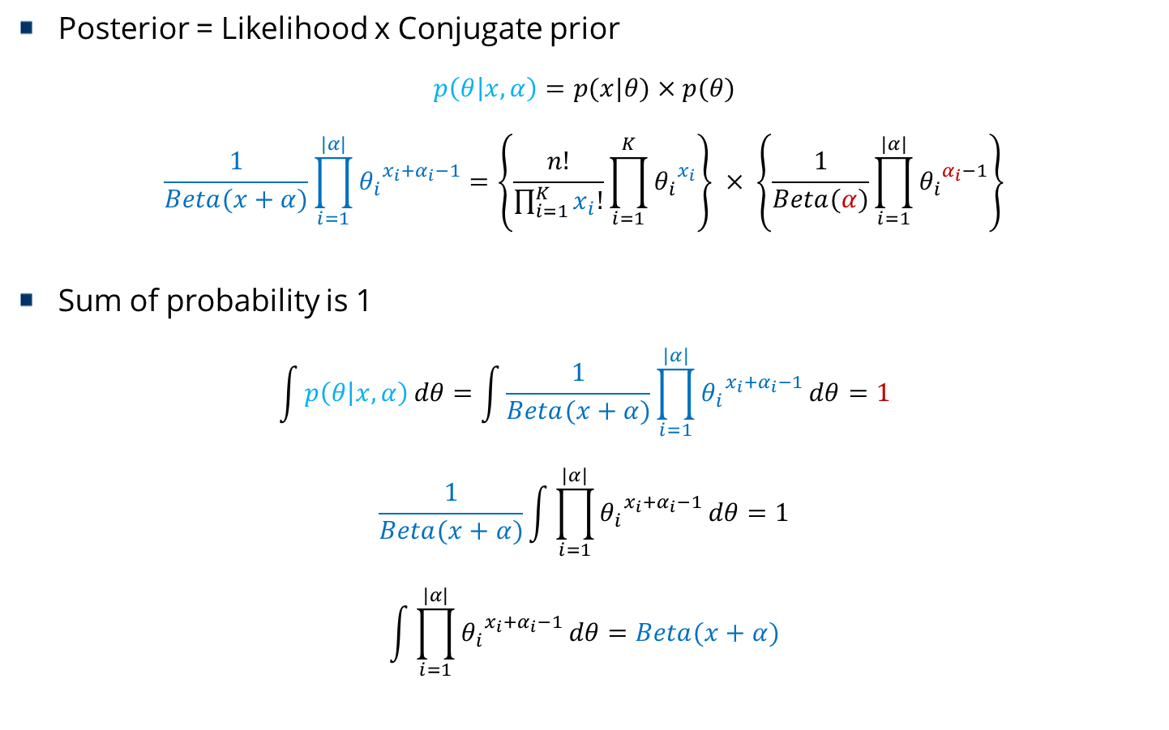
Dirichlet and Multinomial
Posterior = Likelihood x Conjugate prior
$$p\left(θ | x,α\right)=p(x|θ)×p(θ)$$
$$\frac{1}{Beta(x+α)}\prod_{i=1}^{|α|}{{θ_{i}}^{{x_{i}+α}_{i}−1}}=\left\{\frac{n!}{\prod_{i=1}^{K}{x_{i}!}}\prod_{i=1}^{K}{{θ_{i}}^{x_{i}}}\right\} × \left\{\frac{1}{Beta(α)}\prod_{i=1}^{|α|}{{θ_{i}}^{α_{i}−1}}\right\}$$
Sum of probability is 1
$$\int{p\left(θ | x,α\right)}dθ=\int{\frac{1}{Beta(x+α)}\prod_{i=1}^{|α|}{{θ_{i}}^{{x_{i}+α}_{i}−1}}}dθ=1$$
$$\frac{1}{Beta(x+α)}\int{\prod_{i=1}^{|α|}{{θ_{i}}^{{x_{i}+α}_{i}−1}}}dθ=1$$
$$\int{\prod_{i=1}^{|α|}{{θ_{i}}^{{x_{i}+α}_{i}−1}}}dθ=Beta(x+α)$$

Slide 11

Joint Distribution of LDA
Dirichlet distribution
$$p\left(Z,W | α,β\right)=p\left(W | Z,β\right)p\left(Z | α\right)$$
$$P(A|C)=\sum_{B}{P(AB|C)}=\sum_{B}{P\left(A | BC\right)P(B|C)}$$
$$p\left(W | Z,β\right)=\int{p(W|Z,\text{Φ})}\text{p}\text{(}\text{Φ}\text{|}β)d\text{Φ}$$
$\text{Φ}$ ~Dirichlet($β$)
$$\text{p}\text{(}\text{Φ}\text{|}β)=\prod_{k=1}^{K}{\text{p}\text{(}{\text{Φ}}_{k}\text{|}β)}=\prod_{k=1}^{K}{\frac{1}{Beta(β)}\prod_{v=1}^{V}{{{\text{Φ}}_{k,v}}^{β_{v}−1}}}$$
W ~ Multinomial($\text{Φ})$
$$p\left(W | Z,\text{Φ}\right)=\prod_{i=1}^{N}{{\text{Φ}}_{z_{i},w_{i}}}=\prod_{k=1}^{K}{\prod_{v=1}^{V}{{{\text{Φ}}_{k,v}}^{{\text{ψ}}_{k,v}}}}$$
$${\text{ψ}}_{k,v}=\sum_{i=1}^{N}{I\{w_{i}=v∧z_{i}=k\}}$$

Slide 12
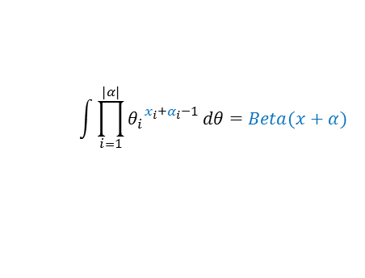

Joint Distribution of LDA
Dirichlet distribution
$$p\left(Z,W | α,β\right)=p\left(W | Z,β\right)p\left(Z | α\right)$$
$$p\left(W | Z,β\right)=\int{p(W|Z,\text{Φ})}\text{p}\text{(}\text{Φ}\text{|}β)d\text{Φ}\text{=}\int{\prod_{k=1}^{K}{\frac{1}{Beta(β)}\prod_{v=1}^{V}{{{\text{Φ}}_{k,v}}^{{{\text{ψ}}_{k,v}+β}_{v}−1}}}}d{\text{Φ}}_{k}$$
$$\text{=}\prod_{k=1}^{K}{\left(\int{\frac{1}{Beta(β)}\prod_{v=1}^{V}{{{\text{Φ}}_{k,v}}^{{{\text{ψ}}_{k,v}+β}_{v}−1}}}d{\text{Φ}}_{k}\right)}=\prod_{k=1}^{K}{\left(\frac{1}{Beta(β)}\int{\prod_{v=1}^{V}{{{\text{Φ}}_{k,v}}^{{{\text{ψ}}_{k,v}+β}_{v}−1}}}d{\text{Φ}}_{k}\right)}$$
$$=\prod_{k=1}^{K}{\frac{Beta({\text{ψ}}_{k}+β)}{Beta(β)}}$$
$$\int{\prod_{i=1}^{|α|}{{θ_{i}}^{{x_{i}+α}_{i}−1}}}dθ=Beta(x+α)$$

Slide 13

Joint Distribution of LDA
Dirichlet distribution
$$p\left(Z,W | α,β\right)=p\left(W | Z,β\right)p\left(Z | α\right)$$
$$p\left(Z | α\right)=\int{p(Z|\text{Θ})}\text{p}\text{(}\text{Θ}\text{|}α)d\text{Θ}$$
$\text{Θ}$~Dirichlet($α$)
$$\text{p}\text{(}\text{Θ}\text{|}α)=\prod_{d=1}^{D}{\text{p}\text{(}θ_{d}\text{|}α)}=\prod_{d=1}^{D}{\frac{1}{Beta(α)}\prod_{k=1}^{K}{{θ_{d,k}}^{α_{k}−1}}}$$
Z ~ Multinomial($θ)$
$$p\left(Z | \text{Θ}\right)=\prod_{i=1}^{N}{θ_{d_{i},z_{i}}}=\prod_{d=1}^{D}{\prod_{k=1}^{K}{{θ_{d,k}}^{{\text{Ω} }_{d,k}}}}$$
$${\text{Ω} }_{d,k}=\sum_{i=1}^{N}{I\{d_{i}=d∧z_{i}=k\}}$$

Slide 14

Joint Distribution of LDA
Dirichlet distribution
$$p\left(Z,W | α,β\right)=p\left(W | Z,β\right)p\left(Z | α\right)$$
$$p\left(Z | α\right)=\int{p(Z|\text{Θ})}\text{p}\text{(}\text{Θ}\text{|}α)d\text{Θ}\text{=}\int{\prod_{d=1}^{D}{\frac{1}{Beta(α)}\prod_{k=1}^{K}{{θ_{d,k}}^{{{\text{Ω} }_{d,k}+α}_{k}−1}}}}dθ_{d}$$
$$\text{=}\prod_{d=1}^{D}{\left(\int{\frac{1}{Beta(α)}\prod_{k=1}^{K}{{θ_{d,k}}^{{{\text{Ω} }_{d,k}+α}_{k}−1}}}dθ_{d}\right)}=\prod_{d=1}^{D}{\left(\frac{1}{Beta(α)}\int{\prod_{k=1}^{K}{{θ_{d,k}}^{{{\text{Ω} }_{d,k}+α}_{k}−1}}}dθ_{d}\right)}$$
$$=\prod_{d=1}^{D}{\frac{Beta({\text{Ω} }_{d}+α)}{Beta(α)}}$$
$$\int{\prod_{i=1}^{|α|}{{θ_{i}}^{{x_{i}+α}_{i}−1}}}dθ=Beta(x+α)$$

Slide 15

Joint Distribution of LDA
Dirichlet distribution
$$p\left(Z,W | α,β\right)=p\left(W | Z,β\right)p\left(Z | α\right)$$
$$p\left(W | Z,β\right)=\prod_{k=1}^{K}{\frac{Beta({\text{ψ}}_{k}+β)}{Beta(β)}}$$
$$p\left(Z | α\right)=\prod_{d=1}^{D}{\frac{Beta({\text{Ω} }_{d}+α)}{Beta(α)}}$$
$$p\left(Z,W | α,β\right)=p\left(W | Z,β\right)p\left(Z | α\right)=\prod_{k=1}^{K}{\frac{Beta({\text{ψ}}_{k}+β)}{Beta(β)}}∙\prod_{d=1}^{D}{\frac{Beta({\text{Ω} }_{d}+α)}{Beta(α)}}$$

Slide 16
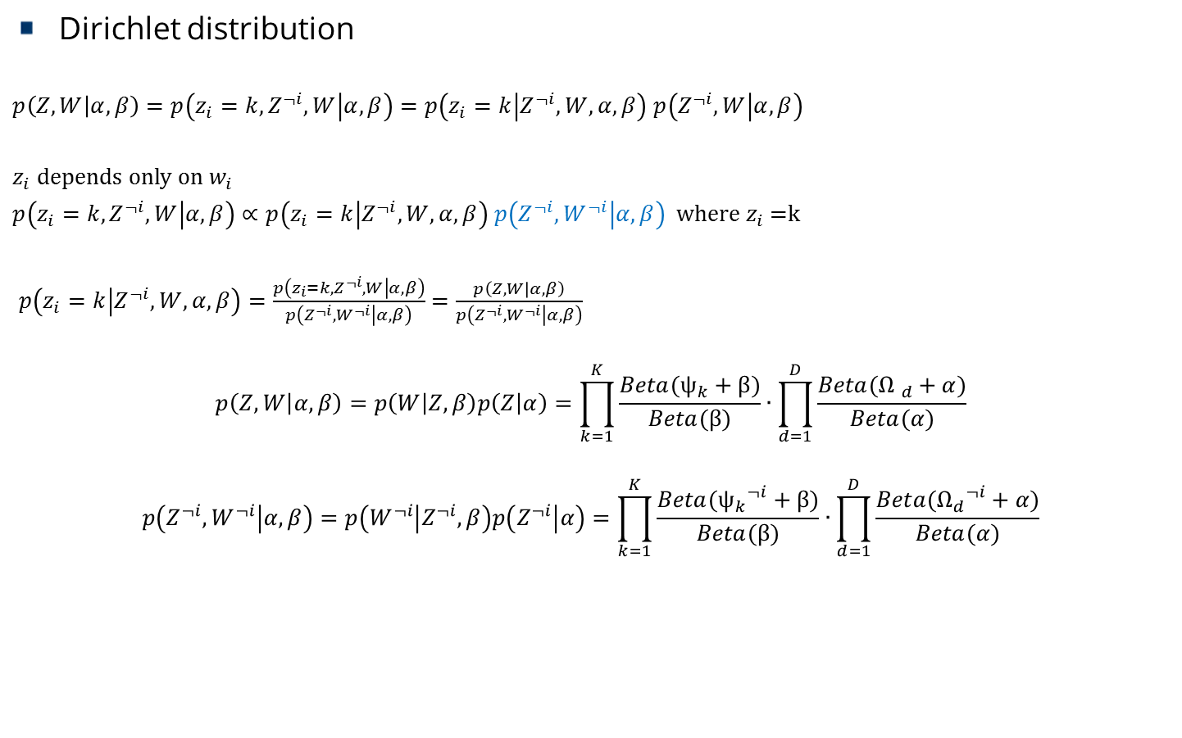
Gibbs Updating Rule
Dirichlet distribution
$p\left(Z,W | α,β\right)=p\left(z_{i}=k,Z^{¬i},W | α,β\right)=$ $p\left(z_{i}=k | Z^{¬i},W,α,β\right)$ $p\left(Z^{¬i},W | α,β\right)$
$z_{i}$ depends only on $w_{i}$
$p\left(z_{i}=k,Z^{¬i},W | α,β\right)∝$ $p\left(z_{i}=k | Z^{¬i},W,α,β\right)$ $p\left(Z^{¬i},W^{¬i} | α,β\right)$ where $z_{i}$=k
$p\left(z_{i}=k | Z^{¬i},W,α,β\right)=\frac{p\left(z_{i}=k,Z^{¬i},W | α,β\right)}{p\left(Z^{¬i},W^{¬i} | α,β\right)}$ $=\frac{p\left(Z,W | α,β\right)}{p\left(Z^{¬i},W^{¬i} | α,β\right)}$
$$p\left(Z,W | α,β\right)=p\left(W | Z,β\right)p\left(Z | α\right)=\prod_{k=1}^{K}{\frac{Beta({\text{ψ}}_{k}+β)}{Beta(β)}}∙\prod_{d=1}^{D}{\frac{Beta({\text{Ω} }_{d}+α)}{Beta(α)}}$$
$$p\left(Z^{¬i},W^{¬i} | α,β\right)=p\left(W^{¬i} | Z^{¬i},β\right)p\left(Z^{¬i} | α\right)=\prod_{k=1}^{K}{\frac{Beta({{\text{ψ}}_{k}}^{¬i}+β)}{Beta(β)}}∙\prod_{d=1}^{D}{\frac{Beta({{\text{Ω}}_{d}}^{¬i}+α)}{Beta(α)}}$$

Slide 17

Gibbs Updating Rule
Dirichlet distribution
$${\text{ψ}}_{k,v}=\sum_{i=1}^{N}{I\{w_{i}=v∧z_{i}=k\}} {{\text{ψ}}_{k,v}}_{}^{¬i}=\sum_{\begin{aligned}j=1 \\ j≠i\end{aligned}}^{N}{I\{w_{j}=v∧z_{j}=k\}}$$
$${\text{Ω}}_{d,k}=\sum_{i=1}^{N}{I\{d_{i}=d∧z_{i}=k\}} {{\text{Ω}}_{d,k}}^{¬i}=\sum_{\begin{aligned}i=1 \\ j≠i\end{aligned}}^{N}{I\{d_{j}=d∧z_{j}=k\}}$$
$${\text{ψ}}_{k,v}=\left\{\begin{matrix}{{\text{ψ}}_{k,v}}_{}^{¬i}+1 if v=w_{i} and k=z_{i} \\ {{\text{ψ}}_{k,v}}_{}^{¬i} otherwise\end{matrix}\right.$$
$${\text{Ω}}_{d,k}=\left\{\begin{matrix}{{\text{Ω}}_{d,k}}^{¬i}+1 if d=d_{i} and k=z_{i} \\ {{\text{Ω}}_{d,k}}^{¬i} otherwise\end{matrix}\right.$$
$$\sum_{v=1}^{V}{{\text{ψ}}_{z_{i},v}}=1+\sum_{v=1}^{V}{{{\text{ψ}}_{z_{i},v}}_{}^{¬i}}$$
$$\sum_{k=1}^{K}{{\text{Ω}}_{d_{i},z}}=1+\sum_{k=1}^{K}{{{\text{Ω}}_{d_{i},z}}_{}^{¬i}}$$

Slide 18
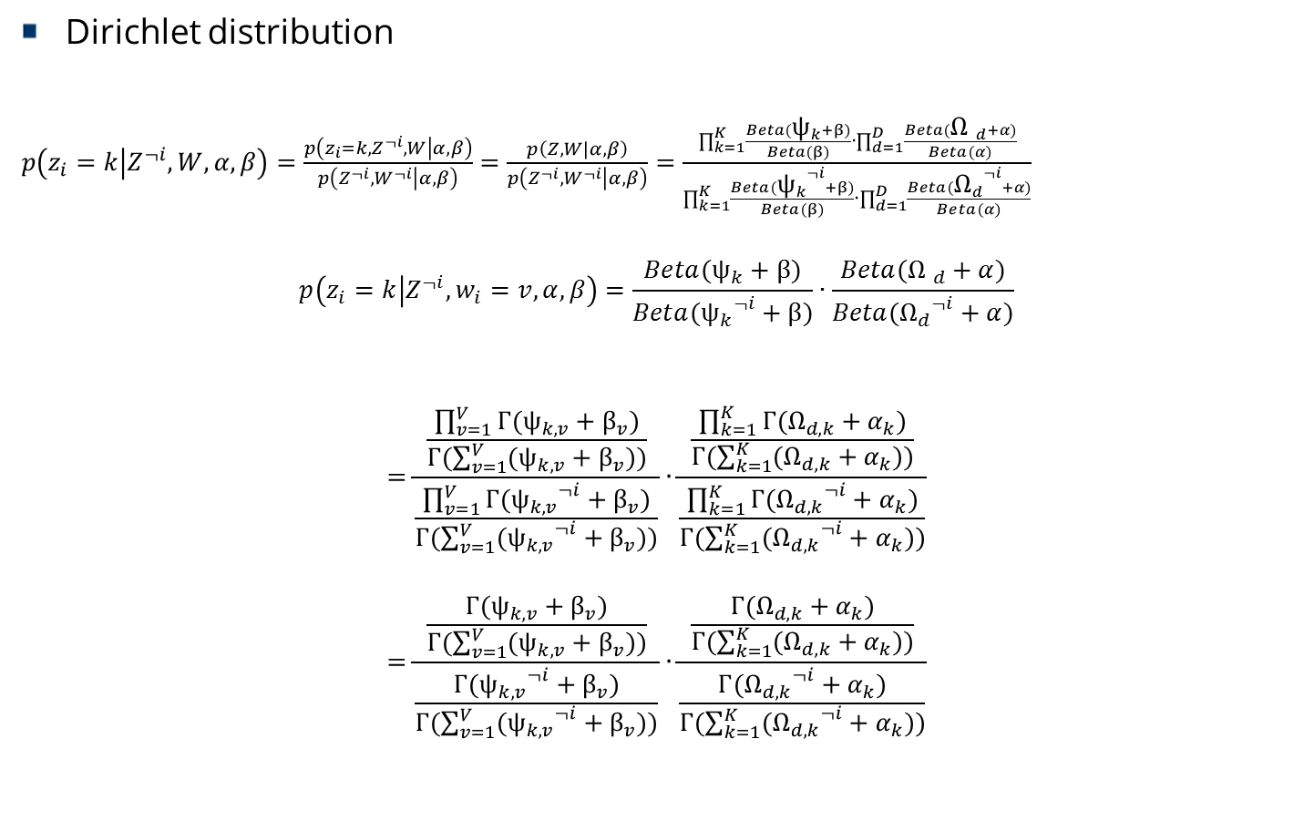
Gibbs Updating Rule
Dirichlet distribution
$p\left(z_{i}=k | Z^{¬i},W,α,β\right)=\frac{p\left(z_{i}=k,Z^{¬i},W | α,β\right)}{p\left(Z^{¬i},W^{¬i} | α,β\right)}$ $=\frac{p\left(Z,W | α,β\right)}{p\left(Z^{¬i},W^{¬i} | α,β\right)}=\frac{\prod_{k=1}^{K}{\frac{Beta({\text{ψ}}_{k}+β)}{Beta(β)}}∙\prod_{d=1}^{D}{\frac{Beta({\text{Ω} }_{d}+α)}{Beta(α)}}}{\prod_{k=1}^{K}{\frac{Beta({{\text{ψ}}_{k}}^{¬i}+β)}{Beta(β)}}∙\prod_{d=1}^{D}{\frac{Beta({{\text{Ω}}_{d}}^{¬i}+α)}{Beta(α)}}}$
$$p\left(z_{i}=k | Z^{¬i},w_{i}=v,α,β\right)=\frac{Beta({\text{ψ}}_{k}+β)}{Beta({{\text{ψ}}_{k}}^{¬i}+β)}∙\frac{Beta({\text{Ω} }_{d}+α)}{Beta({{\text{Ω}}_{d}}^{¬i}+α)}$$
$$=\frac{\frac{\prod_{v=1}^{V}{\text{Γ}({\text{ψ}}_{k,v}+β_{v})}}{\text{Γ}(\sum_{v=1}^{V}{({\text{ψ}}_{k,v}+β_{v})})}}{\frac{\prod_{v=1}^{V}{\text{Γ}({{\text{ψ}}_{k,v}}^{¬i}+β_{v})}}{\text{Γ}(\sum_{v=1}^{V}{({{\text{ψ}}_{k,v}}^{¬i}+β_{v})})}}∙\frac{\frac{\prod_{k=1}^{K}{\text{Γ}({\text{Ω}}_{d,k}+α_{k})}}{\text{Γ}(\sum_{k=1}^{K}{({\text{Ω}}_{d,k}+α_{k})})}}{\frac{\prod_{k=1}^{K}{\text{Γ}({{\text{Ω}}_{d,k}}^{¬i}+α_{k})}}{\text{Γ}(\sum_{k=1}^{K}{({{\text{Ω}}_{d,k}}^{¬i}+α_{k})})}}$$
$$=\frac{\frac{\text{Γ}({\text{ψ}}_{k,v}+β_{v})}{\text{Γ}(\sum_{v=1}^{V}{({\text{ψ}}_{k,v}+β_{v})})}}{\frac{\text{Γ}({{\text{ψ}}_{k,v}}^{¬i}+β_{v})}{\text{Γ}(\sum_{v=1}^{V}{({{\text{ψ}}_{k,v}}^{¬i}+β_{v})})}}∙\frac{\frac{\text{Γ}({\text{Ω}}_{d,k}+α_{k})}{\text{Γ}(\sum_{k=1}^{K}{({\text{Ω}}_{d,k}+α_{k})})}}{\frac{\text{Γ}({{\text{Ω}}_{d,k}}^{¬i}+α_{k})}{\text{Γ}(\sum_{k=1}^{K}{({{\text{Ω}}_{d,k}}^{¬i}+α_{k})})}}$$

Slide 19
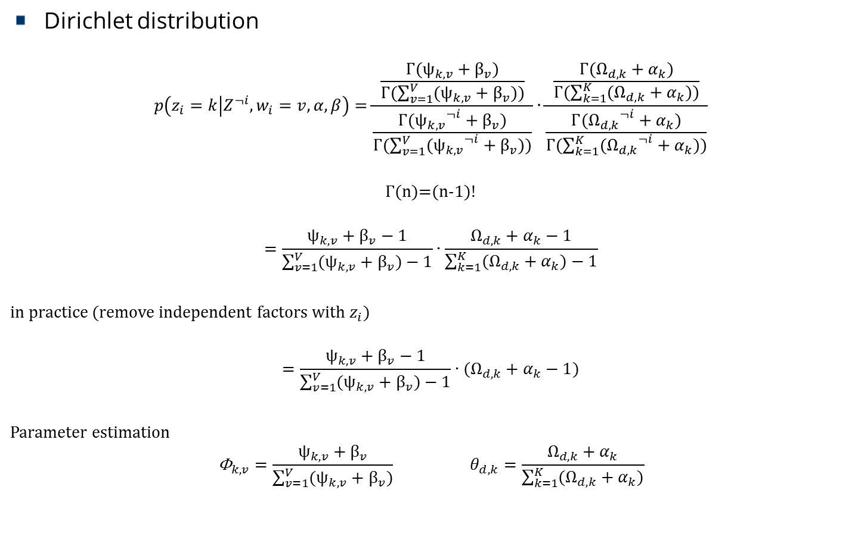
Gibbs Updating Rule
Dirichlet distribution
$$p\left(z_{i}=k | Z^{¬i},w_{i}=v,α,β\right)=\frac{\frac{\text{Γ}({\text{ψ}}_{k,v}+β_{v})}{\text{Γ}(\sum_{v=1}^{V}{({\text{ψ}}_{k,v}+β_{v})})}}{\frac{\text{Γ}({{\text{ψ}}_{k,v}}^{¬i}+β_{v})}{\text{Γ}(\sum_{v=1}^{V}{({{\text{ψ}}_{k,v}}^{¬i}+β_{v})})}}∙\frac{\frac{\text{Γ}({\text{Ω}}_{d,k}+α_{k})}{\text{Γ}(\sum_{k=1}^{K}{({\text{Ω}}_{d,k}+α_{k})})}}{\frac{\text{Γ}({{\text{Ω}}_{d,k}}^{¬i}+α_{k})}{\text{Γ}(\sum_{k=1}^{K}{({{\text{Ω}}_{d,k}}^{¬i}+α_{k})})}}$$
$$\text{Γ}\text{(}\text{n}\text{)=(}\text{n}\text{−1)!}$$
$$=\frac{{\text{ψ}}_{k,v}+β_{v}−1}{\sum_{v=1}^{V}{({\text{ψ}}_{k,v}+β_{v})}−1}∙\frac{{\text{Ω}}_{d,k}+α_{k}−1}{\sum_{k=1}^{K}{({\text{Ω}}_{d,k}+α_{k})}−1}$$
in practice (remove independent factors with $z_{i}$)
$$=\frac{{\text{ψ}}_{k,v}+β_{v}−1}{\sum_{v=1}^{V}{({\text{ψ}}_{k,v}+β_{v})}−1}∙({\text{Ω}}_{d,k}+α_{k}−1)$$
Parameter estimation
$${\text{Φ}}_{k,v}=\frac{{\text{ψ}}_{k,v}+β_{v}}{\sum_{v=1}^{V}{({\text{ψ}}_{k,v}+β_{v})}} θ_{d,k}=\frac{{\text{Ω}}_{d,k}+α_{k}}{\sum_{k=1}^{K}{({\text{Ω}}_{d,k}+α_{k})}}$$

Slide 20
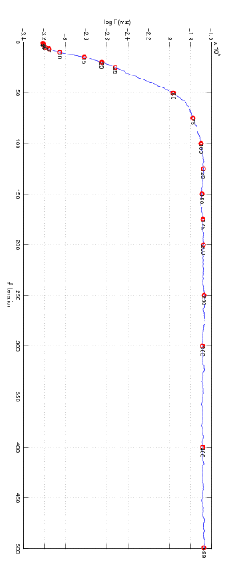
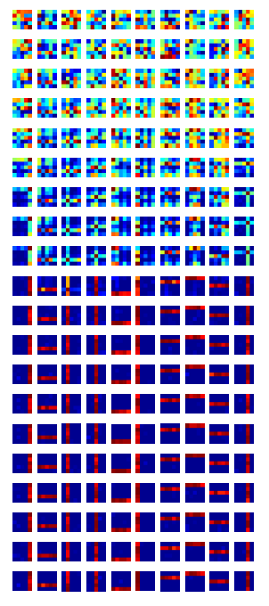

Result of the Gibbs Sampling
log P(w|z)
Iteration
$${\text{Φ}}_{k}$$

Slide 21


Setting Hyperparameters
High alpha value
Each document contain most of the topics
uncertain prior belief (uniform distribution)
Low alpha value
Each document contain a few (even only one) topics
Topics per Document
Topics per Document
Document
Word
𝛼
θ
Z
W
$\text{Θ}$~Dirichlet($α$)
Z ~ Multinomial($θ)$
Notes:
http://stats.stackexchange.com/questions/37405/natural-interpretation-for-lda-hyperparameters
Assume symmetric dirichlet distribution

Slide 22


Setting Hyperparameters
High beta value
Each topic contain most of the words
uncertain prior belief (uniform distribution)
Low beta value
Each document contain a specific word mix
Words per Topic
Words per Topic
$\text{Φ}$ ~Dirichlet($β$)
W ~ Multinomial($\text{Φ})$
Topic
β
Φ
Document
Word
W
Notes:
http://stats.stackexchange.com/questions/37405/natural-interpretation-for-lda-hyperparameters
Assume symmetric dirichlet distribution

Slide 23
Equivalence between PLSI and LDA
LDA
topic distribution has a Dirichlet prior
PLSA
Equivalent to the LDA under a uniform Dirichlet prior distribution
Notes:
Girolami, Mark; Kaban, A. (2003). On an Equivalence between PLSI and LDA. Proceedings of SIGIR 2003. New York: Association for Computing Machinery.

