Slide 1
Multi-column Substring Matching for Database Schema Translation
Robert H. Warren, Frank Wm. Tompa
University of Waterloo
VLDB 2006
SNU IDB Lab.
Hyewon Lim
November 27th, 2008

Slide 2
Contents
Motivation
Previous Work
Proposed Approach
Experimental Results
Algorithmic Analysis
Searching for Separators and Many-to-many Translations
Conclusion

Slide 3
Motivation
Clerical process
A great part of the problem of integration process that has little value-add, except for the information extracted about the very high level semantics of the DB.
We aim to automate in our research.
We wish to find a general purpose method.
Resolve complex schema matches made from concatenating substrings from columns within a DB.

Slide 4
Previous Work
Format learner (Doan et al.)
Infer the formatting and matching of different datatypes
has not been carried forward to multiple columns.
Carreira, Galhardas
Look at conversion algebras required to translate
IMAP system
Domain-oriented approach by utilizing matchers
Designed to detect and deal with specific types of data.
Phone numbers, …
Searching for schema translations for numerical data using equation discovery.

Slide 5
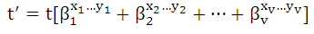
Proposed Approach
B₁ | B₂ | … | B_{n}
A
Operation
Concatenate
Substring
A = w₁ + w₂ + … + w_{v}
w_{i}: a substring function to be applied to some source columns B_{j}

Slide 6
Proposed Approach - Principles of the approach (1/2)
All source columns are scored to identify those most likely to be part of the target column.
Algorithm
1: select an initial source column B_{k}
2: create an initial translation recipe that isolates a
substring w_{x} from it
3: iterating for additional columns
Use the identified column to create an initial translation formula.
Instead of this…
Identify all possible solutions, and then determine which of these are applicable to many tuples.
> Infeasible because of the large # of potential solutions for a single target tuple.
Identify several possible starting points, and then determine which of these fit together to form the beginning of a solution.
> A target column is often produced from one wide subfield and several very narrow ones.

Slide 7
Proposed Approach - Principles of the approach (2/2)
Source |  |  |  | Target
first | middle | last | … | Login
robert | h | kerry | … | nawisema
kyle | s | norman | … | jlmalton
norma | a | wiseman | … | rhkerry
… | … | … | … | …
amy | l | case | … | alcase
josh | a | alderman | … | ksokmoan
john | l | malton | … | ksnorman

Slide 8
Proposed Approach - Beginning the search (1/3)
We need a method to sample values from the source columns.
t values
For each candidate source column, we first sample a pre determined fraction of the distinct values within the column.
t = the # of distinct values of B_{k} * franction
Use each of those t values to produce a larger set of q-grams.
That is, q-length subsequences of consecutive characters from each string.
4-grams of ‘possible’: poss, ossi, ssib, sibl, ible.

Slide 9
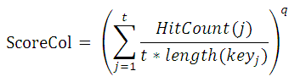
Proposed Approach - Beginning the search (2/3)
We need a method to sample values from the source columns.
Use the set of q-grams as search keys for the target column.
Count the number of matches in target column and normalize the count to yield a score.
Decreased probability of this substring occurring randomly in the target.
The # of distinct hits for each key
Average overlap

Slide 10
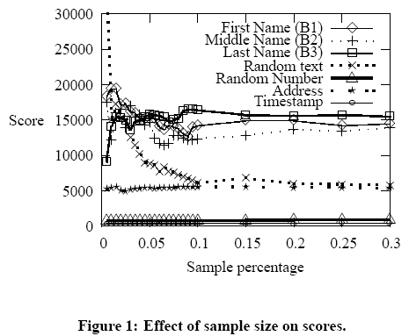
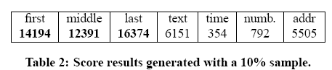
Proposed Approach - Beginning the search (3/3)
Algorithm’s performance

Slide 11
Proposed Approach - Creating an initial translation formula (1/7)
We need to retrieve instances of A that are similar to the sampled values from the current source column B_{k}.
We can use sampled values of B_{k} and the similar A entities to discover a partial translation formula A = w₁+w₂+…+w_{i}.

Slide 12
Proposed Approach - Creating an initial translation formula (2/7)
Identifying candidate pairs
A method that will retrieve similar entities from the A column.
Found tuples from column A based on the occurrence of any q-gram element from the sampled value.
Satisfactory for ranking column
Inadequate for finding suitable matches for specific source values
Suffers from low precision
Serendipitous occurrences of q-gram elements

Slide 13
Proposed Approach - Creating an initial translation formula (3/7)
Identifying candidate pairs
Rank target values according to the number of q-grams of the sampled column B_{k} that are matched.
Improves precision
Score: abcd < abcde with bi-gram ‘ab’, ‘bc’, and ‘de’
Does not take into account the relative frequencies of q-grams
Improperly rank some entities
contain many commonly occurring q-grams over extremely rare and relevant q-grams.

Slide 14
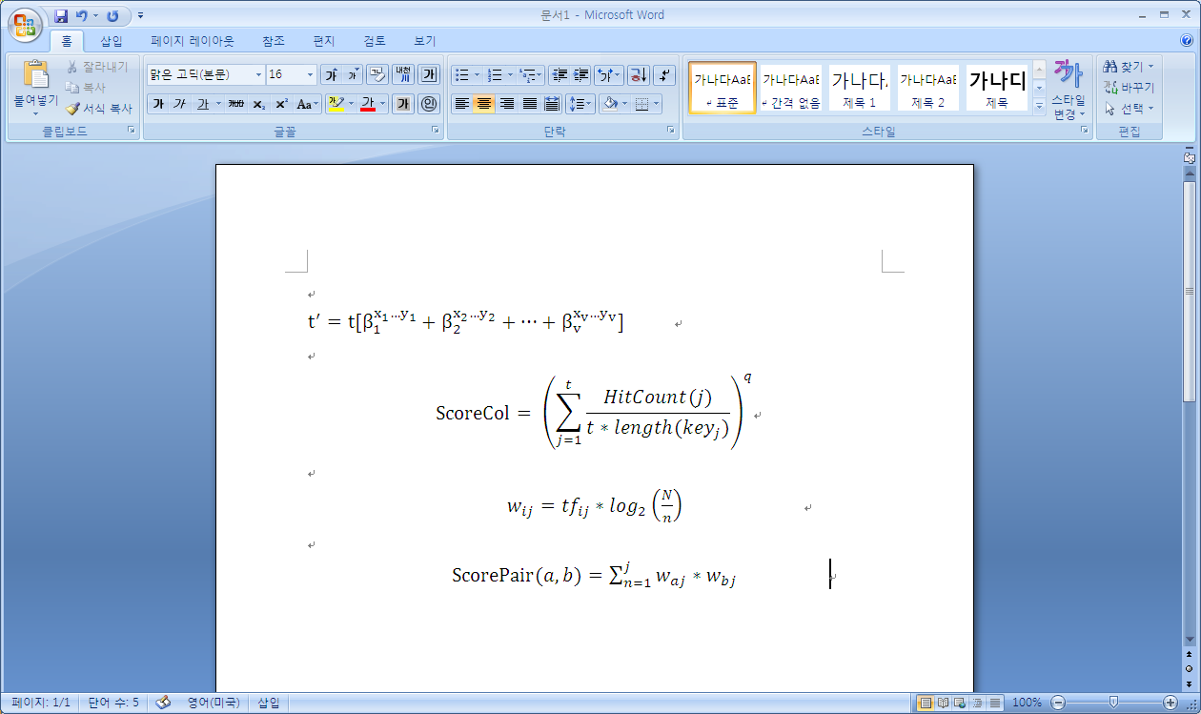
Proposed Approach - Creating an initial translation formula (4/7)
Identifying candidate pairs
Using tf-idf and cosine similarity

Slide 15
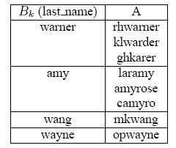
Proposed Approach - Creating an initial translation formula (5/7)
Identifying candidate pairs
To find pairs of similar values from two columns,
A sample of values are chosen from column B_{k}.
For each source value, the target table is queried for values having have scores from ScorePair(a, b) that exceed a given threshold.

Slide 16
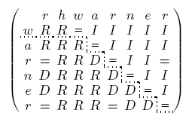
Proposed Approach - Creating an initial translation formula (6/7)
Creating edit recipes for pairs
Look for longest common substrings to find a partial translation formula.
Describe the shortest editing sequence
To discover appropriate recipes for a single pair of source and target values
Methods:
Levenshtein distance
Hirschberg
Hunt and Szymanski

Slide 17
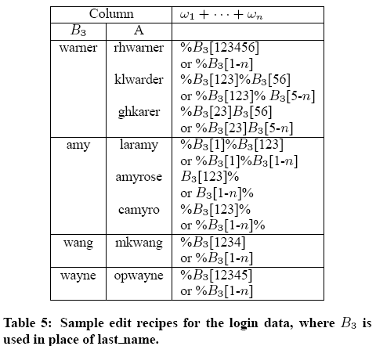
Proposed Approach - Creating an initial translation formula (7/7)
Creating a partial translation formula
Create a candidate w_{n} from each individual region within a recipe.
Then, we collate the candidate translations and select the one that occurs most often.
“%B₃[123456]”
One (partial) translation formula relation the instance “warner” to “rhwarner”

Slide 18
Proposed Approach - Selecting additional columns (1/5)
The only data fragments that are available for providing additional information to the target value are the ones contained within any of the fields of a corresponding row from the source table.
B₁ | B₂ | … | B_{n}
A

Slide 19
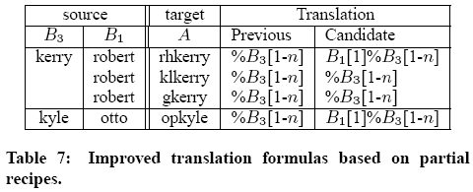
Proposed Approach - Selecting additional columns (2/5)
Identifying refined candidate pairs
Retrieve not only the values for the candidate column but also the corresponding values for the source columns that are already part of the translation.

Slide 20
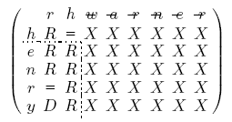
Proposed Approach - Selecting additional columns (3/5)
Creating edit recipes for refined pairs
Add a constraint
Only characters from the target column that are not known to be part of the partial translation formula can be used.

Slide 21
Proposed Approach - Selecting additional columns (4/5)
Improving the partial translation formula
All of the candidate translation formulas are collated according to a complete match between the source columns, the sequence of their individual regions and the character positions within the source columns.

Slide 22
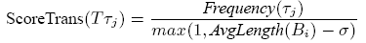
Proposed Approach - Selecting additional columns (5/5)
Scoring and selecting an improved translation formula
Score translations in a normalized manner
Score the individual translations based on both the number of their occurrence and the source column (B_{i}) in use.
Prevents negative
Penalty term
(Esp. noisy columns, long strings)
Prevent columns with less than a certain average width.

Slide 23
Experimental Results (1/7)
Environments
PostgreSQL DBMS
Bi-grams (q=2) for scoring purpose
Recipe generation: modified Hirschberg algorithm
Edit distance: Monge et al.
Operation cost:
Copy = deletion = replacement = 1
10% samples were used for all experiments
Series of noise columns were always added to the source table.

Slide 24
Experimental Results (2/7)
UserID dataset
Translation formular
Login = first[1-1] + last[1-n]
SQL query
select substring(first from 1 for 1) || last as login
from table
where first is not null and char_length(substring(first_name from 1 for 1))=1 and last_name is not null and char_length (last_name)>=1

Slide 25
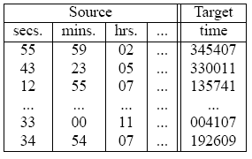
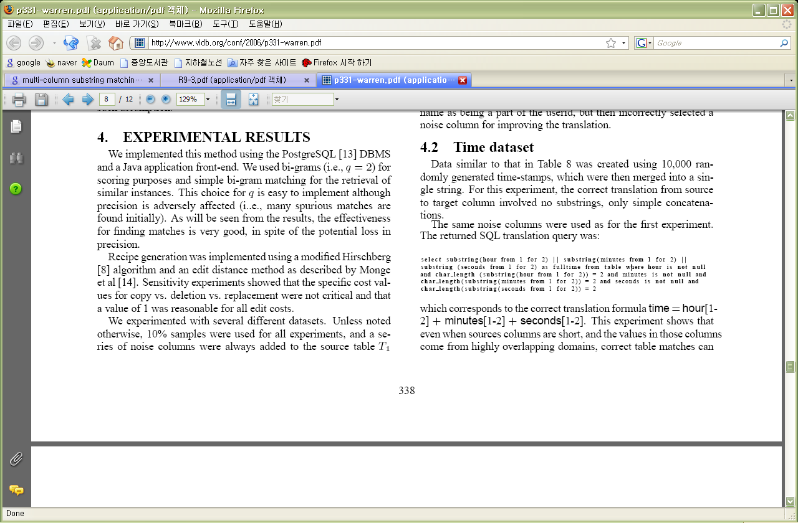
Experimental Results (3/7)
Time dataset
Only simple concatenations.
Translation formular
time = hour[1-2] + minutes[1-2] + seconds[1-2]
SQL query
Even when sources columns are short and the values in those columns come from highly overlapping domains, correct table matches can be found.

Slide 26
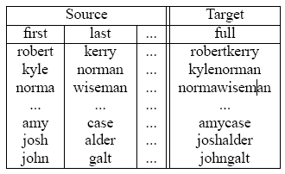
Experimental Results (4/7)
Name concatenations dataset
700,000 rows with about 70,000 unique values in both source columns.
Translation formular
full = first[1-n] + last[1-n]
SQL query
select first || last as full
from table
where first is not nujll and char_length (first)>=1
and last_name is not null and char_length(last_name)>=1

Slide 27
Experimental Results (5/7)
Citeseer dataset
Use the Citeseer citation indexes to provide an additional real-world translation problem.
Preprocessed 526,000 records into a table
Columns for year of publication, title, and a series of 15 columns , each of which contains the name of a single author (up to 15).
Create new table Citation from the concatenation of year, title, first author for all 526,000 records.
Sampling size
only 1% of the distinct values from each column

Slide 28
Experimental Results (6/7)
Citeseer dataset
Transformation formula
Citation = year[1-n] + title[1-n] + author1[1-n]
Run time
Under 20 minutes in Sunfire v880 750MHz machine

Slide 29
Experimental Results (7/7)
Cross dataset translation
How well the methods would work when very little overlap exists between the source and target tables?
Preprocessed the DBLP data similar to the Citeseer data
Optained a 17-column table with 233,000 rows
Translation formula
Citation = year[1-n] + title[1-n] + author2[1-n]
Expected result
Actual result
Only 714 records match across
Title, Year and author1
378 citations within the Citeseer
are also present within DBLP,
But with the first and second
authors reversed

Slide 30
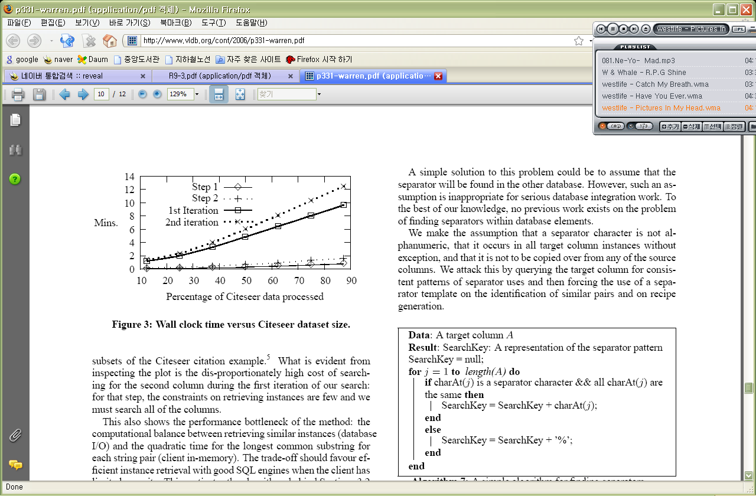
Algorithmic Analysis
The worst case time
O(w * n * s₁ * s₂)
w: the maximum number of characters in any value in the target column in T₂
n: the number of potential source columns from T₁
s₁: the number of tuples in T₁
s₂: the number of tuples in T₂

Slide 31
Searching for Separators and Many-to-many Translations (1/4)
Non-alphanumeric separators in columns
For many reasons, separators are often present within the data.
Ex. 2/15/2005, 11:45:34, FRU-13423-2005, +1-321-555-1212, …
Assumption
Separator character is not alphanumeric.
Occurs in all target column instances without exception.
Not to be copied over from any of the source columns.

Slide 32
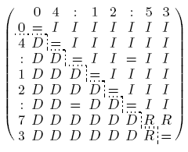
Searching for Separators and Many-to-many Translations (2/4)
Non-alphanumeric separators in columns
Algorithm
Query the target column for consistent patterns of separator uses.
Force the use of a separator template on the identification of similar pairs and on recipe generation.
Search terms do not contain separators.
Use the characters deemed to be separators to align editing and translation generation.
input
output
11:45:34
%:%:%

Slide 33
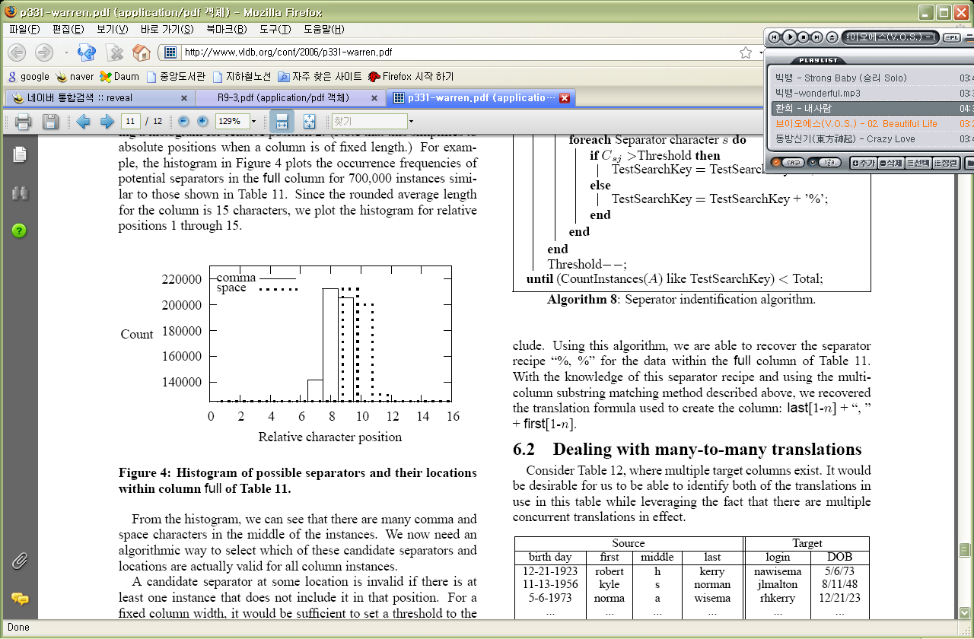
Searching for Separators and Many-to-many Translations (3/4)
Non-alphanumeric separators in columns
We want to deal with both fixed and variable length target columns.
For a fixed column width, set a threshold to the number of instances.
Use a histogram of all non-alphanumeric characters within the target column.

Slide 34
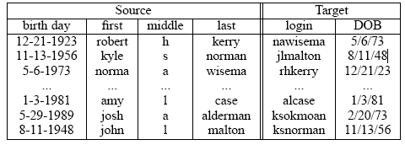
Searching for Separators and Many-to-many Translations (4/4)
Dealing with many-to-many translations
One of the translations has already been identified and resolved, and we wish to use this knowledge in finding a subsequent translation.

Slide 35
Conclusion
We present a generalized algorithm for most string-based matches.
This method attempts to find a translation formula
Bi-grams and 10% sample sizes work well in practice.
We wish to develop a method to combine several applicable translation formulas into a single translation formula.

