Slide 1
Operating System Support for Database Management
Michael Stonebraker
University of California, Berkeley
Communications of the ACM 1981
12 April 2013
SNU IDB Lab.
Inhoe Lee
Notes:
세미나 발표를 맡은 이인회 입니다.
1981년 Communications of the ACM에 실린
Operating System Support for Database management 에 대하여 발표하겠습니다.

Slide 2
Outline
Introduction
Buffer Pool Management
Deficiency / Solution
Scheduling / Process Management
One process per user
Server model
Conclusions
Notes:
발표순서는 Intro
OS service의
Consider the following
BPM
FS
S/PM
과 Conclusions이 되겠습니다.

Slide 3
Introduction
Examine OS services as applicable to database use
UNIX used as example OS
INGRES used as example DBMS
Notes:
In this paper we examine several popular operating system services
and indicate whether they are appropriate for support of database management functions.
Often we will see that the wrong service is provided or that severe performance problems exist.
논문에서 OS service가 DBM의 기능을 support함에 있어서 적당한지를 보고
잘못된 점을 지적하고 해결방법을 제시하고 있습니다.
OS로는 Unix가 사용되었고
DBMS로는 INGRES가 사용되었습니다.

Slide 4
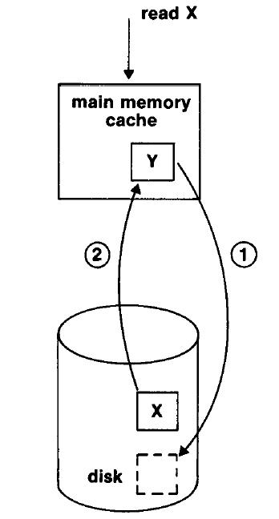
Buffer Pool Management
UNIX provisions:
Fixed-size buffer pool
Size set upon compilation
File I/O handled through this cache
LRU replacement strategy for misses
Block-prefetch for sequential access
Notes:
File-read (Read X) returns data directly from a block in the cache.
If there is a miss (block not yet in cache), a block gets replaced (pushed to disk) and then the needed block is placed in cache from its source (disk.)
LRU used to determine which block gets tossed.
먼저,
OS는 File System을 위해서 Main memory cache를 제공합니다.
Complie할때 생기는 fixed size buffer pool이고요
모든 file IO는 이 cache를 통해서 handle 됩니다.
OS가 sequential access를 detect했을 때는 request가 있지 않아도 prefetch해 놓죠

Slide 5
BPM-Deficiencies
Fetch performance
System call, ex) 5,000 instructions
Replacement strategy(Access Types)
Sequential access one time (projection)
Sequential access cyclically re-referenced (nested loop join)
Random access one time (select)
Random access possible re-referenced (join using index)
Inefficient prefetch
OS cannot effectively prefetch without guidance
Notes:
Fetch Performance: Fetching a block from the buffer pull manager includes a system call and a core-core move. 512 B could exceed 5,000 instructions.
Replacement Strategy: Database access consists of combinations of (4 examples.) DBMS KNOWS IN ADVANCE what type of access is required, and can adjust the replacement strategy accordingly.
1 and 3 – toss immediately (won’t use again.)
4 – LRU.
2. (abcd, abcd, abcd) LRU will result in misses every time! MRU will reduce the misses.
Prefetch:UNIX prefetch works if sequential access is detected. DBMS knows where next block is. Next block is rarely sequential (logically). OS cannot effectively prefetch without guidance (hints from DBMS)
Projection
Nested loop join
Single select
Join using index
LRU is acceptable in operating systems, however, a database system is able to predict future references more accurately

Slide 6
BPM-Solutions
DBMS managed buffer pool in user space
To reduce overhead
Composite replacement strategy
Database access in INGRES:
Sequential access (no re-reference) : toss immediately
Sequential access (cyclical re-reference): MRU
Random access (no re-reference): toss immediately
Random access (potential re-reference): LRU
Prefetch?
INGRES know next block
But, block is not necessarily next one in logical order
Notes:
DBMS-managed buffer pool. Resides in User Space. Reduced overhead. Virtual Memory?
2. OS cannot take advice from program. DBMS must provide its own replacement solution.
Use a Specific replacement strategy for each access category when the DBMS knows category
Reduce miss rate by 10-15%
OS must take “advice” from an application
Once a tuple of borrower has been processed, it is not needed again. Therefore, once processing of an
entire block of tuples is finished, that block is not needed in main memory, even though it has been used very recently.
Buffer manager should free the space occupied by a borrow block as soon as it is processed. This strategy
is called toss-immediate.

Slide 7
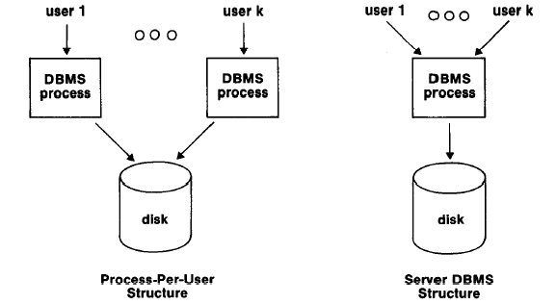
Scheduling, Process Management
Two approaches for running a multi-user database system
One process per user
Server Model
Notes:
Multi user DB system 을 위해서
두 가지 Structure가 가능합니다.
One ps / user
Server Model 입니다.

Slide 8
One process per user
Concurrent database user runs in a separate process
User share code segment
Easy to implement in Unix
<Problems>
Performance
Buffer pool miss will cause a task switch
Critical section
Convoy problem
Notes:
Problems
1. Performance
Buffer pool miss가 일어날 때 task switch가 일어나서 수 천개의 instruction이 발생하여 performance떨어질 수 있다.
2. Critical section
Code segment에 buffer pool을share하게 되면 Critical Section이 생기고
만약에 DBMS가 short term lock을 걸어놨을 때 OS가 그 DB process를 de-schedule하면 모든 DB process가 오랜시간 동안 buffer pool에 접근할 수 없게 된다

Slide 9
Server Model
One run-time database process acts as a server
What facility must the OS provide?
n Processes send messages to one destination
<Problems>
Even then server must do its own
Scheduling
Multitasking
Duplication of OS services

Slide 10
Ultimate Solution
Create a special scheduling class for DBMS
Process never forcibly decheduled
But might voluntarily give up CPU at appropriate interval
Fast path through the task switch / scheduler loop
To pass control to a sibling process
Hence, DBMS process could pass control to another DBMS process at low overhead
Notes:
Task switching requires locking records (semaphore sort of) – task could get queued, while other processes are now locked out of data.
Favored-user scheduling class:
Processes never forcibly descheduled. Could voluntarily give up the CPU at designated intervals.
Fast path through the task-switch loop to pass control to a sibling process.
앞에 두개다 단점이 있다. 그래서 U솔루션은

Slide 11
Conclusion
OS services too slow or inappropriate for database systems
Before designing any system
Carefully study its requirements
Then decide how best to build it
Future OS
A DBMS would prefer a small efficient OS with only desired services
OS offer all things to all people at much higher overhead
Notes:
A DBMS would prefer a small efficient operating system with only desired services.
On the other hand,
most general-purpose operating systems offer all things to all people at much higher overhead.
It is our hope that future operating systems will be able to provide both sets of services
in one environment.

Slide 12
Questions and references
Most material from
“Operating system support for database management ” by Michael Stonebreaker (University of California, Berkeley)
Database System Concepts, 6/e
“Stonebraker”
Cornwall, UK
Local surname, prominent stone
Questions?
Notes:
여담으로 Stonebraker라는 성씨는 local surname을 이용할때
영국 Cornwall이라는 지방에 살 때 어디에 사는지를 성씨로 만들었는데
유명한 돌 옆에 살아서 Stonebraker라고 인터넷에서 보았습니다.

