Slide 1
Chapter 7: Entity-Relationship Model

Slide 2
Overview of the Design Process
Creating a database application
  Design of the database schema
  Design of the programs that access and update the data
  Design of a security scheme to control access to data
Two major pitfalls to avoid in designing a database schema
  Redundancy
    repeating information ➔ data inconsistency
  Incompleteness
    difficult or impossible to model certain aspects of the enterprise

Slide 3
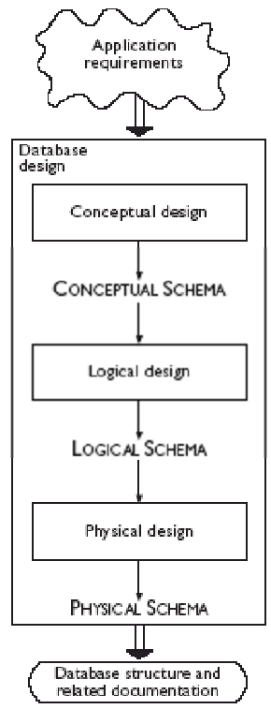
Main Phases of Database Design
Requirements collection and analysis
  Understanding the needs of users and enterprises
Conceptual design
  Choosing an abstract model like E-R Model
  Conceptual schema: descriptions of the data requirements, entities, relationships, and constraints
Logical design
  Converting the abstract model to implementation model
    E-R model to relational model
Physical design
  Specifying physical features of the database
    File organization, index structures (Ch. 10 & 11)

Slide 4
E-R Model
Proposed by P. Chen in 1976
Simple and powerful tool for the database design
  Many database design tools draw on concepts from the E-R model
A database can be modeled as:
  a collection of entities
  relationships among entities

Slide 5
Entity Sets
Entity – an object that exists and is distinguishable from other objects
  Example: specific person, company, event, plant
Entity set – a set of entities of the same type that share the same properties
  Example: set of all persons, companies, trees, holidays
Attribute – descriptive properties possessed by all members of an entity set
  Example: people have names and addresses

Slide 6

Entity Sets – instructor and student
instructor_ID instructor_name student-ID student_name

Slide 7
Relationship Sets
Relationship – an association among several entities
Example:
44553 (Peltier) advisor 22222 (Einstein)
student entity relationship set instructor entity
Relationship set – a mathematical relation among n ≥ 2 entities, each taken from entity sets
{(e₁, e₂, … e_{n}) | e₁ ∈ E₁, e₂ ∈ E₂, …, e_{n} ∈ E_{n}}
where (e₁, e₂, …, e_{n}) is a relationship
  Example:
  (44553,22222) ∈ advisor

Slide 8

Relationship Set – advisor
advisor

Slide 9

Attribute of Relationship Set
An attribute can also be property of a relationship set

Slide 10
Natural Language Sentences to E-R Model
Rules of thumb for mapping natural language descriptions into E-R model:
Noun
  Common noun ➔ entity set
  Proper noun ➔ entity
Verb
  Transitive verb ➔ relationship set
  Intransitive verb ➔ attribute for entity
Adjective ➔ attribute for entity
Adverb ➔ attribute for relationship

Slide 11

E-R Diagrams
Rectangles represent entity sets
Diamonds represent relationship sets
Lines link entity sets to relationship sets
Attributes are listed inside entity rectangles
Underline indicates primary key attributes

Slide 12

Relationship Sets with Attributes
Dashed lines link attributes to the relationship sets

Slide 13

Roles
Entity sets of a relationship need not be distinct
  Each occurrence of an entity set plays a “role” in the relationship
The labels “course_id” and “prereq_id” are called roles.

Slide 14
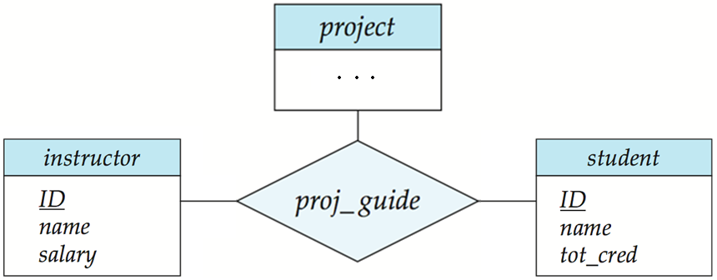
Degree of a Relationship Set
Degree of a relationship set
  The number of entity sets that participate in the relationship
Most relationship sets in a database system are binary
You can define non-binary relationships

Slide 15
Attribute Types
Simple and composite attributes
  Simple attribute: can not be divided into subparts
  Composite attribute: composed of multiple subparts
    Example: name = (first_name, middle_initial, last_name)
    address = (street, city, state, zip_code)
Domain – the set of permitted values for each attribute
  Null value: a special value meaning “missing” or “unknown”
    Some attributes are not allowed to have null values

Slide 16

Attribute Types
Single-valued and multivalued attributes
  Single-valued attribute
    Each attribute has a single value for an entity
    Example: ID, name, address
  Multivalued attribute
    An attribute may have more than one value for an instance
    Example: phone_number = {7287, 7288}
Derived attributes
  Can be computed from other attributes
  Example: age, given date_of_birth

Slide 17
Mapping Cardinality Constraints
Express the number of entities to which another entity can be associated via a relationship set
For a binary relationship set, the mapping cardinality must be one of the following types:
  One-to-one
  One-to-many
  Many-to-one
  Many-to-many

Slide 18

Mapping Cardinalities
One-to-one
One-to-many
Note: Some elements in A and B may not be mapped to any elements in the other set

Slide 19

Mapping Cardinalities
Many-to-one
Many-to-many
Note: Some elements in A and B may not be mapped to any elements in the other set

Slide 20

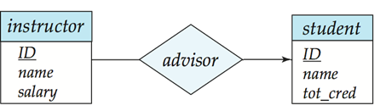
Mapping Cardinality Constraints in E-R diagram
Line types between the relationship set and the entity set
  Directed line (→): at most “one” (including 0)
  Undirected line (—): “many” (including 0)
One-to-one
One-to-many
Many-to-one
Many-to-many

Slide 21

Participation Constraints
Total participation (indicated by double line): every entity in the entity set participates in at least one relationship in the relationship set
  Example: participation of section in sec_course is total
    every section must have an associated course
Partial participation: some entities may not participate in any relationship in the relationship set
  Example: participation of instructor in advisor is partial

Slide 22

Cardinality Limits on Relationship Sets
Cardinality limits can indicate more complex participation constraints

Slide 23
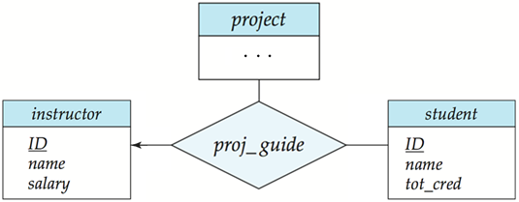
Cardinality Constraints on n-ary Relationship
We allow at most one arrow out of a ternary (or greater degree) relationship
  E.g., an arrow from proj_guide to instructor indicates each student has
  at most one guide for a project
If there is more than one arrow, there are two ways of defining the meaning.
  E.g., a ternary relationship R between A, B and C with arrows to B and C could mean
  1. each A entity is associated with a unique entity from B and C or
  2. each pair of entities from (A, B) is associated with a unique C entity, and each pair (A, C) is associated with a unique B
  To avoid confusion we outlaw more than one arrow

Slide 24
Keys
Keys for entity sets
  A super key of an entity set is a set of one or more attributes whose values uniquely determine each entity.
  A candidate key of an entity set is a minimal super key
    ID is candidate key of instructor
  Although several candidate keys may exist, one of the candidate keys is selected to be the primary key.
Keys for relationship sets
  The combination of primary keys of the participating entity sets forms a super key of a relationship set.
    (s_id, i_id) is the super key of advisor

Slide 25
Keys for Relationship Sets
Must consider the mapping cardinality of the relationship set when deciding what are the candidate keys (primary keys)
Let R be a relationship set involving entity sets E₁, E₂, …, E_{n}.
Primary keys for binary relationship set (n = 2)
  Many-to-many: PK(R) = PK(E₁) U PK(E₂)
  Many-to-one/one-to-many: PK(R) = PK(“many”-side entity)
  One-to-one: PK(R) = PK(E₁) or PK(E₂)
Primary keys for n-ary relationship set
  No arrow edges: PK(R) = PK(E₁) U PK(E₂) U … U PK(E_{n})
  With an arrow edge: PK(R) = PKs of the entity sets not on the “arrow”-side
If the relationship set R’ is the relationship R with attributes {a₁, …, a_{m}}
  PK(R’) = PK(R) U {a₁, …, a_{m}}

Slide 26
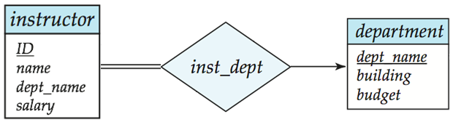
Removing Redundant Attributes
Suppose we have entity sets
Attribute dept_name in entity instructor is redundant
  The attribute replicates information present in the relationship inst_dept, and should be removed from instructor
  BUT: when converting back to tables, in some cases the attribute gets reintroduced, as we will see.

Slide 27
Weak Entity Sets
Weak entity set: an entity set that does not have a primary key
The existence of a weak entity set depends on the existence of an identifying entity set
  It must relate to the identifying entity set via a total, one-to-many relationship set from the identifying to the weak entity set
  Identifying relationship depicted using a double diamond
The discriminator (or partial key) of a weak entity set is the set of attributes that distinguishes among all the entities of a weak entity set.
  We underline the discriminator of a weak entity set with a dashed line.
The primary key of a weak entity set = (the primary key of identifying strong entity set)+ (the weak entity set’s discriminator)

Slide 28

E-R Diagram for a University Enterprise

Slide 29
Exercise
Construct an E-R diagram for the following company enterprise.
  A company has many employees. We store each employee’s name, SSN, address, salary, gender, and birth date.
  The company is organized into departments. Each department has a unique name, a unique number, and a particular employee who manages the department. The department may have several locations.
  An employee works for one department, and we keep track of the employee assignments. We also keep track of the direct supervisor of each employee.
  Also, we want to keep track of the dependents of each employee for insurance purposes. We keep each dependent’s name, gender, birth date, and relationship to the employee.

Slide 31
Reduction to Relation Schemas
Entity sets and relationship sets can be expressed uniformly as relation schemas that represent the contents of the database.
A database which conforms to an E-R diagram can be represented by a collection of schemas.
For each entity set and relationship set there is a unique schema that is assigned the name of the corresponding entity set or relationship set.
Each schema has a number of columns (generally corresponding to attributes), which have unique names.

Slide 32
Representing Entity Sets With Simple Attributes
A strong entity set reduces to a schema with the same attributes
student(ID, name, tot_cred)
A weak entity set becomes a table that includes a column for the primary key of the identifying strong entity set
section ( course_id, sec_id, sem, year )

Slide 33
Representing Relationship Sets
A relationship set is represented as a schema with attributes for the primary keys of the participating entity sets, and any descriptive attributes of the relationship set.
Example: schema for relationship set advisor
advisor = (s_id, i_id)

Slide 34
Redundancy of Schemas
Many-to-one and one-to-many relationship sets that are total on the many-side can be represented by adding an extra attribute to the “many” side, containing the primary key of the “one” side
Example: Instead of creating a schema for relationship set inst_dept,
add an attribute dept_name to the schema arising from entity set instructor

Slide 35
Redundancy of Schemas (Cont.)
For one-to-one relationship sets, either side can be chosen to act as the “many” side
  That is, extra attribute can be added to either of the tables corresponding to the two entity sets
If participation is partial on the “many” side, replacing a schema by an extra attribute in the schema corresponding to the “many” side could result in null values
The schema corresponding to a relationship set linking a weak entity set to its identifying strong entity set is redundant.
  Example: The section schema already contains the attributes that would appear in the sec_course schema

Slide 36
Composite and Multivalued Attributes
Composite attributes are flattened out by creating a separate attribute for each component attribute
Ignoring multivalued attributes, extended instructor schema is
  instructor(ID,
  first_name, middle_initial, last_name,
  street_number, street_name, apt_number,
  city, state, zip_code,
  date_of_birth)

Slide 37
Composite and Multivalued Attributes
A multivalued attribute M of an entity E is represented by a separate schema EM
  Schema EM has attributes corresponding to the primary key of E and an attribute corresponding to multivalued attribute M
  Example: Multivalued attribute phone_number of instructor is represented by a schema:
  inst_phone= ( ID, phone_number)
  Each value of the multivalued attribute maps to a separate tuple of the relation on schema EM
    For example, an instructor entity with primary key 22222 and phone numbers 456-7890 and 123-4567 maps to two tuples:
    (22222, 456-7890) and (22222, 123-4567)

Slide 38
Multivalued Attributes (Cont.)
Special case: entity time_slot has only one attribute other than the primary-key attribute, and that attribute is multivalued
  Optimization: Don’t create the relation corresponding to the entity, just create the one corresponding to the multivalued attribute
  time_slot(time_slot_id, day, start_time, end_time)
  Caveat: time_slot attribute of section (from sec_time_slot) cannot be a foreign key due to this optimization

Slide 39
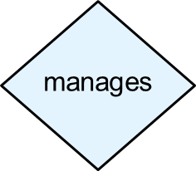
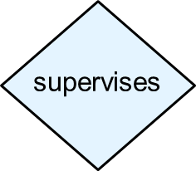
Exercise
Convert the following E-R diagram into a set of relations.
employee
name SSN address salary gender birth_date
department
name number { location }
supervisor
works_for
supervisee
dependent
name gender birth_date relationship
has

Slide 41

Extended E-R Features:
Specialization/Generalization
Specialization
  Designating subgroupings
  within an entity set
  Top-down design process
Generalization
  Combining a number of entity sets
  that share the same features
  into a higher-level entity set
  Bottom-up design process
Attribute inheritance – a lower-level entity set inherits all the attributes and relationship participation of the higher-level entity set to which it is linked.
Lower-level entity sets may have their own specific attributes or participate in relationships that do not apply to the higher-level entity set.

Slide 42
Constraints on Specialization/Generalization
Disjoint constraint – specifies whether or not entities may belong to more than one lower-level entity set within a single generalization/specialization
  Disjoint (denoted by a single arrow)
    An entity can belong to only one lower-level entity set
  Overlapping (denoted by separate arrows)
    An entity can belong to more than one lower-level entity set
Completeness constraint -- specifies whether or not an entity in the higher-level entity set must belong to at least one of the lower-level entity sets within a generalization/specialization
  Total (denoted by a dashed line and the keyword “total”)
    an entity must belong to one of the lower-level entity sets
  Partial(default)
    an entity need not belong to one of the lower-level entity sets

Slide 43
Reduction to Relation Schemas
Method 1:
  Form a schema for the higher-level entity
  Form a schema for each lower-level entity set, include primary key of higher-level entity set and local attributes
  schema attributes
  person ID, name, street, city
  student ID, tot_cred
  employee ID, salary
  Drawback: getting information about, an employee requires accessing two relations, the one corresponding to the low-level schema and the one corresponding to the high-level schema

Slide 44
Reduction to Relation Schemas (Cont.)
Method 2:
  Form a schema for each entity set with all local and inherited attributes
  schema attributes
  person ID, name, street, city
  student ID, name, street, city, tot_cred
  employee ID, name, street, city, salary
  If specialization is total, the schema for the generalized entity set (person) not required to store information
    Can be defined as a “view” relation containing union of specialization relations
    But explicit schema may still be needed for foreign key constraints
  Drawback: name, street and city may be stored redundantly for people who are both students and employees

Slide 45
Entity-Relationship Design Issues
The use of an attribute or an entity set to represent an object
The use of an entity sets or an relationship sets to represent an object
The use of a ternary relationship versus a pair of binary relationships

Slide 46

Use of Attributes vs. Entity Sets
Whether the entity must be treated as an independent entity
  Whether to have multiple entities
  Whether to keep extra information about the entity
Example: use of phone as an entity allows extra information about phone numbers (plus multiple phone numbers)

Slide 47

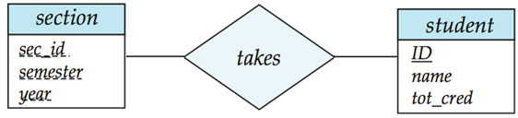
Use of Entity Sets vs. Relationship Sets
Use of entity sets: keeping other information about the entity
Use of relationship sets: more compact
It is not always clear – possible guideline is to designate a relationship set to describe an action that occurs between entities

Slide 48
Binary vs. Non-Binary Relationships
In general, any non-binary relationship can be represented using binary relationships by creating an artificial entity set.
Some relationships that appear to be non-binary may be better represented using binary relationships
  E.g., A ternary relationship parents, relating a child to his/her father and mother, is best replaced by two binary relationships, father and mother
    Using two binary relationships allows partial information (e.g., only mother being know)
But there are some relationships that are naturally non-binary
  Example: proj_guide

Slide 49

Summary of Symbols Used in E-R Notation

Slide 50
Symbols Used in E-R Notation (Cont.)

Slide 51
End of Chapter 7

