Slide 1
Ultrawrap: SPARQL Execution on Relational Data
Juan F. Sequeda, Daniel P. Miranker
University of Texas - Austin
ISWC 2009
Seoul National University
Internet Database Lab.
Kyung-Bin Lim

Slide 2
Ultrawrap
Automatically create SPARQL endpoint for legacy relational databases
Real-time consistency between the relational and RDF data
Making maximal use of existing SQL infrastructure
Research question: Do existing commercial SQL query engines already subsume all the algorithms needed to support effective SPARQL execution on relational data?
Sequeda, Juan F., and Daniel P. Miranker. "Ultrawrap: Sparql execution on relational data." Web Semantics: Science, Services and Agents on the World Wide Web 22 (2013): 19-39.

Slide 3
RDF Triples
Semantic breakdown
“Rick Hull wrote Foundations of Databases.”
Representation
Graph
Statement
<“Foundations of Databases”, hasAuthor, “Rick Hull”>
XML format
hasAuthor
Foundations of Databases
Rick Hull
<rdf:RDF xmlns:rdf="http://www.w3.org/1999/02/22-rdf-syntax-ns#">
<rdf:Description rdf:about="Foundations of Databases>
<hasAuthor>Rick Hull</hasAuthor>
</rdf:Description>
</rdf:RDF>

Slide 4
Example RDF Graph
title
XYZ
MNO
title
ID1
author
language
ID3
Fox, Joe
English
copyright
type
2001
type
type
ID6
BookType
copyright
2004
DVDType
ABC
type
title
artist
ID4
Orr, Tim
title
ID2
copyright
DEF
1985
language
1985
French
copyright
type
GHI
title
CDType
type
ID5

Slide 5
Taxonomy of RDF Data Management
Ultrawrap is a “wrapper” system
RDF
Data Management
Relational Database to RDF
(RDB2RDF)
Wrapper
Systems
Extract-Transform-Load
(ETL)
Triplestores
Native
Triplestores
RDBMS-backed
Triplestores
NoSQL
Triplestores
Sequeda, Juan F., and Daniel P. Miranker. "Ultrawrap: Sparql execution on relational data." Web Semantics: Science, Services and Agents on the World Wide Web 22 (2013): 19-39.

Slide 6
RDB2RDF: Two Ways
Wrapper Systems
Presents a logical(“virtual”) RDF representation of relational data
Real-time consistency between the relational and RDF data
Extract-Transform-Load
Relational data is extracted from RDB, translated to RDF, and loaded into a triplestore
A batch processing
Sequeda, Juan F., and Daniel P. Miranker. "Ultrawrap: Sparql execution on relational data." Web Semantics: Science, Services and Agents on the World Wide Web 22 (2013): 19-39.
Notes:
Wrapper systems that presents a logical RDF representation of relational data that is physically stored in an RDBMS
An alternative is the relational data is extracted from the relational database, translated to RDF, and loaded into a triplestore

Slide 7
Ultrawrap: Overvew
RDB2RDF Mapping
Creates virtual RDF representation of relational data
SPARQL query is translated to SQL to query physical RDB
Relational
Database
SQL
SPARQL
RDB2RDF
Mapping
SQL
Results
RDF
SPARQL/RDF
Results
Notes:
Ultrawrap defines a SQL view whose query component is a specification of a mapping from the relational data to an RDF triple representation, the TripleView (not materialized)

Slide 8
Ultrawrap: Process
Compile time
Create Putative Ontology
Create Virtual Triple Store
Use SQL View
Run Time
Naïve SPARQL to SQL translation
SQL Optimizer is the rewriter
Sequeda, Juan F., and Daniel P. Miranker. "Ultrawrap: Sparql execution on relational data." Web Semantics: Science, Services and Agents on the World Wide Web 22 (2013): 19-39.
Notes:
1. The translation of a SQL schema, including constraints, to an OWL ontology: the putative ontology (PO) [44, 46, 52].
2. The creation of an intensional triple table in the database by augmenting the relational schema with one or more SQL Views: the Tripleview.
3. Translation of SPARQL queries to equivalent SQL queries operating on the Tripleview.
4. The native SQL query optimizer, which becomes responsible for rewriting triple based queries and effecting their execution on extensional relational data.

Slide 9
Wrapper System: Ultrawrap
Ultrawrap Architecture

Slide 10
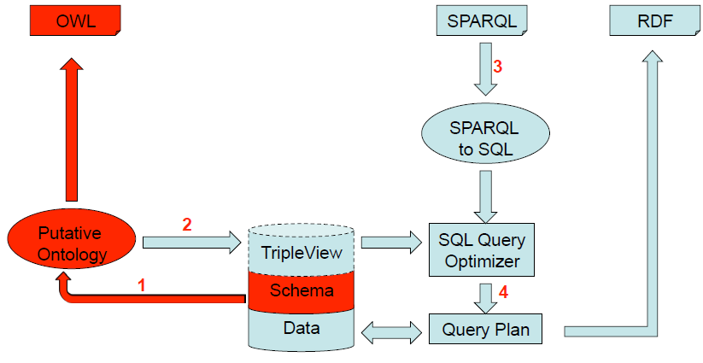
Step 1: Creating a Putative Ontology

Slide 11
Step 1: Creating a Putative Ontology
Putative Ontology
Putative: “commonly regarded as such”
Automatic syntactic transformation from a data source schema to an ontology
Ultrawrap creates PO automatically
Example:
S | P | O
Product | type | Class
Product#ptID | type | Datatype-Property
Product#ptID | domain | Product
Product#label | type | Datatype-Property
Product#label | domain | Product
Product
ptID | label
1 | ACME Inc
2 | Foo Bars
Sequeda, Juan F., and Daniel P. Miranker. "Ultrawrap: Sparql execution on relational data." Web Semantics: Science, Services and Agents on the World Wide Web 22 (2013): 19-39.
Notes:
Quality of the PO depends on the SQL DDL
– Is it normalized?
– Are all the constraints explicit?
• If the Quality is sufficient, all we need to do is rename
• Need to map the Putative Ontology to a Domain
Ontology
• Evidence: SQL schema from E-R models make
“interesting” ontologies
• SQL schemas made without any previous modeling
make “poor” ontologies

Slide 12
Step 1: Creating a Putative Ontology
FOL rules transform SQL DDL to OWL
Full mapping in Datalog
Stratified and safe
Proof of total coverage of all key combinations

Slide 13
Step 2: Create Virtual Triple Store

Slide 14
Step 2: Create Virtual Triple Store
Represent all relational data as triple using a view
Promise of avoiding self joins (optimizer will do this)
Triple table: one view table with three columns
Actually, the view is (s, spk, p, o, opk)
Spk and opk are the index values (optimizer needs to know the index values)
Example:
S | P | O
Product#ptID=1 | type | Product
Product#ptID=2 | type | Product
Product#ptID=1 | label | ACME Inc
Product#ptID=2 | label | Foo Bars
Product
ptID | label
1 | ACME Inc
2 | Foo Bars
Sequeda, Juan F., and Daniel P. Miranker. "Ultrawrap: Sparql execution on relational data." Web Semantics: Science, Services and Agents on the World Wide Web 22 (2013): 19-39.

Slide 15
Step 2: Create Virtual Triple Store
Create SELECT statements that output triples
Use the PO as basis to create all the SELECT statements

Slide 16
Step 2: Create Virtual Triple Store
Triple View is a union of all the SELECT statements
BSBM generates ~80 select statements in order to represent all relational data as triples

Slide 17
Step 3: Naïve SPARQL to SQL Translation

Slide 18
Step 3: Naïve SPARQL to SQL Translation
Syntactic transformation from a SPARQL query to an equivalent SQL query on the Triple View
SELECT ?label ?pnum1 WHERE{ ?x label ?label. ?x pnum1 ?pnum1. }
SELECT t1.o AS label, t2.o AS pnum1 FROM tripleview_varchar t1, tripleview_int t2 WHERE t1.p = 'label' AND
t2.p = 'pnum1' AND
t1.s_id = t2.s_id
Sequeda, Juan F., and Daniel P. Miranker. "Ultrawrap: Sparql execution on relational data." Web Semantics: Science, Services and Agents on the World Wide Web 22 (2013): 19-39.

Slide 19
Step 4: SQL Query Optimizer is the Rewrite system

Slide 20
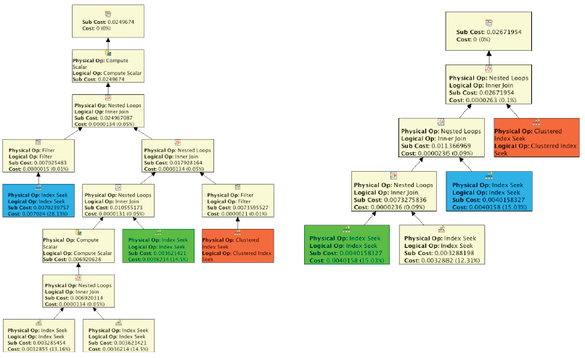
Step 4: SQL Query Optimizer is the Rewrite system
Rewrite translated SQL query into an optimal execution plan
Sequeda, Juan F., and Daniel P. Miranker. "Ultrawrap: Sparql execution on relational data." Web Semantics: Science, Services and Agents on the World Wide Web 22 (2013): 19-39.

Slide 21
Ultrawrap: SPARQL and SQL
Translating a SPARQL query to a semantically equivalent SQL query
SELECT ?label ?pnum1 WHERE{ ?x label ?label. ?x pnum1 ?pnum1. } | → | SELECT label, pnum1 FROM product
What is the
Query Plan?
SELECT t1.o AS label, t2.o AS pnum1 FROM tripleview_varchar t1, tripleview_int t2 WHERE t1.p = 'label' AND
t2.p = 'pnum1' AND
t1.s_id = t2.s_id
SQL on Tripleview

Slide 22
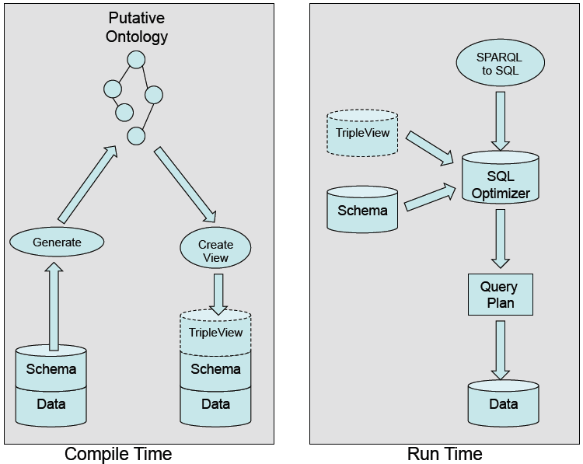
Ultrawrap: Architenture
Sequeda, Juan F., and Daniel P. Miranker. "Ultrawrap: Sparql execution on relational data." Web Semantics: Science, Services and Agents on the World Wide Web 22 (2013): 19-39.

Slide 23
Detection of Unsatisfiable Conditions
Determine that the query result will be empty if the existence of another answer would violate some integrity constraint in the database.
This would imply that the answer to the query is null and therefore the database does not need to be accessed

Slide 24

Detection of Unsatisfiable Conditions
σ_{p = ‘label’}
σ_{p = ‘pnum1’}
Tripleview_varchar t1
Tripleview_int t2
CONTRADICTION
U
U
CONTRADICTION
π _{Product+’id’ AS s} _{, ‘pnum2’ AS p, pnum2 AS o}
π _{Product+’id’ AS s} _{, ‘pnum1’ AS p, pnum1 AS o}
π _{Producer+’id’ AS s} _{, ‘title’ AS p, title AS o}
σ_{pnum2 ≠ NULL}
π _{Product+’id’ AS s} _{, ‘label’ AS p, label AS o}
σ_{pnum1 ≠ NULL}
σ_{title ≠ NULL}
Product
σ_{label ≠ NULL}
Product
Producer
Product

Slide 25
Self Join Elimination
If attributes from the same table are projected separately and then joined, then the join can be dropped
Self Join Elimination of Projection
SELECT p1.label, p2.pnum1
FROM product p1, product p2
WHERE
p1.id = 1 and
p1.id = p2.id
SELECT label, pnum1
FROM product
WHERE
id = 1
Self Join Elimination of Selection
SELECT p1.id
FROM product p1, product p2
WHERE
p1.pnum1 >100 and
p2.pnum2 < 500 and
p1.id = p2.id
SELECT id
FROM product
WHERE
pnum1 > 100 and
pnum2 < 500

Slide 26
Self Join Elimination
π _{t1.o AS label, t2.o AS pnum1}
π _{Product+’id’ AS s} _{, ‘label’ AS p, label AS o}
π _{Product+’id’ AS s} _{, ‘pnum1’ AS p, pnum1 AS o}
σ_{label ≠ NULL}
σ_{pnum1 ≠ NULL}
Product
Product
Join on the same table? → REDUNDANT

Slide 27
Self Join Elimination
π _{label, pnum1}
σ_{label ≠ NULL AND pnum1 ≠ NULL}
Product

Slide 28
Evaluation
Use Benchmarks that stores data in relational databases, provides SPARQL queries and their semantically equivalent SQL queries
BSBM - 100 Million Triples
Imitates the query load of an e-commerce website
Barton – 45 million triples
Replicates search of bibliographic data (Used relational form of DBLP)

Slide 29
Evaluation
 | Detection of Unsatisfiable Conditions | Self Join Elimination
MYSQL
SQL Server
ORACLE
DB2
✖
✖
✔
✖
✖
✔
✔
✔

Slide 30
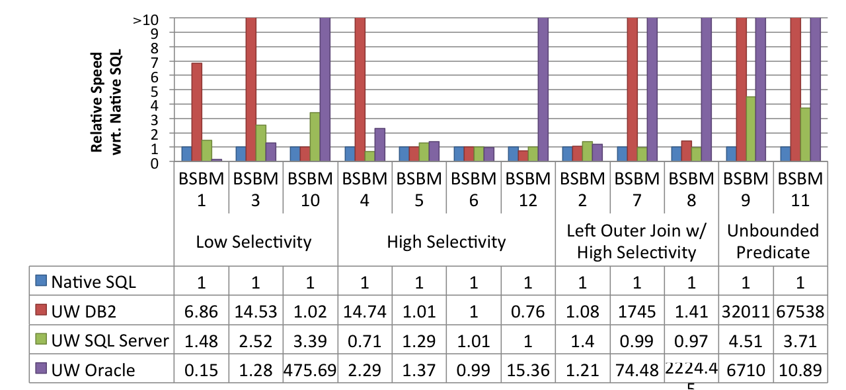
Ultrawrap Experiment

Slide 31
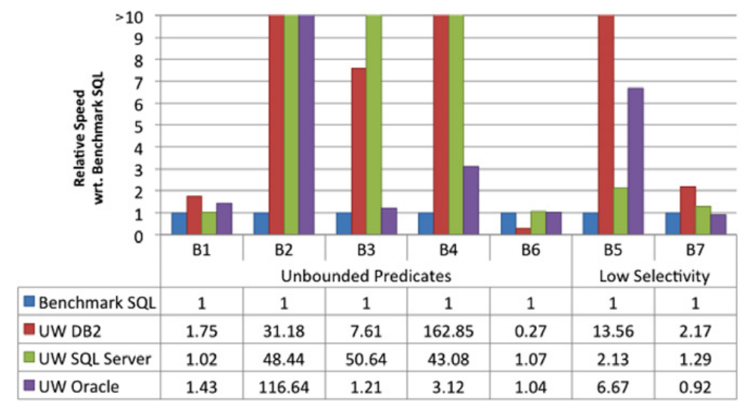
Ultrawrap Experiment

Slide 32
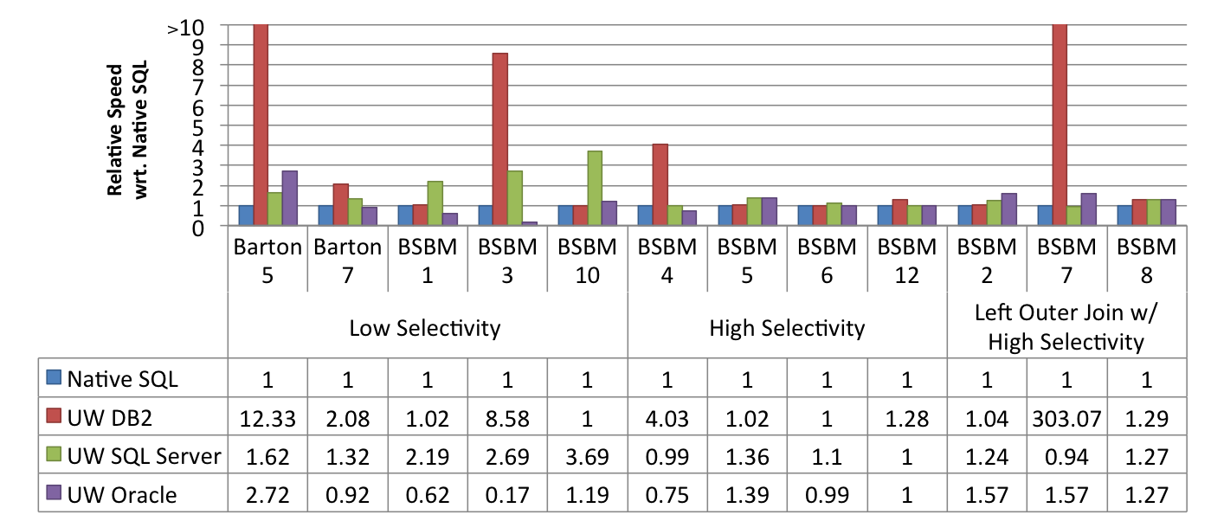
Augmented Ultrawrap Experiment
Implemented DoUC
Hash predicate to SQL query
Few LOC

Slide 33
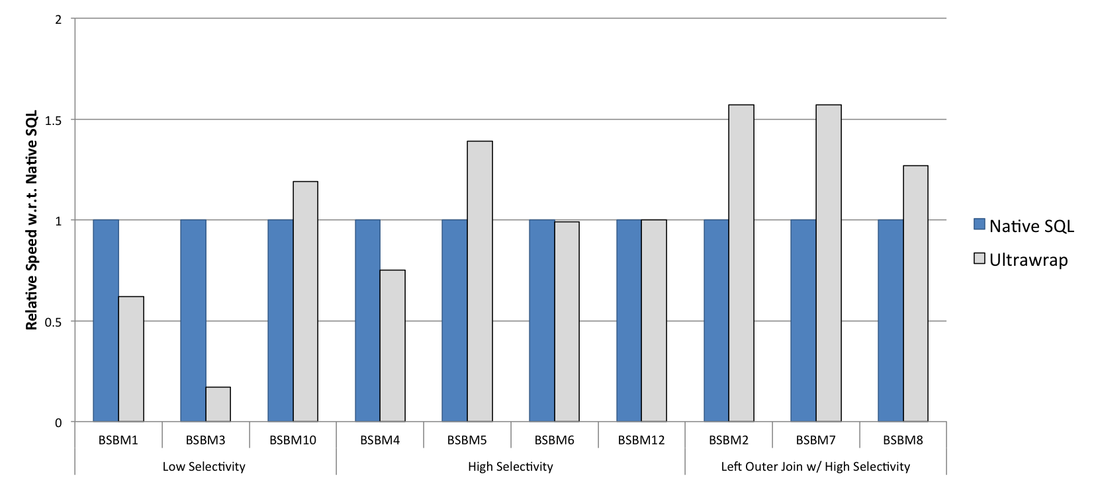
SPARQL as Fast as SQL
Berlin Benchmark on 100 Million Triples on Oracle 11g using Ultrawrap

Slide 34
Conclusion
Running of Microsoft SQL Server
Initial test on BSBM on 1 million triples
Execution time is close to running time of native SQL queries on RDB
Do not replicate relational database content
To date, wrapper systems have suffered problems in performance and scalability
Two optimizations may yield a query plan typical of a relational query plan, but starting from a logical plan representation of a SPARQL query
SPARQL queries with bound predicates on Ultrawrap execute at nearly the same speed as semantically equivalent benchmark-provided SQL queries
Sequeda, Juan F., and Daniel P. Miranker. "Ultrawrap: Sparql execution on relational data." Web Semantics: Science, Services and Agents on the World Wide Web 22 (2013): 19-39.

