Slide 1
TI: An Efficient Indexing Mechanism for Real-Time Search on Tweets
SIGMOD ’11
Chun Chen¹, Feng Li², Beng Chin Ooi², and Sai Wu²
¹Zhejiang University, ²National University of Singapore
18 May 2011
Taewhi Lee

Slide 2
Outline
Introduction
Related Work
System Overview
Content-Based Indexing Scheme
Ranking Function
Experimental Evaluation
Conclusion
<number>/32

Slide 3
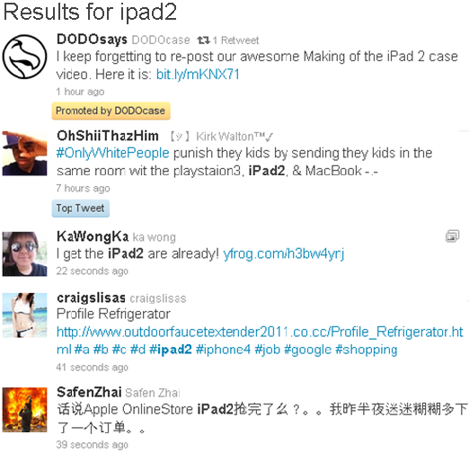
Real-Time Search for SNS
High update and
query loads
Lack of effective ranking functions
  Timestamp + relevance
<number>/32

Slide 4
Main Idea: Tweet Index(TI)
Classifying the tweets into two types
  Distinguished tweets – real-time indexing
  Noisy tweets – background batch indexing
Ranking function
  User’s PageRank
  Popularity of topics
  Similarity between data and query
  Timestamp
<number>/32

Slide 5
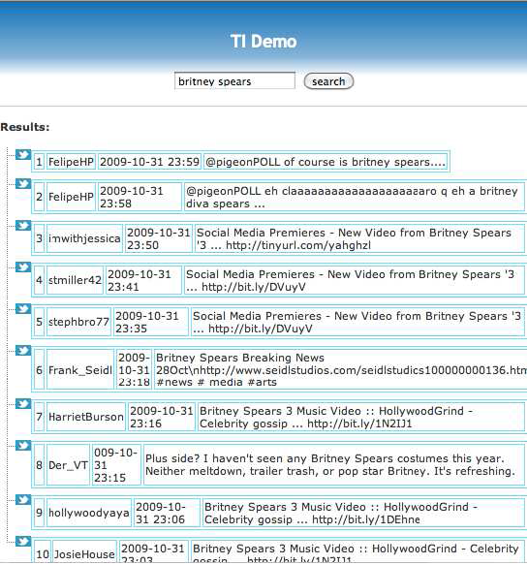
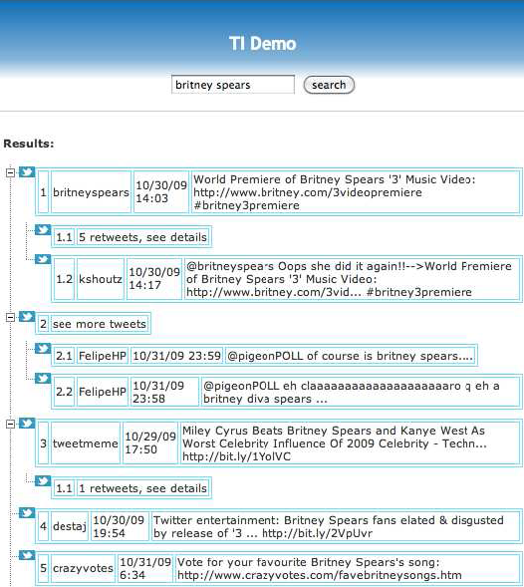
Example of Search Results
<number>/32

Slide 6
Outline
Introduction
Related Work
System Overview
Content-Based Indexing Scheme
Ranking Function
Experimental Evaluation
Conclusion
<number>/32

Slide 7
Related Work
Partial indexing and view materialization
  Adaptive & automatic creation
Microblog search
  Google & Twitter: results are sorted by time
    Google – adaptively crawl the microblogs
    Twitter – rely on an existing technique (e.g., Lucene)
  Proposed ranking schemes are too complex and time consuming
  Forum search – posts to the same thread are organized as a tree
<number>/32

Slide 8
Outline
Introduction
Related Work
System Overview
Content-Based Indexing Scheme
Ranking Function
Experimental Evaluation
Conclusion
<number>/32

Slide 9
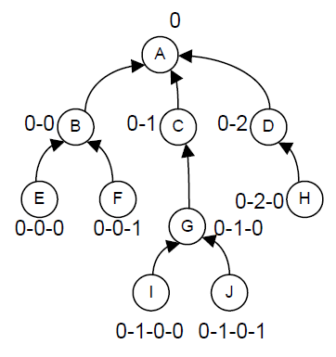
Social Graphs
User graph G_{u} = (U, E)
  U: set of users
  E: friend links
Relationships of tweets
  Tree encoding ID is
  assigned to each tweet
Reply or RT
<number>/32

Slide 10
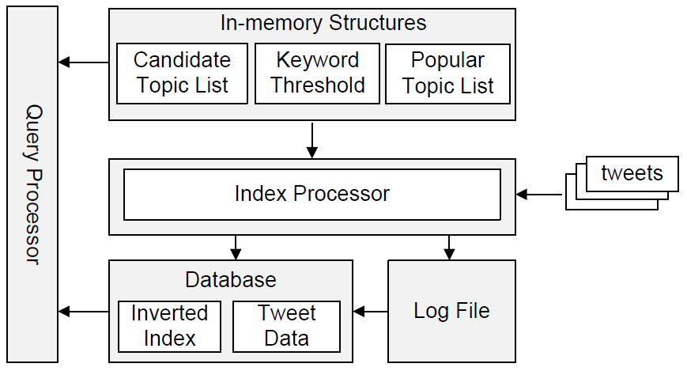
Architecture of the TI
Noisy
tweets
Distinguished
tweets
<number>/32

Slide 11
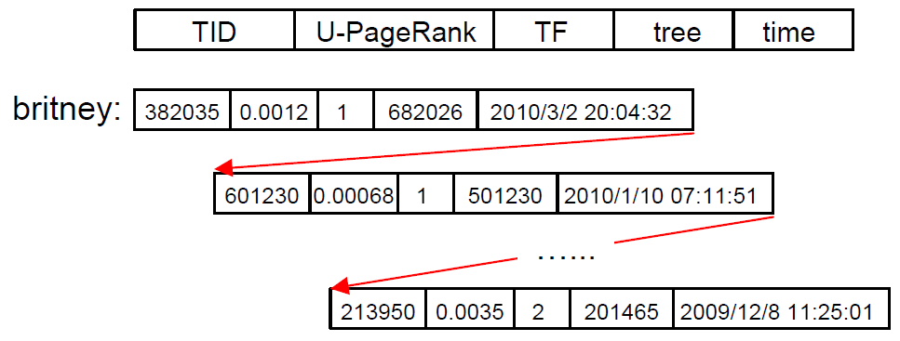
Structure of Inverted Index
<number>/32

Slide 12
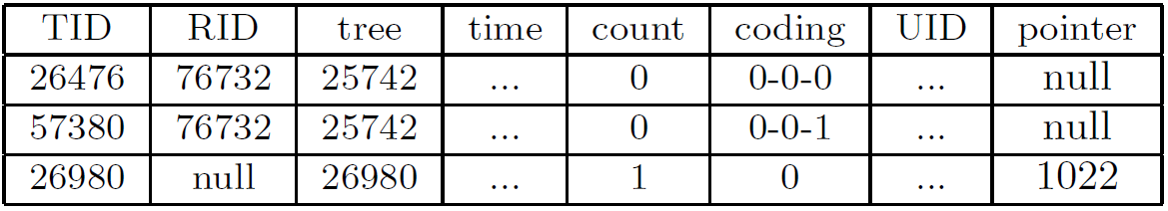
Tweet Table
Metadata of tweets stored in database
# of tweets that
reply to this tweet
Offset in the log file (for unindexed tweets)
ID of the replied tweet
B+ tree index for TID and UID is built
<number>/32

Slide 13
Outline
Introduction
Related Work
System Overview
Content-Based Indexing Scheme
Ranking Function
Experimental Evaluation
Conclusion
<number>/32

Slide 14
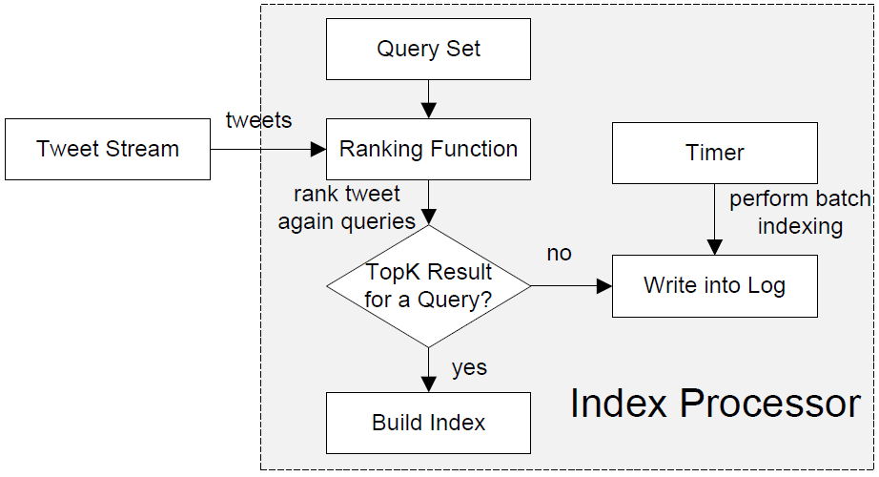
Data Flow of Index Processor
<number>/32

Slide 15
Tweet Classification
Query-based classification approach
  A tweet itself does not provide too much information
Assumption
  Users are only interested in the top-K results
Given a tweet t and a user’s query set Q,
  ∃q_{i} ∈ Q and t is a top-K result for q_{i} based on the ranking function F → t is a distinguished tweet
  Otherwise, t is a noisy tweet
<number>/32

Slide 16


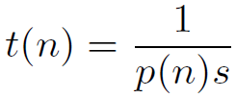
Maintaining Query Set
Suppose the n-th query appears with a prob. of
(Zipf’s distribution)
Let s be the # of submitted queries per sec.
: a prob. that the n-th query appears in a sec.
Expected time interval of the n-th query
Batch indexing
interval
We will keep the n-th query in Q, only if t(n) < t’
<number>/32

Slide 17
Naïve Classifier
For every q_{i} in Q,
  ds(q_{i},t).size < K → distinguished tweet
  Otherwise → noisy tweet
Dominant set ds(q_{i},t)
  The tweets that have higher ranks than t for a query q_{i}
Performance problems
  Full scan of the tweet set is needed (computing DS)
  Testing against every queries is needed for each tweet
<number>/32

Slide 18
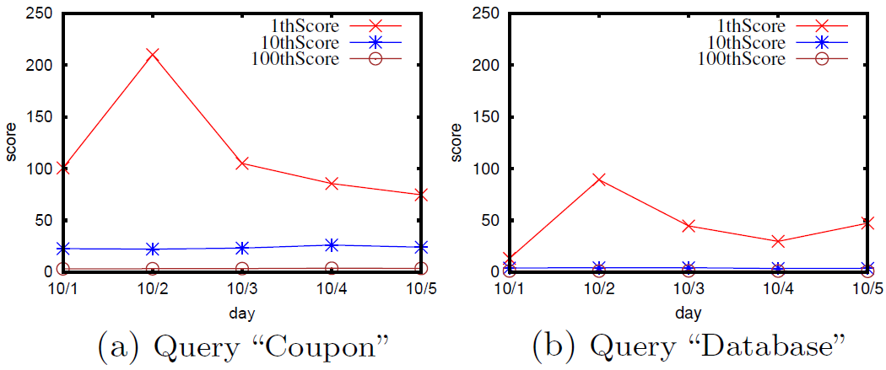
Opt. 1: Top-K Threshold
Observation
  The scores of the top 10th and 100th tweet are quite stable
Computing DS → score comparison
<number>/32

Slide 19
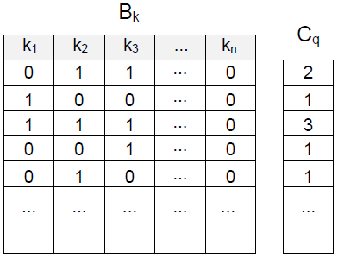


Opt. 2: Matrix Index for Queries
Candidate query set
  Keywords in both tweet and query
<number>/32

Slide 20
Implementation of Indexes
Real-time indexing
Retrieve parent tweet (2-3 I/Os via the index on TID)
Update the count number in the parent tweet (1 I/O)
Insert the tweet into the tweet data table
(insert: 1 I/O, index update: 2-3 I/Os)
Insert the tweet into the inverted index (n I/Os)
Batch indexing
Append the tweet to the log file (1 I/O)
Insert the tweet into the tweet data table
(insert: 1 I/O, index update: 2-3 I/Os)
<number>/32

Slide 21
Outline
Introduction
Related Work
System Overview
Content-Based Indexing Scheme
Ranking Function
Experimental Evaluation
Conclusion
<number>/32

Slide 22
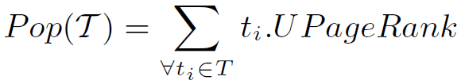
Ranking Function
User’s PageRank
  V: user, E: following link
Popularity of Topics(= tweet tree)
  We just compute the popularities of active trees and maintain them in memory
<number>/32

Slide 23
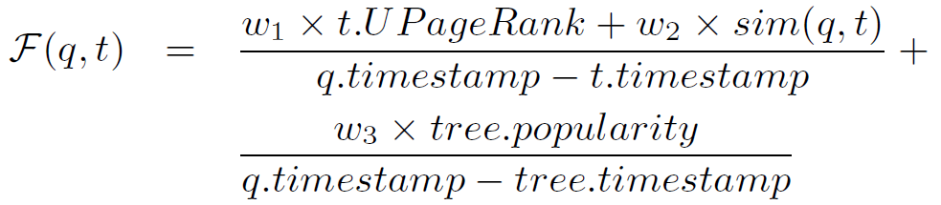
Ranking Function (cont’d)
Time-based Ranking
  F is monotonically decreasing with time
Problem
  Search performance is affected by the size of inverted index
<number>/32

Slide 24
Adaptive Index Search
Adaptive Index Search
  Read a block of the index iteratively
  Stop reading if max. score before ts < T_{Θ}(q)
<number>/32

Slide 25
Outline
Introduction
Related Work
System Overview
Content-Based Indexing Scheme
Ranking Function
Experimental Evaluation
Conclusion
<number>/32

Slide 26
Experimental Setting
Dataset
  Twitter data collected for 3 years(Oct 2006~Nov 2009)
  ~465K users, 25M+ tweets
Experiments
  Queries are generated by randomly
    Combining the keywords
    # of keywords in queries follows Zipf’s distribution
    (1-word: 60%, 2-word: 30%, 3+-word: 10%)
  Queries are submitted at random timestamps
<number>/32

Slide 27
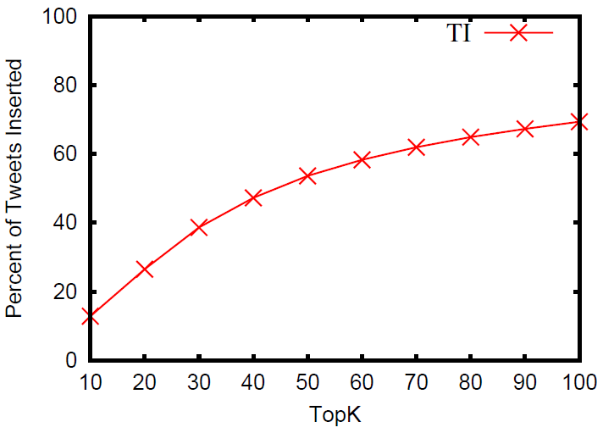
# of Indexed Tweets in Real-Time
<number>/32

Slide 28
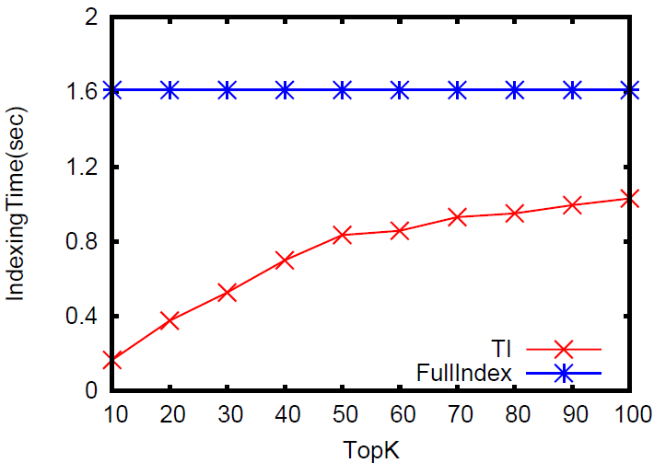
Indexing Cost (per 10K Tweets)
<number>/32

Slide 29
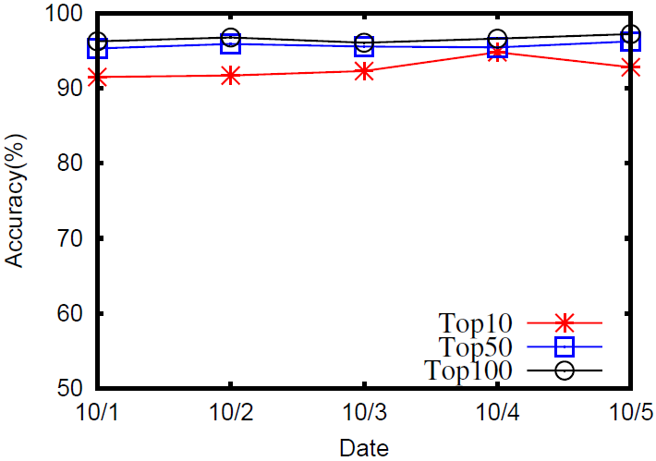
Accuracy (Adaptive Threshold)
<number>/32

Slide 30
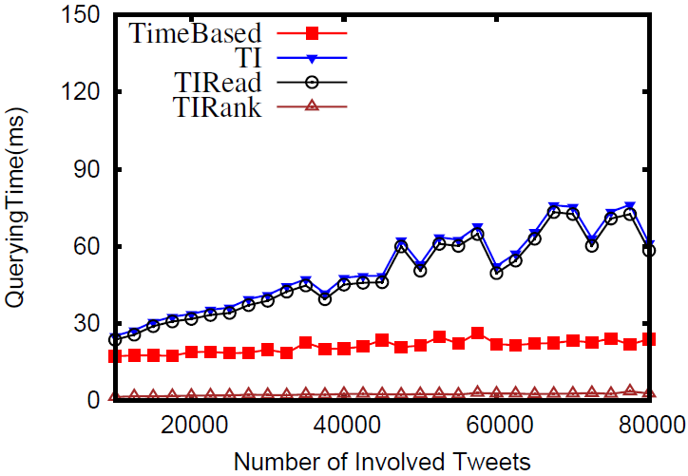
Performance of Query Processing
Size of the inverted index for a keyword k_{i}
is proportional to the # of tweets containg k_{i}
<number>/32

Slide 31
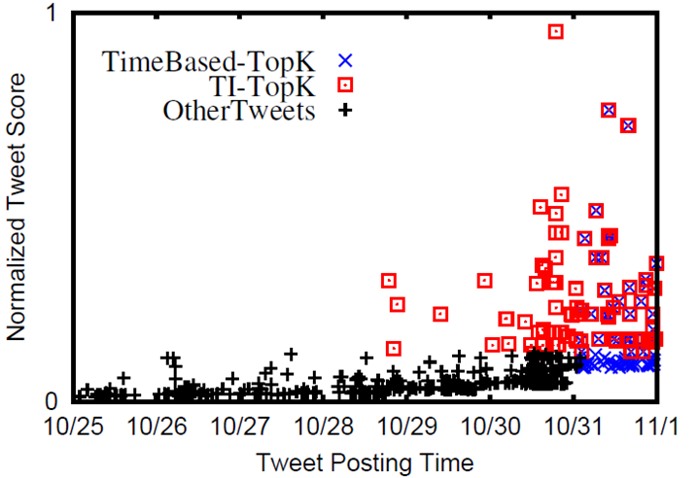
Distribution of Results
<number>/32

Slide 32
Outline
Introduction
Related Work
System Overview
Content-Based Indexing Scheme
Ranking Function
Experimental Evaluation
Conclusion
<number>/32

Slide 33
Conclusion
Classifying the tweets into two types
  Distinguished tweets – real-time indexing
  Noisy tweets – background batch indexing
Ranking function
  User’s PageRank
  Popularity of topics
  Similarity between data and query
  Timestamp
<number>/32

Slide 34
Thank you!

