Slide 1
Chapter 13: Query Optimization

Slide 2

Basic Steps in Query Processing
1. Parsing and translation
2. Optimization
3. Evaluation

Slide 3
Query Optimization
Alternative ways of evaluating a given query
  Equivalent expressions
    E.g., σ_{salary<75000}(∏_{salary}(instructor)) is equivalent to
    ∏_{salary}(σ_{salary<75000}(instructor))
  Different algorithms for each operation
    E.g., to find instructors with salary < 75000,
      can use an index on salary,
      or can perform complete relation scan and discard instructors with salary ≥ 75000
Query optimization
  The process of selecting the most efficient strategies (query evaluation plan) for processing a given query

Slide 4

Equivalent Expression
Two relational-algebra expressions are equivalent if, on every legal database instance, the two expressions generate the same (multi)set of tuples
  Discussion in this chapter is based on the set version of the relation algebra
    In SQL, the inputs and outputs are multisets of tuples, and the multiset version of the relational algebra is used for evaluating SQL queries
Example
(a) ∏_{name,title}( σ_{dept_name=“Music”}(instructor ⋈ (teaches ⋈ course)) )
(b) ∏_{name,title}( (σ_{dept_name=“Music”}(instructor)) ⋈ (teaches ⋈ course) )
(a)
(b)

Slide 5

Query Evaluation Plan
An evaluation plan defines exactly what algorithm is used for each operation, and how the execution of the operations is coordinated

Slide 6
Cost-Based Query Optimization
Cost-based query optimization
  Amongst all equivalent evaluation plans choose the one with lowest cost
Generating query evaluation plan in cost-based query optimization
  Generate logically equivalent expressions using equivalence rules
  Annotate resultant expressions to get alternative query plans
  Choose the cheapest plan based on estimated cost
Estimation of plan cost based on:
  Statistical information about relations.
    Examples: number of tuples, number of distinct values for an attribute
  Statistics estimation for intermediate results
    to compute cost of complex expressions
  Cost formulae for algorithms, computed using statistics

Slide 7



Equivalence Rules #1~4
1. Conjunctive selection operations can be deconstructed into a sequence of individual selections.
2. Selection operations are commutative.
3. Only the last in a sequence of projection operations is needed, the others can be omitted.
  L_{i} = lists of attributes
Selections can be combined with Cartesian products and theta joins.
  σ_{θ}(E₁ X E₂) = E₁ _{θ} E₂
  σ_{θ1}(E_{1 θ2} E₂) = E₁ _{θ1∧θ2} E₂

Slide 8
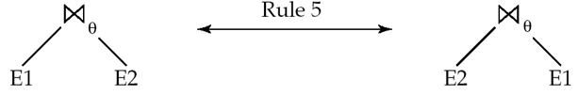
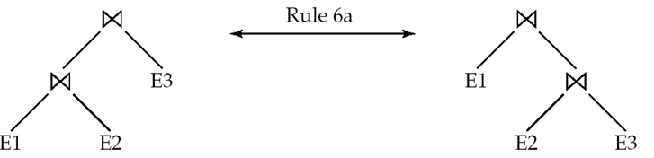
Equivalence Rules #5~6
5. Theta-join operations (and natural joins) are commutative.
E_{1 θ} E₂ = E₂ _{θ} E₁
6. (a) Natural join operations are associative:
(E₁ E₂) E₃ = E₁ (E₂ E₃)
(b) Theta joins are associative in the following manner:
(E_{1 θ1} E₂) _{θ2∧ θ3} E₃ = E_{1 θ1∧ θ3} (E₂ _{θ2} E₃)
where θ₂ involves attributes from only E₂ and E₃.

Slide 9



Example Relations for Equivalence Rules
instructor
teaches
course

Slide 10
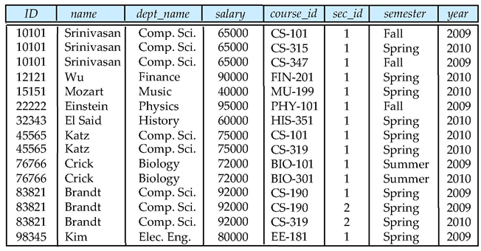
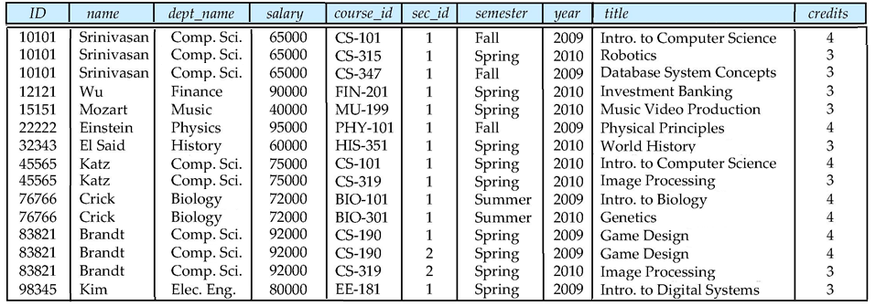
Example for Equivalence Rule #6
Example: (instructor teaches) course
(instructor teaches)
(instructor teaches)
course

Slide 11
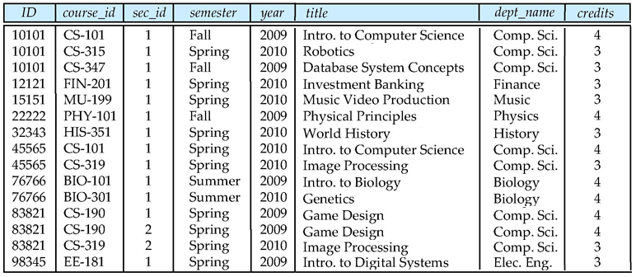
Example for Equivalence Rule #6 (Cont.)
Example: instructor (teaches course)
(teaches course)
instructor
(teaches course)

Slide 12
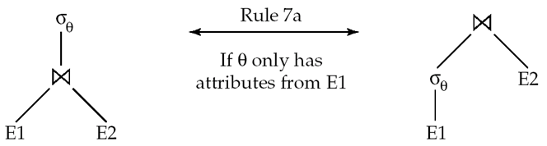
Equivalence Rules #7
7. The selection operation distributes over the theta join operation under the following two conditions:
(a) When all the attributes in θ₀ involve only the attributes of one
of the expressions (E₁) being joined.
σ_{θ0}(E₁ _{θ} E₂) = (σ_{θ0}(E₁)) _{θ} E₂
(b) When θ₁ involves only the attributes of E₁ and θ₂ involves
only the attributes of E₂.
σ_{θ1}∧_{θ2} (E₁ _{θ} E₂) = (σ_{θ1}(E₁)) _{θ} (σ_{θ2} (E₂))

Slide 13
Example for Equivalence Rule #7
Example: σ_{dept_name= “Music”}(instructor (teaches course))
(teaches course)
instructor
(teaches course)
σ_{dept_name= “Music”}(instructor (teaches course))

Slide 14

Example for Equivalence Rule #7 (Cont.)
Example: (σ_{dept_name= “Music”}(instructor)) (teaches course)
σ_{dept_name= “Music”}(instructor)
(teaches course)
(σ_{dept_name= “Music”}(instructor)) (teaches course)

Slide 15
Equivalence Rules #8
8. The projection operation distributes over the theta join operation as follows:
(a) if θ involves only attributes from L₁ ∪ L₂:
(b) Consider a join E_{1 θ} E₂.
  Let L₁ and L₂ be sets of attributes from E₁ and E₂, respectively.
  Let L₃ be attributes of E₁ that are involved in join condition θ, but are not in L₁ ∪ L₂, and
  let L₄ be attributes of E₂ that are involved in join condition θ, but are not in L₁ ∪ L₂.
∏
(
E
E
)
=
(
∏
(
E
))
(
∏
(
E
))
L
1
∪
L
2
1
θ
2
L
1
1
θ
L
2
2
∏
(
E
E
)
=
∏
((
∏
(
E
))
(
∏
(
E
)))
L
1
∪
L
2
1
θ
2
L
1
∪
L
2
L
1
∪
L
3
1
θ
L
2
∪
L
4
2

Slide 16

Example for Equivalence Rule #8
Example: Π_{name, title}((σ_{dept_name= “Music”} (instructor) teaches) course)
σ_{dept_name= “Music”}(instructor)
σ_{dept_name= “Music”}(instructor) teaches
(σ_{dept_name= “Music”}(instructor) teaches) course)
Π_{name, title}((σ_{dept_name= “Music”} (instructor) teaches) course)

Slide 17

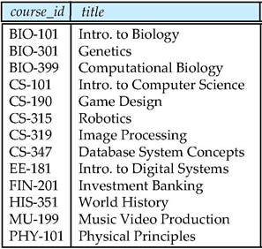
Example for Equivalence Rule #8 (Cont.)
Example: Π_{name, title}((Π_{name, course_id} (σ_{dept_name= “Music”} (instructor)) teaches)
Π_{course_id, title} (course))
σ_{dept_name= “Music”}(instructor)
(σ_{dept_name= “Music”}(instructor))
teaches
Π_{name, course_id} (σ_{dept_name= “Music”} (instructor)) teaches)
Π_{course_id, title} (course)
Π_{name, title}((Π_{name, course_id} (σ_{dept_name= “Music”} (instructor)) teaches) Π_{course_id, title} (course))

Slide 18
Equivalence Rules for Set Operations
The set operations union and intersection are commutative
E₁ ∪ E₂ = E₂ ∪ E₁
E₁ ∩ E₂ = E₂ ∩ E₁
  (set difference is not commutative).
Set union and intersection are associative.
(E₁ ∪ E₂) ∪ E₃ = E₁ ∪ (E₂ ∪ E₃)
(E₁ ∩ E₂) ∩ E₃ = E₁ ∩ (E₂ ∩ E₃)
The selection operation distributes over ∪, ∩ and –.
σ_{θ} (E₁ – E₂) = σ_{θ} (E₁) – σ_{θ}(E₂)
and similarly for ∪ and ∩ in place of –
Also: σ_{θ} (E₁ – E₂) = σ_{θ}(E₁) – E₂
and similarly for ∩ in place of –, but not for ∪
12. The projection operation distributes over union
Π_{L}(E₁ ∪ E₂) = (Π_{L}(E₁)) ∪ (Π_{L}(E₂))

Slide 19
Transformation Example: Pushing Selections
Performing the selection as early as possible reduces the size of the relation to be joined
Example query: Find the names of all instructors in the Music department, along with the titles of the courses that they teach
  Π_{name, title}(σ_{dept_name= “Music”} (instructor (teaches Π_{course_id, title} (course))))
  Transformation using rule 7a
  Π_{name, title}((σ_{dept_name= “Music”}(instructor)) (teaches Π_{course_id, title} (course)))

Slide 20
Transformation Example: Pushing Projections
Performing the projection as early as possible reduces the size of the relation to be joined
Example query:
  Π_{name, title}((σ_{dept_name= “Music”} (instructor) teaches) Π_{course_id, title} (course))
  When we compute (σ_{dept_name = “Music”} (instructor) teaches),
  we obtain a relation whose schema is:
  (ID, name, dept_name, salary, course_id, sec_id, semester, year)
  Push projections using equivalence rules 8a and 8b;
  eliminate unneeded attributes from intermediate results to get:
  Π_{name, title}((Π_{name, course_id} (σ_{dept_name= “Music”} (instructor)) teaches)
  Π_{course_id, title} (course))

Slide 21
Example with Multiple Transformations
Query: Find the names of all instructors in the Music department who have taught a course in 2009, along with the titles of the courses that they taught
  Π_{name, title}(σ_{dept_name= “Music”∧year=2009}(instructor (teaches Π_{course_id, title}(course))))
Transformation using join associatively (Rule 6a):
  Π_{name, title}(σ_{dept_name= “Music”∧year=2009}((instructor teaches) Π_{course_id, title}(course)))
Second form provides an opportunity to apply the “perform selections early” rule
Π_{name, title}((σ_{dept_name = “Music”}(instructor) σ_{year = 2009}(teaches)) Π_{course_id, title}(course))

Slide 22

Multiple Transformations (Cont.)

Slide 23
Join Ordering
For all relations r_{1,} r_{2,} and r₃, (r₁ r₂) r₃ = r₁ (r₂ r₃ ) (Rule 6a)
Choose the expression that will yield smaller temporary result
  If r₂ r₃ is quite large and r₁ r₂ is small, we choose
  (r₁ r₂) r₃
  so that we compute and store a smaller temporary relation
Example
Π_{name, title}((σ_{dept_name= “Music”}(instructor) teaches) Π_{course_id, title} (course))
  Which join expression is it better to compute first?
    1. Compute teaches Π_{course_id, title} (course) first,
    and join result with σ_{dept_name= “Music”} (instructor)
    The result of the first join is likely to be a large relation
  2. Compute σ_{dept_name= “Music”} (instructor) teaches first
    Only a small fraction of the university’s instructors are likely to be from the Music department – This would be better

Slide 24
Enumeration of Equivalent Expressions
Query optimizers use equivalence rules to systematically generate expressions equivalent to the given expression
Can generate all equivalent expressions as follows:
  Repeat
    apply all applicable equivalence rules on every subexpression of every equivalent expression found so far
    add newly generated expressions to the set of equivalent expressions
    Until no new equivalent expressions are generated above
The above approach is very expensive in space and time
  Two approaches
    Optimized plan generation based on transformation rules – avoid examining some of the expressions by considering the estimated cost
    Heuristic-based transformation: special case approach for queries with only selections, projections and joins

Slide 25
Cost Estimation
Cost of each operator computer as described in Chapter 12
  Need statistics of input relations
    E.g. number of tuples, sizes of tuples
Inputs can be results of sub-expressions
  Need to estimate statistics of expression results
  To do so, we require additional statistics
    E.g. number of distinct values for an attribute

Slide 26
Statistical Information for Cost Estimation
n_{r}: number of tuples in a relation r
b_{r}: number of blocks containing tuples of r
  b_{r} = ⎡n_{r} / f_{r} ⎤, if tuples of r are stored together physically in a file
l_{r}: size of a tuple of r
f_{r}: blocking factor of r — i.e., the number of tuples of r that fit into one block
V(A, r): number of distinct values that appear in r for attribute A (= size of ∏_{A}(r))
SC(A, r): selection cardinality of attribute A of relation r
  Average number of records that satisfy equality on A
f_{i}: average fan-out of internal nodes of index i, for B⁺-trees
HT_{i}: number of levels in index i ( i.e., the height of i & on attribute A of relation r)
  For a B⁺-tree index, HT_{i} = ⎡log_{fi}(V(A,r))⎤
  For a hash index, HT_{i} = 1
LB_{i}: number of lowest-level index blocks in i (i.e, the # of blocks at the leaf level)

Slide 27
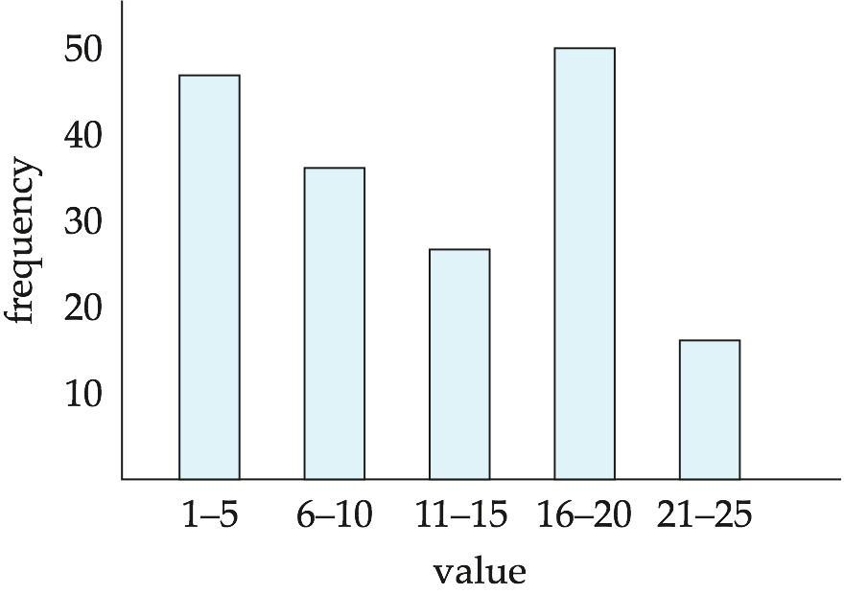
Histograms
Histogram on attribute age of relation person
Equi-width histograms – the size of each range is equal
Equi-depth histograms – each range has the same number of values

Slide 28
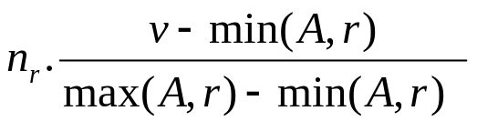
Selection Size Estimation
Equality selection σ_{A=v}(r)
  SC(A, r): number of records that will satisfy the selection
  = 1, if A is a key attribute
  = n_{r} / V(A, r), otherwise
σ_{A≤V}(r) (case of σ_{A ≥ V}(r) is symmetric)
  Let c denote the estimated number of tuples satisfying the condition
  If min(A,r) and max(A,r) are available in catalog
    c = 0 if v < min(A,r)
    c =
  If histograms available, can refine above estimate
  In absence of statistical information c is assumed to be n_{r} / 2

Slide 29
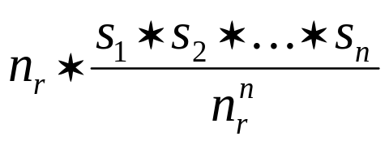
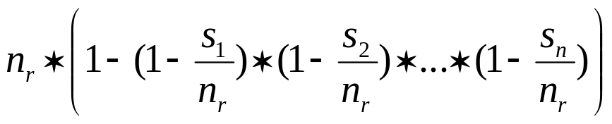
Size Estimation of Complex Selections
Selectivity of a condition θ_{i}: the probability that a tuple in the relation r satisfies θ_{i}
  If s_{i} is the number of satisfying tuples in r, the selectivity of θ_{i} is given by s_{i} / n_{r}
Conjunction: σ_{θ1∧ θ2∧. . . ∧ θn} (r).
Assuming independence, estimate of tuples in the result is:
Disjunction: σ_{θ1∨} _{θ2 ∨. . . ∨} _{θn} (r).
Estimated number of tuples:
Negation: σ_{¬θ}(r).
Estimated number of tuples: n_{r} – size(σ_{θ}(r))

Slide 30
Join Operation: Running Example
Running example: student takes
Catalog information for join examples:
n_{student} = 5,000
f_{student} = 50, which implies that b_{student} = 5000/50 = 100
n_{takes} = 10,000
f_{takes} = 25, which implies that b_{takes} = 10000/25 = 400
V(ID, takes) = 2500, which implies that on average, each student who has taken a course has taken 4 courses.
  Attribute ID in takes is a foreign key referencing student.
V(ID, student) = 5000 (primary key!)

Slide 31
Join Size Estimation
If R ∩ S = ∅, r s = r x s
  r x s contains n_{r} .n_{s} tuples
  Each tuple occupies s_{r} + s_{s} bytes
If R ∩ S is a key for R,
  A tuple of s will join with at most one tuple from r
  → The number of tuples in r s is no greater than the number of tuples in s
  If R ∩ S in S is a foreign key in S referencing R, then the number of tuples in r s is exactly the same as the number of tuples in s.
In the example query student takes,
  ID in takes is a foreign key referencing student
  hence, the result has exactly n_{takes} tuples, which is 10,000

Slide 32


Estimation of the Size of Joins (Cont.)
If R ∩ S = {A} is not a key for R or S,
  If we assume that every tuple t in r produces tuples in r s,
  the number of tuples in r s is estimated to be:
  If the reverse is true, the estimate obtained will be:
  The lower of these two estimates is probably the more accurate one
Can improve on above if histograms are available
  Use formula similar to above, for each cell of histograms on the two relations
Example: students takes without using information about foreign keys
  V(ID, takes) = 2500, and V(ID, student) = 5000
  The two estimates are 5000 * 10000/2500 = 20,000
  and 5000 * 10000/5000 = 10,000

Slide 33
Size Estimation for Other Operations
Projection: estimated size of ∏_{A}(r) = V(A,r)
  Projection eliminates duplicates
Aggregation: estimated size of _{A}g_{F}(r) = V(A,r)
  There is one tuple for each distinct value of A
Set operations
  For operations on different relations:
    estimated size of r ∪ s = size of r + size of s
    estimated size of r ∩ s = minimum size of r and size of s
    estimated size of r – s = r
    All the three estimates may be quite inaccurate, but provide upper bounds on the sizes
  For unions/intersections of selections on the same relation: rewrite and use size estimate for selections
    E.g. σ_{θ1} (r) ∪ σ_{θ2} (r) can be rewritten as σ_{θ1} σ_{θ2} (r)

Slide 34
Estimation of Number of Distinct Values
Selections: σ_{θ} (r)
If θ forces A to take a specified value: V(A,σ_{θ} (r)) = 1
  e.g., A = 3
If θ forces A to take on one of a specified set of values:
V(A,σ_{θ} (r)) = number of specified values
  e.g., (A = 1 V A = 3 V A = 4)
If the selection condition θ is of the form A op r
estimated V(A,σ_{θ} (r)) = V(A,r) * s, where s is the selectivity of the selection
In all the other cases: use approximate estimate of
min(V(A,r), n_{σθ(r)})
  More accurate estimate can be got using probability theory, but this one works fine generally

Slide 35
Size Estimation of Distinct Values (Cont.)
Joins: r s
If all attributes in A are from r
estimated V(A, r s) = min (V(A,r), n _{r s})
If A contains attributes A1 from r and A2 from s,
estimated V(A, r s) = min(V(A1,r)*V(A2 – A1,s), V(A1 – A2,r)*V(A2,s), n_{r s})
  More accurate estimate can be got using probability theory, but this one works fine generally
Projection: Estimation of distinct values are straightforward for projections
  They are the same in ∏_{A (r)} as in r
Aggregation: The same holds for grouping attributes of aggregation
  For aggregated values
    For min(A) and max(A), the number of distinct values can be estimated as min(V(A,r), V(G,r)) where G denotes grouping attributes
    For other aggregates, assume all values are distinct, and use V(G,r)

Slide 36
Choice of Evaluation Plans
Must consider the interaction of evaluation techniques when choosing evaluation plans
  Choosing the cheapest algorithm for each operation independently may not yield best overall algorithm, e.g.,
    Merge-join may be costlier than hash-join, but may provide a sorted output which reduces the cost for an outer level aggregation
    Nested-loop join may provide opportunity for pipelining
Practical query optimizers incorporate elements of the following two broad approaches:
  1. Search all the plans and choose the best plan in a cost-based fashion
  2. Uses heuristics to choose a plan

Slide 37
Cost-Based Optimization
Consider finding the best join-order for r₁ r₂ . . . r_{n}
  There are (2(n – 1))!/(n – 1)! different join orders for above expression (see Practice Exercise 13.10)
  with n = 7, the number is 665280
  with n = 10, the number is greater than 176 billion!
Can reduce search space using dynamic programming
  Using dynamic programming, the least-cost join order for any subset of
  {r₁, r₂, . . . r_{n}} is computed only once and stored for future use
  Time complexity: O(3^{n}), with bushy trees (see Practice Exercise 13.11)
    with n = 10, the number is 59,000 (instead of 176 billion!)
  Space complexity: O(2^{n})

Slide 38
Heuristic Optimization
Cost-based optimization is expensive, even with dynamic programming
Heuristic optimization transforms the query-tree by using a set of rules that typically (but not in all cases) improve execution performance:
  Perform selection early (reduces the number of tuples)
  Perform projection early (reduces the number of attributes)
  Perform most restrictive selection and join operations
  (i.e. with smallest result size) before other similar operations
Some systems use only heuristics, others combine heuristics with partial cost-based optimization

Slide 39

Left Deep Join Trees
In left-deep join trees, the right-hand-side input for each join is a relation, not the result of an intermediate join
  If only left-deep trees are considered, time complexity of finding best join order is O(n 2^{n}) (see Practice Exercise 13.12)
  with n = 10, the number of join orders is 10,000 (c.f., 59,000 or 176 billion)
  Space complexity remains at O(2^{n})
Left-deep join orders are convenient for pipelined evaluation: the right operand is a stored relation and only one input to each join is pipelined
Many optimizers considers only left-deep join orders

Slide 40
End of Chapter 13

