Slide 1
Pairwise Document Similarity in Large Collections with MapReduce
Tamer Elsayed, Jimmy Lin, and Douglas W. Oard
Association for Computational Linguistics, 2008
May 15, 2014
Kyung-Bin Lim

Slide 2
Outline
Introduction
Methodology
Discussion
Conclusion

Slide 3

Pairwise Similarity of Documents
PubMed – “More like this”
Similar blog posts
Google – Similar pages

Slide 4
Abstract Problem
Applications:
Clustering
“more-like-that” queries
0.20
0.30
0.54
0.21
0.00
0.34
0.34
0.13
0.74
~~~~~~~~~~~~~~~~~~~~~~~~~~~~~~~~~~~~~~~~
0.20
0.30
0.54
0.21
0.00
0.34
0.34
0.13
0.74
0.20
0.30
0.54
0.21
0.00
0.34
0.34
0.13
0.74
~~~~~~~~~~~~~~~~~~~~~~~~~~~~~~~~~~~~~~~~
~~~~~~~~~~~~~~~~~~~~~~~~~~~~~~~~~~~~~~~~
0.20
0.30
0.54
0.21
0.00
0.34
0.34
0.13
0.74
0.20
0.30
0.54
0.21
0.00
0.34
0.34
0.13
0.74
~~~~~~~~~~~~~~~~~~~~~~~~~~~~~~~~~~~~~~~~
~~~~~~~~~~~~~~~~~~~~~~~~~~~~~~~~~~~~~~~~

Slide 5
Outline
Introduction
Methodology
Results
Conclusion

Slide 6
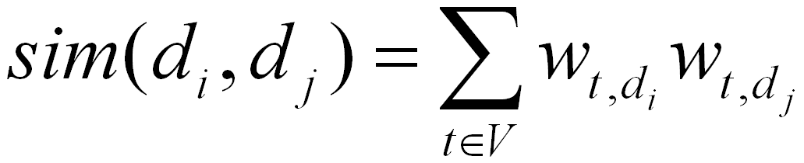
Trivial Solution
Load each vector O(N) times
O(N²) dot products
Goal
scalable and efficient solution for large collections

Slide 7
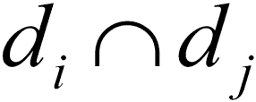
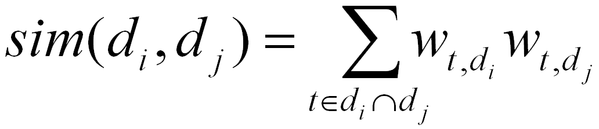
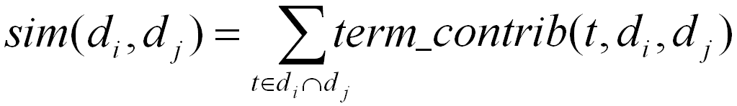
Better Solution
Load weights for each term once
Each term contributes O(df_{t}²) partial scores
Each term contributes only if appears in

Slide 8
Better Solution
A term contributes to each pair that contains it
For example, if a term t₁ appears in documents x, y, z :
List of documents that contain a particular term: Inverted Index
t₁ appears in x, y, z
t1 contributes for pairs:
(x, y) (x, z) (y, z)

Slide 9
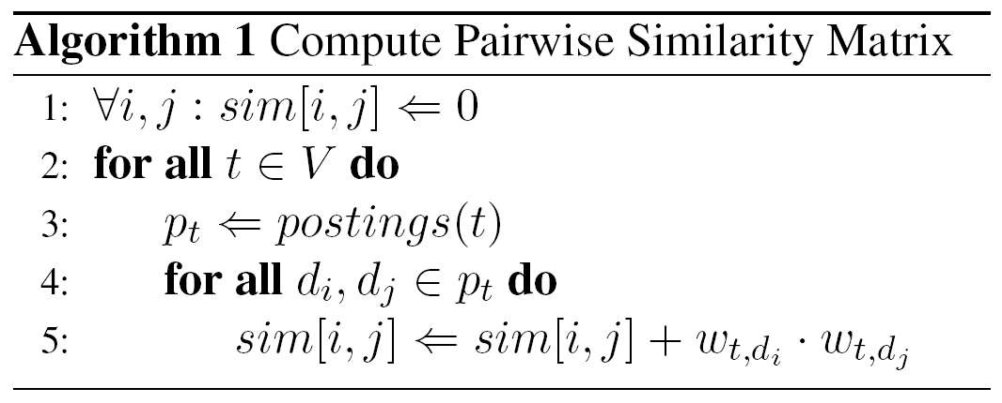
Algorithm

Slide 10
MapReduce Programming
Framework that supports distributed computing on clusters of computers
Introduced by Google in 2004
Map step
Reduce step
Combine step (Optional)
Applications

Slide 11

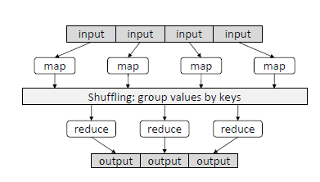
MapReduce Model

Slide 12
Computation Decomposition
Each term contributes only if appears in
reduce
map
Load weights for each term once
Each term contributes o(df_{t}²) partial scores

Slide 13
MapReduce Jobs
(1) Inverted Index Computation
(2) Pairwise Similarity

Slide 14
Job1: Inverted Index
(A,[(d₁,2), (d₃,1)])
reduce
(A,[(d₁,2), (d₃,1)])
d₁
(A,(d₁,2))
(B,(d₁,1))
(C,(d₁,1))
A A B C
map
(B,[(d₁,1), (d₂,1), (d₃,2)])
(B,[(d₁,1), (d₂,1), (d₃,2)])
reduce
d₂
map
(B,(d₂,1))
(D,(d₂,2))
shuffle
B D D
reduce
(C,[(d₁,1)])
(C,[(d₁,1)])
d₃
(A,(d₃,1))
(B,(d₃,2))
(E,(d₃,1))
(D,[(d₂,2)])
reduce
(D,[(d₂,2)])
A B B E
map
(E,[(d₃,1)])
reduce
(E,[(d₃,1)])

Slide 15
Job2: Pairwise Similarity
(A,[(d₁,2), (d₃,1)])
map
((d₁,d₃),2)
((d₁,d₂),[1])
reduce
((d₁,d₂),1)
shuffle
((d₁,d₃),[2,2])
reduce
(B,[(d₁,1), (d₂,1), (d₃,2)])
((d₁,d₂),1)
((d₁,d₃),2)
((d₂,d₃),2)
((d₁,d₃),4)
map
((d₂,d₃),[2])
reduce
((d₂,d₃),2)
(C,[(d₁,1)])
map
(D,[(d₂,2)])
map
(E,[(d₃,1)])
map

Slide 16
Implementation Issues
df-cut
Drop common terms
Intermediate tuples dominated by very high df terms
Implemented 99% cut
efficiency Vs. effectiveness

Slide 17
Outline
Introduction
Methodology
Results
Conclusion

Slide 18
Experimental Setup
Hadoop 0.16.0
Cluster of 19 machines
Each with two processors (single core)
Aquaint-2 collection
2.5GB of text
906k documents
Okapi BM25
Subsets of collection

Slide 19
Running Time of Pairwise Similarity Comparisons

Slide 20
Number of Intermediate Pairs

Slide 21
Outline
Introduction
Methodology
Results
Conclusion

Slide 22
Conclusion
Simple and efficient MapReduce solution
2H for ~million-doc collection
Effective linear-time-scaling approximation
99.9% df-cut achieves 98% relative accuracy
df-cut controls efficiency vs. effectiveness tradeoff

