Slide 1
Who Uses Web Search for What? And How?
Ingmar Weber, Alejandro Jaimes
Yahoo! Research Barcelona
WSDM`11
June 29, 2011
In-seok An
SNU Internet Database Lab.

Slide 2
Outline
Introduction
User Modeling
Data (Pre-)Processing
Web Search User Segmentation
Feature Interdependence
Regional Differences
Conclusion

Slide 3

Introduction
Web search
A multi-billion dollar industry
Challenges
Understanding characteristics of web searchers
Who they are
What they search for
How they search
Analysis of user logs
An important research area
Basis for many business decisions
The results can be used for
SEO strategies
Improving user experience
Advertising
Several other purposes
Fig : http://www.flickr.com/photos/danardvincente/2512148775/

Slide 4
Introduction
Joining behavioral observations and demographic features of users in aggregate
Who is searching
Analyzing users’ demographics
What they are searching for
Analyzing query topics
How they are searching
Analyzing session information
There are different types of searchers
Notes:
이전 연구들과 다르게 이 3가지 질문에 답하기 위해서 demographic 과 behavioral observations를 join 했다.
이렇게 나온 조사 결과를 가지고 디자인 결정, 검색 질 향상 등에 기여 할 수 있다..

Slide 5
Outline
Introduction
User Modeling
Data (Pre-)Processing
Web Search User Segmentation
Feature Interdependence
Regional Differences
Conclusion

Slide 6
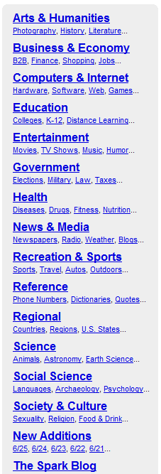
User Modeling
Three orthogonal dimensions
Query topics (“ what? “)
Y! Directory classification
As a definition of a “topic”
User demographics(“ who? “)
user-provided information
Age, gender and ZIP code
ZIP code-derived information
E.g.) Expected income, expected educational level…
If available, actual value
Session characteristics(“ how? “)
User’s session information
Basic measures
Session length, number of queries per session or the fraction of sessions with suggested/guided queries
Fig from : http://dir.yahoo.com/

Slide 7
Outline
Introduction
User Modeling
Data (Pre-)Processing
“Who?” Data
“What?” Data
“How?” Data
Web Search User Segmentation
Feature Interdependence
Regional Differences
Conclusion

Slide 8
Data (Pre-)Processing
Data source
Web search query log of the Yahoo!
between 2008 and 2009
Only U.S. Yahoo! Users
Who had provided demographic information
Log for the U.S. Yahoo! Site
Only included “active” users
Who had issued at least 100 queries
To filter out additional bots
Removed users with more than 100,000 queries
Users who had clicked on organic results for fewer than 1/100 of their queries or more than 100 times per query
Queries for 2.3 million registers users
Notes:
자잘한거..
쿼리는 소문자로, 공백 문자는 앞 뒤 치고, 연속적인 공백 없어짐
스탑워드 제거 같은 다른 작업은 없었다!!
그리고 ZIP 코드가 없는 애들 제거, 인구가 0 명인 지역에 산다고 한 애들 제거..

Slide 9
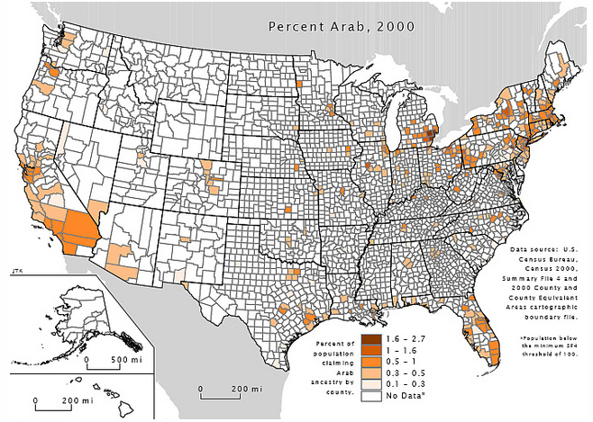
Data (Pre-) Processing “who?” Data
ZIP code
To obtain estimates of demographic information
Per-capita income, level of education, etc.
ZIP-derived demographic information
Expected ( fractional ) values
E.g.) 61.3% white, 30.3% asian, 1.6% black
US census information

Slide 10
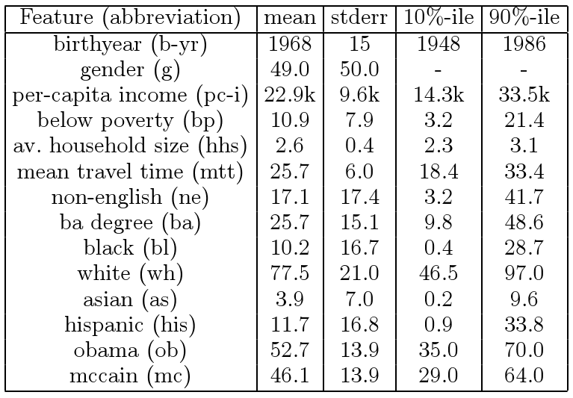
Data (Pre-) Processing “who?” Data
Demographic values for our data set

Slide 11
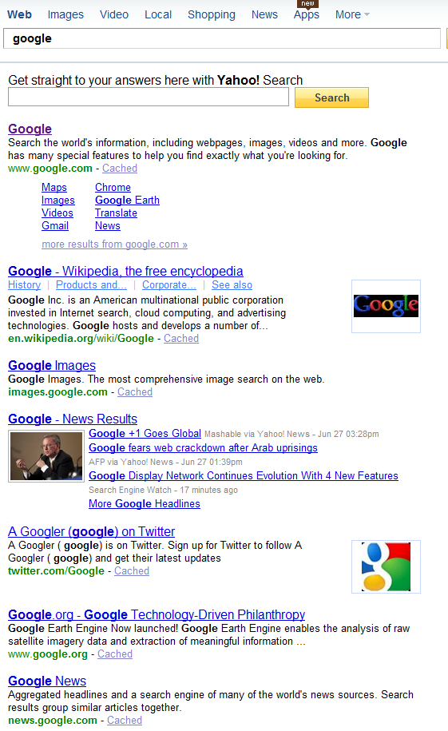
Data (Pre-) Processing “what?” Data
Topic distribution of the queries
What are people searching for?
3 steps
Top 10 Yahoo! Web search results
Unique classification for each result
Include only 71 classes
Found in the first two levels of the Y! Directory
Majority voting scheme
Vote with weight 11-k
In case of ties, common parent class is used

Slide 12
Data (Pre-) Processing “what?” Data
Advantages of this approach
Easier than classifying queries
Pages have more content and structure
Classification is done on the results
Results are optimized by the search engine for a particular query
Takes advantage of the structure of the web
Takes advantage of any other information
Used by search engine ranking algorithm
We classified only queries issued at least 30 times
1.0 million distinct queries

Slide 13
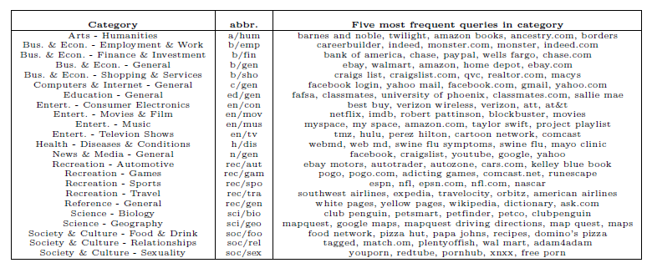
Data (Pre-) Processing “what?” Data
Details for search query topics

Slide 14
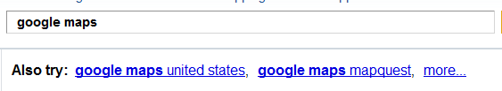
Data (Pre-) Processing “How?” Data
Session
Simple timeout interval of 30 minute
Session length
The time between
The first query within the interval
The last query within the interval
The result click corresponding to a query
Other features
The number of queries issued
Clicked/selected query suggestion
Guided queries

Slide 15
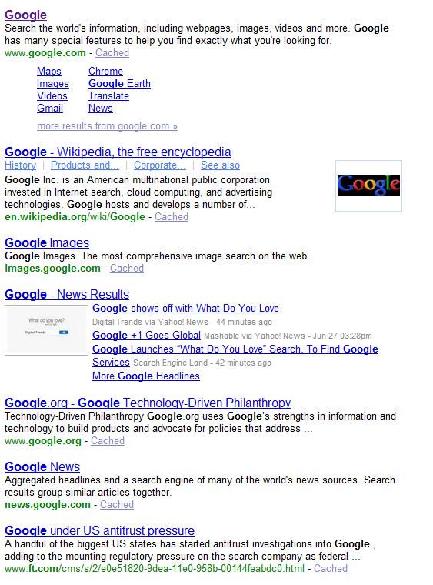
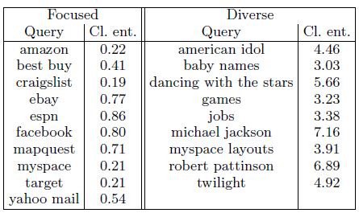
Data (Pre-) Processing “How?” Data
Click entropy
Focused query
Navigational
Diverse query
Informational
To avoid this inherent bias
Queries which were issued at least 20 times
Only used click on “organic”
Entropy ↓
Entropy
↑
↑
↑
↑

Slide 16
Outline
Introduction
User Modeling
Data (Pre-)Processing
Web Search User Segmentation
Informational users
Navigational users
Transactional users
Feature Interdependence
Regional Differences
Conclusion

Slide 17
Web Search User Segmentation
User segmentation of active web search users
K-means clustering algorithm
Clustered users using their representation in the “what?” dimension
Investigated what kind of segmentation in the other two dimensions
Different topical interests also differ in terms of the “who?” and the “how?”

Slide 18
Web Search User Segmentation The Informational Users
The search engine’s role
Serve as an improved and automatic indexing scheme
Pointing the user towards relevant articles
Informational user
Use a web search engine to find information on a wide range of topics
Web search engine as a web research engines
How
More likely to issue non-navigational queries
Less likely to have single-click sessions
More likely to make use of the suggested query alternatives
What
Users are diverse
Do “research” on a wide range of topics
Little interest in adult content
Who
More likely to be well-educated
Have an above-average income

Slide 19
Web Search User Segmentation The Navigational Users
Most frequent queries are navigational
Type the query in the browser’s address bar to re-find a URL from his browsing history
Navigational user
Use a web search engine to navigate to URLs that he already knows exist
Web search engines as a replacement for web page bookmarking
How
More likely to issue navigational queries
More likely to click only on a single result within a session
Less likely to make use of the suggested query alternatives
What
News & Media
Facebook, craiglist or Youtube
Computers & Internet
Yahoo Mail, Gmail
Entertainment / Music
Myspace, project playlist
Recreation / Sports
How
Close to background averages

Slide 20
Web Search User Segmentation The Transactional Users
Web pages are often interactive and allow transactions
Purchase of items
Download of video clips
Transactional user
Use a web search engine to take him to some URL where he can perform the desired transaction
What
Predominant topics
Shopping, adult content and gaming sites
How
High click entropy
Interaction with the search engine tends to be short compared to informational queries
Who
Society & Culture / Sexuality
Dominated by men
Business & Economy / Shopping
Dominated by women
Recreation / Games
Below average income and educational level

Slide 21
Outline
Introduction
User Modeling
Data (Pre-)Processing
Web Search User Segmentation
Feature Interdependence
Interplay between “What?” and “Who?”
Interplay between “What?” and “How?”
Interplay between “Who?” and “How?”
Regional Differences
Conclusion

Slide 22
Feature Interdependence Interplay between “What?” and “Who?”
Popular among male
Topics of Sexuality
Male : 10.1% / Female : 2.8%
Sports
Male : 4.9% / Female : 2.4%
Popular among female
Reproductive Health
Male : 0.1% / Female : 0.3%
Arts/Crafts
Male : 0.2% / Female : 0.6%
Families
Male : 0.4% / Female : 0.9%
Popular among older users
Health / Diseases & Conditions
Gambling
Travel
Popular among late 20s
Health / Fitness
Reproductive Health
Popular among young people
Games
Education / General

Slide 23
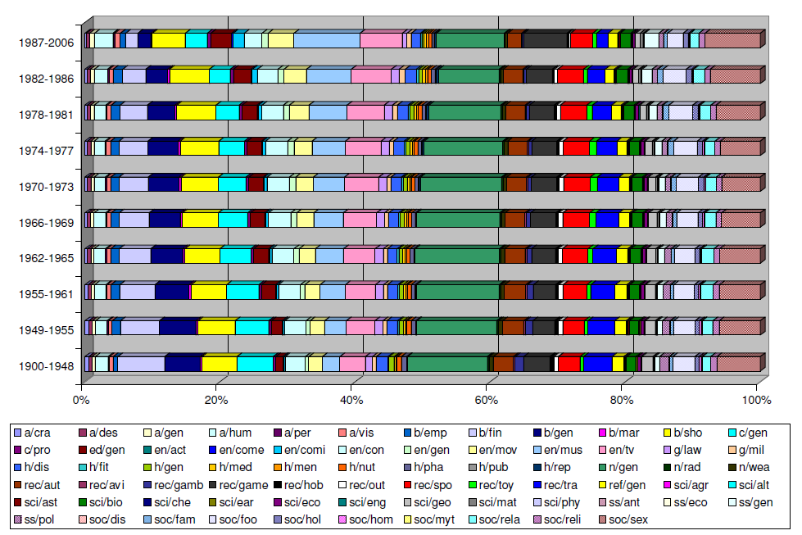
Feature Interdependence Interplay between “What?” and “Who?”

Slide 24
Feature Interdependence Interplay between “What?” and “Who?”
ZIP-derived features
Demographic features
Lowest income
Entertainment / Music
Entertainment / Comics & Animation
Government / Military
Asian decent
Computers & Internet / Programming & Development
White neighborhood
News & Media / Weather
Recreation / Outdoors
Society & Culture / Home & Garden
Science / Agriculture
Notes:
논문에 요약있다.

Slide 25
Feature Interdependence Interplay between “What?” and “How?”
Many single click session
News & Media / General
Society & Culture / Relationships
Computers & Internet / General
Few single click session
Health / Diseases & Conditions
Health / Medicine
Social Science / General
Arts / Humanities
Guided session
Society & Culture / Sexuality
Society & Culture / Relationships
Health / Diseases & Condition
Health / Nutrition
Science / Biology
Social Science / General

Slide 26
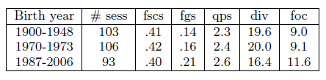
Feature Interdependence Interplay between “Who?” and “How?”
People in educated neighborhoods
Smaller fraction of guided sessions
Their average sessions are shorter
More likely to issue infrequent tail queries
Birth year
Older users have a larger fraction of queries containing the token www
Young user have a larger fraction of “guided sessions”

Slide 27
Outline
Introduction
User Modeling
Data (Pre-)Processing
Web Search User Segmentation
Feature Interdependence
Regional Differences
Conclusion

Slide 28
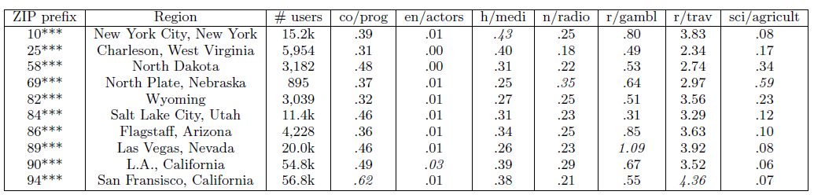
Regional Differences
Regional differences in query topic distributions
Differences seem to correlate with differences in the dominant industry in each region

Slide 29
Conclusion
An analysis of a large-scale search query log
Jointly studied on-line behavior in terms of “who”, “what”, “how”
Information provided by users
Age, sex, zip code
Data obtained from the US census
Analyzed basic session statistics
Click entropy
Informational, navigational, transactional
The findings are “stereotypical”
Men more interested in adult content than women
People with higher educational levels issuing fewer navigational queries

