Slide 1
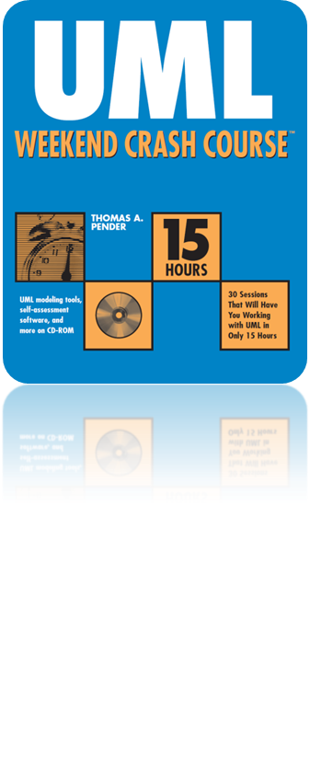
Session 1
What Is the UML?
Written by Thomas A. Pender
Published by Wiley Publishing, Inc.
October 5, 2011
Presented by Kang-Pyo Lee

Slide 2
Contents
Establishing Standards
Some History behind the UML
UML Extension Mechanisms
Ten Diagrams
The Continuing Refinement & Expansion of the UML

Slide 3
Establishing Standards (1/2)
Background
  The whole SW development industry has been explosive
  The SW industry is relatively young and hasn’t yet established itself as a formal discipline
  Most study is focused on programming rather than on engineering
  ⇒ Leading to many failed systems and disastrous problems
Our industry needs a framework for measurable and proven engineering techniques
  This need for a more mature industry is behind the drive for the UML and other related standards

Slide 4
Establishing Standards (2/2)
The UML
  A standard for the creation of models that represent object-oriented SW and business systems
  Combines the best diagramming practices applied by SW developments over the past 40 years
  Standardizes the notations but does not dictate how to apply the notations
  Provides the greatest freedom for developers’ own styles and techniques, while ensuring consistency in their work products

Slide 5
Contents
Establishing Standards
Some History behind the UML
UML Extension Mechanisms
Ten Diagrams
The Continuing Refinement & Expansion of the UML

Slide 6
Some History behind the UML (1/6)
History
  In 1994, Grady Booch and James Rumbaugh, the two market share leaders in OO SW methods, formally joined forces to develop a notation standard
  A year later, they published the Unified Method version 0.8
  Ivar Jacobson, yet another leader in OO development, joined the team
    The team of Rumbaugh, Booch, and Jacobson were soon after dubbed the “three amigos” within OO circles
  At the same time, the Object Management Group (OMG) was establishing the Object-Oriented Analysis and Design (OOA&D) Task Force
  In 1996, the task force issued a request for proposal (RFP) for a standardized metamodel to support the exchange of models among modeling tools
  By 1996, a number of the leading application and modeling tool manufacturers, like IBM and i-Logix, had partnered with the three amigos to sponsor the UML proposal to the task force

Slide 7
Some History behind the UML (2/6)
History (from Wikipedia)
  The “Three Amigos” in Rational Software Corporation
    Rumbaugh: object-modeling technique (OMT)
    Grady Booch: Booch method
    Ivar Jacobson: object-oriented software engineering (OOSE) method
  In 1996, Rational tasked the Three Amigos with the development of a non-proprietary Unified Modeling Language
  In 1996, under the technical leadership of the Three Amigos, an international consortium called the UML Partners was organized to complete the UML specification, and propose it as a response to the OMG RFP
  In January 1997, The UML Partners' UML 1.0 specification draft was proposed to the OMG
  The UML Partners formed a Semantics Task Force to finalize the semantics of the specification and integrate it with other standardization efforts
  In November 1997, the result of this work, UML 1.1, was adopted by the OMG

Slide 8
Some History behind the UML (3/6)
- The UML Metamodel
Metamodel
  A cohesive set of definitions for concepts and their relationships
  Describes in fairly precise syntax the underlying meaning of each element used in visual modeling and the relationships among the elements
    E.g., you find a detailed definition of what a class is; its component parts, attributes, and operations; and the relationships among them
  Defines four layers to the metamodel architecture:
    User object layer
    Model layer
    Metamodel (2M) layer
    Metametamodel (3M) layer

Slide 9
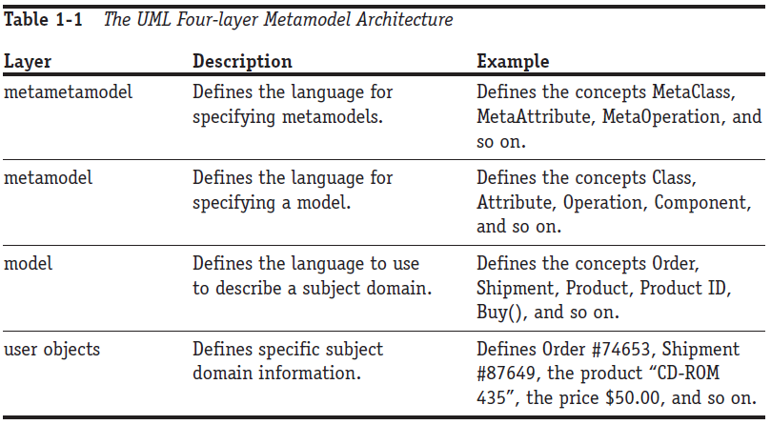
Some History behind the UML (4/6)
- The UML Metamodel

Slide 10
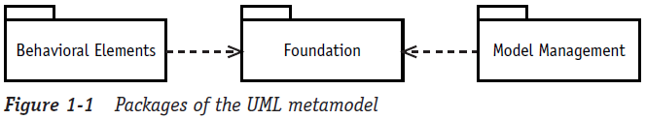
Some History behind the UML (5/6)
- The Organization of the Metamodel
Packages
  A package is basically the UML version of a directory
  Three packages at the first level:
    Foundation, Model Management, and Behavioral Elements
    Behavioral Elements and Model Management depend on the Foundation package
    The Behavioral Elements package contains everything you need to model behavior like Use Cases, Collaborations, Statecharts, and more
    Model Management explains how to model packages, subsystems, and similar organizational structures

Slide 11
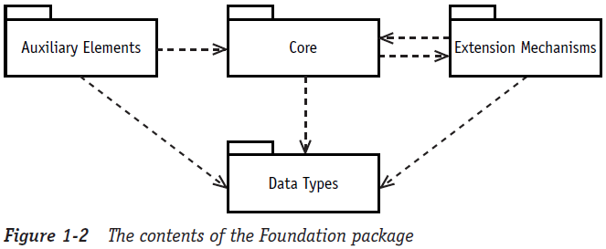
Some History behind the UML (6/6)
- The Organization of the Metamodel
Packages (cont’d)
  The Foundation package contains four more packages:
    CORE, Auxiliary Elements, Data Types, and Extension Mechanisms packages
    The Core package defines all the fundamental concepts used in the UML diagrams like Class, Interface, Association, and Data Type
    The other three packages support the Core package with items like dependencies; primitive data types like integer, string, and time; and some built-in extension mechanisms

Slide 12
Contents
Establishing Standards
Some History behind the UML
UML Extension Mechanisms
Ten Diagrams
The Continuing Refinement & Expansion of the UML

Slide 13
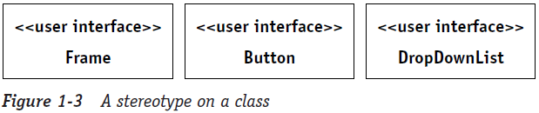
UML Extension Mechanisms (1/2)
The UML also provides some built-in extensions to the diagram notations
Stereotype
  Appears inside of << >> (guillemets)
  Characterizes a type of element like a class or relationship without specifying its implementation
    E.g., you might stereotype a number of classes as <<user interface>> to convey that they are all used in the construction of a user interface
    The individual classes could be as diverse as Frame, Button, and DropDownList

Slide 14
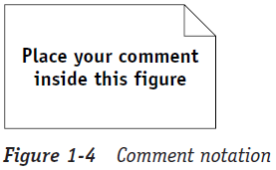
UML Extension Mechanisms (2/2)
Comments
  No notation can cover every possible type of information
  The symbol can be placed anywhere on any diagram
Constraints
  Limit the use of a model element
  You can always spot constraints by the use of { } braces around the text that describes the limitation you want to impose
    E.g., {age > 20 and < 121}

Slide 15
Contents
Establishing Standards
Some History behind the UML
UML Extension Mechanisms
Ten Diagrams
The Continuing Refinement & Expansion of the UML

Slide 16
Ten Diagrams
Ten diagrams are defined in the UML metamodel
Each is fully described using Class diagrams and textual narrative
A key to the successful application of the UML is in understanding that you can use the notation standard with any number of different development methods, process controls, and quality controls

Slide 17
Contents
Establishing Standards
Some History behind the UML
UML Extension Mechanisms
Ten Diagrams
The Continuing Refinement & Expansion of the UML

Slide 18
The Continuing Refinement & Expansion of the UML
The UML grew out of a long list of competing notations and methods and continues to be extended and refined
The UML Revision Task Force (RTF) of the Object Management Group (OMG) is responsible for coordinating and applying suggested changes to the standard
The UML is currently in version 1.4. (as of 2002)
Recent news (from Wikipedia)
  UML 2.0 major revision was adopted by the OMG in 2005
  UML 2.3 was formally released in May 2010
  UML 2.4 is in the beta stage as of March 2011

Slide 19
The End

