Slide 1
Ch. 4: XPath Functions
Seoul National University, Internet Database Laboratory
July, 2011
Hye Chan Bae

Slide 2
Contents
Comparing Two Values
Testing the Position
Multiplying, Dividing, Adding, Subtracting
Counting Nodes
Formatting Numbers
Rounding Numbers
Extracting Substrings
Changing the Case of a String
Totaling Values
More XPath Functions

Slide 3
Comparing Two Values [1/2]
[first-node-set comparer second-node-set(value)]
First-node-set : path to the first node set that you want to compare
Comparer
= (equal to)
!= (not equal to)
&gt; (greater than)
&gt;= (greater than or equal to)
&lt; (less than)
&llt;= (less than or equal to)
Second-node-set(value) : a value or a path to the node set that you want to compare with the first-node-set

Slide 4
Comparing Two Values [2/2]
Tips
Can be used in xsl:template and xsl:apply-templates processing, as well as condition testing using xsl:if and xsl:when
String and text values(second value) should be enclosed in single quotes
and operator and or operator are only valid boolean operators
There is a boolean expression not, but it is a function
< xslt >
...
<h2>Overview</h2>
<table border="1"><tr><th>Wonder
Name</th><th>Location</th>
<th>Height</th></tr>
<xsl:apply-templates
select="ancient_wonders/
wonder[height &gt; 100]">
<xsl:sort select="height"
order="descending"
data-type="number" />
</xsl:apply-templates>
</table>
...

Slide 5
Testing the Position
position() = n
n : the number that identifies the position of the current node set
last() : returns the last node
< xslt >
...
<p>These ancient wonders are
<xsl:for-each select=
"ancient_wonders/wonder/name
[@language='English']">
<xsl:value-of select="."/>
<xsl:choose>
<xsl:when test="position()=last()">.</xsl:when>
<xsl:when test="position()=last()-1">, and </xsl:when>
<xsl:otherwise>, </xsl:otherwise>
</xsl:choose>
</xsl:for-each>
</p>
...

Slide 6
Multiplying, Dividing, Adding, Subtracting [1/2]
first operand operator second operand
First operand : numerical constant / a node set
Operator
* : multiplying
div : dividing (/ is already fraught with meaning)
+ : adding
- : subtracting
Second operand : numerical constant / a node set

Slide 7
Multiplying, Dividing, Adding, Subtracting [2/2]
Tips
You can use parentheses
You can use a number formatting function to control the output
Operator mod
< xslt >
...
<td valign="top">
<xsl:choose>
<xsl:when test="history/year_destroyed != 0">
<xsl:choose>
<xsl:when test="history/year_destroyed/@era = 'BC'">
<xsl:value-of select="
history/year_built - history/year_destroyed"/>
</xsl:when>
<xsl:otherwise>
<xsl:value-of select="
history/year_built + history/year_destroyed - 1"/>
</xsl:otherwise>
</xsl:choose>
</xsl:when>
<xsl:otherwise>
<xsl:value-of select="history/year_built + 2008 - 1"/>
</xsl:otherwise>
</xsl:choose>
</td>
...

Slide 8
Counting Nodes
count(path)
path : the path to the node to be counted
Tip
The location path referenced can include predicates
< xslt >
...
Of these wonders,
<xsl:value-of select="
count(ancient_wonders/wonder/history/how_destroyed[. =
'earthquake'])" />
were destroyed by earthquake,
<xsl:value-of select="count(//how_destroyed[. = 'fire'])"/>
were destroyed by fire, and
<xsl:value-of select="count(//wonder) - count(//how_destroyed)" />
is still standing.
...

Slide 9
Formatting Numbers [1/2]
format-number(expression, ‘format’)
expression : contains the number to be formatted
format
0 : a digit that should always appear
# : a digit that should only appear when not zero
.(a period) : separate the integer and fraction
,(a comma) : separate groups of digits in integer
Tip
Negative numbers are preceded by a minus sign (-) by default
< xslt >
...
"(<em><xsl:value-of select=
"format-number(height * 0.3048, '##0.0')"/> m
</em>)"/> m)
...

Slide 10
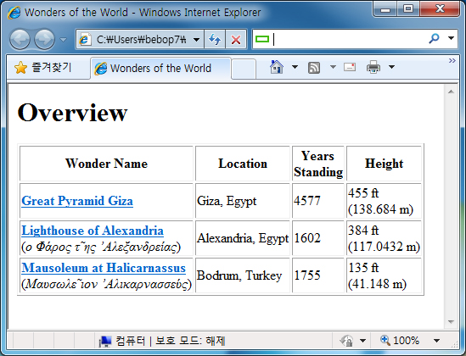
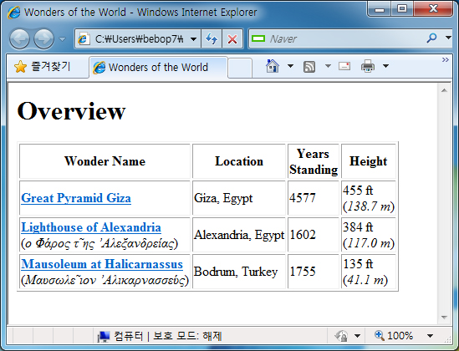
Formatting Numbers [2/2]

Slide 11
Rounding Numbers
ceiling(expression) / floor(expression) / round(expression)
expression : contains the number to be formatted
Tip
When using the format-number(), if there are any decimal places lost, XSLT will automatically round the result
< xslt >
...
<img>
<xsl:attribute name="src">
<xsl:value-of select="./@file"/>
</xsl:attribute>
<xsl:attribute name="width">
<xsl:value-of select="ceiling(./@w div 2)"/>
</xsl:attribute>
<xsl:attribute name="height">
<xsl:value-of select="ceiling(./@h div 2)"/>
</xsl:attribute>
</img>
...

Slide 12
Extracting Substrings
substring-after(expression, ‘c’) substring-before(expression, ‘c’)
expression : contains the number to be formatted
c : the character after or before the substring to be extracted
Tip
substring(s, f, n)
s : expression
f : the position of the first character that you want to extract
n : the total number of characters
< xslt >
...
<h2>Overview</h2>
<table border="1"><tr>
<th>Wonder Name</th>
<th>City</th>
<th>Country</th>
<th>Years<br />Standing</th>
<th>Height</th></tr>
...
<td valign="top">
<xsl:value-of select="
substring-before(location, ',')"/>
</td>
<td valign="top">
<xsl:value-of select="
substring-after(location, ',')"/>
</td>
...

Slide 13
Changing the Case of a String
Example from lower case to upper case
translate(expression, ‘abcdefghijklmnopqrstuvwxyz’, ‘ABCDEFGHIJKLMNOPQRSTUVWXYZ’)
expression : contains the number to be formatted
‘abcdefghijklmnopqrstuvwxyz’ : lower case alphabets
‘ABCDEFGHIJKLMNOPQRSTUVWXYZ’ : upper case alphabets
< xslt >
...
<p align="center">
<strong><xsl:value-of select="
translate(../name[@language='English‘],'abcdefghijklmnopqrstuvwxyz'
,'ABCDEFGHIJKLMNOPQRSTUVWXYZ')"/>
</strong><br />
<xsl:apply-templates select="../main_image"/>
</p>
...

Slide 14
Totaling Values
sum(path)
path : the path to the node set whose nodes should be totaled
< xslt >
...
<tr>
<td valign="top" align="right"
colspan="4">Average Height: </td>
<td valign="top">
<xsl:value-of select="
format-number(
sum(/ancient_wonders/wonder/height)
div
count(/ancient_wonders/wonder/height[.!=0]),
'##0.0')" />
ft</td>
</tr>
...

Slide 15
More XPath Functions
Node Functions
name(node-set) : returns the first node in the specified node-set
id(id-str) : returns all the elements that an ID equal to id-str
String Functions
contains(str1, str2) : returns true if str1 contains str2
string-length(str1) : returns the number of characters in str1
normalize-space(str1) : returns str1 with
all leading and trailing white space removed
Sequences of white space replaced with a single space
Boolean Functions
not(expression) : returns true if expression evaluates to false
| (a vertical bar) : used to combine two node sets into one

