Slide 1
Practical RDF Ch.7
Editing, Parsing, and Browsing RDF/XML
Kim, Ki-Sung
SNU OOPSLA Lab.
Shelley Powers, O’Reilly
August 24, 2004

Slide 2
Contents
Browser
  BrownSauce
Parsers
  ARP2
  ICS_FORTH Validating RDF Parser
Editors
  IsaViz
  RDF Editor in Java

Slide 3

Browser
BrownSauce
Java based RDF/XML browser tool
Parse RDF/XML and transform into a readable format
Server : parse data and transform it into HTML format
Browse a RDF/XML using any Internet browser application
Predicate : hypertext linked
Literal : non-hypertext linked
Doesn’t provide parsed access to data
Provide a human-readable format for examining RDF/XML documents
Web
BrownSauce
Server
RDF/XML URL
Modified result
RDF/XML Document

Slide 4
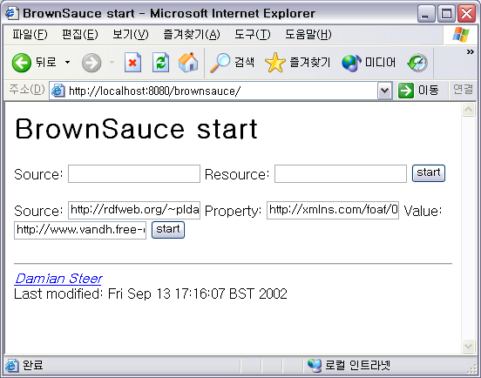
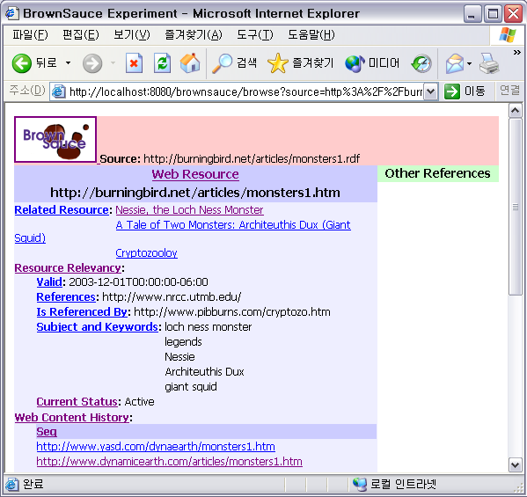
BrownSauce
<pstcn:Resource rdf:about="monsters1.htm">
…
<pstcn:relevancy rdf:parseType="Resource">
<pstcn:currentStatus>Active</pstcn:currentStatus>
<dcterms:valid>2003-12-01…06:00</dcterms:valid>
<dc:subject>legends</dc:subject>
<dc:subject>giant squid</dc:subject>
<dc:subject>loch ness monster</dc:subject>
<dc:subject>Architeuthis Dux</dc:subject>
<dc:subject>Nessie</dc:subject>
<dcterms:isReferencedBy>http://www.pi…</dcterms:isReferencedBy> <dcterms:references>http://www.nrcc.utmb.edu/</dcterms:references>
</pstcn:relevancy>
…
<pstcn:history>
<rdf:Seq>
<rdf:_1 rdf:resource="http://www.yasd.com/dynaearth..." />
<rdf:_2 rdf:resource="http://www.dynamicearth.com/articles/..." />
<rdf:_3 rdf:resource="http://burningbird.net/articles..." />
</rdf:Seq>
</pstcn:history>
…
<pstcn:related rdf:resource="monsters2.htm" />
<pstcn:related rdf:resource="monsters3.htm" />
<pstcn:related rdf:resource="monsters4.htm" />
…
<rdf:Property rdf:about="http://burningbird.net/postcon/elements/1.0/relevancy">
<rdfs:isDefinedBy rdf:resource="http://burningbird.net/postcon/elements/1.0/"/>
<rdfs:label xml:lang="en">Resource Relevancy</rdfs:label>
<rdfs:comment xml:lang="en"> Biographical information for resource </rdfs:comment>
<rdfs:range rdf:resource="http://burningbird.net/postcon/elements/1.0/Resource"/>
<rdfs:domain rdf:resource="http://burningbird.net/postcon/elements/1.0/Resource"/>
</rdf:Property>
Source: http://burningbird.net/articles/monsters1.rdf
Resource : http://burningbird.net/articles/monsters1.htm

Slide 5
Parsers
ARP2
Part of Jena Toolkit
Normally used within another application
NTriple class
  Parse RDF/XML and output N-Triples format
  Produce either a listing of N-Triples or errors if there’s something wrong
  Can be used testing the viability of RDF/XML
<http://burningbird.net/articles/monsters1.htm> <http://www.w3.org/1999/02/22-rdf-syntax-ns#type> <http://burningbird.net/postcon/elements/1.0/Resource> .
_:jA1 <http://purl.org/dc/elements/1.1/title> "Tale of Two Monsters: Legends" .
_:jA1 <http://purl.org/dc/terms/abstract> "\n When I think of \"monsters\" I think of the creatures of \n … " .
_:jA1 <http://purl.org/dc/elements/1.1/description> "\n Part 1 of four-part series on cryptozoology, legends, \n …" .
_:jA1 <http://purl.org/dc/elements/1.1/created> "1999-08-01T00:00:00-06:00" .
_:jA1 <http://purl.org/dc/elements/1.1/creator> "Shelley Powers" .
_:jA1 <http://purl.org/dc/elements/1.1/publisher> "Burningbird Network" .
<http://burningbird.net/articles/monsters1.htm> <http://burningbird.net/postcon/elements/1.0/bio> _:jA1 .
_:jA2 <http://burningbird.net/postcon/elements/1.0/currentStatus> "Active" .
_:jA2 <http://purl.org/dc/terms/valid> "2003-12-01T00:00:00-06:00" .
_:jA2 <http://purl.org/dc/elements/1.1/subject> "legends" .
_:jA2 <http://purl.org/dc/elements/1.1/subject> "giant squid" .
_:jA2 <http://purl.org/dc/elements/1.1/subject> "loch ness monster" .
_:jA2 <http://purl.org/dc/elements/1.1/subject> "Architeuthis Dux" .
_:jA2 <http://purl.org/dc/elements/1.1/subject> "Nessie" .
…
N-Triple Result of monster1.rdf

Slide 6
Parsers
ICS-FORTH Validating RDF Parser
ICS-FORTH
  Institute of Computer Science of the Foundation for Research and Technology – Hellas
  Research area : bio-informatics, web systems and technologies, embedded systems, GRID and large-scale computing, life-like systems, semantic web
  VRP is a part of the RDFSuite
Can be used within another Java application
Present a standalone validating application (GUI)
  Several input and output options
  Output the validating result to a file
Validation
  Syntactic validation
  Semantic validation

Slide 7
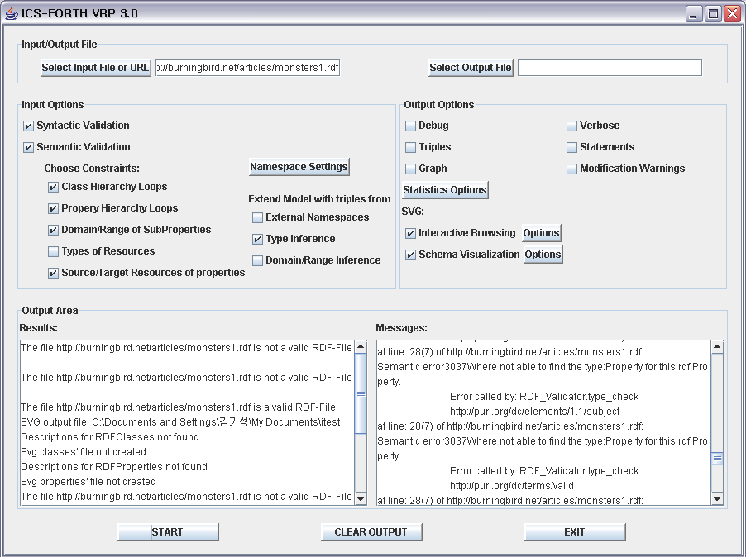
Parsers
ICS-FORTH Validating RDF Parser

Slide 8
Editors
IsaViz
Visual RDF/XML editing tool
Examine and edit the model
Export multiple views of the model
  RDF/XML file
  N-Triples file
  PNG graphic
  SVG graphic

Slide 9
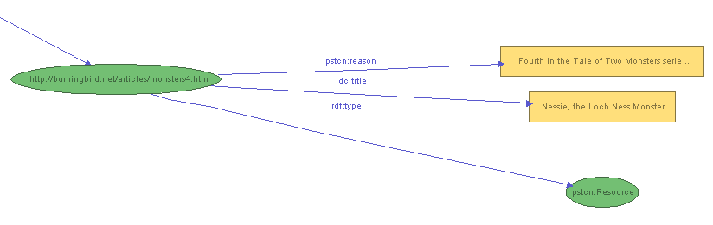
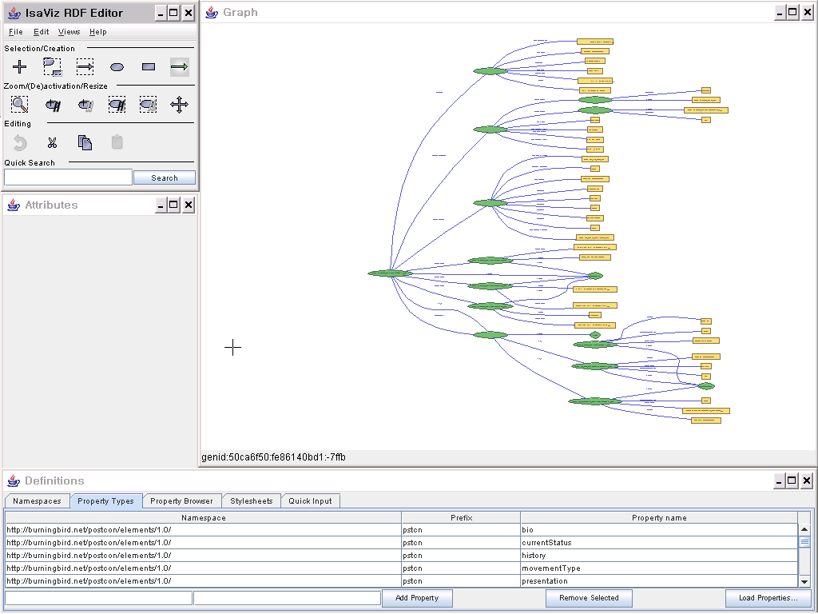
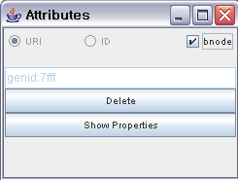
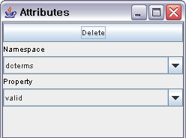
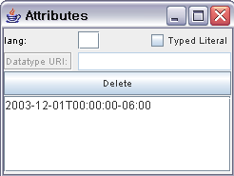
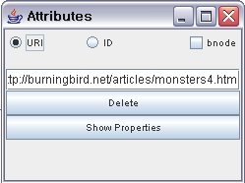
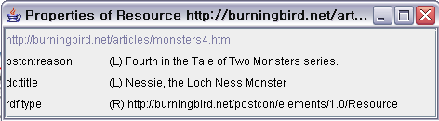
Editors
IsaViz

Slide 10
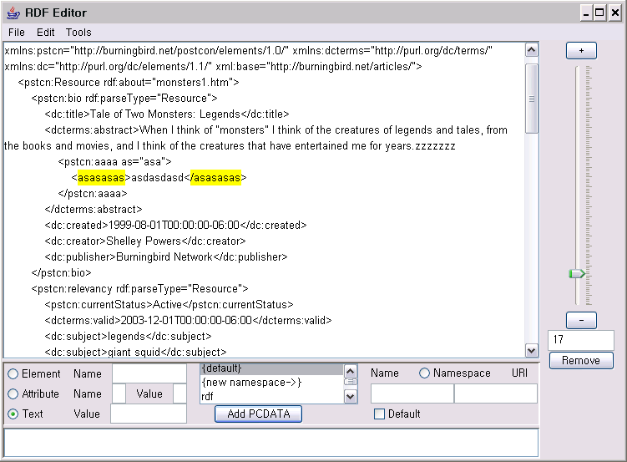
Editor
RDF Editor in Java
RDF editing tool
Simple inter face
Add(remove) elements, attributes and literal
Ruler
Select element
Control bar
Add new element, attributes and literals

Slide 11
URLS
BrownSauce
  http://brownsauce.sourceforge.net
ARP2
  http://www.hpl.hp.com/semweb/arp.htm
ICS-FORTH Validating RDF Parser
  http://athena.ics.forth.gr:9090/RDF
IsaViz
  http://www.w3.org/2001/11/IsaViz
RDF Editor in Java
  http://sourceforge.net/projects/rdfeditor

