Slide 1
The 8 Requirements of Real-Time Stream Processing
Michael Stonebraker, Ugur Cetintemel, Stan Zdonik
StreamBase Systems, Inc
SIGMOD Record 2005
6 April 2012
Hyewon Kim

Slide 2
Outline
Introduction
8 Rules for Stream Processing
Evaluation
Conclusion
Discussion

Slide 3
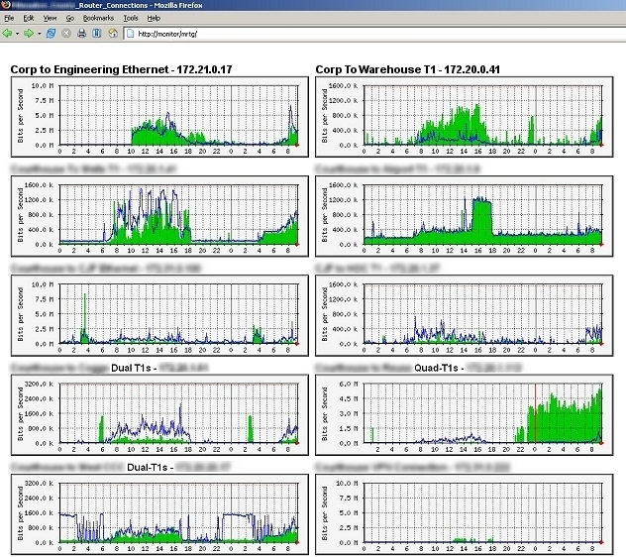


Introduction
There are many applications that require real-time processing of high-volume data streams with very low latency
Electronic trading on wall street
Command and control in military environments
Network monitoring
Stream processing applications should have 8 characteristics to excel at a variety of real-time stream processing

Slide 4
Outline
Introduction
8 Rules for Stream Processing
Evaluation
Conclusion
Discussion

Slide 5
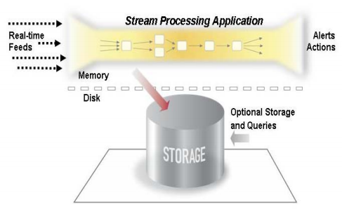


Rule1: Keep the Data Moving
We should remove additional operations to cause unnecessary latency
A costly storage operation in the critical processing path
Messages should be processed ‘in-stream’ as they fly by
Passive systems require applications to continuously poll for conditions of interest
Polling
Stream Processing Application
Incorporating built-in event/data driven processing capabilities
Passive system

Slide 6

Rule2: Query using SQL on Streams
System should support a high-level StreamSQL language with built-in extensible stream-oriented primitives and operators
StreamSQL
A variant of the SQL language specifically designed to express processing on continuous streams of data
ID | First Name | Last Name
101 | Onew | Lee
102 | Jonghyun | Kim
103 | Key | Kim
104 | Minho | Choi
105 | Taemin | Lee
Traditional SQL system knows it is finished computing when it gets to the end of table
Streaming data never ends!
Window

Slide 7



Rule3: Handle Stream Imperfections
System should be resilient against stream imperfections, including delay, missing and out-of-order data
Time-out
YG
JYP
SM
?
BLOCK!
Computing the average price
………?

Slide 8
Rule4: Generate Predictable Outcomes
The results of processing are deterministic and repeatable
SPLITS(symbol, time, split_factor)
1
SPLITS(symbol, 13:57, 2)
2
4
8
9600
4800
1200
150
SPLITS(symbol, 13:58, 2)
2
SPLITS(symbol, 13:59, 4)
2
6
8
9600
4800
800
100
Fault tolerance
&
Recovery
The correct answer can be produced when messages are processed in ascending time order, regardless of when the messages arrive to the system

Slide 9



Rule5: Integrate Stored and Streaming Data
Both historical and live data need to be integrated within the same application for comparison
Historical data
Test it on historical data
Live data
UNUSUAL
Switching it over to a live feed seamlessly
Detecting credit card fraud
Writing a trading algorithm

Slide 10
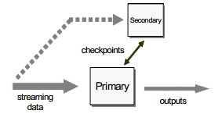
Rule6: Guarantee Data Safety and Availability
Stream processing system must use a high-availability solution
FAILURE!
Stay up all the time
Restarting the operating system and recovering the application from a log incur too much overhead
Financial service firm
Tandem-style backup and failover can ensure high availability for real-time stream processing

Slide 11

Rule7: Partition and Scale Applications Automatically
System should split an application over multiple machines for scalability without the developer having to write low-level code
Automatic and transparent load-balancing
Low-cost commodity clusters

Slide 12
Rule 8: Process and Respond Instantaneously
System should have a highly-optimized execution path that minimized the ratio of overhead to useful work
Unless an application can process high-volumes of streaming data with very low latency…
Rule 3
Rule 5
Rule 1
Rule 4
Rule 6
Rule 2
Rule 7

Slide 13
Outline
Introduction
8 Rules for Stream Processing
Evaluation
Conclusion
Discussion

Slide 14
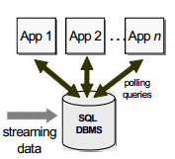
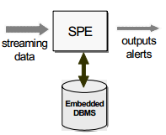
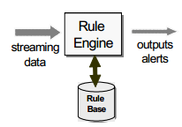
Evaluation - Basic architecture
Stream Processing Engine
DBMS
SPEs perform SQL-style processing on the incoming messages as they fly by, without necessarily storing them
If-then rule
SPE
As streaming data enters the system, they are immediately matched against the existing rules
Rule Engine

Slide 15
Rule1: Keep the Data Moving
 | DBMS | Rule Engine | SPE
Keep the data moving | NO | YES | YES
A ‘process-after-store’ model
Passive System
DBMS
They DO NOT require any storage prior to processing
Active System
Rule Engine
SPE

Slide 16
Rule2: Query using SQL on Streams
 | DBMS | Rule Engine | SPE
SQL on streams | NO | NO | YES
DBMS supports only a rudimentary notion of windowed operation
Rule languages need the notion of aggregation
DBMS
Rule Engine
SPEs perform SQL-style processing on the incoming messages as they fly by, without necessarily storing them
SPE

Slide 17
Rule3: Handle Stream Imperfections
 | DBMS | Rule Engine | SPE
Handle stream imperfections | Difficult | Possible | Possible
DBMS has to specify polling behavior to simulate the effect of time-outs
DBMS triggering has no obvious way to time out
DBMS
They are easy to support time-outs
Rule Engine
SPE

Slide 18
Rule4: Generate Predictable Outcomes
 | DBMS | Rule Engine | SPE
Predictable outcomes | Difficult | Possible | Possible
ACID transactions
Rather enforce the weaker condition of serializability
DBMS
They have a deterministic execution mode that utilizes timestamp order of input messages
Rule Engine
SPE

Slide 19
Rule5: Integrate Stored and Streaming Data
 | DBMS | Rule Engine | SPE
Stored streamed data | NO | NO | YES
DBMSs cannot cope well with streaming data
Rule languages has problems when dealing with state storage
DBMS
Rule Engine
SPEs support integration by simply switching the scope of a StreamSQL command from a live feed to a stored table
SPE

Slide 20
Others
Rule 6: Guarantee Data Safety and Availability
All three systems can incorporate appropriate mechanisms to guarantee data safety and availability
Rule 7: Partition and Scale Application Automatically
There are no fundamental architectural impediments to prevent these systems from partitioning and scaling applications
Rule 8: Process and Respond instantaneously
All architectures can potentially process and respond instantaneously

Slide 21
Outline
Introduction
8 Rules for Stream Processing
Evaluation
Conclusion
Discussion

Slide 22
Conclusion
We show eight necessary features required for high-volume low-latency stream processing applications
Traditional system software fails to meet some of these requirements, justifying the need for and the relative benefits of SPEs
 | DBMS | Rule Engine | SPE
Keep the data moving | NO | YES | YES
SQL on streams | NO | NO | YES
Handle stream imperfections | DIFFICULT | POSSIBLE | POSSIBLE
Predictable outcome | DIFFICULT | POSSIBLE | POSSIBLE
Stored and streamed data | NO | NO | YES
High Availability | POSSIBLE | POSSIBLE | POSSIBLE
Distribution and scalability | POSSIBLE | POSSIBLE | POSSIBLE
Instantaneous response | POSSIBLE | POSSIBLE | POSSIBLE

Slide 23
Outline
Introduction
8 Rules for Stream Processing
Evaluation
Conclusion
Discussion

Slide 24
Discussion
Strong points
This paper gives chance for me to think extending 8 rules to MapReduce
Weak points
Too simple explanations
Examples are difficult to understand
No proper experiments

Slide 25
감사합니다

